Slide 1
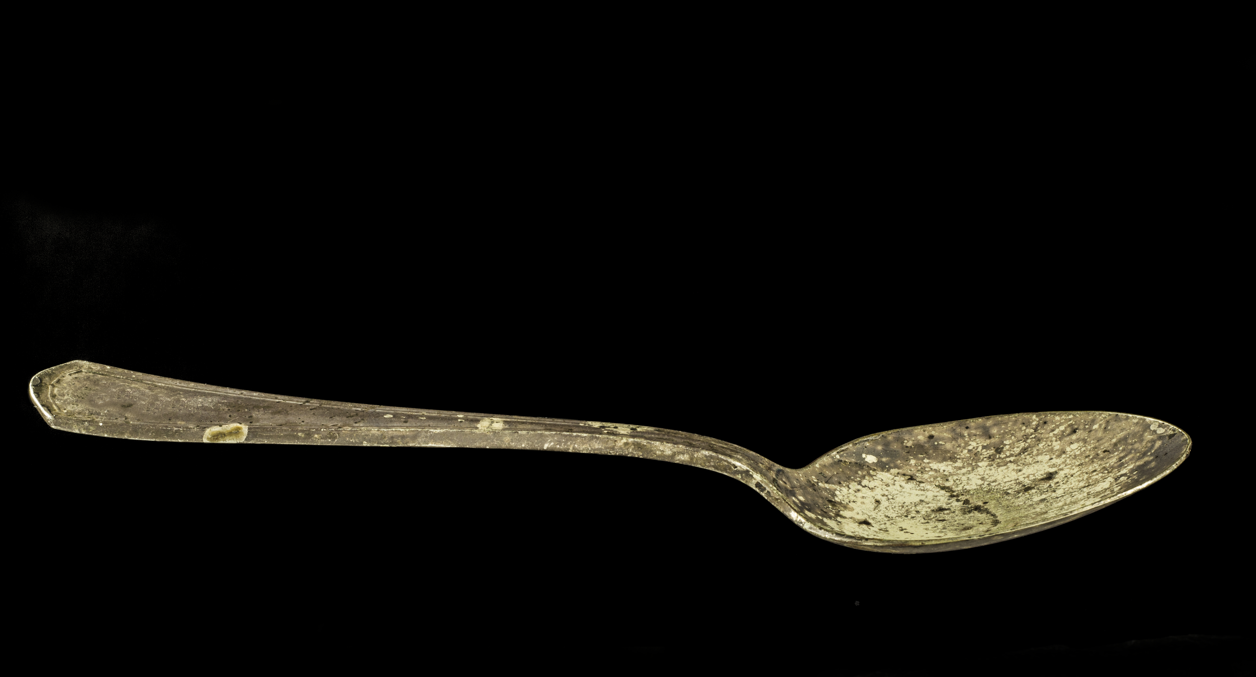
Epigenetic Effects on Metabolic and Heart Health
NATIONAL CENTER FOR CASE STUDY TEACHING IN SCIENCE
A Presentation to Accompany the Case Study
^{The Dutch Hunger Winter}
^{by}
^{Kuei-Chiu Chen}
^{Premedical Education}
Weill Cornell Medical College–Qatar
Notes:
Licensed photo © Iconograff | Dreamstime, id 38322884.

Slide 2
Additional quick facts about the Dutch Hunger Winter
The Netherlands was in a good public health position prior to 1939.
After the German invasion, the Dutch queen went into exile in London and started operating there officially in 1940.
After the German occupation, the health condition the Dutch public was overall adequate until 1944.
By autumn of 1944, the Allied Forces advanced very quickly from France in early September and by mid September they have entered the Netherlands and liberated the southern provinces. With the speed, the Allied Forces were optimistic, believing it would only be a matter of days before the German occupation was over.
In September 1944 the Dutch government-in-exile ordered a train strike. It backfired, and the Germans banned food transportation.
Also, the winter of 1944-45 came earlier and was severe; the cannals and waterways froze earlier, making the transportation of food from the rural farming areas in the east to the west, urban and populated areas almost impossible so the food in the west of the country ran out very quickly. Black market prices for potatos, for example, was > 100 times of the official prices.
During the famine, in several places even the water was cutoff, no fuel for stoves and furnaces, and no light, no heat, no soap for personal use, no fabric or clothing for personal use.
City dwellers went on expeditions to the countryside. They traded their valuables with the farmers for food. Many came back home empty-handed or died on the way.
Hospitals were overcrowded.
Notes:
Information from:
Banning C. 1946. Food Shortage and Public Health, First Half of 1945. Ann Am Acad Pol Soc Sci. 245:93–110. https://about.jstor.org/terms.
Roseboom TJ, Van Der Meulen JHP, Ravelli ACJ, Osmond C, Barker DJP, Bleker OP. 2001. Effects of prenatal exposure to the Dutch famine on adult disease in later life: an overview. www.elsevier.com/locate/mce. Molecular & Cellular Endocrinology, 185: 93-98.

Slide 3
Organize the following names of molecules or molecular structures related to gene expression and regulation based on the categories and the molecules with which they directly interact.
Name | Is it DNA (D) or protein (P)? | Is it found in bacteria (B), eukaryotes (E), or both (B+E)? | Which molecule(s) or unit(s) does it interact with, bind to or is bound by directly? | Does binding increase (I) or decrease (D) gene expression or either (I/D)?
Promoter
Transcription factor
Repressor
Operator
Activator
Regulatory sequence
Enhancer
Silencer
Mediator
Promoter proximal element
General (basal) transcription factors
Notes:
This may be used in a team-based learning activity as a summary after both prokaryotic and eukaryotic gene regulation has been discussed in class. The knowledge provided in this activity is required for a productive case study activity.

Slide 4
Organize the following names of molecules or molecular structures related to gene expression and regulation based on the categories and the molecules with which they directly interact.
Name | Is it DNA (D) or protein (P)? | Is it found in bacteria (B), eukaryotes (E), or both (B+E)? | Which molecule(s) or unit(s) does it interact with, bind to or is bound by directly? | Does binding increase (I) or decrease (D) gene expression or either (I/D)?
Promoter | D | B+E | RNA polymerase | I
Transcription factor | P | B+E | Promoter, other transcription factors | I/D
Repressor | P | B+E | Operator in B, Silencer in E | D
Operator | D | B | Repressor | D
Activator | P | B+E | Mediator, enhancer, promoter proximal element | I
Regulatory sequence | D | B+E | Repressor, activator, transcription factor | I/D
Enhancer | D | E | Activator | I
Silencer | D | E | Repressor | D
Mediator | P | E | Activator | I
Promoter proximal element | D | E | Activator | I
General (basal) transcription factors | P | E | Mediator, RNA polymerase, promoter | I
Notes:
This is the answer key slide.

Slide 5
Histone proteins
DNA
Nucleosome
30-nm fiber
Protein scaffold
Chromosome during cell division
Notes:
Figure 1 of case file.

Slide 6
A
Enhancer
Promoter proximal element
Core promoter
Exon Intron Exon Intron Exon Intron Exon
Enhancer
Activator
B
Transcription factors
RNA polymerase
Notes:
Figure 2 of case file.

Slide 7
A
Silencer
Promoter proximal element
Core promoter
Exon Intron Exon Intron Exon Intron Exon
B
Transcription factors
Repressor
RNA polymerase
Notes:
Figure 3 of case file.

Slide 8
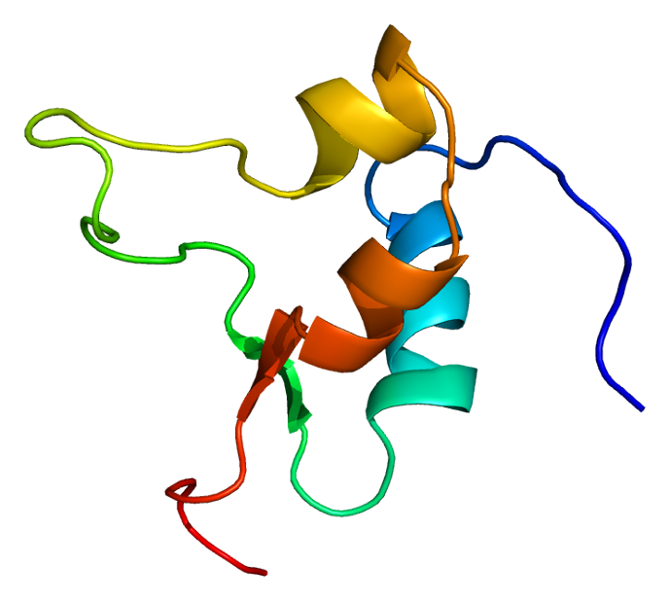
Emw / CC BY-SA (https://creativecommons.org/licenses/by-sa/3.0)
Notes:
Protein IGF2, structure of the IGF2 protein. Based on PyMOL rendering of PDB. It is not included in the case but instructors may consider using it.

Slide 9
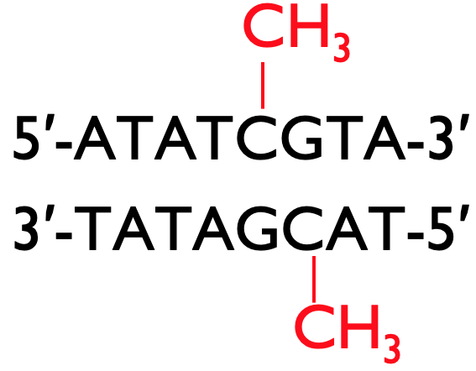
Notes:
Figure 4 of case file.

Slide 10
Histone deacetylase
Histone acetyl transferase
Notes:
Figure 5 of case file.

Slide 11
50
40
30
20
10
0
-10
-20
-30
-40
-50
Difference in mRNA level from orignial IGF2 gene (%)
Control
Increased IGF2
Notes:
Figure 8A of case file

Slide 12
0.00002
0.00001
0
Amount of mRNA from introduced IGF2 gene to standard mRNA in liver cells
Control
Increased IGF2
Notes:
Figure 8B of case file

Slide 13
50
40
30
20
10
0
-10
-20
-30
-40
-50
Difference in total lipids (%)
Control
Increased IGF2
Notes:
Figure 9 of case file

Slide 14
1500
1200
900
600
300
0
Total IGF2 (μg/L)
Optimal BMI control
(n = 26)
Obese & non-diabetic
(n = 24)
Obese & diabetic
(n = 29)
Notes:
Figure 10 of case file.

Slide 15
Gametes
Somatic cells
A B
A B
A B
Spermatogenesis
A B
A B
A B
Male
Gametogenesis
Erase old imprint
Establish sex-specific imprint
A B
A B
A B
Oogenesis
A B
A B
Female
A B
Notes:
Figure 1 of teaching notes.

Slide 16
CTCF
IGF2 DMR
H19 DMR
E
P
IGF2
H19
H19 DMR
IGF2 DMR
E
M
IGF2
CTCF
H19
Notes:
Figure 2 of teaching notes.

Slide 17
INSULIN
IGF2
IGF1
IR
IGF1R
IGF1R
Cellular proliferation or metabolic response
Cellular proliferation
Cellular proliferation
Notes:
Figure 3 of teaching notes.
Schematic representation of receptor binding by insulin or insulin-like growth factor 1 or 2 (IGF1, IGF2) to growth and metabolic response. IR, insulin receptor, IGF1R, IGF1 receptor, which can be bound by both IGF1 or IGF2, which triggers cell division.

Slide 18
Insulin Receptor
Lipotoxicity
Inflammation
Fatty acids
TNF-α
IL-6
Fatty acids
IRS
INSULIN
IKK
JNK
PKCs
Fatty acids
ER stress
Fatty acids
Mitochondrial dysfunction
Acyl-CoAs, Diacylglycerols, Ceramides
β-oxidation
ATP
Notes:
Figure 4 of teaching notes
Figure adapted from Zamora and Villena, 2014.

