Slide 1

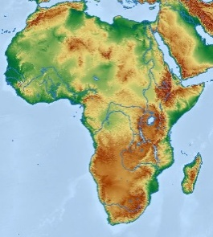
Early modern human migrations simulation game
This simulation game is designed to represent snapshots of the geographic movements and genetic changes relevant to the origins of human populations over the last 100,000 years. A few caveats: Genetic and demographic details are simplified, not all populations are represented, and the game does not illustrate growth and fluctuation of population sizes.
90,000 ya
Where?: Africa
100,000 years ago (ya)
Where did you live?: Africa (position yourself anywhere you like within Africa)
List of current ancestry-informative markers: ABC
List of current ancestry-informative markers: ABC
(During the simulation new markers represent ‘genetic mutations’ and are marked in bold)
Baganda
population
80,000 ya
70,000 ya
60,000 ya
Where?: Africa
Where?: Africa
Where?: Northeast Africa
List of current ancestry-informative markers: ABC
List of current ancestry-informative markers: ABC
List of current ancestry-informative markers: ABCE
Notes:
Image credit: Dylan Walters, CC BY 2.0, https://commons.wikimedia.org/wiki/File:Uganda_-_Ruwenzori_Mountain_Lady.jpg

Slide 2
50,000 ya
40,000 ya
30,000 ya
Where?: East Africa
Where?: South or East Africa
Where?: South or East Africa
List of current ancestry-informative markers: ABCEO
List of current ancestry-informative markers: ABCEO
List of current ancestry-informative markers: ABCEOP
20,000 ya
10,000 ya
~500ya (1491 AD)
Where?: South or East Africa
Where?: East Africa
Where?: East Africa
List of current ancestry-informative markers: ABCEOP
List of current ancestry-informative markers: ABCEOP
List of current ancestry-informative markers: ABCEOPV

Slide 3
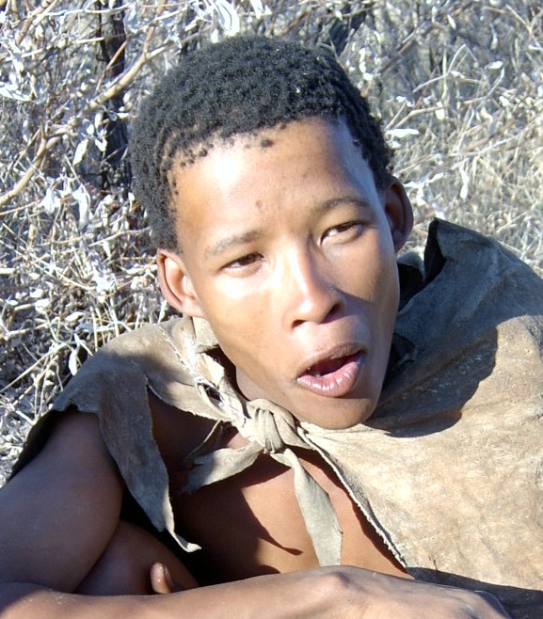

Early modern human migrations simulation game
This simulation game is designed to represent snapshots of the geographic movements and genetic changes relevant to the origins of human populations over the last 100,000 years. A few caveats: Genetic and demographic details are simplified, not all populations are represented, and the game does not illustrate growth and fluctuation of population sizes.
90,000 ya
Where?: Africa
100,000 years ago (ya)
Where did you live?: Africa (position yourself anywhere you like within Africa)
List of current ancestry-informative markers: AC
List of current ancestry-informative markers: ABC
(During the simulation new markers represent ‘genetic mutations’ and are marked in bold)
Bushmen
population
80,000 ya
70,000 ya
60,000 ya
Where?: Africa
Where?: Africa
Where?: Africa
List of current ancestry-informative markers: ACS
List of current ancestry-informative markers: ACS
List of current ancestry-informative markers: ACS
Notes:
Image credit: Petr Kosina, CC BY-NC 2.0, https://www.flickr.com/photos/clobrda/2835207800

Slide 4
50,000 ya
40,000 ya
30,000 ya
Where?: East Africa
Where?: South or East Africa
Where?: South or East Africa
List of current ancestry-informative markers: ACOS
List of current ancestry-informative markers: ACOS
List of current ancestry-informative markers: ACOPS
20,000 ya
10,000 ya
~500ya (1491 AD)
Where?: South or East Africa
Where?: South Africa
Where?: South Africa
List of current ancestry-informative markers: ACOPS
List of current ancestry-informative markers: ACOPSU
List of current ancestry-informative markers: ACOPSU

Slide 5
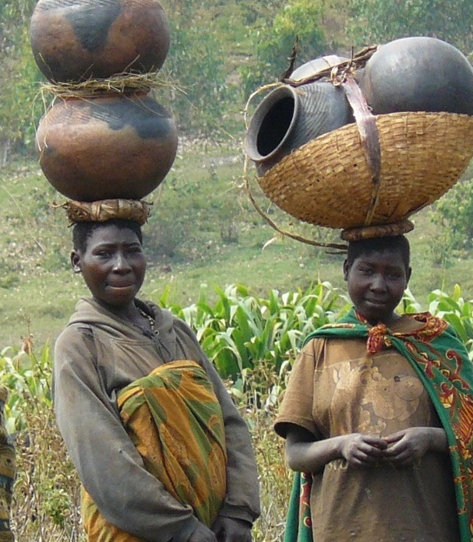

Early modern human migrations simulation game
This simulation game is designed to represent snapshots of the geographic movements and genetic changes relevant to the origins of human populations over the last 100,000 years. A few caveats: Genetic and demographic details are simplified, not all populations are represented, and the game does not illustrate growth and fluctuation of population sizes.
90,000 ya
Where?: Africa
100,000 years ago (ya)
Where did you live?: Africa (position yourself anywhere you like within Africa)
List of current ancestry-informative markers: ABC
List of current ancestry-informative markers: ABC
(During the simulation new markers represent ‘genetic mutations’ and are marked in bold)
Bantu
population
80,000 ya
70,000 ya
60,000 ya
Where?: Africa
Where?: Africa
Where?: Africa
List of current ancestry-informative markers: ABC
List of current ancestry-informative markers: ABC
List of current ancestry-informative markers: ABC
Notes:
Image credit: Doublearc, PD, https://commons.wikimedia.org/wiki/File:Batwa_women_in_Burundi_cropped.jpg

Slide 6
50,000 ya
40,000 ya
30,000 ya
Where?: Africa
Where?: Africa
Where?: Northern or Western Africa
List of current ancestry-informative markers: ABC
List of current ancestry-informative markers: ABC
List of current ancestry-informative markers: ABCX
20,000 ya
10,000 ya
~500ya (1491 AD)
Where?: West Africa
Where?: West Africa
Where?: West Africa
List of current ancestry-informative markers: ABCTX
List of current ancestry-informative markers: ABCTX
List of current ancestry-informative markers: ABCTX

Slide 7

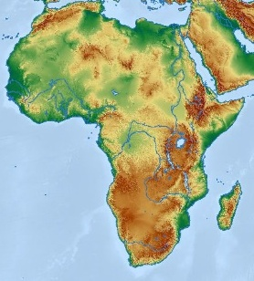
Early modern human migrations simulation game
This simulation game is designed to represent snapshots of the geographic movements and genetic changes relevant to the origins of human populations over the last 100,000 years. A few caveats: Genetic and demographic details are simplified, not all populations are represented, and the game does not illustrate growth and fluctuation of population sizes.
90,000 ya
Where?: Africa
100,000 years ago (ya)
Where did you live?: Africa (position yourself anywhere you like within Africa)
List of current ancestry-informative markers: ABC
List of current ancestry-informative markers: ABC
(During the simulation new markers represent ‘genetic mutations’ and are marked in bold)
Hausa
population
80,000 ya
70,000 ya
60,000 ya
Where?: Africa
Where?: Africa
Where?: Northeast Africa
List of current ancestry-informative markers: ABCS
List of current ancestry-informative markers: ABCS
List of current ancestry-informative markers: ABCS
Notes:
Image credit: Muhammad-Taha Ibrahim, Pexels License, https://www.pexels.com/photo/traditional-hausa-attire-portrait-in-abuja-31485690/

Slide 8
50,000 ya
40,000 ya
30,000 ya
Where?: East Africa
Where?: South or East Africa
Where?: South or East Africa
List of current ancestry-informative markers: ABCS
List of current ancestry-informative markers: ABCS
List of current ancestry-informative markers: ABCS
20,000 ya
10,000 ya
~500ya (1491 AD)
Where?: South or East Africa
Where?: Central Africa
Where?: Central Africa
List of current ancestry-informative markers: ABCST
List of current ancestry-informative markers: ABCST
List of current ancestry-informative markers: ABCSTW

Slide 9
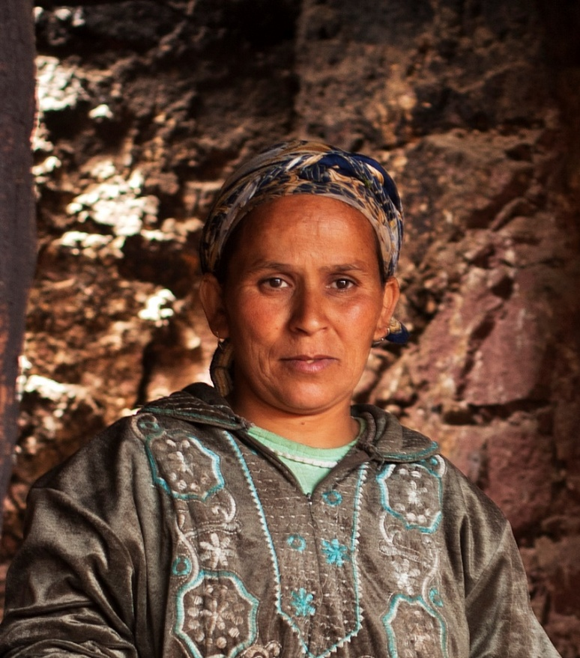

Early modern human migrations simulation game
This simulation game is designed to represent snapshots of the geographic movements and genetic changes relevant to the origins of human populations over the last 100,000 years. A few caveats: Genetic and demographic details are simplified, not all populations are represented, and the game does not illustrate growth and fluctuation of population sizes.
90,000 ya
Where?: Africa
100,000 years ago (ya)
Where did you live?: Africa (position yourself anywhere you like within Africa)
List of current ancestry-informative markers: ABC
List of current ancestry-informative markers: ABC
(During the simulation new markers represent ‘genetic mutations’ and are marked in bold)
Berber
population
80,000 ya
70,000 ya
60,000 ya
Where?: Africa
Where?: Africa
Where?: Africa
List of current ancestry-informative markers: ABCS
List of current ancestry-informative markers: ABCS
List of current ancestry-informative markers: ABCS
Notes:
Image credit: David Rosen, CC BY 2.0, https://www.flickr.com/photos/davidrosenphotography/15842886682

Slide 10
50,000 ya
40,000 ya
30,000 ya
Where?: Africa
Where?: North Africa
Where?: North Africa
List of current ancestry-informative markers: ABCS
List of current ancestry-informative markers: ABQS
List of current ancestry-informative markers: ABQSX
20,000 ya
10,000 ya
~500ya (1491 AD)
Where?: North Africa
Where?: North Africa
Where?: Northwest Africa
List of current ancestry-informative markers: ABQSX
List of current ancestry-informative markers: ABQSX
List of current ancestry-informative markers: ABQSXY

Slide 11


Early modern human migrations simulation game
This simulation game is designed to represent snapshots of the geographic movements and genetic changes relevant to the origins of human populations over the last 100,000 years. A few caveats: Genetic and demographic details are simplified, not all populations are represented, and the game does not illustrate growth and fluctuation of population sizes.
90,000 ya
Where?: Africa
100,000 years ago (ya)
Where did you live?: Africa (position yourself anywhere you like within Africa)
List of current ancestry-informative markers: ABC
List of current ancestry-informative markers: ABC
(During the simulation new markers represent ‘genetic mutations’ and are marked in bold)
Egyptian
population
80,000 ya
70,000 ya
60,000 ya
Where?: Africa
Where?: Africa
Where?: North or East Africa
List of current ancestry-informative markers: ABC
List of current ancestry-informative markers: ABC
List of current ancestry-informative markers: ABCE
Notes:
Image credit: Mohammed Hassan, Pexels License, https://www.pexels.com/photo/egyptian-farmer-with-cows-in-rural-cairo-29831897/

Slide 12
50,000 ya
40,000 ya
30,000 ya
Where?: North or East Africa
Where?: North or East Africa
Where?: North Africa
List of current ancestry-informative markers: ABCE
List of current ancestry-informative markers: ABEQ
List of current ancestry-informative markers: ABEQX
20,000 ya
10,000 ya
~500ya (1491 AD)
Where?: North Africa
Where?: Northeast Africa
Where?: Northeast Africa
List of current ancestry-informative markers: ABEQX
List of current ancestry-informative markers: ABEQX
List of current ancestry-informative markers: ABEQXZ

Slide 13
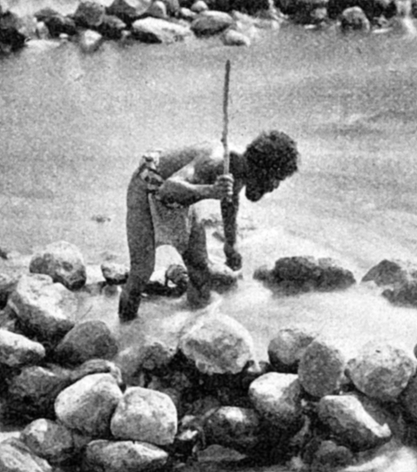
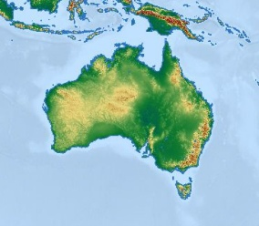
Early modern human migrations simulation game
This simulation game is designed to represent snapshots of the geographic movements and genetic changes relevant to the origins of human populations over the last 100,000 years. A few caveats: Genetic and demographic details are simplified, not all populations are represented, and the game does not illustrate growth and fluctuation of population sizes.
90,000 ya
Where?: Africa
100,000 years ago (ya)
Where did you live?: Africa (position yourself anywhere you like within Africa)
List of current ancestry-informative markers: ABC
List of current ancestry-informative markers: ABC
(During the simulation new markers represent ‘genetic mutations’ and are marked in bold)
Noongar
population
80,000 ya
70,000 ya
60,000 ya
Where?: East Africa
Where?: Southern coast of either the Southwest Asia or South Asia
Where?: Australia
List of current ancestry-informative markers: ABCD
List of current ancestry-informative markers: ABCDN
List of current ancestry-informative markers: ABCDN
Notes:
Image credit: Josef Kořenský, PD, https://commons.wikimedia.org/wiki/File:Indigenous_Australian_Fisherman_1902_Korensky.png

Slide 14
50,000 ya
40,000 ya
30,000 ya
Where?: Australia
Where?: Australia
Where?: Australia
List of current ancestry-informative markers: ABCDN
List of current ancestry-informative markers: ABCDN
List of current ancestry-informative markers: ABCDN
20,000 ya
10,000 ya
~500ya (1491 AD)
Where?: Western Australia
Where?: Western Australia
Where?: Western Australia
List of current ancestry-informative markers: ABCDN
List of current ancestry-informative markers: ABCDN
List of current ancestry-informative markers: ABCDN

Slide 15
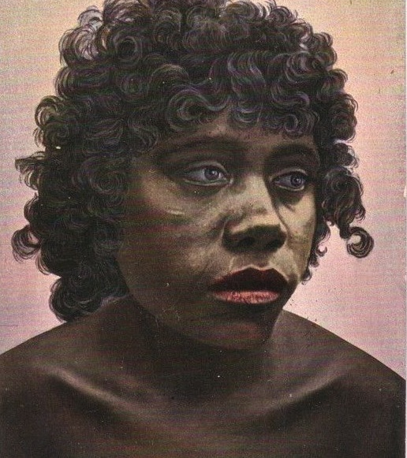

Early modern human migrations simulation game
This simulation game is designed to represent snapshots of the geographic movements and genetic changes relevant to the origins of human populations over the last 100,000 years. A few caveats: Genetic and demographic details are simplified, not all populations are represented, and the game does not illustrate growth and fluctuation of population sizes.
90,000 ya
Where?: Africa
100,000 years ago (ya)
Where did you live?: Africa (position yourself anywhere you like within Africa)
List of current ancestry-informative markers: ABC
List of current ancestry-informative markers: ABC
(During the simulation new markers represent ‘genetic mutations’ and are marked in bold)
Murri
population
80,000 ya
70,000 ya
60,000 ya
Where?: East Africa
Where?: Southern coast of either the Southwest Asia or South Asia
Where?: Australia
List of current ancestry-informative markers: ABCD
List of current ancestry-informative markers: ABCDN
List of current ancestry-informative markers: ABCDN
Notes:
Image credit: PD, https://www.flickr.com/photos/hwmobs/19261977344

Slide 16
50,000 ya
40,000 ya
30,000 ya
Where?: Australia
Where?: Australia
Where?: Australia
List of current ancestry-informative markers: ABCDN
List of current ancestry-informative markers: ABCDN
List of current ancestry-informative markers: ABCDN
20,000 ya
10,000 ya
~500ya (1491 AD)
Where?: Eastern Australia
Where?: Eastern Australia
Where?: Eastern Australia
List of current ancestry-informative markers: ABCDJN
List of current ancestry-informative markers: ABCDJN
List of current ancestry-informative markers: ABCDJN

Slide 17

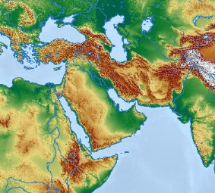
Early modern human migrations simulation game
This simulation game is designed to represent snapshots of the geographic movements and genetic changes relevant to the origins of human populations over the last 100,000 years. A few caveats: Genetic and demographic details are simplified, not all populations are represented, and the game does not illustrate growth and fluctuation of population sizes.
90,000 ya
Where?: Africa
100,000 years ago (ya)
Where did you live?: Africa (position yourself anywhere you like within Africa)
List of current ancestry-informative markers: ABC
List of current ancestry-informative markers: ABC
(During the simulation new markers represent ‘genetic mutations’ and are marked in bold)
Arab
population
80,000 ya
70,000 ya
60,000 ya
Where?: Africa
Where?: Africa
Where?: North or East Africa
List of current ancestry-informative markers: ABC
List of current ancestry-informative markers: ABC
List of current ancestry-informative markers: ABCE
Notes:
Image credit: David Stanley from Nanaimo, Canada, CC BY 2.0, https://commons.wikimedia.org/wiki/File:Jordanian_School_Girls_%2836114344790%29.jpg

Slide 18
50,000 ya
40,000 ya
30,000 ya
Where?: Southwest Asia or Northeast Africa
Where?: Southwest Asia or Northeast Africa
Where?: Southwest Asia
List of current ancestry-informative markers: ABCEF
List of current ancestry-informative markers: ABCEF
List of current ancestry-informative markers: ABCEFI
20,000 ya
10,000 ya
~500ya (1491 AD)
Where?: Southwest Asia
Where?: Southwest Asia
Where?: Southwest Asia
List of current ancestry-informative markers: ABCEFI
List of current ancestry-informative markers: ABCEFI
List of current ancestry-informative markers: ABCEFI

Slide 19

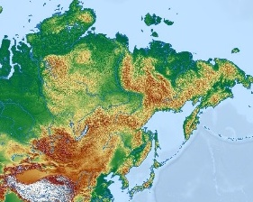
Early modern human migrations simulation game
This simulation game is designed to represent snapshots of the geographic movements and genetic changes relevant to the origins of human populations over the last 100,000 years. A few caveats: Genetic and demographic details are simplified, not all populations are represented, and the game does not illustrate growth and fluctuation of population sizes.
90,000 ya
Where?: Africa
100,000 years ago (ya)
Where did you live?: Africa (position yourself anywhere you like within Africa)
List of current ancestry-informative markers: ABC
List of current ancestry-informative markers: ABC
(During the simulation new markers represent ‘genetic mutations’ and are marked in bold)
Inuit
population
80,000 ya
70,000 ya
60,000 ya
Where?: Africa
Where?: Africa
Where?: North or East Africa
List of current ancestry-informative markers: ABC
List of current ancestry-informative markers: ABC
List of current ancestry-informative markers: ABCE
Notes:
Image credit: Susan van Gelder, CC BY-NC-SA 2.0, https://www.flickr.com/photos/susanvg/4893451989

Slide 20
50,000 ya
40,000 ya
30,000 ya
Where?: Southwest Asia or Northeast Africa
Where?: Southwest Asia
Where?: Central Asia
List of current ancestry-informative markers: ABCEF
List of current ancestry-informative markers: ABCEF
List of current ancestry-informative markers: ABCEFI
20,000 ya
10,000 ya
~500ya (1491 AD)
Where?: Siberia
Where?: Siberia or Alaska
Where?: Siberia
List of current ancestry-informative markers: ABCEFI
List of current ancestry-informative markers: ABCEFIL
List of current ancestry-informative markers: ABCEFIL

Slide 21
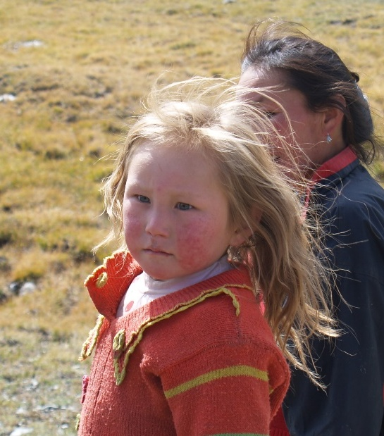
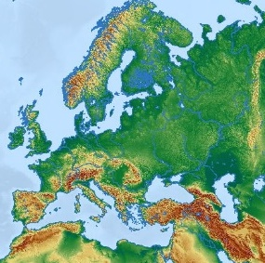
Early modern human migrations simulation game
This simulation game is designed to represent snapshots of the geographic movements and genetic changes relevant to the origins of human populations over the last 100,000 years. A few caveats: Genetic and demographic details are simplified, not all populations are represented, and the game does not illustrate growth and fluctuation of population sizes.
90,000 ya
Where?: Africa
100,000 years ago (ya)
Where did you live?: Africa (position yourself anywhere you like within Africa)
List of current ancestry-informative markers: ABC
List of current ancestry-informative markers: ABC
(During the simulation new markers represent ‘genetic mutations’ and are marked in bold)
Slavic
population
80,000 ya
70,000 ya
60,000 ya
Where?: Africa
Where?: Africa
Where?: North or East Africa
List of current ancestry-informative markers: ABC
List of current ancestry-informative markers: ABC
List of current ancestry-informative markers: ABCE
Notes:
Image credit: Kit SeeBorg, BY-NC-SA 2.0, https://www.flickr.com/photos/kitseeborg/233012392

Slide 22
50,000 ya
40,000 ya
30,000 ya
Where?: Southwest Asia or Northeast Africa
Where?: Southern Europe
Where?: Europe
List of current ancestry-informative markers: ABCEF
List of current ancestry-informative markers: ACEF
List of current ancestry-informative markers: ACEFH
20,000 ya
10,000 ya
~500ya (1491 AD)
Where?: Europe
Where?: Northern Europe
Where?: Northern Europe
List of current ancestry-informative markers: ACEFH
List of current ancestry-informative markers: ACEFHR
List of current ancestry-informative markers: ACEFHR

Slide 23


Early modern human migrations simulation game
This simulation game is designed to represent snapshots of the geographic movements and genetic changes relevant to the origins of human populations over the last 100,000 years. A few caveats: Genetic and demographic details are simplified, not all populations are represented, and the game does not illustrate growth and fluctuation of population sizes.
90,000 ya
Where?: Africa
100,000 years ago (ya)
Where did you live?: Africa (position yourself anywhere you like within Africa)
List of current ancestry-informative markers: ABC
List of current ancestry-informative markers: ABC
(During the simulation new markers represent ‘genetic mutations’ and are marked in bold)
Roman
population
80,000 ya
70,000 ya
60,000 ya
Where?: Africa
Where?: Africa
Where?: North or East Africa
List of current ancestry-informative markers: ABC
List of current ancestry-informative markers: ABC
List of current ancestry-informative markers: ABCE
Notes:
Image credit: Anselm Feuerbach, PD, https://commons.wikimedia.org/wiki/File:Anselm_Feuerbach_-_Half-Length_Portrait_of_a_Roman_Woman_-_Google_Art_Project.jpg

Slide 24
50,000 ya
40,000 ya
30,000 ya
Where?: Southwest Asia or Northeast Africa
Where?: Southern Europe
Where?: Europe
List of current ancestry-informative markers: ABCEF
List of current ancestry-informative markers: ACEF
List of current ancestry-informative markers: ACEFH
20,000 ya
10,000 ya
~500ya (1491 AD)
Where?: Europe
Where?: Southern Europe
Where?: Southern Europe
List of current ancestry-informative markers: ACEFH
List of current ancestry-informative markers: ACEFH
List of current ancestry-informative markers: ACEFH

Slide 25
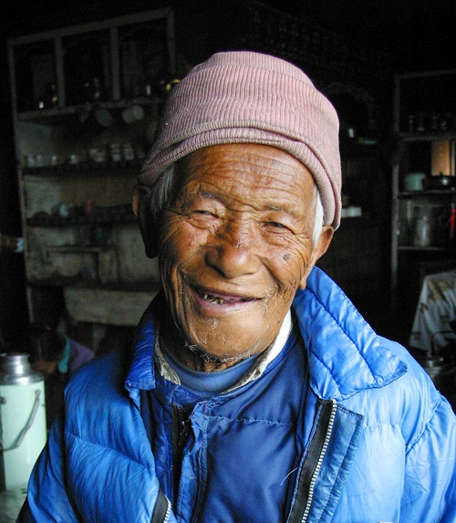
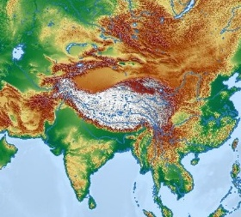
Early modern human migrations simulation game
This simulation game is designed to represent snapshots of the geographic movements and genetic changes relevant to the origins of human populations over the last 100,000 years. A few caveats: Genetic and demographic details are simplified, not all populations are represented, and the game does not illustrate growth and fluctuation of population sizes.
90,000 ya
Where?: Africa
100,000 years ago (ya)
Where did you live?: Africa (position yourself anywhere you like within Africa)
List of current ancestry-informative markers: ABC
List of current ancestry-informative markers: ABC
(During the simulation new markers represent ‘genetic mutations’ and are marked in bold)
Sherpa
population
80,000 ya
70,000 ya
60,000 ya
Where?: Africa
Where?: Africa
Where?: North or East Africa
List of current ancestry-informative markers: ABC
List of current ancestry-informative markers: ABC
List of current ancestry-informative markers: ABCE
Notes:
Image credit: Didrik Johnck, CC BY-NC-SA 2.0, https://www.flickr.com/photos/deetrak/623894807

Slide 26
50,000 ya
40,000 ya
30,000 ya
Where?: Southwest Asia or Northeast Africa
Where?: South Asia
Where?: South Asia
List of current ancestry-informative markers: ABCEF
List of current ancestry-informative markers: ABCEF
List of current ancestry-informative markers: ABCEFG
20,000 ya
10,000 ya
~500ya (1491 AD)
Where?: South Asia
Where?: Northern India
Where?: Northern India
List of current ancestry-informative markers: ABCEFGK
List of current ancestry-informative markers: ABCEFGK
List of current ancestry-informative markers: ABCEFGK

Slide 27

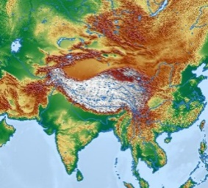
Early modern human migrations simulation game
This simulation game is designed to represent snapshots of the geographic movements and genetic changes relevant to the origins of human populations over the last 100,000 years. A few caveats: Genetic and demographic details are simplified, not all populations are represented, and the game does not illustrate growth and fluctuation of population sizes.
90,000 ya
Where?: Africa
100,000 years ago (ya)
Where did you live?: Africa (position yourself anywhere you like within Africa)
List of current ancestry-informative markers: ABC
List of current ancestry-informative markers: ABC
(During the simulation new markers represent ‘genetic mutations’ and are marked in bold)
Dravidian
population
80,000 ya
70,000 ya
60,000 ya
Where?: Africa
Where?: Africa
Where?: North or East Africa
List of current ancestry-informative markers: ABC
List of current ancestry-informative markers: ABC
List of current ancestry-informative markers: ABCE
Notes:
Image credit: Christophe Meneboeuf, CC BY-SA 3.0, https://commons.wikimedia.org/wiki/File:SriLanka_TeaTamilWoman_(pixinn.net).jpg

Slide 28
50,000 ya
40,000 ya
30,000 ya
Where?: Southwest Asia or Northeast Africa
Where?: South Asia
Where?: South Asia
List of current ancestry-informative markers: ABCEF
List of current ancestry-informative markers: ABCEF
List of current ancestry-informative markers: ABCEFI
20,000 ya
10,000 ya
~500ya (1491 AD)
Where?: South Asia
Where?: South India
Where?: South India
List of current ancestry-informative markers: ABCEFIK
List of current ancestry-informative markers: ABCEFIK
List of current ancestry-informative markers: ABCEFIK

Slide 29
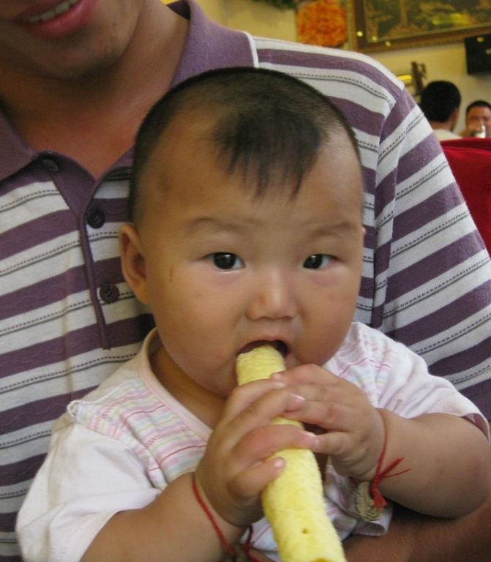

Early modern human migrations simulation game
This simulation game is designed to represent snapshots of the geographic movements and genetic changes relevant to the origins of human populations over the last 100,000 years. A few caveats: Genetic and demographic details are simplified, not all populations are represented, and the game does not illustrate growth and fluctuation of population sizes.
90,000 ya
Where?: Africa
100,000 years ago (ya)
Where did you live?: Africa (position yourself anywhere you like within Africa)
List of current ancestry-informative markers: ABC
List of current ancestry-informative markers: ABC
(During the simulation new markers represent ‘genetic mutations’ and are marked in bold)
Han
population
80,000 ya
70,000 ya
60,000 ya
Where?: Africa
Where?: Africa
Where?: North or East Africa
List of current ancestry-informative markers: ABC
List of current ancestry-informative markers: ABC
List of current ancestry-informative markers: ABCE
Notes:
Image credit: CC BY-NC-SA 2.0

Slide 30
50,000 ya
40,000 ya
30,000 ya
Where?: Southwest Asia or Northeast Africa
Where?: East or Southeast Asia
Where?: East or Southeast Asia
List of current ancestry-informative markers: ABCEF
List of current ancestry-informative markers: ABCEF
List of current ancestry-informative markers: ABCEFGI
20,000 ya
10,000 ya
~500ya (1491 AD)
Where?: East or Southeast Asia
Where?: East Asia
Where?: East Asia
List of current ancestry-informative markers: ABCEFGI
List of current ancestry-informative markers: ABCEFGI
List of current ancestry-informative markers: ABCEFGI

Slide 31


Early modern human migrations simulation game
This simulation game is designed to represent snapshots of the geographic movements and genetic changes relevant to the origins of human populations over the last 100,000 years. A few caveats: Genetic and demographic details are simplified, not all populations are represented, and the game does not illustrate growth and fluctuation of population sizes.
90,000 ya
Where?: Africa
100,000 years ago (ya)
Where did you live?: Africa (position yourself anywhere you like within Africa)
List of current ancestry-informative markers: ABC
List of current ancestry-informative markers: ABC
(During the simulation new markers represent ‘genetic mutations’ and are marked in bold)
Bamar
population
80,000 ya
70,000 ya
60,000 ya
Where?: Africa
Where?: Africa
Where?: North or East Africa
List of current ancestry-informative markers: ABC
List of current ancestry-informative markers: ABC
List of current ancestry-informative markers: ABCE
Notes:
Image credit: Paul Arps from The Netherlands, CC BY 2.0, https://commons.wikimedia.org/wiki/File:Pa-Oh_girl_%28Myanmar_2013%29_%2811773011584%29.jpg

Slide 32
50,000 ya
40,000 ya
30,000 ya
Where?: Southwest Asia or Northeast Africa
Where?: East or Southeast Asia
Where?: East or Southeast Asia
List of current ancestry-informative markers: ABCE
List of current ancestry-informative markers: ABCE
List of current ancestry-informative markers: ABCEGI
20,000 ya
10,000 ya
~500ya (1491 AD)
Where?: East or Southeast Asia
Where?: East or Southeast Asia
Where?: Southeast Asia
List of current ancestry-informative markers: ABCEGI
List of current ancestry-informative markers: ABCEGI
List of current ancestry-informative markers: ABCEGI

Slide 33

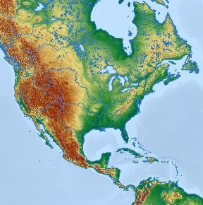
Early modern human migrations simulation game
This simulation game is designed to represent snapshots of the geographic movements and genetic changes relevant to the origins of human populations over the last 100,000 years. A few caveats: Genetic and demographic details are simplified, not all populations are represented, and the game does not illustrate growth and fluctuation of population sizes.
90,000 ya
Where?: Africa
100,000 years ago (ya)
Where did you live?: Africa (position yourself anywhere you like within Africa)
List of current ancestry-informative markers: ABC
List of current ancestry-informative markers: ABC
(During the simulation new markers represent ‘genetic mutations’ and are marked in bold)
Lakota Sioux
population
80,000 ya
70,000 ya
60,000 ya
Where?: Africa
Where?: Africa
Where?: North or East Africa
List of current ancestry-informative markers: ABC
List of current ancestry-informative markers: ABC
List of current ancestry-informative markers: ABCE
Notes:
Image credit: Neeta Lind, CC BY 2.0, https://commons.wikimedia.org/wiki/File:Lakota_girl.jpg

Slide 34
50,000 ya
40,000 ya
30,000 ya
Where?: Southwest Asia or Northeast Africa
Where?: Southwest Asia
Where?: Southwest Asia or Central Asia
List of current ancestry-informative markers: ABCEF
List of current ancestry-informative markers: ABCEF
List of current ancestry-informative markers: ABCEFI
20,000 ya
10,000 ya
~500ya (1491 AD)
Where?: Central Asia or Siberia
Where?: Siberia or North America
Where?: Great Plains
List of current ancestry-informative markers: ABCEFI
List of current ancestry-informative markers: ABCEFIL
List of current ancestry-informative markers: ABCEFIL

Slide 35

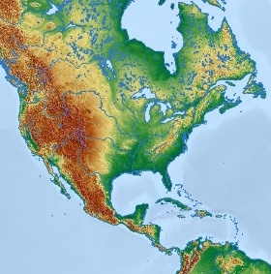
Early modern human migrations simulation game
This simulation game is designed to represent snapshots of the geographic movements and genetic changes relevant to the origins of human populations over the last 100,000 years. A few caveats: Genetic and demographic details are simplified, not all populations are represented, and the game does not illustrate growth and fluctuation of population sizes.
90,000 ya
Where?: Africa
100,000 years ago (ya)
Where did you live?: Africa (position yourself anywhere you like within Africa)
List of current ancestry-informative markers: ABC
List of current ancestry-informative markers: ABC
(During the simulation new markers represent ‘genetic mutations’ and are marked in bold)
Mayan
population
80,000 ya
70,000 ya
60,000 ya
Where?: Africa
Where?: Africa
Where?: North or East Africa
List of current ancestry-informative markers: ABC
List of current ancestry-informative markers: ABC
List of current ancestry-informative markers: ABCE
Notes:
Image credit: Josué Goge, CC BY 2.0, https://commons.wikimedia.org/wiki/File:Reina_Maya_de_Chimaltenango_01.jpg

Slide 36
50,000 ya
40,000 ya
30,000 ya
Where?: Southwest Asia or Northeast Africa
Where?: Southwest Asia
Where?: Southwest Asia or Central Asia
List of current ancestry-informative markers: ABCEF
List of current ancestry-informative markers: ABCEF
List of current ancestry-informative markers: ABCEFI
20,000 ya
10,000 ya
~500ya (1491 AD)
Where?: Central Asia or Siberia
Where?: Siberia or North America
Where?: Southern Mexico
List of current ancestry-informative markers: ABCEFI
List of current ancestry-informative markers: ABCEFIL
List of current ancestry-informative markers: ABCEFIL

Slide 37
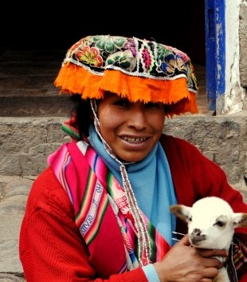
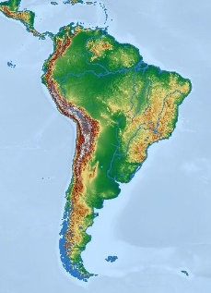
Early modern human migrations simulation game
This simulation game is designed to represent snapshots of the geographic movements and genetic changes relevant to the origins of human populations over the last 100,000 years. A few caveats: Genetic and demographic details are simplified, not all populations are represented, and the game does not illustrate growth and fluctuation of population sizes.
90,000 ya
Where?: Africa
100,000 years ago (ya)
Where did you live?: Africa (position yourself anywhere you like within Africa)
List of current ancestry-informative markers: ABC
List of current ancestry-informative markers: ABC
(During the simulation new markers represent ‘genetic mutations’ and are marked in bold)
Inca
population
80,000 ya
70,000 ya
60,000 ya
Where?: Africa
Where?: Africa
Where?: North or East Africa
List of current ancestry-informative markers: ABC
List of current ancestry-informative markers: ABC
List of current ancestry-informative markers: ABCE
Notes:
Image credit: PD, https://pxhere.com/en/photo/595715

Slide 38
50,000 ya
40,000 ya
30,000 ya
Where?: Southwest Asia or Northeast Africa
Where?: Southwest Asia
Where?: Southwest Asia or Central Asia
List of current ancestry-informative markers: ABCEF
List of current ancestry-informative markers: ABCEF
List of current ancestry-informative markers: ABCEFI
20,000 ya
10,000 ya
~500ya (1491 AD)
Where?: Central Asia or Siberia
Where?: Siberia or North America
Where?: Andes Mountains (Northwest of South America)
List of current ancestry-informative markers: ABCEFI
List of current ancestry-informative markers: ABCEFIL
List of current ancestry-informative markers: ABCEFILM

Slide 39

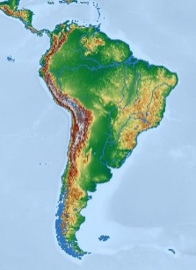
Early modern human migrations simulation game
This simulation game is designed to represent snapshots of the geographic movements and genetic changes relevant to the origins of human populations over the last 100,000 years. A few caveats: Genetic and demographic details are simplified, not all populations are represented, and the game does not illustrate growth and fluctuation of population sizes.
90,000 ya
Where?: Africa
100,000 years ago (ya)
Where did you live?: Africa (position yourself anywhere you like within Africa)
List of current ancestry-informative markers: ABC
List of current ancestry-informative markers: ABC
(During the simulation new markers represent ‘genetic mutations’ and are marked in bold)
Waura
population
80,000 ya
70,000 ya
60,000 ya
Where?: Africa
Where?: Africa
Where?: North or East Africa
List of current ancestry-informative markers: ABC
List of current ancestry-informative markers: ABC
List of current ancestry-informative markers: ABCE
Notes:
Image credit: Sam Sokwoo, CC BY-NC-SA 2.0, https://www.flickr.com/photos/samsokwoo/11846964716/

Slide 40
50,000 ya
40,000 ya
30,000 ya
Where?: Southwest Asia or Northeast Africa
Where?: Southwest Asia
Where?: Southwest Asia or Central Asia
List of current ancestry-informative markers: ABCEF
List of current ancestry-informative markers: ABCEF
List of current ancestry-informative markers: ABCEFI
20,000 ya
10,000 ya
~500ya (1491 AD)
Where?: Central Asia or Siberia
Where?: Siberia or North America
Where?: Amazon jungle (eastern South America)
List of current ancestry-informative markers: ABCEFI
List of current ancestry-informative markers: ABCEFIL
List of current ancestry-informative markers: ABCEFIL

