Slide 1
Diabetic Ketoacidosis Upon Diagnosis: A Biochemistry Case Study
NATIONAL CENTER FOR CASE STUDY TEACHING IN SCIENCE
by
Ali Chaari and Aisha Kafoud Premedical Division Weill Cornell Medicine–Qatar, Doha, Qatar
Notes:
Image credit: © Nataliya Vaitkevich | Pexels, https://www.pexels.com/photo/symbols-for-world-diabetes-day-awareness-6941878/.

Slide 2
Learning Objectives
Understand some of the basis of metabolic acidosis in type 1 diabetes mellitus (T1DM).
Understand the differences between T1DM and T2DM.
Predict the behaviour of the blood buffer equilibrium in response to a physiological change.
Understand Winter’s formula and perform calculations using real patient data.
Correlate real clinical data with biochemical tests.
Explain the role of insulin and how ketoacidosis can occur due to insulin insufficiency.
2

Slide 3
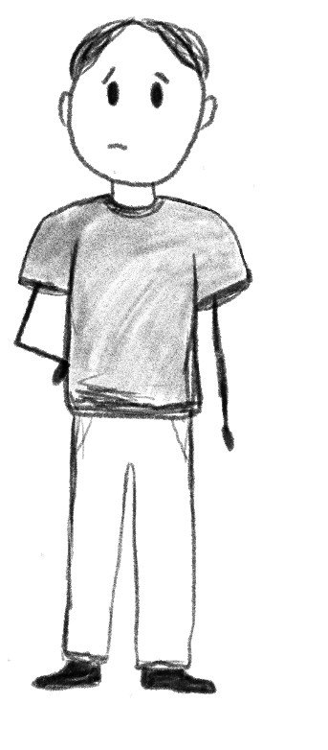
You might have the flu, just like your brother
Hey dad… I don’t feel so good
3

Slide 4
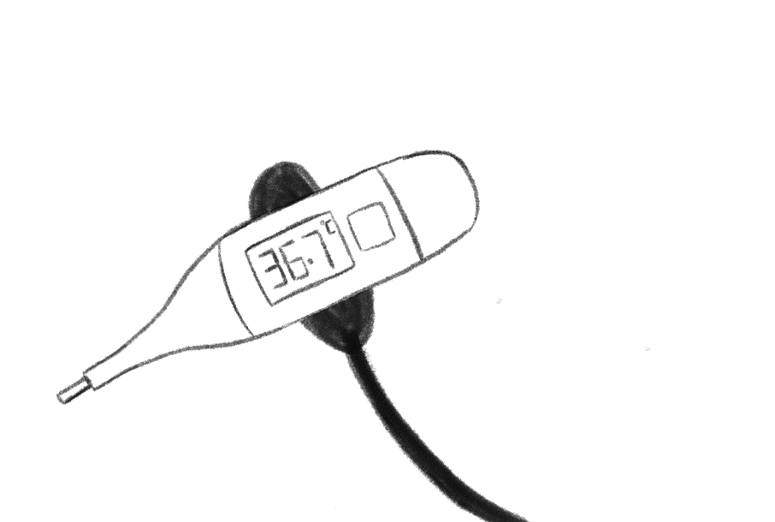
Well, you don’t have a fever…
Dad… I really don’t feel good.
4

Slide 5
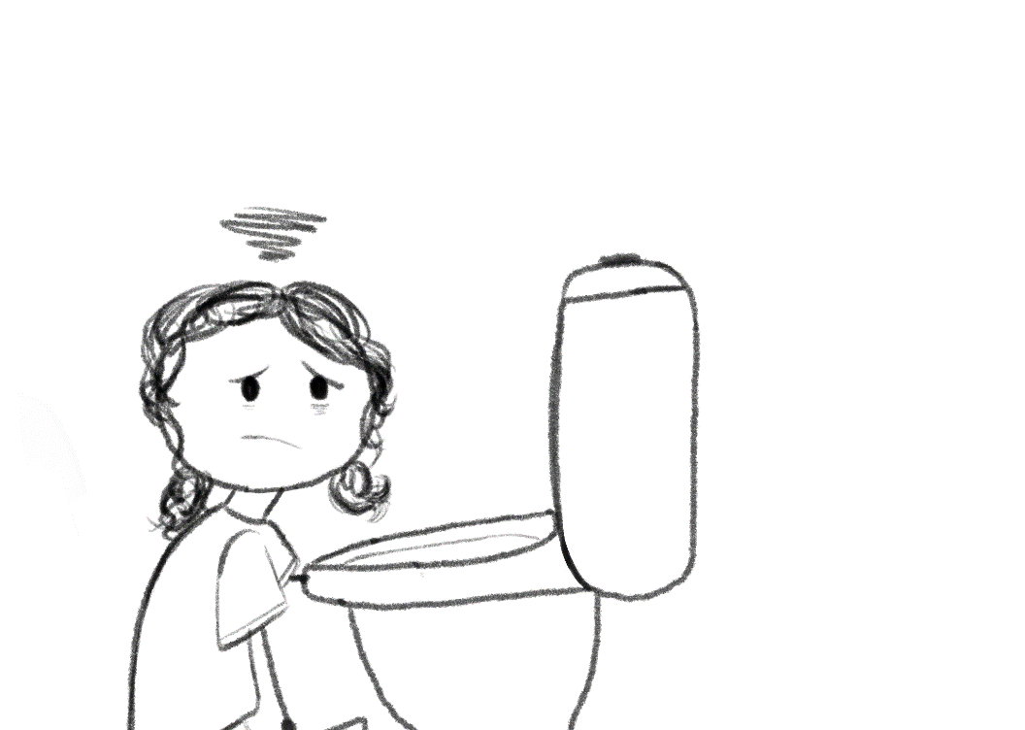
I think we should go to the hospital.
5

Slide 6
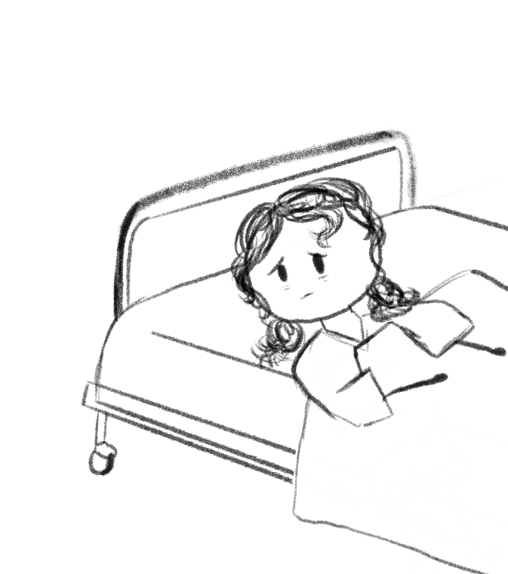
Other than the vomiting, have you been feeling any different these past few weeks?
I don’t think so…
6

Slide 7
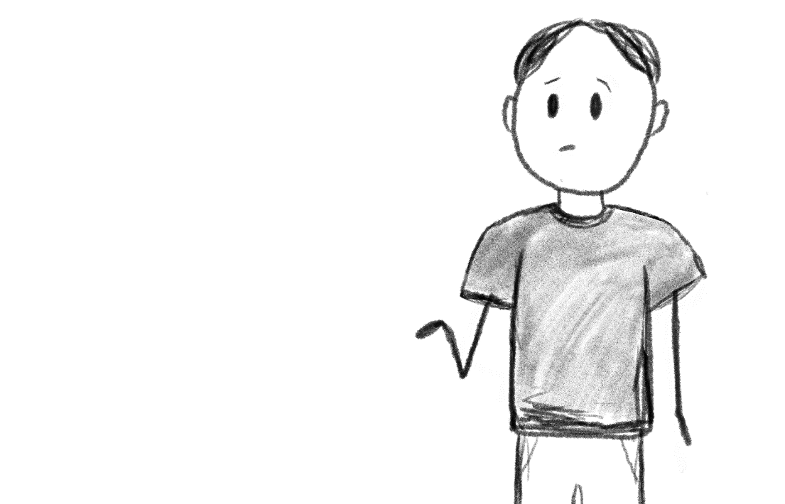
I’ve actually noticed plenty of strange symptoms.
Was fatigue one of them?
7

Slide 8
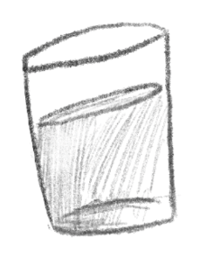
Yeah. She’s been exhausted all the time. I thought it was because of school or something.
Hmm.. Fatigue by itself isn’t always a concern, anything else?
Yup, she’s been drinking a ridiculous amount of water. Not sure if that’s normal.
8

Slide 9
Hey, is this endocrinology? We have a patient here in the ER.
9

Slide 10
She seems drowsy, but she’s still conscious. Her breathing is shallow and pretty fast.
I examined her and I noticed she sorta smelled like nail polish. We’re about to send blood samples to the lab.
10

Slide 11
9 PM
Sounds like diabetes. I’ll come over soon.
I thought so too. She has been vomiting non-stop and matches the presentation.
11

Slide 12
9 PM
Did you get any tests done yet? Blood glucose? Ketones?
I’m looking at her lab results now.
12

Slide 13
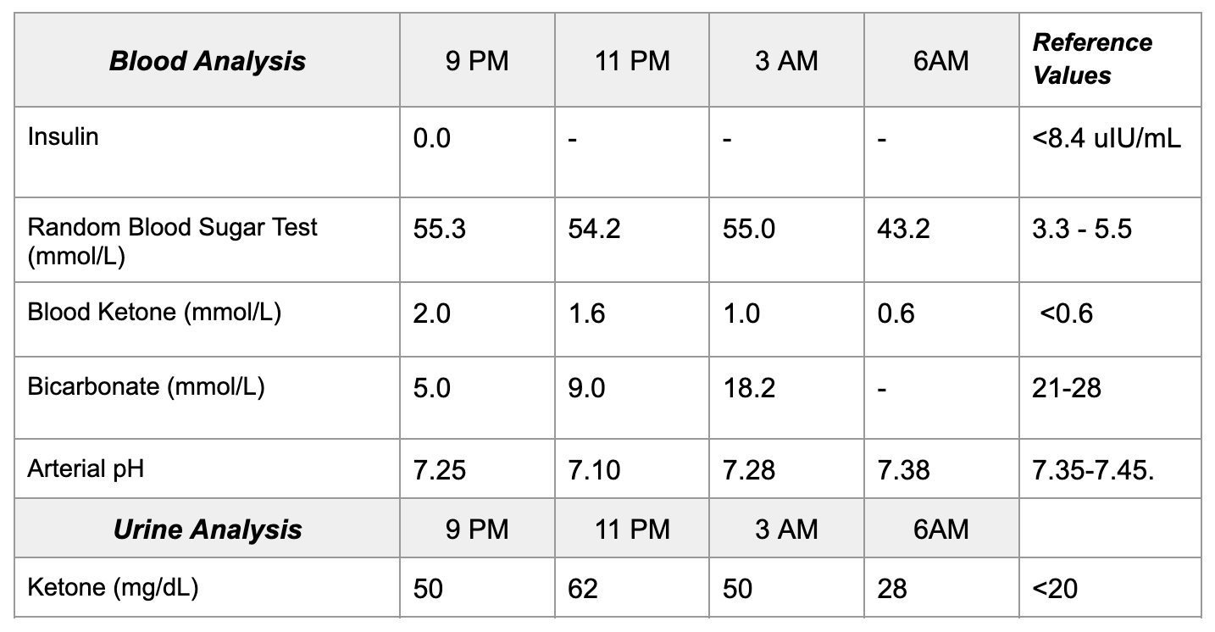
13
The above values reflect lab values measured throughout AJ’s admission

Slide 14
Question 1
Diabetes is characterised by elevated blood glucose. Does the patient have type 1 or type 2 diabetes? Support your answer with data from the physical examination, history, and laboratory values.
14

Slide 15
Question 2
What is the primary treatment for high blood glucose? What can be injected into AJ to treat her ketone bodies? Explain how each treatment works to improve these conditions.
15

Slide 16
Question 3
Suggest an explanation for the increased concentration of ketone bodies in the urine and a decrease of ketone bodies in blood from 9–11 PM.
16

Slide 17
Question 4
Explain why the concentration of ketone bodies is elevated concurrently with instances of high blood sugar. Use Figure 1 on the next slide to aid in answering.
17

Slide 18
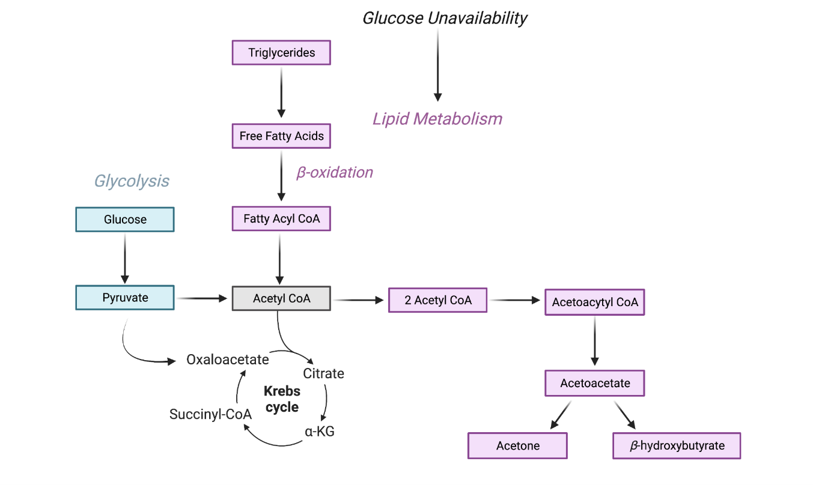
18

Slide 19
Question 5
What caused the scent of nail polish in the patient?
19

Slide 20
Question 6
What is the net charge of β-hydroxybutyric acid at physiological pH? Describe how and why the molecule affects blood pH.
20

Slide 21
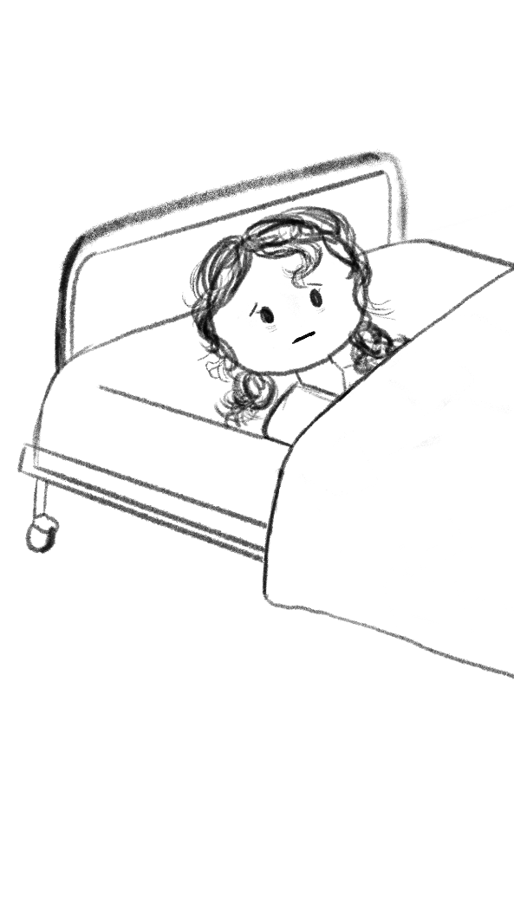
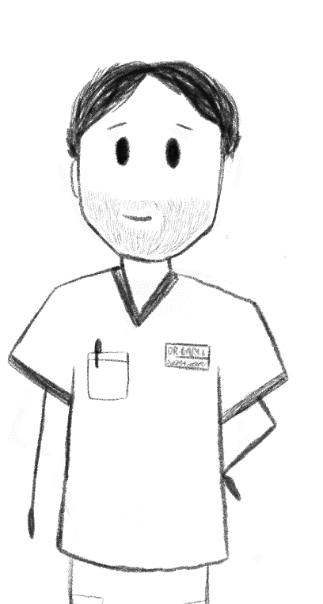
11:30 PM
Hi there! I’m the endocrinologist!
It’s kind of getting hard to breathe…
21

Slide 22
11:30 PM
We’re giving you a bicarb drip. Hopefully that helps you out.
What on Earth is a bicarb drip? I didn’t ask for that!
22

Slide 23
Question 7
Suggest a possible reason for the increase in bicarbonate concentration from 9–11 PM even though the bicarbonate drip had only been administered at 11:30 PM.
23

Slide 24
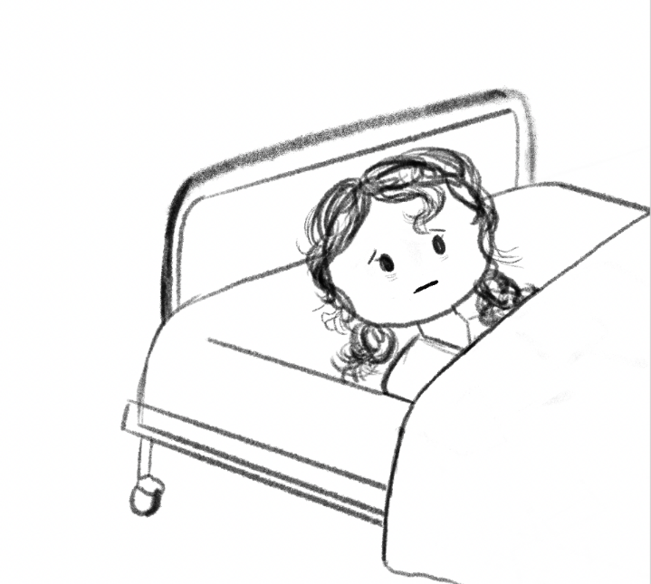
12 AM
Hey, you don’t look so good… you’re breathing pretty fast and deep.
I’m guessing you wouldn’t feel so good if you were just told you had diabetes.
24

Slide 25
12 AM
I’ll let the endocrinologist know what’s going on.
25

Slide 26
Around 12 AM, nurses report a new symptom to AJ’s assigned physician: her breathing has become increasingly fast and deep. Note that at the beginning of AJ’s admission, her breathing was rapid, but shallow. This new pattern of breathing, known as Kussmaul respiration, is often seen in diabetic patients in diabetic ketoacidosis. This is an attempt by the respiratory system to increase blood pH by expelling carbon dioxide. AJ has not stopped vomiting. An IV antiemetic as well as a bicarbonate drip were administered at 11:30 PM.
26

Slide 27
Question 8
The body reacts to blood pH imbalances via compensatory responses. Is it possible for acidosis to directly cause an alkaline arterial pH? Justify your answer.
27

Slide 28
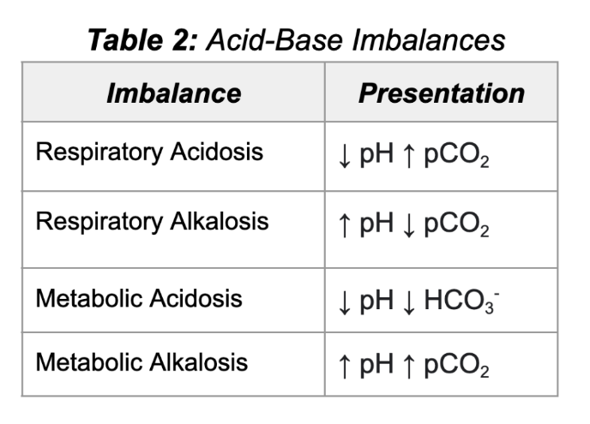
Winter’s formula is a mathematical formula used to calculate whether there is adequate respiratory compensation by the body in a state of metabolic acidosis by predicting the levels of dissolved carbon dioxide in the blood. The output of the formula is an expected pCO₂, which is used as a point of comparison for actual, measured pCO₂.
28

Slide 29
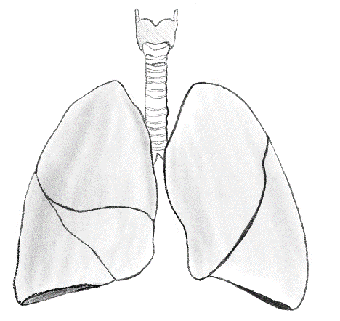
Question 9
Why would AJ’s expulsion of CO₂ lead to an increase in blood pH?
29

Slide 30
Question 10
If the pCO₂ measured in the patient is higher than the predicted value, what acid-base imbalance does that suggest is occurring concurrently?
30

Slide 31
Question 11
Estimate AJ’s pCO₂ at admission using Winter’s formula.
31

Slide 32
Question 12
AJ’s measured pCO₂ is found to be 16 mmHg. What does this say about AJ’s respiratory compensation?
32

Slide 33
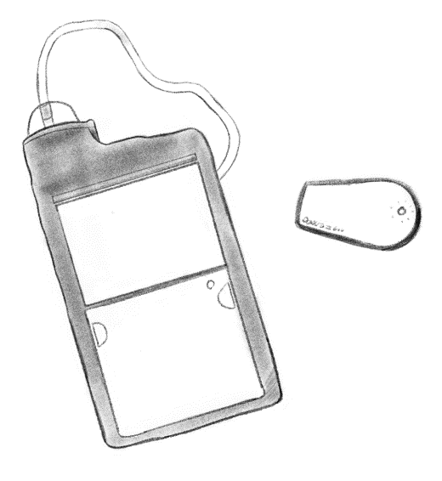
Discharge and Follow-Up
After ketoacidosis and hyperglycemia were treated, AJ displayed enhanced mental clarity and less lethargy. Kussmaul respirations ceased around 3 AM. AJ was referred to the endocrinology department and was given a diagnosis of type 1 diabetes mellitus. It is not uncommon for diabetics to be diagnosed when having a life-threatening emergency such as DKA. T1DM is insulin dependent, and thus AJ was started on both long-acting (insulin glargine) and short-acting insulin therapy via injections and switched over to an insulin pump and continuous glucose monitor (CGM) after 3–4 months.
33

Slide 34
References
Savage MW. Management of diabetic ketoacidosis. Clin Med (Lond). 2011;11(2):154-156. doi:10.7861/clinmedicine.11-2-154
Misra S, Oliver NS. Utility of ketone measurement in the prevention, diagnosis and management of diabetic ketoacidosis. Diabet Med. 2015;32(1):14-23. doi:10.1111/dme.12604
Bruss ML. Chapter 4 - Lipids and Ketones. In: Kaneko JJ, Harvey JW, Bruss ML, eds. Clinical Biochemistry of Domestic Animals (Sixth Edition)Academic Press; 2008:81-115
Lyu X, Miskovsky J. Detecting Concealing Heart Failure in a Young Alcohol-Related Liver Failure Patient Using the Most Basic Pathophysiological Principle. Cureus. 2022;14(3):e23570. doi:10.7759/cureus.23570
34

