Slide 1
Dengue and the Landscape : A Threat to Public Health
Hannah Rusch and Jim Perry
University of Minnesota

Slide 2
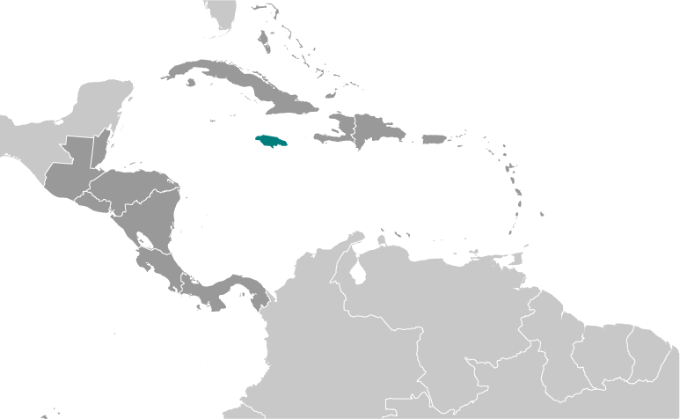
Jamaica
Map courtesy of CIA World Factbook https://www.cia.gov/library/publications/the-world-factbook/geos/jm.html
Notes:
Teaching Notes: This introductory slide helps students set Jamaica within a regional geographical context. It also serves to introduce climate of Jamaica. Some students may recognize that sanitation and climatic conditions in this region of the world are favorable to mosquito-borne tropical diseases, such as malaria and dengue fever. Dengue fever is a focus of this case study.
Talking Points: Jamaica, a Caribbean island, is roughly the area of Connecticut. Jamaica has a sub-tropical climate, with two seasons: wet and dry. The wet season is between June and November; the dry season is December through May.

Slide 3
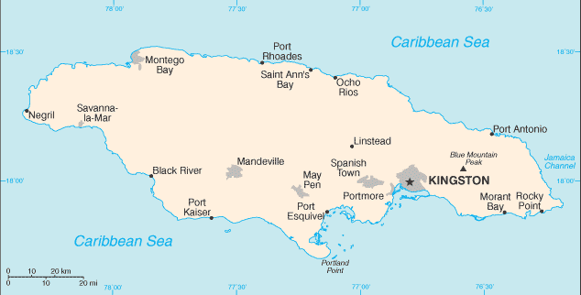
Parish of Saint Mary
Map courtesy of CIA World Factbook https://www.cia.gov/library/publications/the-world-factbook/geos/jm.html
Notes:
Teaching Notes: This slide zooms in on Jamaica. It gives students a closer look at the setting of the case. Of particular interest is Parish of St. Mary (blue box). A parish is a geographic administrative unit used by Jamaican government. St. Mary is one of 14 parishes in Jamaica.
The Talking Points for this slide help students understand general topography and economy of the area. This will become more relevant in the next slide which describes the actual location of the case. It also addresses the reality of low economic activity, an important consideration for students later in the case as they think of practical solutions to the public health threat dengue fever poses. Finally it offers yet another variable for consideration in thinking about sources of dengue fever, namely travel of infected persons to Parish of St. Mary.
Talking Points: For this case we will focus on the rural Parish of St. Mary, located on the northeast coast of Jamaica. The topography of Parish of St. Mary is characterized by steep sloping foothills and mountains. The coastline has been severely eroded by the ocean, resulting in a rugged coastline. Agriculture is the primary economic activity in Parish of St. Mary, although agricultural productivity is very low. The principle agricultural products include: banana, sugar, citrus, pimento, cocoa, coconuts, coffee, vegetables, and breadfruit. Pastoralism is also practiced in the Parish. Parish of St. Mary has risen from the poorest parish in Jamaica to the sixth poorest parish according to the mayor and chairman of the St. Mary Parish Council, Richard Creary. New infrastructure, including an international airport, a new highway, and increased tourism are partly to credit.

Slide 4
Frontier and Kemar’s Field
18°21'53.94"N
76°53'27.92"W
http://maps.google.com/
Notes:
Teaching Notes: Using satellite imagery, zoom in on Frontier to take a closer look at land management and conditions at Kemar’s field.
Port Maria is the capital city of Parish of St. Mary. Being a low-lying area surrounded by hills suggests pooling of water in the area. The lack of adequate sanitation presents a challenge to public health, and creates conditions favorable to the breeding of mosquitoes. Soak-away pits (latrines) dug into residents’ backyards are acknowledged as being mosquito breeding sites, as are clogged drainage channels. There is a pond near Kemar’s field that is an asset to the place in that it drains water from the landscape to permit agriculture. The fish stocked in the pond prevented mosquito larvae from breeding up in any significant number. The introduction of a cup-shaped invasive lily pad, however, presents a new opportunity for mosquitoes to breed up on the pond. The clogged drainage channels present other opportunities for mosquito breeding.
Talking Points: Port Maria is the capital of Parish of St. Mary. It sits below sea level, in a valley bordered by agricultural lands to the south, east and west. The Caribbean Sea is to the north of Port Maria. The City of Port Maria can be divided into three areas: the downtown area along the coast; urban Cock Street, which lies west of the North Coast Highway; and peri-urban Frontier, east of the North Coast Highway, which is the focus of this case. A gravel road running through Frontier is the result of a two phase development project, which was abandoned before completion, and which resulted in a squatter settlement. Frontier residents have access to electricity, piped water, and garbage collection but not sanitation. Residents dig soak-away pits (latrines) in their yards. The homes in Frontier are made of plyboard and zinc. In contrast, nearby Cock Street is a permanent establishment with paved roads, cement houses, piped water, electricity, garbage collection and sanitation services.
Frontier contains many small scale agricultural plots. Fruit trees are common in yards, especially around homes on the hill east of Frontier. Historically, the land in Frontier was a saltwater wetland, which was drained by the construction of drainage channels. Until 1960, the lands of Frontier were used for intensive export agriculture, primarily sugar cane and bananas. After the death of the land’s owner around 1960, the land fell into disrepair. Today the drainage channels are filled with cattails, and makeshift homes are set in between small-production agricultural fields operated by Frontier locals.
Kemar is one of the main characters of this case. The land he farms is just north of a pond that was constructed to help drain water from the landscape. The pond is stocked with fish and is covered with two kinds of lily pads, a flat-leaved native variety, and a cup-shaped exotic, invasive species type. Drainage channels overgrown with reeds also surround the field. Vegetable cash crops are grown on the fields for subsistence, and some small sales at the local market.

Slide 5
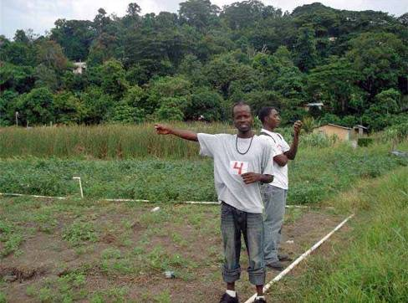
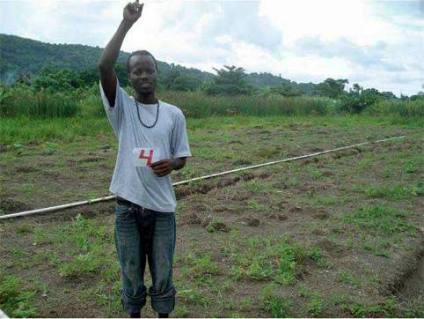
360* On the Ground
West
North
Notes:
Teaching Notes: The following slides are intended to give an on-the-ground perspective. Photos show vegetables (e.g., callaloo, cucumbers, squash) growing in field in the (photo foreground), reeds (half way back), and fruit trees on the hill (photo background). Students should note the hills and drainage channels (mentioned in previous slides) as important variables to consider when thinking about mosquito breeding. **The people in the photo are locals from Parish of St. Mary that served as my field assistants during sample collection.
Talking Points: Now we’ll move from a birds’-eye view of the landscape to an on-the-ground view from Kemar’s field. The mountains are evident in the background, as are the drainage channels behind the persons photographed in this picture.

Slide 6
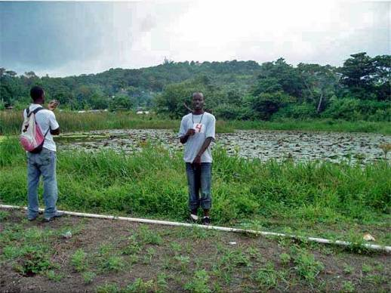
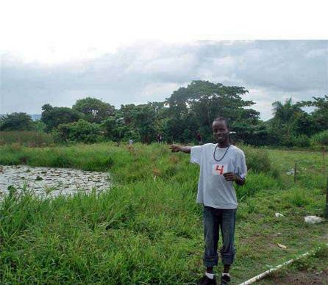
360* On the Ground
Port Maria Hospital
South
East
Notes:
Teaching Notes: Students should identify the pond as a potential mosquito breeding site when they work on questions later in the case. Rain clouds are evident over the hills, suggesting the rainy season, which should also be identified as a favorable condition for mosquito breeding.
Talking Points: The constructed pond (south of Kemar’s field) is visible in these photos. Another subsistence farmer works the land just east of Kemar’s field (photo on right). The arrow identifies Port Maria Hospital, which is an important landmark in the area (photo on left).

Slide 7
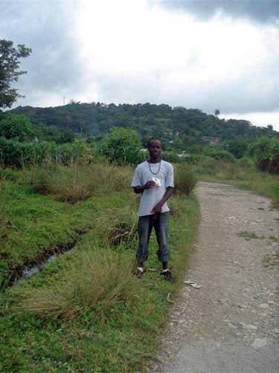
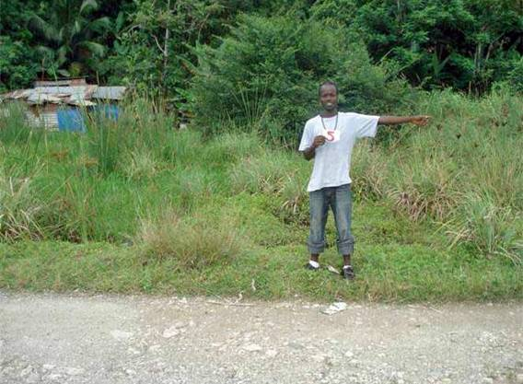
Conditions in the Surrounding Area
Port Maria Hospital
Example of a Frontier dwelling and evidence of overgrown drainage canal
Notes:
Teaching Notes: The following two slides conditions just east of Kemar’s field. The chocked drainage channels are a mosquito breeding site. The impoverished condition of the peri-urban area should recommend to students that a lack of access to resources is the reality of residents of this community. Also, the proximity of people to the many potential mosquito breeding sites is an important consideration for answering case questions.
Talking Points: A house with a zinc roof is obscured from view by overgrown reeds choking the drainage canal. The drainage canal is immediately behind the person in the photo on the left. The gravel road shown in both photos is a remnant of the abandoned government project to develop the area.

Slide 8
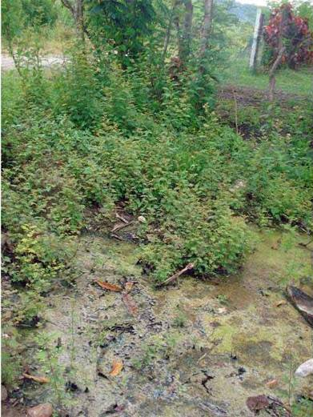
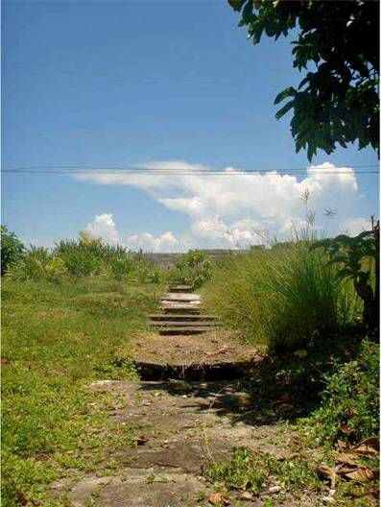
Conditions in the Surrounding Area
Pond in front of a neighbor’s home
Cement-covered drain to the sea
Notes:
Teaching Notes: This slide gives students more examples for ideas of where mosquitoes could breed in Frontier. Water samples from the pond did contain mosquito larvae. The cement-covered drain to the sea is intended to be misleading. Mosquitoes do not breed in salt water, which is the type of water found in this drainage pipe.
Talking Points: The photo on the left shows a pond that is up the gravel road from Kemar’s field in the front yard of a woman’s house. On the right you see a cement-covered drain that spills into the Caribbean Sea. It has a diameter of about 2 feet, and a length of a half mile. Some of the slabs covering the drain are missing, exposing the water contained within (black lines).

Slide 9
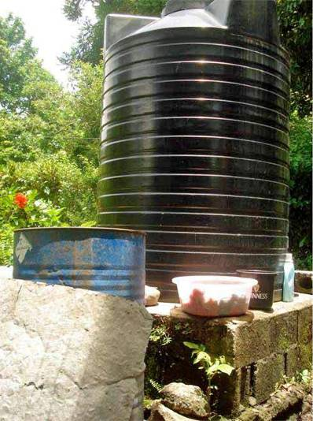
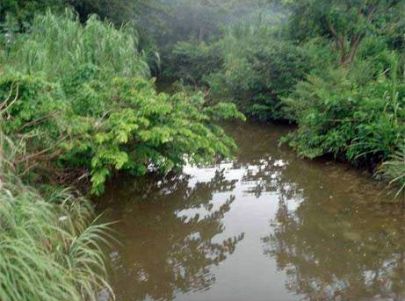
Conditions in the Surrounding Area
Water storage
Otrum River (West of North Coast Highway)
Notes:
Teaching Notes: This slide gives students another idea of where mosquitoes could breed in Frontier. The river is not a likely breeding site because it the water is moving. Mosquito larvae like still water.
The black covered barrel prevents mosquitoes from breeding. Uncovered rain catchments (blue barrel) are an acknowledged breeding site for mosquitoes.
Talking Points: The Otrum River spills into the Caribbean Sea just beyond Port Maria. It carries a lot of sediment from its source in the hills, which is evident by its brown color. The black tank stores potable (drinkable), piped water. The blue drum is a rain catchment. Water from the blue drum is used for chores such as watering plants and animals, and for washing.

