Slide 1
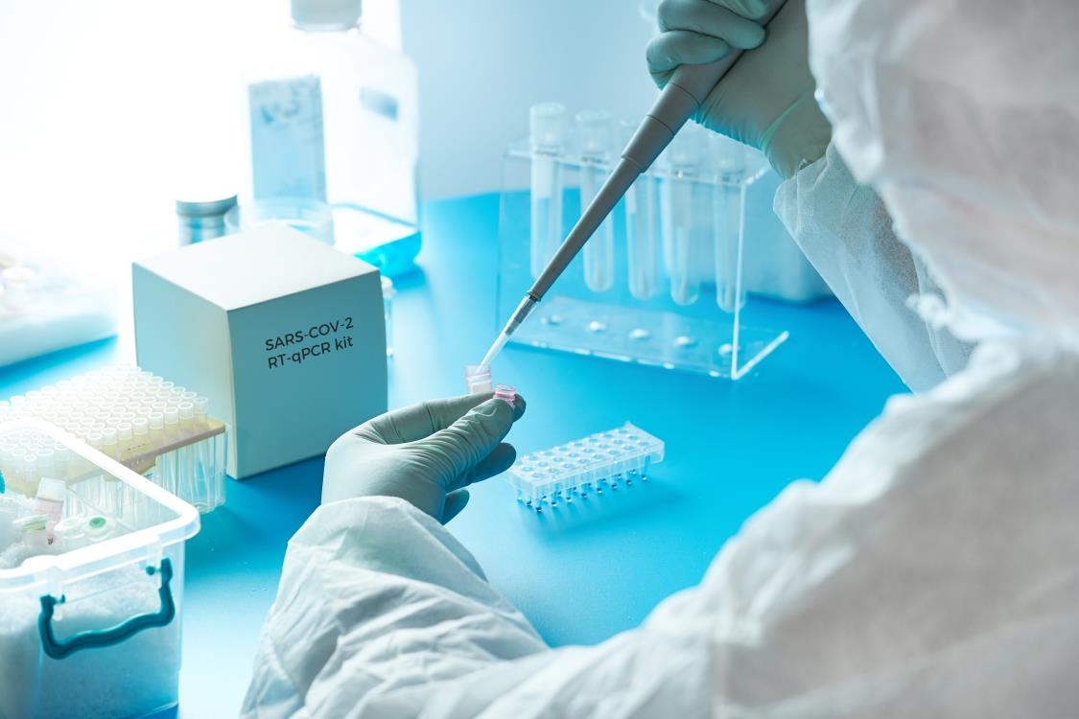
NATIONAL CENTER FOR CASE STUDY TEACHING IN SCIENCE
Figures to Accompany the Case Study
The Power of a Test:
How COVID-19 Is Diagnosed and Who Does It
by
Alison Kieffer, Emaly J. Piecuch,
Christina Vallianatos, and Sarah A. Wojiski
Genomic Education
The Jackson Laboratory, Bar Harbor, ME
Notes:
Credit: Licensed image © Skypixel | Dreamstime, ID 176737042.

Slide 2
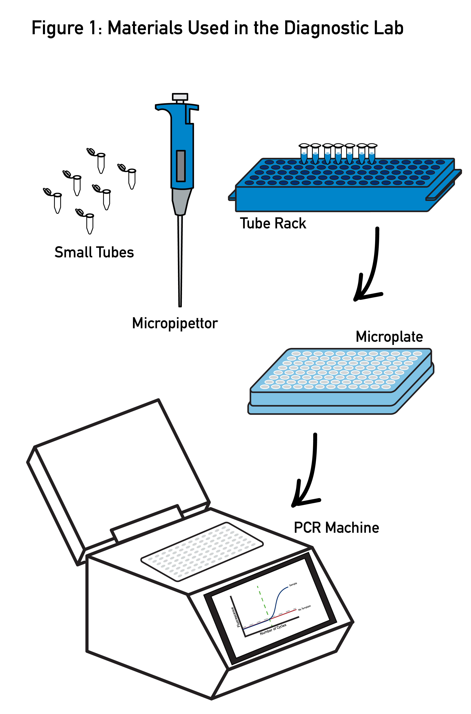
Notes:
Fig. 1: Materials Used in the Diagnostic Lab
The essential molecular biology equipment used in a diagnostic lab is depicted here.
2

Slide 3
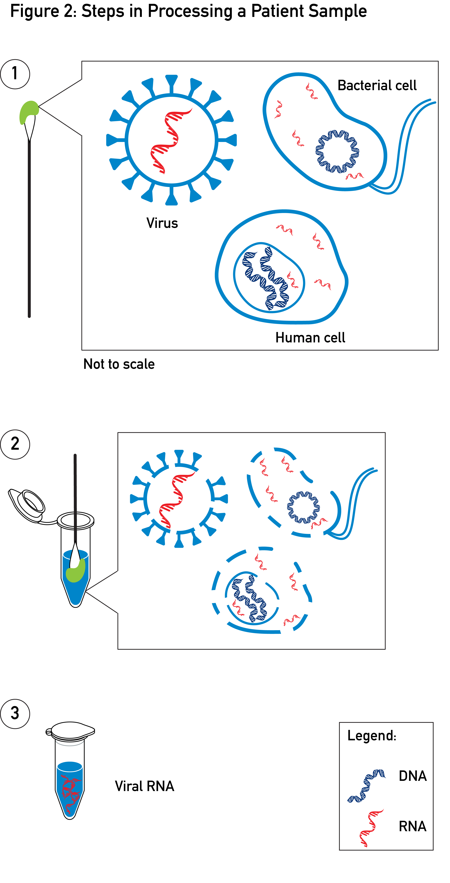
Notes:
Fig. 2: Steps in Processing a Patient Sample
Here the steps required to isolate viral RNA for diagnostic testing from a patient sample are shown. In step one, the different biological entities obtained from a swab are depicted. In step two, all nucleic acids are released into solution. Step three shows viral RNA, isolated and ready to analyze. Please note the images is not to scale.
3

Slide 4
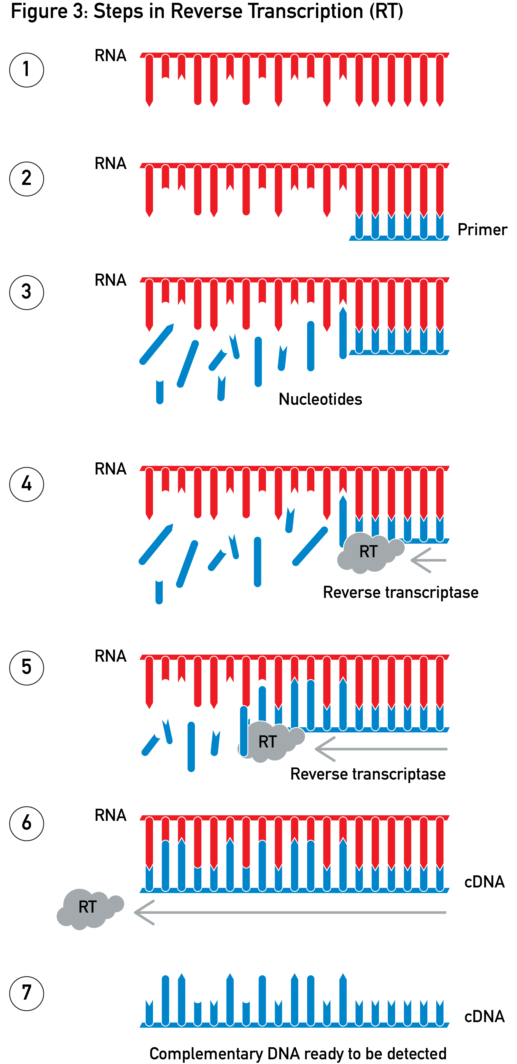
Notes:
Fig. 3: Steps in Reverse Transcription (RT)
Here are the molecular biology steps in the process of reverse transcription (RT) which leads to the generation of complementary DNA (cDNA) from an RNA sample. This process allows for the amplification of the sample in the next step of quantitative PCR (qPCR) based diagnostic testing.
4

Slide 5
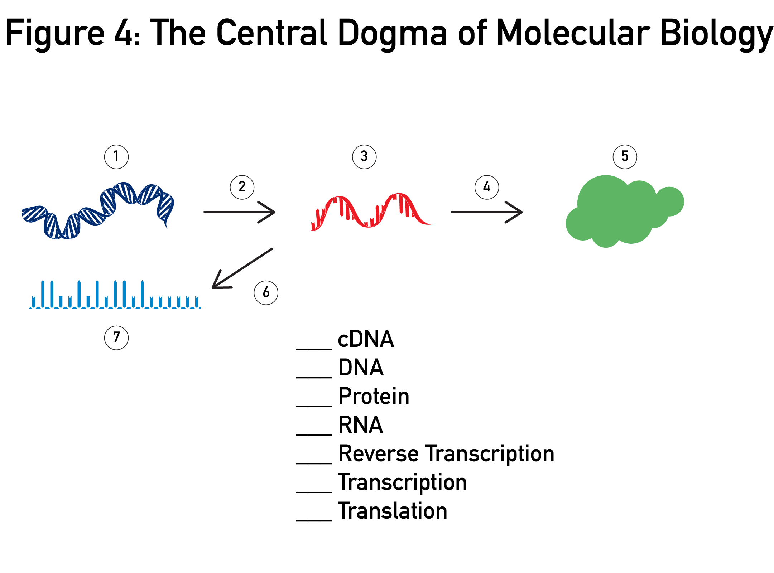
Notes:
Fig. 4: The Central Dogma of Molecular Biology
Use your knowledge of central dogma to match each term to the numbers in the figure and identify how reverse transcription (RT) fits into this process.
5

Slide 6
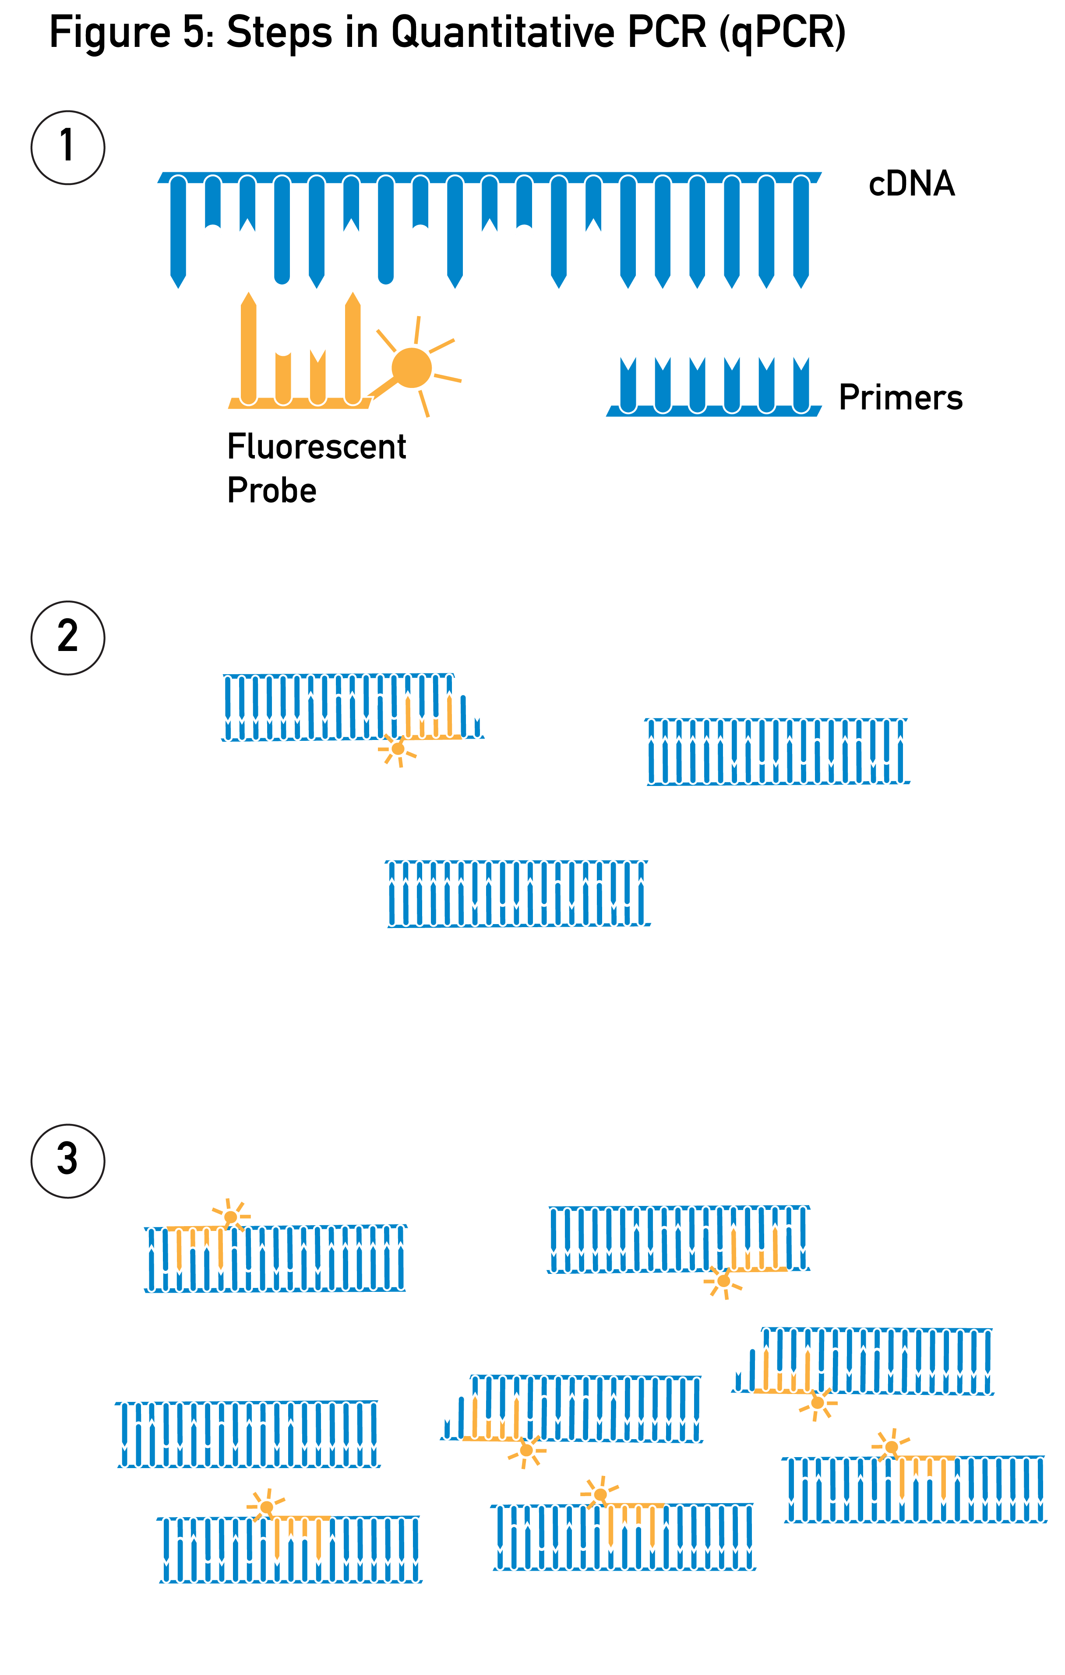
Notes:
Fig. 5: Steps in Quantitative PCR (qPCR)
Here are the steps in the process of the quantitative PCR (qPCR) assay. This process leads to the amplification and quantification of a cDNA sample. This process is the basis of CDC COVID-19 diagnostic testing.
6

Slide 7
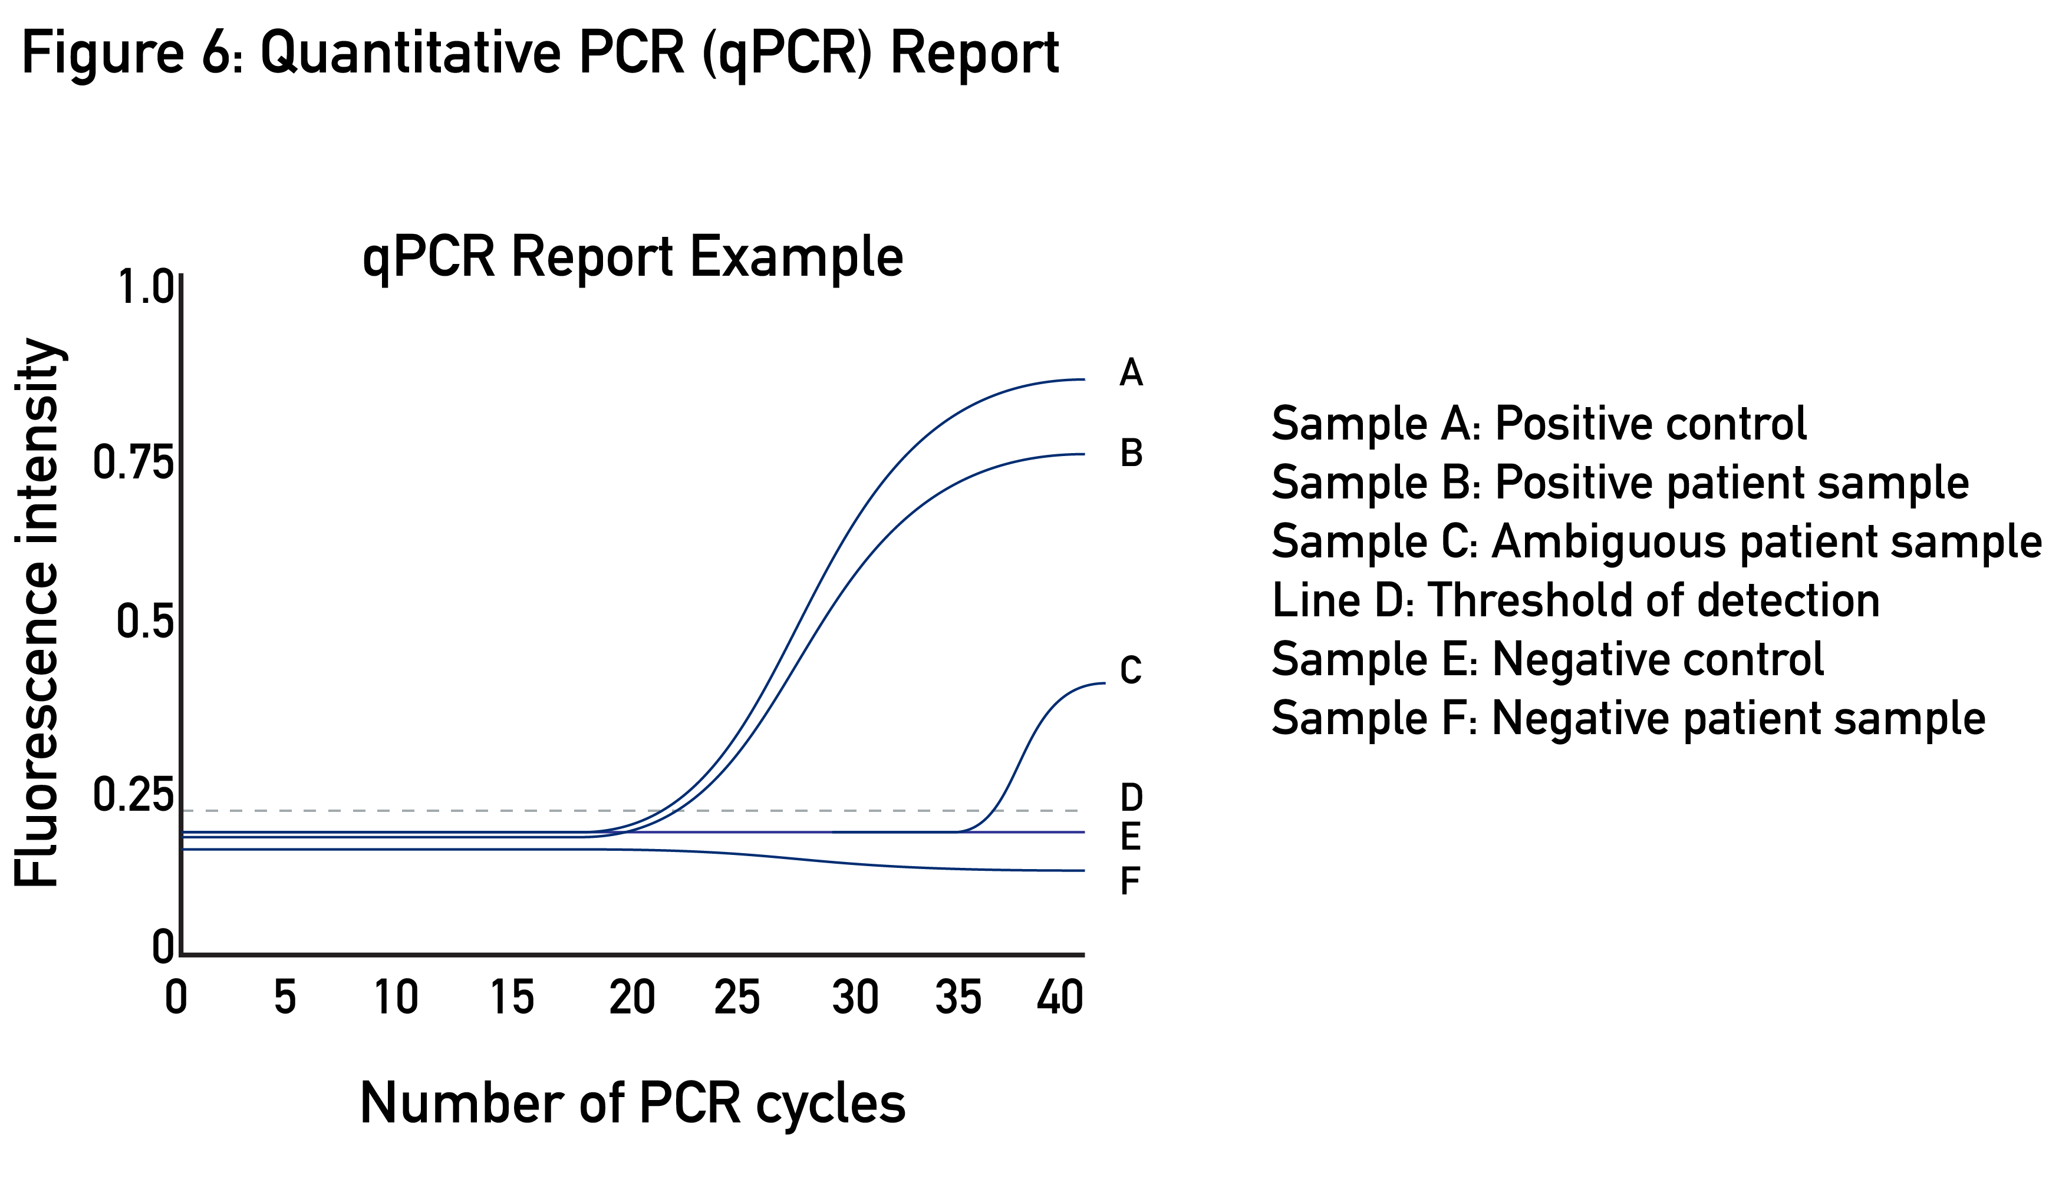
Notes:
Fig. 6: Quantitative PCR (qPCR) Report
Depicted here is an example of a qPCR assay report. This is the data that needs to be interpreted for diagnosis. A positive control sample is used to determine the fluorescence intensity of a known sample. A negative control sample is used to determine the fluorescence intensity of a sample that is known to have no viral RNA. The fluorescence of a patient sample can be compared to that of the control samples to determine if the sample is positive or negative. Sometimes, sample fluorescence can be intermediate, which is interpreted as an ambiguous patient sample (unsure if the sample is positive or negative).
7

Slide 8
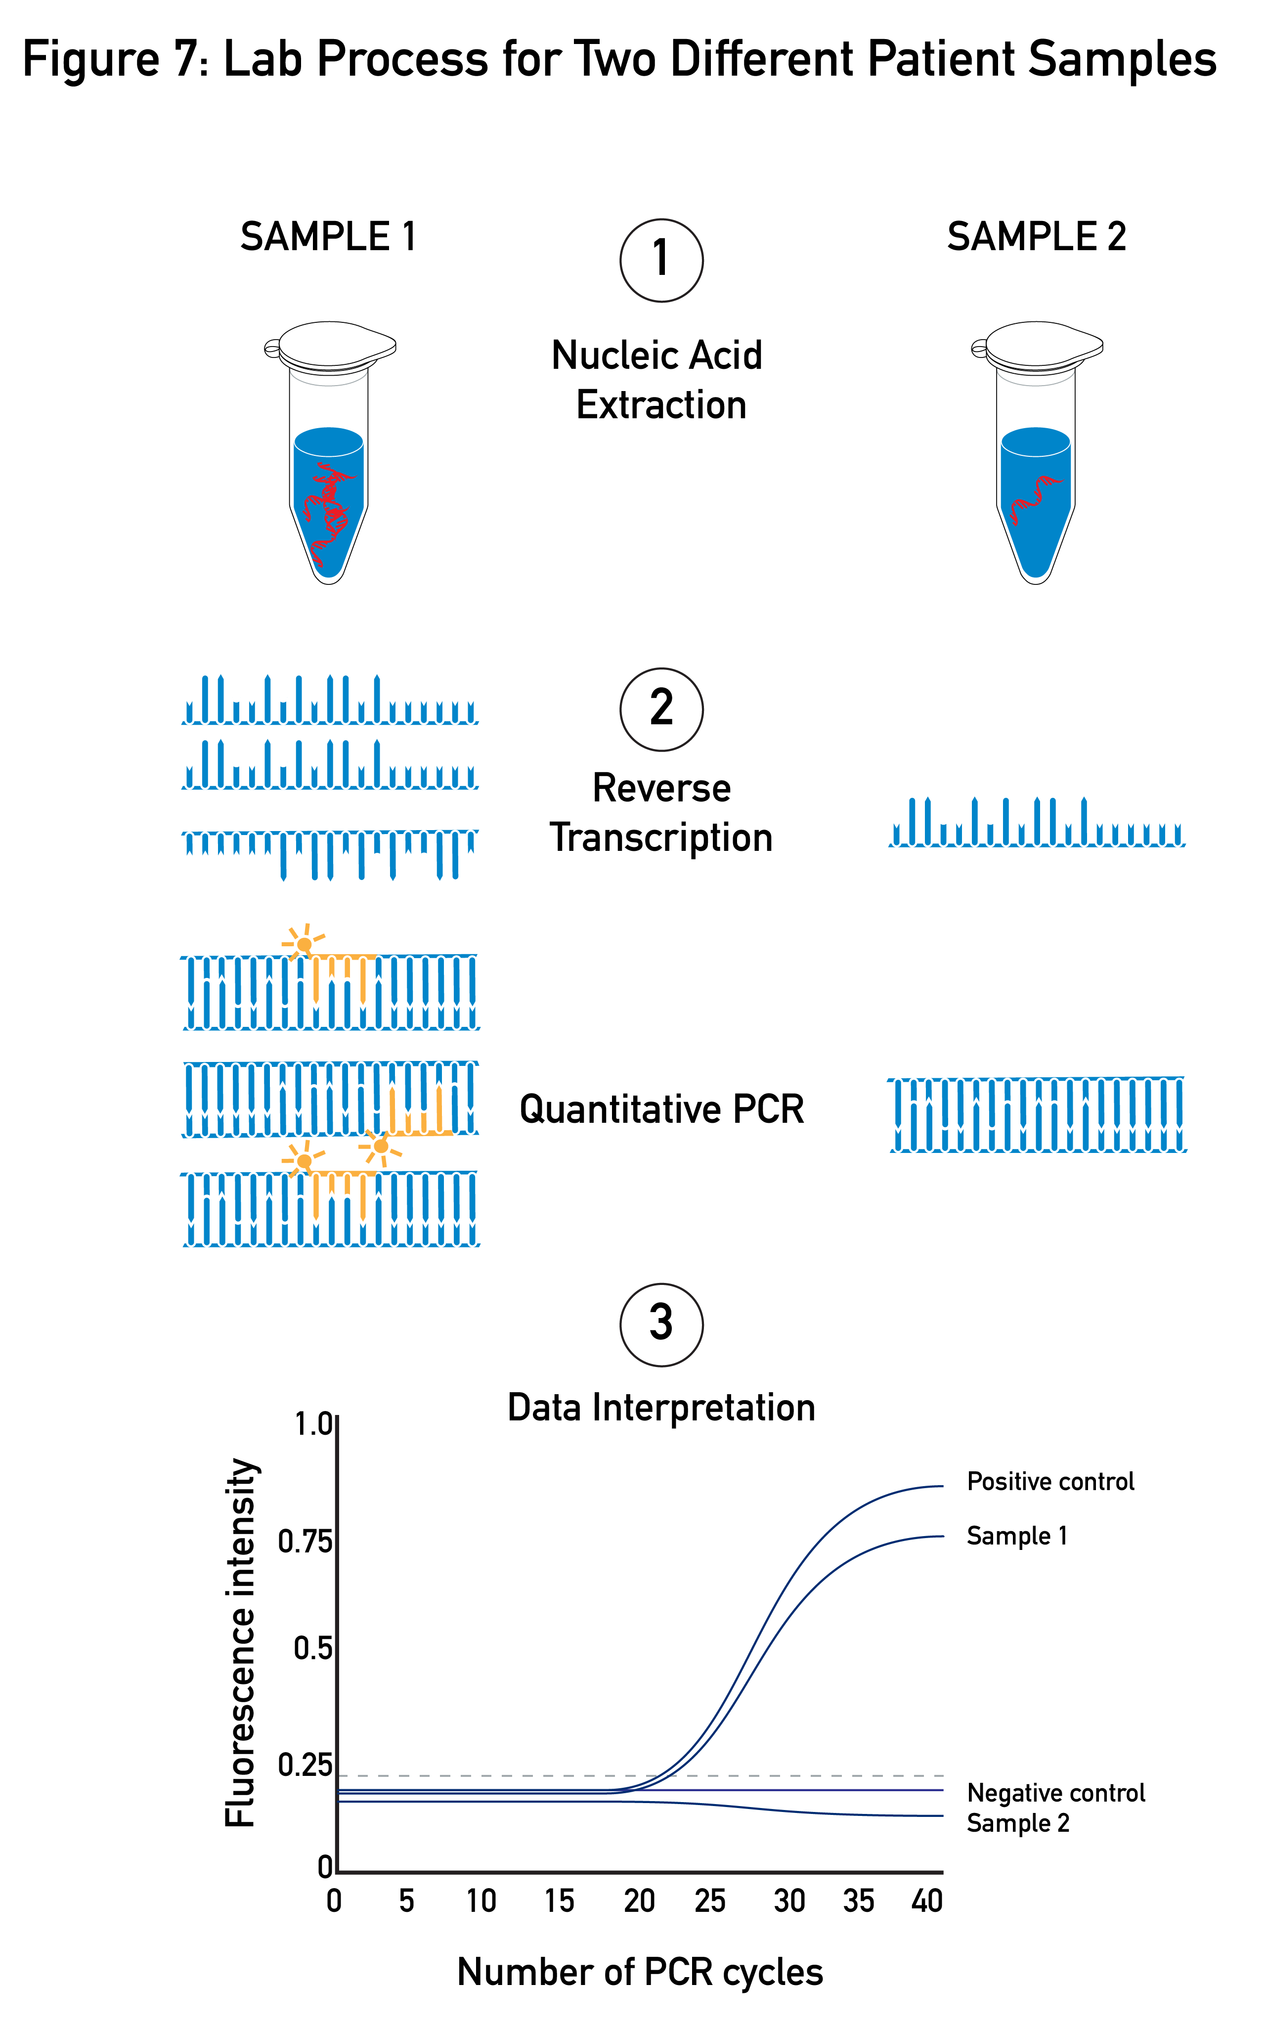
Notes:
Fig. 7: Lab Process for Two Different Patient Samples
Depicted here is an example of diagnostic sample processing for two different patient samples. In step one, notice the amount of RNA in each tube is different. In step two, notice the amount of cDNA that is synthesized during the RT step is different. In step three, notice the amount of amplification during the qPCR step varies. Due to these factors and other variables in sample processing you can that the diagnostic result for each sample is quite different.
8

Slide 9
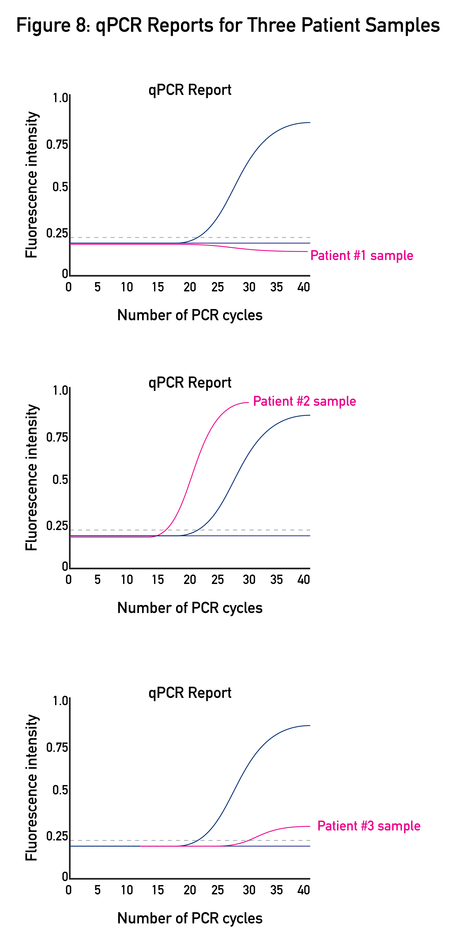
Notes:
Fig. 8: qPCR Reports for Three Different Patient Samples
Using the knowledge you have gained of the diagnositic lab process of the review the qPCR repot diagnosis for each of the patient samples.
9

