Slide 1

NATIONAL CENTER FOR CASE STUDY TEACHING IN SCIENCE
Figures to Accompany the Case Study
Coronavirus Quandaries for
Patients with Cardiovascular Disease
by
Janine Bartholomew
Department of Biology
Carlow University, Pittsburgh, PA
Notes:
Credit: Licensed image © Bartlomiej Kopczynski | Dreamstime, ID 177371334.

Slide 2
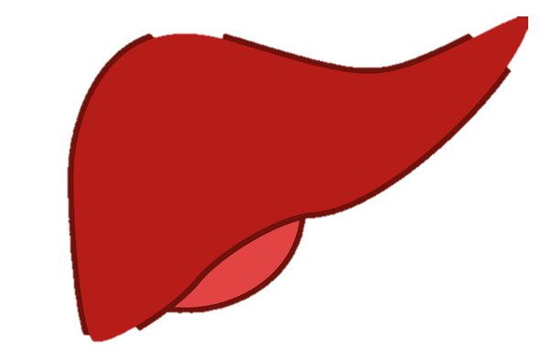
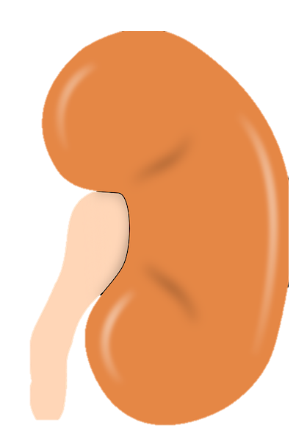
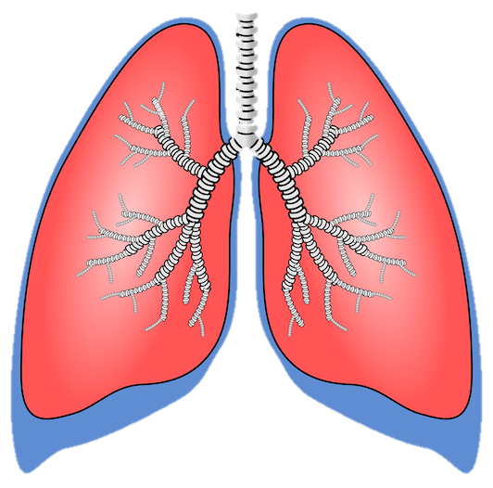
↓renal BP/perfusion
Angiotensinogen
Renin
Vasodilation via NO
Ang I
Bradykinin
ACE
ACE
Ang II
Vasodilation via NO
Ang II
AT₁R
Aldosterone
(Sodium Reabsorption)
Vasoconstriction
ADH
(Water Reabsorption)
Thirst
↑ BV
↑ Peripheral Resistance
↑ Blood Pressure
AT₁R also mediates:
Inflammation
Atherosclerosis
Hypertrophy and fibrosis in the heart
Sympathetic Activity

Slide 3
↓renal BP/perfusion
Angiotensinogen
Vasodilation via NO
Renin
ACE
Bradykinin
Ang I
Vasodilation via NO
ACE
Ang II
NOVEL RAAS PATHWAY
Ang II
Ang II
Ang 1-7
Ang 1-7
AT₁R
ACE2
MAS
MAS
Aldosterone
(Sodium Reabsorption)
Vasoconstriction
Ang1-7/Mas Cardioprotection:
↓Vasoconstriction
↑ Sodium excretion
↑ Water excretion
ADH
(Water Reabsorption)
Thirst
↑ BV
↑ Peripheral Resistance
↑ Blood Pressure
AT₁R also mediates:
Inflammation
Atherosclerosis
Hypertrophy and fibrosis in the heart
Sympathetic Activity

Slide 4
Expert Opinion/Letter to Editor/Correspondence
Meta-Analysis or Systemic Reviews
Randomized controlled trials
Cohort studies
Case reports
Animal and in vivo studies
Strongest
Evidence
Experimental
Observational and descriptive in nature
Experimental but non-human
Weakest
Evidence
Notes:
Modified from: Anon. 2016. The hierarchy of evidence: is the study’s design robust? [Blog]. The Logic of Science. Retrieved March 25, 2020, from <https://thelogicofscience.com/2016/01/12/the-hierarchy-of-evidence-is-the-studys-design-robust/>.

Slide 5
Expert Opinion/Letter to Editor/Correspondence
Meta-Analysis or Systemic Reviews
Randomized controlled trials
Cohort studies
Case reports
Animal and in vivo studies
Strongest
Evidence
Experimental
Studies linking COVID-19 severity and mortality to diabetes, hypertension, and cardiovascular disease; and those showing how ACEi and ARBS affect ACE2 expression
Observational and descriptive in nature
Experimental but non-human
Studies on whether ACEi and ARBs increase or decrease ACE2
Weakest
Evidence
Hypotheses that ACEi and ARBs may worsen COVID-19 in high risk groups

