Slide 1
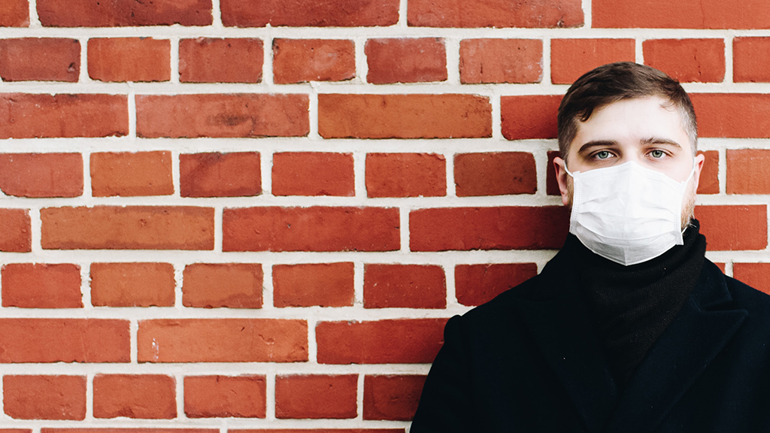
NATIONAL CENTER FOR CASE STUDY TEACHING IN SCIENCE
Images to Accompany the Case Study:
^{A New York State of Mind:}
Transmission and Management of COVID-19
by
Samantha N. Jewell and Julian A. Brix
Department of Physical and Life Sciences
Nevada State College, Henderson, NV
Notes:
Image Credit: Photo by Anastasiia Chepinska on Unsplash, https://unsplash.com/photos/9Un9417AXRI, used in accordance with Unsplash license.

Slide 2
Titer (TCID₅₀/ml of medium)
Hours
Figure 1. Viability of SARS-COV-2 versus SARS-COV-1 on surfaces. 50 microliters of 105 TCID50/ml were added to copper, cardboard, steel, and plastic and extracted with 1 ml of media at 1, 4, 8, 24, 48, 72 and 96 hours post inoculation. (Adapted from van Doremalen et al., 2020.)

Slide 3
6/18 Masks were required in public spaces.
6/12 Gyms, hotels, restaurants, bars, wineries, entertainment centers were reopened. Filming of music and TV resumed with precautions.
8/31 Developed a more gradual four-tiered plan to reopen businesses than 1st attempt based on infection rates.
6/1 Sports could return without spectators and with precautions.
QUARANTINE
QUARANTINE
March | April | May | June | July | Aug | Sept | Oct | Nov
5/8 Low-risk workplaces: bookstores, florists and clothing stores were reopened.
7/1 Bars and indoor dining were closed.
Opened low-risk stores: bookstores, florists and clothing stores. Personal-care businesses and restaurants for outdoor dining or carryout. Still closed in most of the state: Bars, gyms, nightclubs and movie theaters.
5/26 Barber shops and hair salons were opened in most of state. Los Angeles and San Francisco remained closed.
7/13 Theaters, indoor gyms, places of worship, malls, hair salons and barbershops were closed.
7/15 Public schools closed for fall semester. Private school students in 3rd grade or higher must wear a mask; younger students were encouraged to wear masks.
Figure 2. California Governor Gavin Newsom’s response to COVID-19 from March-November 2020 (Washington Post staff, 2020).

Slide 4
6/26 graduation ceremonies with up to 150 people permitted.
6/22 2nd phase for NYC. Restaurants and bars open for outdoor service.*
6/17 3rd phase for state, gatherings of up to 25 people permitted. Indoor dining at 50% (excluded NYC) and personal care business reopened.
4/6 Extended stay at home order. $500 - $1000 fine for violation of social distancing.
6/8 1st phase for NYC. Nonessential stores were cleared to reopen for delivery and curbside pickup only. Construction, manufacturing and wholesalers cleared for work.
8/25 Schools set to reopen in Sept. Outdoor classes suggest by NY mayor.
6/1 Dental offices open, masking, temperature checks, and social distancing required.
8/18 Contact tracing measures in effect for guests at hotels and rentals.
QUARANTINE
March | April | May | June | July | Aug | Sept | Oct | Nov
5/13 Elective surgeries permitted in most of state.
7/6 3rd phase for NYC: personal-care businesses reopen at 50% capacity.
Opened in most areas: Outdoor activities. At reduced capacity: gyms, restaurant dine-in services, bars, state beaches, elective surgeries, personal-care businesses such as salons and barbershops, drive-in movie theaters and curbside pickup for retail stores. Still closed: Movie theaters and amusement parks.
9/30 NYC. Indoor dining at restaurants at 25% capacity.
5/22 State beaches reopened with limited capacity and social distancing measures.
7/10 4th phase for state, malls reopened with reduced capacity and precautions (excluding NYC).
5/28 Executive order: businesses permitted to deny service for customers without a mask.
5/29 2nd phase for state, non-essential retail and personal care businesses reopened at 50% capacity in state (excluded NYC).
7/16 NYC. Alcoholic drinks must be sold with food.
* Malls, indoor dining service, large event venues, gyms, casinos and movie theaters, among other businesses, remained under shutdown
Figure 3. New York Governor Andrew Cuomo’s response to COVID-19 from March-November 2020 (Washington Post staff, 2020).

Slide 5
Figure 4. Incidence of COVID-19 cases in New York and California from March 15 through October 15, 2020 (Washington Post staff, 2020).

