Slide 1
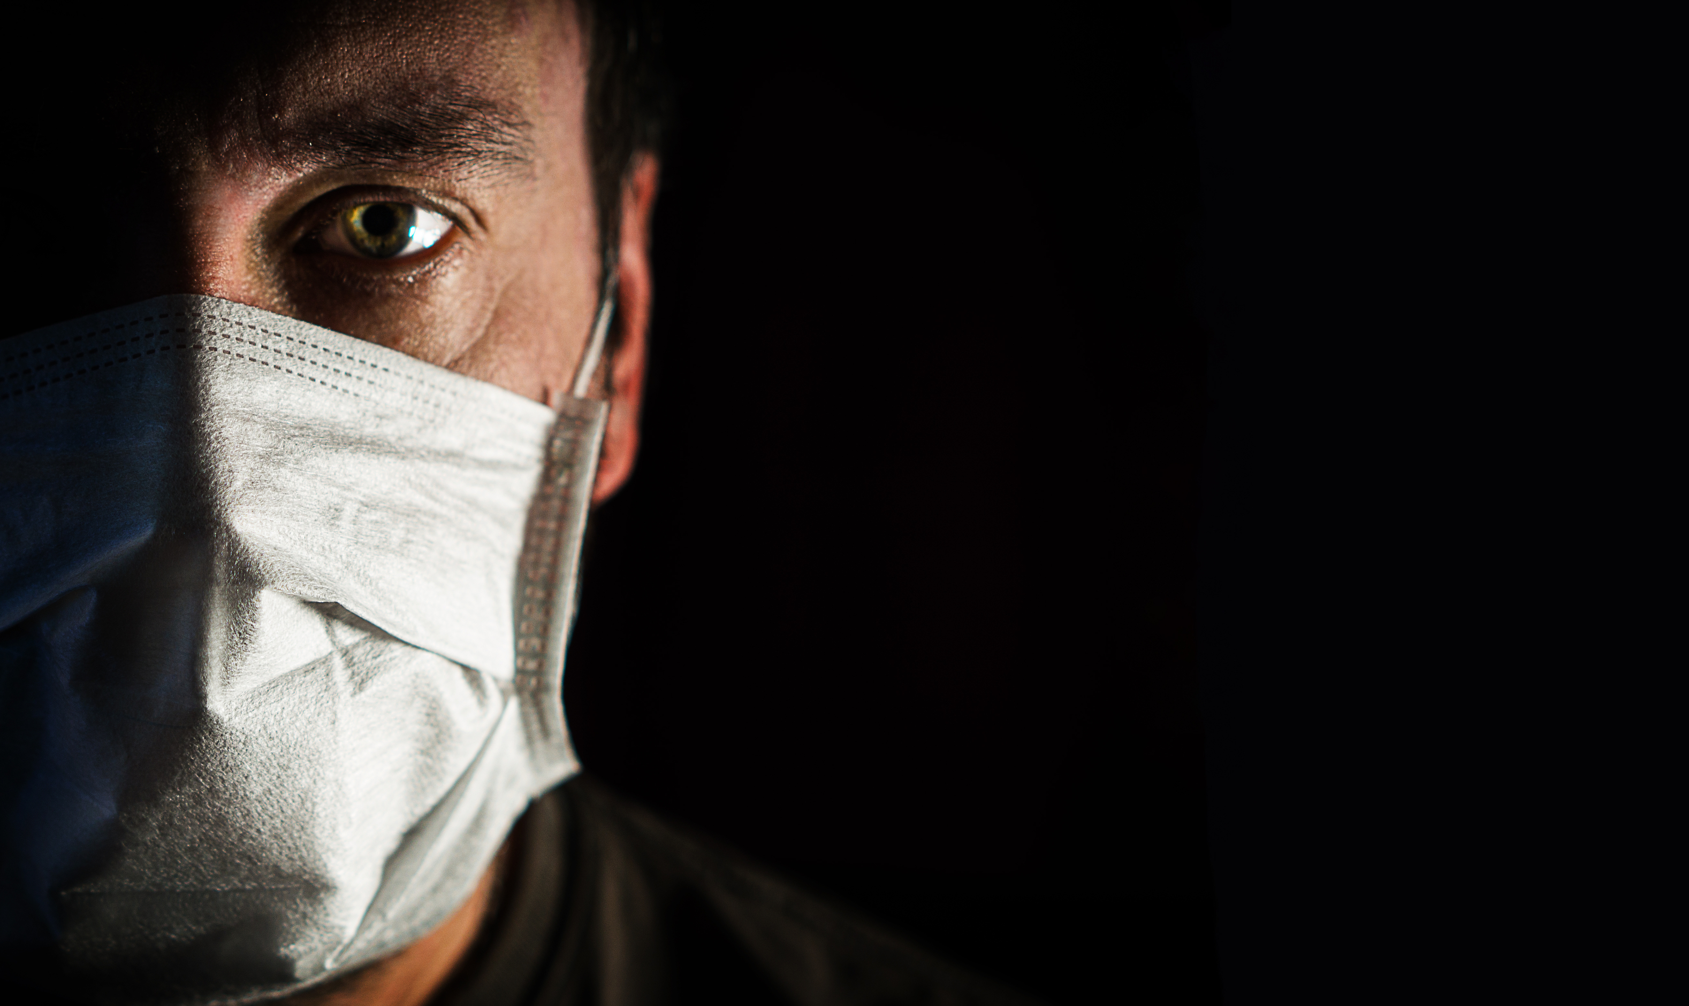
NATIONAL CENTER FOR CASE STUDY TEACHING IN SCIENCE
Figures to Accompany the Case Study
Put to the Test: RT-PCR and
Antibody Detection Diagnostic
Tools for COVID-19
by
Melissa S. Kosinski-Collins, Lindsay Mehrmanesh,
Jessie Cuomo and Kene N. Piasta
Department of Biology
Brandeis University, Waltham, MA
Notes:
Credit: Licensed image © Bartlomiej Kopczynski | Dreamstime, ID 177371334.

Slide 2
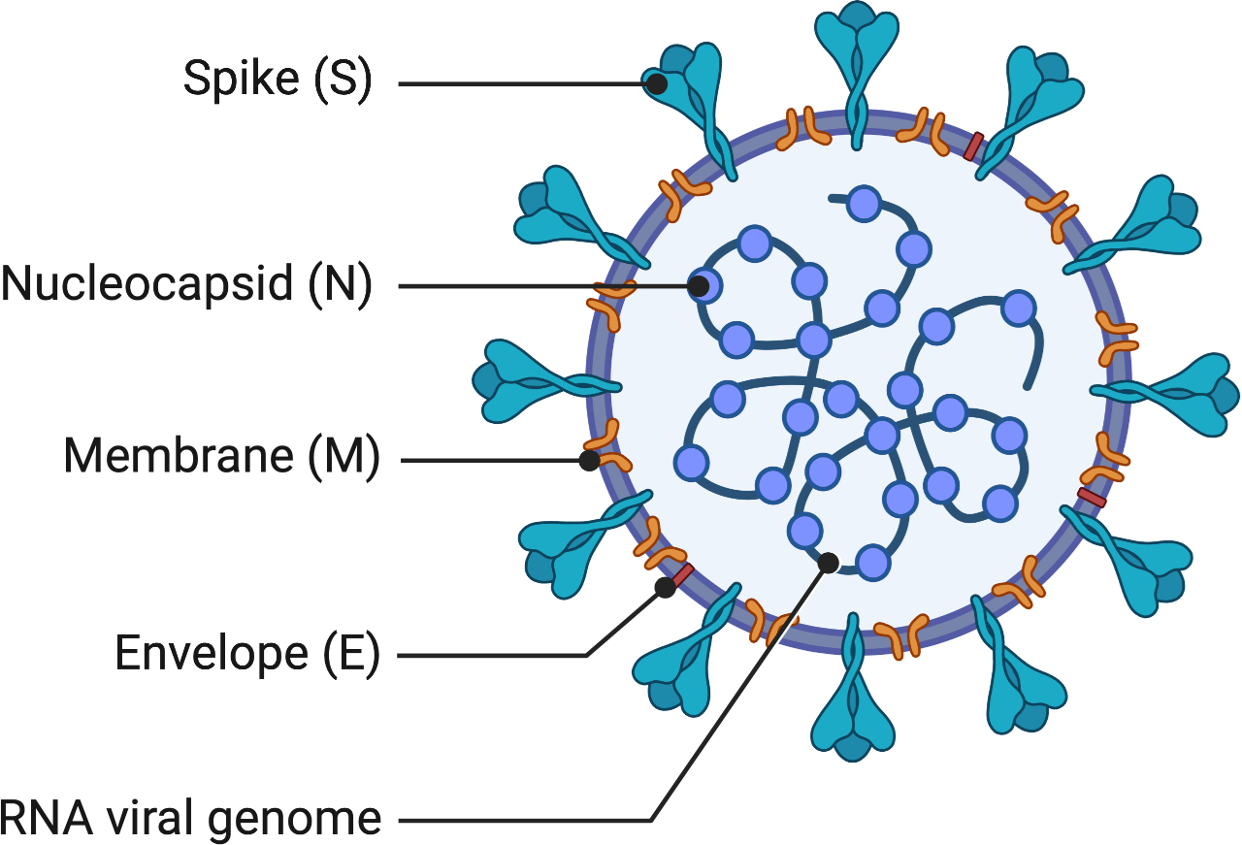
Figure made in Biorender.

Slide 3
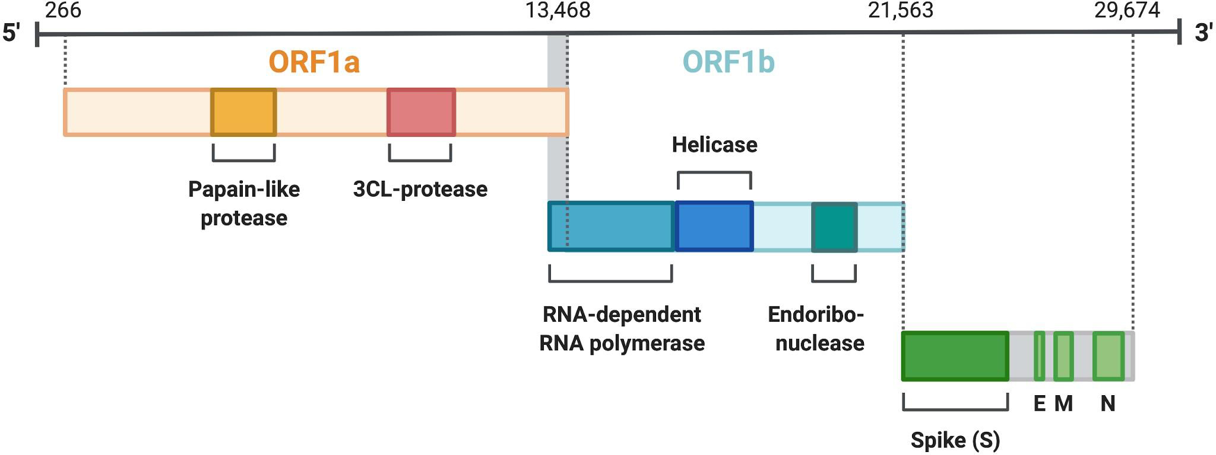
Figure made in Biorender.

Slide 4
Figure made in Biorender.

Slide 5
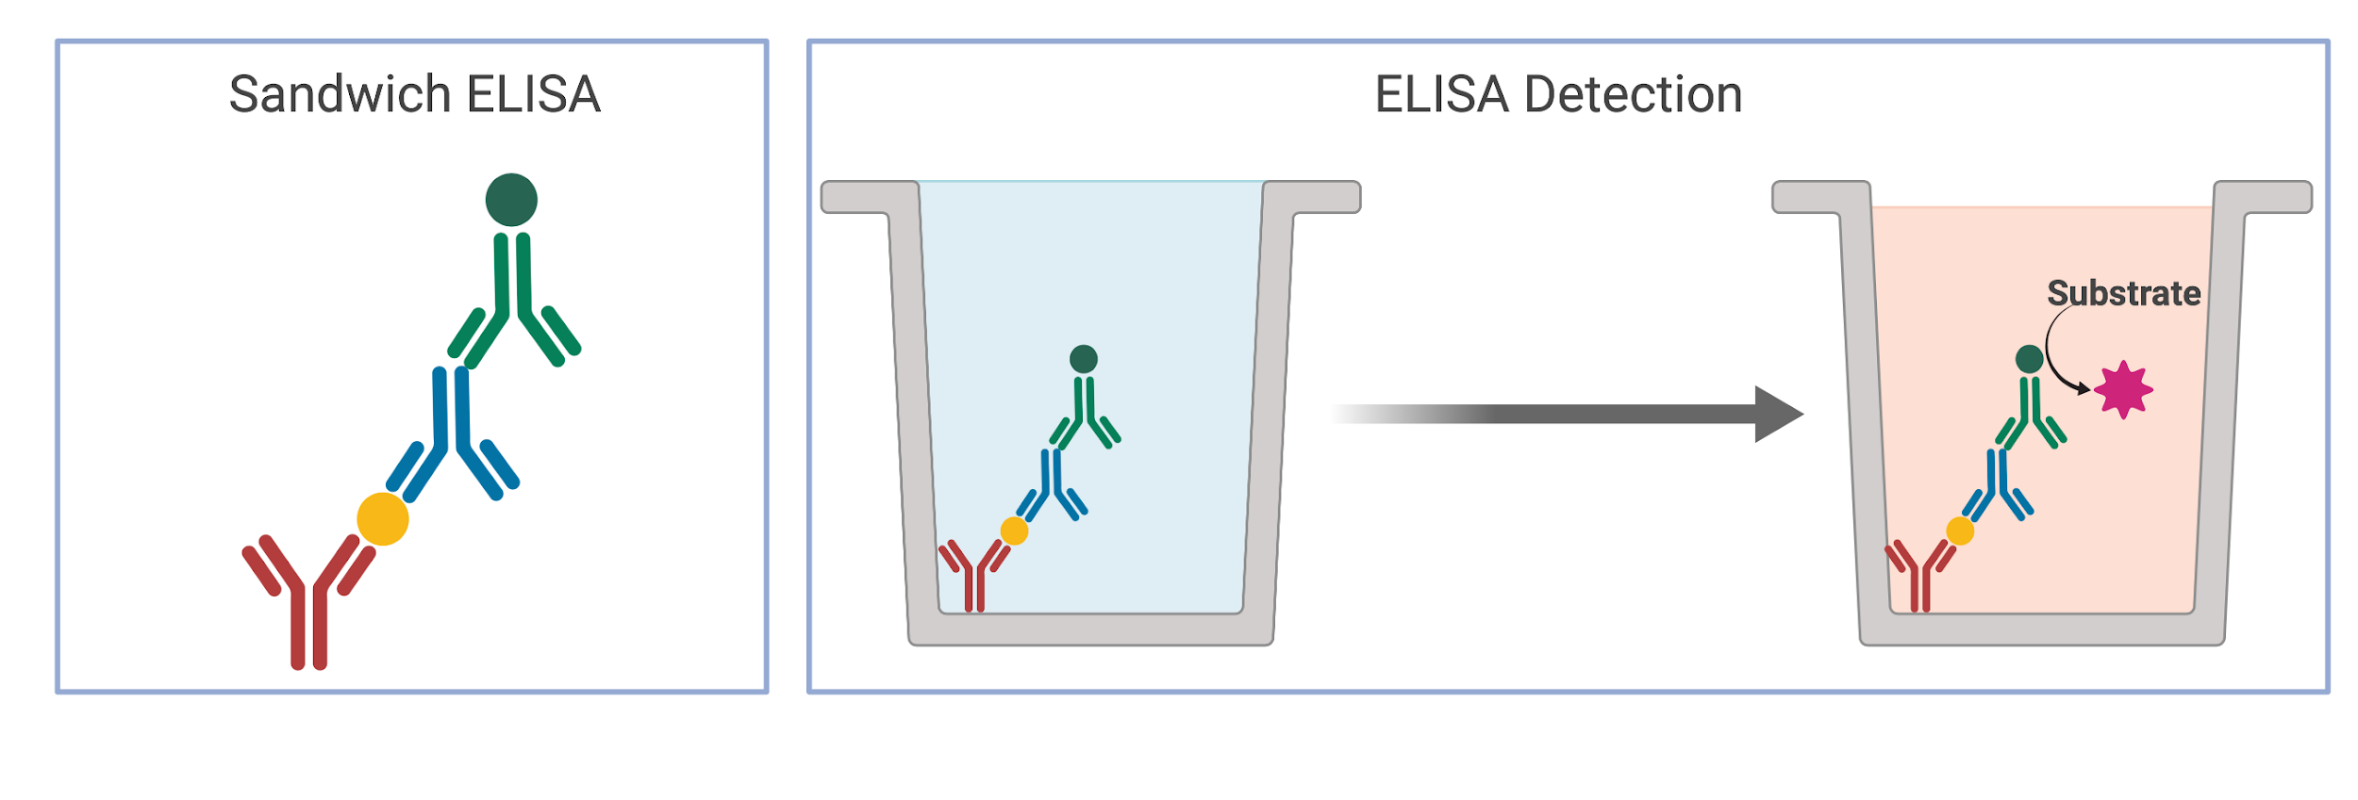
Figure made in Biorender.

