Slide 1
Conservation Concerns: Investigating Threats to Native Wetland Biodiversity
NATIONAL CENTER FOR CASE STUDY TEACHING IN SCIENCE
A Presentation to Accompany the Case Study:
by
Krystal A. Nunes
Department of Chemistry and Biology
Toronto Metropolitan University, Toronto, ON, Canada
Notes:
Credit: Licensed photo of Ontario wetlands © Ahkenahmed | Dreamstime.com, id 85658883.

Slide 2
How can we quantify biodiversity?
There are many measures!
Notes:
Stress that there are many measures we can use, each with their own pros and cons. The measure of diversity used will depend on what is mo.st appropriate for the research question

Slide 3
Species Richness
Number of species found in a local area
What is the plant species richness of this simple community?
Notes:
Arguably the most simple measure of biodiversity is species richness: the number of unique species found in a given area. In the simple example provided on the slide, species richness = 2.

Slide 4
Species Evenness
Comparison of relative abundance of each species
Location A
Location B
Same species richness, but location A has greater evenness
Notes:
Location A: equal species representation of 25% each.
Location B: Dark green deciduous (46%), mid-green deciduous (31%), light green deciduous (15%), coniferous (8%).

Slide 5
How can we visualize differences in species evenness?
Construct rank-abundance curves
0.5
0.4
0.3
0.2
0.1
0
Location A
Relative Abundance
Location B
1 2 3 4
Ranked Abundance
Notes:
When constructing rank-abundance curves (also called Whittaker plots), plot each species from most abundant to least abundant.
In this example, the sites have the same species richness (4) but community B has much greater evenness.
Greater evenness is represented by the lesser slope of the line.
Common sticking point for students: the ranked abundance on the x-axis is not indicative of a certain species. Position “1” is allocated to whichever species is most abundant in each site regardless of species identity.

Slide 6
Rank-Abundance Curves
Can also visualize differences in richness
1
-1
-2
-3
Location B has greater richness
Location A has greater evenness
Location A
Relative Abundance (log)
Location B
1 2 3 4 5 6 7 8 9
Ranked Abundance
Notes:
Evenness is determined by the slope of the line. A steeper curve indicates a site with lower species evenness, while a shallower slope represents greater species evenness.
Note that rank-abundance curves are often plotted using a log scale on the y-axis.

Slide 7
At what scale do we quantify biodiversity?
Alpha, beta, and gamma diversity

Slide 8
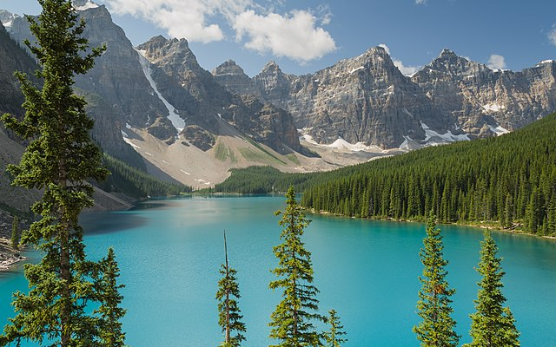
Quantifying Diversity: Alpha
Local diversity – single, localized habitat
E.g., aquatic plant diversity in a lake
Lake Moraine, Banff National Park, Canada (Florian Fuchs, Wikimedia Commons)
Notes:
Most simple metric: species richness.

Slide 9
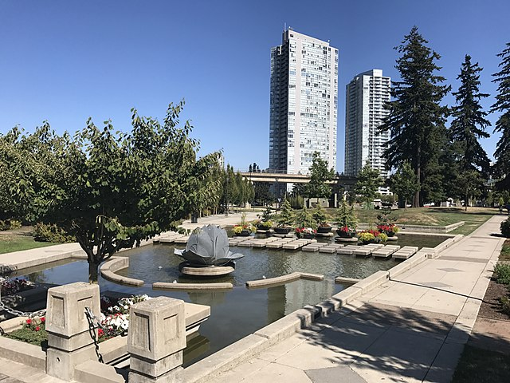
Quantifying Diversity: Gamma
Regional diversity – landscape level
E.g., bird diversity across all urban parks in a large metropolis
Holland Park, Surrey, British Columbia, Canada (Clee7903, Wikimedia Commons)
Notes:
Can quantify gamma diversity using a simple metric such as species richness. If all species are found in all habitats, local diversity = regional diversity.
Usually regional diversity > local diversity.
Note there exists no consensus on what spatial scale is appropriate to qualify as gamma diversity. There is some subjectivity in their application, and is often determined by what is most appropriate for the research question (and locations/species of interest).

Slide 10
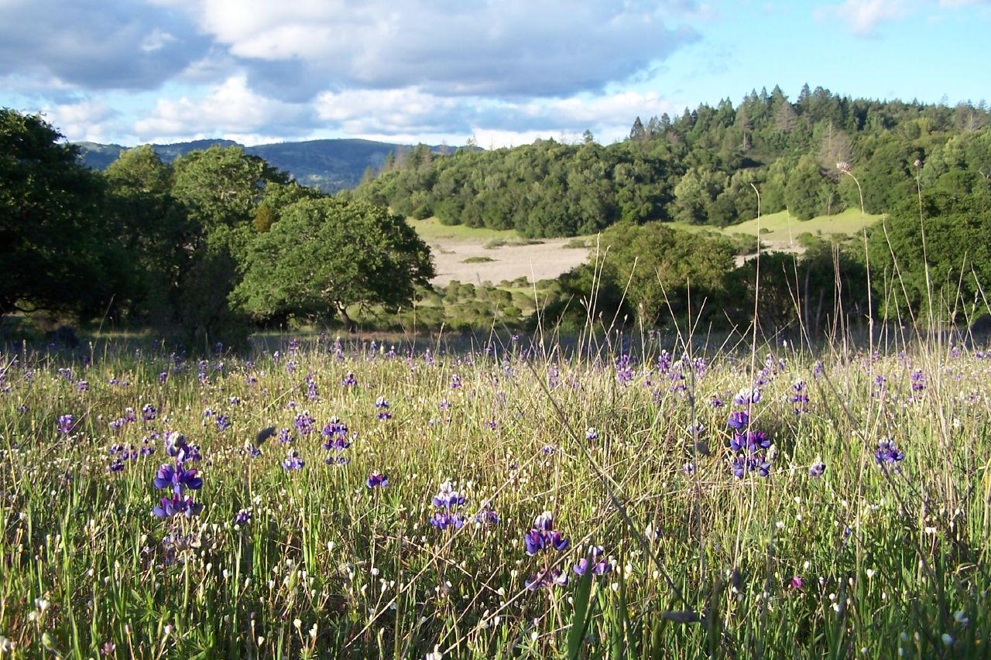
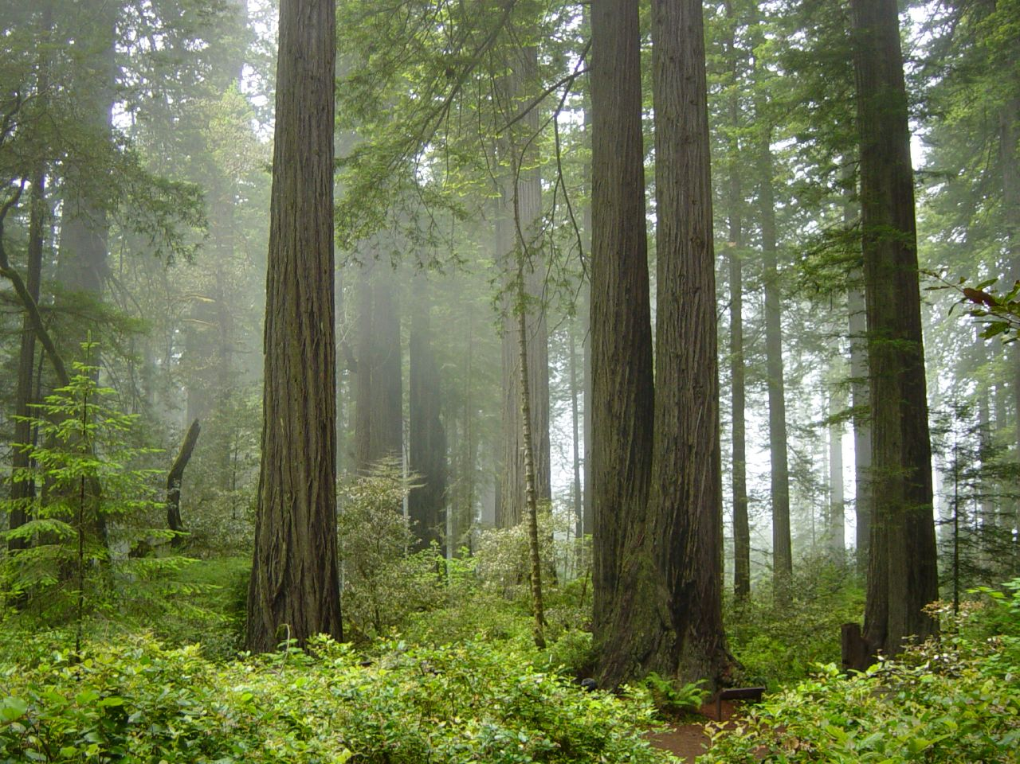
Quantifying Diversity: Beta
Measure of similarity between two locations
Several indices exist
vs.
Annadel State Park, California, U.S. (Brian Michelsen, Wikimedia Commons)
Redwood National Park, California, U.S. (Michael Schweppe, Wikimedia Commons)
Notes:
Several indices exist (e.g., Sorensen’s index, Jaccard’s index as described in this presentation).

Slide 11
A measure of β diversity: Jaccard’s Index
Pairwise comparisons of differences in species composition between sites
S_{J} = a/(a + b + c), where
a = # of species shared by sites b = # of species unique to first site c = # of species unique to second site
Notes:
S_{J} = Jaccard similarity coefficient.
This metric uses presence/absence data.
Ranges from 0 to 1 (no overlap in species identity = 0, the exact same species found in both sites = 1).

Slide 12
Calculating Jaccard’s Similarity Coefficient
A
B
S_{J} = a/(a + b + c)
= 2/(2+1+1)
= 0.5
Notes:
Species represented by color of fish.
Two species shared by both sites: green and yellow.
One species unique to site A (red) and one species unique to site B (purple).

Slide 13
Threats to Biodiversity: Habitat Fragmentation

Slide 14
Threats to Biodiversity
Disruptions that:
Limit resources needed by an organism
Alter species interactions (e.g., competition, predation)
Five major threats: climate change, invasive species, pollution, resource exploitation, habitat loss
Notes:
Habitat loss is the current greatest threat to biodiversity.

Slide 15
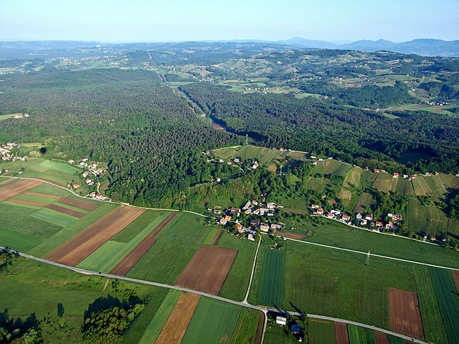
Habitat Fragmentation
Habitat patches increase isolation among populations
Smaller populations supported
May reduce genetic exchange
Fields in Krško, Slovenia (Matjaž Mirt, Wikimedia Commons)
Notes:
Smaller habitat patches support smaller populations. Due to stochastic demographic and genetic factors, small populations are at greater risk of extinction.
Depending on the dispersal ability of the organisms, the quality of the matrix surrounding the patches, and the ability for organisms to move between patches, fragmentation may reduce genetic exchange among populations (i.e., there is a varying degree to which they may form a metapopulation).

Slide 16
How can we apply ecological theory to this conservation issue?

Slide 17
Theory of Island Biogeography
R. MacArthur and E. O. Wilson (1967)
Postulate #1: island size is positively correlated with species richness
Postulate #2: distance from the source (colonizing) population is negatively correlated with species richness
Notes:
A phenomenon not just isolated to physical islands. Same relationships can be applied to habitat patches (e.g., wetland size).

Slide 18
Theory of Island Biogeography
# of species reflects balance between colonization of new species and extinction of existing species
Colonization Rate
Equilibrium Point
Extinction Rate
# of Species
Notes:
Colonization curve represents number of new species arriving to the island/habitat patch.
Colonization declines because (A) as species colonize it becomes increasingly less likely that they are species not already represented on the island, and (B) any species that are not represented from the mainland community are likely poor dispersers.
Extinction rate is high when there are many species as there is an increased likelihood for negative species interactions including increased predation, competition, parasitism, etc.
Equilibrium point tells us the number of species an island can support but not which species are present.
Can be great turnover in species composition.

Slide 19
Combined Effects of Size and Isolation
4 possible equilibrium points
Fewest species: small and far
Most species: large and near
Near
Small
Colonization Rate
Far
Extinction Rate
Large
# of Species
Notes:
Lower richness is generally found on smaller islands.
Small islands support smaller populations. As a result, they have a greater likelihood of extinction.
Lower richness is generally found on more distant islands.
Nearby islands experience greater colonization.

Slide 20
Threats to Biodiversity: Invasive Species

Slide 21
Invasive Species
Found outside of historical range through intentional or accidental introductions
Negative impact on recipient community, typically reduction in biodiversity
Note: Not all non-native species are invasive!
Notes:
Reduces native biodiversity through the novel species interactions (e.g., superior competitor, novel defenses).
Note that all non-native species are invasive. Many non-native species are introduced to new areas, establish small populations, and do not disrupt ecosystem function. It is only those few species that have a negative impact on the recipient community (typically through the reduction of biodiversity) are classified as “invasive.”

Slide 22
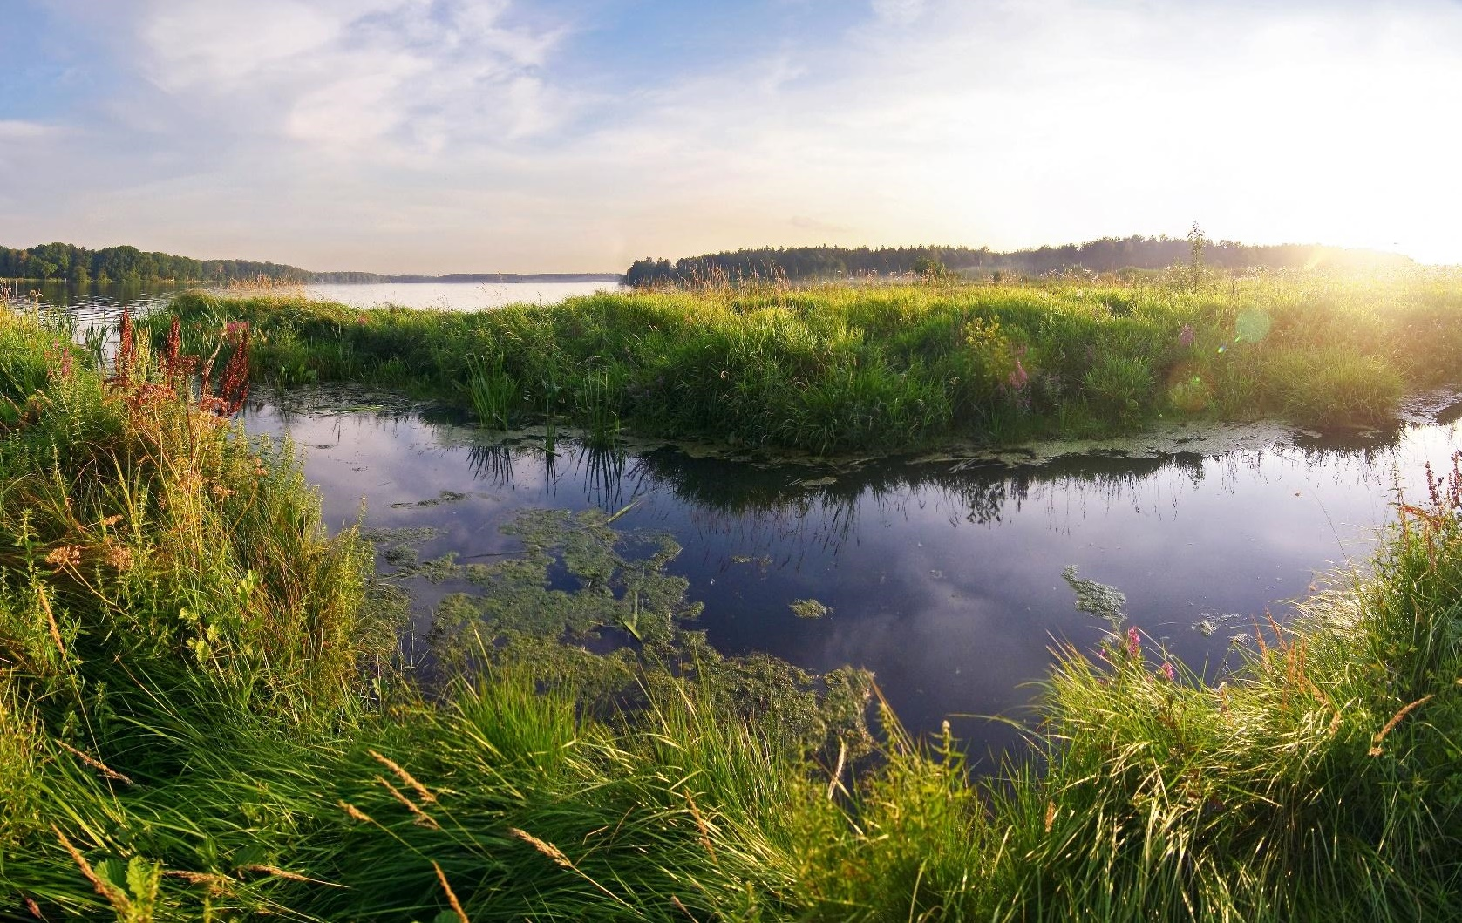
Case Study: Wetland Biodiversity
Reduction in biodiversity due to:
Habitat fragmentation
Invasive species
Wetland (Svetlana Makarova, Wikimedia Commons)
Notes:
Case study will provide opportunity to apply knowledge from this lesson: invasive species, diversity indices, and the theory of island biogeography.

Slide 23
Image Credits
Images in this presentation were created by the authors except for the following:
Slide 1: Licensed photo of Ontario wetlands © Ahkenahmed | Dreamstime.com, id 85658883.
Slide 8: Lake Moraine, Banff National Park, Canada. Wikimedia Commons. 2012. Author Florian Fuchs. Licensed under the Creative Commons Attribution 3.0 Unported license. https://commons.wikimedia.org/wiki/File:Lake_Moraine-Banff_National_Park.jpg.
Slide 9: Holland Park, Surrey, British Columbia, Canada. Wikimedia Commons. 2017. Author Clee7903. Licensed under the Creative Commons Attribution-Share Alike 4.0 International license. https://commons.wikimedia.org/wiki/File:Holland_Park,_Surrey_BC.jpg.
Slide 10:Annadel State Park, California. Wikimedia Commons. 2004. Author Brian Michelsen. Licensed under the Creative Commons Attribution 2.0 Generic license. https://commons.wikimedia.org/wiki/File:Lupines_AnnadelStateParkCA.jpg. Redwood National Park, California. Wikimedia Commons. 2008. Author Michael Schweppe. Licensed under the Creative Commons Attribution 2.0 Generic license. https://commons.wikimedia.org/wiki/File:Redwood_National_Park,_fog_in_the_forest.jpg
Slide 15: Fields in Krško, Slovenia. Wikimedia Commons. 2011. Author Matjaž Mirt. Licensed under the Creative Commons Attribution 2.0 Generic license. https://commons.wikimedia.org/wiki/File:Kr%C5%A1ko_polje_(8778027807).jpg.
Slide 22: Wetland. Wikimedia Commons. 2009. Author Svetlana Makarova. Licensed under the Creative Commons Attribution-Share Alike 2.0 Generic license. https://commons.wikimedia.org/wiki/File:Wetlands_%28Moscow,_Russia%29.jpg.

