Slide 1
The Science of Composting
NATIONAL CENTER FOR CASE STUDY TEACHING IN SCIENCE
A presentation to accompany the case study:
The Poop on
Composting
^{by}
^{Teresa C. Weglarz}
Department of Biological Sciences
University of Wisconsin – Fox Valley

Slide 2
CQ#1: How much waste do you think you generate per day?
0.5 lbs.
2 lbs.
4.5 lbs. (the average weight of a 13″ screen laptop)
9 lbs. (about the weight of a gallon of milk or a newborn baby)

Slide 3
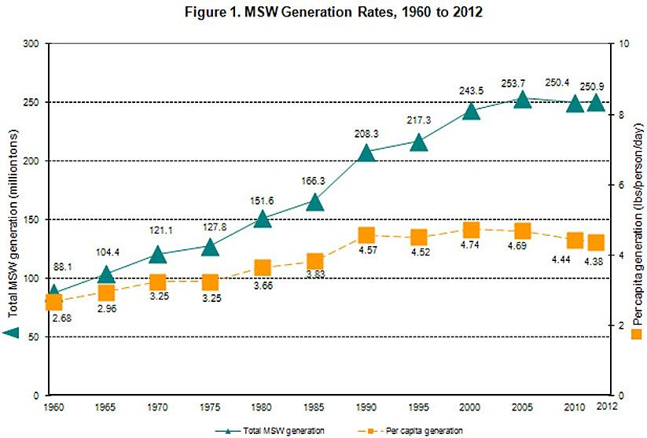
Municipal Solid Waste (MSW)
Notes:
MSW Generation: http://www.epa.gov/epawaste/nonhaz/municipal/images/2012_totl_msw_gen_fig5_lg.jpg

Slide 4
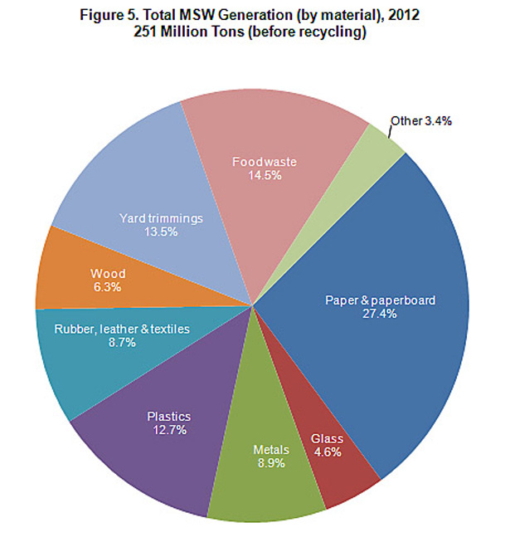
Composition of MSW
~30% is compostable
+ ~50% is recyclable
= 80% can be diverted from landfills
Notes:
http://www.epa.gov/epawaste/nonhaz/municipal/images/2012_totl_msw_gen_fig5_lg.jpg

Slide 5
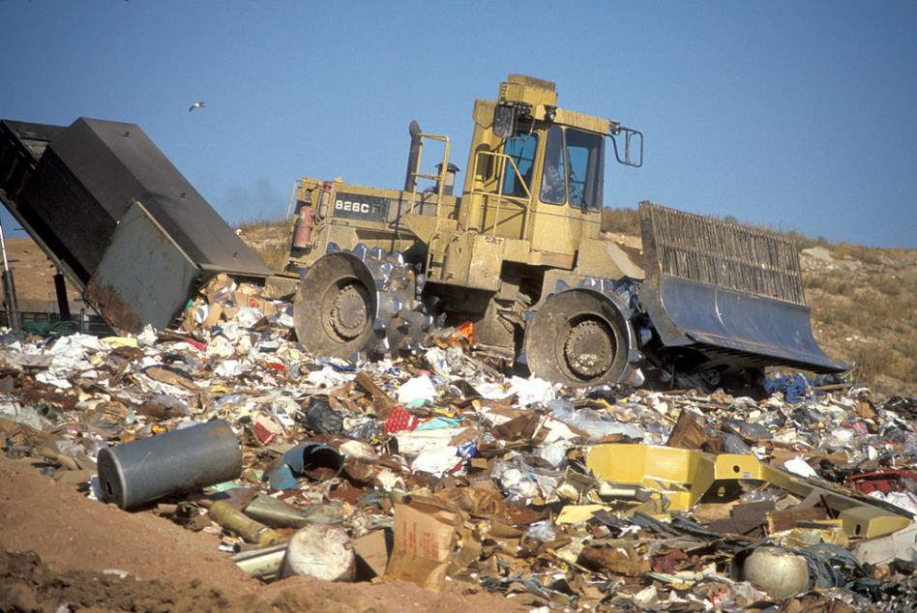
Landfill
Nutrients from organic material not returned to the soil
Methane produced due to anaerobic decomposition
Potential for groundwater contamination
Notes:
DNR photo (WI):https://www.flickr.com/photos/widnr/6589525327/sizes/l/in/photostream/

Slide 6
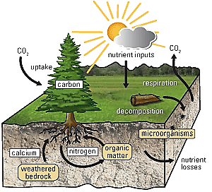
Law of Conservation of Matter
Matter can be transformed but cannot be created or destroyed
In natural ecosystems there is no waste
Matter is recycled and reused
Decomposers are critical in recycling
Notes:
http://pubs.usgs.gov/fs/2009/3078/images/fig2.png

Slide 7
Biogeochemical Cycles
Abiotic reservoirs
Atmosphere
Rock
Fossil fuels
Ocean
Biotic
Plants
Animals
Biological interactions, geologic activity and chemical reactions move nutrients through the environment
Biotic
Abiotic

Slide 8
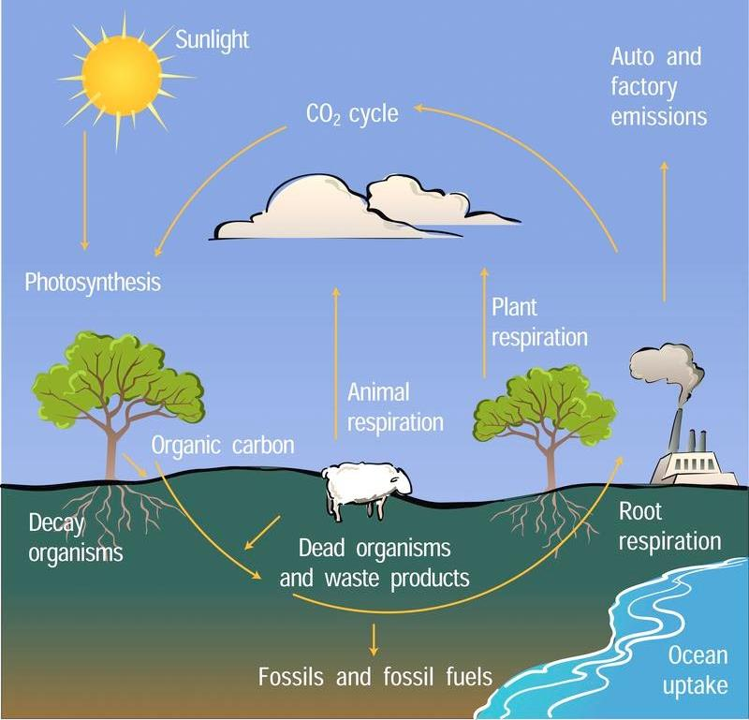
Carbon Cycle Overview
Carbon is an essential building block of biological molecules
DNA, proteins, sugars, lipids, etc.
Chemical bonds in carbon compounds provide metabolic energy
Notes:
Compost: http://www.howtocompost.org/
Carbon Cycle: http://www.nar.ucar.edu/2008/NCAR/highlights/energizing/carboncycle_full.jpg

Slide 9
Photosynthesis and Cellular Respiration are Complementary
C₆H₁₂O₆ + 6O₂
6CO₂ + 12H₂O
Aerobic Respiration
Photosynthesis

Slide 10
CQ#2: Which of the following about the cycling of carbon is false?
CO₂ is released by all plants and animals through cellular respiration.
All living organisms are made up of carbon.
CO₂ is absorbed by plants through photosynthesis.
CO₂ is a greenhouse gas.
CO₂ is converted to glucose by cellular respiration.

Slide 11
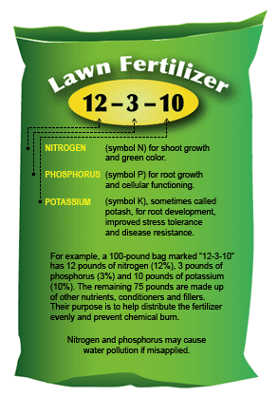
Nitrogen Cycle
N₂ gas in the atmosphere must be fixed before it can be taken up by plants
Limiting factor in plant growth
Required for proteins and nucleic acids
Microorganisms need ~20-30 parts of C:N
Notes:
http://www.swfwmd.state.fl.us/yards/fertilizing/img/fertilizer-bag.gif

Slide 12
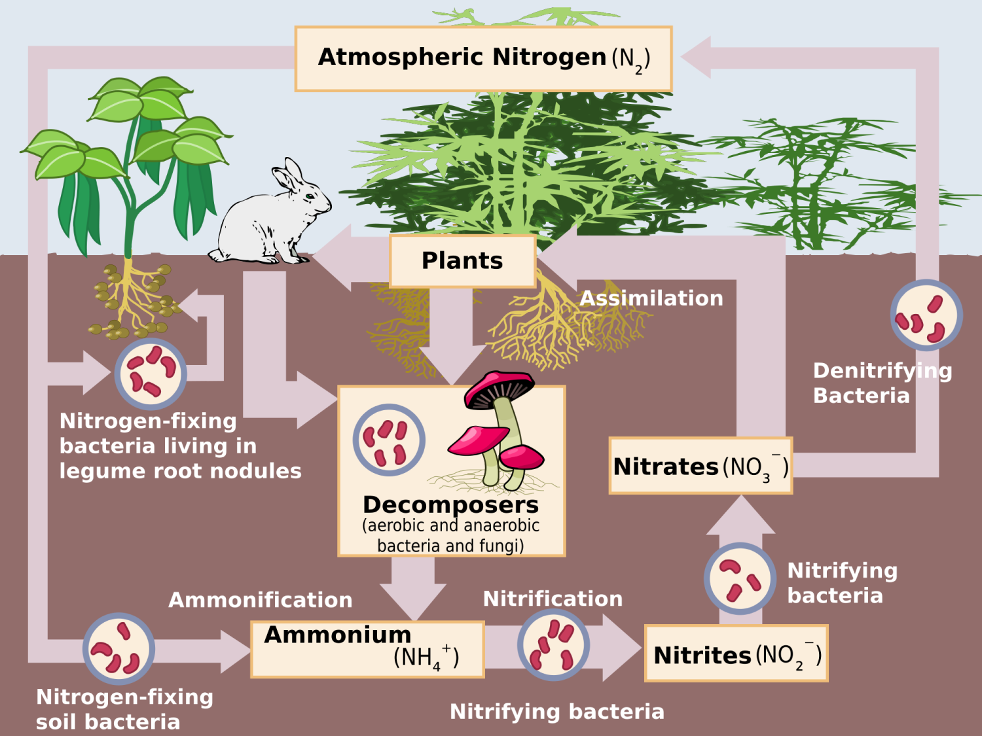
Nitrogen Cycle
Notes:
http://upload.wikimedia.org/wikipedia/commons/thumb/f/fe/Nitrogen_Cycle.svg/2000px-Nitrogen_Cycle.svg.png

Slide 13
Phosphorous Cycle
Phosphorous is primarily found in rock and sediment
Weathering slowly releases phosphorous
Limiting factor in plant growth
Required in cell membranes, DNA, and other compounds

Slide 14
Phosphorous Cycle
Animals obtain phosphorous by eating other organisms
Fertilizer & manure runoff
Plants take up phosphorous from soil
Weathering of rock
Decomposers
Burial
Waste Products
Notes:
Phosphorous Cycle – Created by T. Weglarz using open source clip art.

Slide 15
CQ#3: Inputs of additional phosphorous from chemical fertilizers into waterways would:
encourage growth of aquatic plants.
lead to global warming.
increase the rate of photosynthesis by plants.
increase the amount of oxygen in the water.

Slide 16
CQ#4: If algae and other aquatic plants begin to die off, then:
decomposers would decrease oxygen concentrations in the water.
decomposers would increase oxygen concentrations in the water.
the biogeochemical cycle of phosphorous ends.

Slide 17
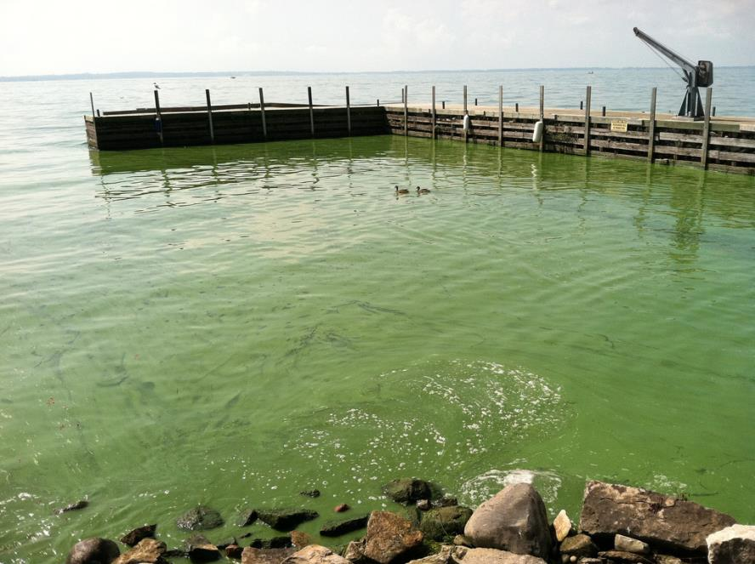
Eutrophication
Excess nitrogen and phosphorous in aquatic ecosystems encourages algae growth
May lead to hypoxic water
Dead zone
Notes:
Algal bloom in Lake Erie, Kelly’s Island https://www.flickr.com/photos/noaa_glerl/6267289096/sizes/l/in/photostream/

Slide 18
Food Waste is a Valuable Resource
CO₂
Nutrients
Organic compounds
Food waste is composed of:
Carbohydrates
Lipids
Proteins
Water
Decomposition process breaks these macronutrients down to simpler compounds

Slide 19
CQ#5: Which one of the following is not part of a carbohydrate?
Carbon
Oxygen
Phosphorous
Hydrogen

Slide 20
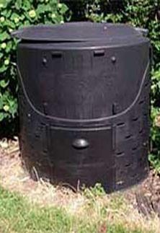
CQ #6: Do you have a compost pile or bin at home?
Yes
No
Backyard Compost Bin
Notes:
Browncountyrecycling.org

Slide 21
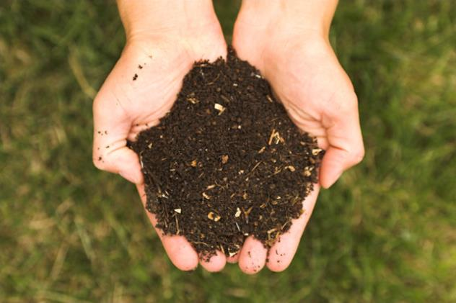
Composting Definition
Composting is the process of biological decomposition of organic material.
The end-product of composting is compost.
Compost is a nutrient-rich material that is valuable as a soil additive.
Notes:
http://commons.wikimedia.org/wiki/Compost File:Real_Compost.jpg

Slide 22
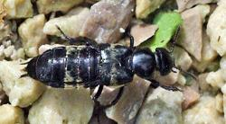
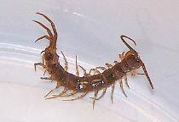
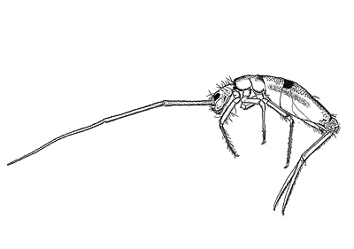
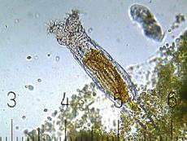
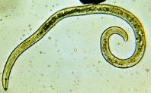
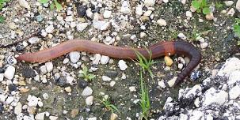
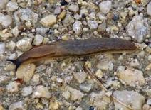
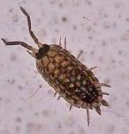
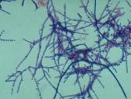
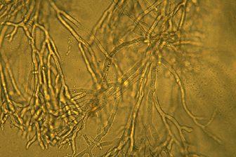
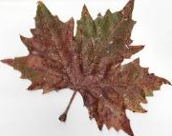
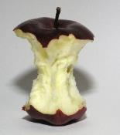
Composting Trophic Pyramid
Tertiary Consumers
rove beetle
centipede
Secondary Consumers
rotifer
nematode
springtail
*
*
*
*Detritivore – feeds on organic material and increases surface area of organic material by breaking it down
Primary Consumers
actinomycetes
fungi
worm
slug
sowbug
Organic Matter
food waste, leaves, sawdust, grass clippings
Notes:
See also: Invertebrates of the Compost Pile. Cornell Waste Management Institute. ©1996 http://compost.css.cornell.edu/invertebrates.html
Sowbug, centipede, rove beetle, worm, and slug pictures: https://www4.uwm.edu/fieldstation/naturalhistory/bugoftheweek/images/sowbug1_300_1.jpg
Leaf: http://upload.wikimedia.org/wikipedia/commons/thumb/7/79/Autumn_American_Sycamore_Leaf.jpg/609px-Autumn_American_Sycamore_Leaf.jpg
Nematode: http://www.discoverlife.org/20/q?search=Nematoda
Rotifer: http://upload.wikimedia.org/wikipedia/commons/2/2d/Bdelloid_Rotifer.jpg
Springtail: http://www.discoverlife.org/nh/id/lucid/Insect_orders/html/Collembola.html
Apple core: http://upload.wikimedia.org/wikipedia/commons/3/30/Apple_stark_s.jpg

Slide 23
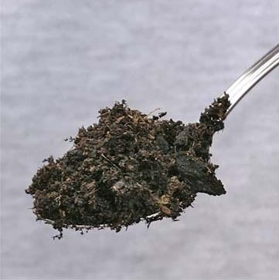
Microorganism Biodiversity
Compost from food waste contains a wide variety of bacteria and fungi
A gram of compost contains millions of microorganisms
Bacteria | Fungi | Actinomycetes
100 million - 1 billion | 10,000 - 1 million | 100,000 - 100 million
Responsible for most of the decomposition | May appear as gray or white colonies on compost | May form long gray web-like strands throughout compost and give off earthy smell
Notes:
p.44 Humanure
http://kentwa.gov/assets/0/3844/3846/161525c7-9afd-4b28-8aef-214c63ff5558.jpg

Slide 24
Critical Composting Conditions:
C:N ratio
Moisture
Temperature
Oxygen

Slide 25
C:N Ratio
Material | C:N ratio
Paper | 100-800
Cardboard | 400-563
Straw | 80
Leaves | 54
Fruit | 40
Coffee grounds | 20
Vegetables | 19
Fresh grass clippings | 12-19
Farm manure | 14
Excess of nitrogenous material can lead to production of ammonia (smelly compost)

Slide 26
CQ#7: Which of the following has the highest C:N ratio?
Material | Typical Chemical Composition
Mixed Paper | C₂₆₆H₄₃₄O₂₁₀N
Grass | C₂₃H₃₈O₁₇N
Food Waste | C₁₈H₂₆O₁₀N
Mixed paper
Grass
Food Waste
Notes:
Chemical Compositions from The Practical Handbook of Compost Engineering by Roger T. Haug

Slide 27
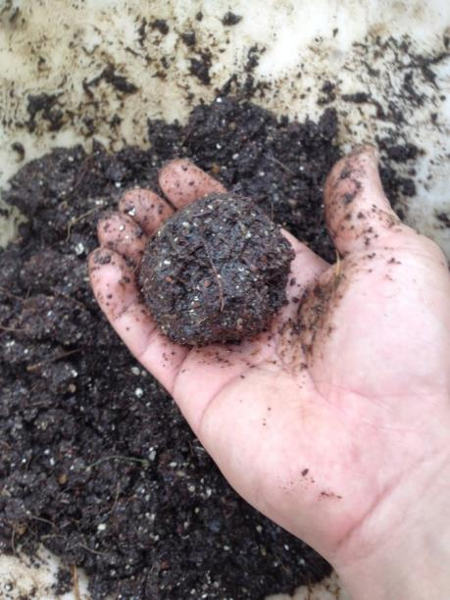
Moisture
Optimal moisture is ~50%
A compost pile that is too dry does not support bacteria and fungi that are necessary for decomposition
Compost should hold its shape when formed into a ball but not be so wet that water can be squeezed out
A compost pile that is too wet quickly goes anaerobic
Oxygen flow is limited
Notes:
Photo: http://myhomemygardenmyrules.blogspot.com/2014/04/diy-seed-starters-easy-way.html

Slide 28
Temperature
Temperatures above 130°F kill most pathogens and weed seeds
Pathogens can be killed at lower temperatures but it takes longer
Temperatures that are too high can kill beneficial microorganisms
Frozen compost won’t decompose since bacteria are mostly inactive

Slide 29
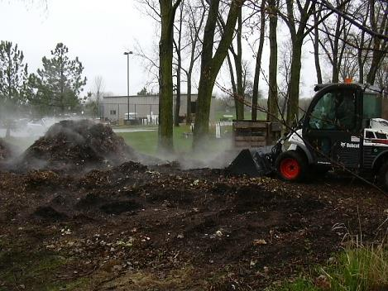
Heating Up
2nd law of thermodynamics: disorder (or entropy) increases over time
Energy is used by organisms to maintain order
Use of energy is not 100% efficient and therefore some heat is released to the environment
Notes:
T. Weglarz: Personal Picture

Slide 30
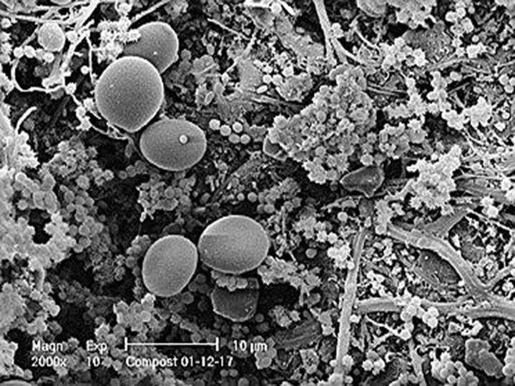
Chemical Reactions of Composting
Microbes are workhorses of composting
6O₂ + C₆H₁₂O₆ → 6CO₂ + 6H₂
C₆H₁₂O₆ + 3SO₄²⁻ +6H⁺ → 6CO₂ +6H₂O +3H₂S
H₂S smells like rotten eggs
C₆H₁₂O₆ →3CH₄ + 3CO₂ (simplified)
Notes:
Image: Soil Foodweb Institute

Slide 31
CQ#8: Which of the following reactions would supply the greatest amount of energy to microbes?
6O₂ + C₆H₁₂O₆ → 6CO₂ + 6H₂O
ΔG = -677 kcal/mol
C₆H₁₂O₆ + 3SO₄²⁻ +6H⁺ → 6CO₂ +6H₂O +3H₂S
B. ΔG = -107 kcal/mol
C₆H₁₂O₆ →3CH₄ + 3CO₂ (simplified)
C. ΔG = -96 kcal/mol

Slide 32
Oxygen
Aerobic composting is the most efficient form of composting
Pile may smell if oxygen is limited
Aeration adds oxygen
Push in (blades fold up) and pull out (blades fan out)
Notes:
T. Weglarz: Personal Picture

Slide 33
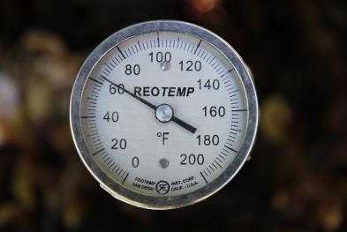
Hot vs. Cold Composting
Hot Composting
Cold Composting
Use ~2-3× high-carbon material to nitrogen-containing material
Need to add all the material at one time
Aerate to encourage growth of microorganisms
Temperature should be around 140°F-160°F for 7-10 days
Add materials as they are available
Do not add weeds since the temperature will not be hot enough to kill the seeds
Does not require turning
May take a year or more
Notes:
T. Weglarz – personal picture

Slide 34
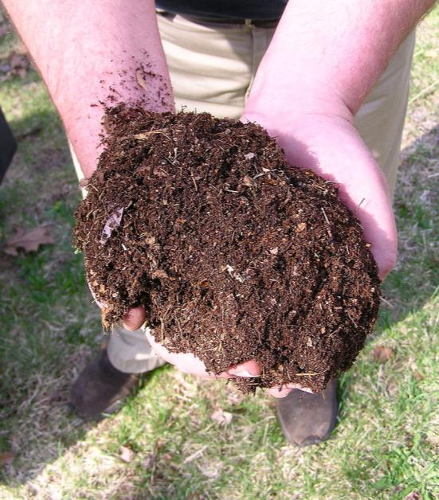
Compost
Finished compost has an earthy smell
A good sign that the composting process is complete is that the temperature drops
Improves soil fertility because it contains essential plant nutrients
Holds moisture and increases drought tolerance
A natural pesticide
Compost is being used instead of pesticides in some areas since pesticides have been linked to colony collapse disorder of honeybees
Notes:
By normanack - http://www.flickr.com/photos/29278394@N00/2457055952/, CC BY 2.0, https://commons.wikimedia.org/w/index.php?curid=7018453

Slide 35
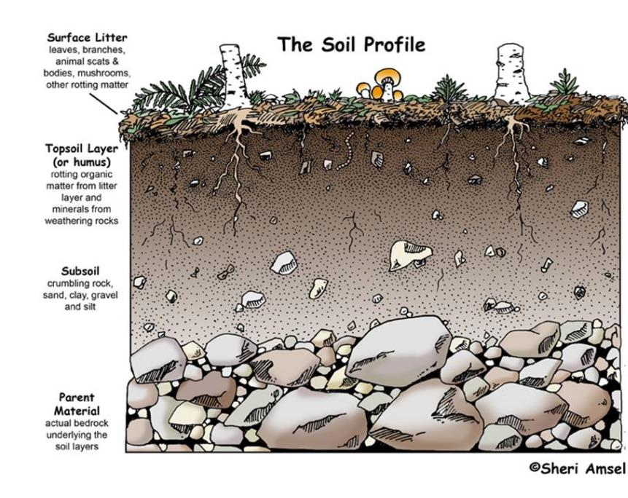
Compost ≠ Soil
Soil
Formed largely via weathering of rock
Can take up to 500 years to generate 1 inch of soil
~50% mineral matter and 5% organic matter + air + water
Organic matter can be used up by crops and other plants
Living organisms: bacteria, fungi, worms, etc.
Notes:
Zarovy. “Soil vs. Compost.” Kenosha County, University of Wisconsin – Extension. 2014, April 21. http://kenosha.uwex.edu/2014/04/21/soil-vs-compost/
Amsel, Sheri. “Ecology.” The Dirt on Dirt -- Why is Soil Important?. Exploring Nature Educational Resource. © 2005 - 2015. May 28, 2015. <http://exploringnature.org/db/detail.php?dbID=27&detID=1206>

Slide 36
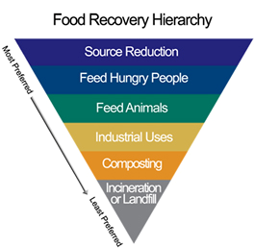
Food Waste Reduction
Composting reduces food waste but not creating food waste in the first place is preferable
A recent study found that an average American throws away $640 worth of food ever year.
Notes:
Image: http://www.epa.gov/foodrecovery/

Slide 37
CQ#9: Are human poop and pee valuable natural resources?
Yes, they can be reused and recycled.
No, they are wastes that have no economic or other value.

Slide 38
How much Feces and Urine?
Amount produced per person per day
Feces: ~0.3 lbs
0.3 lbs. × 300+ million people in the U.S. = ( a lot!)
May contain bacteria and other pathogens
Urine: 800-2,000 ml (or up to 0.5 gal.)
Ammonia smell is due to breakdown of urea by bacteria and is high in nitrogen
Relatively sterile
C:N ratio
Urine is 15-19% N
Feces has a C:N ratio of 5-10
Notes:
http://www.scientificamerican.com/article/human-urine-is-an-effective-fertilizer/

Slide 39
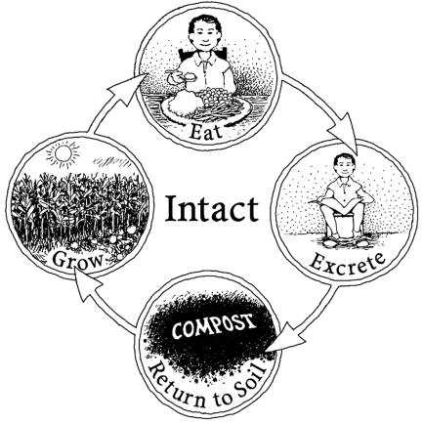
Night Soil
Application of raw human waste has been common practice in Asia for thousands of years
High in N, so it is a valuable fertilizer
Concern is spread of disease
Smells bad
Nutrient Cycle
Notes:
Jenkins, Joseph C. The Humanure Handbook: A Guide to Composting Human Manure. 3rd ed. Grove City, PA: Joseph Jenkins, 2005. p.10. Print.

Slide 40
Toilets
Most toilets use ~1.6 gallons per flush
~26% of household water use is for flushing the toilet
Less than 3% of water on Earth is freshwater and most of that is tied up in glaciers and ice caps
To conserve water: If it’s brown, flush it down. If it’s yellow, let it mellow.
But, where does it go?

Slide 41
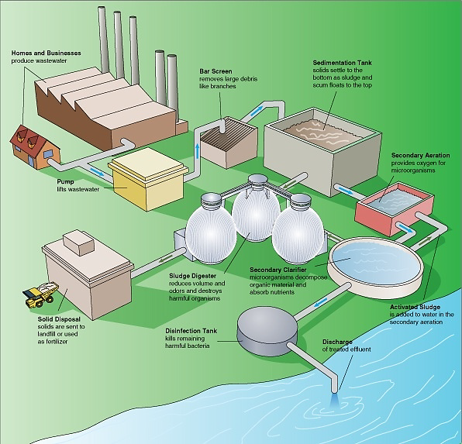
Wastewater Treatment
Uses bacteria to decompose organic matter
Chlorine or UV light is used to kill pathogens
Difficult and expensive to remove N + P
Notes:
http://commons.wikimedia.org/wiki/File:Steps_in_a_typical_wastewater_treatment_process.png

Slide 42
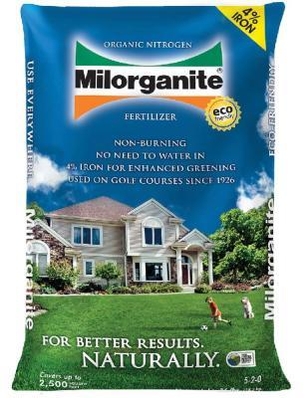
Biosolids
Biosolids are the composted solids from wastewater treatment
Can be land applied as a fertilizer
Concern of heavy metals and other chemicals since wastewater treatment plants also process industrial wastewater
Commercially sold biosolids:
Milorganite (Milwaukee, WI)
Oshkonite (Oshkosh, WI)

Slide 43
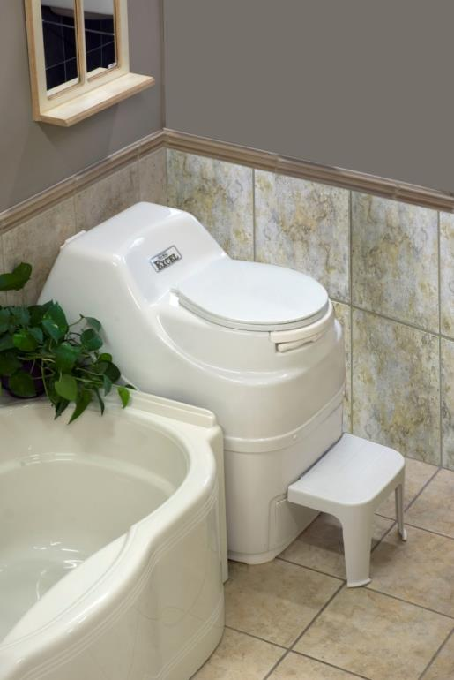
Composting Toilet
Sun-Mar Excel $1645.00
Manually rotate internal drum to aerate
Liquid is evaporated
Add one cup of bulking material (peat) per person per day
Notes:
Composting toilet
http://commons.wikimedia.org/wiki/File:Sun_Mar_Excel.jpg

Slide 44
The Future
2. 6 million people lack access to proper sanitation
Bill and Melinda Gates Foundation proposal to “Reinvent the Toilet” on-site sanitation system
On-site sanitation system
Off-the-grid
Low cost
Source of revenue via resource recovery
Notes:
Reference: http://www.gatesfoundation.org/media-center/speeches/2011/10/why-we-need-to-reinvent-the-toilet

