Slide 1
NATIONAL CENTER FOR CASE STUDY TEACHING IN SCIENCE
Figures to Accompany the Case Study:
If You Could See Through My Eyes: The Experience of
Color Vision
by
Andrew M. Petzold
Center for Learning Innovation
University of Minnesota Rochester
Notes:
Credit: Licensed image © Korn Vitthayanukarun | Dreamstime, id 148259843

Slide 2
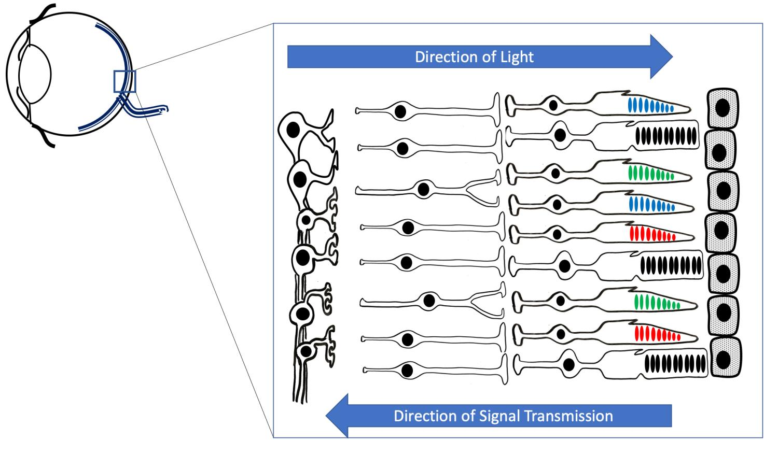

Slide 6
