Slide 1
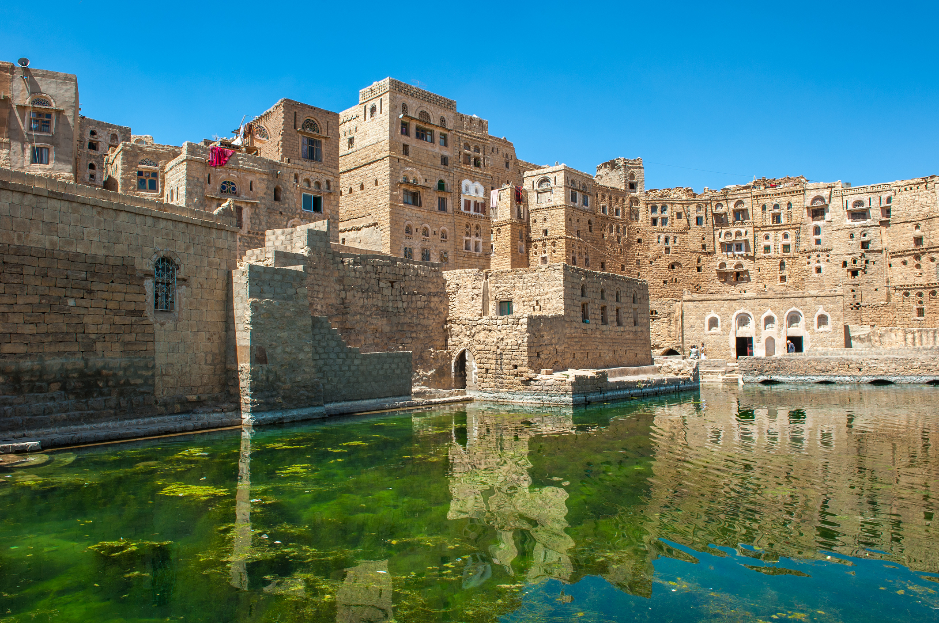
Cholera and Conflict in Yemen
by
NATIONAL CENTER FOR CASE STUDY TEACHING IN SCIENCE
by
Mehron S. Dhillon, Daniel Na, Christopher R. Kawata, Jacelyn Swede, Parth N. Patel, Angelika F. Ringor, Joshua Chu, and Andrea Nicholas
Notes:
Water cistern at Hababah traditional village, Yemen. Licensed photo © Javarman | Dreamstime.com, ID 34756271.

Slide 2
What is Cholera?
Cholera is a disease caused by the gram-negative form of Vibro cholerae. Gram negative bacteria are often resistant to antibiotics.
It is an extremely virulent disease that causes severe, acute watery diarrhea. It takes between 12 hours and 5 days for a person to show symptoms.
Most people infected with cholera do not show any symptoms, but the bacteria are present in their feces 1–10 days after infection and can be transmitted to other people.
The majority of cases are mild or moderate, while a minority develop severe and potentially fatal diarrhea and dehydration.
Notes:
General cholera overview

Slide 3
Our Patient

Slide 4
Age 22, ♂
Height: 5' 10"
Temperature: 98.7°
HR: 95 bpm
BP: 100/65
Weight: 105 lbs

Slide 5
Patient History
1 day ago, his pain was now severe. He had watery diarrhea (“rice-water” stool), nausea, and muscle cramping.
3 days ago, our patient began to feel stomach pain and mild diarrhea.
4 days ago, our patient visited his family in a rural area and drank from the well without purifying the water first.
2 days ago, his diarrhea and pain became worse.
Today our patient was vomiting and had difficulty holding fluids down. He felt generally weak, and decided ultimately to visit the ER.

Slide 6
Diagnostics
1. Complete Metabolic Panel
2. CT scan
3. Stool sample
4. Hemoccult stool sample
Notes:
The complete metabolic panel is necessary to assess the patient’s electrolyte status. The stool sample and the hemoccult stool sample are necessary to assess what kind of infection is at play, and whether the patient is suffering from a GI bleed. The CT scan may be used in the context of abdominal pain to rule out several diagnoses, however it is not necessary to evaluate for cholera. Additionally, a CT scanner may not be available for use in more resource limited settings.

Slide 7
Treatment Plan
Antibiotics (Azithromycin)
Rehydration (Water + Salts + Sugars)
Zinc pills (seems to help)
Clear Liquid diet only
Zofran (anti-nausea)
Notes:
Treatment plan

Slide 8
Game Rules
If you are selected to be a doctor for this activity, come to the front of the class and collect the doctor handout before proceeding to the designated hospital. If you are selected to be a patient, please go take a seat in the hospital.
Once in the hospital, wait for the doctor. If a doctor shakes your hand, you are cured and may return to your original seat.
If they tap your shoulder, you have passed away from the disease. Put a tally on the whiteboard and return to your original seat. On the way to your seat, pick two people to “infect” and send them to the hospital.
If the row or seat you are in is called at any point, proceed to the hospital as you have been infected.
If at any time you are sent to the hospital and there are no seats available, form a line next to the hospital.
Notes:
At this point, the instructor should describe the general overview of the game as described in the teaching notes. Remember to allow the students a few minutes to get used to how the game is supposed to progress!

Slide 9
Yemen: October 2015-August 2016
Notes:
Slides 9-10 cover “First Mini-Lecture: The Yemeni Civil War” as described in the teaching notes.

Slide 10
The war started in 2011 by the Houthi movement against president Abdrabbuh Mansour Hadi, who fled to Aden and eventually out of the country for his safety.
In 2015, the bordering country of Saudi Arabia teamed with the Yemeni government to send airstrikes and blockages to the regions of under the rebels [1].
Water reservoirs and water treatment plants have been systematically targeted by both internal fighting and by external intervention [2].
Military blockages restrict many in the population from humanitarian aids such as food, water and medicine. The lack of a functional government has caused widespread unemployment for civil workers such as teachers, nurses, and other government officials [3].

Slide 11
Round 1
Notes:
Round 1 of gameplay should begin now.

Slide 12
Problem 1: The Yemeni Trade Blockade
Notes:
Slides 12-13 cover “Second Mini-Lecture: The Blockade of Yemen” as described in the teaching notes.

Slide 13
Yemen experienced trade blockades of its naval and aerial ports during a majority of the Yemeni Civil War, and as of March 2018, there is still an ongoing blockade in place.
This led to the restriction of medical resources such as the IV fluids and antibiotics necessary for controlling the cholera outbreak. This has also led to the loss of safe drinking water and water purification equipment to supply villages and towns [3].
In addition, diseases like cholera and malaria have become more virulent due to widespread malnutrition. 1.8 million children and 1.1 million pregnant women are experiencing Moderate Acute Malnutrition (MAM). Additionally, 462,000 children are suffering from Severe Acute Malnutrition (SAM). A child under the age of 5 dies every 10 minutes from preventable causes in Yemen, largely due to complications resulting from malnutrition [3].

Slide 14
Round 2
Notes:
Round 2 of gameplay should begin.

Slide 15
Problem 2: Sanitation and Healthcare
Notes:
Slides 15-16 cover “Third Mini-Lecture: The Bombing of Sanitation and Healthcare Facilities” as described in the teaching notes.

Slide 16
Over 160 airstrikes have been performed against Yemeni health facilities [2].
Many of the hospitals targeted were public hospitals. Several of these were run by Doctors Without Borders, a nonprofit organization offering medical assistance in war-torn regions.
Due to the damages of the war, over 15 million Yemenis are lacking access to proper healthcare.
However, the ongoing conflict continues to hinder relief efforts.

Slide 17
Water has also become even more scarce in a nation that has historically been lacking water.
Airstrikes targeting the Yemeni water supply were aimed at forcing an end to the conflict, but only made conditions worse. The remaining water plants are in need of fuel and chlorine (4).
Due to the damages of the war, over 20 million Yemenis are lacking access to clean water and basic sanitation. This is worsened by the formation of roadblocks and travel blockades as the war has progressed.
However, the ongoing conflict continues to hinder relief efforts.

Slide 18
Round 3
Notes:
Round 3 of gameplay should begin.

Slide 19
Problem 4: Medication Shortages
Notes:
Slides 18-19 cover “Fourth Mini-Lecture: Medication Shortages” as described in the teaching notes.

Slide 20
Basic medical supplies, medicines, and vaccines hit critical shortages preventing delivery of medical care to those requiring immediate aid, mainly due to naval blockades.
The delivery of fuel used to power healthcare facilities was also cut off by the blockades, which in turn damaged the national store of medicines that need to be stored at cold temperatures and causing power outages, making critical equipment like incubators useless.
Access to emergency medical kits, trauma kits, diarrheal disease kits and blood bank supplies was also cut off due to airstrikes and bombings, leaving pharmacists and doctors overwhelmed (2).

Slide 21
Round 4
Notes:
Round 4 of gameplay begins.

Slide 22
Problem 5: Insufficient Funding
Notes:
Slides 22-23 cover “Fifth Mini-Lecture: Insufficient Funding” as described in the teaching notes.

Slide 23
More than 14.8 million Yemenis lack access to basic healthcare, and insufficient funding limits efforts to respond to the country’s humanitarian crisis [5].
The current humanitarian response in Yemen is only 10.3% funded, resulting in the further discontinuation of medical relief programs and famine prevention efforts [6].
Due to insufficient funding, healthcare personnel are not given their rightful salary and water and sanitation systems continue to fail in the face of the ongoing cholera epidemic.

Slide 24
Round 5
Notes:
Round 5 of gameplay should now begin.

Slide 25
References
[1] BBC News. 2018. Yemen crisis: why is there a war? World, Middle East. BBC News. http://www.bbc.com/news/world-middle-east-29319423
[2] BBC News. 2017. Saudi “should be blacklisted” over Yemen hospital attacks. World, Middle East, Yemen Crisis. BBC News. http://www.bbc.com/news/world-middle-east-39651265
[3] OCHA. 2018. Crisis overview. United Nations Office for the Coordination of Human Affairs, Yemen. https://www.unocha.org/yemen/crisis-overview
[4] Al-Mujahed, A., and H. Naylor. 2015. In Yemen’s grinding war, if the bombs don’t get you, the water shortages will. Washington Post. https://www.washingtonpost.com/world/middle_east/in-yemens-grinding-war-if-the-bombs-dont-get-you-the-water-shortages-will/2015/07/22/a0f60118-299e-11e5-960f-22c4ba982ed4_story.html
[5] MSF. 2018. Yemen: Crisis update. Medecins Sans Frontieres. https://www.msf.org/www.msf.org/en/article/yemen-crisis-update-january-2018
[6] FTS. 2018. Yemen 2018 (Humanitarian Response Plan). Financial Tracking Service. https://fts.unocha.org/appeals/657/summary
Notes:
List of references

