Slide 1
NATIONAL CENTER FOR CASE STUDY TEACHING IN SCIENCE
A Presentation to Accompany the Case Study:
^{Get a Chemical Clue:}
The Biochemistry of Macromolecules
^{by}
Megan Lee and Anna K.S. Jozwick
^{Center for Natural Sciences}
^{Goucher College, Baltimore, MD}
Notes:
Credit: Licensed image © Helen Vonallmen | Dreamstime.com, ID 54291834.

Slide 2
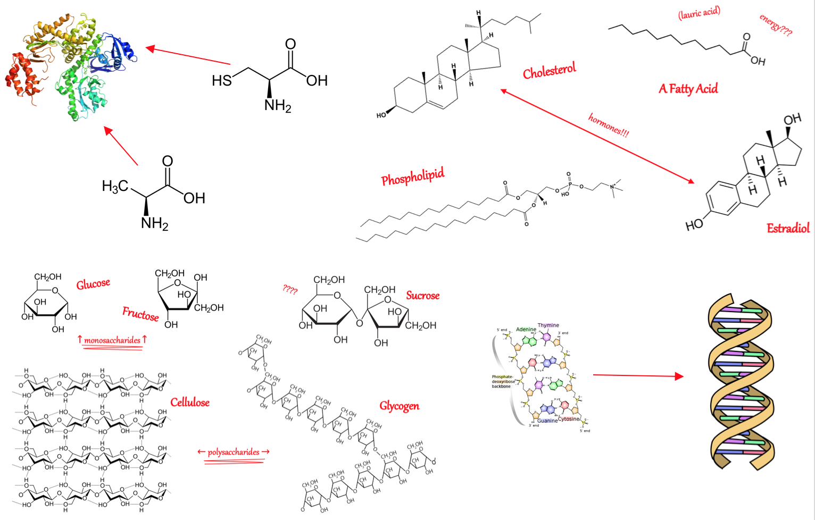

Slide 3
Goals for today:
Identify macromolecules based on their chemical structures.
Describe how the chemical structures of macromolecules are linked with their biological functions.
Socrative: Classroom Key: INSERT YOUR KEY HERE

Slide 4
Part I – Procrastination
Q1: What question(s) do you have about the molecules on Dr. Doubykey's wall?

Slide 5
Part I – Procrastination
Q2: What type(s) of molecules are found on Detective Doubtkey's wall?
nucleic acids
proteins
lipids
carbohydrates
all of the above
nucleic acids AND carbohydrates
nucleic acids AND proteins

Slide 6
Part I – Procrastination
Q3: Once finished with Task 1.2, indicate which molecule you understand the least.
Proteins
Lipids
Carbohydrates
Nucleic acids
Notes:
Any answer is correct. This is a polling question to gauge student understanding.

Slide 7
Part II – Water and Polarity
Q4: In a water molecule, oxygen is less electronegative than hydrogen.
A. True
B. False

Slide 8
Part II – Water and Polarity
Q5: A water molecule is composed of polar bonds.
A. True
B. False

Slide 9
Part II – Water and Polarity
Q6: Water molecules are polar, hydrophilic molecules.
A. True
B. False

Slide 10
Part II – Water and Polarity
Q7: Which bond(s) are polar?
C-O
C-C
O-H
N-H
C-C and N-H
C-O and O-H
C-O, O-H, and N-H

Slide 11
Part III – Lipids
Q8: What features could you use to identify a lipid from its chemical structure?

Slide 12
Part IV – Carbohydrates
Q9: Sucrose can be best described as a:
monosaccharide
disaccharide
trisaccharide
polysaccharide

Slide 13
Part IV – Carbohydrates
Q10: What features could you use to identify a carbohydrate from its chemical structure?

Slide 14
Part V – Proteins
Q11: Name a role that proteins play in the body.

Slide 15
Part V – Proteins
Q12: What features could you use to identify a protein from its chemical structure?

Slide 16
Part V – Proteins
Q13: Which parts are consistent across all amino acids?
carboxyl groups
R groups
amine groups
disulfide bridges
A & B
A & C
B & C
A, B, C, & D

Slide 17
Part V – Proteins
Q14: All amino acid monomers are polar.
True
False

Slide 18
Part V – Proteins
Q15: Which is NOT a function of proteins in living things?
structural support
cell membrane component
store genetic material
catalyzing reactions
immune system component
all of the above are functions of proteins
none of the above are functions of proteins

Slide 19
Part VI – Nucleic Acids
Q16: What are some functions of nucleic acids in living things?
structural support
cell membrane component
store genetic material
none of the above
all of the above

Slide 20
Part VI – Nucleic Acids
Q17: What features could you use to identify a nucleic acid from its chemical structure?

Slide 21
Part VII – Epilogue
Q18: What is the most interesting/memorable thing you learned today?

Slide 22
Part VII – Epilogue
Q19: Which macromolecule are you still confused about?
nucleic acid
protein
lipid
carbohydrate
none, this is as easy as sleeping in on the weekends!
all... what is a macromolecule anyway?

Slide 23
Detective Doubtkey’s Wall

Slide 24
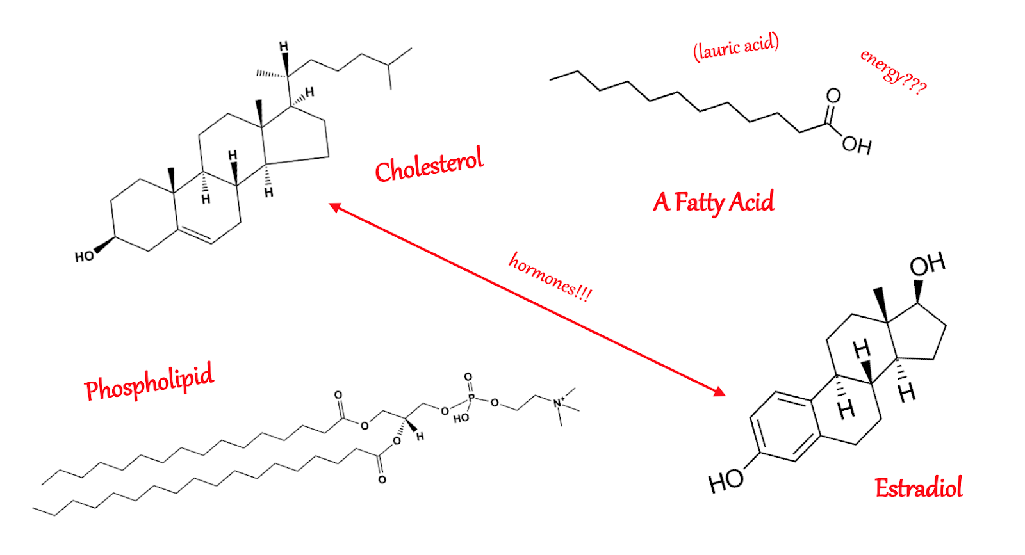
Part III: Lipid Image

Slide 25
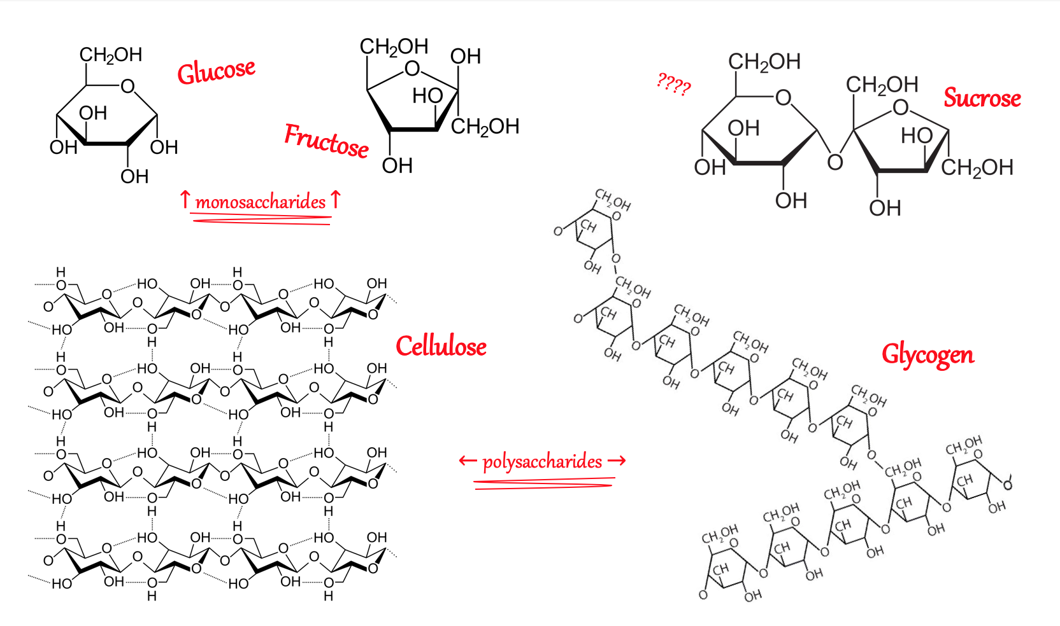
Part IV: Carbohydrate Wall Section

