Slide 1
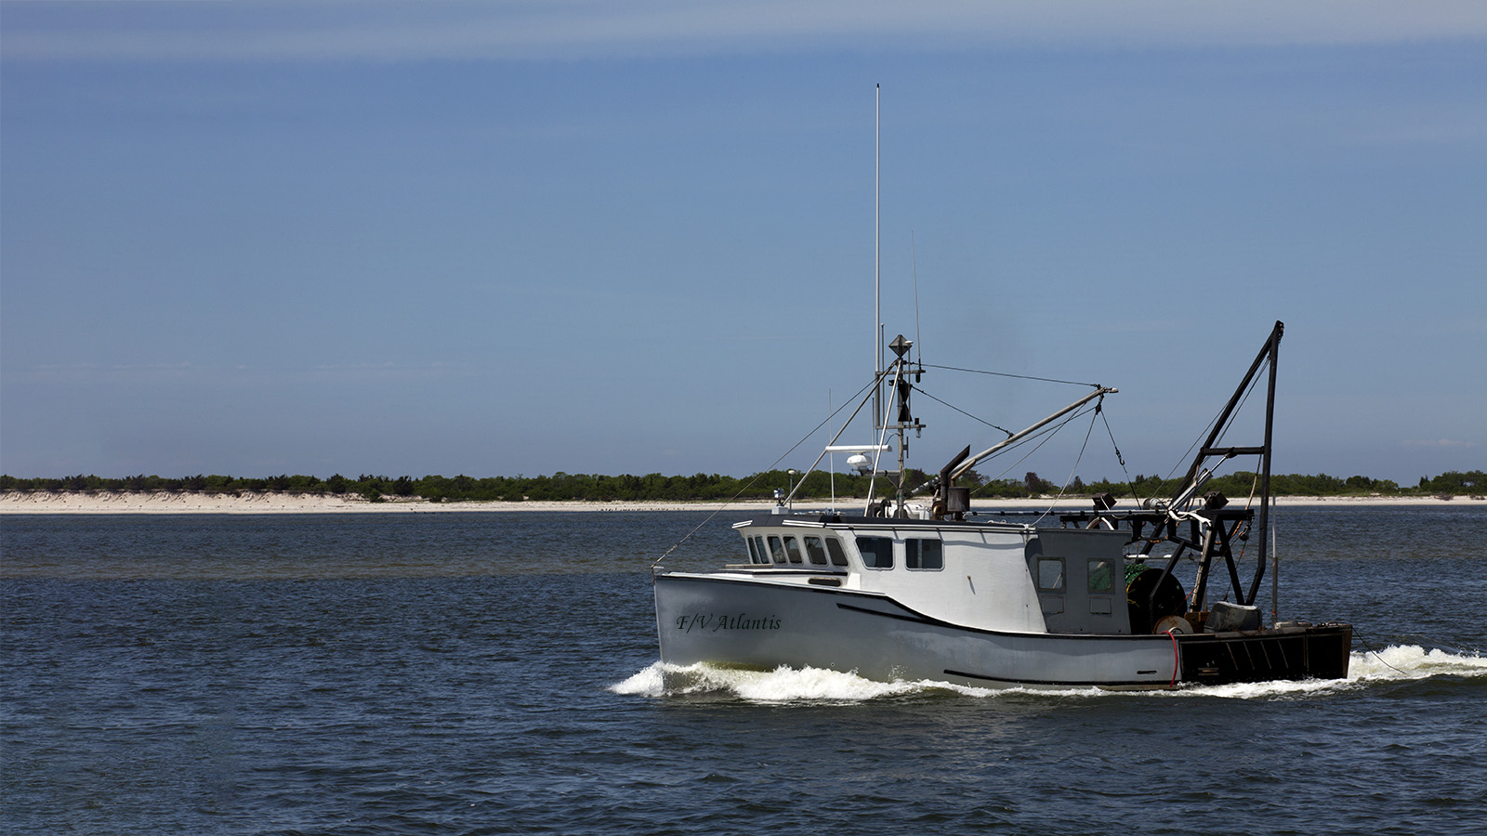
What’s the Catch?
NATIONAL CENTER FOR CASE STUDY TEACHING IN SCIENCE
A Presentation to Accompany the Case Study:
Understanding and Managing Fisheries in
Response to Climate Change
^{by}
Margaret A. Holzer, Carrie A. Ferraro, Malin L. Pinsky, Rebecca L. Selden, and Eva A. Papaioannou
Notes:
Credit: Licensed image © Anthony Aneese Totah Jr | Dreamstime.com, id 31552971.

Slide 2
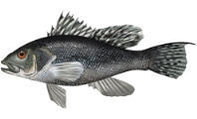
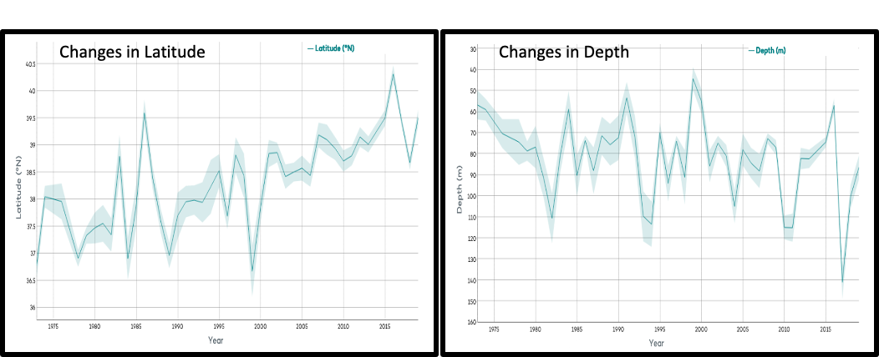
Black Sea Bass
(Centropristis striata)
Figure 2: Population shift by latitude, depth and season (spring) for black sea bass (Centropristis striata). The solid line indicates the mean and the shaded area surrounding the mean is the standard deviation.
Notes:
Data from Part I of What’s the Catch? Data are from: http://oceanadapt.rutgers.edu/regional_data

Slide 3
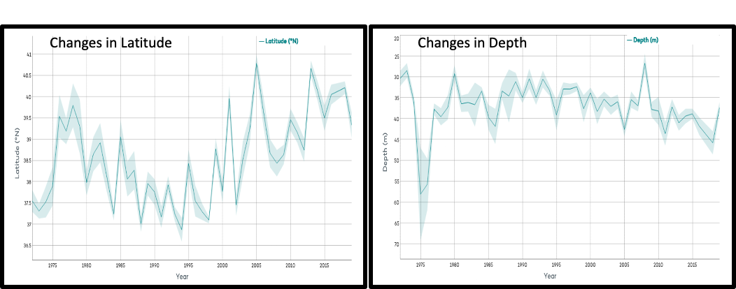
Black Sea Bass
(Centropristis striata)
Figure 3: Population shift by latitude, depth and season (fall) for black sea bass (Centropristis striata). The solid line indicates the mean and the shaded area surrounding the mean is the standard deviation.
Notes:
Data from Part I of What’s the Catch? Data are from: http://oceanadapt.rutgers.edu/regional_data

Slide 4
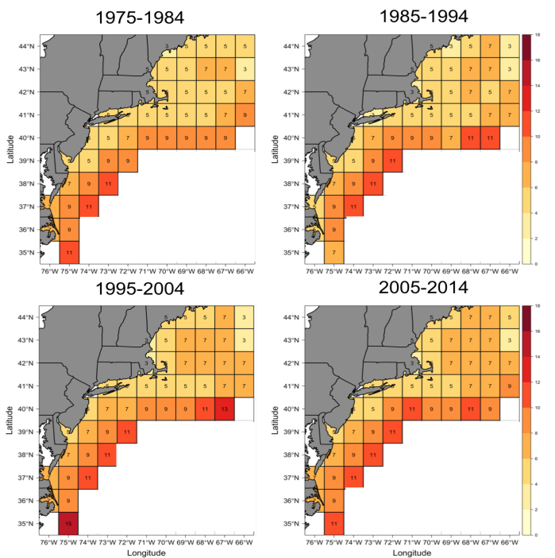
Temperatures at the bottom of the ocean (∘ C)
Notes:
Data from Part II of What’s the Catch? Individual maps by Data are from: http://oceanadapt.rutgers.edu/regional_data

Slide 5
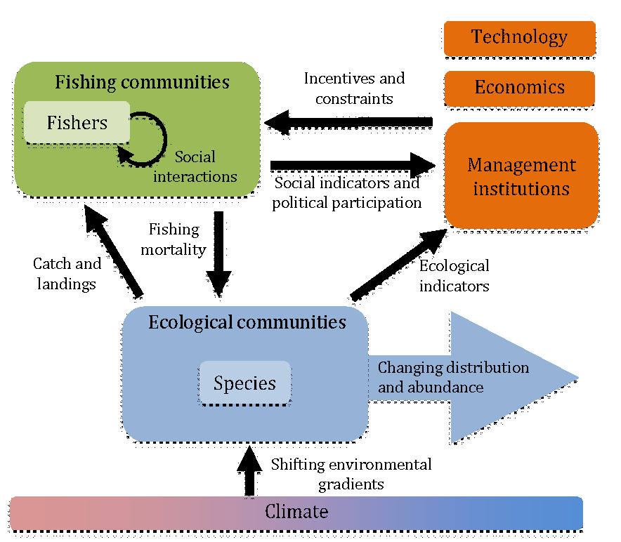
Coastal SEES Model
Notes:
Model presented in Part III of What’s the Catch?

Slide 6
Additional Data for Part I

Slide 7
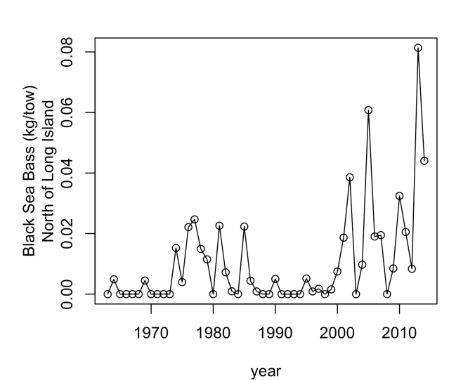
Black Sea Bass off the Coast of Long Island
Notes:
Extra data for Part I: The chart presents data collected from NOAA’s National Marine Fisheries Service (NMFS) and shows the average weight (kg) of black sea bass caught per “tow” by their research vessels off the coast of Long Island, NY. A tow refers to each time they pull in their survey net. This value is interpreted as a measure of the amount of fish in an area.

Slide 8
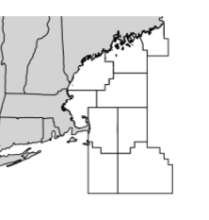
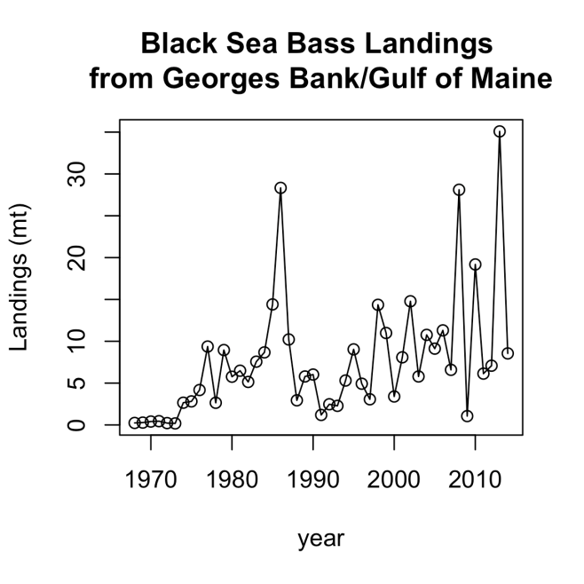
Notes:
The chart presents fisheries data collected from NOAA’s National Marine Fisheries Service (NMFS) and shows the average weight (metric ton or 1000 kg) of black sea bass caught by commercial fishing vessels.

Slide 9
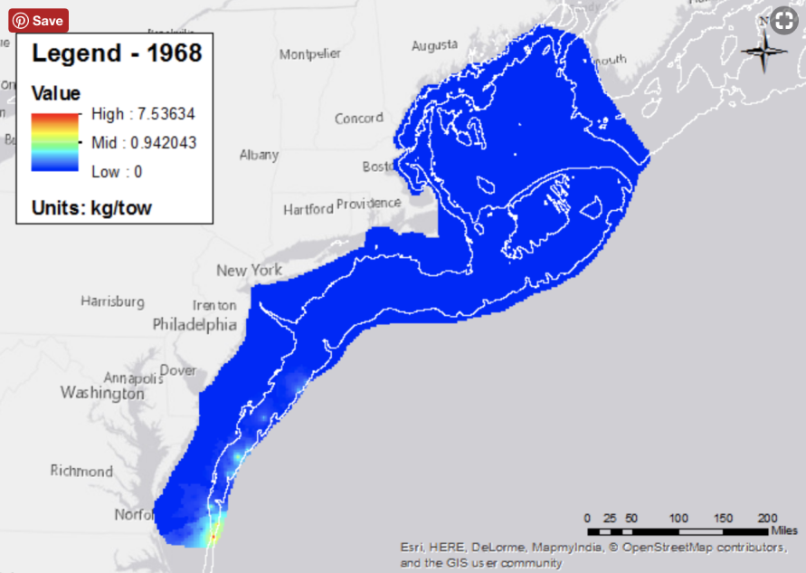
Notes:
Data is from http://oceanadapt.rutgers.edu/regional_data. The units are in kilograms per survey tow. The values are the average changes in the amount of black sea bass caught in the spring survey. These values do not reflect what is being caught by fisheries. Red indicates where the surveys caught increased amount of black sea bass, and the blue reflects where there was little or none.

Slide 10
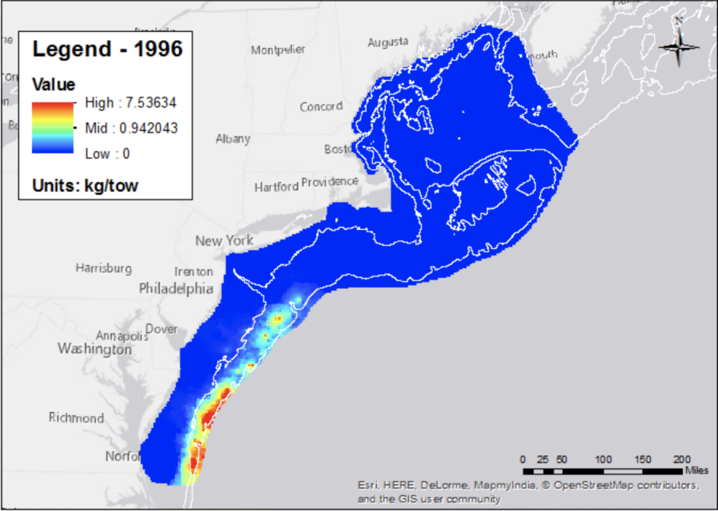

Slide 11
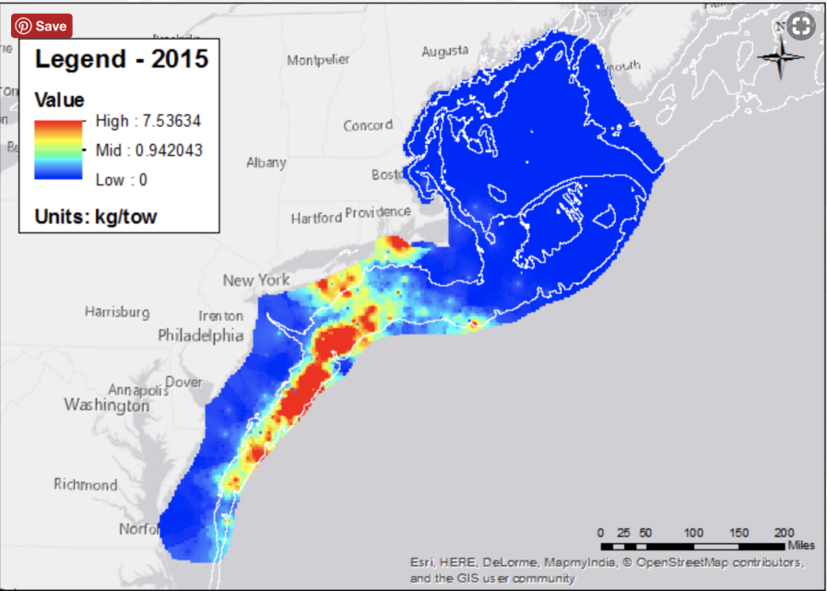

Slide 12
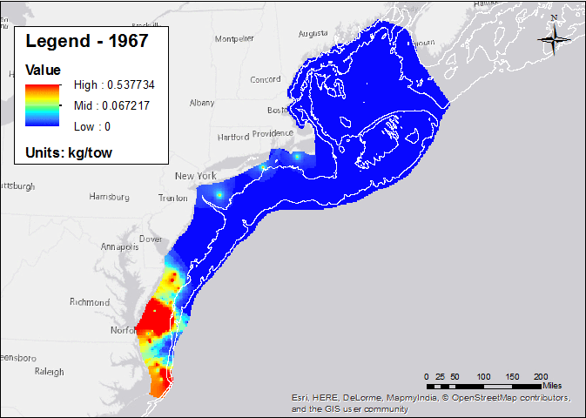
Notes:
Data is from http://oceanadapt.rutgers.edu/regional_data. The units are in kilograms per survey tow. The values are the average changes in the amount of black sea bass caught. These values do not reflect what is being caught by fisheries. Red indicates where the surveys caught increased amount of black sea bass, and the blue reflects where there was little or none.

Slide 13
Additional Data for Part II
Food Web and Ocean Bottom Temperature Maps

Slide 14
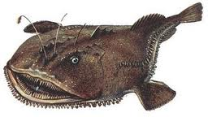
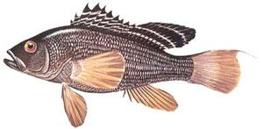
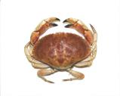
Goosefish
Dogfish
Black Sea Bass
Squid
Rock Crab
Lobster
Euphausiids
Herring
Notes:
The Northeast Fisheries Science Center (NEFSC) food habits database lists the following species as predators of black sea bass: spiny dogfish (Squalus acanthias), Atlantic angel shark (Squatina dumeril), clearnose skate, little skate (Raja erinacea), spotted hake, summer flounder, windowpane, and goosefish (Lophius americanus).
Source:
https://www.nefsc.noaa.gov/sos/spsyn/og/seabass/
https://www.nefsc.noaa.gov/publications/tm/tm143/tm143.pdf (Black Sea Bass)

Slide 15
Ocean Bottom Temperature
See notes associated with this slide for additional information on these maps
Notes:
The numbers in each cell are the bottom temp in degrees Celsius. The data from 1980-2010 was collected using sensors during bottom trawls. The projected data (2020-2100) comes from the NOAA Geophysical Fluid Dynamics Laboratory’s (GFDL) model of bottom temperature.
A further extension using this data can be found here: https://www.sciencefriday.com/educational-resources/interpreting-the-impacts-of-rising-ocean-temperatures-on-ecosystems/

Slide 16
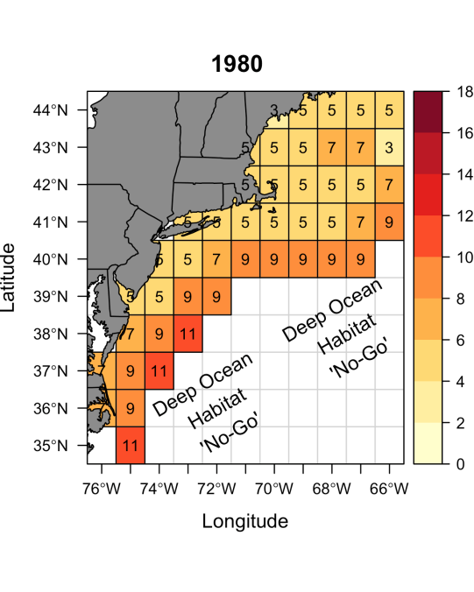
Notes:
Bottom temp data collected using sensors during bottom trawls.

Slide 17
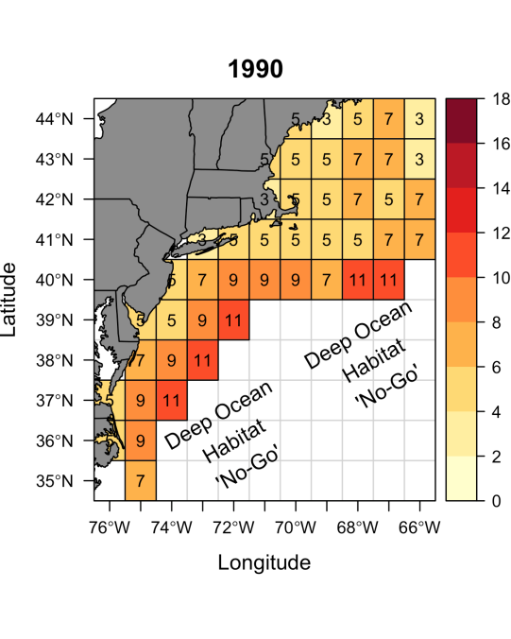
Notes:
Bottom temp data collected using sensors during bottom trawls.

Slide 18
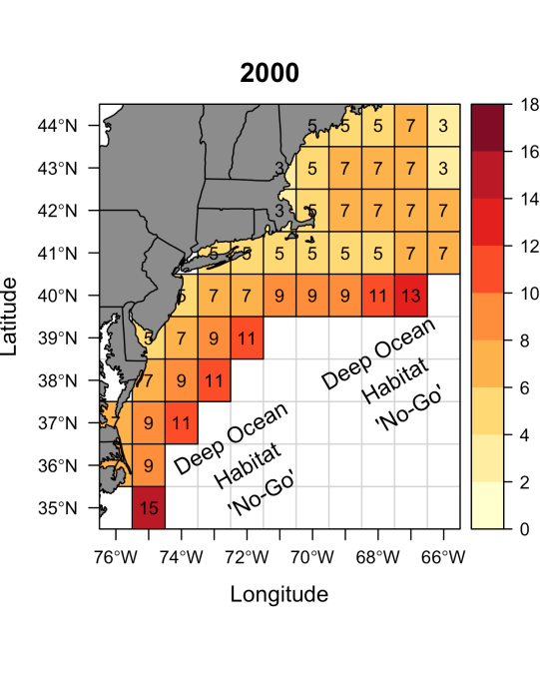
Notes:
Bottom temp data collected using sensors during bottom trawls.

Slide 19
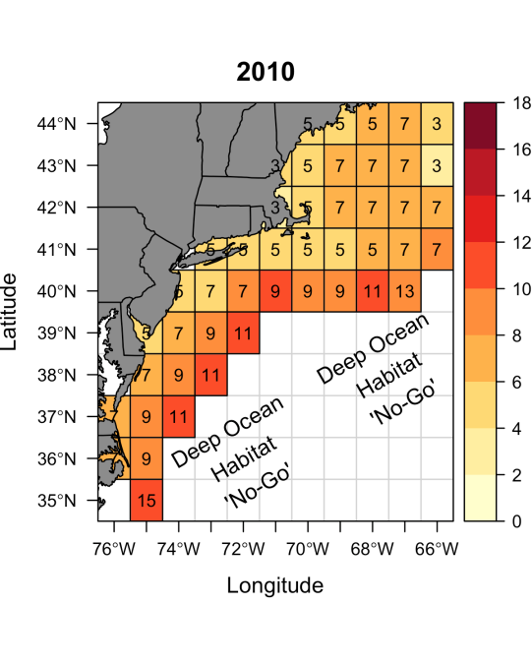
Notes:
Bottom temp data collected using sensors during bottom trawls.

Slide 20
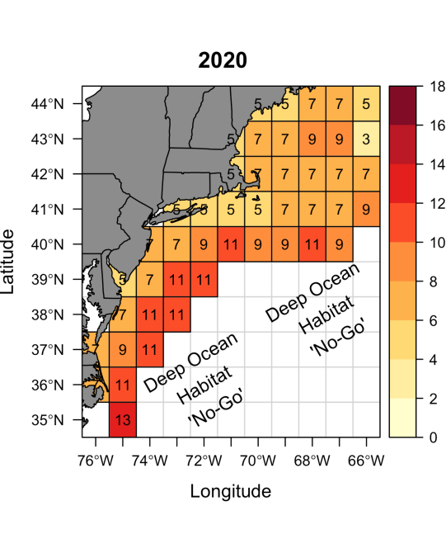
Notes:
Model prediction of bottom temperature for 2020

Slide 21
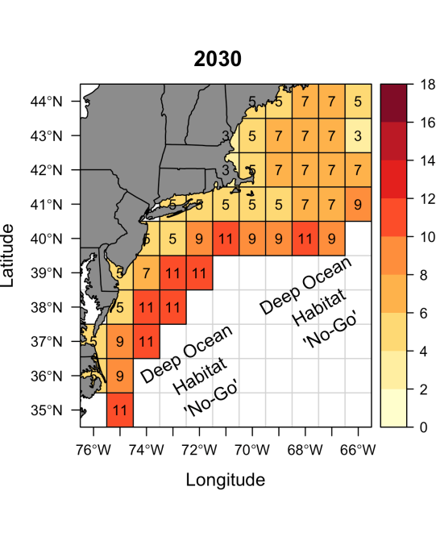
Notes:
Model prediction of bottom temperature in 2030

Slide 22
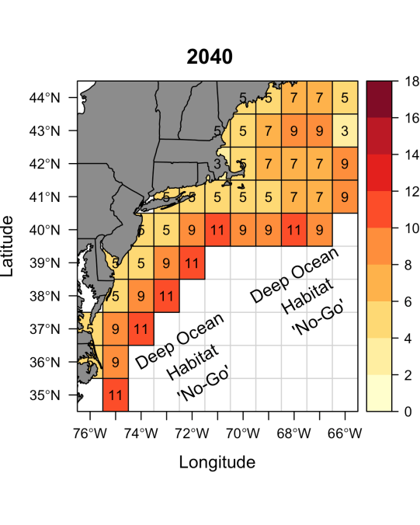
Notes:
Model prediction of bottom temperature in 2040

Slide 23
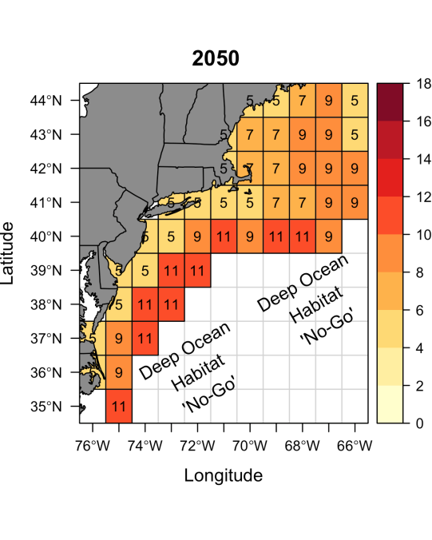
Notes:
Model prediction of bottom temperature in 2050

Slide 24
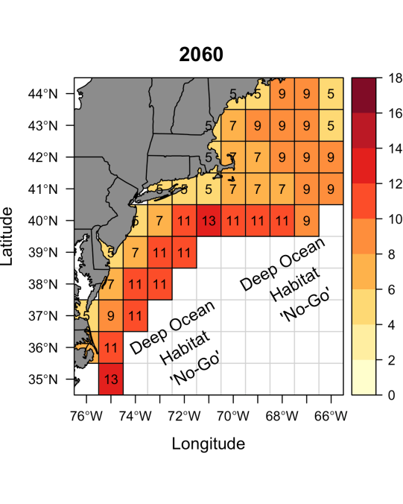
Notes:
Model prediction of bottom temperature in 2060

Slide 25
Notes:
Model prediction of bottom temperature in 2070

Slide 26
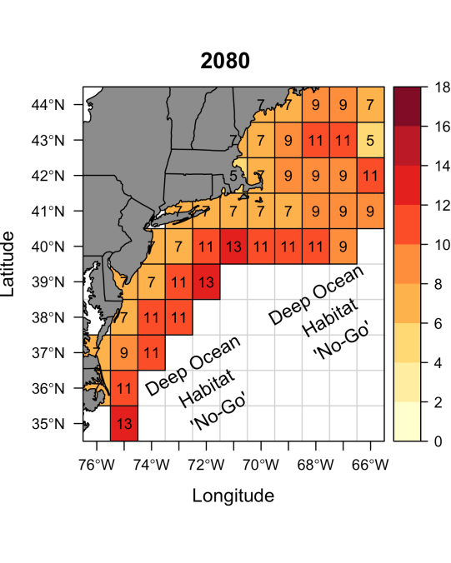
Notes:
Model prediction of bottom temperature in 2080

Slide 27
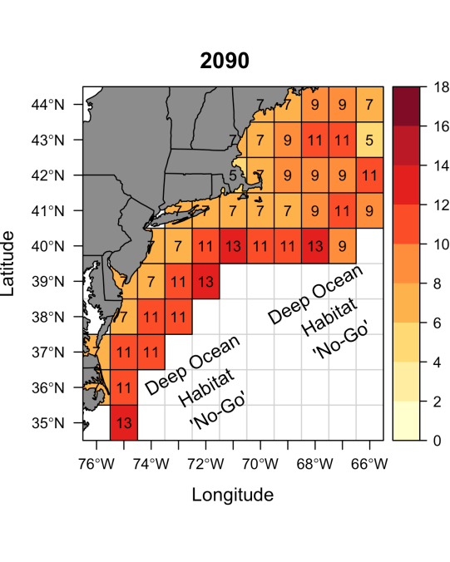
Notes:
Model prediction of bottom temperature in 2090

Slide 28
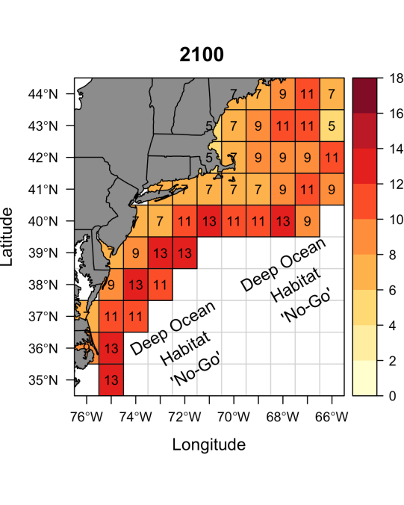
Notes:
Model prediction of bottom temperature in 2100

Slide 29
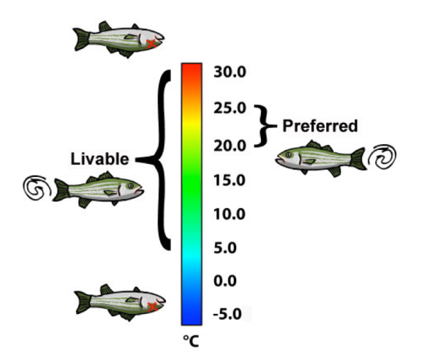
Why would a fish care about temperature?
Ectotherms
Larval development and survival
Metabolism – oxygen consumption
Ability to reproduce
Growth
Notes:
Fish are ectotherms and often have a narrow preferred range of temperatures in which they can survive. Preferred temperature ranges for some species in the Northeast US are in the next few slides.

Slide 30
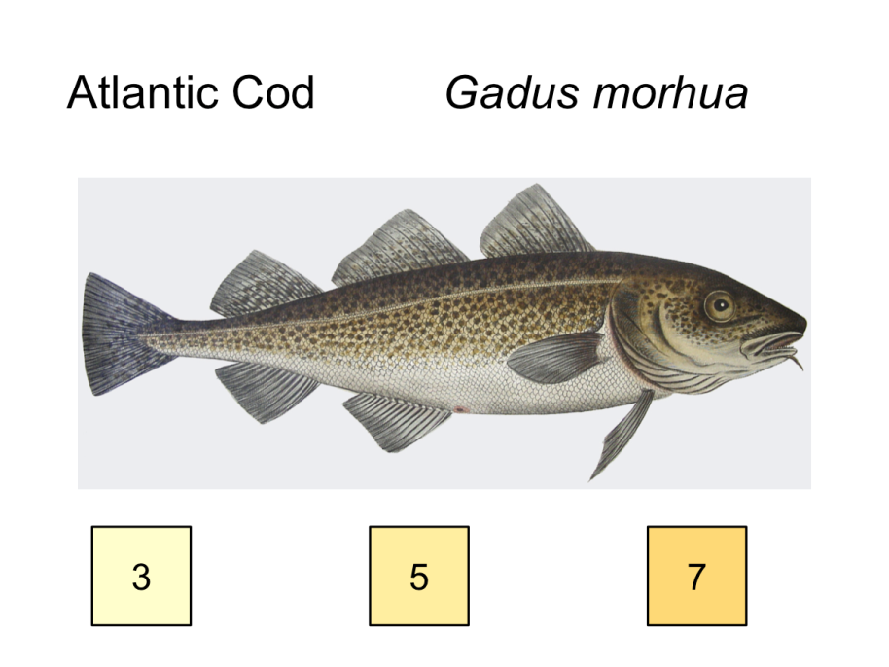

Slide 31
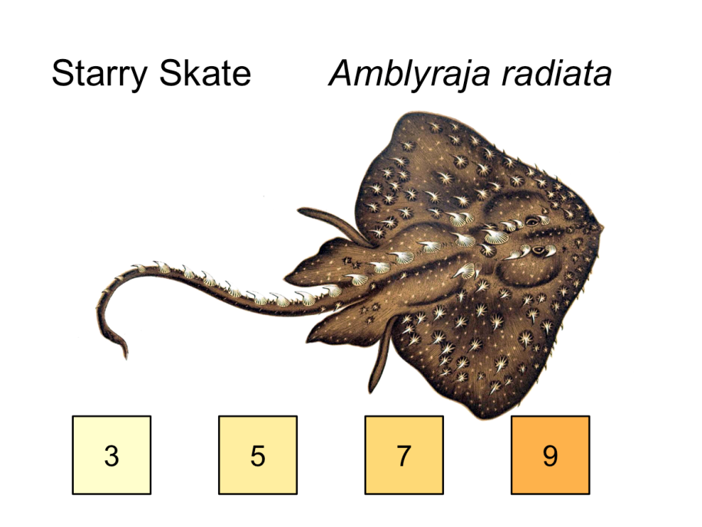

Slide 32
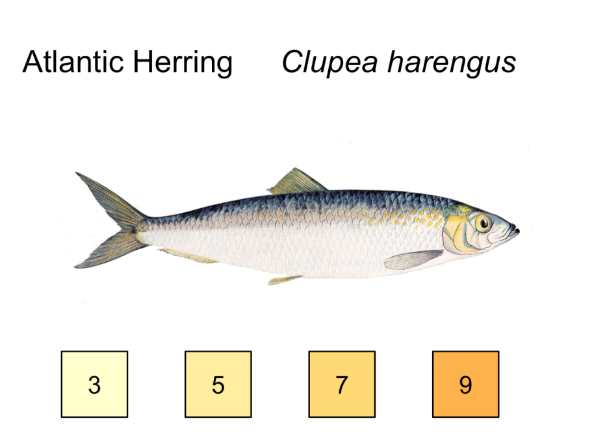

Slide 33
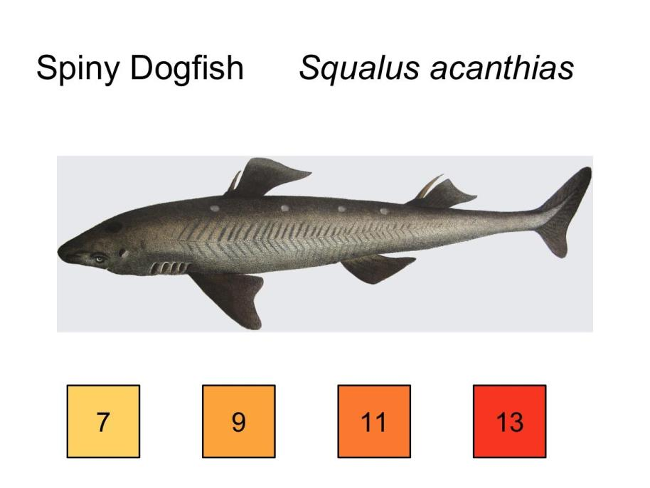

Slide 34
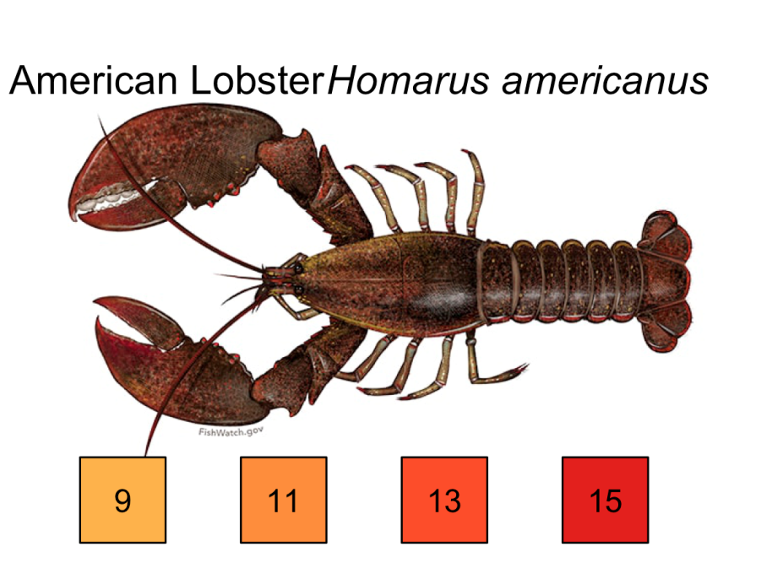

Slide 35
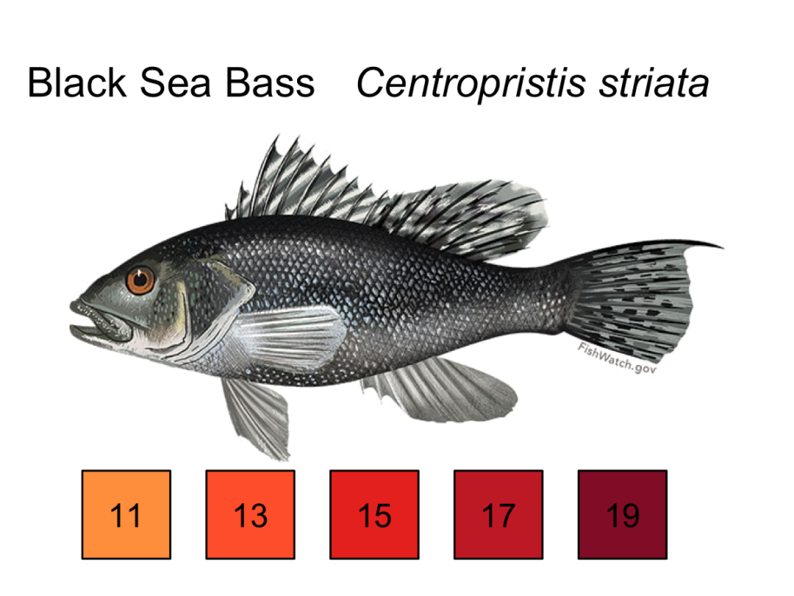

Slide 36
Additional Data for Part III
Management and changes in fishing communities

Slide 37
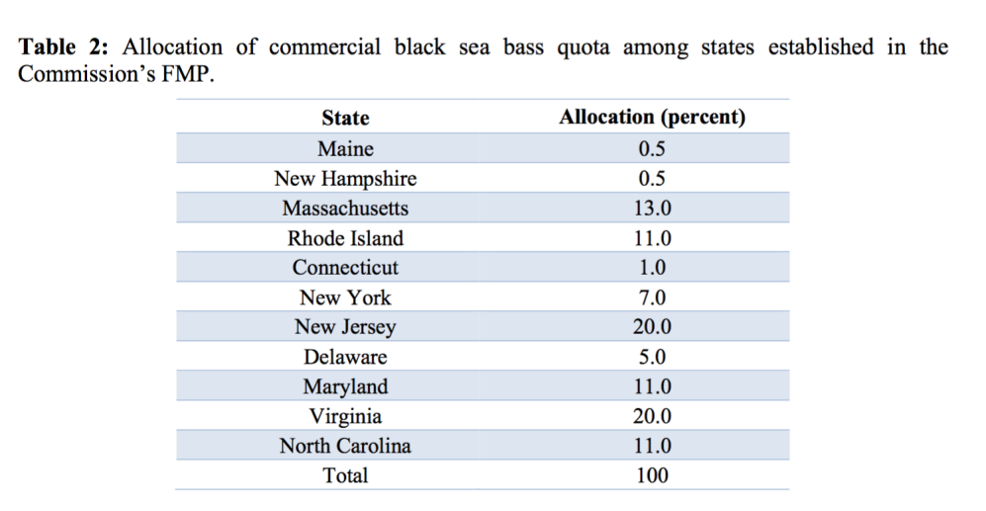
Black Sea Bass State Quotas
Notes:
Source: www.mafmc.org/s/BSB_fishery_info_doc2015_final.pdf
The black sea bass fishery off the east coast is cooperatively regulated by the Mid-Atlantic Fishery Management Council (MAFMC or Council), Atlantic States Marine Fisheries Commission (ASMFC or Commission), and National Marine Fisheries Service (NMFS). The MAFMC provides the commercial fishery with 49% of the total allowable landings as a commercial quota. The remaining 51% goes to the recreational fishery.
The 49% of the commercial allowance is then further divided by state by the ASMFC. Each state much them set measures to ensure that they do not go beyond their quotas. This data shows the quota for black sea bass by state.

