Slide 1
NATIONAL CENTER FOR CASE STUDY TEACHING IN SCIENCE
A Presentation to Accompany the Case Study:
Butterfly Hunt
The Role of Density Dependence in Batesian and Müllerian Mimicry
by
Mayra C. Vidal, Kylee Grenis, Whitley R. Lehto, Robin M. Tinghitella, and Shannon M. Murphy Department of Biological Sciences University of Denver, Denver, CO
Notes:
Licensed image © Panuruangjan | Dreamstime, ID 32821642.

Slide 2
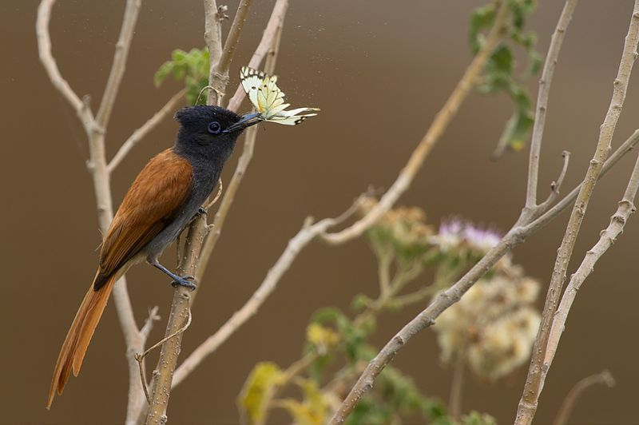
Birds are voracious predators of butterflies. But some butterflies are noxious!

Slide 3
Be a butterfly hunter and catch as many butterflies as you can!
Patch A
Patch B
There are four patches of butterflies in the hallway.
Find a partner to hunt butterflies with you! You will fill out your instruction sheet in pairs.
Patch C
Patch D

Slide 4
Get an instruction sheet and check the rules!
Rules:
When the instructor says “go,” go to your assigned patch (A, B, C or D) with your partner.
When the instructor starts the timer, alternate group members and pick one butterfly at a time.
Check the back of the butterfly you caught before you continue.
If there is a circle on the back, it is a noxious butterfly!
If you and your partner get >3 noxious butterflies, stop hunting – you are dead!
Keep the butterflies you catch with you! Do not put them back on the floor.
Fill out the table with the number of butterflies you and your partner caught of each type on your instruction sheet and return to class.
Noxious:
Harmless:

Slide 5
Fill in the data!
Patch A
Noxious model =
Palatable mimic =
Patch B
Noxious model =
Palatable mimic =
Noxious model =
Noxious mimic =
Patch D
Noxious model =
Noxious mimic =
Patch C

Slide 6
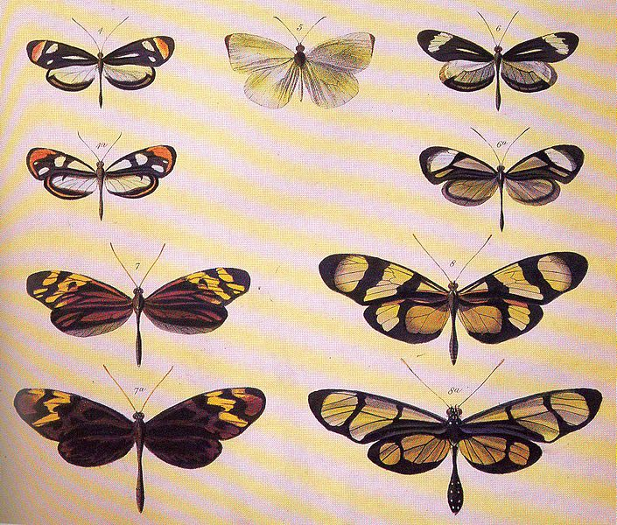
Class discussion: Density-dependence and mimicry
Batesian mimicry: Palatable species mimic noxious species’ warning signals to escape predation.
Lower densities of palatable mimic
Lower chance of predator getting the palatable mimic instead of noxious model

Slide 7
Class discussion: Density-dependence and mimicry
Müllerian mimicry: 2 or more noxious species mimic each other’s warning signals to escape predation.
More noxious species with similar warning signal
Predator learns faster to avoid signal and fewer individuals die

Slide 8
Class discussion: Butterfly hunt
Why did the relative number of the same type of mimics caught vary between the two patches (A and B, C and D)?
If you were a predator, what would getting >3 noxious butterflies mean?

Slide 9
Image credits
Slide 2 Description: African Paradise Flycatcher with a butterfly catch at Maasai Mara
Credit: Sumeet Madhukar Moghe
Source: Wikimedia Commons, https://commons.wikimedia.org/wiki/File:African_Paradise_Flycatcher.jpg Clearance: Used in accordance with Creative Commons Attribution-Share Alike 3.0 Unported license.
Slide 8 Description: Plate from Bates (1862) illustrating Batesian mimicry between Dismorphia species (top row, third row) and various Ithomiini (Nymphalidae) (second row, bottom row) Source: Henry Walter Bates 1862. Contributions to an insect fauna of the Amazon Valley. Lepidoptera: Heliconidae. Trans. Linn. Soc. 23: 495-566.
Wikimedia Commons, https://commons.wikimedia.org/wiki/File:Batesplate.jpg
Clearance: Public domain.
Slide 9 Description: Photo of Uraniid moth Alcides agathyrsus (left) and papilionid butterfly Papilio laglaizei .(right), with background removed Credit: Anaxibia
Source: Wikimedia Commons, https://commons.wikimedia.org/wiki/File:Alcidis_agathyrsus_%26_Papilio_laglaizei.JPG
Clearance: Used in accordance with Creative Commons Attribution-Share Alike 3.0 Unported license.

