Slide 1
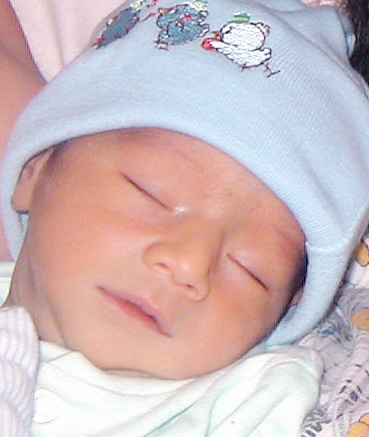
The Breathless Heart
NATIONAL CENTER FOR CASE STUDY TEACHING IN SCIENCE
Images to Accompany the Case Study:
by
Nalini V. Broadbelt¹, Amitoj S. Sawhney², and Michelle A. Young¹
¹ School of Arts and Sciences, MCPHS University, Boston, MA
² Thoracic Disease Research, Mayo Clinic, Rochester, MN

Slide 2
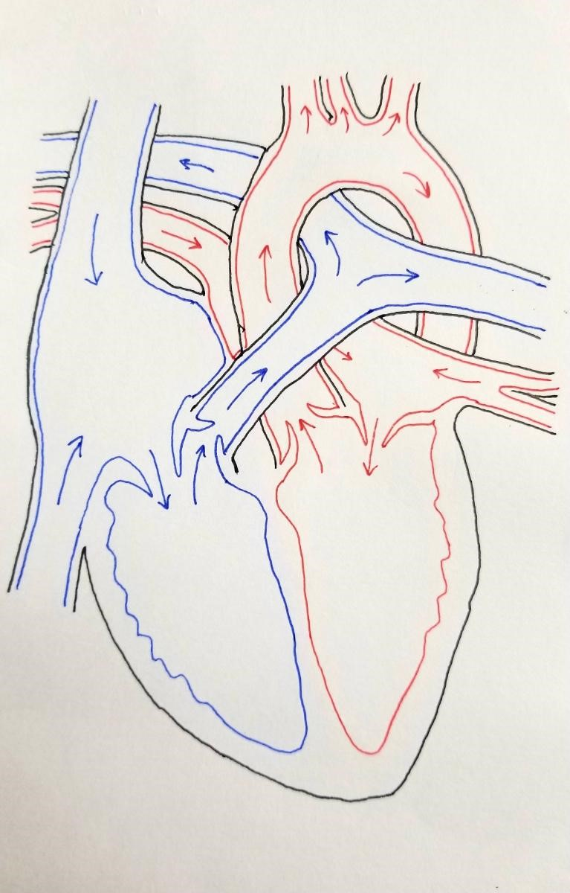
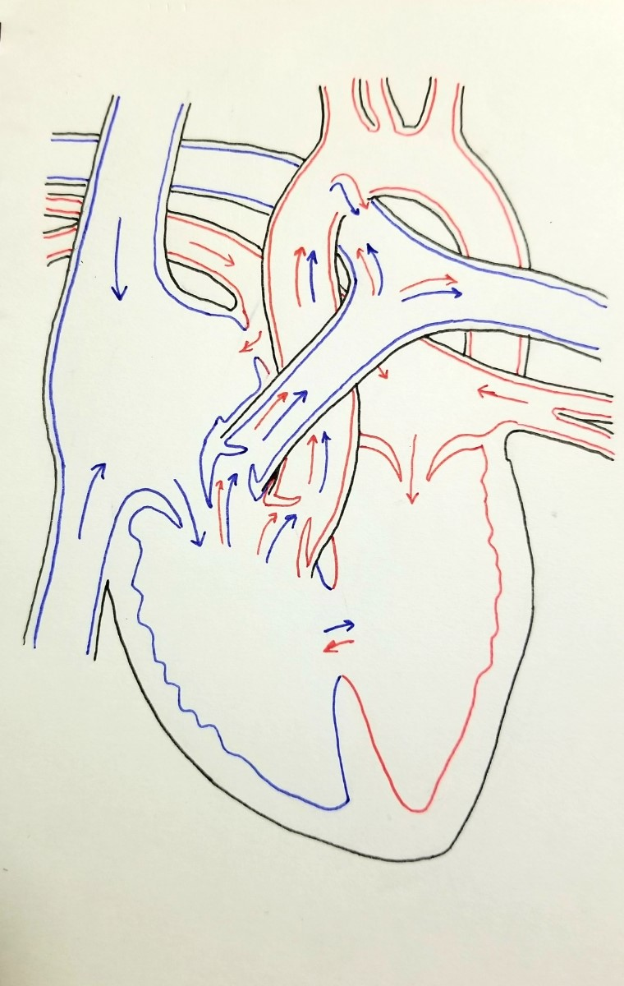
Normal heart
Pavit’s heart
Notes:
Credit: Illustrations by Anna Vasyuraanna (vasyura03@gmail.com).

