Slide 1
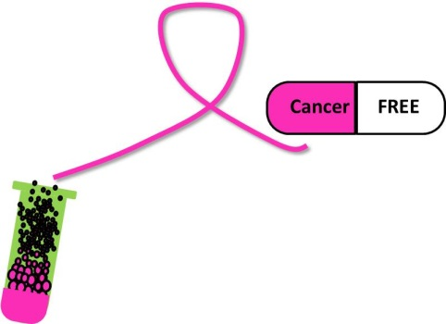
In Search of a Cure for Breast Cancer
NATIONAL CENTER FOR CASE STUDY TEACHING IN SCIENCE
A Presentation to Accompany the Case Study:
by
Jolanta Skalska
Division of Biology
Alfred University, Alfred, NY

Slide 2
Preparation
Chemotherapeutics: Mechanisms of Action and Their Effects on Patients
You will use this when working through the case study. Turn it in after completing Part IV.

Slide 3
Part I Hormones and Breast Cancer
Questions 1 and 2
Time expectation: 5 min

Slide 4
Part II Receptors
Questions 3-5
Time expectation: 15 min

Slide 5
Part III Generating TamC3 and TamR3 Cell Lines
Questions 6 and 7
Time expectation: 7 min

Slide 6
Part IV Killing TamC3 and TamR3 Cell Lines
Questions 8–10,
Refer to Preparation
Time expectation: 15 min
Short Essay: HW assignment

