Slide 1
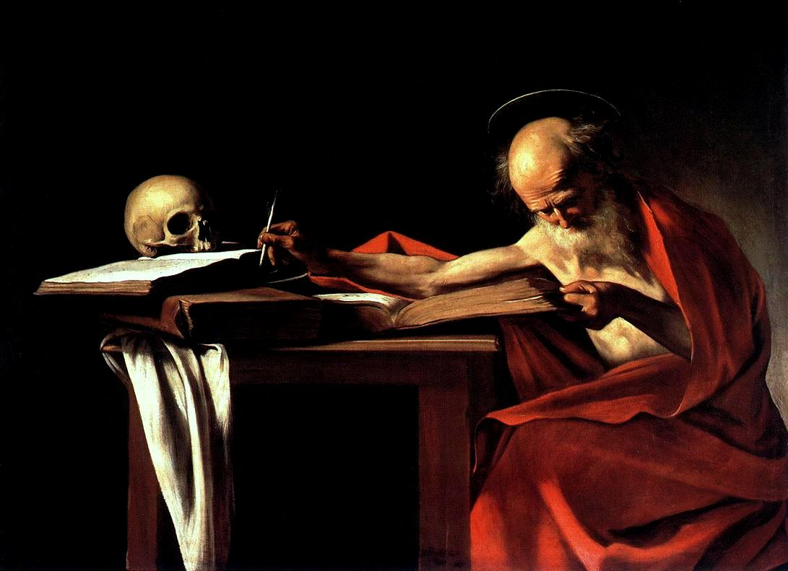
Bioluminescence and 16th-century Caravaggism:
NATIONAL CENTER FOR CASE STUDY TEACHING IN SCIENCE
Questions to Accompany:
The Glowing Intersection between
Art and Science
by Yunqiu (Daniel) Wang Department of Biology University of Miami Coral Gables, FL
Notes:
“Saint Jerome Writing,” Caravaggio, 1605-1606, <https://upload.wikimedia.org/wikipedia/commons/d/db/Caravaggio_-_San_Gerolamo.jpg>.

Slide 2
CQ#1: According to Dr. Lapucci, the light-sensitive substance Caravaggio might have used to “fix” images onto a canvas was most likely to be ________________.
Luciferin
Firefly cells
Live fireflies
Dead fireflies
Both b and d

Slide 3
CQ#2: Which of the following statements about bioluminescence is correct?
Bioluminescence can be produced when the organism is being illuminated by UV light.
Bioluminescence can be produced by minerals when photon emission occurs under certain conditions.
Bioluminescence can be produced through a chemical reaction of a living organism under certain conditions.
Bioluminescence can be produced by absorbing photons, which temporarily excite electrons to a higher energy state. As these electrons rapidly relax to their ground state, they release their energy in the form of light.
It is not possible to produce bioluminescence in a non-living system.

Slide 4
CQ#3: Scientists discovered that both D-luciferin and L-luciferin are found in fireflies, but only D-luciferin is used as the primary substrate in the light-emitting reaction catalyzed by luciferase. Why is that?
L-luciferin is converted to D-luciferin by an enzyme-catalyzed inversion with participation of CoA.
Luciferase is able to distinguish two isomers between D-luciferin and L-luciferin. L-luciferin is a competitive inhibitor of luciferase with D-luciferin. But D-luciferin is favored by luciferase as the substrate for bioluminescence reaction.
Only in the absence of D-luciferin can L-luciferin serve as an alternative substrate for light production.
All of the statements above are correct.
None of the above statements are correct.

Slide 5
CQ#4: The purpose of bioluminescence in animals is for communication. What message do the firefly eggs or larvae convey with their luminescent activity?
A signal for courtship.
A camouflage to be indistinguishable from the surroundings.
A warning signal.
An illuminating tool for movement.
To keep firefly eggs and larvae warm.

Slide 6
CQ#5: Why do you think adult fireflies emit flashes that are species-specific in duration and frequency?
Fireflies use this signal to tell whether they belong to the same species or not.
Fireflies use this signal for courtship.
Fireflies use this signal to warn away potential predators.
Fireflies use this signal to attract prey.
Both b and d are correct.

Slide 7
CQ#6: Male fireflies of each specific species do most, if not all, of the flying while flashing and performing luminous gymnastic displays, while female fireflies usually just sit, often immobile. Which one of the following statements is incorrect in explaining why male fireflies and female fireflies behave so differently in their flying style?
Male fireflies have a smaller body size, which makes it easier for them to fly while flashing as compared to females.
Male fireflies have to compete with other males by displaying unique flying and flashing style to make themselves attractive to females.
Female fireflies have a larger body size, which make them less mobile but more suitable to provide parental care for offspring.
Female fireflies do less flying, which makes it easy for them to pick and choose their mates.
Male fireflies have to fly long distances, and they need light to get around and find their mates.

Slide 8
CQ#7: Dr. Trimmer and coworkers discovered that the synthesis of the free radical gas nitric oxide (NO) is the missing pathway between the release of the neurotransmitter, octopamine, and the light production in firefly lantern cells. How does nitric oxide (NO) induce and maintain firefly bioluminescence?
NO can be freely distributed to the light-producing cells, and broken into N₂ and O₂. The O₂ from NO is then used as the biochemical trigger for the light-producing reaction.
NO can be freely distributed to the light-producing cells, and interacts with mitochondria of firefly lantern cells to increase the cellular respiration rate to produce more ATP molecules. The ATP molecules provide the energy for the light-producing reaction.
NO can be freely distributed to the light-producing cells, and interacts with mitochondria of firefly lantern cells to inhibit the cellular respiration by blocking the consumption of oxygen. The increased O₂ redirected from the cellular respiration process is used as the biochemical trigger for the light-producing reaction.
NO can be freely distributed to the light-producing cells, and interacts with mitochondria of firefly lantern cells to enhance the mitochondria cytochrome c oxidase synthesis to increase the oxygen production. The increased O₂ redirected from the cellular respiration process is used as the biochemical trigger for the light-producing reaction.
NO can be freely distributed to the light-producing cells, and interacts with peroxisomes of firefly lantern cells to enhance the permeability of oxygen to increase the oxygen concentration. The increased O₂ in peroxisomes is used as the biochemical trigger for the light-producing reaction.

Slide 9
Question #8: Could luciferin be the secret ingredient to Caravaggio’s chiaroscuro style of painting 400 years ago? If so, what procedures would Caravaggio have had to follow in order to take advantage of bioluminescence in his chiaroscuro style of painting in his time?

