Slide 1
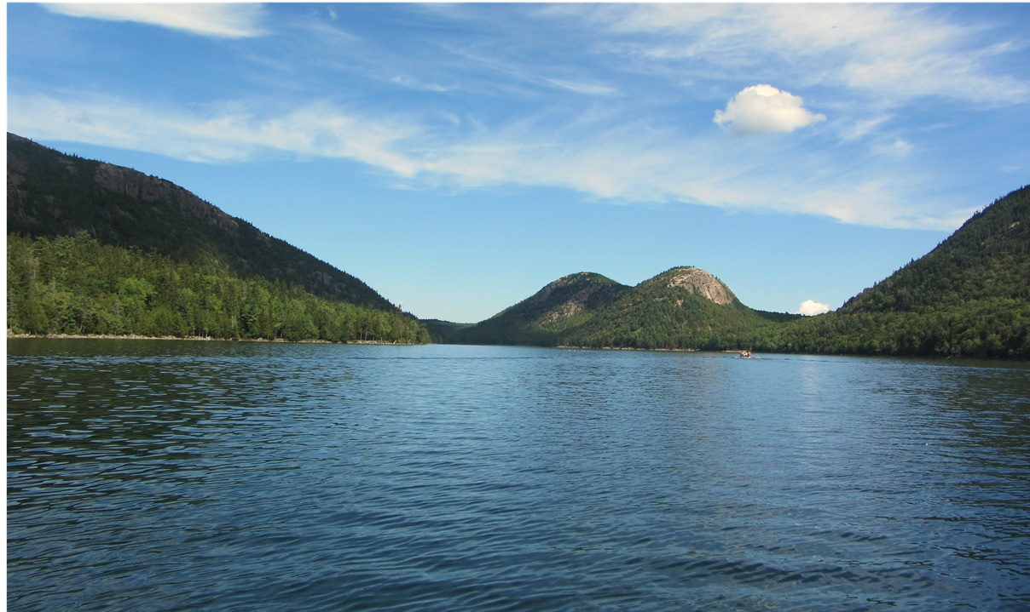
NATIONAL CENTER FOR CASE STUDY TEACHING IN SCIENCE
A Presentation to Accompany the Case Study:
^{Dead Fish in Bear Pond:}
Paleoecology and Clues at the Core
by
Krista E. Slemmons
Department of Biology
University of Wisconsin—Stevens Point
Notes:
Photo credit: Krista Slemmons, Acadia National Park.

Slide 2
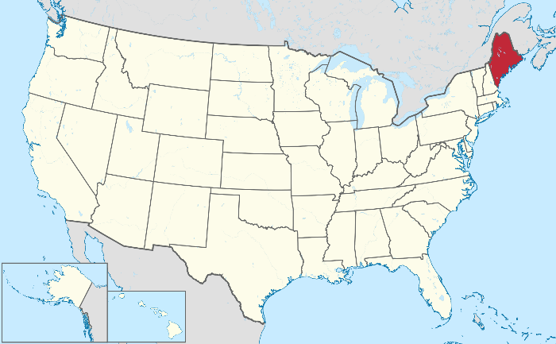
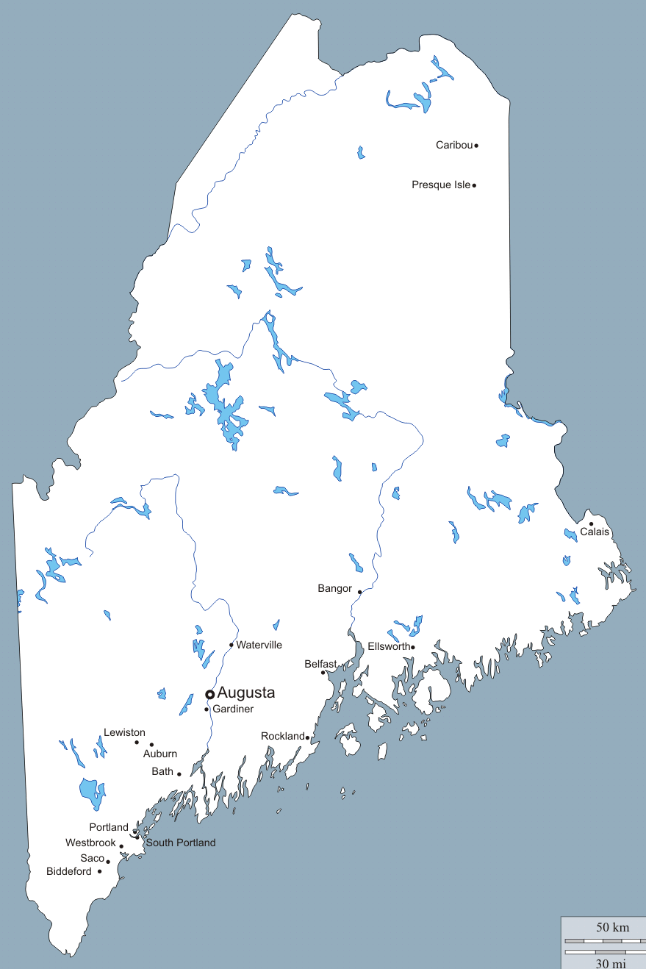
Part I –
The Problem
Bear Pond, Maine
Notes:
Ivan and Kristin were two college students pursuing careers in the field of biology. They first met when taking General Botany at Dartmouth College in New Hampshire.
Every summer Ivan would drive up the east coast to his family’s camp near Bear Pond, Maine. After a long year of difficult college classes, he planned on having an enjoyable and relaxing summer. He had also invited Kristin to spend two weeks with him at their family camp. He was excited to show her the beautiful scenery, woods and coastlines that define Maine. After arriving, Ivan decided to give Kristin a tour around the small town and then hike to Bear Pond by sunset. On their hike, they chatted as they walked along.
Image credit: Krista Slemmons

Slide 3
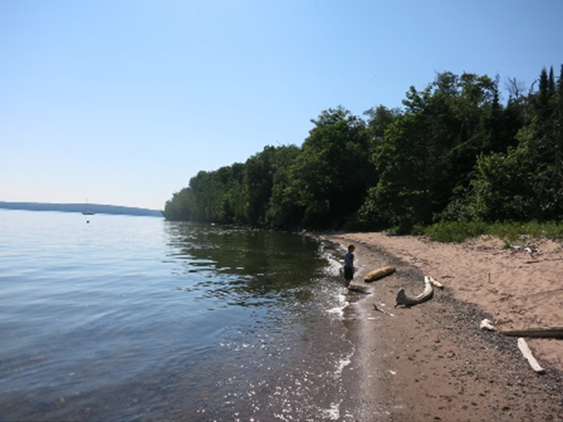
Kristin and Ivan were walking along the shore…
Notes:
“I can’t wait for you to see how majestic the woods and pond look during the summer months. Ever since I was little, it’s been my favorite place to clear my mind. It even inspired me to study biology,” explained Ivan.
“Sounds exciting! Maybe if it’s still warm enough once we reach the lake we can take a dip to cool off,” suggested Kristin.
Photo credit: Krista Slemmons, Apostle Islands National Park.

Slide 4
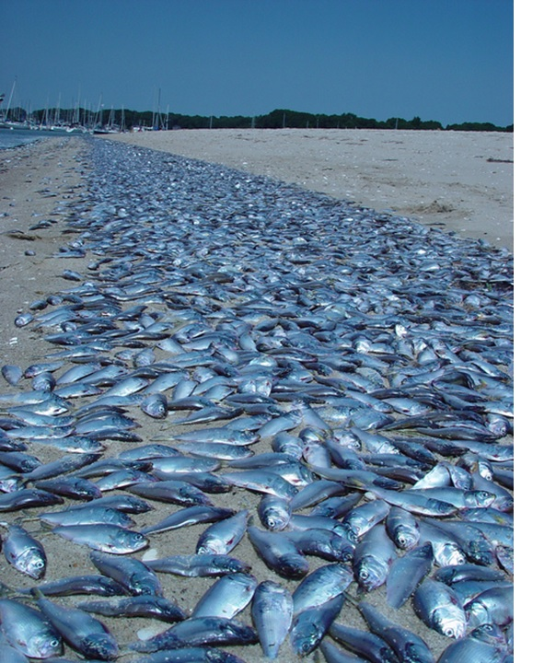
… when they noticed dead fish washed up on the shore and almost no vegetation growing.
Photo credit: Chris Deacutis
Notes:
When they arrived at the pond, Ivan was in shock. It was nothing like he remembered. The woods surrounding the lake seemed dry, thin and unhealthy, almost ghostly looking. More shocking, however, were the countless dead fish washed up on the shore. “Why are there so many dead fish? What’s killing all the trees?” Kristin asked.
“I’m not sure, but I don’t think we should swim here. Let’s go back to the camp and ask my parents if they have any idea what’s happening,” Ivan replied.
Photo credit: Chris Deacutis | IAN

Slide 5
Question #1:
What could have caused the recent death of plants and fish in this area? Brainstorm a list of possibilities….
Pollution from runoff
Oxygen depletion
Temperature change
Toxins
Diseases
Acid rain
Notes:
Ask the students to come up with possible explanations for the dying fish and vegetation. Have the students work with others around them to come up with three reasons. Go around the room and have each group write one reason on the board. All the ideas that the students came up with are important causes, but try to get them thinking about it more scientifically. Acid rain might not be something that they come up with right away, so the teacher might have to provide hints and direction.

Slide 6
Question #2:
Choose one of the ideas that you listed and write a testable hypothesis.
Describe how you would test this hypothesis with an experiment.
Share your experimental design with your colleague sitting next to you.
Notes:
Have students write a hypothesis about the fish dying. Ask a few of the students to share with the class what they came up with. It is important to keep the students thinking critically and scientifically through this entire process.

Slide 7
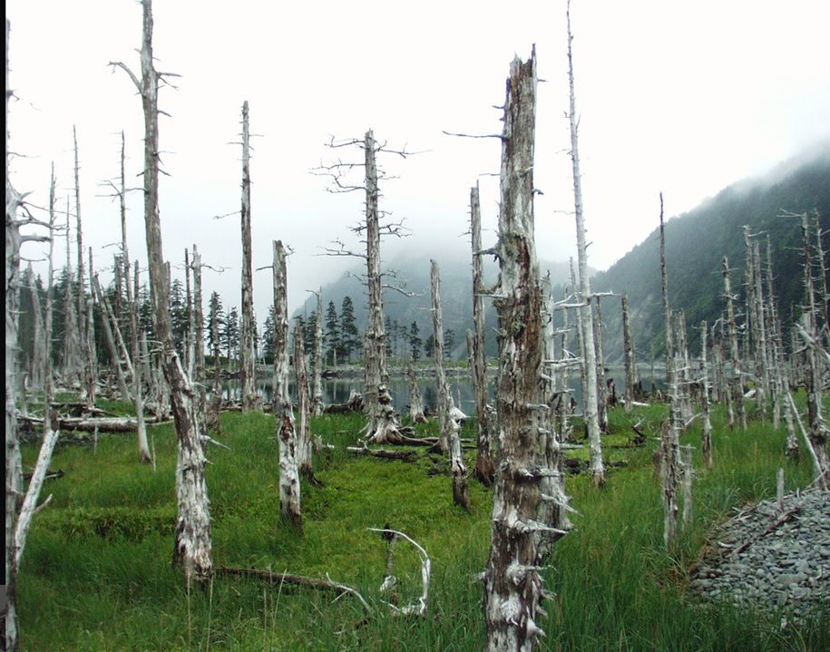
Part II – Is Acid Rain to Blame?
7
Notes:
Photo credit: Krista Slemmons, Resurrection Bay, Alaska.

Slide 8
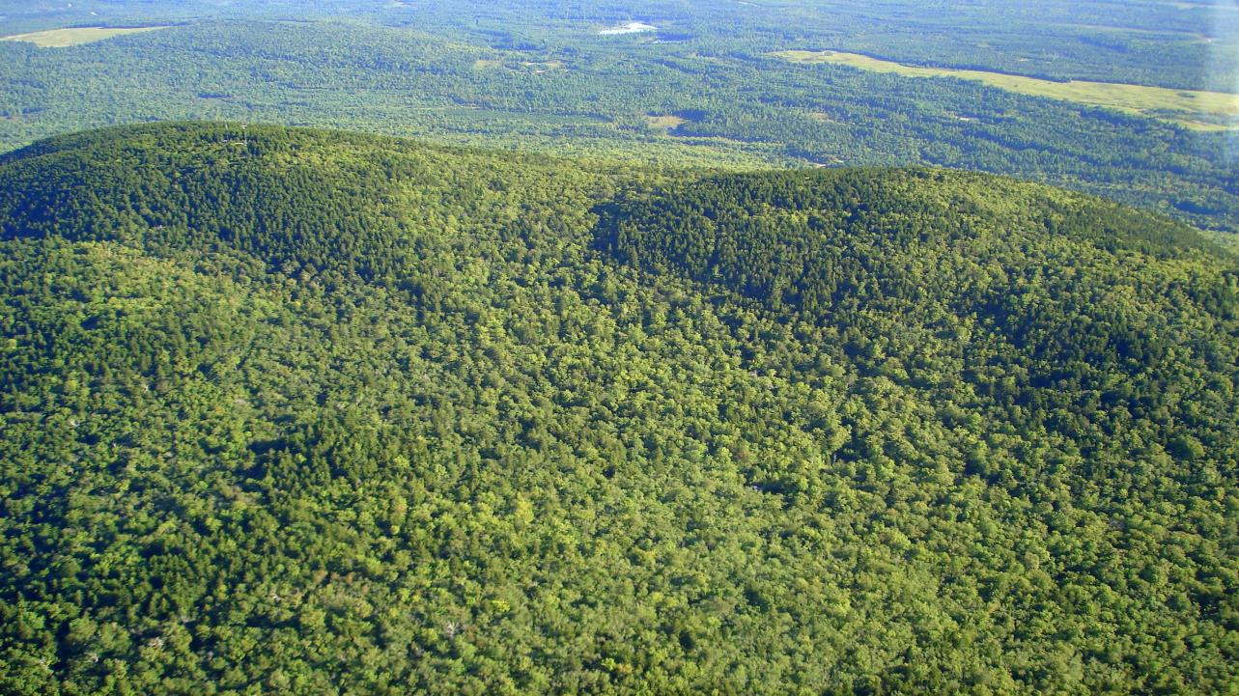
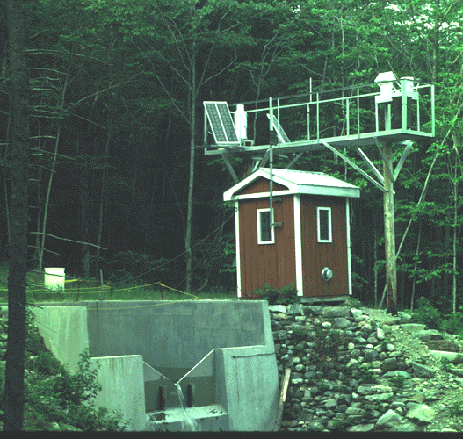
Bear Brook Watershed in Maine: Began in the 1980s as study in acid deposition; now examines a wide variety of environmental issues.
East Bear Brook
Reference
West Bear Brook
Treated
Image credit: Ivan Fernandez, used with permission.
Notes:
When they arrived back at Ivan’s camp, they told his parents what they had observed. His parents mentioned that other landowners in the area had noticed similar conditions at their camps. Ivan’s parents recalled reading a news story from the University of Maine that talked about the influence of acid rain on forests, lakes and streams in the area.
The researchers were examining the influence of acid on a local watershed near Bear Brook and had established a long-term research study that began in the 1980s. In the study half of the watershed was treated with chemical additions of nitrogen and sulfur (in the form of (NH3)2SO4) to examine the effects of acid deposition on surface waters (BBWS, University of Maine, 2017).
“Research scientists at the university might understand the influence of acid rain on lakes and may have some insight on what is happening at the camps,” said Ivan.
“I think we should contact them and dig deeper into how acid rain is formed and what impact it has on the environment,” Kristin replied.
“Great idea!” exclaimed Ivan. “But maybe we should do a little research first to brush up on our knowledge of acid rain.”
Image credit: Ivan Fernandez, used with permission.
More information about BBWS from the University of Maine: “The Bear Brook Watershed in Maine (BBWM) research program is centered on two small first-order adjacent forested stream watersheds in eastern Maine. The research was begun in the mid-1980s as part of the national agenda of research to determine the effects of acid deposition on surface waters and their related watersheds. Since then, the BBWM program of research has grown to encompass an array of scientific objectives that include acid deposition, climate change and carbon sequestration, nitrogen saturation, base cation depletion, and studies of the evolution of watershed biogeochemistry under prolonged experimental acidification. The primary principal investigators for this research are faculty at the University of Maine, with strong collaborations with the USDA Forest Service and the US Geological Survey. However, many other scientists and students from other institutions have and continue to work at BBWM.
Research at the BBWM site is internationally recognized for its contributions to understanding the effects of elevated nitrogen (N) and sulfur (S) deposition on forested watersheds through whole-ecosystem experimental manipulations. Monitoring of the paired catchments began in 1987. Chemical additions of N and S, as (NH₄)₂SO₄, have been delivered bimonthly via manual and helicopter applications to the West Bear watershed since November, 1989 and continue through to the present. The adjacent untreated East Bear watershed serves as a reference. Precipitation and stream chemistry, along with hydrological flux, result in the core input/output fluxes (PDF) of these watersheds.
The Bear Brook Watershed in Maine is a National Science Foundation Long Term Research in Environmental Biology project.”

Slide 9

 | Gastric Acid | Lemon Juice | Orange Juice | Tomato Juice | Black Coffee | Urine | Distilled Water | Sea Water | Baking Soda | Milk of Magnesia | Ammonia solution | Soapy Water | Bleach
0 | 1 | 2 | 3 | 4 | 5 | 6 | 7 | 8 | 9 | 10 | 11 | 12 | 13 | 14
10⁻⁰ | 10⁻¹ | 10⁻² | 10⁻³ | 10⁻⁴ | 10⁻⁵ | 10⁻⁶ | 10⁻⁷ | 10⁻⁸ | 10⁻⁹ | 10⁻¹⁰ | 10⁻¹¹ | 10⁻¹² | 10⁻¹³ | 10⁻¹⁴
Acidic |  |  |  |  |  |  |  | Alkaline
Neutral
Question #3: What is an acid?
An ACID:
A measure
of the
amount of
H⁺ ions in a solution
Notes:
pH is a measure of the amount of H⁺ in solution. This makes a solution either neutral, acidic or alkaline. Lower pH levels (<7) indicate an acidic environment, higher pH levels (>7) indicate a basic environment.
Image credit: Krista Slemmons.

Slide 10
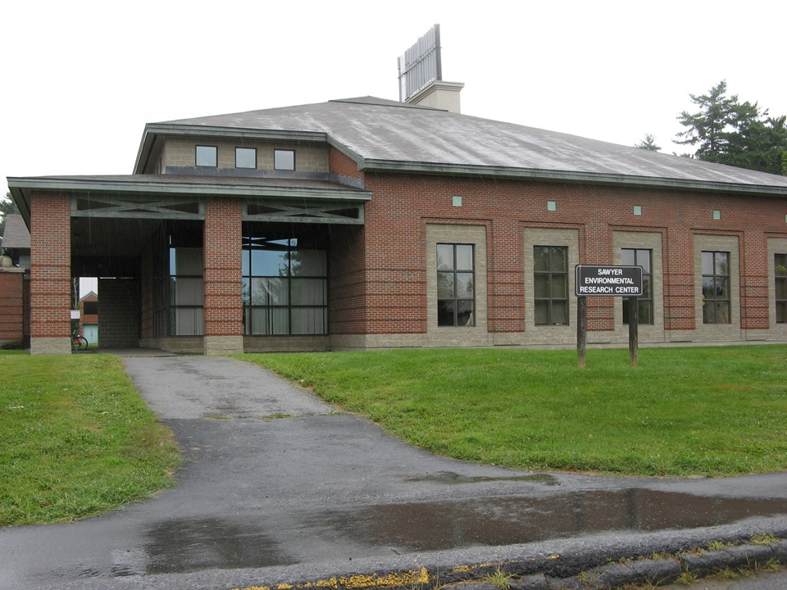
Kristin and Ivan visited Dr. Karrie Simons at the University of Maine
10
Notes:
Ivan and Kristin had a conversation the next day with Dr. Karrie Simons at the University of Maine. During the conversation, they took notes on what was said.
Image credit: Krista Slemmons, Sawyer Environmental Research Center, University of Maine.

Slide 11
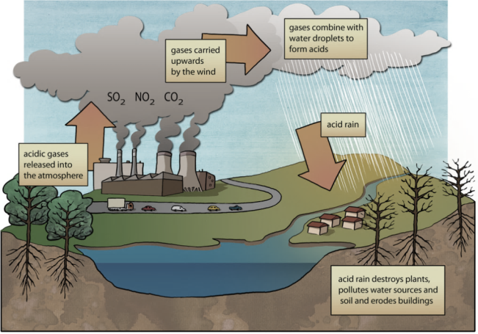
Question #4 What is acid rain?
Oct 3rd: Meeting with Dr. Karrie Simons University of Maine
Any acidic form of precipitation
Sulfuric acid or nitric acid
  Wet and dry forms:
    Rain
    Snow
    Fog
    Hail
    Dust
  Has a pH less than 5.6
Siyavula Education
11
Notes:
Here is what they jotted down:
“Over the past decades there has been a drastic increase in sulfur dioxide (SO2) and nitrogen oxides (NOx) being emitted into the air. The largest source of SO2 emissions is the burning of fossil fuels by power plants and similar industrial processing (EPA: <https://www.epa.gov/so2-pollution/sulfur-dioxide-basics>). The sulfur dioxide reacts with water, oxygen, and other chemicals to form sulfuric and nitric acids. With increases in human populations in the area, fuel emissions (another source of SO2 and NOx ) have also been on the rise. The acidic emissions fall to Earth in both wet (rain, snow, fog, hail, and dust) and dry (particles and gases) forms. As this acid rain falls to the ground, it can negatively influence vegetation and wildlife. This is a possible reason for the fish and tree death.”
Image credit: Siyavula Education, https://www.flickr.com/photos/121935927@N06/13579612483, CC BY 2.0.

Slide 12
Question #5 How is acid rain formed?
Oct 3rd: Meeting with Dr. Karrie Simons University of Maine
SO₂ and NO₂ released into the air
React with water, oxygen, and other chemicals to form sulfuric and nitric acids
Particles fall to Earth in wet or dry deposition
Harmful effects to ecosystems
Siyavula Education
12
Notes:
Before the words come up on the slide about the different forms of acid rain see if any students can identify a few.
Image credit: Siyavula Education, https://www.flickr.com/photos/121935927@N06/13579612483, CC BY 2.0.

Slide 13
Chemical reactions forming Acid Rain
Oct 3rd: Meeting with Dr. Karrie Simons University of Maine
  Equation 1: CO₂ (g) + H₂O (l) → H₂CO₃ (aq)
  Equation 2: H₂CO₃ (aq) → H ⁺ (aq) + HCO₃⁻ (aq)
  Equation 3: N₂ (g) + O₂ (g) → 2NO (g)

Slide 14
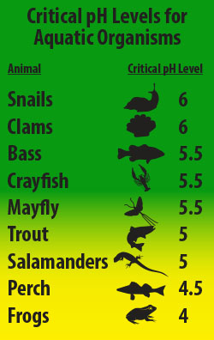
Question 6: How does changing the pH of an ecosystem affect aquatic organisms?
Some plants and animals are sensitive to acidic conditions. There is a critical pH range in which organisms are able to survive. This varies depending on the organism.
As acid flows through soil, it causes aluminum to leach into streams and lakes.
Acid rain removes nutrients and mineral from soil necessary for plant growth (EPA, 2017).
Notes:
Image credit: U.S. Environmental Protection Agency, https://www.epa.gov/acidrain/effects-acid-rain.

Slide 15
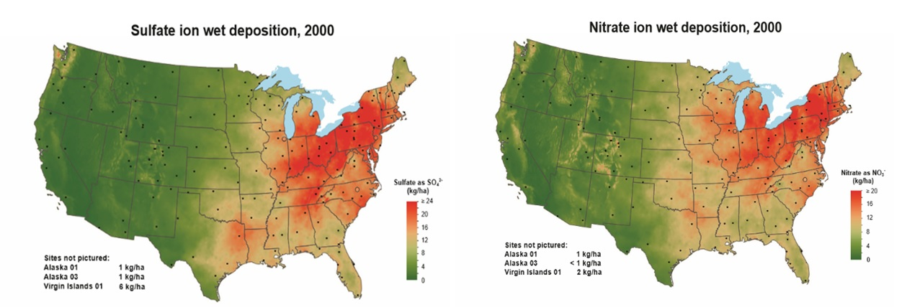
Question #7. Examine the maps of SO₂ and NO_{x} emissions from 2000. What patterns do you observe? Why do you think these patterns exist?
National Atmospheric Deposition Program http://nadp.sws.uiuc.edu/NTN/maps.aspx
Notes:
Kristin and Ivan were curious if high SO2 and NOx rates had been recorded elsewhere in the country. They asked Dr. Simmons and she sent them home to examine a few maps from the National Atmospheric Deposition Program (NADP) showing the acidity of different regions within the United States. The following maps were created from 250 different monitoring sites throughout the United States.
Acidity of rain is measured by collecting samples of rain and measuring its pH. Remember that areas with the greatest acidity have the lowest pH values. Looking at this map it is obvious that the Northeastern United States has the greatest acidity. The amount of acidity in an area is due to large number of cities and population sizes.
Image credit: National Atmospheric Deposition Program (NRSP-3). 2017. NADP Program Office, Illinois State Water Survey, University of Illinois, Champaign, IL 61820. http://nadp.sws.uiuc.edu/. Used with permission.

Slide 16
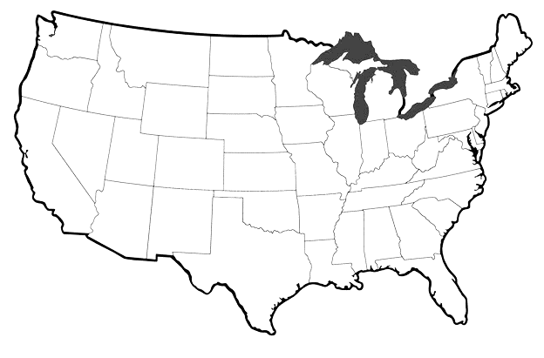
Question #8: Predict what a map of acid rain (H⁺) might look like based on your interpretation of SO₂ and NO_{x}.

Slide 17
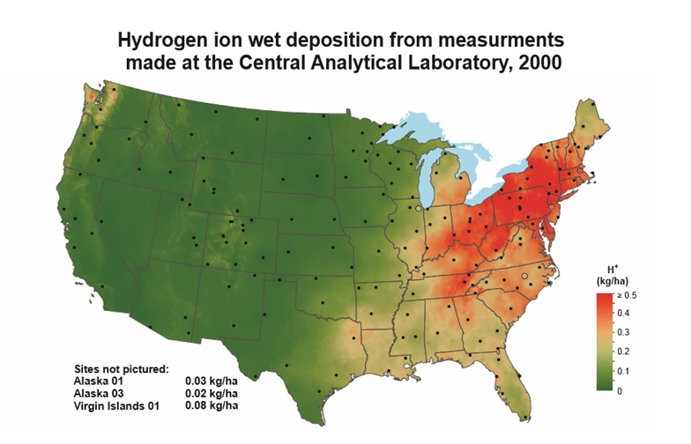
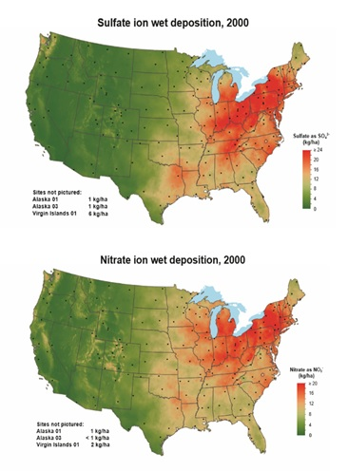
Question #8: Predict what a map of acid rain (H⁺) might look like based on your interpretation of SO₂ and NO_{x}.
Question #9: These maps are from data collected during 2000. How do you think these maps compare to current SO₂, NO_{x} and H⁺ maps and why?
Notes:
Image credits: National Atmospheric Deposition Program (NRSP-3). 2017. NADP Program Office, Illinois State Water Survey, University of Illinois, Champaign, IL 61820. http://nadp.sws.uiuc.edu/. Used with permission.

Slide 18
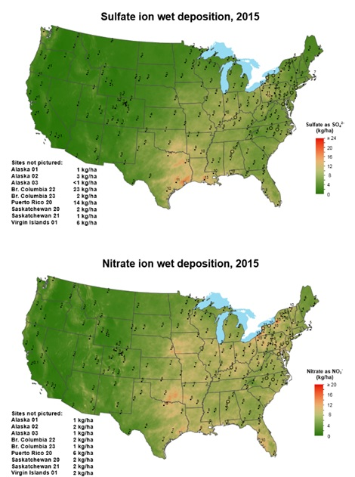
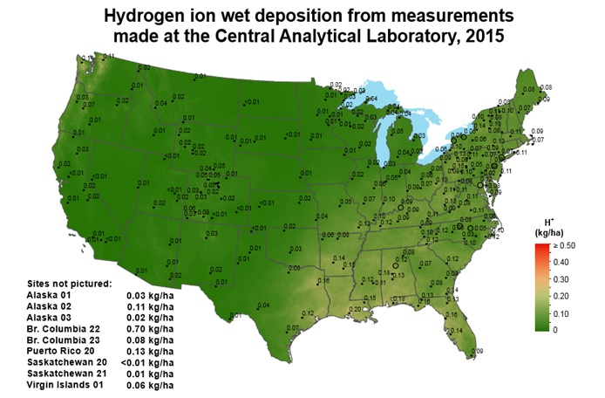
Question #10: Why do you think the maps look so dramatically different from 2000 to 2015?
Notes:
Acid rain levels have declined in the last 25 years in large part due to the regulation of sulfuric acid emissions. The NADP monitors these levels at 250 stations across the United States.
Image credits: National Atmospheric Deposition Program (NRSP-3). 2017. NADP Program Office, Illinois State Water Survey, University of Illinois, Champaign, IL 61820. http://nadp.sws.uiuc.edu/. Used with permission.

Slide 19
Part III – Using Paleoecology to Identify Historical Patterns
Have these fish and forest kills always occurred because of acid rain?
19
Notes:
Kristin and Ivan wondered whether there was a way to determine if the rain had always been acidic, or if this was a new development, or if it was just a part of the natural fluctuation of the region. They wondered if water quality data gathered in the past could be used as a comparison to current conditions. They called up Dr. Simons to see if she knew of such data. Dr. Simons said there was no historical water quality data for that region but there were other ways of inferring changes in pH over time. Since Kristin and Ivan were biology majors, they were familiar with biological water quality indicators.
Image credit: Krista Slemmons, Resurrection Bay, Alaska.

Slide 20

Indicators of the Past: Diatoms
Type of algae
Sensitive to environmental change
Composed of silica cell walls
Have ornate patterns
SEM credit: Sol Sepsenwol
Notes:
Diatoms were the first thing that came to mind. Diatoms are a major group of photosynthesizing algae that are unicellular and composed of a silica-based cell wall. Diatoms are sensitive indicators of environmental change. They have been used to infer changes in lake level, temperature, nutrients, light and numerous other parameters over long periods. Could diatoms be used to see how the pH of Bear Pond had changed over time? Kristin and Ivan did a little research and found out the answer: yes!
One of the earliest ways diatoms were used by scientists was to reconstruct lake histories; more specifically, diatoms have been used to determine that acid rain was real and affecting ecosystems in the Northeast.
Acidophilus pH<7
Acidobiontic tolerances <5.5 (Lowe 1974, van Dam et al. 1994)
Alkaliphilus pH >7
Alkalibiontic exceeding pH = 7
Circumneutral optimum = pH 7
Indifferent
Image credit: Scanning electron microscopy diatom images by Sol Sepsenwol, University of Wisconsin-Stevens Point, used with permission.

Slide 21
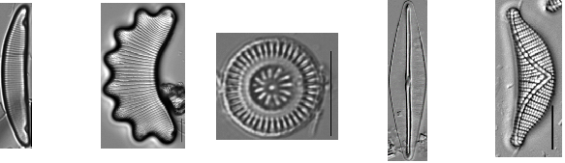
Diatoms have certain pH (optima) preferences for optimal survival and growth
Acidobiontic (living in acid; pH<5.5) | Acidophilus (acid loving; pH<7) | Circumneutral pH = 7 | Alkaliphilus (living in a base; pH>7) | Alkalibiontic (acid loving; pH exceeding 7)
Eunotia incisa Photo credit: Paula Furey | Eunotia diadema Photo credit: Loren Bahls | Discostella stelligera Photo credit: Rex Lowe | Frustulia saxonica Photo credit: Pat Kocoilek, Carrie Graeff | Epithemia sorex Photo credit: Rex Lowe
Notes:
Diatoms provide an understanding of how pH changes over time because certain species of diatoms are very sensitive to pH fluctuation.
Image credits: “Diatoms of the United States,” https://westerndiatoms.colorado.edu/. Spaulding, S.A., Lubinski, D.J. and Potapova, M. (2010). Accessed on 16 November, 2017. Used with permission.

Slide 22
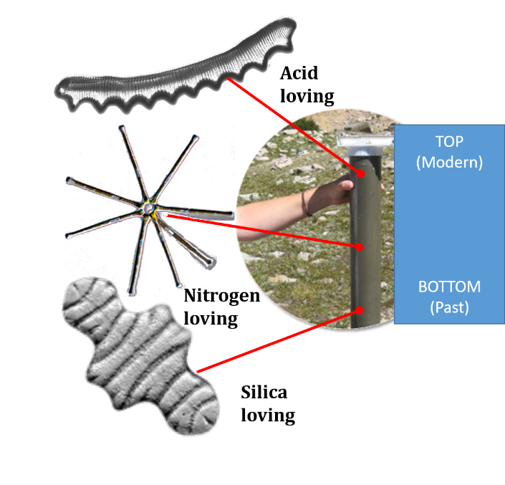
How can diatoms in the past be identified?
Silica “shells” (frustules) can be extracted and used to recreate past environments (similar to methods of archeologists)
Notes:
But how could you determine which diatoms lived in the past? Since diatoms are made of silica, they do not easily degrade over time when they die.
Image credits: Photo by Krista Slemmons, Albino Lake, Beartooth Mountains, SEM images by Sol Sepsenwol, University of Wisconsin-Stevens Point, used with permission.

Slide 23
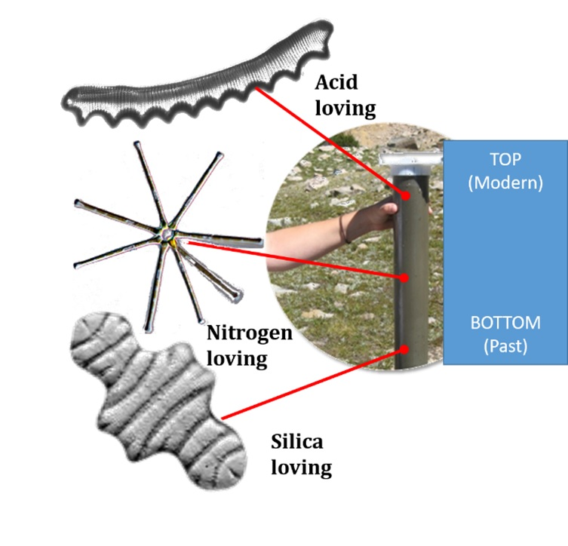
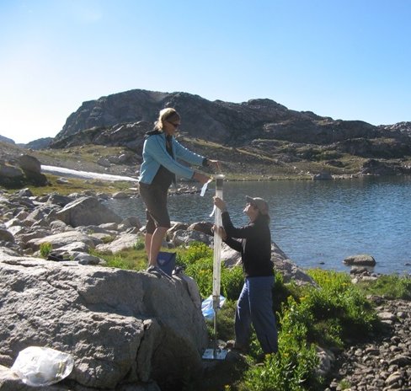
How can diatoms in the past be identified?
When diatoms die, the sink to the bottom of a lake and can be extracted.
Notes:
But how could you determine which diatoms lived in the past? Since diatoms are made of silica, they do not easily degrade over time when they die. Rather, they sink to the bottom of a lake and accumulate in the lake sediment. Scientists can extract the sediment and then determine what species were alive in the past. Based on the optimal environmental conditions that each species requires, scientists can reconstruct the environmental conditions of the past based on which diatoms are present in different segments of the lake core. Similar to an archeologist digging up dinosaur bones, they can draw some conclusions about the past environment.
Image credits: Photo by Krista Slemmons, core from Albino Lake, Beartooth Mountains, SEM images by Sol Sepsenwol, University of Wisconsin-Stevens Point, used with permission.

Slide 24
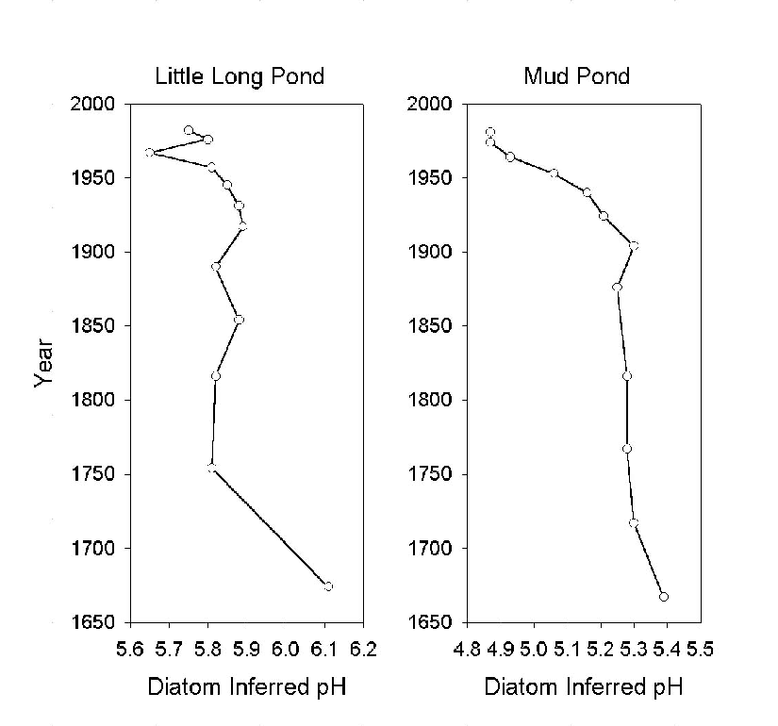
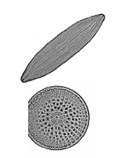
Based on the pH optima of each diatom in different segments of the core and the number of those diatom present, lake pH can be reconstructed.
Each species shows a different optima for pH
Davis et al., 1990
Notes:
By examining lake sediment cores and understanding the ecology of a system, scientists can reconstruct the pH of these lakes back in time prior to recorded data.
We can extract the cores and examine them. The number and type of diatom in the sediment can tell us what the climate was like back through time. We can do this by digging cores at the bottom of lakes and then looking at the glass-like fossils of diatoms.
Image credit: Adapted from Figure 3 in: Davis, R.B., D.S. Anderson, M.C. Whiting, J.P. Sol and S.S. Dixit. 1990. Alkalinity and pH of three lakes in northern New England, U.S.A. over the past 300 years. Phil.Trans.R. Soc. Lond. B 327: 413-21. https://royalsocietypublishing.org/doi/pdf/10.1098/rstb.1990.0083.

Slide 25
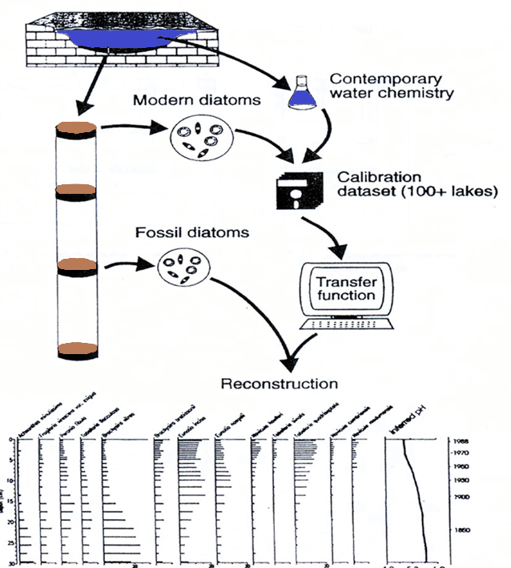
How can diatoms in the past be identified and used to reconstruct past lake conditions?
Calibration set
Notes:
Once diatoms are identified through time (at different segments in the core). A calibration set can be established or one that is already been established can be used. A calibration set is based on contemporary water chemistry data from numerous lakes. Then correlations between parameters and the abundance of certain diatoms in each lake are determined. A transfer function is then developed and applied to the fossil diatoms. From this transfer function, a reconstruction of the past lake can be calculated.
Image credit: Krista Slemmons.

Slide 26
Making a calibration set
Estimated optimum (abundance-weighted mean) for each diatom species
Observed pH
of sample i
n
Σ
^
y_{ik}x_{i}
u_{k}
=
i=1
_____
n
Σ
y_{ik}
i=1
Optimum of
species k
Abundance of taxon k
in sample i
Notes:
We can extract the cores and examine them
The number and type of diatom in the sediment can tell us what the climate was like back through time. We can do this by digging cores at the bottom of lakes and then looking at the glass like fossils of diatoms.

Slide 27
Reconstructing an environmental variable
from a fossil assemblage
Weighted–averaging calibration
Optimum pH of species k
m
Σ
^
y_{ik}u_{k}
K=1
X_{i}
________
=
m
Σ
y_{ik}
Abundance of taxon k in
fossil sample i
Estimate of environmental
variable for fossil sample i
K=1
Notes:
We can extract the cores and examine them
The number and type of diatom in the sediment can tell us what the climate was like back through time. We can do this by digging cores at the bottom of lakes and then looking at the glass like fossils of diatoms.

Slide 28
Question #11 Based on the changes in abundance of two diatom species shown below (Eunotia), predict how you would expect the change in pH over time might appear. Sketch an image in the box to the right.
Notes:
Ivan and Kristin found a study from 1992 by Dixit et al. that reconstructed the past pH in Baby Lake in Ontario using extracted diatoms. Two key species were used in reconstructing the past pH: Acidophilus Eunotia (acd, acid loving) and Acidobiontic Eunotia (acb, living in acidic environments).

Slide 29
Question #12: Speculate on the long term ecological impact if acid rain levels increase.
Questions #13: Do you think the government should regulate nitrogen and sulfate emissions from power plants and industry? Why or why not?
Question #14:What actions could we take to decrease SO₂ and NO_{x}?

Slide 30
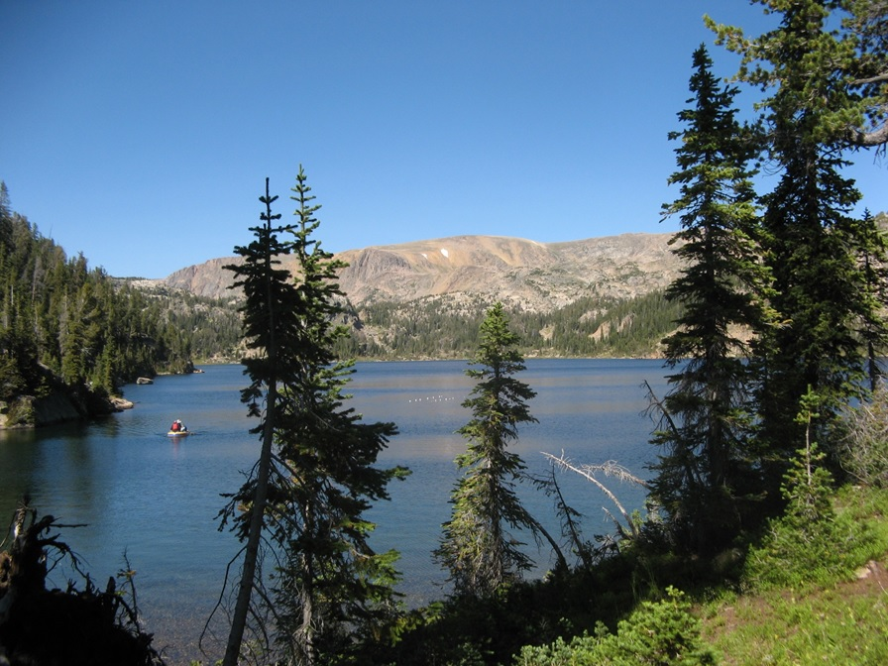
Kristin and Ivan resolved to core Bear Pond, identify the diatoms over time and determine if acid rain has always inflicted this ecosystem or if it is a one time, abnormal occurrence.
Notes:
Kristin and Ivan resolved to core Bear Pond, identify the diatoms over time and determine if acid rain has always inflicted this ecosystem or if it is a one time, abnormal occurrence.
Photo credit: Krista Slemmons, Beauty Lake, Beartooth Mountains.

