Slide 1
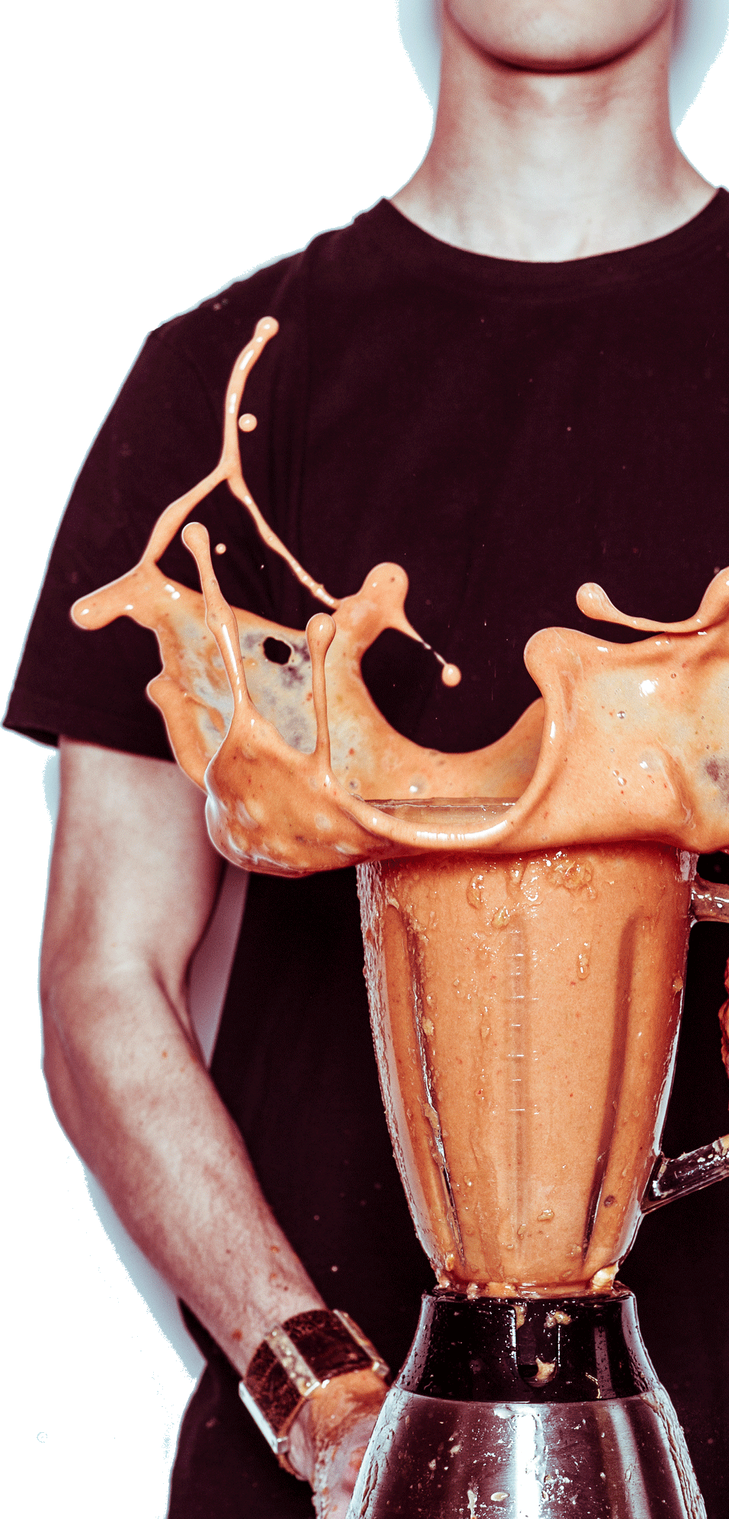
^{How to Make ATP:}
^{Three Classic Experiments}
^{in Biology}
NATIONAL CENTER FOR CASE STUDY TEACHING IN SCIENCE
A Presentation to Accompany the Case Study:
^{by}
^{Monica L. Tischler}
Department of Biological Sciences
Benedictine University, Lisle, IL
Notes:
Licensed photo © Hennyvanroomen | Dreamstime.com, id 67259556.

Slide 2
Energy transformations define life
Cells take energy from the environment
Cells transform energy and store it
All cellular processes use energy: growth, reproduction, communication, movement
Cells store energy in a high energy phosphate bond in the ATP molecule

Slide 3
Historical background
By 1940, scientists knew that ATP was how cells stored energy
Scientists also knew that ATP could be formed via substrate level phosphorylation
Adenosine
P
P
Adenosine
P
P
P
Substrate
P
Substrate
Substrate level phosphorylation

Slide 4
In the 1950s, a metabolic puzzle:
Why is so much ATP produced by cells in the presence but not absence of oxygen?
Is there some intermediate in some sort of biochemical pathway that forms ATP?

Slide 5


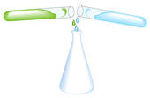
Is there some intermediate in some sort of biochemical pathway that forms ATP?
Scientific approach at the time:
Grind up cells
Purify component parts
Put parts together for each step of a pathway

Slide 6
1961: Peter Mitchell
Presented a different mechanism for ATP synthesis via electron transport chains
It took almost two decades for scientists to accept his model
Three fundamental questions that needed to be addressed to understand Mitchell’s model
  What are electron transport chains?
  What do they do?
  How do they do it?

Slide 7
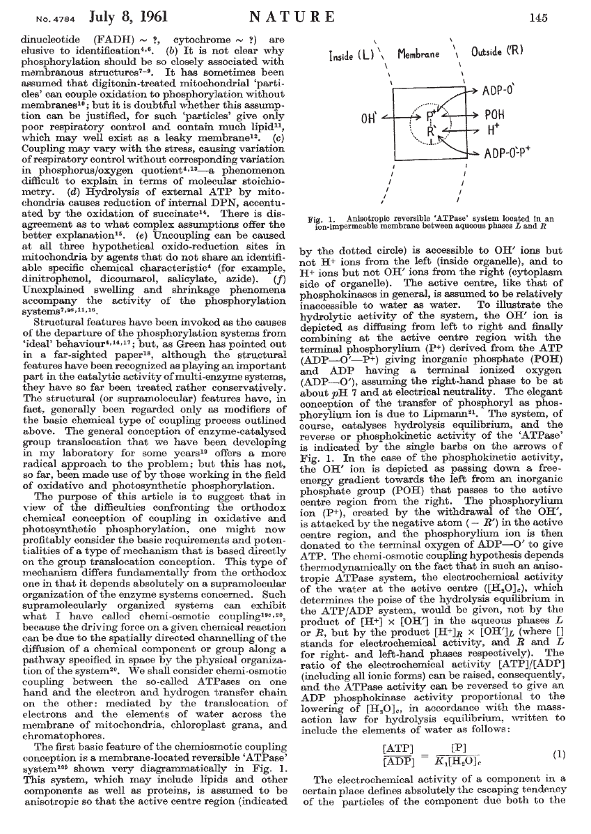
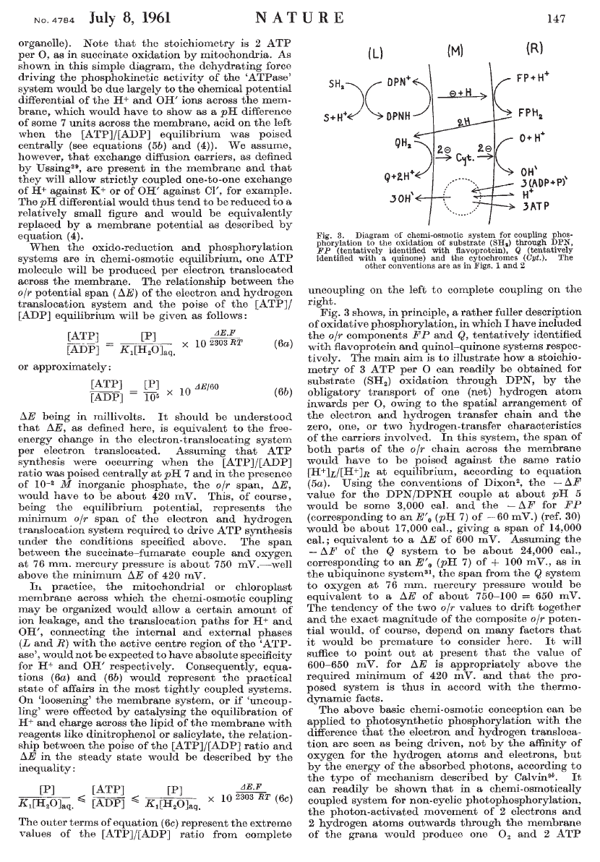
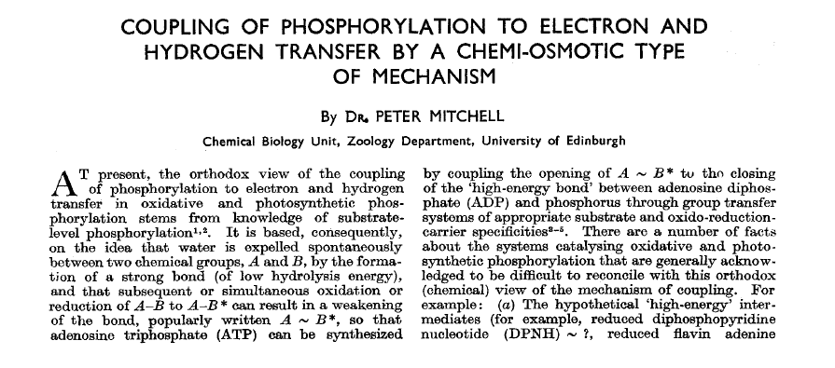
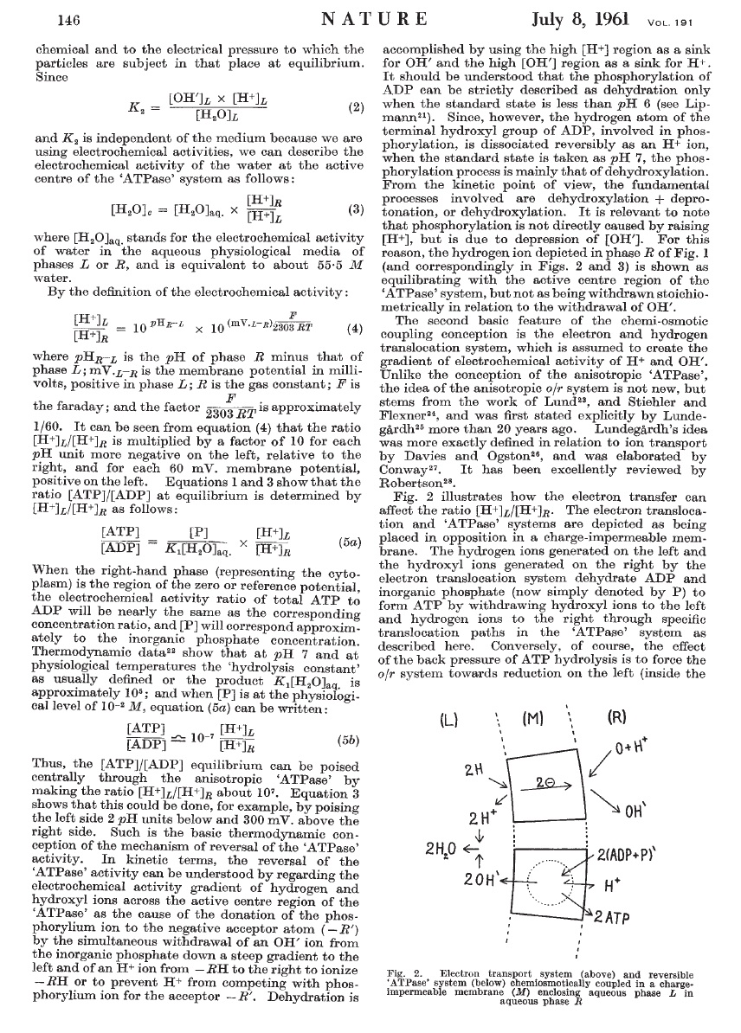
Part I
What are they?
(What are electron transport chains?)

Slide 8
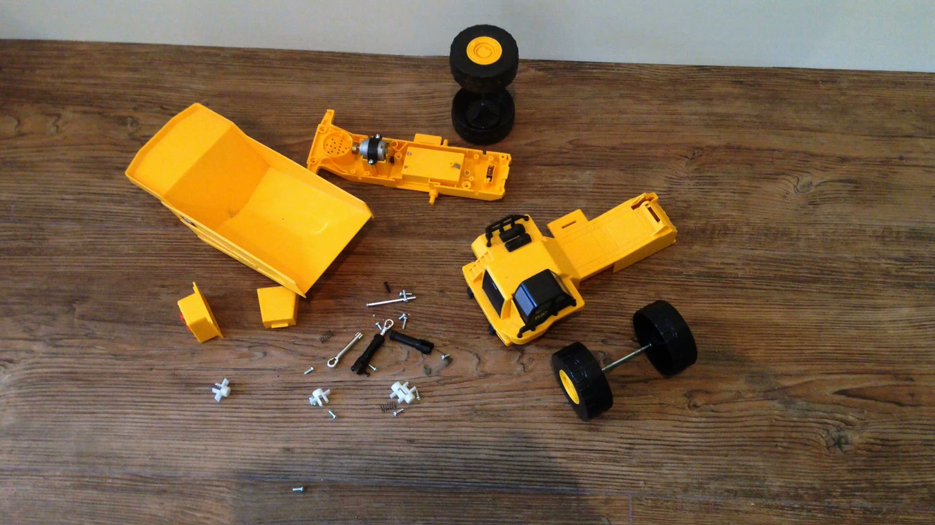

Mitchell’s hypothesis depended on spatial positioning
Which image is an example of spatial positioning?

Slide 9
What does Mitchell’s drawing in Figure 1 represent?
What is the charge outside the membrane?
What is the charge inside the membrane?
Which side of the membrane has a lower pH?
Which side of the membrane is more acidic?
Notes:
Figure reprinted by permission from Macmillan Publishers Ltd: Nature ©1961.

Slide 10
What is the charge outside the membrane?
Positive
Negative
Both positive and negative
Notes:
Figure reprinted by permission from Macmillan Publishers Ltd: Nature ©1961.

Slide 11
What is the charge inside the membrane?
Positive
Negative
Both positive and negative
Notes:
Figure reprinted by permission from Macmillan Publishers Ltd: Nature ©1961.

Slide 12
What side of the membrane has a lower pH?
Inside
Outside
Both inside and outside should have the same pH
Notes:
Figure reprinted by permission from Macmillan Publishers Ltd: Nature ©1961.

Slide 13
Which side of the membrane is more acidic?
Inside
Outside
Both inside and outside should have the same acidity
Notes:
Figure reprinted by permission from Macmillan Publishers Ltd: Nature ©1961.

Slide 14

In this diagram, does a proton or an electron cross the membrane first?
Is the cytochrome translocating protons or electrons?
In this diagram, how many ATP are made via the spatially positioned system?
Do you know how many ATP scientists currently think are made with the electron transport chain?
Notes:
Figure reprinted by permission from Macmillan Publishers Ltd: Nature ©1961.

Slide 15
In this diagram, which crosses the membrane first?
A proton
An electron
Both a proton and an electron
DPN+

Slide 16
In this diagram, what is the cytochrome translocating across the membrane?
Protons
Electrons
Both protons and electrons
Cytochromes

Slide 17
In this diagram, how many ATP are made via the spatially positioned system?
One
Two
Three
The diagram does not specify the number
Notes:
Figure reprinted by permission from Macmillan Publishers Ltd: Nature ©1961.

Slide 18
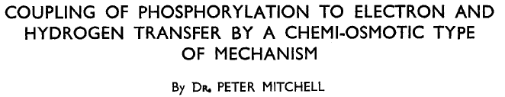
Conclusion:
  Where the individual components of a reaction chain are placed in space can be important.
  ATP synthesis depends on transport of electrons and hydrogen (protons) in a membrane.
  Mitchell’s hypothesis was contrary to conventional thinking at the time.

Slide 19
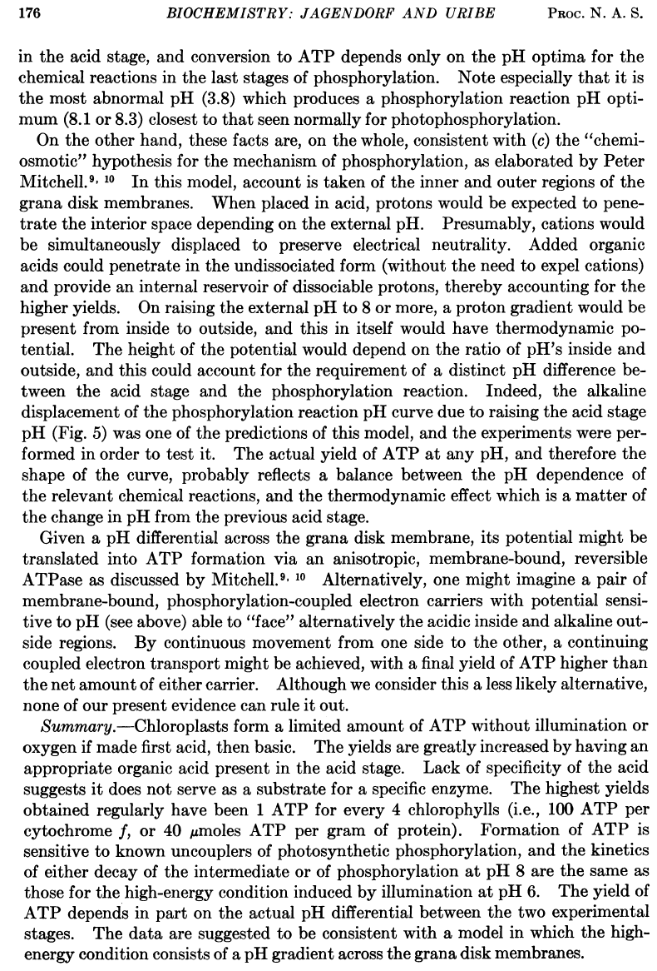
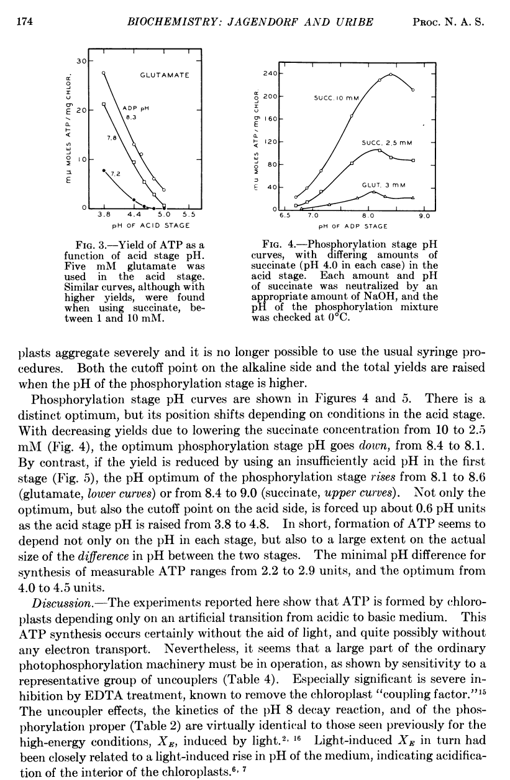
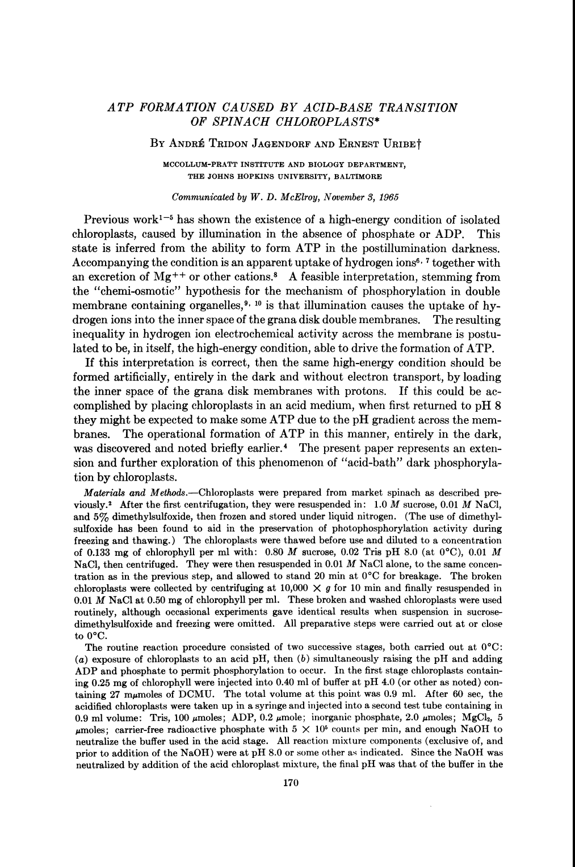
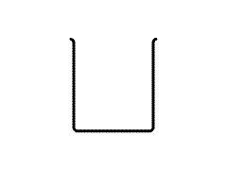
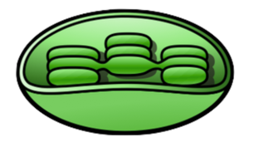
Part II:
What do electron transport chains do?
Jagendorf and Uribe took isolated chloroplasts and put them into acid pH in the dark
H+
H+
H+
H+
H+
H+
H+

Slide 20
ATP
They then changed the pH to basic, and the chloroplasts made ATP!
OH-
OH-
OH-
OH-
OH-
OH-
OH-
OH-
OH-
OH-
OH-
OH-

Slide 21
Figure 3 shows the amount of ATP that was produced by chloroplasts with different starting (acid phase) and ending pH’s. Each data point is a different experiment with a different starting and ending pH.
What is measured on the X-axis?
What is measured on the Y-axis?
What was the starting and ending pH that gave the most ATP?
Can you make a conclusion about whether a large or a small difference in pH yields more ATP?
Ending pH
8.3
7.8
7.2

Slide 22
Figure 3 shows the amount of ATP that was produced by chloroplasts with different starting (acid phase) and ending pH’s. Each data point is a different experiment with a different starting and ending pH.
What is measured on the X-axis?
Ending pH
8.3
7.8
7.2
Time
Amount of ATP
pH

Slide 23
Figure 3 shows the amount of ATP that was produced by chloroplasts with different starting (acid phase) and ending pH’s. Each data point is a different experiment with a different starting and ending pH.
What is measured on the Y-axis?
Ending pH
8.3
7.8
7.2
Time
Amount of ATP
pH

Slide 24
Figure 3 shows the amount of ATP that was produced by chloroplasts with different starting (acid phase) and ending pH’s. Each data point is a different experiment with a different starting and ending pH.
What was the starting and ending pH that gave the most ATP?
Ending pH
8.3
7.8
7.2
3.8; 8.3
5.0; 7.2
3.8; 7.2
5.0; 7.8

Slide 25
Figure 3 shows the amount of ATP that was produced by chloroplasts with different starting (acid phase) and ending pH’s. Each data point is a different experiment with a different starting and ending pH.
Which yields more ATP?
Ending pH
8.3
7.8
7.2
A large pH change
A small pH change
A pH change has no effect on the amount of ATP made

Slide 26
Figure 4 shows the amount of ATP produced by isolated chloroplasts when the starting pH is 4.0.
What is measured on the X-axis?
What is measured on the Y-axis?
Does there appear to be an optimum pH difference for ATP yield?
What can you conclude about whether a large or a small difference in pH yields more ATP?
Ending pH

Slide 27
Figure 4 shows the amount of ATP produced by isolated chloroplasts when the starting pH is 4.0.
What is measured on the Y-axis?
Time
Amount of ATP generated
pH at the start of the experiment
pH at the end of the experiment
Ending pH

Slide 28
Figure 4 shows the amount of ATP produced by isolated chloroplasts when the starting pH is 4.0.
Which pH yielded the most ATP?
6.7
7.3
8.3
8.5
8.7
Ending pH

Slide 29
Figure 4 shows the amount of ATP produced by isolated chloroplasts when the starting pH is 4.0.
Does there appear to be an optimum pH difference for ATP yield?
Yes
No
How can you tell?
Ending pH

Slide 30
Figure 4 shows the amount of ATP produced by isolated chloroplasts when the starting pH is 4.0.
In general, which yields more ATP?
A large pH change
A small pH change
A pH change has no effect on the amount of ATP made
Ending pH

Slide 31
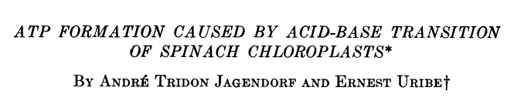


Conclusion:
  ATP was formed by chloroplasts in the dark when the pH surrounding the chloroplasts changed.
  Something (other than light) was driving the ATP synthesis.
  A difference in pH across the membrane is sufficient to form ATP.

Slide 32
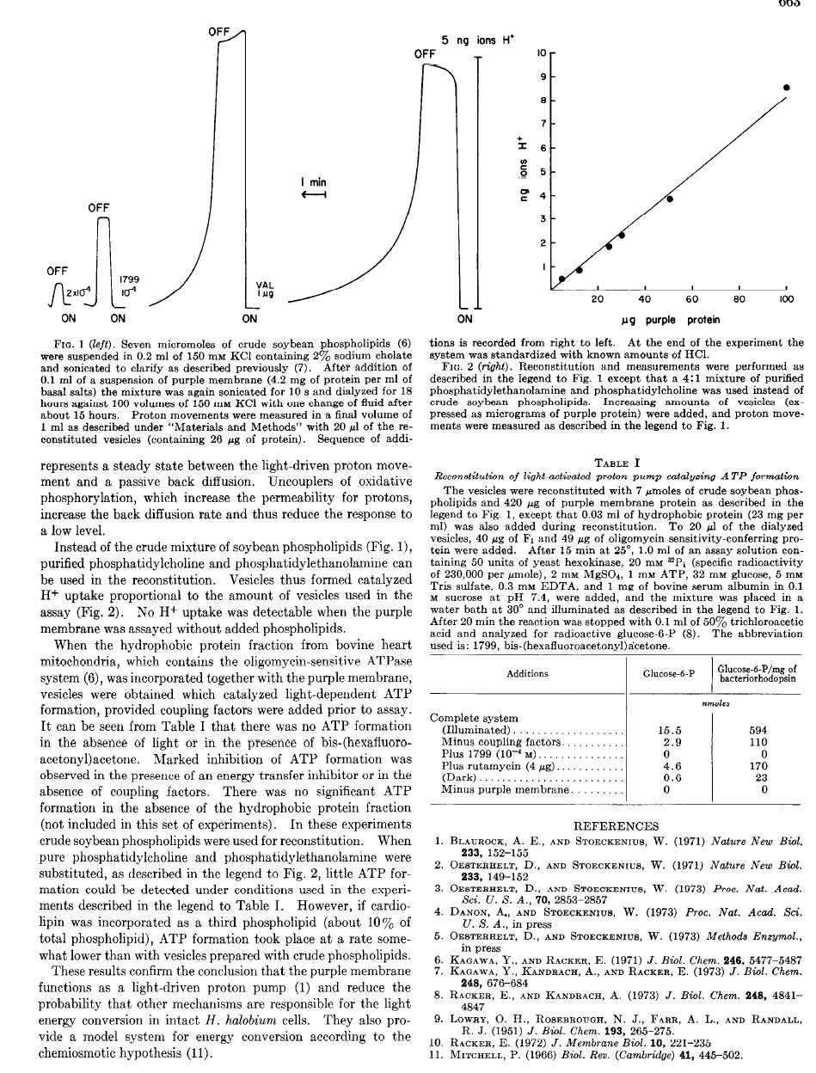
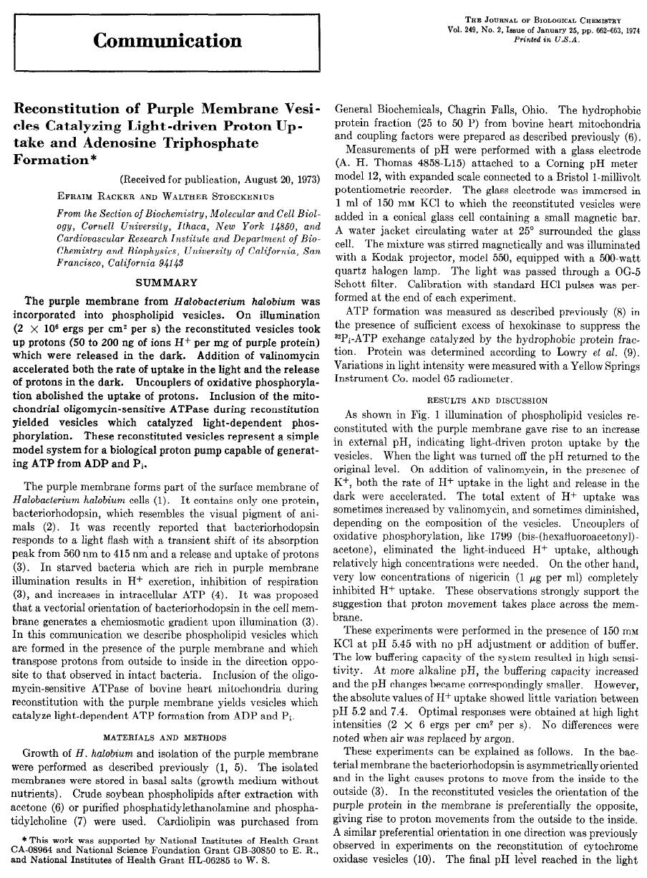
Part III:
What do electron transport chains do it?
Racker and Stoeckenius used the purple photosynthetic bacterium, Halobacterium halobium.
This purple membrane of this organism has only one protein, bacteriorhodopsin (called purple protein at the time), which responds to light by transporting protons.

Slide 33
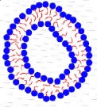
Racker and Stoeckenius purified purple protein from Halobacterium halobium and made artificial membrane vesicles from soybean lipids.
Step One:
Purify
purple protein
Make membrane vesicles
from soybean lipids

Slide 34
Racker and Stoeckenius inserted the purple protein into the artificial membrane vesicles.
Step Two:
Purple protein
inserted into artificial membrane vesicles

Slide 35
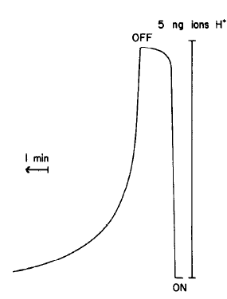
When the membrane vesicles receive light (on), protons are transported.
When the membrane vesicles do not receive light (off), protons are not transported.
Proton concentration was measured by changes in pH in the medium.
Light OFF
Would they have been able to measure pH changes if the membranes vesicles were not intact?
Does this experiment show that the scientists were successful in making artificial membrane vesicles?
Does this experiment show that the scientists were successful in inserting the purple protein into the membrane? Why or why not?
Protons produced
1 min
Light ON

Slide 36
When the membrane vesicles receive light (on), protons are transported.
When the membrane vesicles do not receive light (off), protons are not transported.
Proton concentration was measured by changes in pH in the medium.
Light OFF
What is on the X-axis?
Time
pH
Protons produced
Light
Protons produced
1 min
Light ON

Slide 37
When the membrane vesicles receive light (on), protons are transported.
When the membrane vesicles do not receive light (off), protons are not transported.
Proton concentration was measured by changes in pH in the medium.
Light OFF
What is on the Y-axis?
Time
pH
Protons produced
Light
Protons produced
1 min
Light ON

Slide 38
When the membrane vesicles receive light (on), protons are transported.
When the membrane vesicles do not receive light (off), protons are not transported.
Proton concentration was measured by changes in pH in the medium.
Light OFF
Would they have been able to measure pH changes if the membranes vesicles were not intact?
Yes
No
It depends on the situation
How could they predict this?
Protons produced
1 min
Light ON

Slide 39
When the membrane vesicles receive light (on), protons are transported.
When the membrane vesicles do not receive light (off), protons are not transported.
Proton concentration was measured by changes in pH in the medium.
Light OFF
Does this experiment show that the scientists were successful in making artificial membrane vesicles?
Yes
No
It depends on the situation
How could they predict this?
Protons produced
1 min
Light ON

Slide 40
When the membrane vesicles receive light (on), protons are transported.
When the membrane vesicles do not receive light (off), protons are not transported.
Proton concentration was measured by changes in pH in the medium.
Light OFF
Does this experiment show that the scientists were successful in inserting the purple protein into the membrane?
Yes, because protons were produced in the light
No, because protons were produced in the light
This experiment has nothing to do with whether or not the purple protein was inserted into the membrane
Protons produced
1 min
Light ON

Slide 41
Racker and Stoeckenius added different amounts of purple protein (bacteriorhodopsin) to the soybean phospholipid vesicles.
What is the X-axis?
What is the Y-axis?
Does the amount of purple protein (or bacteriorhodopsin) affect the amount of protons that are transported?
Why did they do this experiment?

Slide 42
Racker and Stoeckenius added different amounts of purple protein (bacteriorhodopsin) to the soybean phospholipid vesicles.
What is the X-axis?
Time
Amount of purple protein
Amount of protons
pH

Slide 43
Racker and Stoeckenius added different amounts of purple protein (bacteriorhodopsin) to the soybean phospholipid vesicles.
What is the Y-axis?
Time
Amount of purple protein
Amount of protons
pH

Slide 44
Racker and Stoeckenius added different amounts of purple protein (bacteriorhodopsin) to the soybean phospholipid vesicles.
Does the amount of purple protein (or bacteriorhodopsin) affect the amount of protons that are transported?
Yes
No
It depends on the starting pH
It depends on the amount of light

Slide 45
Racker and Stoeckenius added different amounts of purple protein (bacteriorhodopsin) to the soybean phospholipid vesicles.
Why did they do this experiment?
To demonstrate that more protons are transported when there is more purple protein
To demonstrate that purple protein transported protons
To demonstrate that the pH is proportional to the membrane structure

Slide 46
Racker and Stoeckenius took the next step and incorporated proteins from bovine heart mitochondria into their artificial membranes.
Bovine heart mitochondria protein
(We now know that protein is ATP synthase.)
In the presence of light, ATP was formed!
light
ADP + Pi
ATP
H+
H+
H+
H+
H+
H+

Slide 47
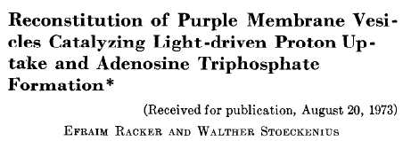

Conclusion:
  ATP was formed by in artificial membrane vesicles when there was a protein to make an artificial proton gradient and an enzyme to make the ATP.

Slide 48
Part IV:
Putting It Together
Inside
(matrix)
Inner
membrane
Outside
(intermembrane space)
NADH
H+
H+
Complex I
FMN
H+
NAD+
Succinate
Complex II
FAD
CoQ
Fumarate
H+
2 H+
Complex III
Cyt b
Cytc1
H+
H+
H+
Cyt C
½ O2
2 H+
Complex IV
Cyt a
Cyt a3
H+
H+
H2O
H+
ADP + Pi
H+
H+
ATP
synthase
Complex V
H+
H+
H+
ATP

Slide 49
