Slide 1
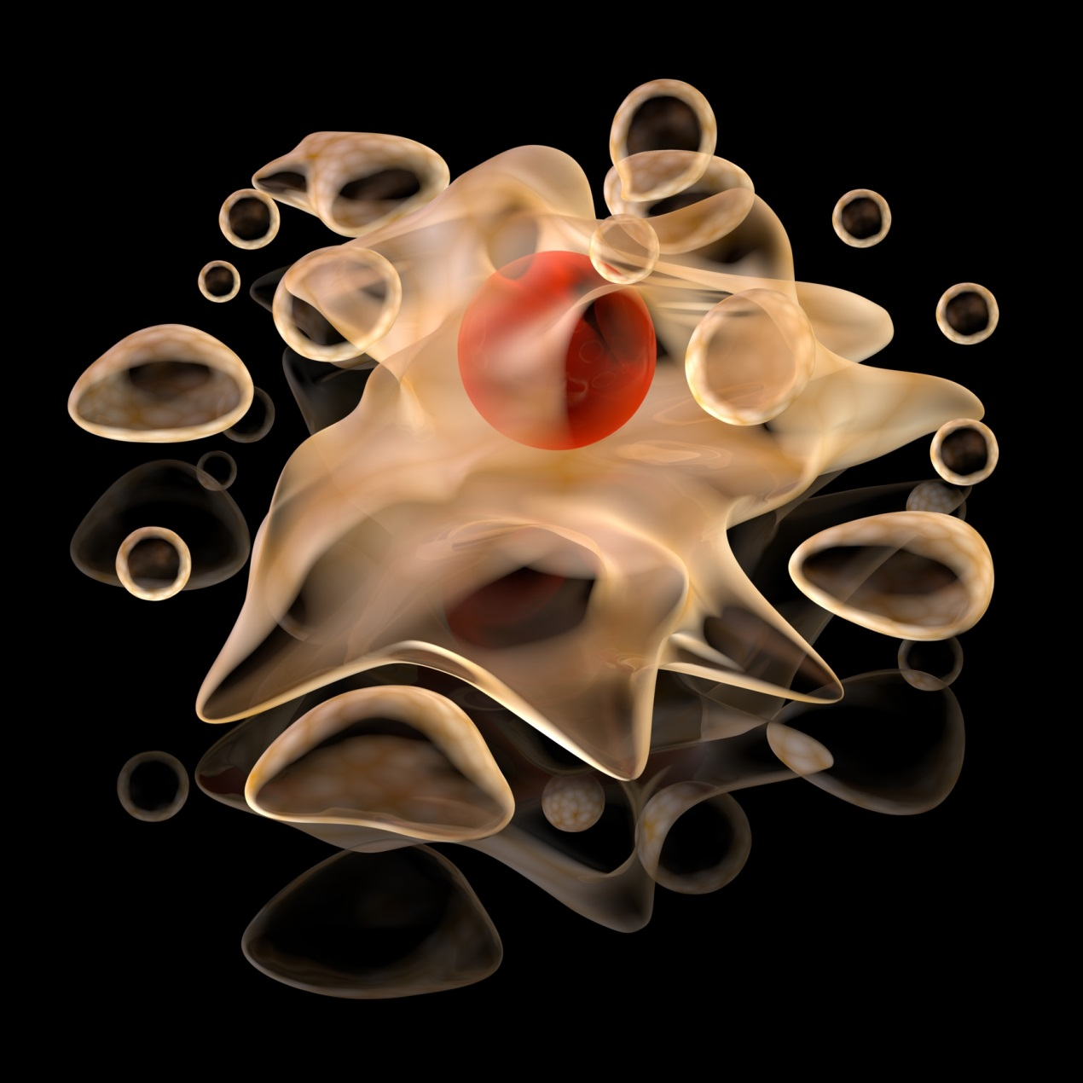
Death Becomes Us: Apoptosis and Carcinogenesis
NATIONAL CENTER FOR CASE STUDY TEACHING IN SCIENCE
A Presentation to Accompany the Case Study:
by
Michele M. Cox
Department of Biology
University of the Virgin Islands
Notes:
Credit: Licensed image ©Dmitry Knorre | Dreamstime.com, ID27827210.

Slide 2
apoptotic
signal
Figure 1
Caspase Activation during Apoptosis
Initiator Caspase
adaptor-binding domain
adaptor proteins
large subunit
protease domain
cleavage
sites
DIMERIZATION, ACTIVATION & CLEAVAGE
inactive monomers
active caspase
small subunit
active caspase
ACTIVATION BY CLEAVAGE
Executioner Caspase
CLEAVAGE OF MULTIPLE SUBSTRATES
APOPTOSIS

Slide 3
Fas ligand
Cell Membrane
Fas receptors
Figure 2
Extrinsic Pathway
(Fas Ligand) Mechanism 1
FADD
DISC
Caspase-8
inactive
Caspase-8
active
Caspase-3
APOPTOSIS

Slide 4
Fas ligand
Cell Membrane
Fas receptors
Figure 3
Extrinsic Pathway
(Fas Ligand) Mechanism 2
Apaf-1
FADD
DISC
dATP/ATP
Mitochondria
Caspase-8
inactive
Bid C terminal
Cytochrome c
Caspase-8
active
Bid
Caspase-3
Caspase-9
inactive
Caspase-9
active
APOPTOSIS
Apoptosome

Slide 5
Cell Membrane
Apoptotic Stimuli
Apaf-1
Figure 4
Induction of Apoptosis (Intrinsic Pathway
Bax
Mitochondria
dATP/ATP
Cytochrome c
Caspase-3
Caspase-9
active
Caspase-9
inactive
APOPTOSIS
Apoptosome

Slide 6
Figure 5
Execution Phase of Apoptosis
Normal cell
Membrane blebbing
Cell shrinkage
Chromatin Condensation
Apoptotic body formation
Lysis of Apoptotic bodies
Nuclear collapse
Continued blebbing

Slide 7
Fas ligand
Cell Membrane
Fas receptors
Figure 6
Regulation of apoptosis
by c-FLIP
FADD
DISC
Caspase-8
inactive
c-FLIP
Caspase-8
active
c-FLIP
TRAF2
RIP
Raf-1
Caspase-3
ERK
APOPTOSIS
FLIP
PROLIFERATION/DIFFERIATION

Slide 8
APOPTOTIC
STIMULUS
Inactive effector
Bcl2 family protein
aggregated
active effector
Bcl2 family protein
Intermembrane
space
cytochrome c
other proteins in
Intermembrane space
Figure 7
Role of pro-apoptotic
effector Bcl2 family proteins in the intrinsic
pathway of apoptosis.

Slide 9
active anti-apoptotic
Bcl2 family protein
Inactive effector
Bcl2 family protein
Intermembrane
space
cytochrome c
other proteins in
Intermembrane space
Figure 8
Role of anti-apoptotic
Bcl2 family proteins in the intrinsic pathway of apoptosis.

Slide 10
APOPTOTIC
STIMULUS
inactive anti-apoptotic
Bcl2 family protein
Activated BH3-only
protein
aggregated
active effector
Bcl2 family protein
Intermembrane
space
cytochrome c
other proteins in
Intermembrane space
Figure 9
BH3-only protein activation during apoptosis

