Slide 1
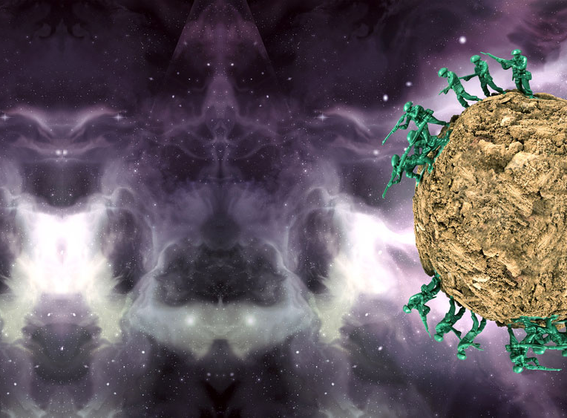
NATIONAL CENTER FOR CASE STUDY TEACHING IN SCIENCE
Images to accompany the case study
The Ebola Wars
Advanced Edition
by
Derek Dube, Department of Biology, University of Saint Joseph
Linda M. Chicoine, Department of Biological Sciences, Quinnipiac University
Tracie M. Addy, Teaching & Learning Center, Yale School of Medicine
Notes:
This PowerPoint presentation is intended for use as a supplement to the case study The Ebola Wars: Advanced Edition, ©National Center for Case Study Teaching in Science, available at http://sciencecases.lib.buffalo.edu/cs/collection/. All images created by the authors, except for the licensed image on the title slide (©Ezume Images | Fotolia, id#93050753).

Slide 5
Notes:
Image modified from: Dube, Derek. 2010. Ebolavirus Entry: Cell Adhesion-Dependent Control of Viral Tropism. Doctoral Thesis for the University of Virginia.

Slide 6
http://makeagif.com/i/MKqWnP
Notes:
Figure 5. Ebola virus entry. An animation of this process can be found at: http://makeagif.com/i/MKqWnP.

Slide 7
Negative-Strand RNA Genome of the Ebola Virus
Hypothetical Rearrangement of Ebola Virus Genome

