Slide 1
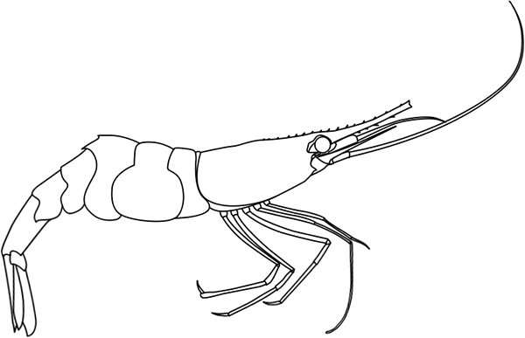
Animals on Treadmills
NATIONAL CENTER FOR CASE STUDY TEACHING IN SCIENCE
A Presentation to Accompany the Case Study:
Critical Thinking and Public Perception Of Science
Will Run 4 Science
^{by}
Kylee Grenis, Whitley R. Lehto, Shannon M. Murphy, Mayra C. Vidal, and Robin M. Tinghitella Department of Biological Sciences University of Denver, Denver, CO

Slide 2
What is Research?
Systematic study directed toward fuller scientific knowledge or understanding of the subject studied.
Research is classified as either applied or basic according to the objectives of the sponsoring agency.

Slide 3
Applied Research
Systematic study to gain knowledge or understanding necessary to determine the means by which a recognized and specific need may be met.
Solving problems
Examples in Ecology: conservation biology, global change, pollution, wildlife & habitat management, aquatic resources, restoration ecology, and management of pests, weeds and disease

Slide 4
Basic Research
Systematic study directed toward fuller knowledge or understanding of the fundamental aspects of phenomena and of observable facts without specific applications towards processes or products in mind.
Exploring for Exploring’s Sake
Examples in Ecology: natural history, biodiversity inventories, predation, population dynamics, herbivory, etc.

Slide 5
Basic Research
Although basic research does not aim to solve a problem, it can produce discoveries that unexpectedly contribute to a variety of scientific disciplines.
Example: Thomas Brock, Taq polymerase, & PCR
Thermophilic bacteria found in the hot springs of Yellowstone National Park: Thermus aquaticus
DNA Polymerase isolated from T. aquaticus (Taq polymerase) critical to the success of DNA amplification via Polymerase Chain Reaction (PCR) in 1980
(Brock and Freeze 1969)
Notes:
Brock characterized thermophilic bacteria in the hot springs of Yellowstone National Park, one of which was named Thermus aquaticus in the 1960s
DNA Polymerase isolated from T. aquaticus (Taq polymerase) was critical to the success of DNA amplification via Polymerase Chain Reaction in 1980

Slide 6
How do we do research?
Start with a Research Question: A research question is based on what we can see or measure.
Example: How does the amount of light affect growth in shade tolerant versus intolerant plants?
Is this an applied or basic research question?
Notes:
Start with a research question based on our direct observation. Develop hypotheses to explain/predict what the answer to the question could be.

Slide 7
How do we do research?
Form a Hypothesis: A hypothesis is a proposed answer to the research question based on considerable prior experience, scientific background knowledge, preliminary observations, and logic.
A hypothesis must be testable.
Example: Plants that are more shade-tolerant may experience increased growth rates in low-light conditions compared to plants that are not shade-tolerant.
Notes:
Start with a research question based on our direct observation. Develop hypotheses to explain/predict what the answer to the question could be.

Slide 8
Proximate and Ultimate Causes
Research questions and hypotheses might aim to explain proximate and/or ultimate causes for the phenomenon of interest.
Proximate causes are mechanistic and answer the “how”.
concerned with the environmental stimuli and the underlying genetic, physiological, developmental, and anatomical mechanisms
Ultimate causes address evolutionary significance and answer the “why”.
concerned with selection (natural/sexual), fitness
Notes:
There are two types of questions, proximate questions are more mechanistic and focus on understanding things like the stimuli that trigger a behavior, the genetic, physiological, and anatomic mechanisms that underlie behaviors. They are how questions like how do female sticklebacks recognize appropriate mates? How do honeybees know where to go to get food? How is navigation behavior controlled genetically? Etc. We commonly call them How questions, but that doesn’t mean the question always starts with the word how.
Ultimate questions are why questions that address the evolutionary significance of something. For instance, questions like why do oystercatchers choose the size mussels that they do? Because it maximizes energy gain per effort – and energy gain is translated into offspring. Why do whales migrate from one part of the world to another? Because they’re following areas of high prey availability. Commonly called why questions, but that doesn’t mean they always start with the word why.
There also may be proximate and ultimate answers to the same question. For instance, why do I love to eat cookie dough? The proximate answer is that it tastes good. But that is not a satisfying answer – why does it taste good? The ultimate answer is that over evolutionary time, my species has been limited in fats and sugars so I crave those resources in my diet.
8

Slide 9
Animals on Treadmills: A Case Study
The following videos depict research performed by scientists.
As you watch, start to think about basic and applied research questions that might be addressed by these “animals on treadmills”.
Notes:
Start with a research question based on our direct observation. Develop hypotheses to explain/predict what the answer to the question could be.

Slide 10
Animals on Treadmills: Puma
https://youtu.be/G3c1SpV6jvE
Notes:
Pumas are commonly called both Mountain Lions and Cougars, but they all refer to the same animal.
Video is at:
https://youtu.be/G3c1SpV6jvE
(The video is best shown muted. The sound quality is poor and is not necessary, so it may be turned off.)

Slide 11
Animals on Treadmills: Shrimp
https://youtu.be/BUe78awZMT0
Notes:
Video is at:
https://youtu.be/BUe78awZMT0
(The video is best shown muted. The sound is not necessary, so it may be turned off.)

