Slide 1
Yeast Cryptography:
A Budding New Way to Keep Your Dough
NATIONAL CENTER FOR CASE STUDY TEACHING IN SCIENCE
by
Brian K. Sato, Eduardo Cruz-Hinojoza, and Duyen Dinh-Dang
Department of Molecular Biology and Biochemistry
University of California, Irvine, CA

Slide 2
Learning Objectives
Describe the steps necessary to insert exogenous DNA into the yeast genome.
Explain the impact of blunt versus sticky end restriction digests on the cloning procedure.
Design a transformation experiment with the appropriate selection marker and selective media.
Define a negative control.
Describe how Sanger sequencing works and be able to translate sequencing data into a specific DNA sequence.
Notes:
Picture that represents learning

Slide 3
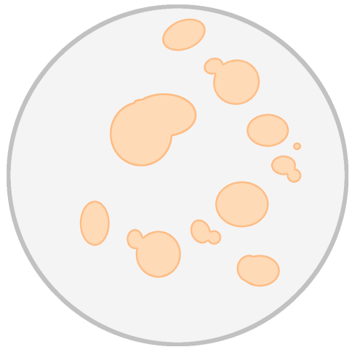
Patented Yeast Design
You are part of a Yeastly Corp team that has discovered a mutant strain of baker’s yeast (Saccharomyces cerevisiae), named HiRise, which makes bread extra fluffy. Yeastly Corp immediately files a patent for your team’s discovery.
The company CEO is concerned a competing company may repackage HiRise and sell it as their own. She tasks your group with finding a way to label the yeast strain as company property.
HiRise

Slide 4
Discussion Question 1 (DQ1): With your neighbors, discuss how you could “label” your yeast strain.
Notes:
Science picture

Slide 5
Clicker Question 1 (CQ1): Which of the following would be the best option to successfully label your yeast?
Add a generic DNA stain to the yeast cells.
Insert a specific (non-coding) DNA sequence into the yeast genome.
Add a GFP tag to the DNA polymerase IV gene.

Slide 6
You present the CEO with the following two-level security plan.
HiRise will be modified to contain:
A particular DNA sequence hidden inside its genome.
A message hidden in that sequence that only your company _knows.

Slide 7
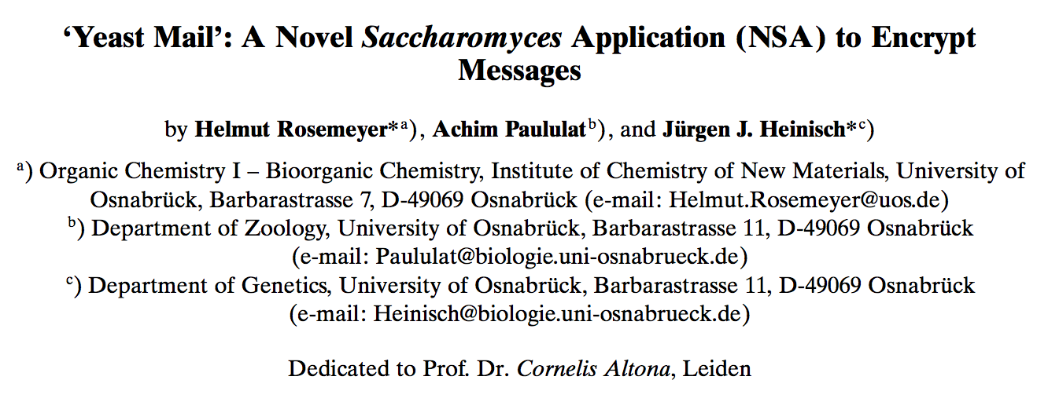
DNA Cryptography
Utilize DNA nucleotides to generate a coded message that both sender and receiver can decipher.
Insert this sequence into an organism’s genome.

Slide 8
DQ2: Design an experiment that would allow you to insert a specific double stranded DNA sequence (using homologous recombination) into the genome of HiRise yeast.

Slide 9
Insertion of Coded Message into HiRise
Oligonucleotide synthesis
The sequence of interest needs to be surrounded by restriction enzyme (RE) sites to insert it into a plasmid.
GAATTC
Oligonucleotide containing sequence
GAATTC
CTTAAG
CTTAAG
Restriction Enzyme sequences

Slide 10
Insertion of Coded Message into HiRise
Oligonucleotide synthesis
Cloning of oligonucleotide into a plasmid
GAATTC
Oligonucleotide containing sequence
GAATTC
CTTAAG
CTTAAG
Identical restriction enzyme sequences

Slide 11
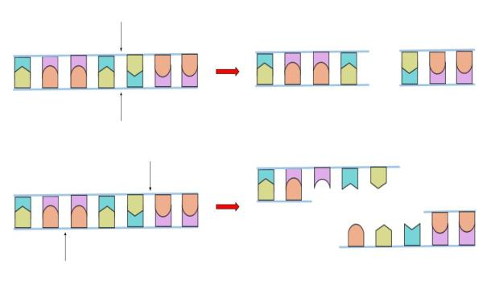
CQ2: Would we prefer to use blunt end or sticky end RE sites for the cloning?
Sticky
Blunt
Either would work the same.

Slide 12
CQ3: Why?
These ends make the RE digestion more efficient.
These ends mean the cloning does not require DNA ligase.
These ends make the ligation procedure more efficient.

Slide 13
Insertion of Coded Message into HiRise
Oligonucleotide synthesis
Cloning of oligonucleotide into a plasmid
The plasmid must contain sequences homologous to the yeast genome (where we want the message inserted).
Oligonucleotide containing sequence (500bp)
Plasmid
500bp
Homologous Recombination
Yeast Genome
2kb
Yeast Genome

Slide 14
Insertion of Coded Message into HiRise
Oligonucleotide synthesis
Cloning of oligonucleotide into a plasmid
Transformation of the ligated plasmid into bacteria

Slide 15
CQ4: Why do we need to transform the plasmid into bacteria?
Because the bread making strain is a bacterium.
To complete the ligation process.
To produce more of our plasmid.

Slide 16
CQ5: The oligonucleotide and plasmid (containing an ampicillin resistance gene) are digested by the same RE and added together with DNA ligase. This mix is transformed into ampicillin-sensitive bacteria and plated on LB with ampicillin media. As a control, bacteria without the transformation mix are also plated on the same media. The colony growth on each plate is seen below. Based on these results, which of the following is the best conclusion?
Plasmid acquisition is essential for bacterial survival on ampicillin containing media.
All colonies from the “ligation mix” transformation likely have your cloned oligonucleotide.
Spontaneous resistance to ampicillin can occur.
It is possible for the bacteria to acquire the oligonucleotide but not the plasmid.
Bacteria transformed with:
No DNA (control)
Ligation Mix

Slide 17
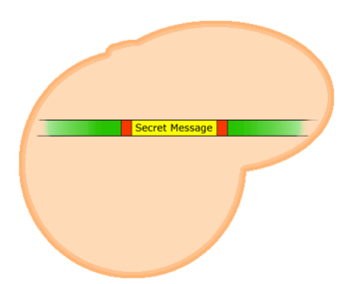
Insertion of Coded Message into HiRise
Oligonucleotide synthesis
Cloning of oligonucleotide into a plasmid
Transformation of the ligated plasmid into bacteria
Plasmid extraction from bacteria and transformation into HiRise
HiRise

Slide 18
Insertion of Coded Message into HiRise
Oligonucleotide synthesis
Cloning of oligonucleotide into a plasmid
Transformation of the ligated plasmid into bacteria
Plasmid extraction from bacteria and transformation into HiRise
Confirmation of correct integration of DNA sequence into the HiRise genome

Slide 19
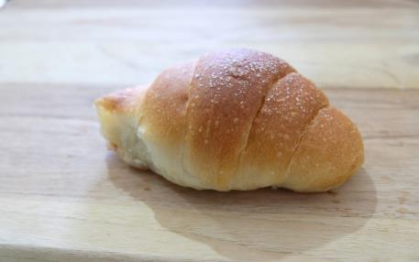
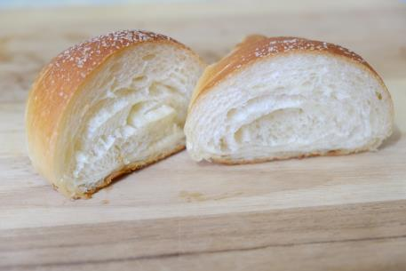
Six months later, Wyse Bioengineering claims they have independently isolated their own strain of baker’s yeast, which they call FluffMax, that makes equally fluffy bread.
You bring them to patent court as you believe they have stolen your company’s yeast strain. The judge asks that you present proof that their “new” yeast strain is in fact HiRise.

Slide 20
CQ6: Which of the following experiments might allow you to differentiate between HiRise yeast and a wild type S. cerevisiae strain? More than one answer may be correct.
Perform a PCR experiment at the genomic site where the oligonucleotide sequence was integrated and run the PCR product on a gel.
Perform a restriction enzyme digest on the genomic DNA and run the fragmented DNA on a gel.
Sequence the region of the genome where the oligonucleotide sequence was integrated.

Slide 21
CQ7: You plan to test the HiRise yeast and the competitor’s FluffMax, but you also need to include a negative control. Which of the following would best serve as a negative control?
Wild type S. cerevisiae
Bacterial DNA from the strain used in the cloning procedure
A different yeast strain that you also marked with the same integrated DNA
A different species of bread-making yeast

Slide 22
DQ3: Your group extracts genomic DNA from the control strain, from HiRise, and from FluffMax and performs a PCR reaction with primers that bind the DNA surrounding the site where the oligonucleotide containing DNA was inserted. If FluffMax is in fact stolen HiRise, draw the results from the experiment on the gel below.
Ladder Control HiRise FluffMax
2000
2kb
1000
Wild Type Yeast
500
400
500bp
300
200
HiRise Yeast
100

Slide 23
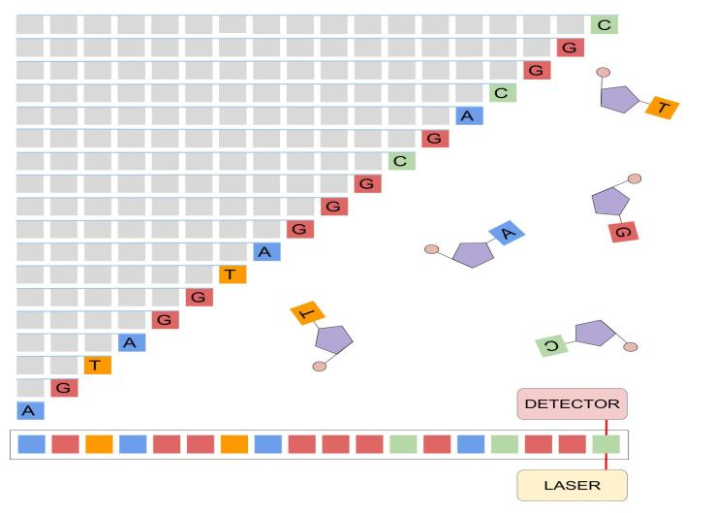
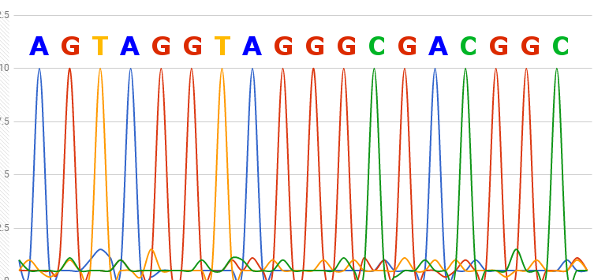
As added confirmation of your claim, your group uses Sanger sequencing to decode the message hidden in the yeast genome.

Slide 24
DQ4: The following chromatogram is obtained from the sequencing reaction. Using the key below, what message did you integrate into the yeast genome?
Key
A | AAA |  | J | GGG |  | S | TTT
B | AAT |  | K | GGA |  | T | TTC
C | AAG |  | L | GGT |  | U | TTA
D | AAC |  | M | GGC |  | V | TTG
E | ATT |  | N | GAA |  | W | TGT
F | ATG |  | O | GAC |  | X | TGA
G | ATC |  | P | GAT |  | Y | TGG
H | AGT |  | Q | GTT |  | Z | TAA
I | AGG |  | R | GTA |  | (SPACE) | TAG

Slide 25
Congratulations! You have won your case and as a reward, your CEO has given you unlimited HiRise fluffy bread for a full year!

