Slide 1
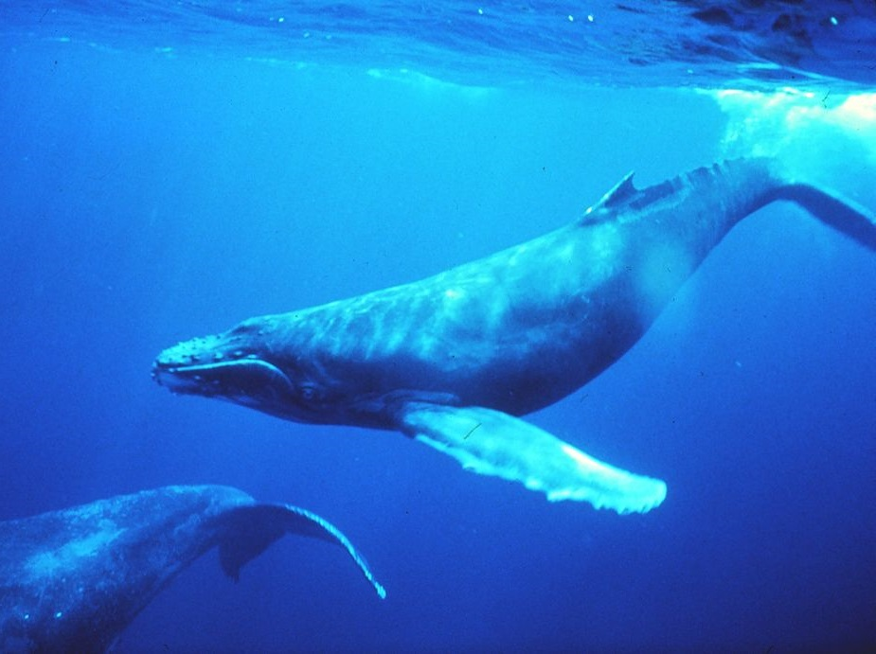
A Whale of a Tale? The Evidence for the Evolution of Whales
by Gabriel D. McNett
Department of Biology & Environmental Science Westminster College, Fulton, MO
NATIONAL CENTER FOR CASE STUDY TEACHING IN SCIENCE
Notes:
Image credit:
Description: Humpback whale in singing position, near Hawaiian Islands.
Source: Wikimedia Commons, from NOAA http://www.photolib.noaa.gov/htmls/sanc0602.htm
Author: Dr. Louis M. Hermin
Clearance: Public domain

Slide 2
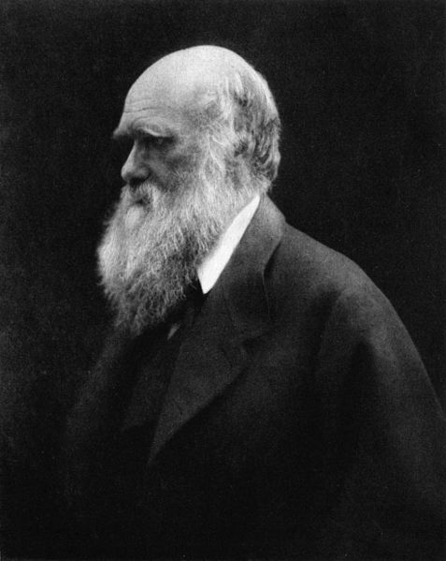
“In North America the black bear was seen by Hearne swimming for hours with widely open mouth, thus catching, like a whale, insects in the water. Even in so extreme a case as this, if the supply of insects were constant, and if better adapted competitors did not already exist in the country, I can see no difficulty in a race of bears being rendered, by natural selection, more and more aquatic in their structure and habits, with larger and larger mouths, till a creature was produced as monstrous as a whale.”
Charles Darwin (1859), Origin of Species
Notes:
Image credit:
Description: Charles Darwin, 1868
Source: Wikimedia Commons, Reprinted in Charles Darwin: His Life Told in an Autobiographical Chapter, and in a Selected Series of His Published Letters, edited by Francis Darwin. London: John Murray, Albemarle Street. 1892. http://commons.wikimedia.org/wiki/File:Charles_Darwin_by_Julia_Margaret_Cameron_2.jpg
Author: Julia Margaret Cameron
Clearance: Public domain

Slide 3
“The absence of unambiguous transitional fossils is strikingly illustrated by the fossil record of whales … If whales did have land mammal ancestors, we should expect to find some transitional fossils. Why? Because the anatomical differences between whales and terrestrial mammals are so great that innumerable in-between stages must have paddled and swam the ancient seas before a whale as we know it appeared. So far these transitional fossils have not been found.”
Davis and Kenyon (1989), Of Pandas and People

Slide 4
Is the evolution of whales from land-dwelling ancestors supported by evidence, or is it just a whale of tale?

Slide 5
CQ#1: Which statement best describes your understanding of the origin of whales?
Whales were created in their current form and did not evolve from four-legged, terrestrial (land-dwelling) ancestors.
Whales evolved from four-legged, terrestrial ancestors over millions of years.
Whales evolved, but only in terms of adapting to a changing environment; they did not evolve from a terrestrial creature.

Slide 6
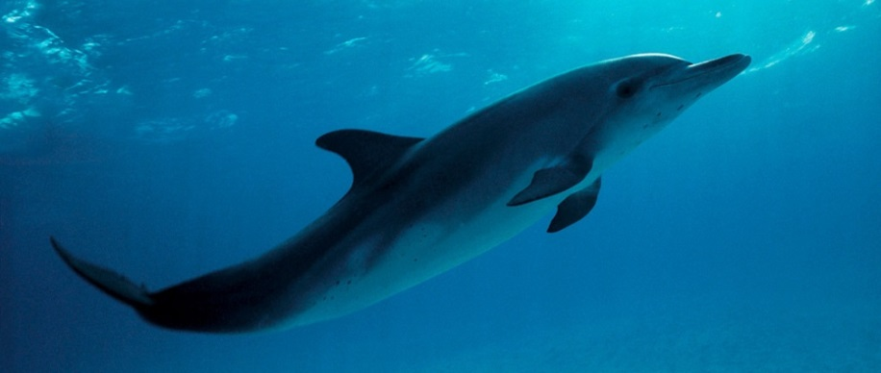
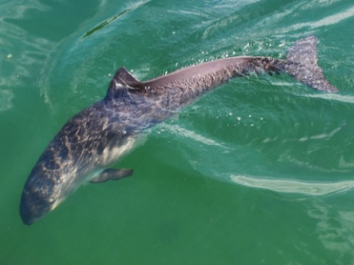
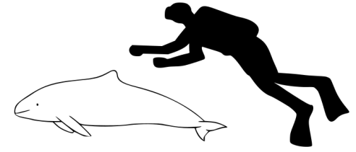
Introduction to Order Cetacea
(whales, dolphins, porpoises, and relatives)
Highly specialized for aquatic lifestyle
Most are marine, some live in freshwater
Many are highly intelligent and social
Broadly separated into “toothed whales” and “baleen whales”
Whales (blue whale)
Dolphins (Atlantic spotted dolphin)
Porpoises (Harbour porpoise)
Notes:
Image credits:
Top:
Description: Size comparison of an average human and a blue whale (Baleaenoptera musculus).
Source: Wikimedia Commons, http://commons.wikimedia.org/wiki/File:Blue_whale_size.svg
Author: Kurzon
Clearance: GNU Free Documentation License, Version 1.2 or later
Middle:
Description: Juvenile Atlantic spotted dolphin (Stenella frontalis)
Source: Wikimedia Commons, Dolphind
Author: sheilapic76
Clearance: Creative Commons Attribution 2.0 Generic license.
Bottom, left
Description: Fjord & Bæltcentret i Kerteminde - Denmark. The Harbor Porpoise (Phocoena phocoena) is one of six species of porpoise
Source: Own work
Author: Erik Christensen
Clearance: Creative Commons Attribution-Share Alike 3.0 Unported license.
Bottom, right
Description: Size comparison of an average human and a harbour porpoise (Phocoena phocoena)
Source: Own work
Author: Chris_huh
Clearance: GNU Free Documentation License, Version 1.2 or later

Slide 7
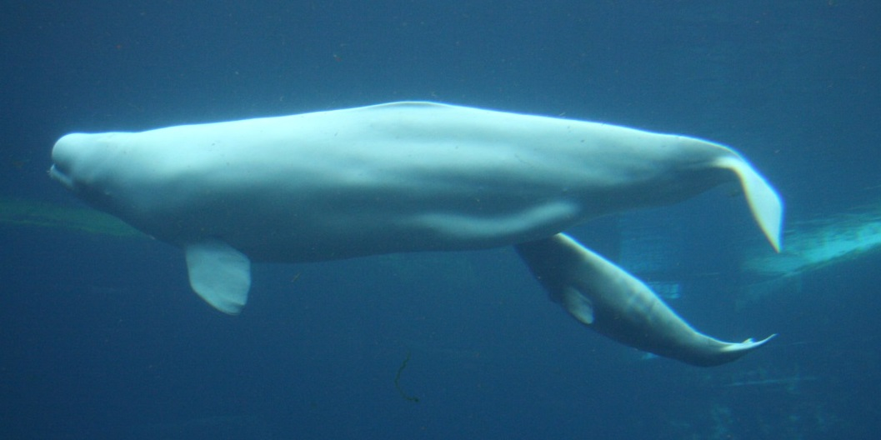
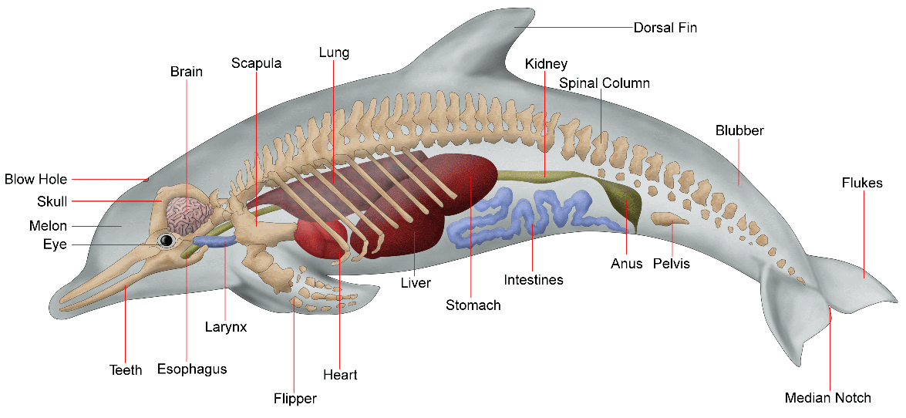
Clearly Not Fish: Whales Are Mammals
Warm-blooded
Have hair, lungs, placenta, & produce milk
Bear live young
Two nasal passages (with 1 or 2 blowholes)
Have arm, wrist, & finger bones, & some with vestigial pelvis / legs
Tale moves vertically
Notes:
Image credits:
Top:
Description: Beluga whale nursing calf
Source: Wikipedia Commons, https://commons.wikimedia.org/wiki/File:Delphinapterus_leucas_16.jpg
Author: http://www.flickr.com/photos/iwona_kellie/
Clearance: cc-by-2.0
Bottom:
Description: Dolphin anatomy
Source: Wikipedia Commons, w:en; http://commons.wikimedia.org/wiki/File:Dolphin_anatomy.png
Modifications: cropped
Author: WikipedianProlific
Clearance: GNU Free Documentation License version 1.2 or later

Slide 8
CQ#2: If you could imagine a “missing link” for whale evolution, how might you describe its appearance?
Half whale, half land animal.
Like a whale or fish, but with legs.
Like a land animal, such as a bear, wolf, or hippo.
None of the above.

Slide 9
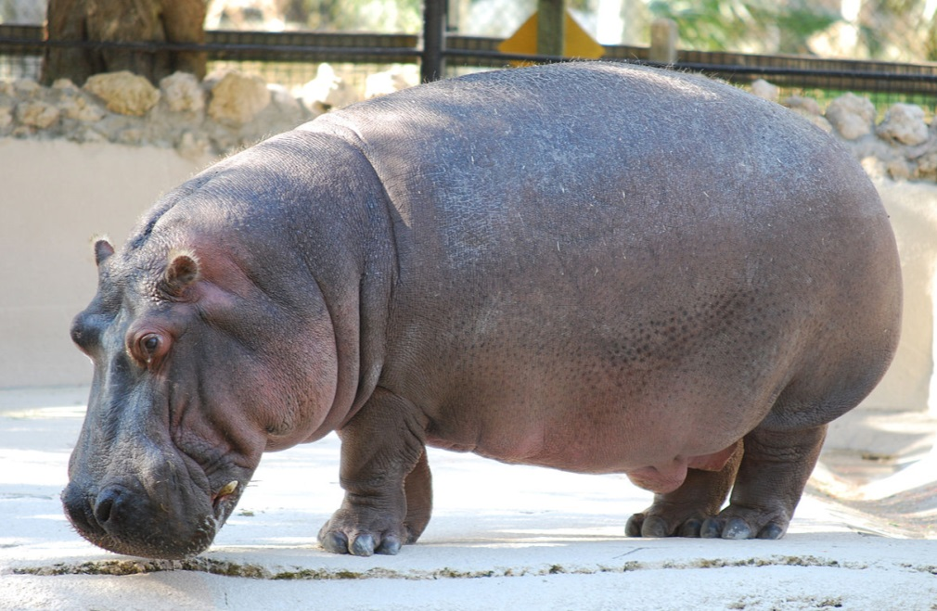
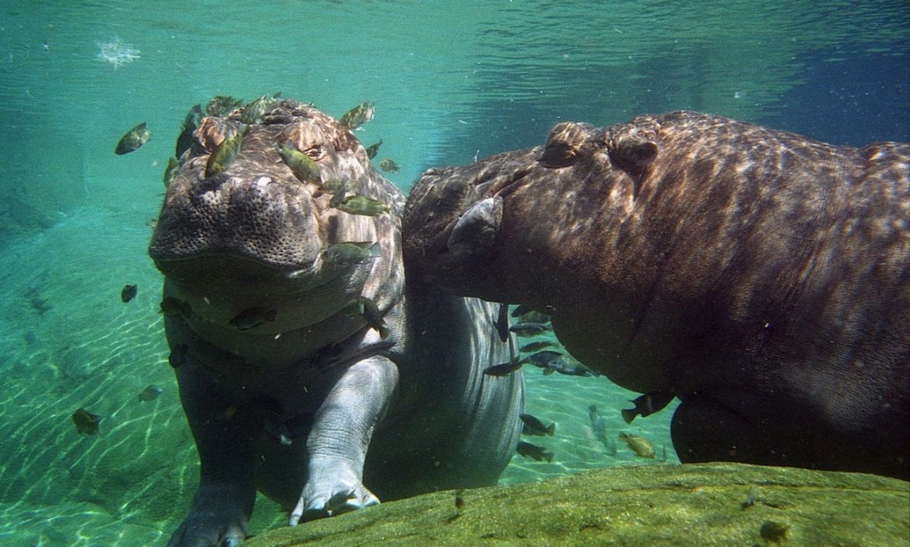
First, meet the closest living relative of whales
Notes:
Image credits:
Left:
Description: Hippopotamus amphibious – Homosassa Springs Wildlife State Park, Florida – 2010-01-13.
Source: Wikimedia Commons; Own work; http://commons.wikimedia.org/wiki/File:Hippopotamus_amphibius_-_Homosassa_Springs_Wildlife_State_Park,_Florida_-_2010-01-13.jpg
Author: Micha L. Rieser
Clearance: GNU Free Documentation License version 1.2 or later
Right
Description: Two Hippopotamus at San Diego Zoo, California, USA.
Source: Wikimedia Commons; Hippos; Uploaded by Snowmanradio; http://commons.wikimedia.org/wiki/File:Hippopotamus_amphibius_-San_Diego_Zoo,_California,_USA_-under_water-8a.jpg
Author: Brian Snelson from Hockley, Essex, England
Clearance: Creative Commons Attribution 2.0 Generic license

Slide 10
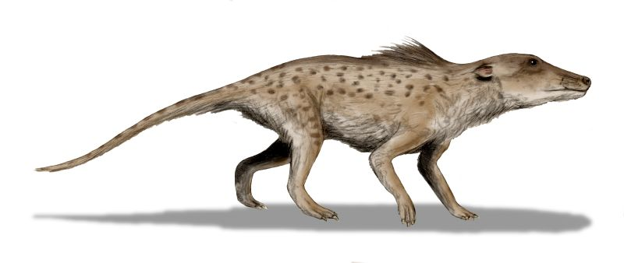
The Earliest Cetacean?
Pakicetus species
wolf size, terrestrial / semi-aquatic
brain case shows clear connections to cetaceans
teeth suggest carnivory; molars similar to terrestrial vertebrate, premolars whale-like
terrestrial, near-stream habitat; likely ventured in water to hunt fish
~ 48-52 million years ago (mya)
(artist reconstruction)
Notes:
Image credits:
Top
Description: Pakicetus inachus, a whale ancestor from the Early Eocene of Pakistan, after Nummelai et al., (2006), pencil drawing, digital coloring
Source: Wikimedia Commons; Own work; http://commons.wikimedia.org/wiki/File:Pakicetus_BW.jpg
Modifications: flipped horizontally
Author: Nobu Tamura (http://spinops.blogspot.com)
Clearance: GNU Free Documentation License version 1.2 or later
Bottom left:
Description: Skeletons of the pakicetid cetaceans Pakicetus (a) and Ichthyolestes (b).
Source: Figure 2 in Thewissen et al. 2001
Author: Thewissen et al. 2001
Clearance: Reprinted by permission from Macmillan Publishers Ltd: Nature (Thewissen, J. G. M., E. M. Williams, L.J. Roe., and S. T. Hussain. 2001. Skeletons of terrestrial cetaceans and the relationship of whales to artiodactyls. Nature, 413: 277-281), copyright 2001.

Slide 11
A Whale of a Tale?
?
Modern whales (blue whale)
Pakicetus
Notes:
Image credits:
Left:
Description: Pakicetus inachus, a whale ancestor from the Early Eocene of Pakistan, after Nummelai et al., (2006), pencil drawing, digital coloring
Source: Wikimedia Commons; Own work; http://commons.wikimedia.org/wiki/File:Pakicetus_BW.jpg
Modifications: flipped horizontally
Author: Nobu Tamura (http://spinops.blogspot.com)
Clearance: GNU Free Documentation License version 1.2 or later
Right:
Description: Size comparison of an average human and a blue whale (Baleaenoptera musculus).
Source: Wikimedia Commons, http://commons.wikimedia.org/wiki/File:Blue_whale_size.svg
Author: Kurzon
Clearance: GNU Free Documentation License, Version 1.2 or later

Slide 12
Importance of Fossils
Fossils can provide a great deal of information:
Complete skeletons are rare, but even a single bone can yield important information
Fossils can reveal more than just age, anatomy, and identity …
… also diet, locomotion, senses, physiology, habitat, and more!

Slide 13
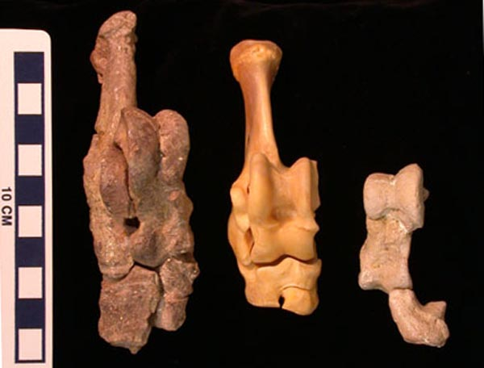
Importance of Fossils
For example, one bone shows whales are artiodactyl mammals.
Artiodactyla = Taxonomic group that includes all even-toed ungulates (e.g., pronghorns, hippos, deer, camels, giraffes, sheep, more)
Pronghorn
Astragalus: ankle bone, “double-pulley” shape (boxes) unique to artiodactyls.
Also found in fossil whales.
Therefore, whales are artiodactyl mammals.
Fossil whales
Notes:
Image credits:
Description: Ankle bones of middle Eocene protocetid archaeocetes, Rodhocetus balochistanensis (left) and Artiocetus clavis (right) from Pakistan, compared to those of the pronghorn Antilocapra americana (center).
Source: Figure 8 from the following website: http://www-personal.umich.edu/~gingeric/PDGwhales/Whales.htm;
Modifications: Text, arrows, and boxes added.
Author: Gingerich, P.
Clearance: copyright 2001 by Gingerich, P; figure can be reproduced for non-profit educational use.
Figure text:
“Ankle bones of middle Eocene protocetid archaeocetes Rodhocetus balochistanensis (left) and Artiocetus clavis (right) from Pakistan, compared to those of the pronghorn Antilocapra americana (center). Note double-pulleyed astragalus, notched cubloid, and prominent fibular facet on the calcaneum (not preserved in Artiocetus), which are characteristic of mammals of the order Artiodactyla. These fossil specimens, preserved as parts of associated skulls and skeletons of protocetid archaeocetes, show that early whales shared a common ancestry with artiodactyls. Skull of the Artiocetus specimen is shown in Fig. 7. Scale is in cm. Photograph ©2001 Philip Gingerich. Figure may be reproduced for non-profit educational use.”
“At left, the ankle bones of two middle Eocene protocetid archaeocetes, Rodhocetus balochistanensis (left) and Artiocetus clavis (right) from Pakistan, compared to those of the pronghorn Antilocapra americana (center). At right, the ankle region and foot of Basilosaurus. The pulley part of the astragalus (outlined) connects to the tibia and fibula.“

Slide 14
Understanding the Pattern of Evolution
Analogy: Using the terms below sketch a diagram you believe best represents the relationships.
Aunt
You
Grandparents
Cousin #1
Parents
Sibling
Cousin #2
Notes:
Need to emphasize 1) some relationships are direct, or ‘vertical’, while others are ‘horizontal,’ and 2) some individuals are alive at the same time.

Slide 15
CQ#3: Which diagram best resembles the sketch / relationships you envisioned?
A.
B.
You
Sibling
You
Cousin 1
Cousin 2
Parents
Cousin 2
Sibling
Aunt
Parents
Aunt
Cousin 1
Grandparents
Grandparents
C.
Grand-
parents
Parents
Aunt
Cousin 1
Cousin 2
Sibling
You

Slide 16
Consider the Fossil Record
?
Modern whales (blue whale)
Pakicetus
Notes:
Image credits:
Left:
Description: Pakicetus inachus, a whale ancestor from the Early Eocene of Pakistan, after Nummelai et al., (2006), pencil drawing, digital coloring
Source: Wikimedia Commons; Own work; http://commons.wikimedia.org/wiki/File:Pakicetus_BW.jpg
Modifications: flipped horizontally
Author: Nobu Tamura (http://spinops.blogspot.com)
Clearance: GNU Free Documentation License version 1.2 or later
Right:
Description: Size comparison of an average human and a blue whale (Baleaenoptera musculus).
Source: Wikimedia Commons, http://commons.wikimedia.org/wiki/File:Blue_whale_size.svg
Author: Kurzon
Clearance: GNU Free Documentation License, Version 1.2 or later

Slide 17
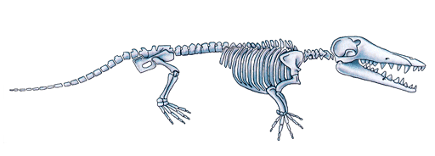
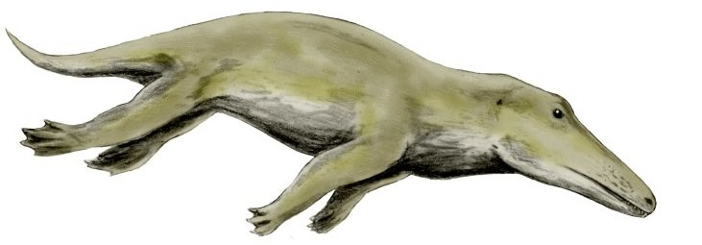
Ambulocetus natans
(“walking whale that swims”)
About size of large sea lion; large head, large hind feet.
Could walk (inefficiently) and also swim.
Likely swam with spine undulation and hind-feet propulsion (mix between seal or otter & whale).
Teeth intermediate, slightly more whale-like.
Elbows, wrists, digits flexible (terrestrial feature).
Lived in coastal marine environment.
~ 49 mya
Notes:
Image credits:
Top:
Description: Reconstruction of Ambulocetus.
Source: Wikimedia Commons; https://upload.wikimedia.org/wikipedia/en/archive/5/51/20070602133507!Whale_legs.png
Modifications: Flipped horizontally and cropped
Author: Unknown
Licensing: GNU Free License version 1.2 or later
Bottom:
Description: Ambulocetus natans, a primitive whale from the Eocene of Pakistan, pencil drawing, digital coloring
Source: Wikimedia Commons; Own work; http://commons.wikimedia.org/wiki/File:Ambulocetus_BW.jpg
Modifications: flipped horizontal and rotated slightly
Author: Nobu Tamura
Licensing: GNU Free License version 1.2 or later

Slide 18
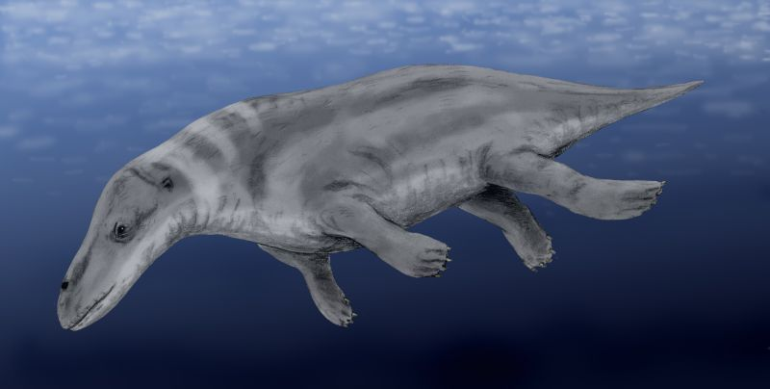
Rodhocetus kasrani
~ 46-47 mya
Reduced hind limbs, likely webbed toes.
Limb/trunk swimmer with longer, more flexible vertebral column.
Shallow, offshore marine habitat, but could support weight on land.
Likely had a mandibular fat pad for underwater hearing.
Nostrils higher and farther back.
Notes:
Image credits:
Top:
Description: Skeleton of Rodhocetus kasrani
Source: Figure 1 from Gingerich et al. 1994, Nature 368: 844-847.
Modifications: cropped to show only part (a)
Clearance: Reprinted by permission from Macmillan Publishers Ltd: [Nature] Gingerich, P.D., S. M. Raza, M. Arif, M. Anwar, and X. Zhou. 1994. New whale from the Eocene of Pakistan and the origin of cetacean swimming. Nature, 368: 844-847, copyright (1994).
Bottom:
Description: Rodhocetus kasrani, an archaeoceti whale from the Eocene of Pakistan, digital (reconstruction)
Source: Wikimedia Commons; Own work; http://commons.wikimedia.org/wiki/File:Rhodocetus_BW.jpg
Author: Nobu Tamura
Clearance: GNU Free License version 1.2 or later

Slide 19
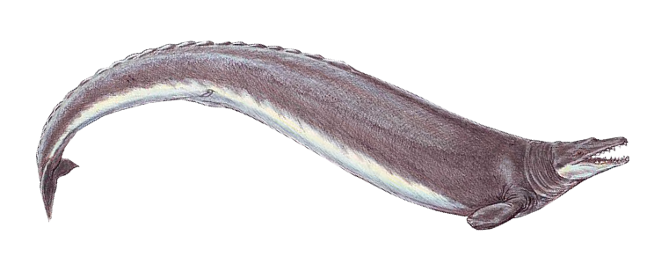
Basilosaurus species
Discovered in 1832, initially thought to be a giant lizard.
Unusually long (~56 feet), clearly aquatic, trunk swimmer.
Hind limbs nearly complete but highly reduced & isolated from spine; possibly used for mating (for clasping?).
Single nostril, more retracted but still intermediate.
Likely had large mandibular fat pad.
~ 38 mya
Notes:
Image credits:
Top:
Description: Basilosaurus (reconstruction)
Source: Wikimedia Commons; File:Basilosaurus1DB.jpg; http://commons.wikimedia.org/wiki/File:Basilosaurus_cropped.png
Author: Dmitry Bogdanov, dmitrchel@mail.ru
Clearance: Creative Commons Atribution-Share Alike 3.0 Unported
Bottom:
Description: Skeleton of Basilosaurus as reconstructed by Gidley 1913
Source: Gidley, J. W. (1913). "A recently mounted Zeuglodon skeleton in the United States National Museum". Proceedings of the U. S. National Museum (Washington) 44: 649–654.
Author: James William Gidley
Clearance: Public domain (published in the US before 1923)

Slide 20
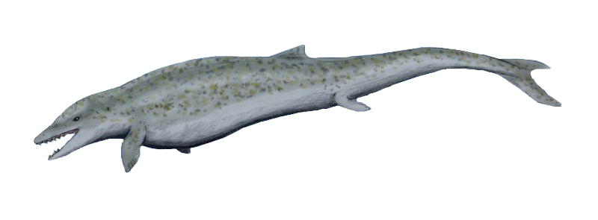
Dorudon species
Fully marine, close relative to all modern whales.
Hindlimbs greatly reduced, detached from spine.
Forelimbs: hands as flippers; elbows still slightly flexible.
Caudal vertebrae flattened, consistent with tail fluke.
Nostrils farther back.
Teeth simple, more whale-like.
~ 37 mya
Notes:
Image credits:
Top:
Description: Dorudon (reconstruction)
Source: Wikimedia Commons; File:DorudonBW.jpg; http://commons.wikimedia.org/wiki/File:Dorudon_cropped.png
Modifications: flipped horizontally
Author: Nobu Tamura email:nobu.tamura@yahoo.com www.palaeocritti.com
Clearance: Creative Commons Attribution-Share Alike 3.0 Unported
Bottom:
Description: Skeleton of the protocetid Dorudon atrox
Source: Figure 6 from Thewissen, J. G. M., and S. Bajpai. 2001. Whale origins as a poster child for macroevolution. BioScience, 51(12): 1037-1049.
Clearance: Used with permission of Oxford University Press.

Slide 21
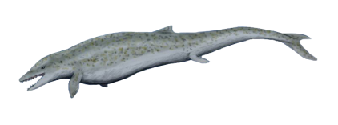
CQ#4: Which diagram do you believe best represents the relationships among fossil whale species and modern whales?
A.
Pakicetus
Ambulocetus
Dorudon
Modern whales
B.
C.
Notes:
Image credits:
Top, left:
Description: Pakicetus inachus, a whale ancestor from the Early Eocene of Pakistan, after Nummelai et al., (2006), pencil drawing, digital coloring
Source: Wikimedia Commons; Own work; http://commons.wikimedia.org/wiki/File:Pakicetus_BW.jpg
Modifications: flipped horizontally
Author: Nobu Tamura (http://spinops.blogspot.com)
Clearance: GNU Free Documentation License version 1.2 or later
Second from top left:
Description: Ambulocetus natans, a primitive whale from the Eocene of Pakistan, pencil drawing, digital coloring
Source: Wikimedia Commons; Own work; http://commons.wikimedia.org/wiki/File:Ambulocetus_BW.jpg
Modifications: flipped horizontal and rotated slightly
Author: Nobu Tamura
Clearance: GNU Free License version 1.2 or later
Third from top left:
Description: Dorudon (reconstruction)
Source: Wikimedia Commons; File:DorudonBW.jpg; http://commons.wikimedia.org/wiki/File:Dorudon_cropped.png
Modifications: flipped horizontally
Author: Nobu Tamura email:nobu.tamura@yahoo.com www.palaeocritti.com
Clearance: Creative Commons Attribution-Share Alike 3.0 Unported
Far right, top:
Description: Size comparison of an average human and a blue whale (Baleaenoptera musculus).
Source: Wikimedia Commons, http://commons.wikimedia.org/wiki/File:Blue_whale_size.svg
Author: Kurzon
Clearance: GNU Free Documentation License, Version 1.2 or later

Slide 22
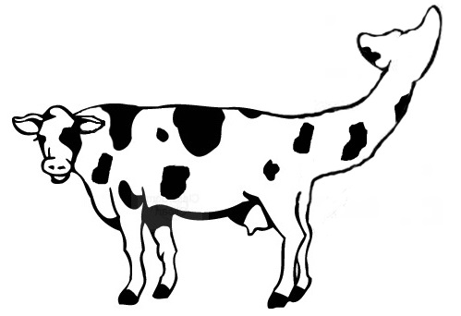
Why Is “Missing Link” a False Concept?
Umm … is this a “wow”?
Notes:
Image credits:
Description: Modified clip art.

Slide 23
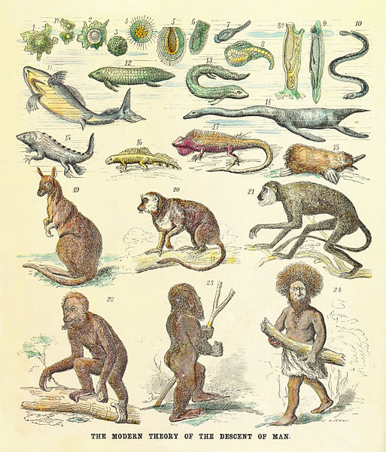
Evolution Is Not a Great Chain of Being
Ancient, erroneous idea that portrays organisms in a linear, rank order.
Evolution does not imply “linear” progress towards a particular goal.
The descent of man as a “Great Chain of Being” by Ernst Haeckel, 1874
Notes:
Image credits:
Description: The modern theory of the descent of man, published in Anthropogenie oder Entwicklungsgeschichte des Menschen (The Evolution of Man),1874. The figure show the human pedigree as a Great Chain of Being, illustrated by modern and fossil species.
Source: Wikimedia Commons; http://commons.wikimedia.org/wiki/File:Human_pidegree.jpg
Author: Petter Bøckman
Clearance: Public domain
Legend: 1 Amoeba; 1a Asexual reproduction (amoeba dividing); 2 Sexual reproduction (cell with spore); 3 Multi-cellular organism (early embryonic stage); 4 Muliticellular organism with three germ layers (blastula); 5 Organism with primitive mouth (gastrula); 6 Planaria; 7 Worm (leech); 8 Primitive chordate (tunicate larva); 8a Adult tunicate; 9 Lancelet; 10 Jawless fish (lamprey); 11 Cartilaginous fishes (shark); 12 Australian lungfish; 13 South American lungfish; 14 Aquatic reptile (plesiosaur); 15 Early amphibian (labytinthodont); 16 Modern amphibian (newt); 17 Reptile (iguana); 18 Monotreme (platypus); 19 Marsupial (kangaroo); 20 Prosimian (lemur); 21 Monkey (langur); 22 Ape (orangutan); 23 Ape-man (Pithecanthropus); 24 Modern human (a Papuan)
Date: 29 February 2012
Source: Own work
Author: Petter Bøckman
License: Public domain

Slide 24
Depicting Evolution as a Branching Process
Sister taxa
(e.g., B & C)
Terminal nodes, “tips,”
(or terminal taxa)
A
B
C
D
E
F
G
*
**
The evolution of a particular trait is often marked with a hash.
Branch, or
lineage
Internal nodes
(= an ancestor of 2 lineages)
Time
* = common ancestor of E & F
** = common ancestor of (E&F) & G
Root
Notes:
A-G are hypothetical taxa that as represented in the phylogeny, are still extant (presently alive).
Imagine grabbing a tree at any point and “cutting” the branch below your hand. You would be holding a “clade” in your hand (a twig and all the branches that sprouted from it; or a lineage and all of its descendants). In family genealogy terms you would have a “family group.”

Slide 25
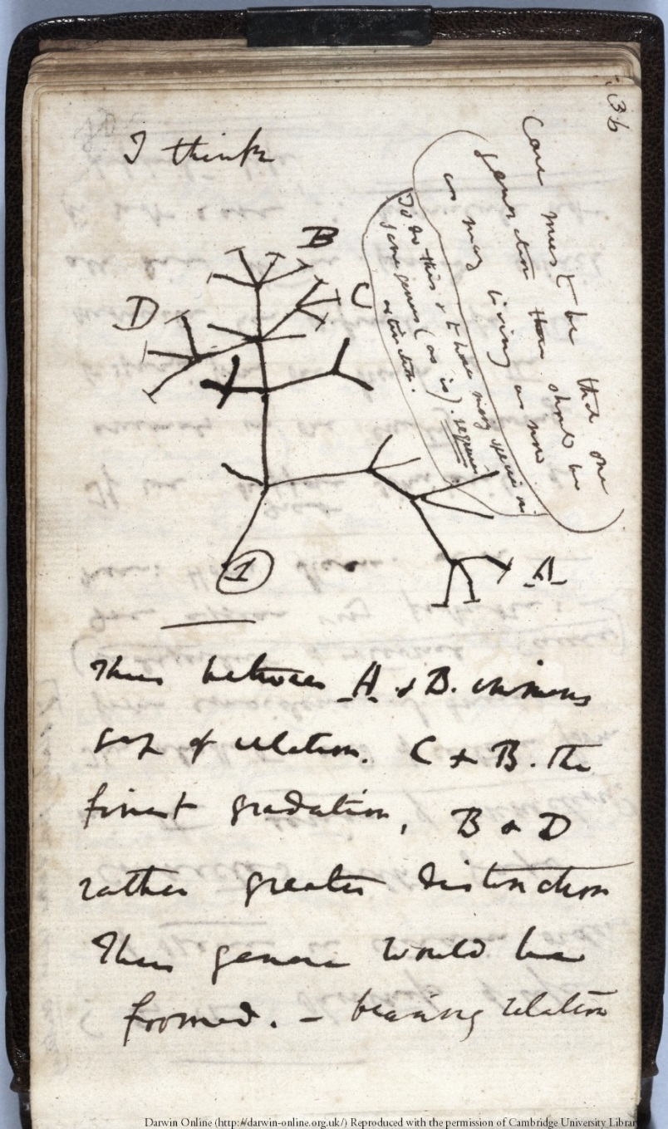
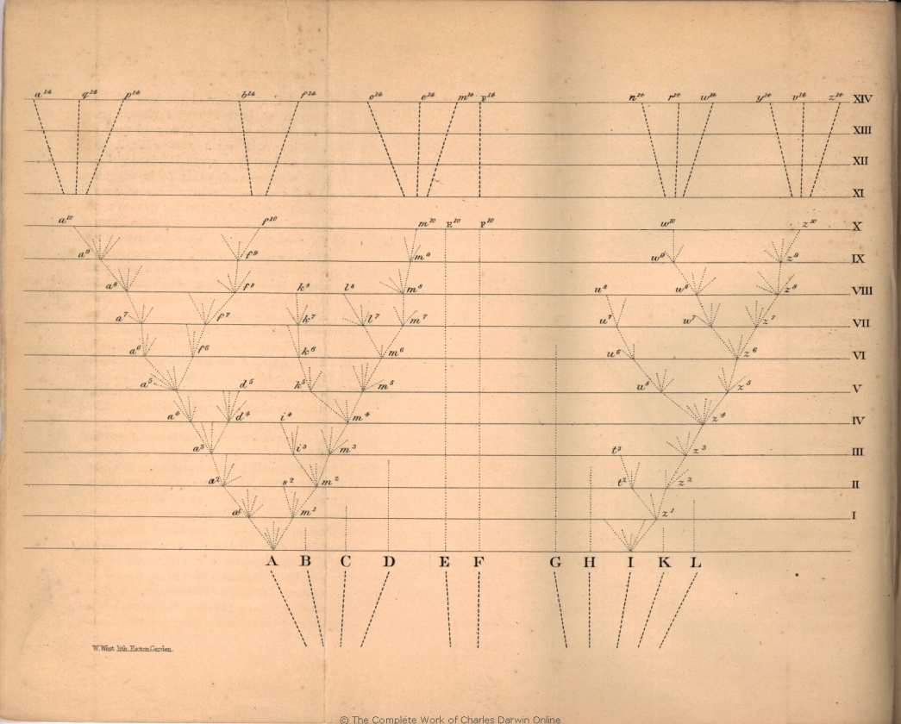
Evolution as Envisioned by Darwin
The Origin of Species (1859)
Ch.IV Divergence of Character
Notebook B, ~July, 1837
Notes:
Image credits:
Left:
Description: The only image in The Origin, in Ch. IV on Divergence of Character, Darwin’s evolutionary tree.
Source: Darwin Online
Author: C. Darwin
Clearance: Public domain
Right:
Description: Darwin’s first sketch of an evolutionary tree in Notebook B, approximately July, 1837
Source: Darwin Online
Author: C. Darwin
Clearance: Public domain

Slide 26
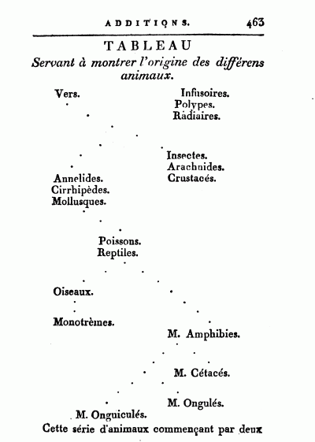
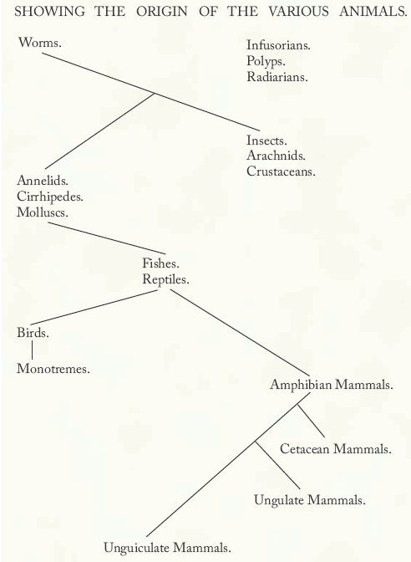
Lamarck (1809) Philosophie Zoologique
Notes:
Image credits:
Left:
Description: Page 463 of Lamarck's Philosophie Zoologique, an image of the tree of life, titled "origins of the various animals“
Source: Wikipedia; http://en.wikipedia.org/wiki/File:Lamark%27s_depiction_of_the_origins_of_the_animals.gif
Author: J. Lamarck
Clearance: Public domain
Right:
Description: Lamarck’s evolutionary tree (re-drawn from Lamarck 1809)
Source: From Wheelis, M. 2007. Darwin: Not the first to sketch a tree. Science 315: p. 597.
Author: Wheelis, M.

Slide 27
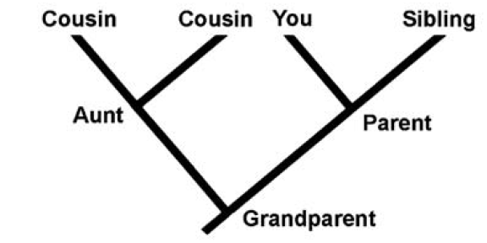
Evolutionary Trees
Evolutionary trees show relatedness and descent.
An analogy
You and your sibling share a “common ancestor,” your parent.
You are equally related to both of your cousins.
Relationships can be of direct descent, or collateral but still closely related.
You did not “descend” from your cousin or sibling.
Notes:
Description: A simple “phylogeny” of human relationships
Source: Part (a) from figure 3 in Gregory (2008), Evo Edu Outreach 1: 121-137
Author: Gregory, T. Ryan

Slide 28
“Shoots” and not “Ladders” (Mead 2009)
Incorrect
(linear conception)
Correct
(branching conception)
Search for “missing links” to fill in a linear evolutionary chain.
Reconstruct relationships among related organisms.
Fossil organisms have “half-and-half” features.
An array of fossils showing transitional features at various stages and may reveal trends.
Ancestral organisms get replaced by descendants (transmutation).
Organisms have descendant (direct) and collateral relationships.
Ancestral organisms are of lower “rank”—”simpler,” “primitive,” or “lower.”
Descendants show varying levels of change from their ancestors and do not reflect any inherent progress or improvement.
Notes:
The use of the catchy terms “shoots” and “ladders” with respect to macroevolution is found in Mead 2009, “Transforming our thinking about transitional forms,” Evo Edu Outreach (2009) 2:310–314.

Slide 29
Misconceptions by Critics
Linear view of evolution:
“… no chain of descent from archaeocetes to modern whales has been identified.”
(from http://www.trueorigin.org/whales.asp, retrieved 22 Dec 2015)
Primitive/advanced, simple/complex progressive view:
“The generally accepted order of the archaeocete species, in terms of both morphological (primitive to advanced) and stratigraphical (lower/older to higher/younger) criteria, is Pakicetus, Ambulocetus, Rodhocetus, Indocetus, Protocetus, and Basilosaurus.”
(from http://www.trueorigin.org/whales.asp, retrieved 22 Dec 2015)
Linear view with replacement (transmutation):
“There are, of course, huge problems in converting a hippo-like creature into a whale. … It’s all a whale of a tale.”
(from http://creation.com/rodhocetus, retrieved 22 Dec 2015)

Slide 30
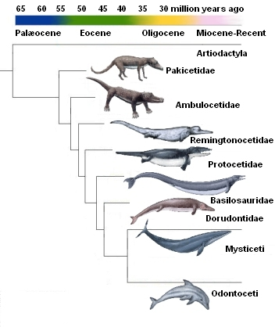
The Cetacean Family Tree
Note: No fossil is assumed to be a direct ancestor of another. Only collateral relationships are assumed.
Notes:
Image credit:
Description: The relations of early whales (archaeocetes) to artiodactyls and the two extant groups, odonticeti and mysticeti.
Source: From the Cetacean Paleobiology website: http://palaeo.gly.bris.ac.uk/palaeofiles/whales/archaeoceti.htm
Author: Tree by Felix G. Marx, University of Bristol. Images of cetacenas adapted from National Geographic's The evolution of whales by Douglas H. Chadwick, Shawn Gould and Robert Clark .
Clearance: Re-illustrated for public access distribution by Sharon Mooney ©2006. Open source licence. Creative Commons-Attribution-ShareAlike 2.5 Generic

Slide 31
CQ#5: Using the simple tree to the right, which of the following statements is TRUE?
A
B
C
D
Taxon C is more closely related to B than to D.
Taxon B descended from A.
Time proceeds from left to right (A → D).
Taxa A and B are close relatives, as are C and D.

Slide 32
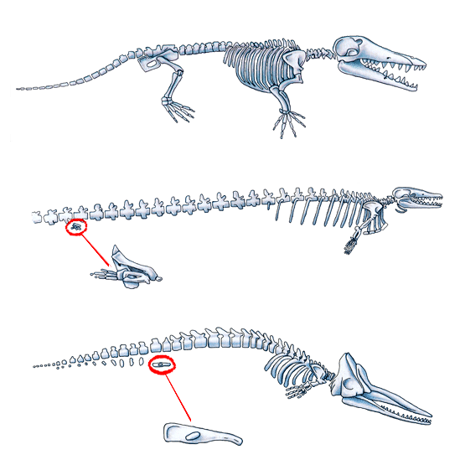
Do whale fossils show “transitional features at various stages?”
1. Reduction of hind pelvis and limbs
Ambulocetus hind limb (top)
Weight-bearing, but also adapted for swimming.
Basilosaurus isis hind limb (middle) Small, disarticulated, but relatively complete; digits I and II tiny or lost entirely; some bones fused.
Modern sperm whale hind limb (bottom)
Only a small bony remnant of pelvic bone remains.
Notes:
Image credit:
Description: Reconstruction of Ambulocetus, Basilosaurus, and a sperm whale
Source: Wikimedia Commons; https://upload.wikimedia.org/wikipedia/en/archive/5/51/20070602133507!Whale_legs.png
Author: Unknown
Licensing: GNU Free License version 1.2 or later

Slide 33
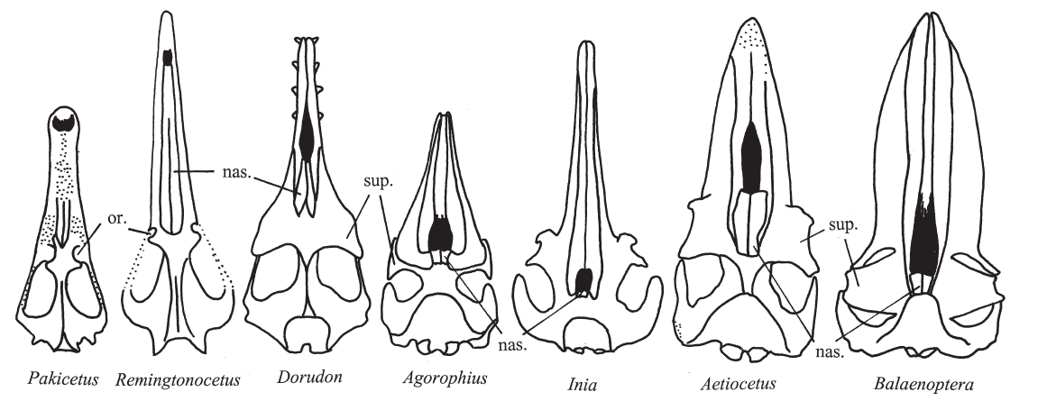
Do whale fossils show “transitional features at various stages?”
2. Changes in eye position (or.) and nasal opening (nas.)
Eye
orbits
From dorsal … to more lateral, with supraorbital process (sup.)
Nasal
opening
From snout tip … to a single blowhole between the eyes
Notes:
Image credits:
Description: Changes in nasal opening and orbits in cetaceans (nas.=nasal opening; or. = orbits; sup.= supraorbital process).
Source: Figure 9 from Thewissen, J. G. M., and S. Bajpai. 2001. Whale origins as a poster child for macroevolution. BioScience, 51(12): 1037-1049.
Author: Thewissen and Bajpai
Clearance: Used with permission of Oxford University Press.
Figure text: Dorsal view of cetacean skulls. From left are pakicetid Pakicetus; remingtonocetid Remingtonocetus (after Bajpai and Thewissen 1998); dorudontid Dorudon (after Kellogg 1937); Oligocene toothed whale Agorophius (after Kellogg 1928); modern Amazon River Dolphin Inia (after Kellogg 1928); Oligocene mysticete Aetiocetus (after Barnes et al. 1994); and the modern mysticete Balaenoptera musculus, or blue whale (after Kellogg 1928). Note the varying position and size of the orbits (or.), which are covered by a supraorbital process (sup.) in dorudontids, odontocetes, and mysticetes. The nasal opening (black) shifted to a more posterior position on the skull as the nasals (nas.) became shorter. Drawings are not to scale; stippled areas are not known.

Slide 34
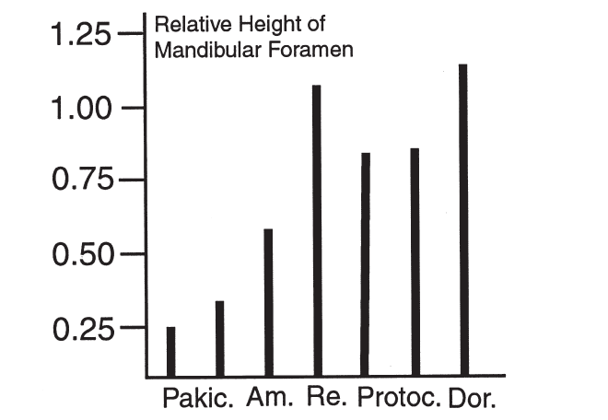
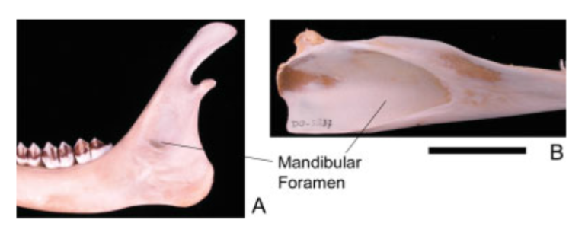
Do whale fossils show “transitional features at various stages?”
3. Changes to the mandibular foramen
Canal containing a fat pad, used for hearing in modern toothed whales.
Becomes progressively larger, with presumed pad in some fossil cetaceans.
Mandibles of a deer (left) and a dolphin (B) highlighting mandibular foramina.
Notes:
Image credits:
Right –
Description: Relative height of the mandibular foramen for pakicetids.
Source: Figure 8 from Thewissen, J. G. M., and S. Bajpai. 2001. Whale origins as a poster child for macroevolution. BioScience, 51(12): 1037-1049.
Author: Thewissen and Bajpai
Licensing: Used with permission of Oxford University Press.
Figure text: Relative height of the mandibular foramen for pakicetids (Pakic.; Pakicetus, Ichthyolestes), ambulocetids (Am.; Ambulocetus), remingtonocetids (Re.; Dalanistes), protocetids (Protoc.; Georgiacetus,Rodhocetus), and dorudontids (Dor.; Zygorhiza).Height of foramen is expressed as a fraction of the jaw depth below the last tooth. The mandibular foramen of modern land mammals is similar in size to that of pakicetids, whereas that of modern odontocetes (toothed whales) is similar to remingtonocetids and dorudontids. Ambulocetus is intermediate.
Bottom left inset:
Description: Medial view of lower jaw showing the mandibular foramen size. A: Right mandible of deer, Odocoileus. B: Left mandible of dolphin, Lagenorhynchus. Scale bar = 5 cm.
Source: Fig. 3 from Nummela et al. 2007, The Anatomical Record, 290: 716-733.
Author: S. Nummela
Clearance: Used with permission of John Wiley and Sons, Inc.

Slide 35
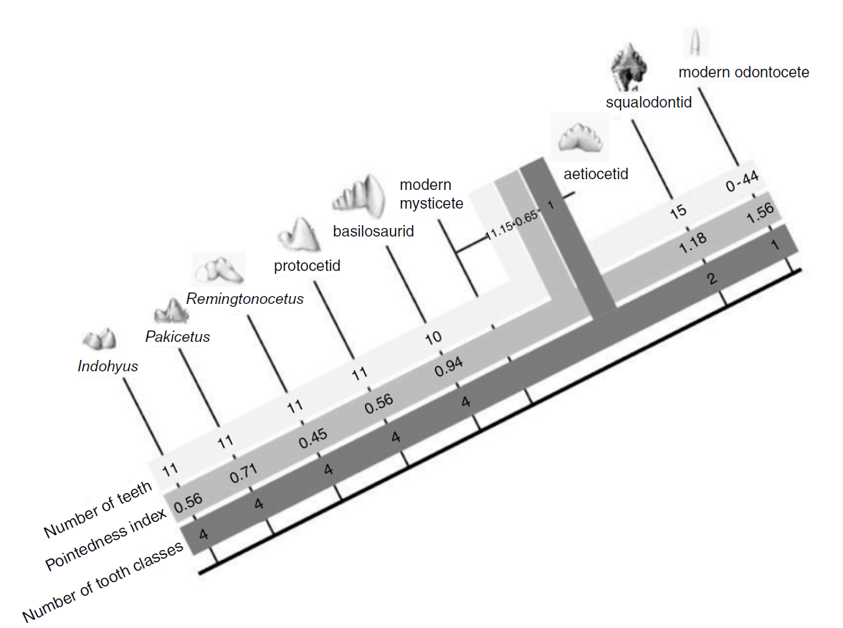
Do whale fossils show “transitional features at various stages?”
4. Changes to dental anatomy
Shift from variety of teeth, some complex (e.g., molar-like), to all simple and prong-like.
Notes:
Image credits:
Description: The evolution of cetacean tooth morphology. Grey bars indicate, respectively, number of teeth per jaw quadrant, pointedness and number of tooth classes. Modern mysticete dental patterns are unknown due to their tooth buds resorbing before eruption.
Source: Figure 6 from Armfield et al. 2013, Development and evolution of the unique cetacean dentition. PeerJ 1:e24; DOI 10.7717/peerj.24
Author: Armfield et al.
Clearance: copyright PeerJ, used in accordance with CC-BY 4.0.

Slide 36
Do whale fossils show “transitional features at various stages?”
Other changes include habitat, torso, cranial anatomy, physiology, mode of locomotion, and more!
Notes:
Image credits:
Bottom:
Description: Pakicetus inachus, a whale ancestor from the Early Eocene of Pakistan, after Nummelai et al., (2006), pencil drawing, digital coloring
Source: Wikimedia Commons; Own work; http://commons.wikimedia.org/wiki/File:Pakicetus_BW.jpg
Modifications: flipped horizontally
Author: Nobu Tamura (http://spinops.blogspot.com)
Clearance: GNU Free Documentation License version 1.2 or later
Second from bottom:
Description: Ambulocetus natans, a primitive whale from the Eocene of Pakistan, pencil drawing, digital coloring
Source: Wikimedia Commons; Own work; http://commons.wikimedia.org/wiki/File:Ambulocetus_BW.jpg
Modifications: flipped horizontal and rotated slightly
Author: Nobu Tamura
Clearance: GNU Free License version 1.2 or later
Third from bottom:
Description: Dorudon (reconstruction)
Source: Wikimedia Commons; File:DorudonBW.jpg; http://commons.wikimedia.org/wiki/File:Dorudon_cropped.png
Modifications: flipped horizontally
Author: Nobu Tamura email:nobu.tamura@yahoo.com www.palaeocritti.com
Clearance: Creative Commons Attribution-Share Alike 3.0 Unported
Top:
Description: Size comparison of an average human and a blue whale (Baleaenoptera musculus).
Source: Wikimedia Commons, http://commons.wikimedia.org/wiki/File:Blue_whale_size.svg
Author: Kurzon
Clearance: GNU Free Documentation License, Version 1.2 or later

Slide 37
CQ#6: Using the concept of human evolution, which of the following statements reflects a branching, rather than a linear process?
Chimpanzees are the simpler, more primitive ancestors of humans, which are their descendants.
Humans will eventually be replaced by a more advanced organism.
Humans and chimpanzees are evolutionary cousins; one is not the direct descendant of the other.
If we evolved from chimps, there should not be any more chimps.

Slide 38
It’s Not Just About Fossils
Whale evolution is supported by several independent lines of evidence
Fossils
Anatomy
Development & Embryology
Paleoecology / Sedimentology
DNA / Genetics

Slide 39
1. Fossils
Numerous fossils show a clear shift in habitat from terrestrial to aquatic, and a radical change in form over millions of years.
Notes:
Image credit:
Description: The relations of early whales (archaeocetes) to artiodactyls and the two extant groups, odonticeti and mysticeti.
Source: From the Cetacean Paleobiology website: http://palaeo.gly.bris.ac.uk/palaeofiles/whales/archaeoceti.htm
Author: Tree by Felix G. Marx, University of Bristol. Images of cetacenas adapted from National Geographic's The evolution of whales by Douglas H. Chadwick, Shawn Gould and Robert Clark .
Clearance: Re-illustrated for public access distribution by Sharon Mooney ©2006. Open source license. Creative Commons-Attribution-ShareAlike 2.5 Generic.

Slide 40
2. Anatomy
Recall that whales are mammals.
Warm-blooded
Have hair, lungs, placenta, & produce milk
Bear live young
Two nasal passages (with 1 or 2 blowholes)
Have arm, wrist, & finger bones, & some with vestigial pelvis / legs
Tale moves vertically
Notes:
Image credits:
Description: Beluga whale nursing calf
Source: Wikipedia Commons, https://commons.wikimedia.org/wiki/File:Delphinapterus_leucas_16.jpg
Author: http://www.flickr.com/photos/iwona_kellie/
Clearance: cc-by-2.0
Bottom:
Description: Dolphin anatomy
Source: Wikipedia Commons, w:en; http://commons.wikimedia.org/wiki/File:Dolphin_anatomy.png
Modifications: cropped
Author: WikipedianProlific
Clearance: GNU Free Documentation License version 1.2 or later

Slide 41
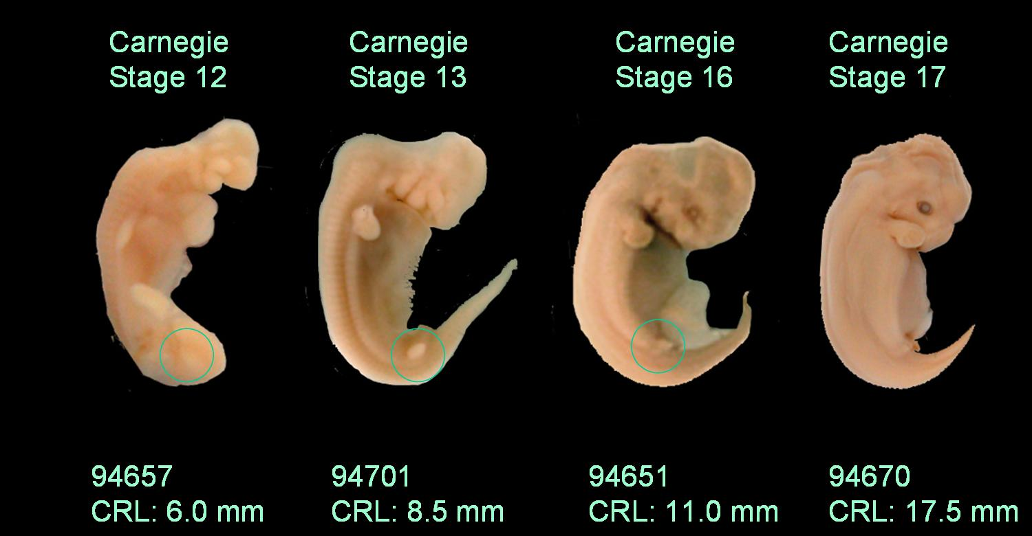
3. Development & Embryology
Vestigial structures: hind limbs
Notes:
Image credits:
Description: Hind limb development and subsequent reduction in spotted dolphin embryos.
Source: Digital Library of Dolphin Development; http://web.neomed.edu/web/anatomy/DLDD/index.html
Author: JGM Thewissen et al.
Clearance:
See also: Fig. 1 (Fetus of the pantropical dolphin with whiskers along the rostrum) in Thewissen et al. 2009, Evolution Education and Outreach, v2:272-288.

Slide 42
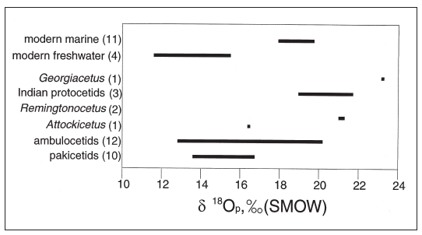
4. Paleoecology / Sedimentology
Stable oxygen isotopes in modern and fossil cetaceans
Bars shifted to the left = ingested freshwater
Bars shifted to the right = ingested marine water
Modern marine and freshwater cetaceans as control
Pakicetus clearly freshwater
Ambulocetus transitional
Georgiacetus, Indian protocetids, Remingtonocetus clearly marine.
Notes:
Image credit:
Description: Stable oxygen isotopes in modern and fossil cetaceans.
Source: Figure 13 from Thewissen, J. G. M., and S. Bajpai. 2001. Whale origins as a poster child for macroevolution. BioScience, 51(12): 1037-1049.
Clearance: Used with permission of Oxford University Press.
Figure text: Stable oxygen isotopes in modern and fossil cetaceans. The ratio between ¹⁸O and ¹⁶O is indicated as 𝛿¹⁸O_{p} (SMOW), whereby higher values indicate more ¹⁸O. Number of species represented in each group is indicated in parentheses. Note the clear separation of modern cetaceans with known water ingestion behaviors (modern freshwater dolphins and marine cetaceans). This difference is mirrored in the difference between freshwater pakicetids and marine protocetids and Remingtonocetus. Ambulocetus lived in a transitional habitat, and different individuals fall along a wide range of stable oxygen isotope ratios. Graph modified from Roe et al. 1998.

Slide 43
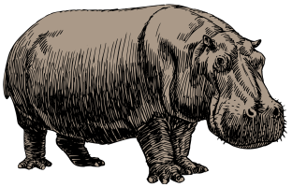
5. DNA & Genetics
If cetaceans really evolved from terrestrial mammals, then it should also be reflected in their DNA.
Numerous molecular studies have confirmed that hippos are the closest living relative to cetaceans (i.e., they are sister taxa).
Deer
Pig
Camel
Non-artiodactyl
mammals
(Relationships based on Zhou et al. 2011)
Notes:
Image credits:
Top:
Description: Size comparison of an average human and a blue whale (Baleaenoptera musculus).
Source: Wikimedia Commons, http://commons.wikimedia.org/wiki/File:Blue_whale_size.svg
Modifications: Flipped horizontal
Author: Kurzon
Clearance: GNU Free Documentation License, Version 1.2 or later
Bottom:
Description: Hippopotamus (vectorized version of File:Hippopotamus (PSF).png).
Source: Wikimedia Commons, http://commons.wikimedia.org/wiki/File:Hippopotamus-PSF-Oksmith.svg
Author: Oksmith uploaded vector file to http://www.openclipart.org/ under public domain license (see http://www.openclipart.org/detail/26544 )
Clearance: Public domain (released by author Oksmith)

Slide 44
Is the evolution of whales from land-dwelling ancestors supported by evidence, or is it just a whale of tale?

Slide 45
CQ#7: Now what do you think? Which statement best describes your current understanding of the origin of whales?
Whales were created in their current form and did not evolve from four-legged, terrestrial (land-dwelling) ancestors.
Whales evolved from four-legged, terrestrial ancestors.
Whales evolved, but only in terms of adapting to a changing environment; they did not evolve from a terrestrial creature.

Slide 46
Summary
Evolution …
is best represented with a branching, not a linear pattern.
is a discipline of reconstructing past relationships, not filling in a linear chain of “missing links.”
Whale evolution …
was once dominated by speculation and criticism, but is now one of the best documented evolutionary transitions.
is supported by numerous lines of independent evidence, not just fossils.

