Slide 1
Plant Transpiration: A Story of Clean Air
NATIONAL CENTER FOR CASE STUDY TEACHING IN SCIENCE
by
Sandra J. Connelly
Thomas H. Gosnell School of Life Sciences
Rochester Institute of Technology, Rochester, NY

Slide 2
Plants Indoors – Let’s Discuss!
They are pretty …
but do they serve a purpose?

Slide 3
In your group, discuss …
What is plant transpiration?
Why do plants transpire? What is exchanged with the environment?
What might affect the transpiration rate of plants?
Why would different plants potentially have different transpiration rates?
Could you design an experiment to test any of the above?

Slide 4
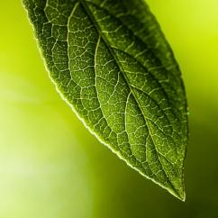
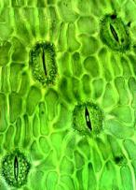
Plant Transpiration
The facts!
Plants transpire through stomata
Exchange CO₂ and O₂

Slide 5
Plant Transpiration
The facts!
Plants depend on transpiration for the movement of water from roots to leaves

Slide 6
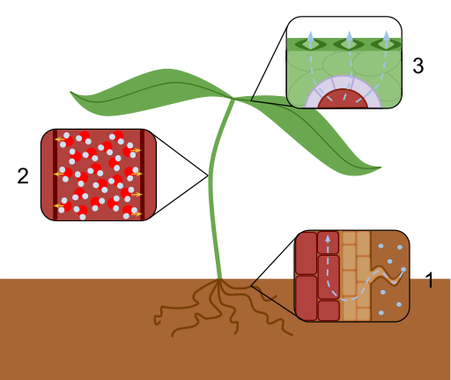
How do we know?

Slide 7
Plant Transpiration
The facts!
Plants transpire through stomata
Exchange CO₂ and O₂ – But what can they lose?
Notes:
Stomatal density: https://flic.kr/p/s9TQdk (Attribution — You must give appropriate credit, provide a link to the license, and indicate if changes were made. You may do so in any reasonable manner, but not in any way that suggests the licensor endorses you or your use.) flickr account: microbiologybytes
Leaf: https://flic.kr/p/6y9kcg (Attribution — You must give appropriate credit, provide a link to the license, and indicate if changes were made. You may do so in any reasonable manner, but not in any way that suggests the licensor endorses you or your use.) flickr account: Andreas Levers

Slide 8
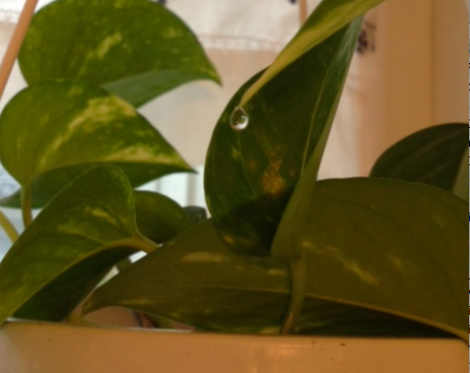
How do we know?

Slide 9
Applying Transpiration
Plant leaves can “inhale” aerosols and destroy the chemicals (“metabolic breakdown”)
Proven by radioactively labeled (C¹⁴) formaldehyde (Doman and Romanova, 1962)

Slide 10
Applying Transpiration
How does transpiration in plants help them break down toxins in the air?
WHAT is the link to transpiration?
HOW could we test this?

Slide 11
Experimenting with Transpiration
Day 1
Set up experiment to measure transpiration rates in plants OR run a simulation.
Day 2
Estimate your transpiration in g H₂O / (dm² * hr).
Correlate your results to uptake of chemical vapors.
Determine the potential of plants to “clean” a room.

Slide 12
Day 1 Experimental Setup
Notes:
Use slides 12-18 if the students will set up their own plant experiments to measure transpiration rates.

Slide 13
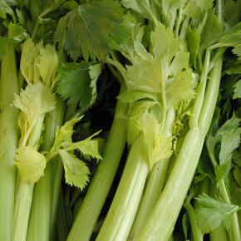
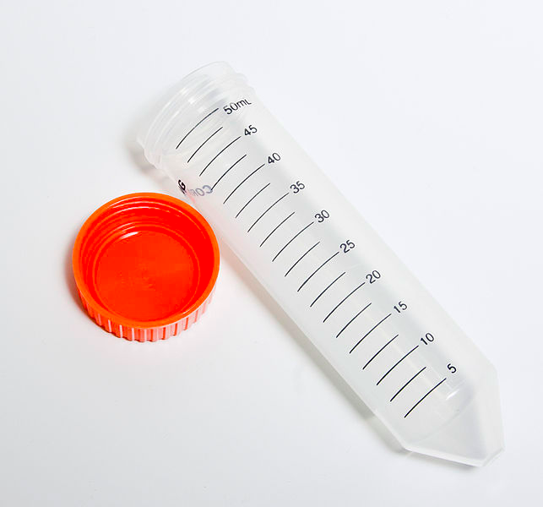
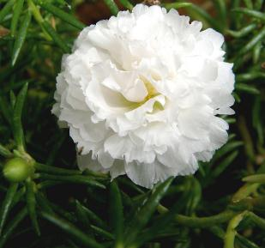
Experimental Setup
Set up your experiment –Take VERY careful notes!

Slide 14
Experimental Setup: Day 1
Within your group:
Obtain a tube and write your name on it.
Measure fixed volume of water in centrifuge tube (water fountain or bathroom!)
Add food coloring to your water (~5 drops / 25 mL)
Choose your plant / vegetable.
Measure and record everything that you can think of!
Surface area of leaves/petals, stems, volume water, etc.

Slide 15
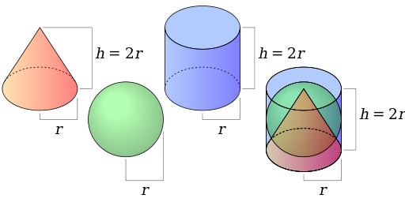
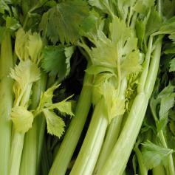
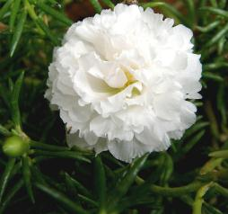

Slide 16
Experimental Setup: Day 1
Within your group:
Cover the top of your tube with parafilm.
“Seal” your plant – but the top should stick out!
Return your experimental tube to your instructor.

Slide 17
Experimental Setup: Day 1
Seal around the top to minimize evaporation from the tube.
Make sure your plant can breathe!

Slide 18
Experimental Hypothesis
In your group, write a working hypothesis based on your plant in your experiment and your knowledge of transpiration.
Keep track of this for Day 2!
Do you have all of the notes that you are going to need to calculate transpiration rates and apply your data on Day 2?

Slide 19
Day 1 Simulation
Notes:
Use slides 19 and 20 if you are going to have the students run the virtual transpiration lab

Slide 20
Transpiration Simulation
Run simulation:
Virtual Lab: Plant transpiration
Work with at least four plants and use the fan, heater, or both!
Take notes of your results and email your results to your group members and/or your instructor!
Notes:
http://www.mhhe.com/biosci/genbio/virtual_labs/BL_10/BL_10.html

Slide 21
Day 2 Data & Application

Slide 22
Transpiration Discussion
What did you do on Day 1?
You set up your experiment to measure transpiration rates in your selected plants
Where have your plants been?
What have your plants done?
Notes:
Use slides 22 and 23 if students set up their own experiment.

Slide 23
Transpiration Rates
Using data from your experimental set up …
Your plants have transpired since Day 1 – don’t forget to calculate rate per hour!
What is your plants surface area (in dm²)?
How much does water weigh?
Estimate transpiration rate as
______ g H₂O / (dm² * hr)
Notes:
Use slides 22 and 23 if students set up their own experiment.

Slide 24
Simulation Discussion
What did you do on Day 1?
Ran a simulation of plant transpiration
Did transpiration rates differ? WHY?
What had the most significant effect on plant transpiration in the simulation?
Notes:
Use slides 24 and 25 if students ran the simulation.

Slide 25
Transpiration Rates
Using data from the simulation …
Pick one plant from the simulation.
Assume a plant surface area of 100 dm² for your calculations.
How much does water weigh?
Estimate transpiration rate as
______ g H₂O / (dm² * hr)
Notes:
Use slides 24 and 25 if students ran the simulation.

Slide 26
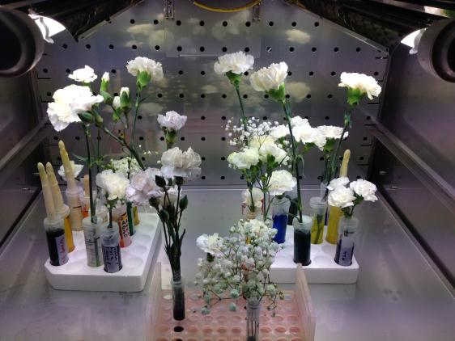
Consider the following …

Slide 27
Applying Your Results
Do you remember how the movement of water and the movement of CO₂ / O₂ is related?

Slide 28
Applying Your Results
How much CO₂ could your plant take up?
At 20°C, transpiration of water causes the uptake of organic vapors at a rate of
1.8 g H₂O / (dm² * hr) =
16.8 mg CO₂ / (dm² * hr)
Notes:
http://www.epa.gov/otaq/climate/documents/420f11041.pdf

Slide 29
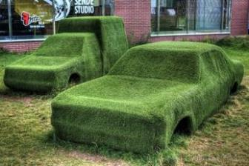
Let’s think …
PROBLEM
You want to “green” your commute to school in your “fuel efficient” vehicle!
KNOWN
Avg CO₂ per 1 gallon of gas = 8,887 grams
QUESTION
How many hours would it take your experimental plant to “clean up” after your car?
** http://www.epa.gov/otaq/climate/documents/420f11041.pdf

Slide 30
Let’s think …
What do you need to answer this question?
Work in your group to “clean up” at least one of your commutes.
Your answer should be in plant hours.
Hint: How long does your plant have to transpire to take up your car’s carbon emissions?

Slide 31
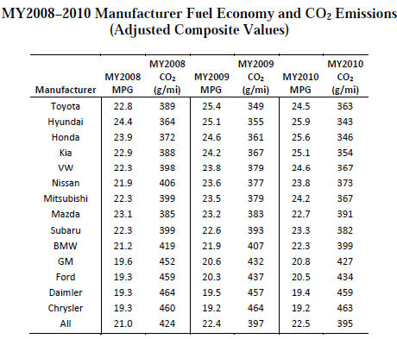
http://www.epa.gov/otaq/climate/documents/420f11041.pdf

Slide 32
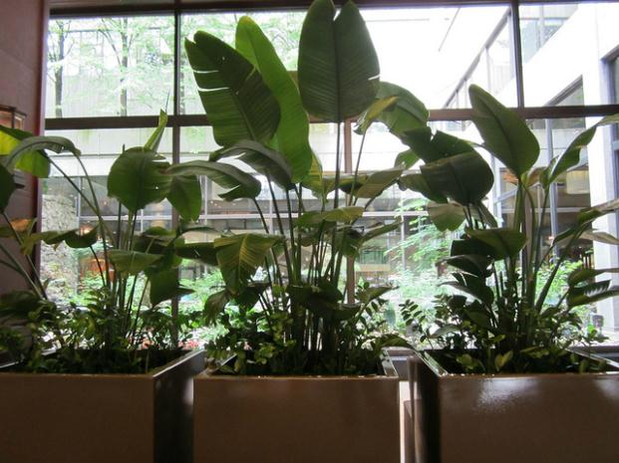
Consider the following …

Slide 33
Plants Indoors
They are pretty …
but do they serve a purpose?

Slide 34
Applying Your Results
Do you remember how the movement of water and the movement of CO₂ / O₂ is related?
How could this idea be applied to other aerosols / vapors in a room?
Consider: Is the air actually “dirty” and can plants remove that “dirt”?

Slide 35
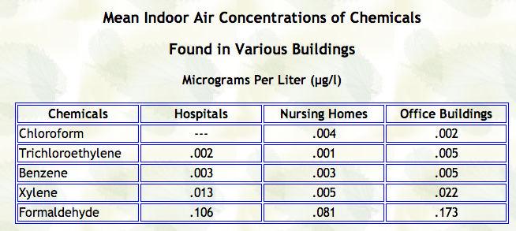
Well .. how dirty is the air?
Notes:
Table: EPA report on Indoor Air Quality in Public Buildings: Vols. I and II, August 1988, EPA/00/6-88/009ab.
US EPA. 1989a. Report to Congress on Indoor Air Quality, Volume I: Federal Programs Addressing Indoor Air Quality. http://nepis.epa.gov/Exe/ZyPDF.cgi/9100LM9H.PDF?Dockey=9100LM9H.PDF Indoor Air Division, Office of Air and Radiation. U.S. Environmental Protection Agency, Washington, D.C.
US EPA. 1989b. Report to Congress on Indoor Air Quality, Volume II: Assessment and Control of Indoor Air Pollution. http://nepis.epa.gov/Exe/ZyPDF.cgi/9100LMBU.PDF?Dockey=9100LMBU.pdf Indoor Air Division, Office of Air and Radiation. U.S. Environmental Protection Agency, Washington, D.C.

Slide 36
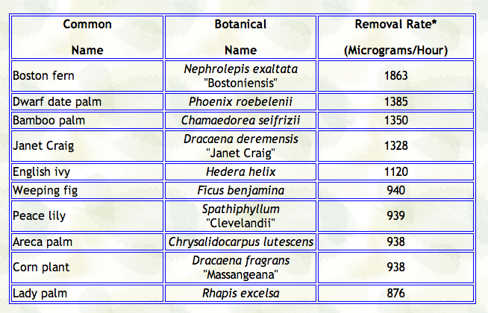
How efficient are plants?
Notes:
Table: EPA report on Indoor Air Quality in Public Buildings: Vols. I and II, August 1988, EPA/00/6-88/009ab.
US EPA. 1989a. Report to Congress on Indoor Air Quality, Volume I: Federal Programs Addressing Indoor Air Quality. http://nepis.epa.gov/Exe/ZyPDF.cgi/9100LM9H.PDF?Dockey=9100LM9H.PDF Indoor Air Division, Office of Air and Radiation. U.S. Environmental Protection Agency, Washington, D.C.
US EPA. 1989b. Report to Congress on Indoor Air Quality, Volume II: Assessment and Control of Indoor Air Pollution. http://nepis.epa.gov/Exe/ZyPDF.cgi/9100LMBU.PDF?Dockey=9100LMBU.pdf Indoor Air Division, Office of Air and Radiation. U.S. Environmental Protection Agency, Washington, D.C.

Slide 37
Let’s think …
PROBLEM
You manage a building with dirty air!
KNOWN
100 ft² space with 8 ft ceiling = 800 ft³ of air needs to be cleaned!!
= ______ liters?
QUESTION
How many plants do you need to “clean” your space in a 24 hour period (constantly)?

Slide 38
Data Table

Slide 39
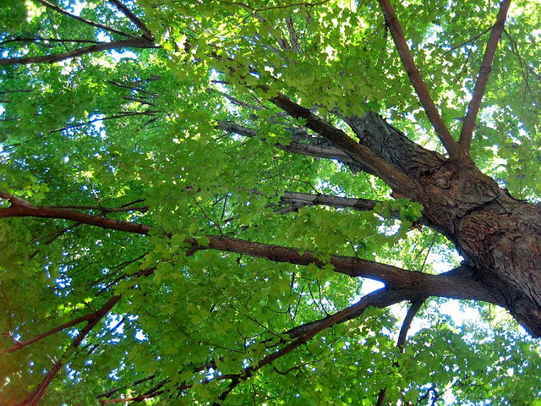
Time to exhale …

Slide 40
Image Credits
Slide 4, 5, 7
Stomata Image: https://flic.kr/p/s9TQdk, flickr account: microbiologybytes, CC BY-SA 2.0.
Slide 4, 5, 7
Leaf: https://flic.kr/p/6y9kcg, flickr account: Andreas Levers, CC BY-NC 2.0.
Slide 6
Transpiration Overview.svg: https://en.wikipedia.org/wiki/Transpiration#/media/File:Transpiration_Overview.svg, CC BY-SA 3.0 Uploaded by Laurel Jules Created: May 26, 2013)
Slide 8
Transpiration Water Drop; Photo by: Sandi Connelly (sjcsbi@rit.edu)
Slide 13, 15 Celery: https://flic.kr/p/6UFR7, flickr account: Dave Morris, CC BY-NC-SA 2.0.
Slide 13 Falcon tube 50ml 2.jpg; https://commons.wikimedia.org/wiki/File:Falcon_tube_50ml_2.jpg (CC BY-SA 3.0) 22 January 2011 Nadina Wiórkiewicz
Slide 13, 15 White flower: https://flic.kr/p/FNYZT, flickr account: Balaji Photography, CC BY 2.0.
Slide 15 File:Inscribed cone sphere cylinder.svg A cone, sphere and cylinder of radius r and height h. https://commons.wikimedia.org/wiki/File:Inscribed_cone_sphere_cylinder.svg#/media/File:Inscribed_cone_sphere_cylinder.svg (CC BY-SA 3.0) Uploaded by Cmglee Uploaded: April 22, 2011

Slide 41
Image Credits
Slide 17 Transpiration Flower Setup; Photo by: Sandi Connelly (sjcbi@rit.edu)
Slide 26 Image credit: Transpiration Flower Setup 2; Photo by: Sandi Connelly (sjcbi@rit.edu)
Slide 29, 30 Green cars https://flic.kr/p/6TMyJq, Flickr account: Michael Caven, CC BY 2.0.
Slide 32 Plants. https://flic.kr/p/cu57wU, flickr account: Ann Lusch, CC BY-NC-SA 2.0.
Slide 37 Image: Austin, Texas https://flic.kr/p/icBiYj, Flickr account: Jim Allen
Slide 37 Emergency Entrance https://flic.kr/p/N7HHY, Flickr account: Taber Andrew Bain, CC BY 2.0.
Slide 39 Image: meditation spot https://flic.kr/p/5nEKbe, Flickr account: MTSOfan CC BY-NC-SA 2.0.

