Slide 1
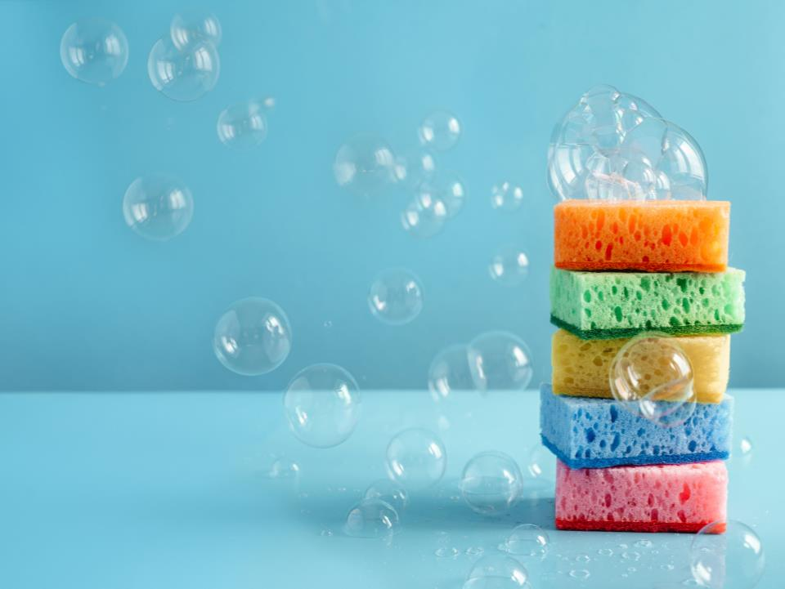
Sponges and Bubbles:
NATIONAL CENTER FOR CASE STUDY TEACHING IN SCIENCE
A Refreshed Investigation
of pH and Buffers
by
Geoffrey M. Lippa¹, Heather Zimbler-DeLorenzo²,
and Jean A. Cardinale ¹
¹ Department of Biology, Alfred University, Alfred, NY
² Department of Life and Earth Sciences, Perimeter College at Georgia State University, Decatur, GA
Notes:
Credit: Licensed image © Marinacibis | Dreamstime.com, ID 215804902.

Slide 2
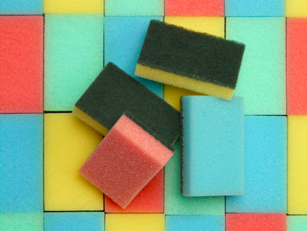
  Sponge Experiment
  In biology, we are interested in the physical properties of molecules and how these properties affect biological processes.
  Experiment with the sponges and beakers filled with water that have been provided. Generate a hypothesis relating the sponge’s ability to absorb water.
  Write down all your observations on the worksheet.
Notes:
Image credit: Sponges https://pixabay.com/en/sponge-sponges-clean-colorful-many-52113/ Creative Commons CC0

Slide 3
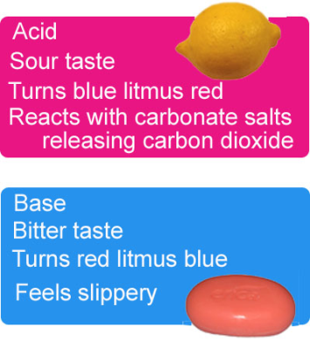
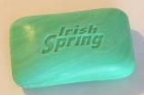
  Question 1:
  What is an acid?
Donates protons (H⁺)
Accepts protons (H⁺)
  Question 2:
  What is a base?
  Question 3:
  What is pH?
Acidic
Basic
Neutral
Notes:
Image Credit: Lemon-By Bordercolliez (Own work) [CC0], via Wikimedia Commons. Soap-By Maksim, https://creativecommons.org/licenses/by-sa/3.0/ via Wikimedia Commons
Image Credit: pH scale 2-By Piercetheorganist at English Wikipedia via Wikipedia Commons.

Slide 4
Increasing acidity
  Living cells have a limited pH range within which they can survive. Biological organisms take advantage of chemicals that moderate and control changes in pH. These chemicals, protons, and cells exist in an aqueous environment.
  Remember:
  pH = -log[H⁺] → [H⁺] = 10^{-pH}
  Soda
  (pH ~ 2.5)
  Beer
  (pH ~ 4.4)
  Blood
  (pH ~ 7.4)
  Baking Soda Solution
  (pH ~ 9.5)
  Household Ammonia
  (pH ~ 11.6)
  Household Bleach
  (pH ~13)
  Saturated NaOH
  (pH 15.1)
Increasing basicity

Slide 5
  Every acid has a dissociation constant (K). This value allows us to calculate the concentrations of H⁺ and OH⁻ present in pure water or an aqueous solution at equilibrium.
K = [H⁺][OH⁻] = 1x10⁻¹⁴
  * Because water is the solvent it is left out of the equation.
  Using this relationship, we can approximate the pH of a solution if we know the [OH⁻] and vice versa.

Slide 6
K = [H⁺][OH⁻] = 1x10⁻¹⁴
  Question 4: Assuming that the only two ions present in pure water are H⁺ and OH⁻, what are the concentrations of H⁺ and OH⁻ in pure water?
  Question 5: If a bleach solution has a pH of 10, what is the concentration of OH⁻?

Slide 7
Read Part I of Molly's story: “Symptoms and Examination.”
Discuss Molly's symptoms with your group.
Question 6: What do you think is happening in Molly's case?

Slide 8
  In this case we have an example of the carbon dioxide to carbonate equilibria.
  Carbonic acid Bicarbonate Carbonate
  Question 7: When Molly and Molly's mother are breathing deeply and heavily what are they doing with respect to the equilibria?

Slide 9
  When breathing heavily is not enough! Read Part II of Molly’s story: “Treatment.”
  Carbonic acid Bicarbonate Carbonate
  Question 8: When Molly is administered bicarbonate by the doctor, what effect does this have on the equilibria?

Slide 10
  Carbonic acid Bicarbonate Carbonate
  Question 9: Explain Molly's treatment using what you learned from the sponge experiment and the last two slides.

Slide 11
  We are going to conduct a series of experiments to determine the effect of CO₂ levels on the acidity of an aqueous solution.
  DO NOT TOUCH ANYTHING UNTIL TOLD TO DO SO
  Already prepared for you:
  5 mL of the NaOH(aq) (pH 10.5), 2mM NaHCO₃ (pH 10.5), 10mM NaHCO₃ (pH 10.5), and 50mM NaHCO₃ (pH 10.5) solutions are in four separate 15 mL tubes.
  25 uL of 10mg/ml phenolphthalein added to each tube
To do:​
1. Write down initial observations of the tubes.
2. Record the time.​
3. Begin to GENTLY blow into the tube using the straw until the solution changes color.
4. Record the time when the color change is complete.​
 | Water and NaOH (aq) (pH 10.5) | 2mM NaHCO₃ (pH 10.5) | 10mM NaHCO₃ (pH 10.5) | 50mM NaHCO₃ (pH 10.5)
Initial Color
Duration of aeration (minutes)
Final Color
Notes

Slide 12
  Question 10: What does blowing into the straw do to the solution? In other words, what is the difference between your breath and the air?
  Question 11: How do your conclusions compare to the theoretical relationship between pH and buffers and the sponge metaphor?

Slide 13
  pH Indicators
  A pH indicator is a weak acid that undergoes an observable chemical transformation when the pH changes. The indicator that we are going to use is phenolphthalein.
  Question 12: At what pH would you expect the color of the solution to turn from fuchsia to clear?

Slide 14
  Back to the story: Molly’s problem is the result of a weak acid…
  She has ingested far too much aspirin (acetylsalicylic acid), which has brought her to the emergency room
  Human normal blood pH range is between 7.35 and 7.45
  Blood pH outside of that range leads to coma and death
  Thus, rapid treatment for Molly is crucial
  Question 13: Why is Molly breathing so rapidly and deeply when she arrives at the emergency room, despite being nearly comatose?

Slide 15
Read Part III of Molly’s story: “Explanations.”
With your group provide an explanation for how Molly's treatment saved her life.

Slide 16
  Molly's life depends on a buffer
A buffer is a solution of a weak acid and its conjugate base
A buffer resists changes in pH in both directions—increases or decreases proton concentration
A buffer works best in the middle of its range
  Where the concentration of conjugate acid (HA) is equal to the concentration of the conjugate base (A⁻)
  The conjugate base (A⁻) can bind excess H⁺
  The conjugate acid (HA) can release H⁺
  Carbonic Acid
  Bicarbonate
Notes:
Move slide? After 10?

Slide 17
  Question 14: Based on what you know about buffers, why was breathing heavily not enough?
  Hint - Think about the experiment you did with the bicarbonate solutions.
  Question 15: How did the bicarbonate treatment help Molly?
  Question 16: How else might you raise the pH of Molly's blood to get it back into the normal range? How does this work?

Slide 18
  Insights for the Future
pH control is important, as many enzymes have a narrow range in which they function optimally.
Buffering capability is essential for the well-being of organisms, to protect them from unwelcome changes in pH.
For example, your stomach environment is about pH 1, yet the adjacent portion of your intestine is near pH 7—think about (or look up) how that might happen. (Hint: What is one function of the pancreas?)
Many compounds and macromolecules in addition to bicarbonate can serve a buffering function—proteins comprise one of the major classes of biological buffers.

Slide 19
Image Credits
Slide 1: Licensed image © Marinacibis | Dreamstime.com, ID 215804902.
Slide 2: Sponges https://pixabay.com/en/sponge-sponges-clean-colorful-many-52113/ Creative Commons CC0
Slide 3: Lemon-By Bordercolliez (Own work) [CC0], via Wikimedia Commons. pH scale-By Patricia R [CC0], via Wikimedia Commons. “Bar of Irish Spring deodorant soap.jpg-By Dwight Burdette [CC0], via https://search.creativecommons.org/photos/8c2dcda0-b2fa-47e3-bad1-cb7d777cb02f

Slide 20
References
Platt, T. 2010. Acids, pH and Buffers: Some Basic Chemistry for Biological Science. National Case Study for Teaching in Science, University at Buffalo, State University of New York.
Clark MA, Douglas M, and Choi J. Biology 2e. [Internet] Houston (TX): Rice University; 2018 Mar 28 [cited 2020 Jun 10]. Available from https://openstax.org/details/books/biology-2e
Flowers P, et al. Chemistry 2e. [Internet] Houston (TX): Rice University; 2019 Feb 14 [cited 2020 Jun 10] Available from https://openstax.org/details/books/chemistry-2e
Betts, JG, et al. Anatomy and Physiology [Internet] Houston (TX): Rice University; 2013 Apr 25 [cited 2020 Jun 10] Available from https://openstax.org/details/books/anatomy-and-physiology

