Slide 1
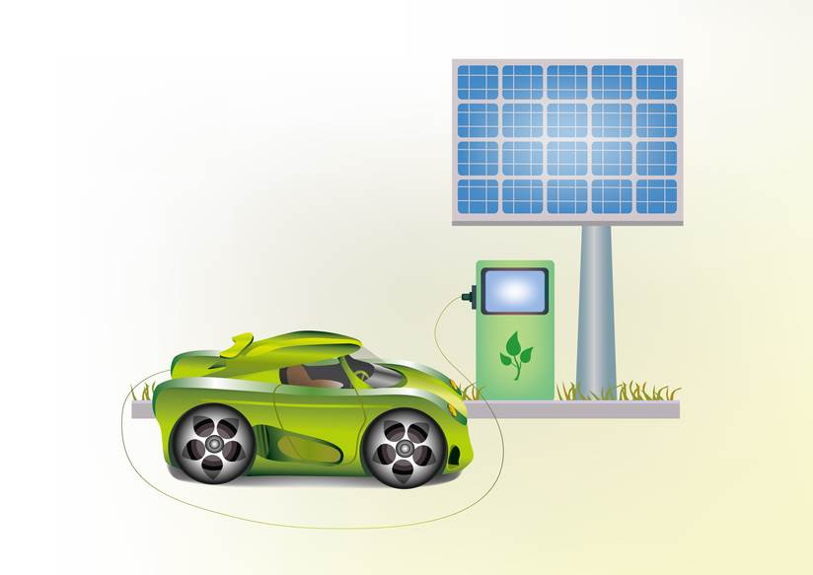
Fuel from Water and the Sun: An Application of Electrochemistry and Thermodynamics
by Joshua D. Hartman and Jack F. Eichler Department of Chemistry University of California-Riverside
Notes:
Licensed image © dobrik72 - Fotolia.com, file ID #47743042.

Slide 2
“A Sun-Powered Hydrogen Car (Sort of)”
By Andrew C. Revkin
Published: February 7, 2008
http://dotearth.blogs.nytimes.com/2008/02/07/the-sun-powered-hydrogen-toy-car-is-here/

Slide 3
The H2GO car seems to have it all worked out. The basic energy source is a solar panel that both charges the radio-control unit and provides the electricity to split water into hydrogen and oxygen in a little fueling station. The hydrogen fills a tiny bladder inside the car as needed. The hydrogen there generates a flow of electricity sufficient to power the car for about 5 minutes, according to Corgi International, the manufacturer. That’s shorter than the 15 minutes a typical battery-powered toy like this runs. But Corgi says the H2GO simply pops back over to the filling station for an immediate fill-up, while toys with batteries have to be recharged.

Slide 4
So, the car of the future is here now, at least in miniature, and at $99.99 apiece. A lot more fuel-cell-powered toys are in the works.
Keep in mind that if we all end up buzzing around in full-size hydrogen-powered cars someday, that still won’t solve the congestion problem in an urbanizing world heading toward 9 billion people. But having all the steps in a clean-energy transportation system worked out in front of kids’ eyes might open a few.

Slide 5
Analysis
1. What are the potential issues and major topics in this scenario that we as chemists/scientists can address?

Slide 6
Analysis
2. Compile a list for each category:
What do I know? | What do I need to know?
3. Rank the importance of the questions in the “What do I need to know” column.

