Slide 1
Selection on a Case by Case Basis
NATIONAL CENTER FOR CASE STUDY TEACHING IN SCIENCE
by
Adam Irvine, Eva Horna Lowell, Matt Driscoll and E. Dale Broder
Department of Biology
University of Denver, CO

Slide 2
Peppered Moth Coloration
1
4
2
5
3
6
Notes:
Photo credit:
E Dale Broder made cartoon images in Inkscape

Slide 3
Could we make a graph to show color distribution in this population of moths?
Notes:
Photo credit:
E Dale Broder made cartoon images in Inkscape

Slide 4
Try a histogram!

Slide 5
Does it look like this?

Slide 6
Can we represent this as a curved line instead of a histogram?

Slide 7
Does it look like this?

Slide 8
Initial phenotypic distribution of moth coloration:
High
Frequency
Low
Dark
Light
Moth Coloration

Slide 9
From histograms to lines!
Imagine that instead of six color morphs there are 100. Most traits are continuous, like human height.
It makes more sense to use a smooth line to represent continuous data.
There are statistical programs that do this.
For the rest of this exercise, we will use curves to represent trait distributions.

Slide 10
Example 1: Peppered Moth
Adapted from Grant et al., 1996

Slide 11
Phenotypic Distribution of Moth Coloration
High
Frequency
Low
Dark
Light
Moth Coloration

Slide 12
Time Zero (Generation 1)

Slide 13
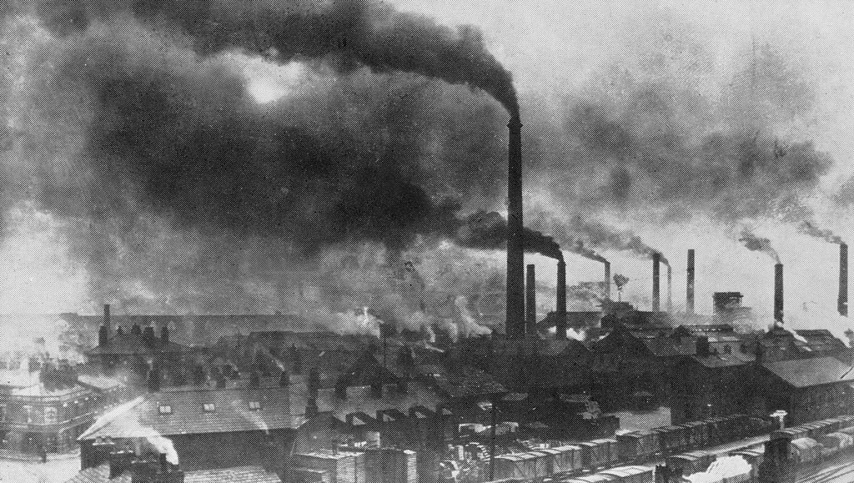
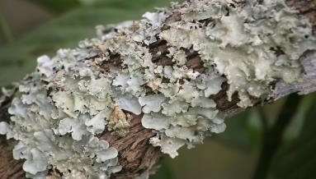
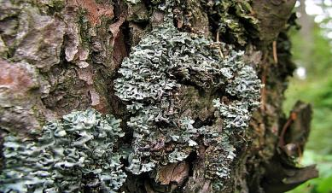
The Industrial Revolution
→
Notes:
Open Source Photo Credit:
https://commons.wikimedia.org/wiki/File:Widnes_Smoke.jpg
https://www.flickr.com/photos/httpoldmaisonblogspotcom/2798037679
https://commons.wikimedia.org/wiki/File:Lichen_(5465493518).jpg
https://pixabay.com/en/lichen-the-bark-tree-moss-1278358/

Slide 14
New Background Color

Slide 15
Predation Event

Slide 16
Predation Event

Slide 17
Surviving Moths

Slide 18
Each moth reproduces (one identical offspring):

Slide 19
Predation Event in Generation 2

Slide 20
Survivors

Slide 21
Each moth reproduces to make Generation 3:

Slide 22
“Initial” phenotypic distribution of moth coloration.
“After” phenotypic distribution of moth coloration?
High
Frequency
Low
Dark
Light
Moth Coloration

Slide 23
“After” phenotypic distribution of moth coloration:
High
Frequency
Low
Dark
Light
Moth Coloration

Slide 24
Environmental Laws Introduced
What happens after the environment changes?
→
Notes:
Open Source Photo Credit:
https://commons.wikimedia.org/wiki/File:Lichen_(5465493518).jpg
https://pixabay.com/en/lichen-the-bark-tree-moss-1278358/

Slide 25
“After” phenotypic distribution of moth coloration.
“Cleaned-up” phenotypic distribution of moth coloration?
High
Frequency
Low
Dark
Light
Moth Coloration

Slide 26
“Cleaned up” phenotypic distribution of moth coloration:
High
Frequency
Low
Dark
Light
Moth Coloration

Slide 27
CQ1: Can selection pressure change over time?
Yes, but only across generations, never within a generation.
Yes, but only in response to human actions.
Yes, and changes in the environment can cause selection to reverse direction.
Yes, and time can also be reversed.
No

Slide 28
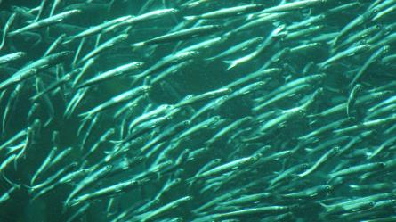
Example 2: Sardines
Adapted from Landi et al., 2014
Notes:
Open Source Photo Credit:
https://commons.wikimedia.org/wiki/File:Pacific_sardine_(Sardinops_sagax)_01.jpg

Slide 29
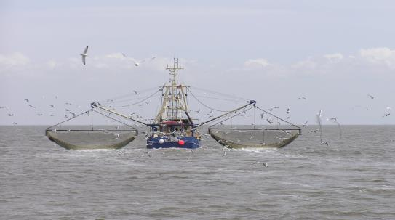
Sardines
Small oily fish in the herring family (multiple species).
Fisheries can catch fish from the ocean or lakes with a license.
Notes:
Open Source Photo Credit:
https://commons.wikimedia.org/wiki/File:Krabbenkutter_Ivonne_Pellworm_P5242390jm.JPG

Slide 30
“Initial” sardine size before harvest/fishing:
High
Frequency
Low
Small
Large
Size of Sardine

Slide 31
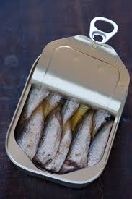
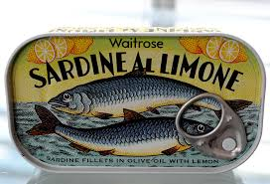
Fishing Practices
Fisheries and fishermen select for fish around the medium size because that size is ideal for human purposes (cooking, transportation, and sale).
Notes:
Open Source Photo Credit:
https://www.flickr.com/photos/wikidave/7719813806
https://commons.wikimedia.org/wiki/File:Sardines_in_a_can.jpg

Slide 32
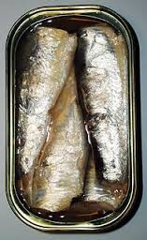
“After” sardine size distribution?
High
Frequency
Low
Small
Large
Size of Sardine
Notes:
Open Source Photo Credit:
https://commons.wikimedia.org/wiki/File:2006_sardines_can_open_top.jpg

Slide 33
“After” sardine size distribution:
High
Frequency
Low
Small
Large
Size of Sardine
Notes:
Open Source Photo Credit:
https://commons.wikimedia.org/wiki/File:2006_sardines_can_open_top.jpg

Slide 34
CQ2: Which of the following is false?
Humans can be a selective force by directly impacting survival and reproduction of organisms.
Humans can be a selective force by indirectly impacting survival and reproduction of organisms.
Political and legal systems can impact traits in animals.
In the presence of harvesting, natural selection no longer occurs.
Notes:
Open source photo credit:
https://pixabay.com/en/shovel-trowel-digging-equipment-575661/

Slide 35
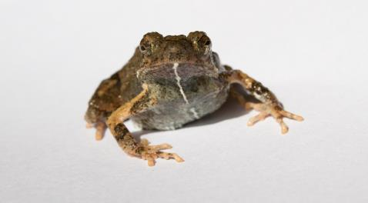
Example 3: Tungara Frogs
Adapted from Ryan and Rand, 1990
Notes:
Open Source Photo Credit:
https://commons.wikimedia.org/wiki/File:Tungara_Frog_female_Engystomops_pustulosus.jpg

Slide 36
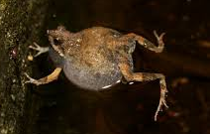
Tungara Frogs and Mating Calls
Male tungara frogs produce mating calls that range in complexity.
Complex call (3 chucks)
Not-complex call (0 chucks)
Notes:
Figure Credit:
Ryan M.J., (1990). The sensory basis of sexual selection for complex calls in the Tungara Frog, Physalaemus pustulosus (Sexual selection for sensory exploitation). Evolution, 44(2), 305-314.
Open Source Photo Credit:
http://maxpixel.freegreatpicture.com/Frog-Funny-Cute-Excuse-Me-Sweet-I-Beg-Your-Pardon-927750
https://commons.wikimedia.org/wiki/File:Tungara_Frog_(Engystomops_pustulosus).jpg

Slide 37
“Initial” phenotypic distribution of male call type:
High
Frequency
Low
not-complex
complex
Male song type

Slide 38
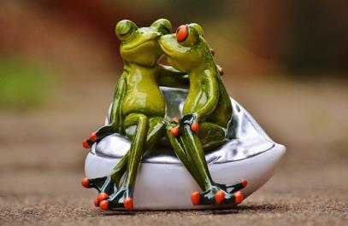
Mating Call and Effects of Females
Females prefer to mate with males who produce complex calls.
Notes:
Open Source Photo Credit:
https://pixabay.com/en/frogs-lovers-funny-together-smooch-1234585/

Slide 39
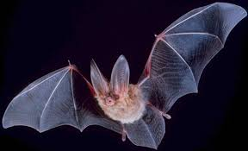
Mating Call and Effects of Predators
Predatory bats are attracted to complex songs.
Notes:
Open Source Photo Credit:
https://upload.wikimedia.org/wikipedia/commons/7/77/Big-eared-townsend-fledermaus.jpg

Slide 40
What would the “after” curve look like?
High
Frequency
Low
not-complex
complex
Male song type

Slide 41
“After” phenotypic distribution of male call type:
High
Frequency
Low
not-complex
complex
Male song type

Slide 42
“After” phenotypic distribution of male call type:
High
Bat Predator
Female Frog
Frequency
Low
not-complex
complex
Male song type

Slide 43
CQ3: Which of the following statements is true?
Sexual selection always opposes natural selection.
Multiple selective forces can act on the same trait in different directions.
Multiple selective forces can act on the same trait but always in the same direction.
Sexual selection is always directional.
Sexual selection is always stabilizing.
Notes:
Open Source Photo Credit:
https://pixabay.com/en/shovel-trowel-digging-equipment-575661/

Slide 44
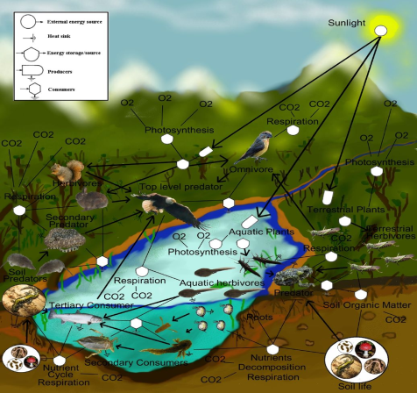
Can multiple selective forces act on the same trait?
Notes:
Open source photo credit:
https://en.wikipedia.org/wiki/File:FoodWeb.jpg

Slide 45
Concepts

Slide 46
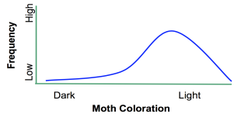
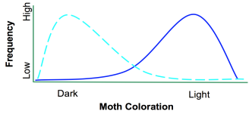
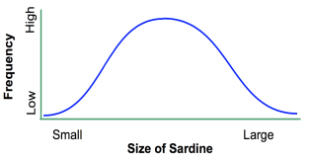
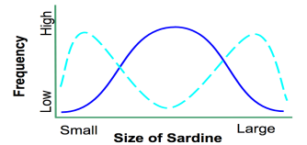
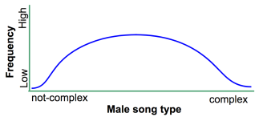
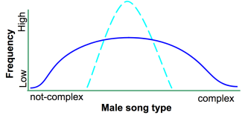
Before selection
After selection

Slide 47
Before selection
After selection
Directional
Disruptive
Stabilizing

Slide 48
CQ4: Based on what you know about each of these types of selection, which type would most likely lead to speciation (creating a new species)?
A
Directional
B
Stabilizing
C
Disruptive
Notes:
Open source photo credit:
https://pixabay.com/en/shovel-trowel-digging-equipment-575661/

Slide 49
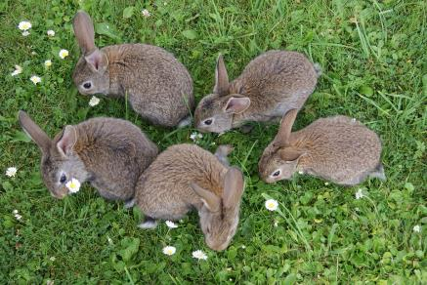
How do we measure selection?
Fitness is the number of viable offspring that an individual produces!
Through fitness!
OR
Notes:
Open Source Photo Credit:
https://maxer.dk/artikler/5-split-traeningsprogram
https://pixabay.com/en/photos/rabbits/

Slide 50
Peppered Moth Coloration Results
High
Frequency
Low
Dark
Light
Moth Coloration

Slide 51
Peppered Moth Coloration Results
High
Fitness
Low
Dark
Light
Moth Coloration

Slide 52
Peppered Moth Coloration Results
High
Fitness
Low
Dark
Light
Moth Coloration

Slide 53
Peppered Moth Coloration Results
High
Fitness
Low
Dark
Light
Moth Coloration

Slide 54
Peppered Moth Coloration Results
High
Fitness
Low
Dark
Light

Slide 55
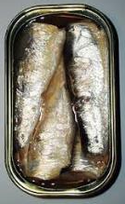
Sardine Selection
High
Frequency
Low
Small
Large
Size of sardines

Slide 56
Sardine Selection
High
Fitness
Low
Small
Large
Size of sardines

Slide 57
Sardine Selection
High
Fitness
Low
Small
Large
Size of sardines

Slide 58
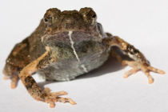
Complexity of Frog Calls
High
Frequency
Low
not-complex
complex
Male song type

Slide 59
Complexity of Frog Calls
High
Fitness
Low
not-complex
complex
Male song type

Slide 60
Complexity of Frog Calls
High
Fitness
Low
not-complex
complex
Male song type

Slide 61
Quiz Time

Slide 62
The Case of the Hawk Moth and the Iris
Adapted from Alexandersson and Johnson, 2002

Slide 63
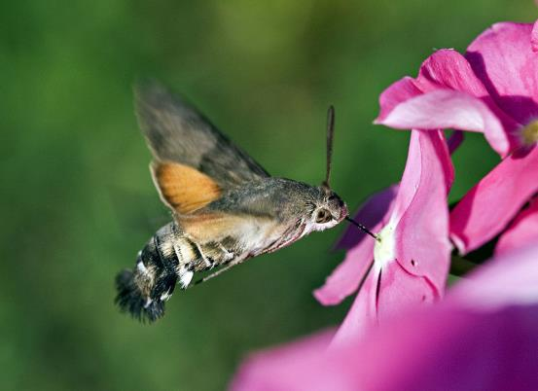
Hawkmoths and the S. African Iris
Hawkmoths are important pollinators!
S. African iris produces nectar inside the “flower tube” as a reward for pollinators.
The flower tube can vary in length.
How does the Hawkmoth
pollinate?
Notes:
Open Source Photo Credit:
https://commons.wikimedia.org/wiki/File:Kaibara87_-_Hummingbird_Hawk-moth_(by).jpg

Slide 64
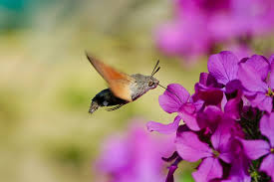
How do hawkmoths pollinate S. African iris?
Hawkmoths stick their long tongues inside the flower tube to collect the nectar.
With their tongue inside, the pollen from the stigma sticks to the hawkmoth head.
When they visit a different flower, they fertilize the new plant with the pollen they obtained from the previous plant!
Tongue length!
Flower tube length!
Notes:
Open Source Photo Credit:
https://commons.wikimedia.org/wiki/File:Hummingbird_Hawk-moth.jpg

Slide 65
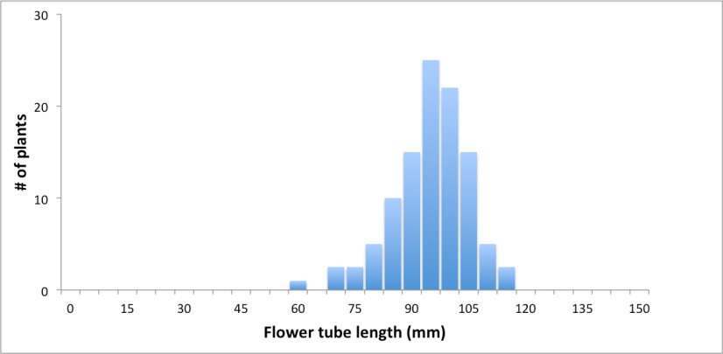
Distribution of Flower Tube Length

Slide 66
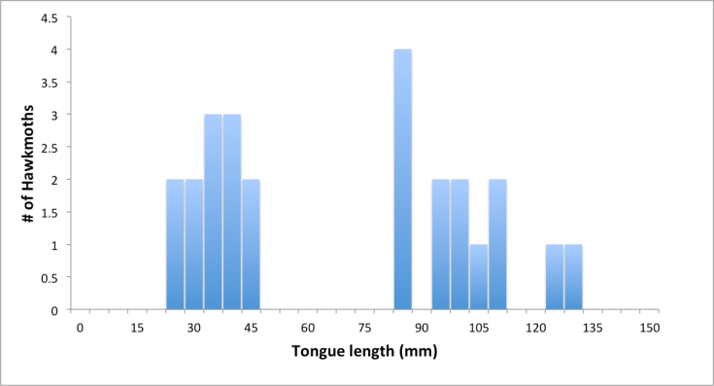
Distribution of Moth Tongue Lengths

Slide 67
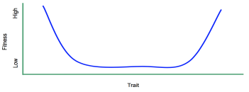
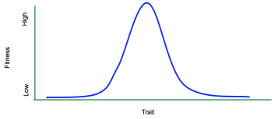
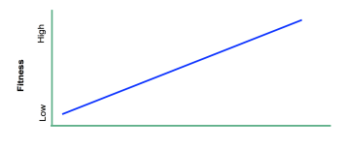
CQ5: In this example of pollinator-mediated selection, what kind of selection do you think hawkmoth tongue length will have on flower tube length?
A
B
C
Short Flower tube length Long

Slide 68
2. The Case of the Black-Bellied Seedcracker
Adapted from Smith, 1993

Slide 69
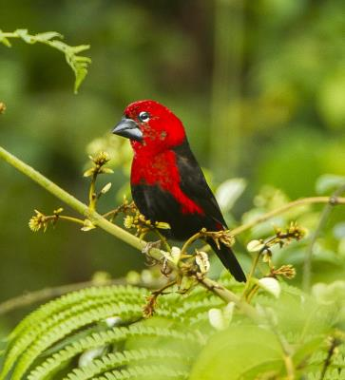
Black-Bellied Seedcracker
The black-bellied seedcracker is an African finch that lives in a large variety of habitats.
Notes:
Open Source Photo Credit:
https://commons.wikimedia.org/wiki/File:Black-bellied_Seedcracker_-_Kakum_-_Ghana_S4E2847_(22799387200).jpg

Slide 70
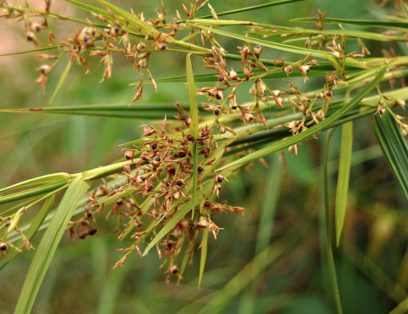
Black-Bellied Seedcracker
This species only eats seeds from sedges.
Birds with smaller beaks are more efficient at eating smaller seeds. Larger beaks are better at eating larger seeds.
Notes:
Open Source Photo Credit:
https://commons.wikimedia.org/wiki/File:Scleria_sumat_150918-0241_srl.JPG

Slide 71
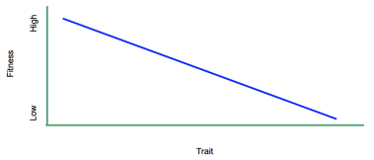
CQ6: Suppose that a drought destroys many of the seeds, but both small and large seeds are still abundant.
What kind of selection will act on the seedcracker population? Their beaks are adapted to break open seeds.
A
B
C
Small Bird Beak Size Large

Slide 72
3. The Case of the Fruit Fly Wing
Adapted from Hansen et al., 2004

Slide 73
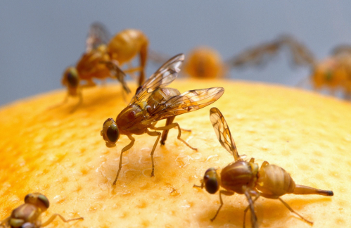
Drosophila Veins in Wings
Drosophila refers to the many species of fruit flies that exist.
Fruit flies are aptly named for their strong attraction to rotten fruit.
Notes:
Open Source Image Credit:
https://commons.wikimedia.org/wiki/File:Female_Mexican_fruit_fly_insect.jpg

Slide 74
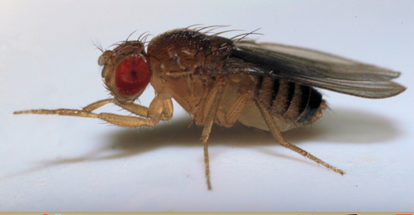
Drosophila Veins in Wings
Fruit flies have many different behaviors that can distinguish species, however all species of fruit fly have nearly the exact same wing structure . . .

Slide 75
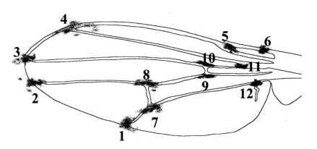
Drosophila Veins in Wings
Scientists can use landmarks (numbered points on the wing) to quantify similarities and differences in wings among species.
Intermediate distances between veins are optimal for flight.
Notes:
Figure Credit:
Hansen, T. F., & Houle, D. A. V. I. D. (2004). Evolvability, stabilizing selection, and the problem of stasis. Phenotypic integration: studying the ecology and evolution of complex phenotypes. Oxford University Press, Oxford, 130-150.
Open Source Image Credits:
https://commons.wikimedia.org/wiki/File:Female_Mexican_fruit_fly_insect.jpg

Slide 76
CQ7: What kind of selection do you think was acting on the different species of fruit fly over generations?
A
B
C
Average Distance Between Veins
Notes:
Figure Credit:
Hansen, T. F., & Houle, D. A. V. I. D. (2004). Evolvability, stabilizing selection, and the problem of stasis. Phenotypic integration: studying the ecology and evolution of complex phenotypes. Oxford University Press, Oxford, 130-150.

Slide 77
4. The Case of the Lizards and the Sand
Adapted from Rosenblum, 2005

Slide 78
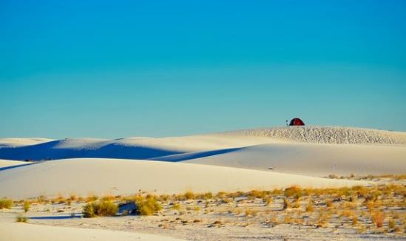
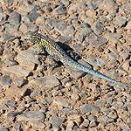
Lizard Coloration in the White Sands Ecotone
Lizards originate from NM in an environment with dark soil and substrate.
They avoid predators by camouflaging into their environment.
Therefore the lizards were originally dark in color.
Notes:
Open Source Photo Credit:
http://maxpixel.freegreatpicture.com/Tipi-Teepee-Hdr-Wigwam-Clouds-Tent-2000996
https://www.nps.gov/whsa/learn/nature/reptiles.htm

Slide 79
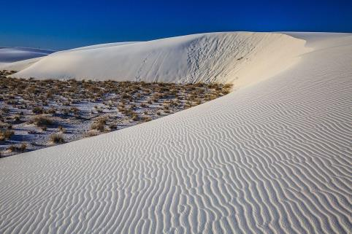
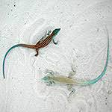
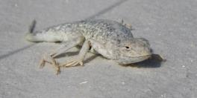
Lizard Coloration in the White Sands Ecotone
Last glacial period brought dune sedimentation into the area creating an ecotone!
This geographical change introduced two new “background colors” into the environment:
White sand
The darker region between the sand and dark substrate
The original dark substrate
Did the environmental change alter the lizard’s coloration?
Notes:
Open Source Photo Credit:
https://commons.wikimedia.org/wiki/File:White_Sands_National_Monument_-_New_Mexico_-_dawn_in_the_desert_-_(17913304838).jpg
https://www.nps.gov/whsa/learn/nature/bleachedearlesslizard.htm
https://www.nps.gov/whsa/learn/nature/reptiles.htm

Slide 80
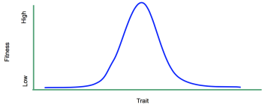
CQ8: What kind of selection did the new environments have on lizard coloration?
A
B
C
Light Lizard Coloration Dark
Notes:
Open Source Photo Credit:
https://www.nps.gov/whsa/learn/nature/bleachedearlesslizard.htm
https://www.nps.gov/whsa/learn/nature/reptiles.htm

Slide 81
5. The Case of the Insular Single-Leaf Bat
Adapted from Russo et al., 2009

Slide 82
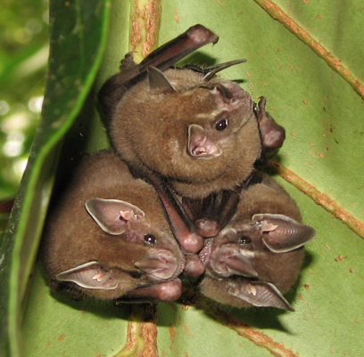
Social Calls in Insular Bats
Bats are known for their ability to see via sonar and sound waves (echolocation), however they also use social calls to communicate with other bats.
Often, these calls are specific to a single bat community to help avoid confusion with other bats in the area.
Notes:
Open Source Photo Credit:
https://upload.wikimedia.org/wikipedia/commons/1/12/Artibeus_sp._Tortuguero_National_Park_crop.jpg

Slide 83
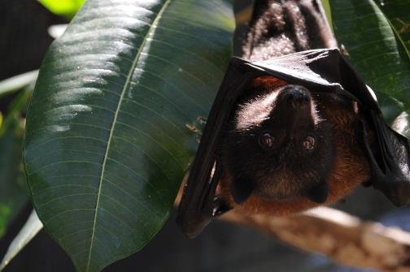
Social Calls in Insular Bats
They use their calls to locate one another and communicate the location of resources.
If bats are not as communicative or don’t help out their conspecifics it is less likely that they will receive help from others.
But, the more often they call, the more likely a predator is to find them and their resources.
Notes:
Open Source Photo Credit:
https://www.google.com/url?sa=i&rct=j&q=&esrc=s&source=images&cd=&ved=0ahUKEwjnmZGX867UAhUF6oMKHVPcAacQjBwIBA&url=https%3A%2F%2Fmedia.defense.gov%2F2013%2FMay%2F22%2F2000047855%2F-1%2F-1%2F0%2F130520-F-AA000-246.JPG&psig=AFQjCNF7qJKiTA7VPhdUU6hBZCvkFwzyig&ust=1497033638198973&cad=rjt

Slide 84
CQ9: What kind of selection is acting on the frequency of social calls in these bats?
A
B
C
Few Rate of social calling Many
Notes:
Open Source Photo Credit:
https://www.nps.gov/whsa/learn/nature/bleachedearlesslizard.htm
https://www.nps.gov/whsa/learn/nature/reptiles.htm

Slide 85
Summary
Selection can act on traits in three ways, or modes:
Directional Selection
Stabilizing Selection
Disruptive Selection
CQ10: Which types of selection can act in these three ways?
Natural selection
Sexual selection
Artificial selection
Human-induced natural selection
All of the above
Notes:
Recap on each mode of selection, restating what they are and any outlying details that you want to clear up.

Slide 86
Classroom Discussion
For each of the five following discussion topics there is a main question, a relevant publication for reading, and additional leading questions.
Speciation
Natural and sexual selection
Selection on multiple traits
Time
Human impacts on the environment

