Slide 1
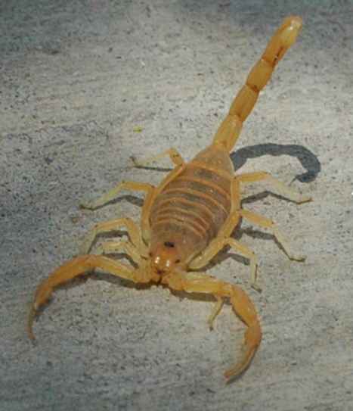
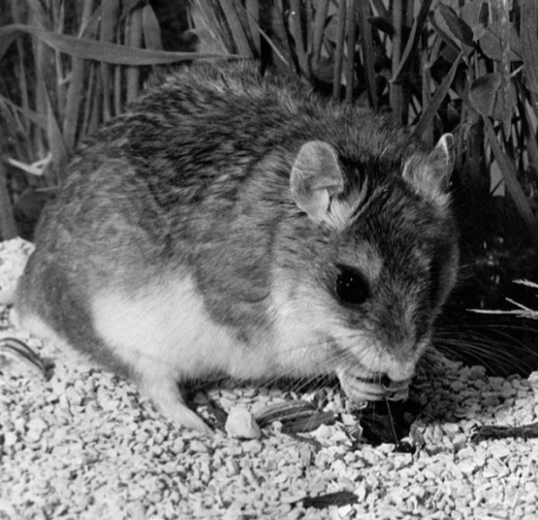
Scorpion vs. Mouse: A Tale of Venom and Action Potentials
NATIONAL CENTER FOR CASE STUDY TEACHING IN SCIENCE
by
Justin F. Shaffer
Department of Chemical and Biological Engineering
Colorado School of Mines, Golden, CO

Slide 2
Learning Objectives
Compare and contrast the structures and functions of neurons and glia.
Explain how ion channels contribute to membrane potential.
Explain how action potentials are generated and propagated.
Predict how membrane potential and action potentials may be altered by foreign substances.

Slide 3
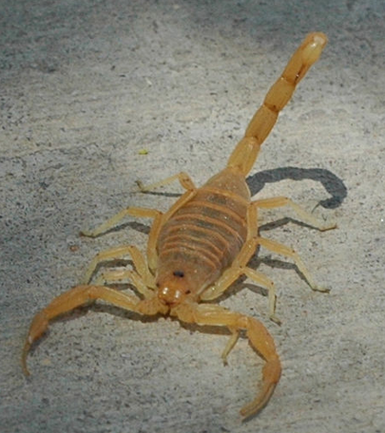
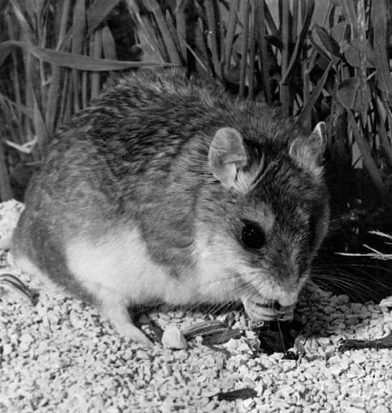
Arizona Bark Scorpion
Southern Grasshopper Mouse
Lives in Sonoran Desert of US Southwest.
Most venomous scorpion in North America.
Intense pain for 24 – 72 hours in humans.
Grasshopper Mouse vs. Bark Scorpion. Video. Running time: 1:27 min. Produced by Michigan State University, 2014. https://youtu.be/s-YZwYHrD24
Notes:
Show the video at https://youtu.be/s-YZwYHrD24. Note that the video is preceded by a YouTube warning that reads: “This video may be inappropriate for some users.” You will need to consent to viewing by clicking “I understand and wish to proceed.”

Slide 4
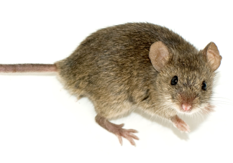
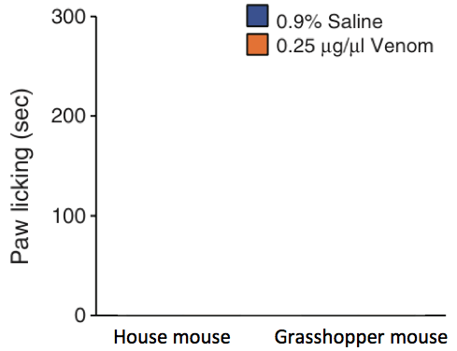
When mice feel pain on a part of their body, they lick that part
Experiment: Researchers injected bark scorpion venom into the hind paws of the common house mouse and the southern grasshopper mouse; As a control, they injected 0.9% saline solution. Then they measured how long they licked their paws afterwards.
What data do you think they observed?
House Mouse
Southern Grasshopper Mouse

Slide 5
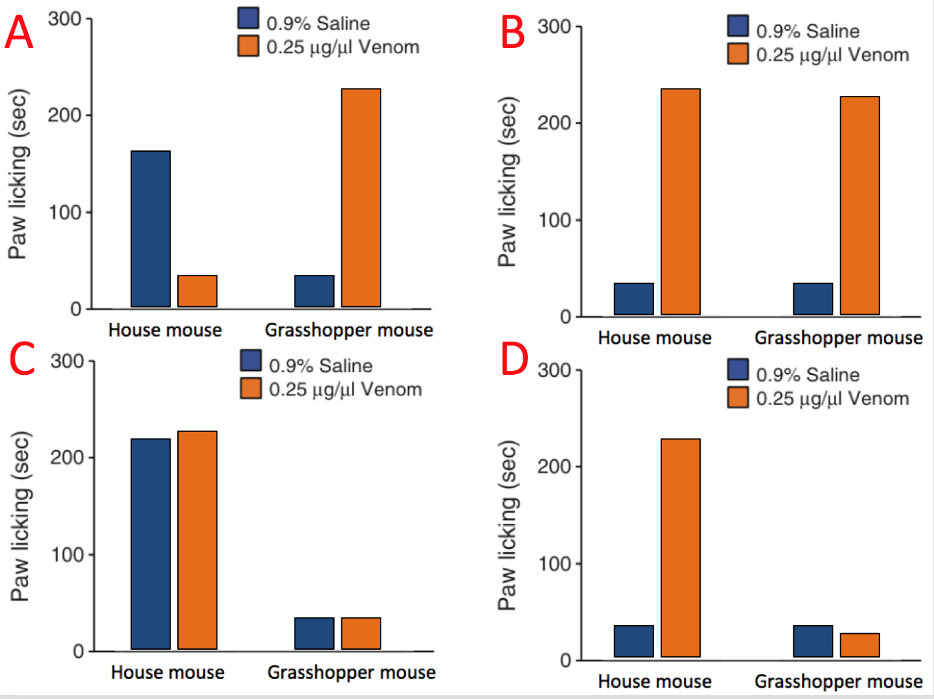
CQ1: What data do you think they observed?

Slide 6
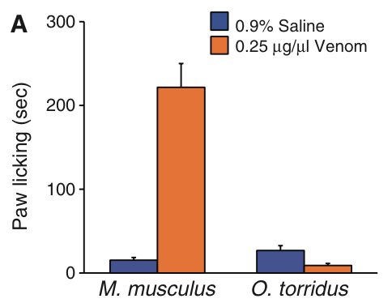
House mouse Grasshopper mouse
How is this possible?

Slide 7
Can you label this image?
Dendrite
Synaptic terminal
CQ2: What is true about this image?
A – The image shows a neuron and glia.
B – The image shows only a neuron.
C – The image shows only glia.
A
Schwann cell
F
Cell body
E
B
D
C
Axon
Nucleus
CQ3: Action potentials travel through which structure?

Slide 8
CQ4: What is the major contributor to a neuron’s resting membrane potential of -60 to -80 mV?
A – Diffusion of sodium ions through ungated sodium channels.
B – Diffusion of potassium ions through ungated potassium channels.
C – Diffusion of sodium ions through voltage-gated sodium channels.
D – Diffusion of potassium ions through voltage-gated potassium channels.

Slide 9
1. What components are shown in this figure?
2. Which side has more potassium ions? More sodium ions?
3. Which side is more negatively charged? Positively charged?
Extracellular
Intracellular

Slide 10
Sodium ion (Na⁺)
Ungated sodium channel
Ungated potassium channel
Potassium ion (K⁺)
Extracellular
+
+
+
+
+
+
+
_
_
_
_
_
_
_
Intracellular
More positively charged ions are leaving the cell than are coming in, so there is a net negative charge inside the cell.

Slide 11
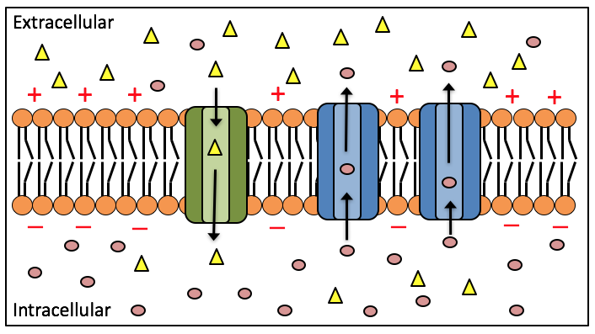
CQ5: What would happen if this ungated sodium channel was blocked?
A – The neuron would hyperpolarize.
B – The neuron would depolarize.
Hyperpolarization – membrane potential becomes more negative.
Depolarization – membrane potential becomes less negative.
What happens if a neuron depolarizes such that it reaches threshold?

Slide 12
What happens in each phase of an action potential?
50
Now we are talking about voltage gated channels and NOT ungated channels!
3
0
Membrane potential (mV)
4
-50
Threshold
2
1
5
-100
Time

Slide 13
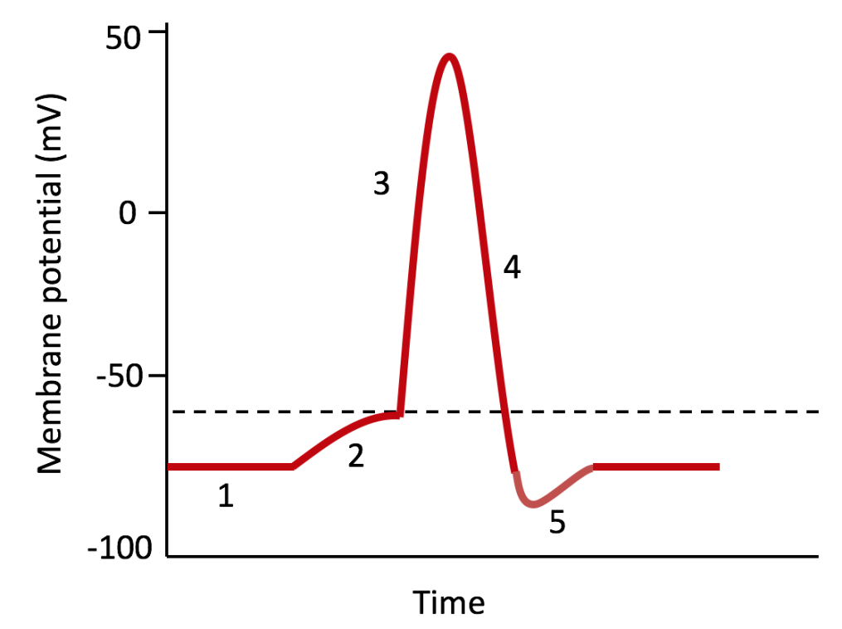
CQ6: In what stage do voltage-gated Na channels begin to open?
A – Stage 1
B – Stage 2
C – Stage 3
D –Stage 4
E – Stage 5
Threshold

Slide 14
CQ7: In what stage do voltage-gated K channels begin to open?
A – Stage 1
B – Stage 2
C – Stage 3
D –Stage 4
E – Stage 5
Threshold

Slide 15
50
1 – Resting state
2 – Depolarization
3 – Rising phase
4 – Falling phase
5 – Undershoot
3
0
Membrane potential (mV)
4
-50
Threshold
2
1
5
-100
Time

Slide 16
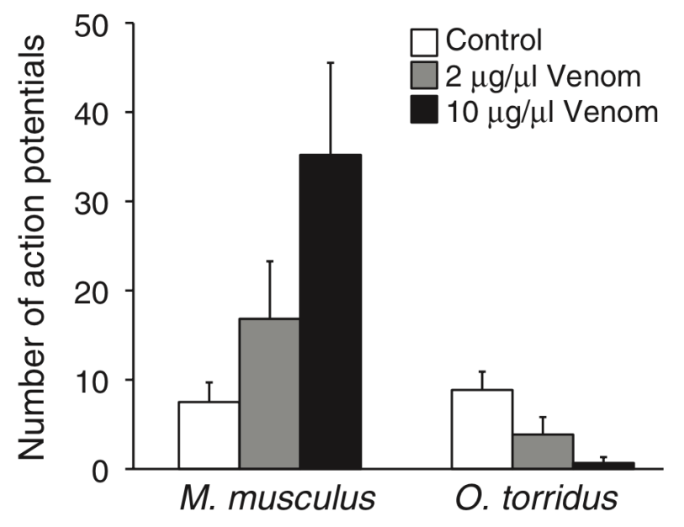
Experiment: Injected bark scorpion venom into mouse neurons and measured how many action potentials were generated after the venom was introduced
CQ8: Based on these data, what effect do you think the venom is having in the grasshopper mouse?
A – The venom is only blocking voltage-gated sodium channels.
B – The venom is only blocking voltage-gated potassium channels.
C – The venom is opening voltage-gated sodium channels or blocking voltage-gated potassium channels.
D – The venom is opening voltage-gated potassium channels or blocking voltage-gated sodium channels.
House mouse Grasshopper mouse
These neurons transmit pain signals (action potentials) to the grasshopper mouse brain.
What effect does the venom have on the grasshopper mouse?
The venom blocks pain sensations in the grasshopper mouse.

Slide 17
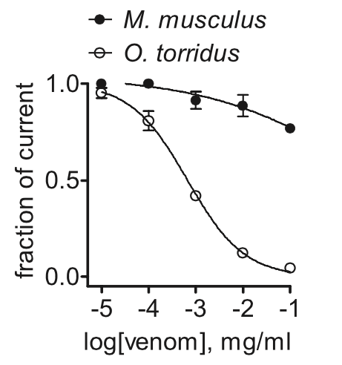
Experiment: Injected increasing amounts of bark scorpion venom into mouse neurons and measured the flow of sodium ions (current) across the cell membrane.
House mouse
CQ9: Which conclusion about the effects of venom on the grasshopper mouse is supported by these data?
A – The venom is blocking voltage-gated sodium channels.
B – The venom is blocking voltage-gated potassium channels.
C – The venom is opening voltage-gated sodium channels.
D – The venom is opening voltage-gated potassium channels.
Grasshopper mouse
Fraction of sodium current
Can you explain why the grasshopper mouse is resistant to the bark scorpion venom?

Slide 18
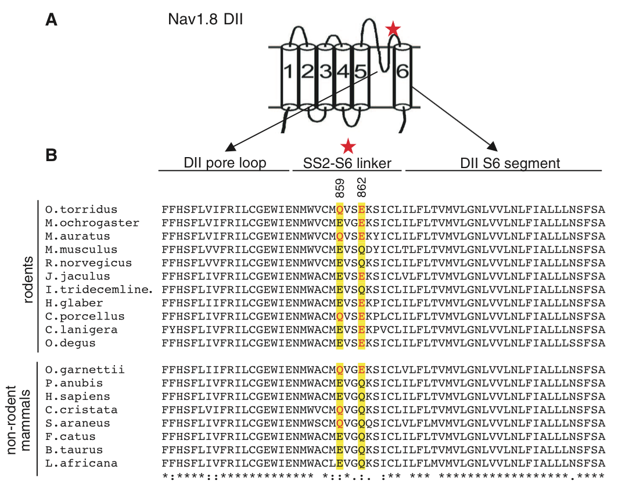
There are two missense mutations in a specific voltage-gated sodium channel in the grasshopper mouse!
The venom binds to the mutant sodium channel and blocks its function.
E859Q and Q862E

Slide 19
Image Credits
Slide 1. Photo of grasshopper mouse.
This image is a work of a United States Department of Energy (or predecessor organization) employee, taken or made as part of that person's official duties. As a work of the U.S. federal government, the image is in the public domain.
https://commons.wikimedia.org/wiki/File:Grasshopper_mouse_HD.16.jpg
Slide 1. Photo of Bark Scorpion by Brian Basgen, CC BY-SA 3.0.
https://commons.wikimedia.org/wiki/File:Bbasgen-scorpion-front.jpg
Slide 3. Photo of house mouse by George Shuklin, CC BY-SA 1.0.
https://commons.wikimedia.org/wiki/File:%D0%9C%D1%8B%D1%88%D1%8C_2.jpg
Slide 5. Modified Figure 1A from Rowe et al. 2013 paper
http://science.sciencemag.org/content/342/6157/441
Slide 6 . Figure 1A from Rowe et al. 2013 paper
http://science.sciencemag.org/content/342/6157/441
Slide 7. Drawing of neuron by Quasar Jarosz, CC BY-SA 3.0.
https://commons.wikimedia.org/wiki/File:Neuron_Hand-tuned.svg
Slide 16. Modified Figure 3C from Rowe et al. 2013 paper.
http://science.sciencemag.org/content/342/6157/441
Slide 17. Modified Figure 2D from Rowe et al. 2013 paper.
http://science.sciencemag.org/content/342/6157/441
Slide 18. Modified Figures 6A and 6B from Rowe et al. 2013 paper.
http://science.sciencemag.org/content/342/6157/441

