Slide 1
Protein Targeting Gone Awry:
NATIONAL CENTER FOR CASE STUDY TEACHING IN SCIENCE
The Importance of
Proper Localization
^{by}
^{Michèle I. Shuster} ^{Department of Biology} New Mexico State University, Las Cruces, NM
Notes:
Licensed image © Digitalstormcinema | Dreamstime.com, ID 31854580.

Slide 2
Work with your neighbors
Review your prep assignment

Slide 3
CQ#1: Which organelle breaks down fatty acids?
mitochondria
nucleus
peroxisome
ER

Slide 4
CQ#2: Which macromolecule is digested to release fatty acids?
triglycerides
proteins
nucleic acids
carbohydrates

Slide 5
CQ#3: Which organelle produces ATP?
mitochondria
nucleus
peroxisome
ER

Slide 6
CQ#4: Which of the following require(s) energy (E) (e.g., as ATP)?
simple diffusion
facilitated diffusion
active transport
osmosis

Slide 7
CQ#5: Which is the first step in the generation of urine?
excretion
filtration
reabsorption
secretion

Slide 8
Targeting Proteins
CQ#6: Which of the following is true of peroxisomal proteins?
They are translated entirely in the cytoplasm.
They enter the ER and endomembrane system.
So …
CQ#7: Do peroxisomal proteins have an ER signal peptide?
A. Yes
B. No

Slide 9
Peroxisome Targeting
Sequence at C-terminus
Question 1 on Worksheet
(identify the peroxisomal targeting sequence [PTS])

Slide 10
A family with a disease in many generations
Rickets
Bone malformation
b/c of low calcium and phosphate levels in blood (despite adequate dietary intake)
Glucose in urine
Amino acids in urine

Slide 11
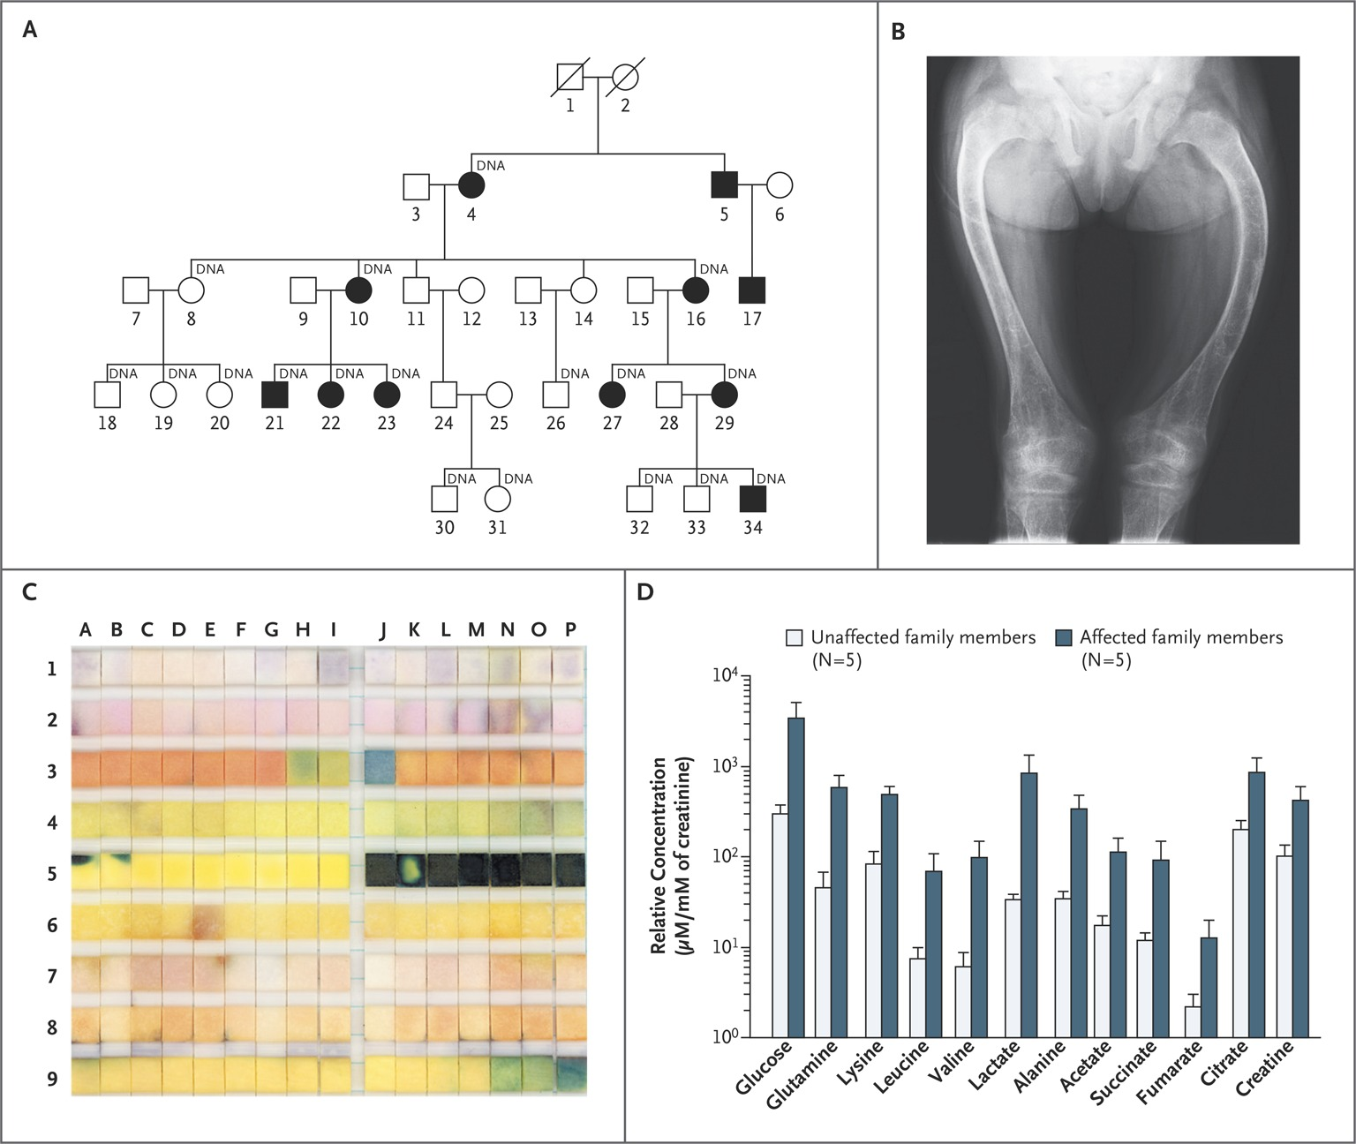
Clinical Characteristics of the Family Members.
Klootwijk ED et al. N Engl J Med 2014;370:129-138
From [Publication Title, Author(s), Title of Article, Volume No., Page No. Copyright © (notice year) Massachusetts Medical Society. Reprinted with permission from Massachusetts Medical Society.
Notes:
From New England Journal of Medicine, Klootwijk, ED., Reichold, M., Helip-Wooley, A., et al., Mistargeting of peroxisomal EHHADH and inherited renal Fanconi’s syndrome, 370(2), pp. 129–138. Copyright © 2014 Massachusetts Medical Society. Reprinted with permission from Massachusetts Medical Society.

Slide 12
A family with a disease in many generations
Rickets
Bone malformation
b/c of low calcium and phosphate levels in blood (despite adequate dietary intake)
Glucose in urine
Amino acids in urine
Brainstorm…
What do these symptoms have in common?

Slide 13
Nephron Function
CQ#8: What happens first (at “A”)?
Excretion
Filtration
Reabsorption
Fine-tuning
D
A
B
C
Credit: Nephron Secretion Reabsorption by Openstax College.
Notes:
Nephron Secretion Reabsorption by Openstax College is licensed under CC BY 3.0.

Slide 14
Nephron Function
CQ#9: What happens next (at “B”)?
Excretion
More Filtration
Reabsorption
Fine-tuning
D
A
B
C
Credit: Nephron Secretion Reabsorption by Openstax College.

Slide 15
Nephron Function
CQ#10: And what happens at “D”?
Excretion
More Filtration
Reabsorption
Fine-tuning
D
A
B
C
Credit: Nephron Secretion Reabsorption by Openstax College.

Slide 16
Kidney/Nephron Function
Filtration
Of blood
~180 L per day
Everything except cells and large proteins
→ filtrate in nephron
Need to get most of it back!
Sugar, water, ions, amino acids

Slide 17
Nephron function
Reabsorption
Taking back the good stuff
Active transport
Secretion
Dumping excess
Dumping toxins
Excretion
~1.5 L per day

Slide 18
Our family
Glucose in urine
Amino acids in urine
Low ion levels in blood (where do you suspect those ions are?)
CQ#11: Which step is not working?
Filtration
Reabsorption
Secretion
Excretion

Slide 19
Nephron Function
Proximal Convoluted Tubule
Reabsorption
Active transport

Slide 20
What might be going on?
Does this condition run in the family?
Is it likely to be genetic?
What process is a possible mutation interfering with?

Slide 21
Hypothesis
Mutation
Interfering with reabsorption
Genome-wide sequencing
Affected family members
Unaffected family members
Looking for mutation only in affected family members
Found a single nucleotide change

Slide 22
In a peroxisomal protein (EHHADH)
Wild type (WT) EHHADH
Mitochondria (mitos)
WT (not in mitos)
Mutant EHHADH
Mitochondria (mitos)
Mutant (in mitos)
Klootwijk ED et al. N Engl J Med 2014;370:129-138
Notes:
From the appendix of the paper:
Top Panel (WT)
Left: WT EHHADAH protein (green); Middle: mitotracker (Red); right: Merge (no overlap)
Bottom Panel (Mutant)
Left: Mutant EHHADH protein (green) (note broader intracellular localization of mutant relative to WT); Middle: Mitotracker (red); right: Merge (see overlap)
Credit: From New England Journal of Medicine, Klootwijk, ED., Reichold, M., Helip-Wooley, A., et al., Mistargeting of peroxisomal EHHADH and inherited renal Fanconi’s syndrome, 370(2), pp. 129–138. Copyright © 2014 Massachusetts Medical Society. Reprinted with permission from Massachusetts Medical Society.

Slide 23
In a peroxisomal protein (EHHADH)
Wild type (WT) EHHADH
Mitochondria (mitos)
WT (not in mitos)
Mutant EHHADH
Mitochondria (mitos)
Mutant in mitos
& peroxisomes
Klootwijk ED et al. N Engl J Med 2014;370:129-138
Notes:
From the appendix of the paper:
Top Panel (WT)
Left: WT EHHADAH protein (green); Middle: mitotracker (Red); right: Merge (no overlap)
Bottom Panel (Mutant)
Left: Mutant EHHADH protein (green) (note broader intracellular localization of mutant relative to WT); Middle: Mitotracker (red); right: Merge (see overlap)
Credit: From New England Journal of Medicine, Klootwijk, ED., Reichold, M., Helip-Wooley, A., et al., Mistargeting of peroxisomal EHHADH and inherited renal Fanconi’s syndrome, 370(2), pp. 129–138. Copyright © 2014 Massachusetts Medical Society. Reprinted with permission from Massachusetts Medical Society.

Slide 24
Brainstorm
What might be going on?

Slide 25
Based on the C-terminal sequence …
Does it still have a PTS?
C-terminus
WT: WQSLAGSPSSKL
Mutant: WQSLAGSPSSKL

Slide 26
Why is it in mitochondria?
Question 2 on Worksheet
Look at N-terminus of wild-type and mutant protein

Slide 27
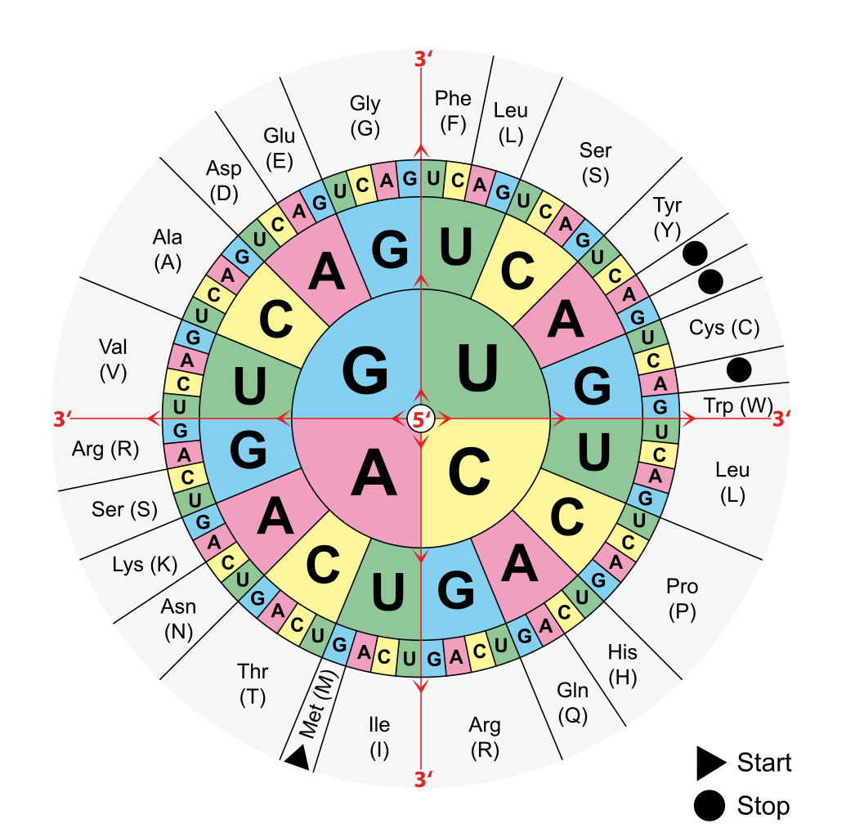

Slide 28
Use a prediction program iPSORT
Takes N-terminal amino acid sequence
Analyzes
Presence of an ER signal peptide
Presence of mitochondrial targeting sequence

Slide 29
http://ipsort.hgc.jp/
Question 3 on Worksheet
Do wild type 1st; then a new prediction for mutant
Enter amino acid sequence here (cut and paste)
Non-Plant
(it’s a human protein)

Slide 30
Wild Type Protein
CQ#12: Does the wild type protein have an ER signal peptide?
Yes
No
CQ#13: Does the wild type protein enter the endomembrane/secretory system?
Yes
No

Slide 31
Wild Type Protein
CQ#14: Does the wild type protein have a mitochondrial targeting sequence?
Yes
No
So overall, what sequences direct it to which location(s)?

Slide 32
Mutant Protein
CQ#15: Does the mutant protein have an ER signal peptide?
Yes
No
CQ#16: Does the mutant protein have a mitochondrial targeting sequence?
Yes
No

Slide 33
So what happened?
Mutation created new mitochondrial targeting sequence
Retains PTS at other end
Does this explain its localization pattern?

Slide 34
Why is the mutant in the mitos?

Slide 35
Right place?
CQ#17: Some EHHADH is in peroxisomes.
True
False
CQ#18: Some EHHADH is in mitos.
True
False

Slide 36
Can mitochondria do their job with wrong protein?
What is the job of mitochondria?
Which kidney process needs lots of ATP?
Which kidney process is not working in these patients?
Put it all together…
Question 4 on Worksheet

Slide 37
In case of internet connectivity issues
iPSORT predictions for wild type and mutant shown on next two slides

Slide 38
Wild type protein
Analyzed by an online prediction program
Looks for
ER signal peptide
Mitochondrial targeting sequence

Slide 39
Mutant protein
Analyzed by an online prediction program
Looks for
ER signal peptide
Mitochondrial targeting sequence

