Slide 1
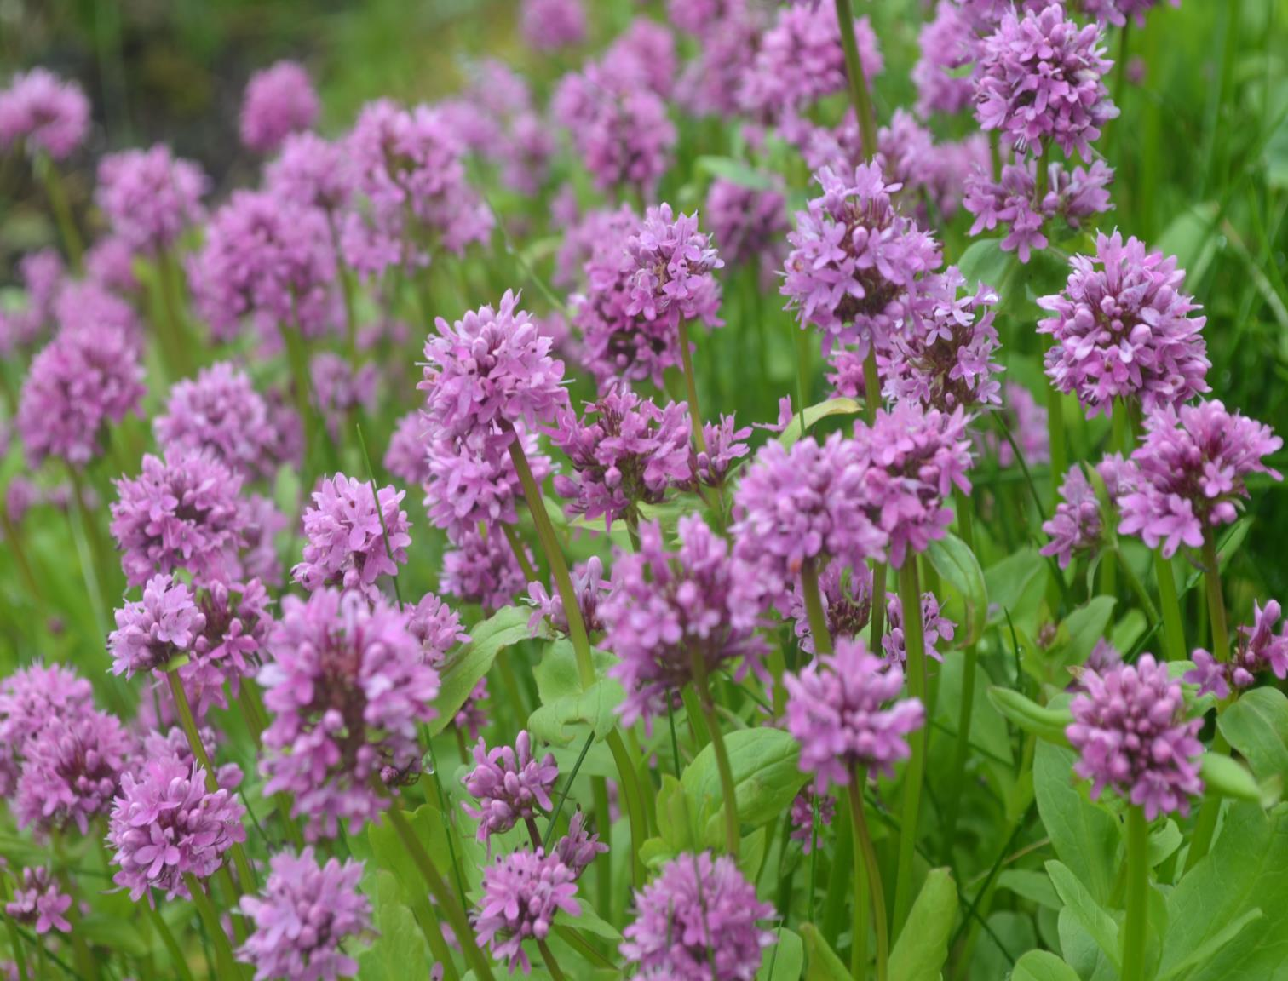
Animals Can Run Away, but Plants Must Stay: Responses to Herbivory
NATIONAL CENTER FOR CASE STUDY TEACHING IN SCIENCE
^{by}
Nicole D. Tunbridge, Department of Biology, Kwantlen Polytechnic University, Surrey, BC
Carol Pollock, Department of Zoology, University of British Columbia, Vancouver, BC
Joan Sharp, Department of Biological Sciences, Simon Fraser University, Burnaby, BC

Slide 2
What are some of the challenges faced by plants in order to survive and reproduce?

Slide 3
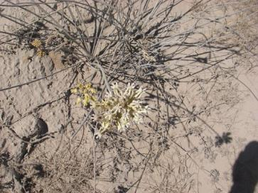
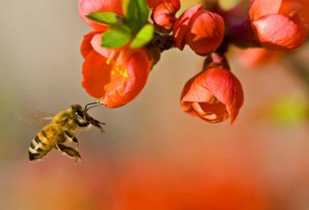
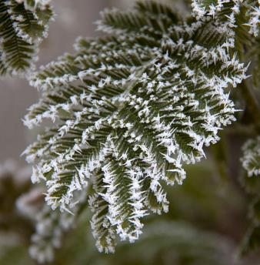
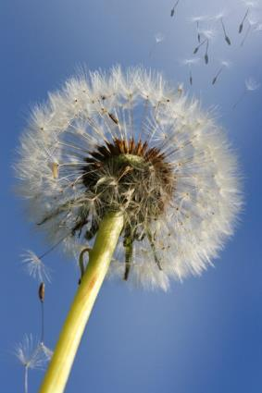
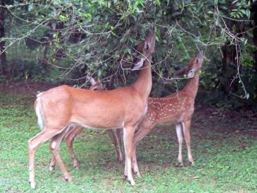
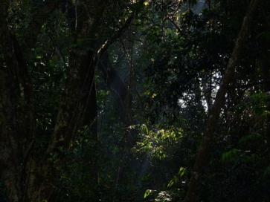
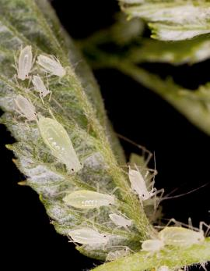
Challenges:
Pollination
Water & nutrients
Temperature
Seed dispersal
Herbivory
Light

Slide 4
CQ#1: Which of the following might induce a morphological response in plants?
A change in temperature
A change in soil moisture
Feeding by an herbivore
A and B
All of the above

Slide 5
CQ#1: Which of the following might induce a morphological response in plants?
A change in temperature
A change in soil moisture
Feeding by an herbivore
A and B
All of the above

Slide 6
How do plants respond to these challenges?

Slide 7
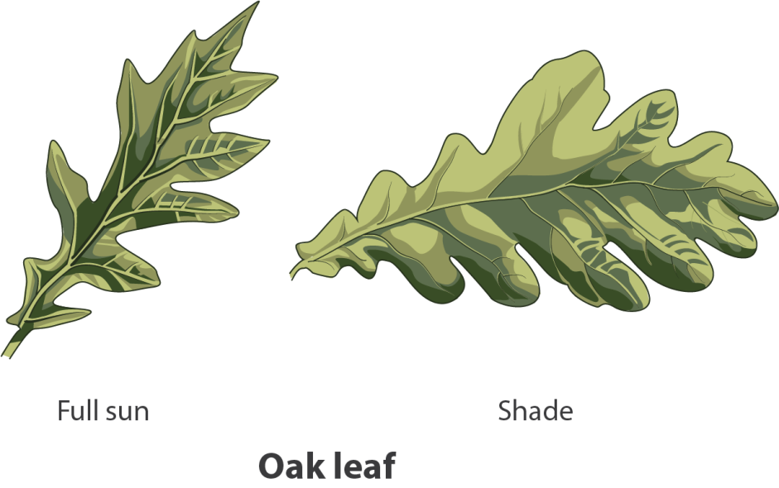
Phenotypic variation in response to abiotic factors (light)
Leaf surface area and shape vary with light availability

Slide 8
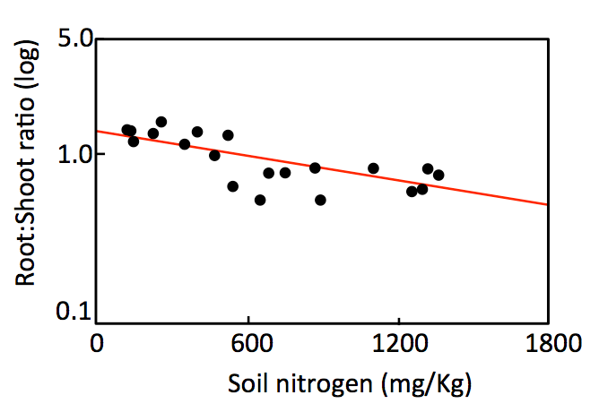
Phenotypic variation in response to abiotic factors (nutrients)
Root to shoot mass ratio varies with nutrient availability
R:S Low
R:S High
Low
High
Nutrients

Slide 9
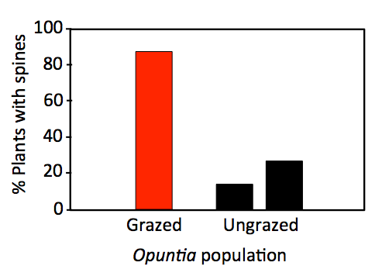
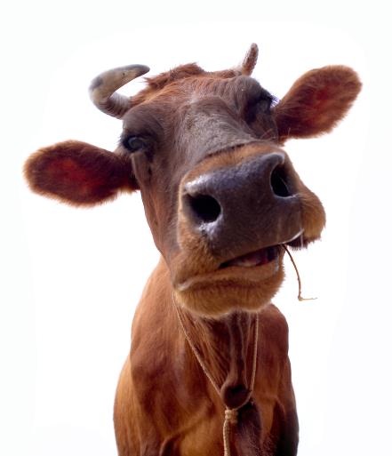
Phenotypic variation in response to biotic factors (herbivory)
Opuntia cacti that grow on islands grazed by cattle are more likely to have spines than those grown on cattle-free islands

Slide 10
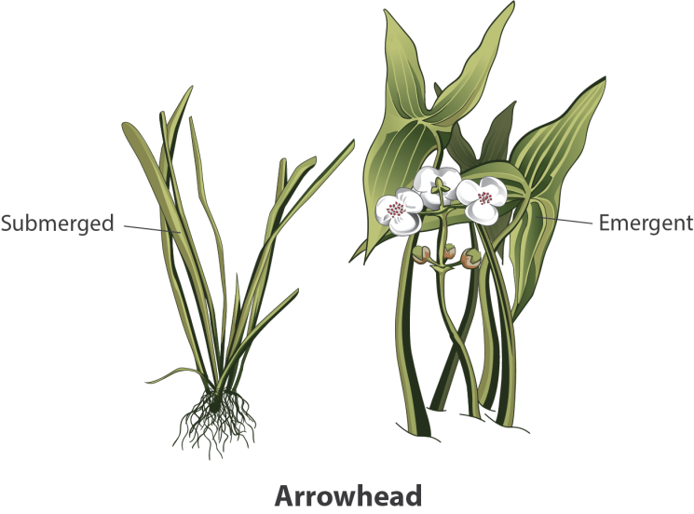
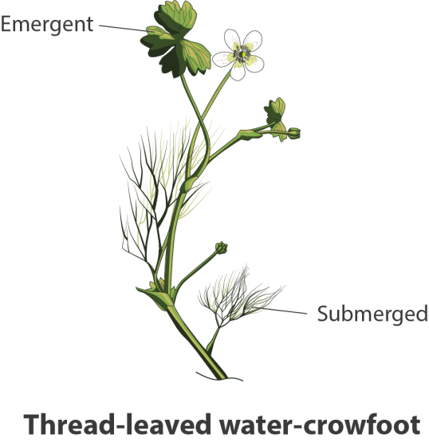
Environmental vs. Genetic Variation
Some phenotypic variation is due to environmental variation rather than genetic variation.
For example, many aquatic plants produce different leaves above and below water.

Slide 11
Environmental vs. Genetic Variation
How would you determine if observed variations have a genetic basis?

Slide 12
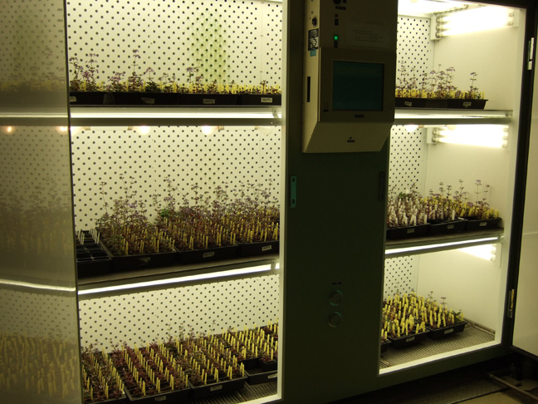
Environmental vs. Genetic Variation
How would you determine if observed variations have a genetic basis?
Grow plants in a common environment and measure variation.

Slide 13
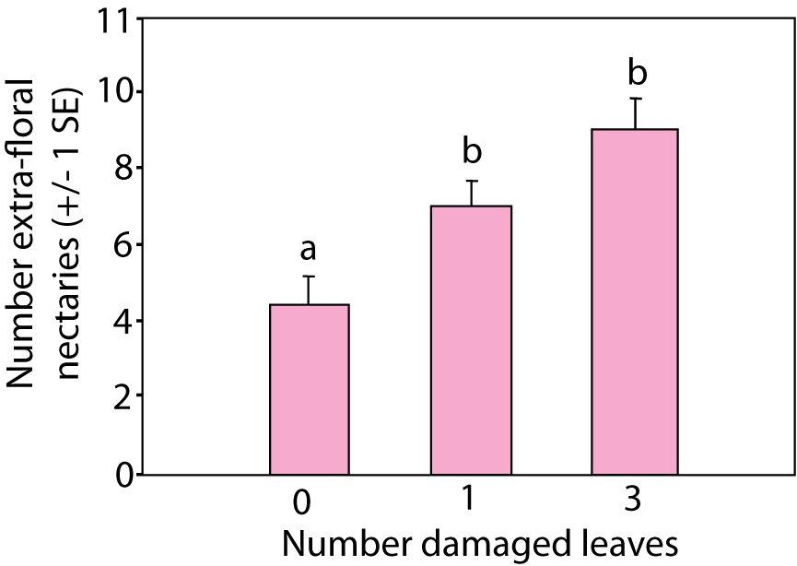
Group Discussion:
Explain the responses to leaf damage in Vicia faba plants shown below.
Notes:
Columns with different letters are significantly different, P < 0.05.

Slide 14
Constitutive Defenses vs. Induced Responses
Constitutive defenses: always present
Induced responses: produced in response to damage

Slide 15
When should plants have constitutive defenses vs. induced responses to herbivory?

Slide 16
When should plants have constitutive or induced responses to herbivory?
1
Induced
Constitutive
Predicted Type of Defense
0
0
1
Probability of Attack

Slide 17
Environmental vs. Genetic Variation
Plectritis growing on the Gulf Islands in the Salish Sea in the absence of deer (herbivores) demonstrate mostly tall phenotype.
Plectritis growing on Gulf Islands in the presence of deer demonstrate mostly short phenotype.
The following slides are based on research by Cora Skaien and Ada Roman.

Slide 18
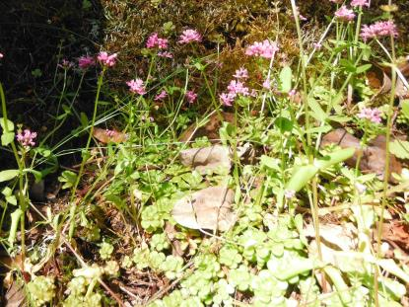
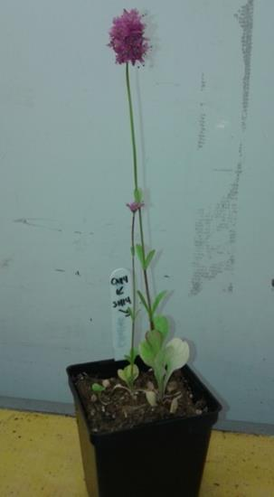
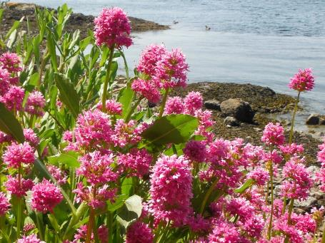
Environmental vs. Genetic Variation
Phenotypic differences between populations were maintained in the growth chamber.
Deer-present
Deer-absent

Slide 19
Herbivory Experiments
How would you simulate deer herbivory under lab conditions?

Slide 20
Herbivory Experiments
How would you simulate deer herbivory under lab conditions?
Mechanical damage can be used to simulate feeding by herbivores.

Slide 21
Experiment #1: Independent Variables
Population of origin: deer-present or deer-absent
Simulated herbivory: plants clipped 2.5 cm above soil or not clipped
Plectritis from environment with deer absent
Growth Chamber
Plectritis from environment with deer present
Clipped
Not Clipped

Slide 22
Experiment #1: Dependent Variables
What dependent variables would you measure?

Slide 23
Experiment #1: Dependent Variables
What dependent variables would you measure?
In this experiment the researchers measured:
Proportion of height lost.
Proportion of seeds on lateral branches.

Slide 24
Experiment #1: Predictions
What results would you expect to see if Plectritis has an induced response to deer herbivory?

Slide 25
Experiment #1: Results

Slide 26
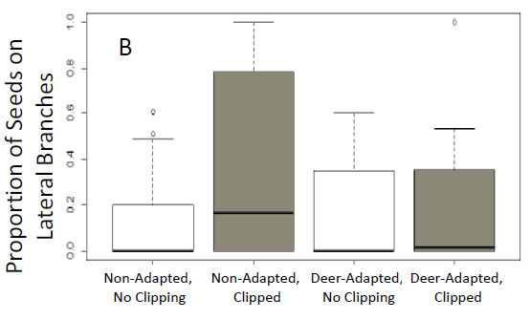
Experiment #1: Results
* significant
Deer-absent
Not clipped
Deer-absent
Clipped
Deer-present
Not clipped
Deer-present
Clipped

Slide 27
CQ#2: Which of the following conclusions could you draw from these experimental results?
Populations of Plectritis that have evolved in presence of deer express constitutive defenses.
Populations of Plectritis that have evolved in the absence of deer have induced responses to herbivory.
Plectritis respond to herbivorous attack on surrounding plants with induced defenses.
A and B are correct.
A, B, and C are correct.

Slide 28
CQ#2: Which of the following conclusions could you draw from these experimental results?
Populations of Plectritis that have evolved in presence of deer express constitutive defenses.
Populations of Plectritis that have evolved in the absence of deer have induced responses to herbivory.
Plectritis respond to herbivorous attack on surrounding plants with induced defenses.
A and B are correct.
A, B, and C are correct.

Slide 29
Herbivory Experiments
How could you determine if plants will respond to actual herbivory in the same way?

Slide 30
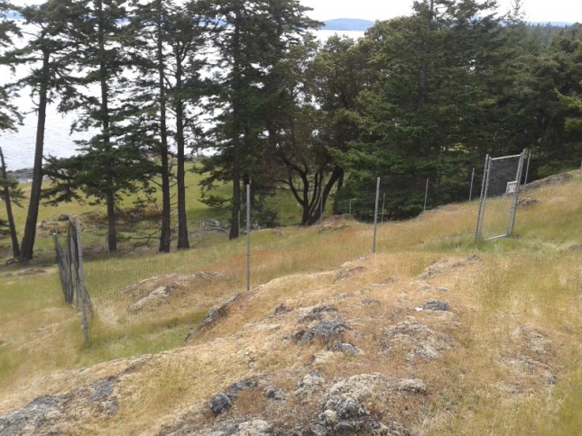
Herbivory Experiments
How could you determine if plants will respond to actual herbivory in the same way?
Experiment #2:
Transplant plants to plots on deer-present islands, inside and outside enclosures that exclude deer.

Slide 31
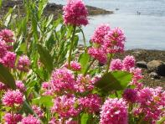
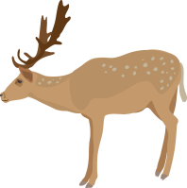
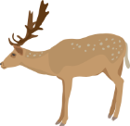
Experiment #2: Independent Variables
Population of origin: deer-present or deer-absent
Exposure to herbivores: inside or outside enclosures
Plectritis from environment with deer absent
Plectritis from environment with deer present
Outside Enclosure
Inside Enclosure

Slide 32
Experiment #2: Dependent Variables

Slide 33
Experiment #2: Predicted Results

Slide 34
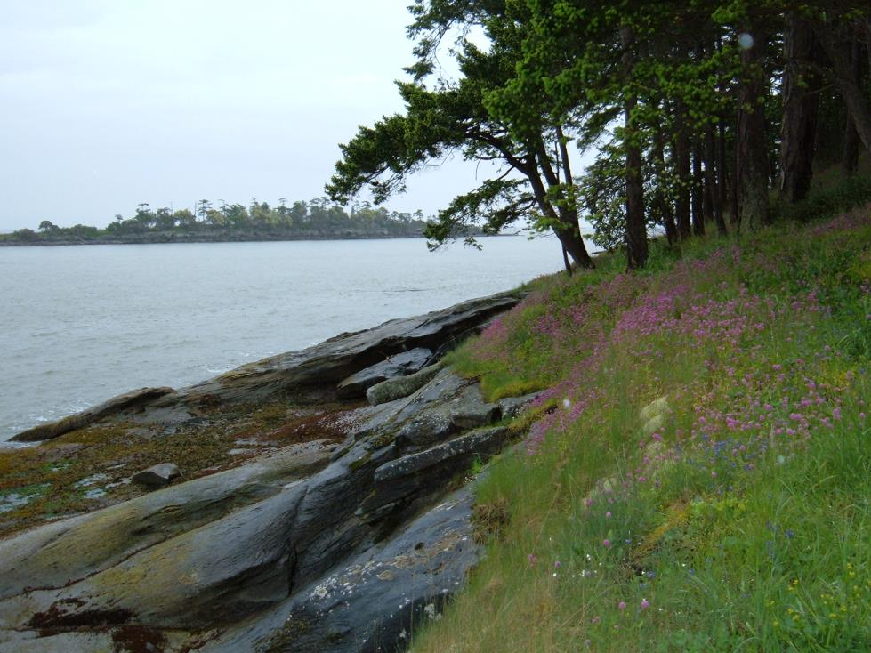
Wait and see…

Slide 35
Image Credits
Slide 1
Photographer: Jennifer McNew, Bureau of Land Management. https://commons.wikimedia.org/wiki/File:Seablush_plectritus_congesta_1_(18465135565).jpg, CC BY 2.0.
Slide 3
Water and nutrients: http://commons.wikimedia.org/wiki/File:Desert_plants_13.JPG?uselang=en-gb, Jcomeau ictx, CC BY-SA 3.0.
Temperature: http://commons.wikimedia.org/wiki/File:Frosted_Leaves_2_(5238111572).jpg?uselang=en-gb, Tony Hisgett from Birmingham, UK, CC BY 2.0. Light: http://commons.wikimedia.org/wiki/File:Forest_light.jpg, L. Shyamal, CC BY-SA 3.0.
Herbivory (aphids): https://commons.wikimedia.org/wiki/File:Raspberry_aphids.jpg?uselang=en-gb, U.S. Dept of Agriculture, p.d.
Herbivory (deer): http://en.wikipedia.org/wiki/Herbivore#mediaviewer/File:White-tailed_deer_(Odocoileus_virginianus)_grazing_-_20050809.jpg, Raul654, CC BY-SA 3.0. Pollination: http://commons.wikimedia.org/wiki/Category:Bee_pollination?uselang=en-gb#mediaviewer/File:Pollinationn.jpg , Louise Docker, CC BY 2.0. Seed dispersal: http://commons.wikimedia.org/wiki/Category:Blown_dandelions#mediaviewer/File:Diente_de_le%C3%B3n_soltando_semillas.jpg, Louise Docker, CC BY 2.0.
Slide 7
Drawing of shade and sun leaves. Credit: Greg Holoboff, used with permission.
Slide 8
Cartoon on right by author (Tunbridge). Graph on left drawn after: Tilman, D. and M.L. Cowan. 1989. Growth of old field herbs on a nitrogen gradient. Functional Ecology 3(4): 425-438. See Fig. 3 on page 432 of the article.
Slide 9
Cow: © Dary423 | Dreamstime, ID 10116845, licensed.
Graph redrawn based on: Myers JH and Bazely D. 1991. Thorns, spines, prickles, and hairs: Are they stimulated by herbivory and do they deter herbivores? In: Tallamy D, Raup M (eds.) Herbivore-induced Phytochemical Changes in Plants. John Wiley, New York.

Slide 36
Image Credits cont.
Slide 10
Drawing of aquatic plants. Credit: Greg Holoboff, used with permission.
Slide 12
Photo credit: Cora Skaien
Slide 13
Redrawn after Mondor EB, Addicott JF. 2003. Conspicuous extra-floral nectaries are inducible in Vicia faba. Ecology Letters, 6: 495–497.
Slide 16
Figure redrawn and modified, based on a figure from Zangerl AR and Bazzaz FA. 1992. Theory and pattern in defense allocation. Page 377 in Fritz R and Simms EL, eds. Plant resistance to herbivores and pathogens. University of Chicago Press, Chicago.
Slides 17, 18, 21, 30, 31
Photo credit: Cora Skaien & Ada Roman
Slides 20, 21, 25, 26, 31
Drawings by Nicole Tunbridge
Slides 25, 26
Graphs by Cora Skaien and Nicole Tunbridge
Slide 34
Photo credit: Nicole Tunbridge

