Slide 1
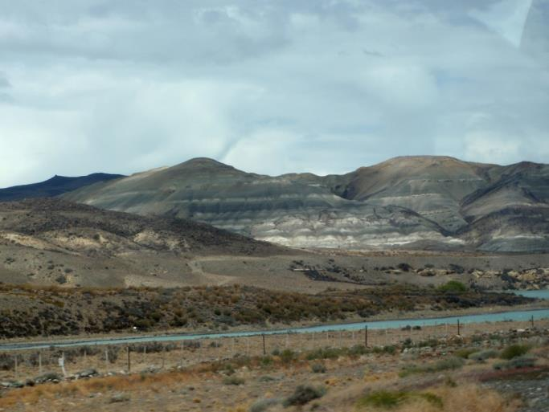
Restoring Resilience: Changing the Landscape Legacy in Patagonia
by Dawn R. Tanner and Jim A. Perry Department of Fisheries, Wildlife and Conservation Biology University of Minnesota, St. Paul, MN
A decision case building upon The Great Patagonia Land Grab by Courtney Quinn and John Quinn
NATIONAL CENTER FOR CASE STUDY TEACHING IN SCIENCE

Slide 2
Review: The Great Patagonia Land Grab
International people buying millions of acres
Goal: Protect species and landscapes by creating national parks
Indigenous people are being excluded from their historical lands
Some argue that cultural heritage (ranching) is being replaced by ecotourism
Debates over water rights and land access

Slide 3
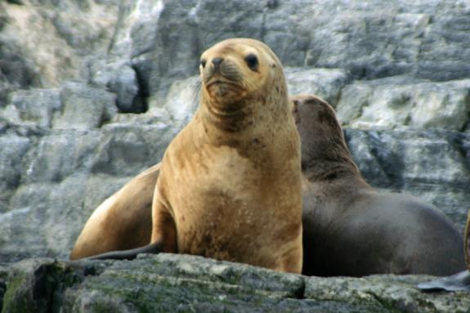
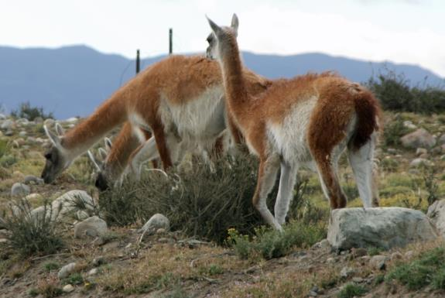
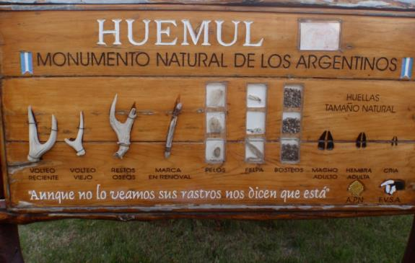
Review: Patagonian biodiversity
Landscape features
Upland grasslands
Wetlands
Rivers
There are few protected areas
Threats include
Farmland/ranching expansion
Invasive species
Over grazing
Climate change
Threatened and endangered species
Sea lion (Lobo de dos pelos)
Guanaco
Patagonia mara
Lesser gray fox (Zorro gris chico)
Andean condor
Huemul deer

Slide 4
Review: Policy simulation
Issues to consider building a new PA in Patagonia
Threats to biodiversity
Major stakeholders
Role of public vs. private protection
Group policy creation
Policy recommendations

Slide 5
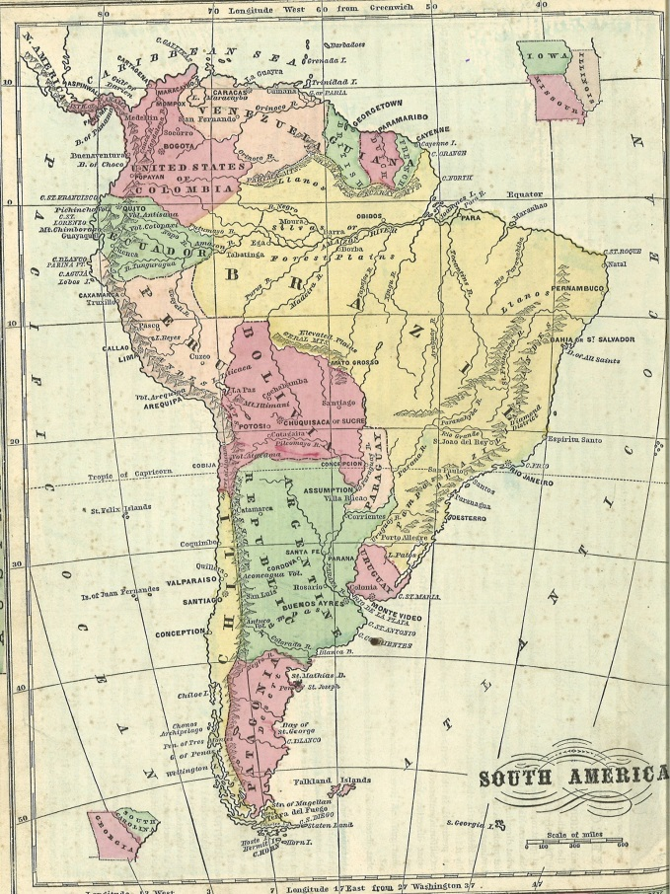
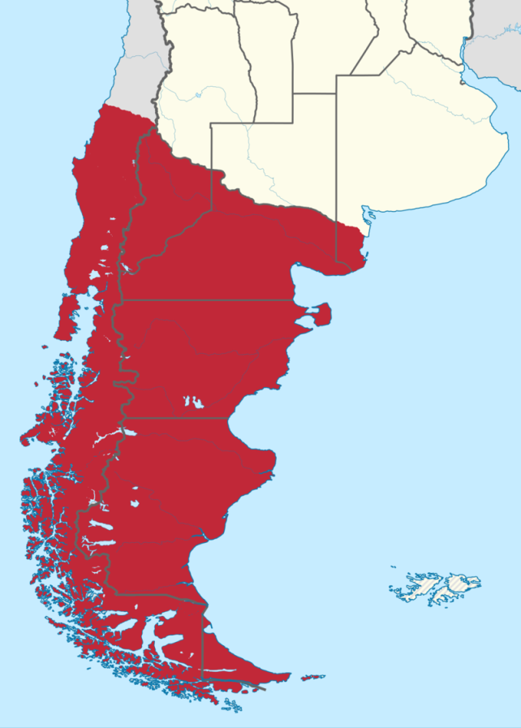
Patagonia: Location
A place of myth and legend
Steppe lands of Argentina and Chile
Charles Darwin and the Beagle visited here in 1834
Expansive landscape: Land area of Argentina a bit larger than area of TX, CA, NV, AZ, UT, OR, NM, and CO combined
Notes:
Map 1 (left): Political divisions in South America in 1860's, from Monteith's Physical ad Political Geography, 1872, hhttp://commons.wikimedia.org/wiki/File:South_America.jpg, public domain.
Map 2 (right): Patagonia, CT Johansson, http://commons.wikimedia.org/wiki/File:Patagonien001.png, CC BY-SA 3.0.

Slide 6
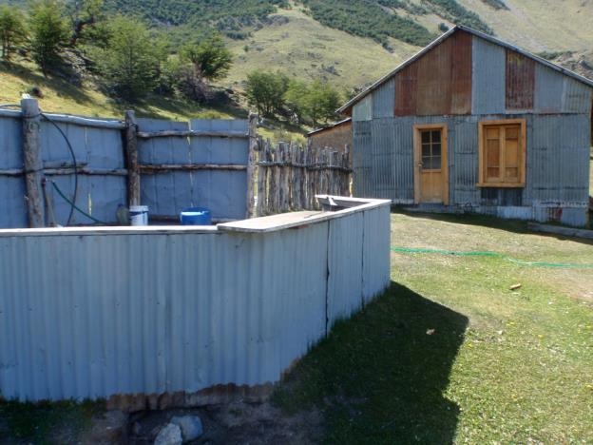
History of land conversion
Estancia are large ranches
Sheep estancias dominated from 1930-1970
European settlement and sheep farming wiped out local people (Tehuelche, Selk’nam, Yámana, Kawéskar) through slavery, disease, and displacement

Slide 7
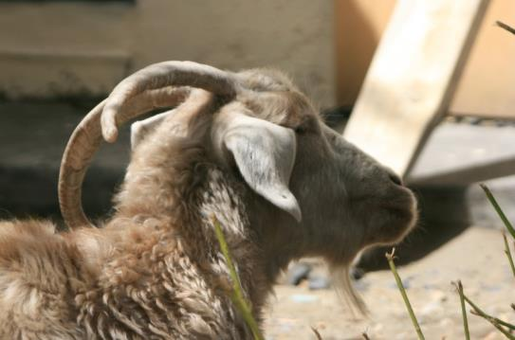
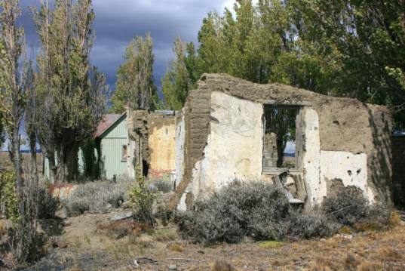
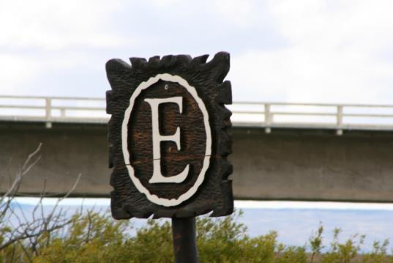
History of land conversion
Culture and economy built on raising sheep
Falling wool prices in 1970s = market collapse
Final blow was 1991 volcanic eruption in Chile; ash killed many remaining sheep
Price reached low of $0.30 per pound; recovering now ($3.00-$4.00 per pound)

Slide 8
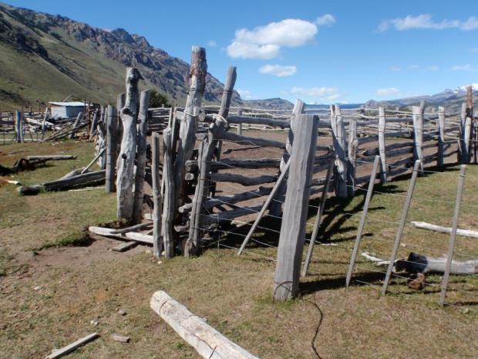
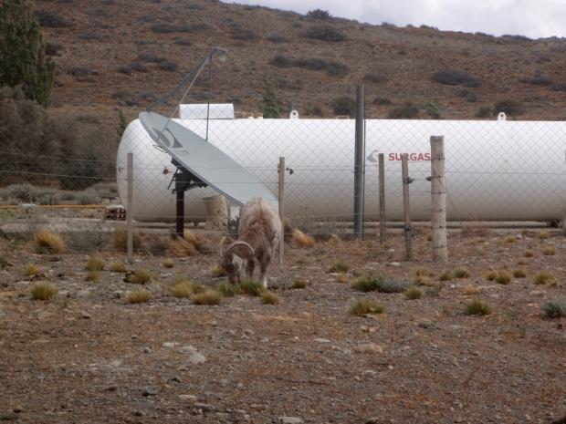
History of land conversion
90% of S. Argentina is privately owned
1/6 of Argentine Patagonia is owned by only 350 foreign owners

Slide 9
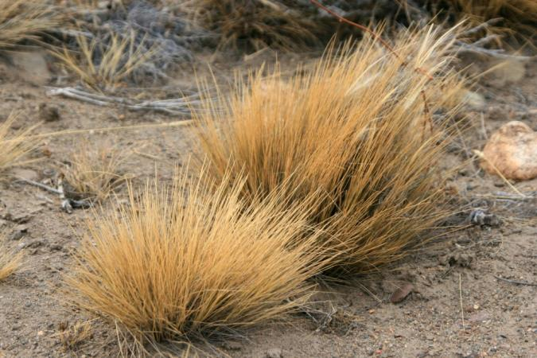
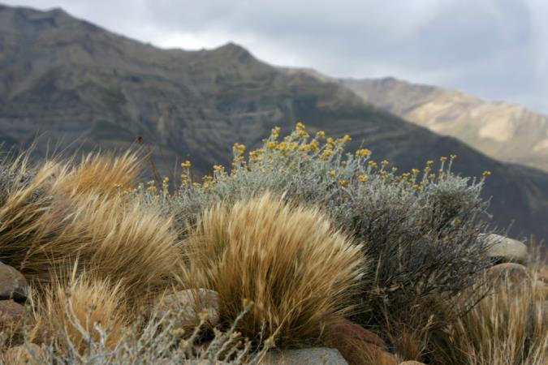
Sheep grazing impacts
Native grasses stabilize soil; loss of grasses leads to erosion
Guanacos browse plants; allows plants to survive
Sheep eat roots of grasses first; kills plants

Slide 10
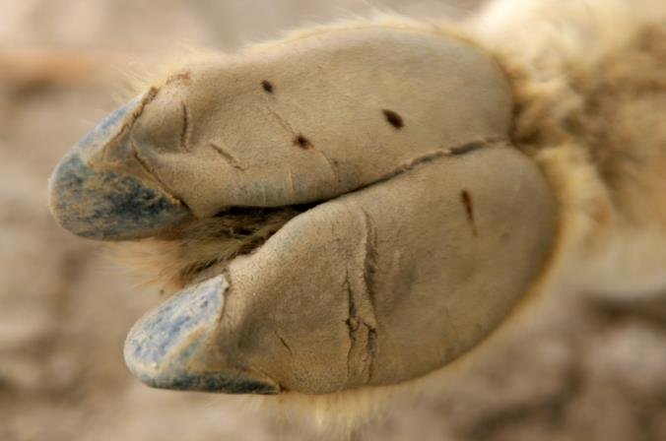
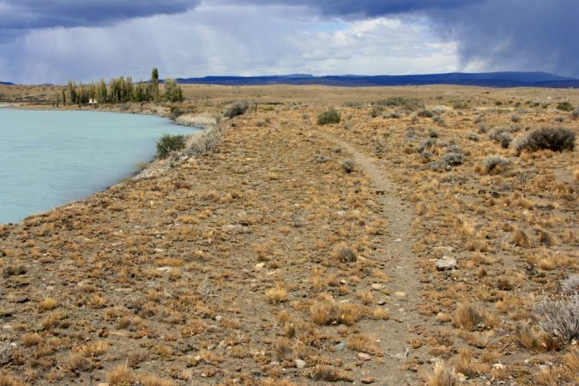
Sheep grazing impacts
Soft pads on a guanaco foot
Soft guanaco hooves protect soil
Hard sheep hooves compact soil
Too many sheep accelerate effects
Leads to erosion and desertification
Eroded sheep trail, years after estancia collapse

Slide 11
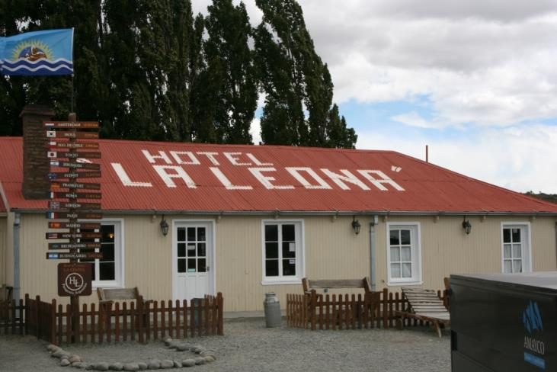
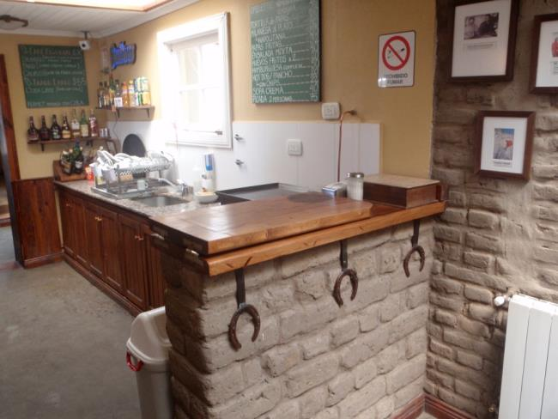
Opportunities
Sheep ranching still severely depressed
Tourism income is the only way many estancias can survive
Estancias close to roads become popular rest stops

Slide 12
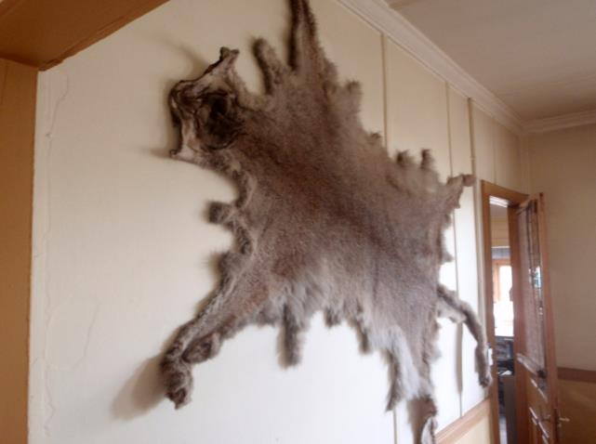
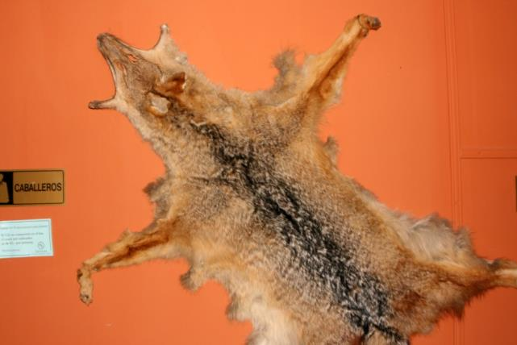
Species targeted by ranchers
Hunted, trapped, poisoned
Cougars: Bounty (1000 Argentine pesos = a month of good wages)
Fox: Bounty (300 Argentine pesos)
Guanacos: Protected, but ranchers want right to hunt to prevent competition with sheep
Indirectly killed, when poisoned carcasses are used
Andean condors

Slide 13
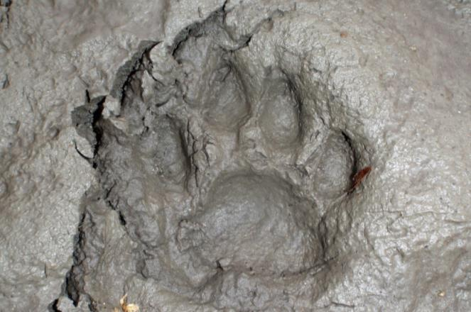
Cougars
Not a species of concern (IUCN)
Elusive, wide-ranging predator
Sheep predation causes conflict
~70 cougars killed per year on a single estancia
Keystone role in Patagonia, hunting meat that is taken over by scavengers
Provide 3x more food to wild community than wolves in Yellowstone National Park
Source: http://www.panthera.org/node/3491

Slide 14
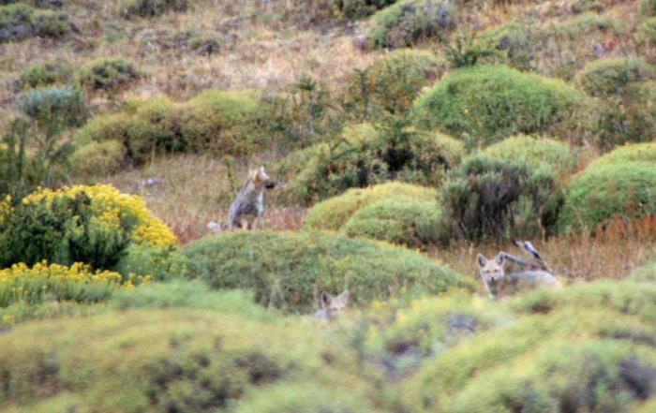
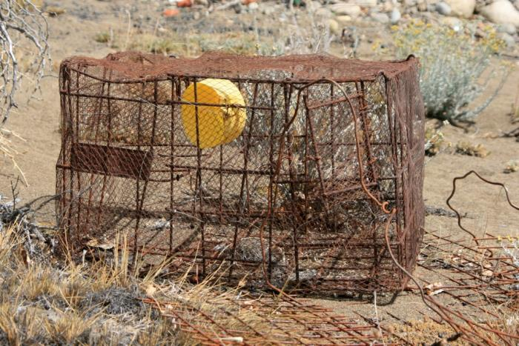
Fox
Red and gray fox targeted
Not species of concern
Indiscriminant traps and carcasses poisoned with arsenic affect native fox and other species

Slide 15
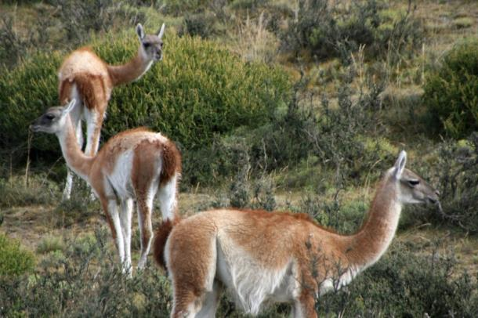
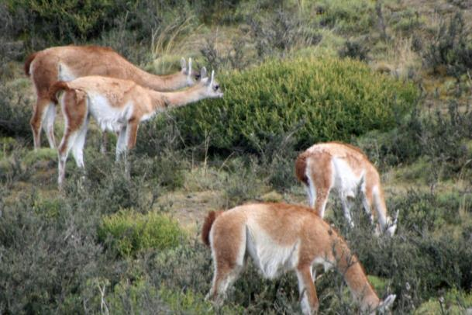
Guanacos
Pre-Spanish conquest: 30-50 million
Across Chile, Argentina, parts of Bolivia, Peru, Paraguay
Threats
Conflict with sheep
Legal overhunting
Habitat loss
Lack of sound management schemes

Slide 16
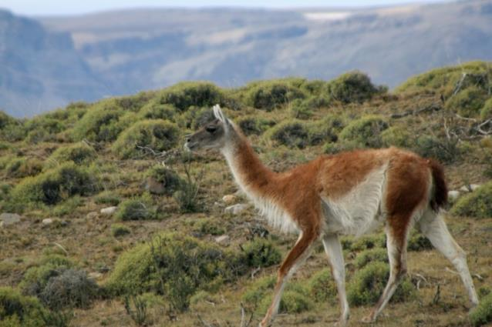
Guanacos
Hunted to extinction in the wild in some areas
DNA studies show evidence of small, remnant populations and subspecies
Reintroduction efforts underway
Current estimate: 600,000 mainly on private land

Slide 17
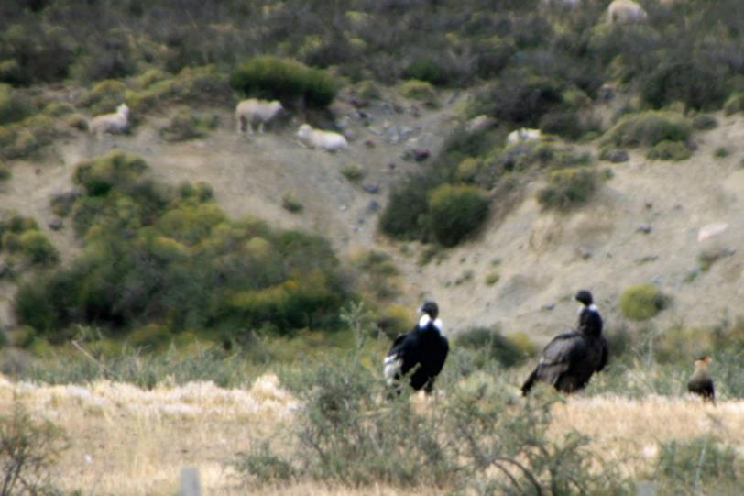
Andean condors
Largest populations found in Patagonia
Classified as Near Threatened (IUCN)
Predator control on estancias can affect condors

Slide 18
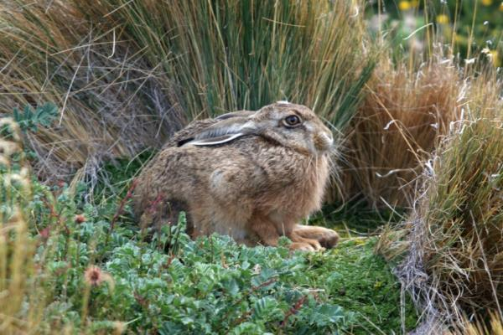
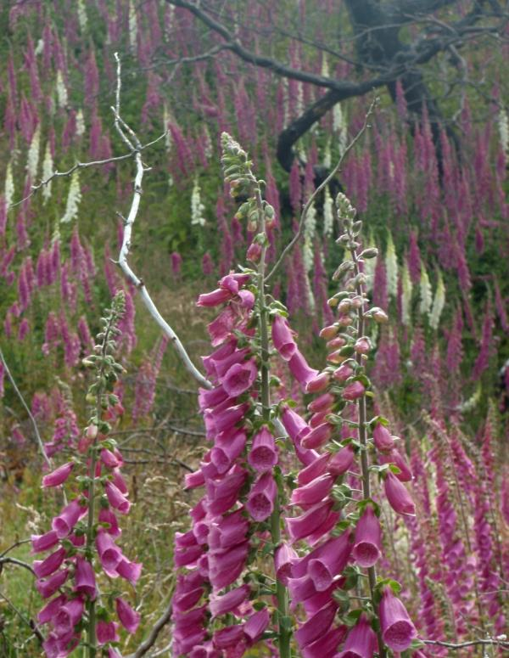
Threats: Invasives
European hare inside national park
320 native terrestrial mammals
31 exotic mammal species
Introduced species causing conservation problems
European hare
Wild boar
Beaver
Mink
Plants including lupines and foxgloves
Last “successful” introduction: American beaver (1940s)
Hillside in national park colonized by foxgloves

Slide 19
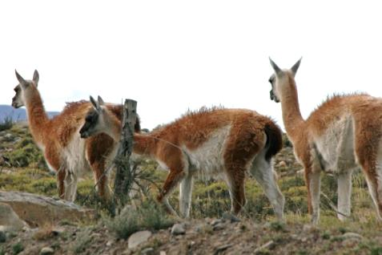
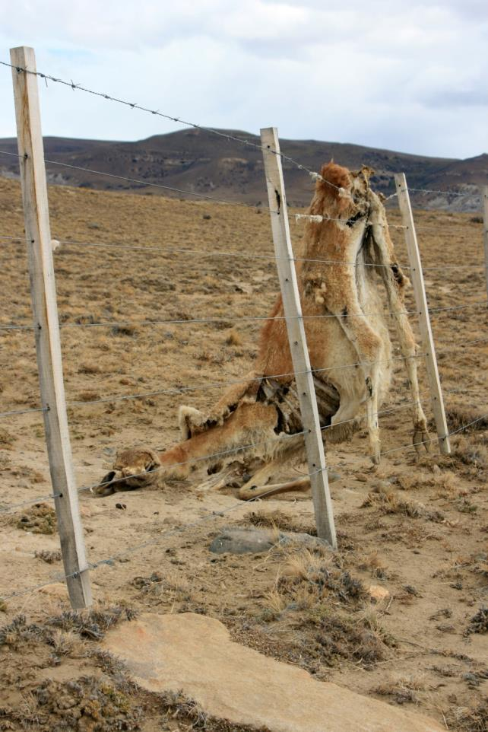
Threats: Fencing
>164,000 km of wire fences
Entanglement in fences is major problem
Guanaco-friendly designs exist but are not widely implemented

Slide 20
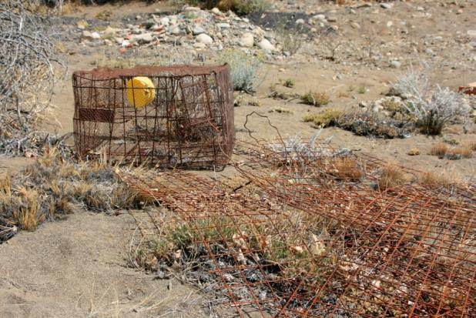
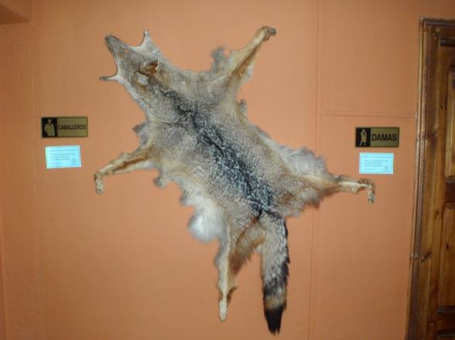
Threats: Hunting/poaching

Slide 21
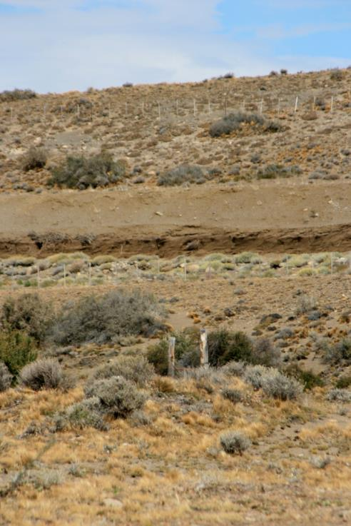
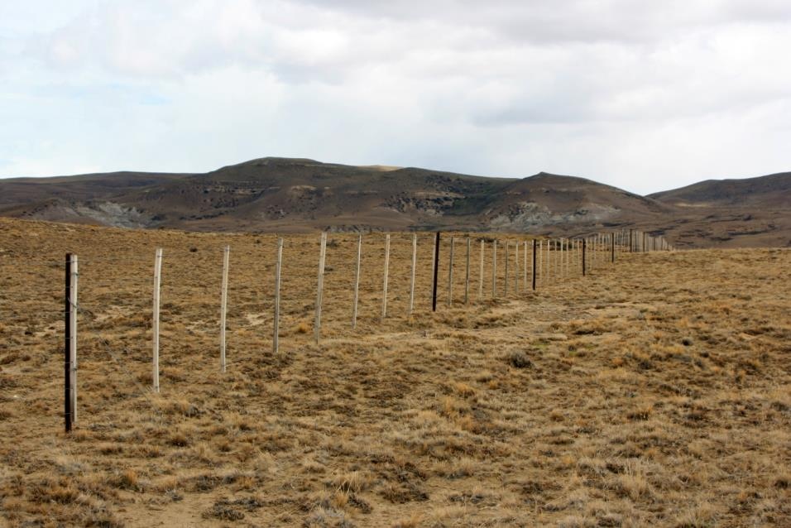
Threats: Habitat loss

Slide 22
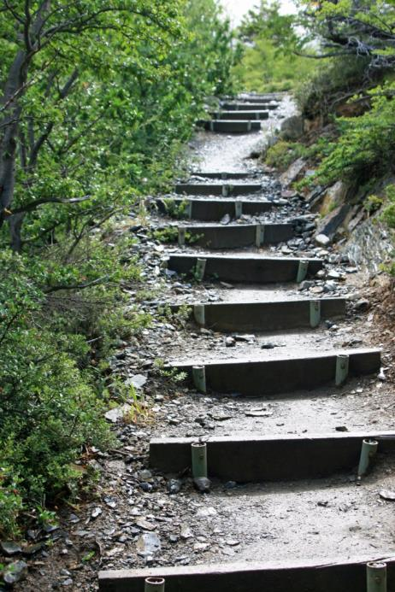
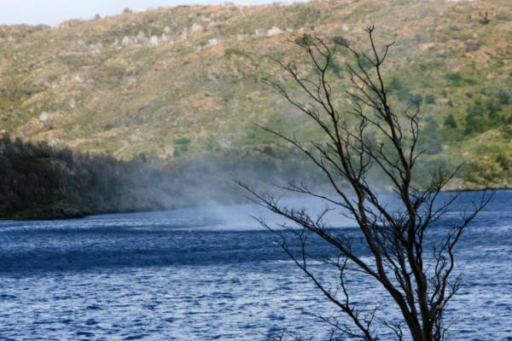
Threats: Fire
Trying to prevent trail erosion
Fire risk is highest where:
Habitat quality is reduced
Erosion is high
Desertification is increasing
Wind is high
Tourists build campfires
Winds blast across the land and water

Slide 23
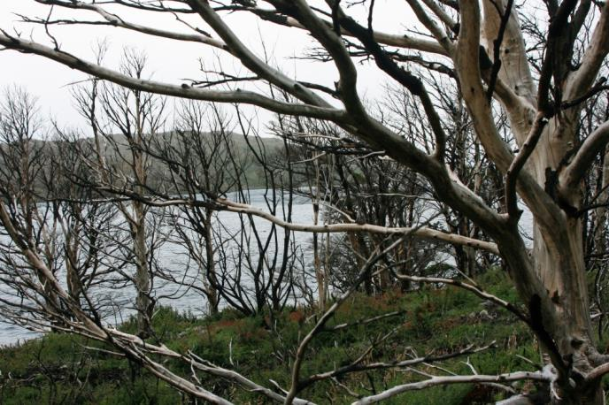
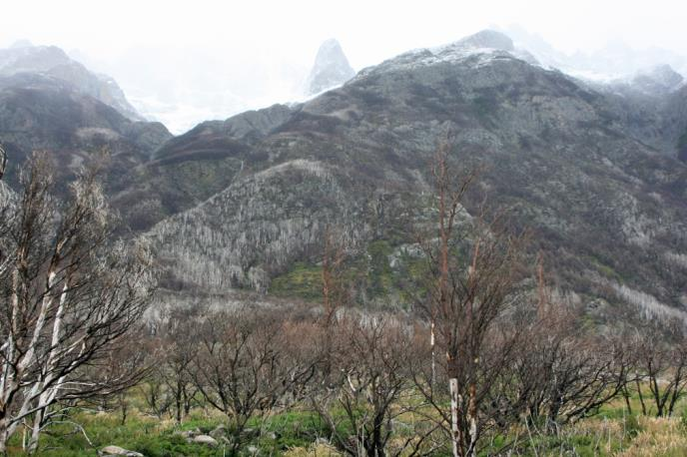
Recent catastrophic fires
Torres del Paine National Park
March, 2005: 15,000 hectares burned
December, 2012: 17,000 hectares burned
Destroyed guard building and park offices
Caused park closure for 10 days

Slide 24
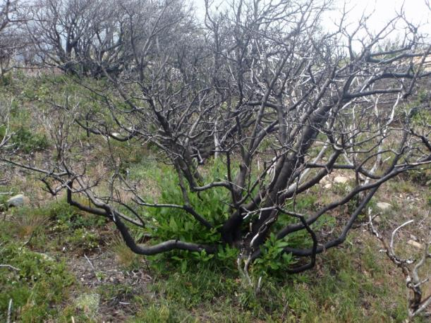
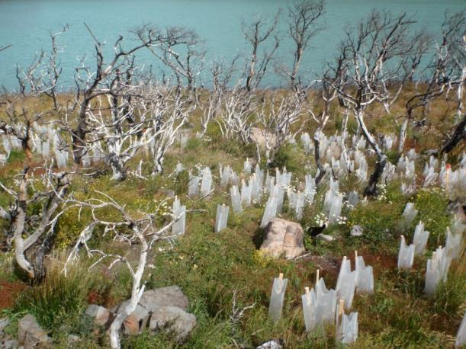
Recovery is slow
Forest regeneration takes >30 years
Recovery expected to take >150 years
Park guards are vigilant against careless campfires
Fines used to prevent future fires

Slide 25
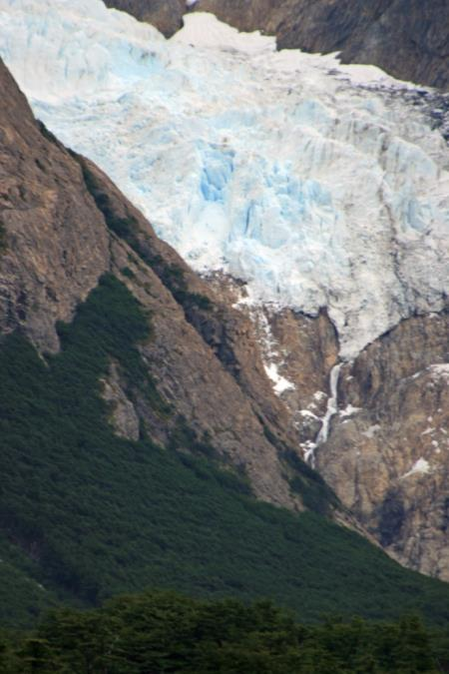
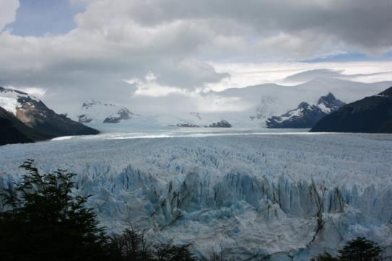
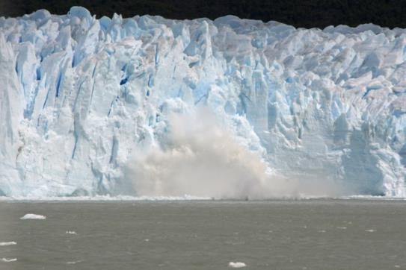
Threats: Climate change
Glaciers declining worldwide
Patagonia glacier field is #3 largest reservoir of fresh water in the world
Estancias and associated land uses have resulted in a large landscape with low connectivity for wildlife
Notes:
#1 = Antarctica and #2 = Greenland

Slide 26
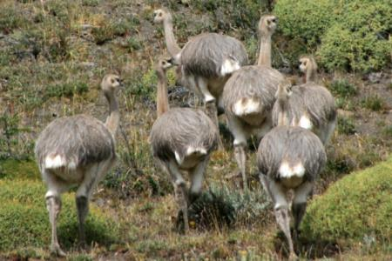
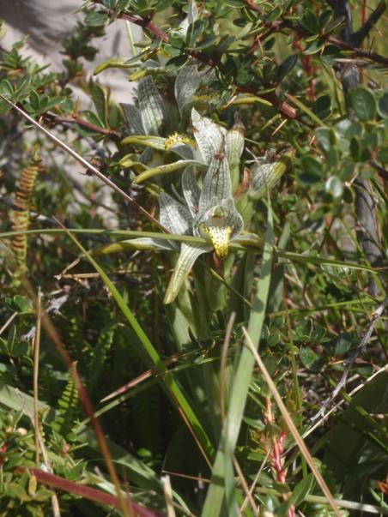
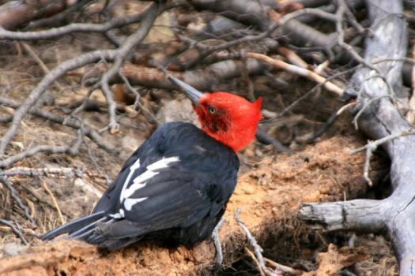
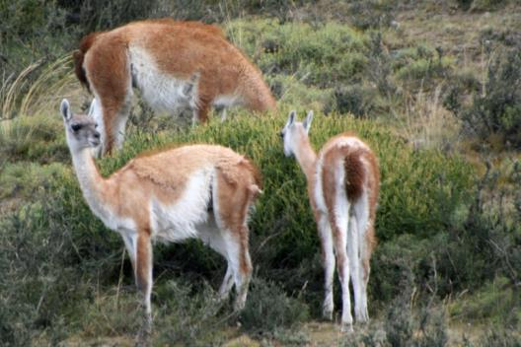
Torres del Paine National Park Biosphere Reserve & World Heritage Site
Darwin’s rheas
“Torres del Paine is a bastion of wildlife biodiversity surrounded by a landscape dominated by ranching.”
-Franklin et al. 1999
Rare orchid species
Magellanic woodpecker

Slide 27
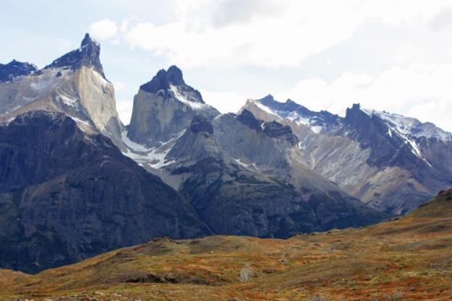
Torres del Paine National Park Biosphere Reserve & World Heritage Site
Was estancia land
Converted to a national park (1959)
Land owners offered land elsewhere
Not all moved; some families own land in park and profit from tourism
Native species rebounded
Highest land value in region based on “view” not biodiversity
Mountains and hiking opportunities bring tourist dollars

Slide 28
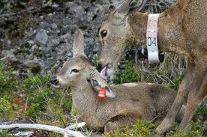
Torres del Paine National Park Biosphere Reserve & World Heritage Site
Huemul deer: Critically endangered (IUCN)
National animal of Chile
Habitat loss and hunting led to decline
< 2,000 animals remain in the wild
Currently studied at Torres del Paine
Sensitive to human disturbance
International collaboration funds research
Photo credit: http://www.conservacionpatagonica.org/buildingthepark_biodiversity_huemul.htm

Slide 29
Known huemul activity (Feb. 2014)
Family of 3 huemul deer
Family of huemul deer
Recent huemul sightings
Collared huemul study area

Slide 30
Torres del Paine National Park Biosphere Reserve & World Heritage Site
Outside park, most land is privately owned
Much of it is for sale
Landscape connectivity for wildlife greatly reduced
Land that is for sale is often degraded from sheep ranching

Slide 31
Conservation opportunities: Local people
Volunteers: Students work on restoring trails and educating tourists
Rangers: Trained in conservation, knowledgeable and skilled
Citizen science: New program to detect invasive species, especially mink
Estancia organization: Asociacion Rural, connecting ranching families and biodiversity issues, 9 parks included

Slide 32
Conservation opportunities: Political will
Government support: Initiatives with Chile and Argentina working together on invasive beaver control
Research institutions: Knowledge and infrastructure to support conservation efforts and scientific research
National Park office in Tierra del Fuego: Established to conduct science and conservation for the region

Slide 33
Conservation opportunities: Economic
Guanaco shearing: Research shows guanacos can be humanely sheared; wool may offer economic incentive
May be a key species for rural development

Slide 34
Review: The Great Patagonia Land Grab
Stakeholders
Public vs. Private
International environmental groups and wealthy landowners
Local indigenous people
Local ranchers
Government
Do you understand the stakeholders for conservation near Torres del Paine?
Do you favor public or private protection for conservation?
Considering a particular species
Considering a large landscape (like Patagonia)
If you build a new protected area, how do you use this information to decide?
Notes:
Facilitate conversation with students here. List specific stakeholders with respect to conservation near Torres del Paine on the board and pros/cons for public vs. private protection for these stakeholders.

Slide 35
Building a new protected area
Your budget = $50 million (U.S.)
Where will you build your PA?
Will you expand at the park border?
Will you build a separate PA?
How will you consider landscape connectivity?

Slide 36
Building a new protected area
Cheaper land where degraded and lacking stunning views
Native wildlife populations reduced in these areas
Research shows that wild populations may rebound quickly when protected
How will you consider climate change and projected impacts on your new PA?

Slide 37
Building a new protected area
Land is more expensive near existing PAs and where the views are spectacular
Native wildlife are more abundant
Existing PAs are not sufficient to protect native species
Invasive species complicate native species conservation

Slide 38
Building a new protected area
Use Google Earth map to build your PA
Write a defense of your choices
Demonstrate that purchase meets available budget
Prepare a presentation that shows area and location of your PA and includes rationale for your choices

Slide 39
Good Luck!

Slide 40
Special thanks:
People on-site in Patagonia doing conservation work, researching invasive species impacts, and educating tourists in Patagonia’s national parks including experts who took the time to meet with us during our time in Patagonia (2014), specifically:
Alejandro Valenzuela: Southern Patagonia Coordination Office, Argentine National Parks Administration
Christopher Anderson: National University of Tierra del Fuego
Lic. Maria Luisa Carranza, Directora Gral. De Areas Protegidas y Biodiversidad
Roberto Barrientos Benitez: Guías Asociados, Torres del Paine National Park

Slide 41
References:
Bank, M.S., R.J. Sarno, W.L. Franklin. 2003. Spatial distribution of guanaco mating sites in southern Chile: conservation implications. Biological Conservation 112: 427-434
Burgi, M.V., A. Marino, M.V. Rodriguez, G. Pazos, R. Baldi. 2011. Response of guanacos Lama guanicoe to changes in land management in Peninsula Valdes, Argentine Patagonia: conservation implications. Oryx 46: 99-105.
Elbroch, L.M., H.U. Wittmer. 2013. The effects of puma prey selection and specialization on less abundant prey in Patagonia. Journal of Mammalogy 94: 259-268
Franklin, W.L., W.E. Johnson, R.J. Sarno, J.A. Iriarte. 1999. Ecology of the Patagonia puma Felis concolor patagonica in southern Chile. Biological Conservation 90: 33-40
Johnson, W.E., W.L. Franklin. 1994. Role of body size in the diets of sympatric gray and culpeo foxes. Journal of Mammalogy 75: 163-174
Lambertucci, S., K.S. Speziale. 2009. Some possible anthropogenic threats to breeding Andean Condors (Vultur gryphus). Journal of Raptor Research 43: 245-249

Slide 42
References:
Marin, J.C., B.A. Gonzalez, E. Poulin, C.S. Casey, W.E. Johnson. The influence of the arid Andean high plateau on the phylogeography and population genetics of guanaco (Lama guanicoe) in South America. Molecular Ecology 22: 463-482
Merino, M.L., B.N. Carpinetti, A.M. Abba. 2009. Invasive mammals in the national parks system of Argentina. Natural Areas Journal 29: 42-49
Montes, M.C., P.D. Carmanchahi, A. Rey, M.C. Funes. 2006. Live shearing free-ranging guanacos (Lama guanicoe) in Patagonia for sustainable use. Journal of Arid Environment 64: 616-625
Patterson, B.D. 2010. Climate change and faunal dynamics in the uttermost part of the earth. Molecular Ecology 19: 3019-3021
Pedrana, J., J. Bustamante, A. Travaini, A. Rodriguez. 2010. Factors influencing guanaco distribution in southern Argentine Patagonia and implications for its sustainable use. Biodiversity Conservation 19: 3499-3512
Rey, A., A.J. Novaro, M.L. Guichon. 2012. Guanaco (Lama guanicoe) mortality by entanglement in wire fences. Journal for Nature Conservation 20: 280-283.

Slide 43
References:
Rumboll, M. 2008. National parks, forest reserves, and regional reserves of Southern Argentina and Chile pgs: 231-242 in Gut, B. J., Guzzetti, M. P., & Díaz, A. 2008. Trees in Patagonia. Basel: Birkhäuser
Science. 2013. Guanacos enlisted for Restoration. 342: 1024. www.sciencemag.org
Silva, C.A. B. Saaverdra. 2008. Knowing for controlling: ecological effects of invasive vertebrates in Tierra del Fuego. Revista Chilena de Historia Natural 81: 123-136
Valenzuela, A.E.J., C.B. Anderson, L. Fasola, J.L. Cabello. 2013. Linking invasive exotic vertebrates and their ecosystem impacts in Tierra del Fuego to test theory and determine action. Acta Oecologica 54: 1-9
Wittmer, H.U., L.M. Elbroch, A.J. Marshall. 2013. Good intentions gone wrong: did conservation management threaten Engandered huemul deer Hippocamelus bisulcus in the future Patagonia National Park? Oryx 47: 393-402
Worral, S. 2004. Land of the living wind. National Geographic . http://ngm.nationalgeographic.com/features/world/south-america/argentina/wind-text.html

