Slide 1
Is p53 a Smoking Gun?
NATIONAL CENTER FOR CASE STUDY TEACHING IN SCIENCE
How Mutational
Signatures Forced
Big Tobacco to Change
by
Michèle I. Shuster, Joann Mudge, Meghan Hill, Katelynn James, Gabriella A. DeFrancesco, Maria P. Chadiarakou, and Anitha Sundararajan
Notes:
Credit: Licensed photo Photo © Александр Марко | Dreamstime.com, ID 157844331.

Slide 2
Take 2-3 minutes
Review your preparatory assignment.
Any lingering questions?

Slide 3
Why is p53 so important? What can happen if p53 is not working?
Think (on your own)
Pair (with a classmate)
Share with the class

Slide 4
Part I
Identify Mutational Hotspots in the p53 Protein in Lung Cancer

Slide 5
p53 is frequently mutated in cancer
Let’s figure out where these mutations occur.
We have 100 p53 sequences with cancer-causing mutations (amino acid sequences).
All are from lung cancers.
Some patients have a smoking history or history of exposure to secondhand smoke (smokers).
Some do not (non-smokers).
We are going to compare each mutant p53 to the wild-type in order to find the mutation and note its location in the protein.

Slide 6
Our tool: blastp
An online program
Compares two protein sequences
Can identify differences
See handout for details
Next slides give an overview

Slide 7
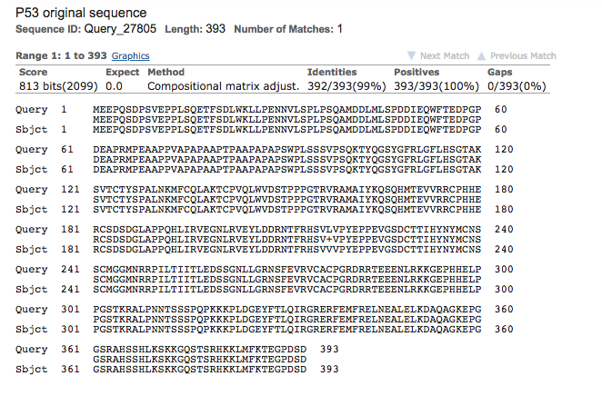
You will generate a blastp alignment
Mutant
Wildtype

Slide 8
blastp will align the mutant and wildtype p53 sequences
Look for a gap (blank) or a symbol in the middle row
→ position of mutation
Record:
Original (wt) amino acid
New amino acid
Position (amino acid #)
Domain of p53
Smoking history
If you only see a partial alignment (less than 393 amino acids lined up)
A stop codon was inserted at the position immediately after last amino acid in the alignment

Slide 9
Identifying the mutation using an alignment
V → L
Position 217
Which domain?
Mutant
Wildtype

Slide 10
Your Task
For each of your assigned mutant sequences:
Use blastp to compare the mutant to the wild type
Note the amino acid (number) that is altered in the mutant
Note the domain (of p53) that the mutation is in
Also keep track of the smoking history for your p53 sequences
As a class, assemble a histogram (next slide)
Place an “x” on the approximate position of your mutation(s)
If there is already an “x” at that position, place yours above it
→ histogram
OR: complete the class spreadsheet of mutations

Slide 11
1
42
100
292
324
355
363
393
A
B
C
D

Slide 12
Based on the class data
1. Which domain is most frequently mutated?
2. What are the “hotspot” amino acids?
Amino acids mutated at >4% of the mutations in our series
3. Remove mutations from non-smokers
How many mutations are left?
What hotspots (>4%) are present in the collection of mutations from smokers?

Slide 13
How do our data compare to other sources?
1996 study to look at mutations in the TP53 gene in lung cancers from smokers
Codon # | 154 | 157 | 175 | 179 | 245 | 248 | 249 | 273 | 282
# of mutations | 7 | 17 | 0 | 1 | 13 | 23 | 13 | 37 | 13
Data from Denissenko et al. (1996) Science 274:430-432 (Figure 1)

Slide 14
How do our data compare to other sources?
Any apparent hotspots (codons mutated at high frequency)?
How do these compare to what we saw in our collection?
Codon # | 154 | 157 | 175 | 179 | 245 | 248 | 249 | 273 | 282
# of mutations | 7 | 17 | 0 | 1 | 13 | 23 | 13 | 37 | 13
Data from Denissenko et al. (1996) Science 274:430-432 (Figure 1)

Slide 15
Part II
Chemical Exposure and TP53 Gene Mutations

Slide 16
There appear to be hotspots for TP53 mutations in smokers. Why?
Could chemicals in smoke be causing these?
Expose cultured human cells to BPDE.
(±)-anti-7β,8α-dihydroxy-9α,10α-epoxy-7,8,9,10-tetrahydrobenzo[a]pyrene
When a person smokes, they inhale and absorb BaP (benzo[a]pyrene).
In the body, BaP is converted to BPDE.

Slide 17
BPDE
Known to bind to DNA and cause mutations.
Researchers isolated DNA from the cultured cells exposed to BPDE and analyzed to determine where BPDE bound to TP53 gene.
Codon # | 154 | 157 | 175 | 179 | 245 | 248 | 249 | 273 | 282
BPDE Binding | No | Yes | No | No | No | Yes | No | Yes | No
Data from Denissenko et al. (1996) Science 274:430-432 (Figure 2)

Slide 18
How does BPDE binding compare to observed mutational hotspots?
Codon # | 154 | 157 | 175 | 179 | 245 | 248 | 249 | 273 | 282
BPDE Binding | No | Yes | No | No | No | Yes | No | Yes | No
Data from Denissenko et al. (1996) Science 274:430-432 (Figure 2)

Slide 19
How does BPDE binding compare to observed mutational hotspots?
Codon # | 154 | 157 | 175 | 179 | 245 | 248 | 249 | 273 | 282
BPDE Binding | No | Yes | No | No | No | Yes | No | Yes | No
Data from Denissenko et al. (1996) Science 274:430-432 (Figure 2)

Slide 20
BPDE Binding
At specific “G” (guanine) nucleotides
Leads to a conversion of the G to a T (thymine)
G>T mutational “signature” (at DNA level)
Results for BPDE, which is derived from BaP in cigarette smoke

Slide 21
Part III
Looking for the G>T “Signature” at Hotspots in Lung Cancer
(Both Smokers and Non-Smokers)

Slide 22
Let’s look at G>T mutations at our hotspots
The 3 hotspot codons where BPDE binds, and where we see high frequencies of mutations in cancers from smokers
We will look in lung cancers
Smokers
Non-smokers

Slide 23
Use the data from the data tables (handout) to complete this table for each codon (handout)
Codon #__________ | All Mutations (#) | Number G>T | % G>T
Smokers
Non-smokers

Slide 24
Now combine for all three codons (handout)
All Three Codons | All Mutations (#) | Number G>T | % G>T
Smokers
Non-smokers

Slide 25
Re-cap
1. Is there a domain of p53 that is more frequently mutated? Which one?
2. Based on the nucleotide level codon data for codons 157, 248, and 273:
What percent of the mutations in smokers are G>T signatures?
What percent of the mutations in non-smokers are G>T signatures?
3. Given the data from cultured cells treated with BPDE and the data from hotspots from lung cancer patients who were smokers vs. non-smokers, can a conclusion be made about the role of chemicals in smoke and lung cancer?

Slide 26
Part IV
Smoking, Lung Cancer, and the Tobacco Companies
If a smoker develops lung cancer and sues tobacco companies, is it possible to prove that smoking caused their cancer by sequencing the TP53 gene from their cancer?
Discuss with a classmate

Slide 27
It is not black and white
Not every smoker has the G>T signature.
Some non-smokers have the G>T signature.
So for any one smoker with lung cancer:
We can’t definitively say that smoking caused their particular cancer.
Although smoking does substantially increase the risk of developing lung cancer.

Slide 28
But we can look at population-level data
And use statistics to determine the probability that the increase of TP53 G>T mutations in smokers is “real.”
I.e., a real result of smoke exposure, and not just a chance of how we sampled cancers.
A chi-square independence test tells us how likely it is that two variables (in our case smoking and specific mutation type) are independent (don’t affect each other).

Slide 29
Chi-square test
We go in with the assumption that the two variables are independent.
“null hypothesis”
Alternative hypothesis:
Two variables are associated.
Accept the alternative hypothesis when the p-value for the null hypothesis is less than 0.05 (when there is less than a 5% chance that the null hypothesis is correct).

Slide 30
Chi-square test
If there is less than a 5% chance that the two variables are not related
That is, if there is less than a 5% chance that the null hypothesis is correct…
Then accept the alternative hypothesis that there is a statistically significant relationship between smoking and mutation type (G>T).
See handout for instructions.
Use data from Part C.

Slide 31
What do you conclude?
What is the probability that smoking is NOT related to the frequency of G>T mutations?
What does this mean about the probability that smoking IS related to the frequency of G>T mutations?

Slide 32
State vs Individual Lawsuits
In the 1990s, states sued the tobacco companies, arguing that smoking caused health problems whose costs were carried by public health systems. Are these lawsuits more likely to be successful compared to the individual lawsuits? Why or why not? Use what you have learned about G>T mutations in your answer.

