Slide 1
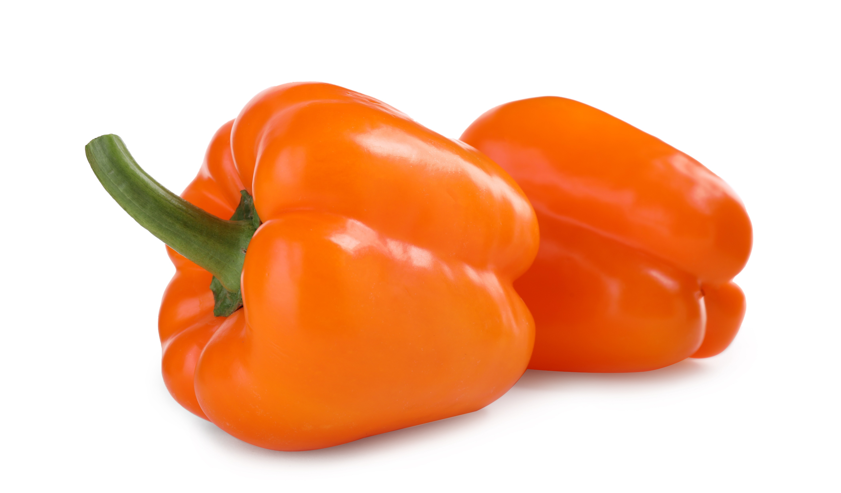
NATIONAL CENTER FOR CASE STUDY TEACHING IN SCIENCE
To Pick a Peck of Orange Peppers:
From Molecular Variation to Macroscopic Change
by
Pamela Kalas and Fatima Syed
Notes:
Slide 1 is displayed at the start of the lecture, to signal the start of class, while copies of the handout for Part I of the case are distributed to the students.
Image credit: Licensed image © Chernetskaya | Dreamstime.com, ID 165283093.

Slide 2
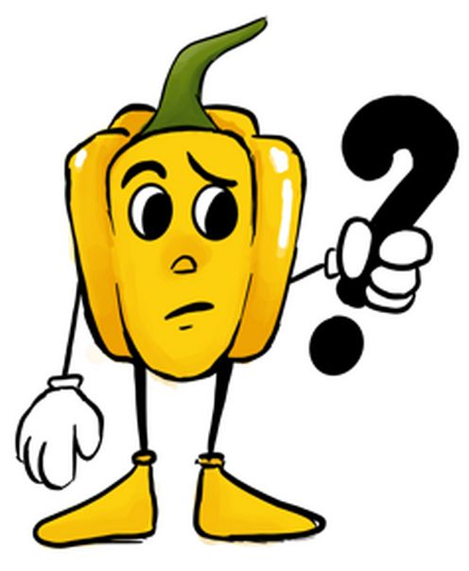
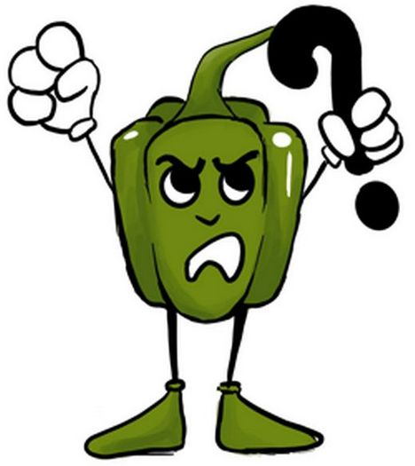
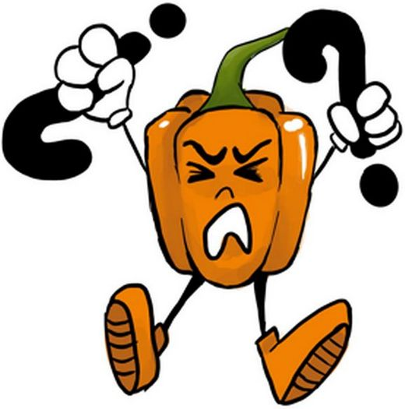
To Pick a Peck of Orange Peppers – Part I
Two good friends share a room at their university’s dorm. Invited to a potluck, they decide to bring a dish of stuffed peppers - but before they know it, they find themselves investigating the genetics of Capsicum annuum fruit color.
While we follow the two characters and try to answer some of their questions, keep an eye out for the four pepper cartoons (and take note on your handout):
Super Challenging
Question
Important/Useful
Question
Challenging Question
2
Notes:
Instructors introduce the case study by displaying and reading through Slide 2, and (especially in large classes) reiterating that copies of the handouts are being distributed.

Slide 3
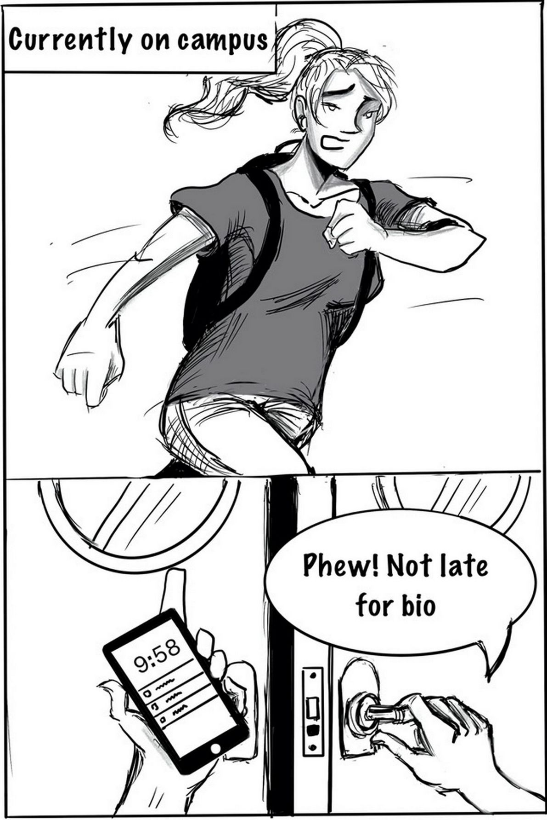
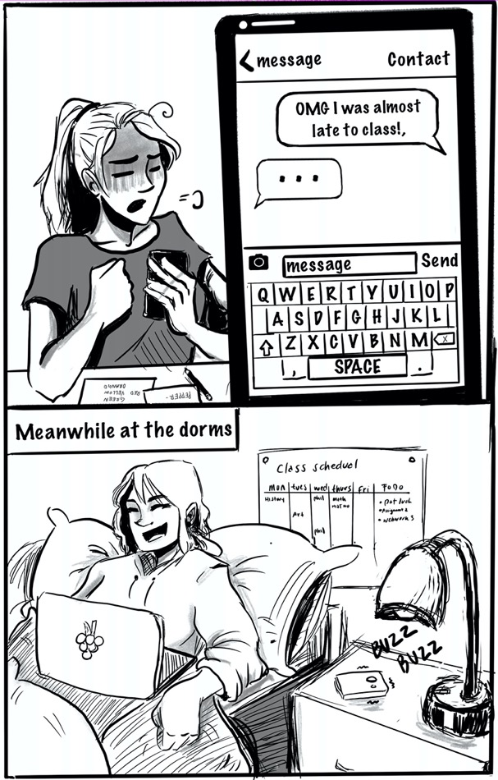
To Pick a Peck of Orange Peppers – Part I
3
Notes:
Slide 3 is then displayed, just long enough for students to familiarize themselves with the scenario and read through it, to signal the start of the case study. Some students will prefer to read the story from their handout, while others may prefer to follow it on the screen. Showing the story on the screen is also beneficial for those who have not yet received the handout, as it allows them not to fall behind. Students should have access to their or their neighbor’s carotenoids biosynthesis pathway chart throughout the case.

Slide 4
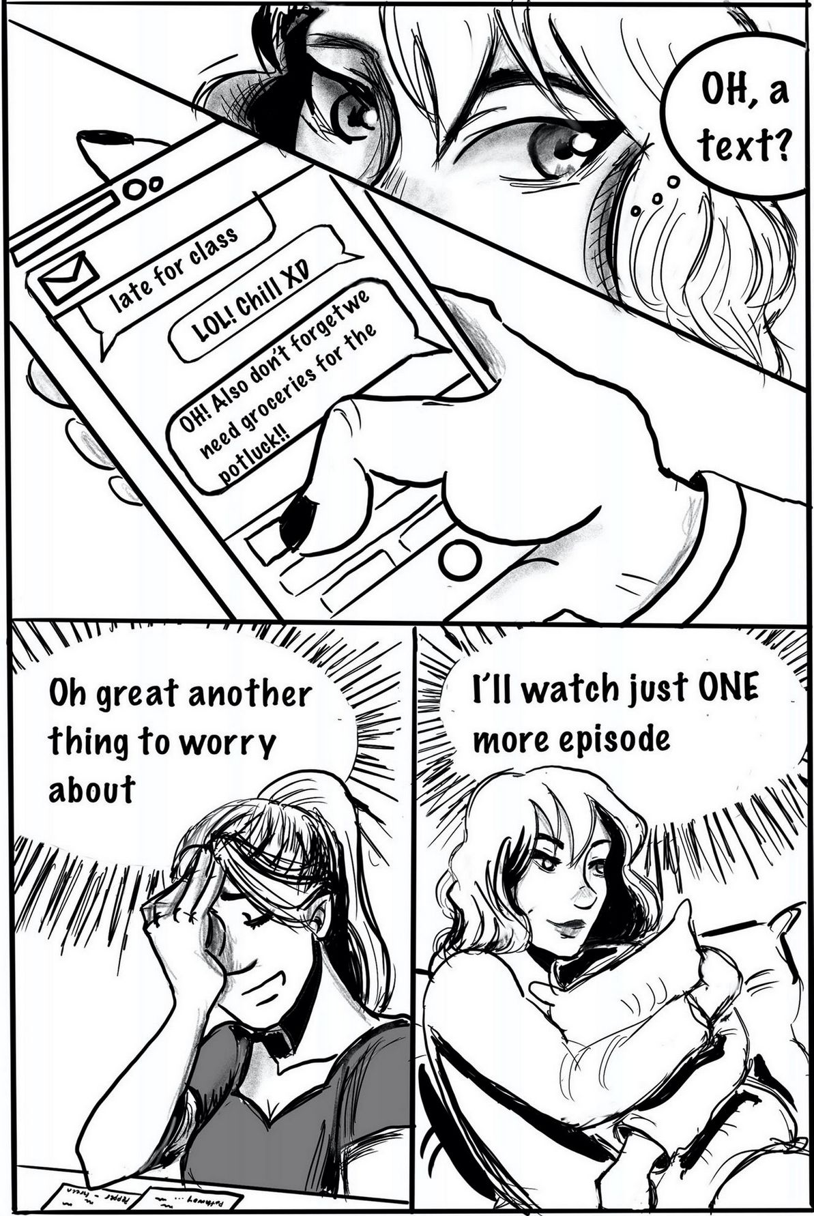
To Pick a Peck of Orange Peppers – Part I
Before we go any further, do you have any questions about the content of your preparatory readings?
Individually or in pairs, please make a list of all the points that are still unclear to you. You have three minutes.
4
Notes:
Slide 4 invites students to spend three minutes making a list of questions that they still have about the preparatory reading. Here, it is helpful for instructors to repeat this invitation orally and truly stick to the three-minute time limit. Instructors should also have handy the list of those points of confusion submitted in response to Preparation Quiz Question 11 that were not addressed in the feedback provided to students.
When the time is up, students are invited to share their questions with the rest of the class. Upon hearing each question, instructors decide whether knowing its answer is critical for students to be able to productively participate in the case study. Questions deemed critical should be addressed by the instructor either directly, or by inviting contributions from students who are comfortable providing an answer. If not deemed critical, questions can be “parked” (i.e., summarized and listed) on the blackboard, document camera, or in the instructor’s notes. Some of these “parked” questions may be addressed or resolved by later parts of the case; instructors should point out when this happens. Other questions may go beyond the scope of the class, and instructors can encourage students to visit office hours or post them on the course bulletin board in order to discuss them.
If any essential, still unaddressed questions and points of confusions from the quiz remain, they should be addressed.

Slide 5
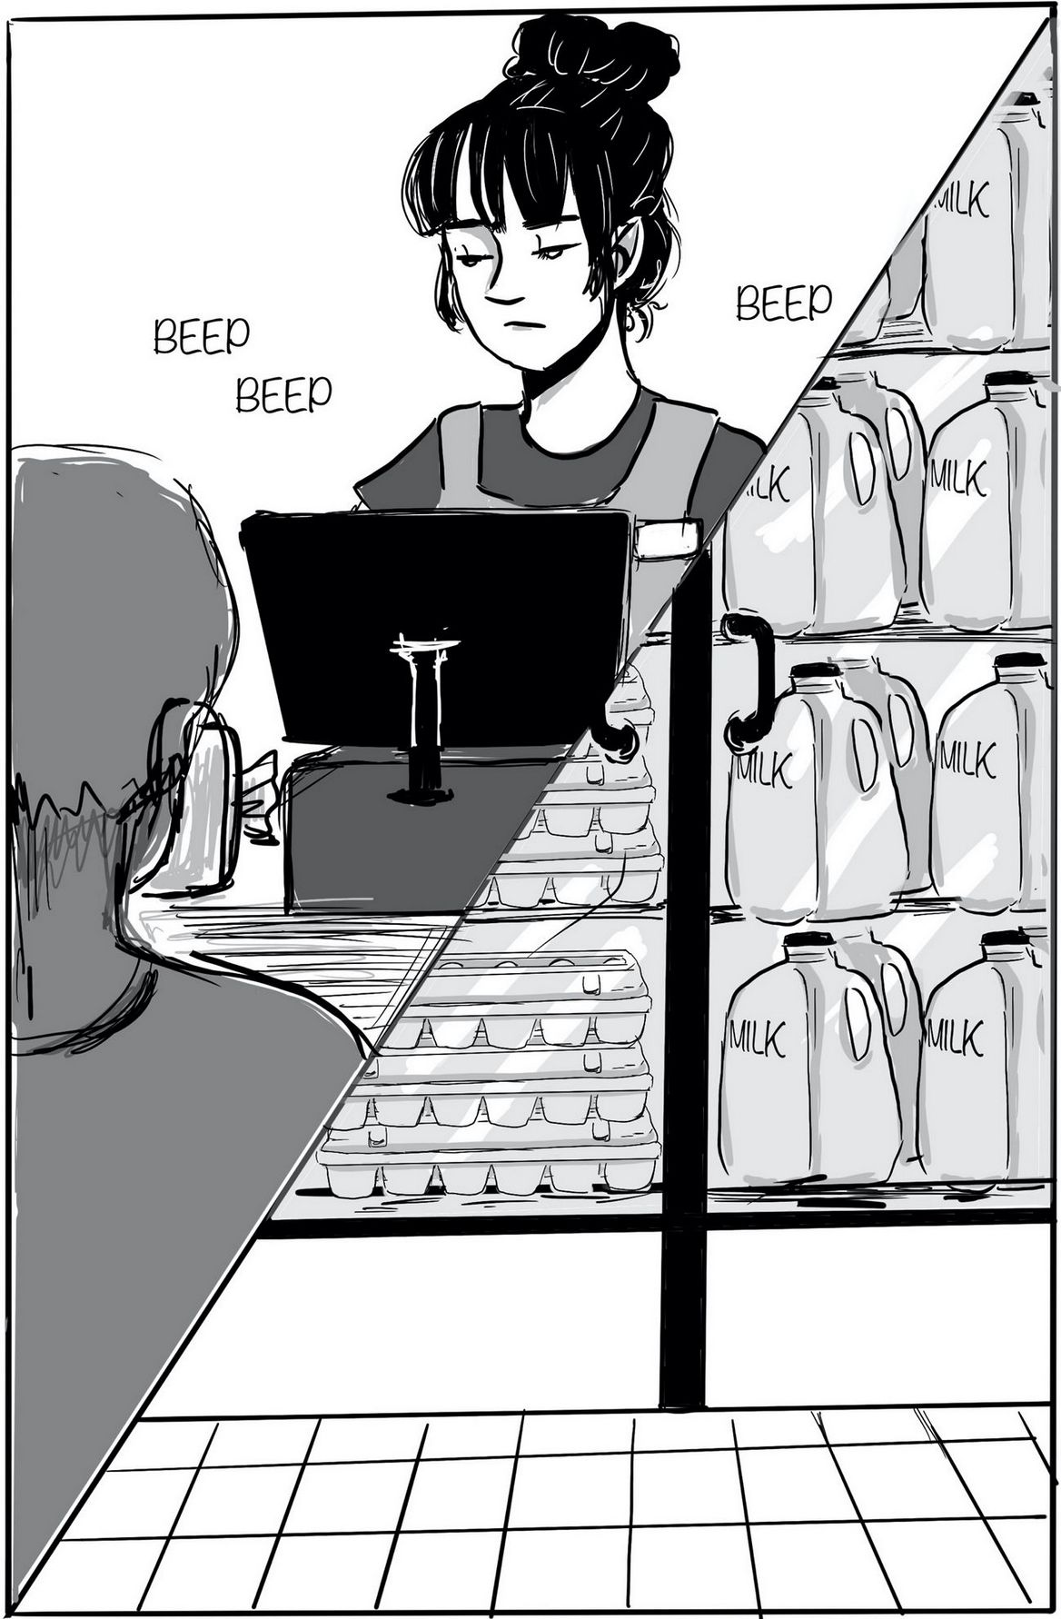
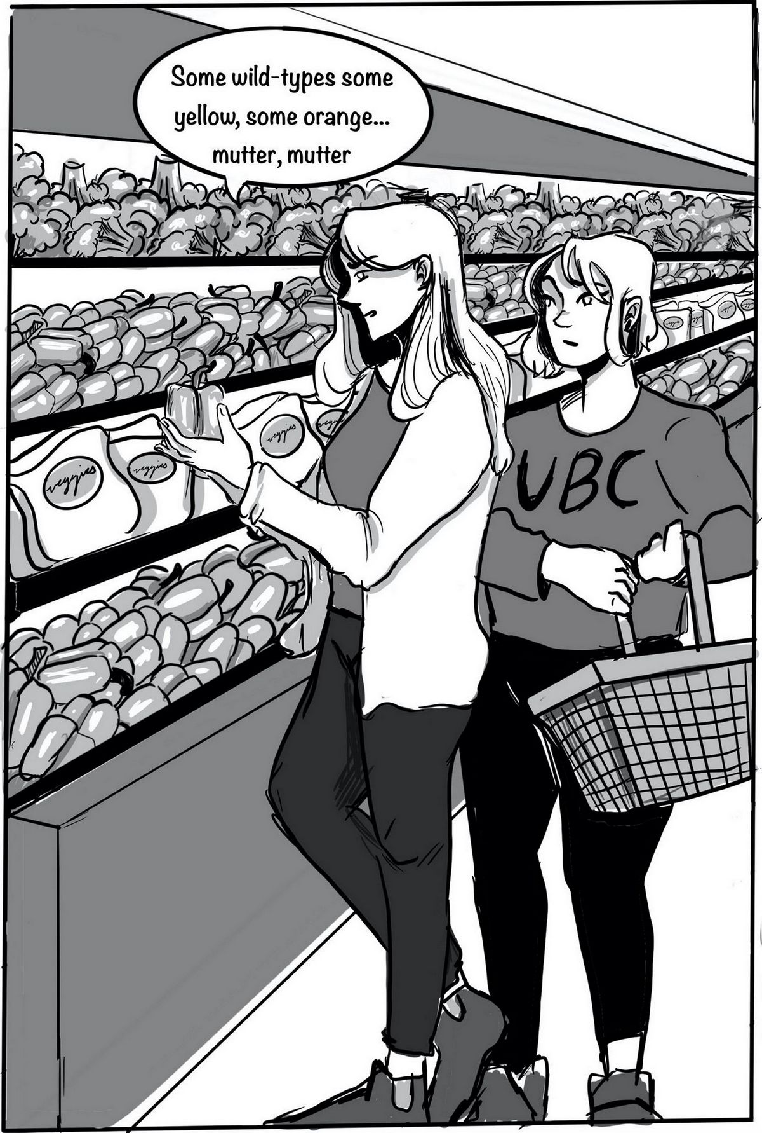
To Pick a Peck of Orange Peppers – Part I
5
Notes:
Displaying Slide 5 (just long enough for students to take it in) signals to the students that the lesson is moving on and they should focus on what is coming next, while Slide 6 sets up the first “real” question of the case. After giving students a moment to read this part of the story, instructors can informally ask Question 1 (e.g. “What could cause a plant to make yellow peppers?”) and then display the question on Slide 7.

Slide 6
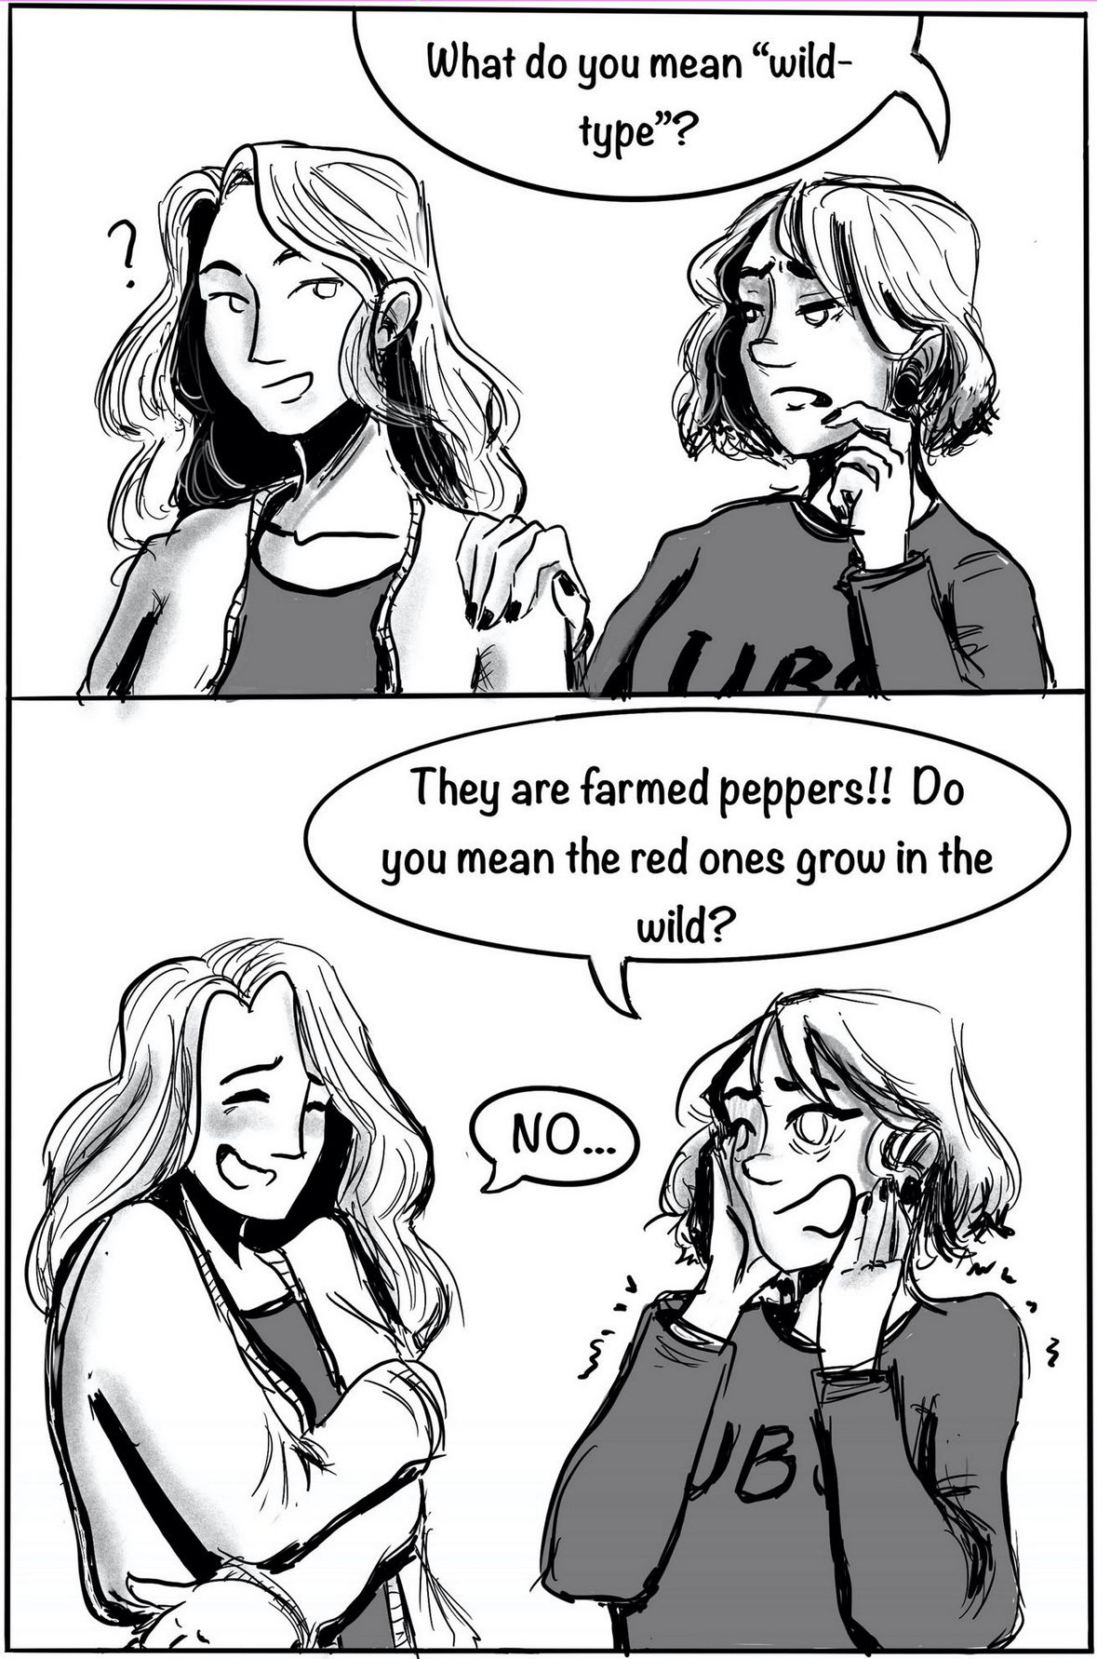
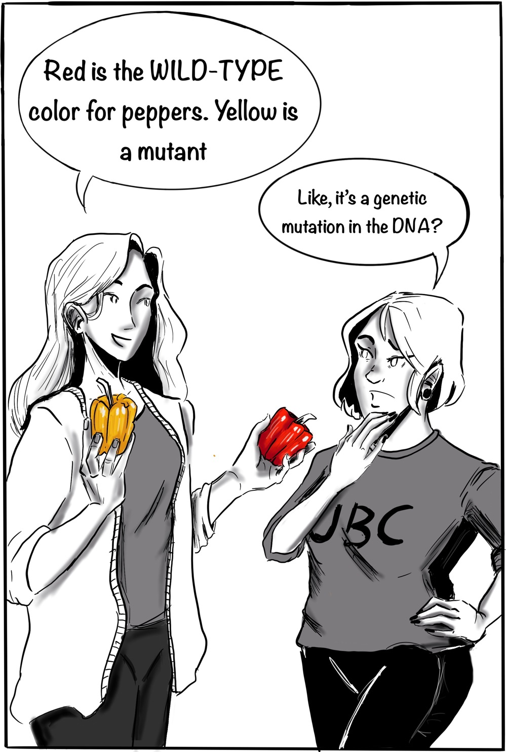
To Pick a Peck of Orange Peppers – Part I
6
Notes:
Slide 6 sets up the first “real” question of the case. After giving students a moment to read this part pf the story, instructors can informally ask Question 1 (“What could cause a plant to make yellow peppers?”) and then display the question on Slide 7.

Slide 7
To Pick a Peck of Orange Peppers – Part I
What could be a genetic cause, and a non-genetic cause, for the yellow color of a bell pepper fruit?
As you answer the question, please feel free to consult the information in your assigned preparatory readings. The carotenoids biosynthesis pathway will be particularly useful.
7
Notes:
As the slide is on display, ask students to spend about three minutes working (individually or in pairs) on the question and jot down their ideas. The portion asking about a possible genetic cause should be very easy for students, as it is simply the “reverse” of Question 9 on the preparation quiz. The non-genetic cause may prove a little more challenging, but here we are not looking for a detailed explanation. Once the time is up, instructors ask students to share their answers, they provide feedback, and for the genetic cause, we encourage probing students for details. Students may be tempted to simply propose a mutation in Ccs; instructors can ask what kind of mutation, in what part of the gene, how it would result in a lack of CCS function, or even whether the plant in question would be homozygous or heterozygous for the mutation. For the portion asking about potential non-genetic causes, the main goal is for students to become aware that environmental factors can and do affect gene transcription and protein function.
Finally, before moving on, instructors emphasize to students that for the purpose of this case study, the focus will be on genetic causes of phenotypic differences.

Slide 8
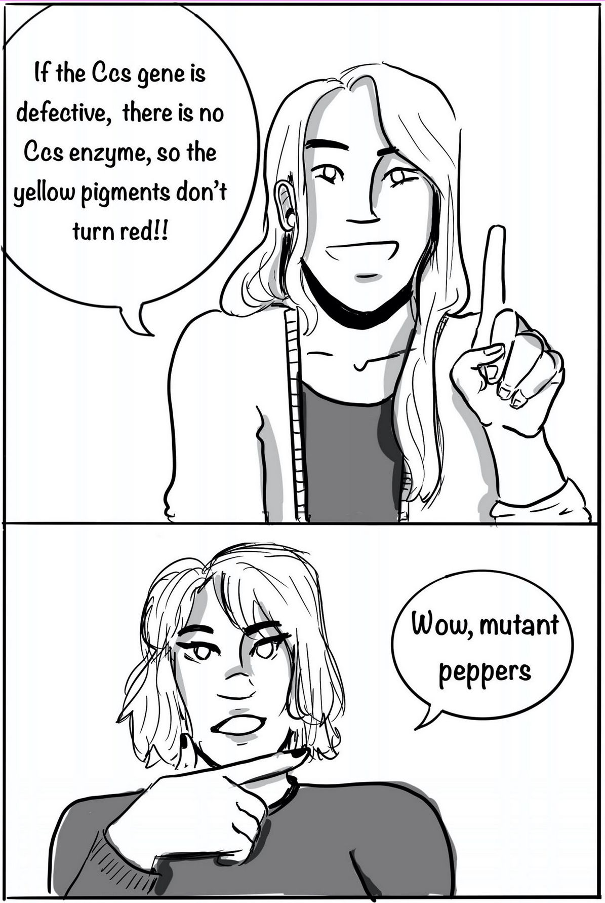
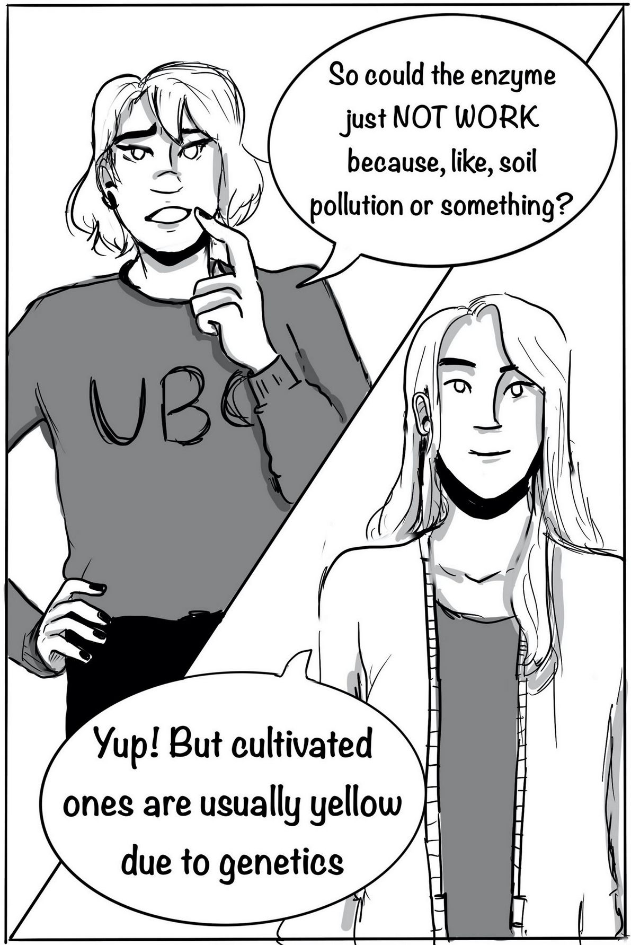
To Pick a Peck of Orange Peppers – Part I
8
Notes:
Slides 8 and 9 are briefly displayed, in sequence, signaling that the class is now moving on and the story continues. Before showing Slide 10, instructors may emphasize to students that the focus has switched from yellow peppers to green ones.

Slide 9
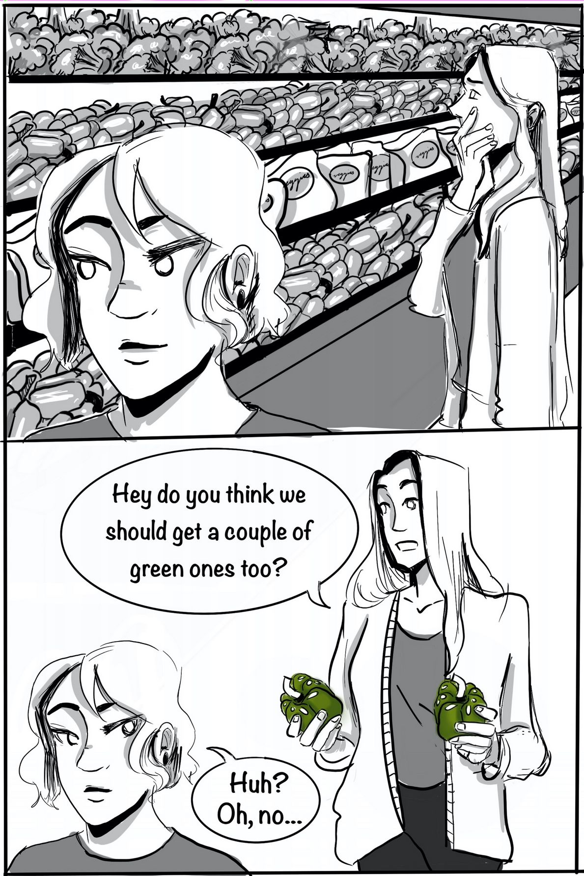
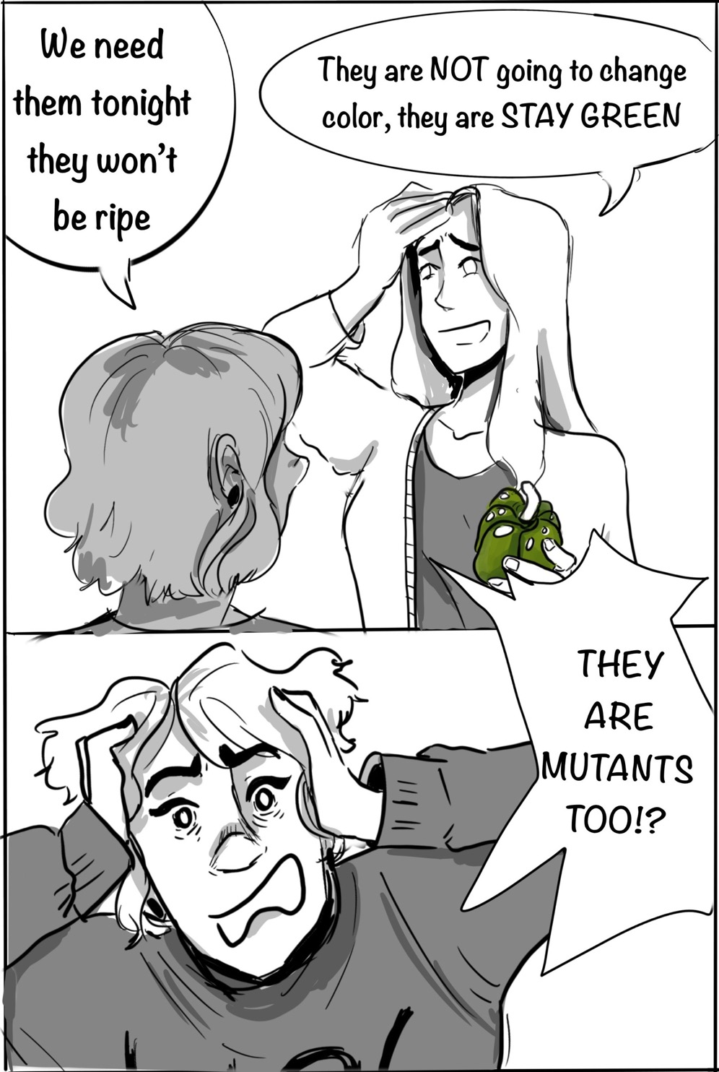
To Pick a Peck of Orange Peppers – Part I
9
Notes:
Slides 8 and 9 are briefly displayed, in sequence, signaling that the class is now moving on and the story continues. Before showing Slide 10, instructors may emphasize to students that the focus has switched from yellow peppers to green ones.

Slide 10
To Pick a Peck of Orange Peppers – Part I
What kinds of mutations, and at what loci, do “permanently green” peppers possibly have?
To help constructing and articulating your answer, please address the following points:
What pigments are present, and what pigments are missing, in ripe red peppers and in permanently green peppers, respectively?
What proteins do you expect to be absent or non-functional in a plant that produces permanently green peppers?
What kinds of mutations, and at what loci, would result in the protein defects you postulated in (ii) above? What would this mutation (or these mutations) cause in terms of mRNA?
10
Notes:
Slide 10 is displayed and students are invited to spend about three to four minutes, individually or in pairs, working on Question 2 and writing down their ideas. This may seem a big question to answer in such a short time, but the answers can be in large part found in, or directly deduced from, the pre-class readings. Instructors can help by circulating, encouraging, and providing some time warming (e.g., two minutes left, one minute left, etc.). The class then reconvenes and students are invited to share their answers; instructors provide feedback and answer questions as necessary. For part iii of the question, it is beneficial to hear/solicit ideas from multiple students so as to illustrate a variety of valid answers. This offers the opportunity for students to review how different kinds of DNA mutations affect gene products.
Once the debrief is complete, the handout for Part II starts being distributed to students.

Slide 11
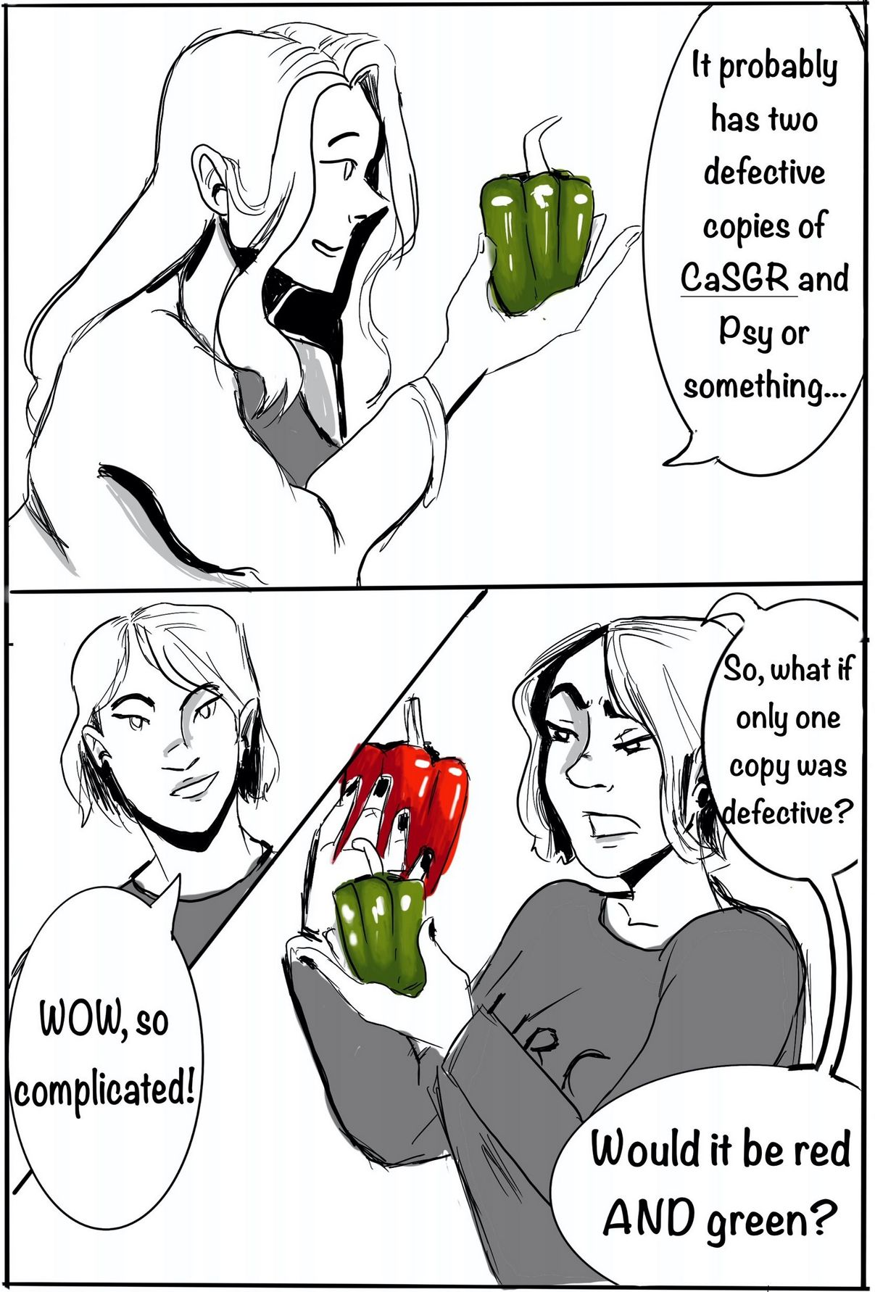
To Pick a Peck of Orange Peppers – Part II
Right…what if one CaSGR allele was wild-type and the other had a large deletion in the promoter region, making it non-functional? What fruit color would such a plant produce?
It depends on which of the two CaSGR alleles is dominant.
Most likely permanently green fruits.
Most likely purple-brown fruits.
Most likely red fruits.
11
Notes:
The slide is displayed while the handout for Part II is distributed, and students are invited to take two minutes to a) consider the characters’ conversation, b) choose the best answer to Question 3, and c) get their personal response systems (e.g., clickers, cards, etc.) ready. Instructors then open the “polls” for 10 to 15 seconds and students vote for the question they selected.
This question is not designed to be followed up with feedback or a debrief, as it was designed for the purpose of activating students’ relevant prior knowledge (be it accurate or not) and for them to start thinking about what happens in a cell when two different alleles of a gene are present. Before moving on, however, instructors should take note (if possible) of the distribution of answers. It is also a good idea to let students know that multiple different answers have received votes (if that is the case), and reassure them that everyone will have ample time to reconsider their answers, ask for clarification, and receive feedback after the next case question.
The correct and incorrect answers for this question are presented with Question 4 (slide 15), which is identical to Question 3 and allows students to reconsider their answers after some instruction.

Slide 12
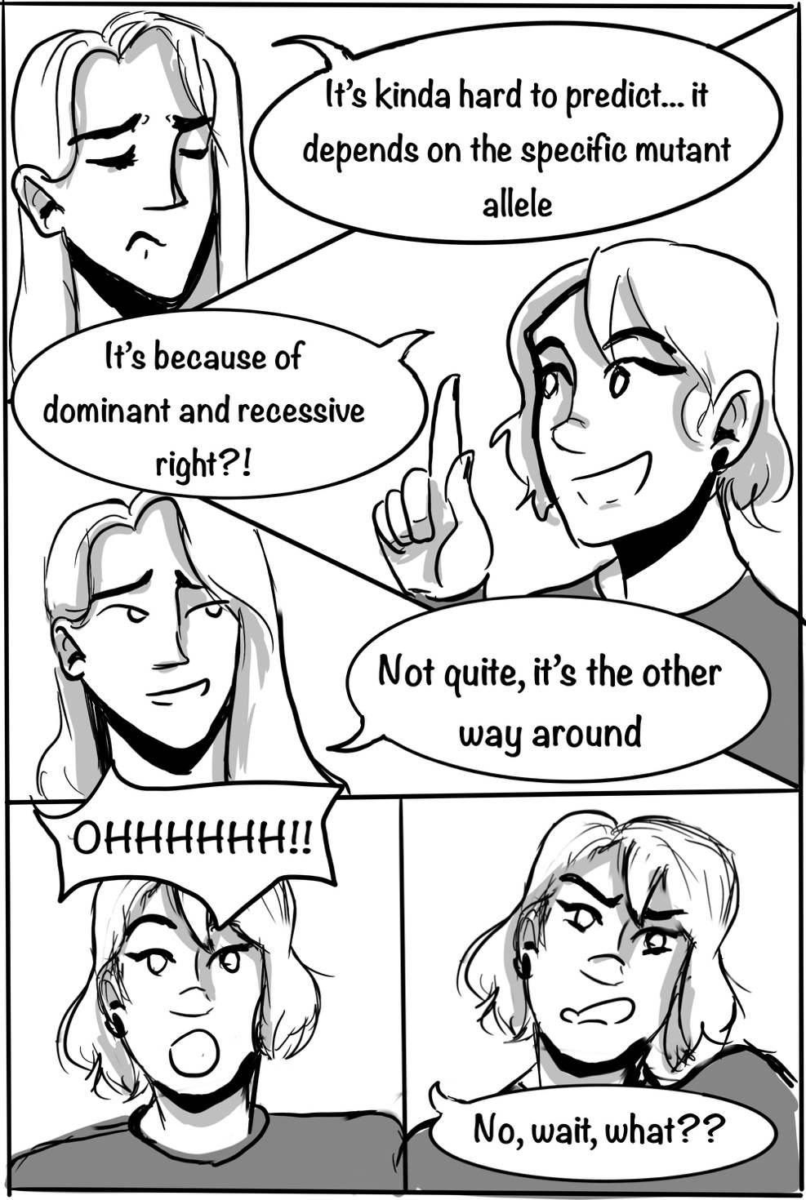
To Pick a Peck of Orange Peppers – Part II
Is anyone as confused as our curious friend ? Pay attention to the explanations that follow.
12
Notes:
Students may take a minute to read through the slide and grasp what is happening. Before continuing to the “intermission,” it is helpful for instructors to informally ask students to raise their hand if they are confused about the character saying that “it’s the other way around.” It is also worth acknowledging to the class that this is indeed a common point of confusion, and it is going to be addressed next.

Slide 13
To Pick a Peck of Orange Peppers – Part II
Intermission: Dominant & Recessive 101
To determine the dominance relationship between two alleles of a gene, A1 and A2, we first need to know the following:
What is the general phenotype that we are interested in? (e.g. height, fruit color, amount of CCS enzyme, …)
What is the specific phenotype of individuals of genotype A1/A1?
What is the specific phenotype of individuals of genotype A2/A2?
What is the specific phenotype of individuals of genotype A1/A2?
Then, we compare the phenotype of heterozygous (A1/A2) individuals to that of each of
the two homozygotes (A1/A1 and A2/A2). If one homozygote has the same phenotype as
the heterozygote, that phenotype is said to be dominant. By extension, the allele present in
two copies in the homozygote is said to be dominant to the other allele.
13
Notes:
Instructors can go through these two slides point by point and, if deemed appropriate, acknowledge that these definitions and process for defining dominance may seem very “picky”, but they are important. Students often ask whether copies of these slides will be made available after class; this should depend on the instructor’s preference and on what the norm is in the course. Students may also have relevant clarification questions, which should be addressed.
Note that throughout this case study we use the expression “neither dominant nor recessive to each other” without going into detail about the distinctions among incomplete dominance, semi-dominance, and co-dominance. This decision was made after seeing numerous students becoming excessively focused on distinguishing between incomplete dominance and co-dominance, and losing sight of the bigger picture (and is something that can be shared with the students).

Slide 14
To Pick a Peck of Orange Peppers – Part II
Intermission: Dominant & Recessive 101 - continued
Example: Dominance relationship between A1 and A2 alleles with respect to the phenotype fruit color.
A1/A1
A2/A2
If plants with genotype A1/A2 (heterozygotes) make…
red fruits (like A1/A1), then A1 is dominant to A2.
yellow fruits (like A2/A2) , then A2 is dominant to A1.
fruits that are neither red nor yellow (unlike both homozygotes; e.g. blue) then A1 and A2 are neither dominant nor recessive to each other.
14

Slide 15
To Pick a Peck of Orange Peppers – Part II
Reconsider: A pepper plant has one CaSGR allele that is wild-type and one that has a large deletion in the promoter region, making it non-functional. What fruit color will such a plant produce?
It depends on which of the two CaSGR alleles is dominant.
Most likely permanently green fruits.
Most likely purple-brown fruits.
Most likely red fruits.
15
Notes:
This is a repeat of Question 3, serving the double purpose of a post-test and of an opportunity for students to share their thought process and receive feedback. Instructors display the question and invite students to take about 30 seconds to choose the best answer (we suggest encouraging students to mark their choice on their handout), then open the “polls” for 10 to 15 seconds and students vote. There should be few, if any, votes for options A and B, with most of the class being split between options C and D. Instructors can focus first on inviting students who chose answers C and D to share their rationale, providing any necessary feedback and pointing out how both answers are acceptable. If needed, instructors can then reiterate why answer A is inaccurate, and explain why B is not acceptable here.

Slide 16
To Pick a Peck of Orange Peppers – Part II
A pepper plant has one CaSGR allele that is wild-type and the other has a large deletion in the promoter region, making it non-functional. What do you expect the dominance relationship between these two alleles to be?
The wild-type allele is dominant to the “deletion” allele.
The wild-type allele is recessive to the “deletion” allele.
The wild-type allele and the “deletion” allele are neither dominant nor recessive to each other.
We do not have enough information to predict the dominance relationship between these two alleles.
16
Notes:
Question 5 works similarly to Question 3: it is displayed and students are invited to take one minute to read it and choose the best answer. Instructors then open the “polls” for 10 to 15 seconds and students vote for the question they selected. Instructors can share what the distribution of answers looks like, and let students know that the upcoming question will help them unpack Question 5.

Slide 17
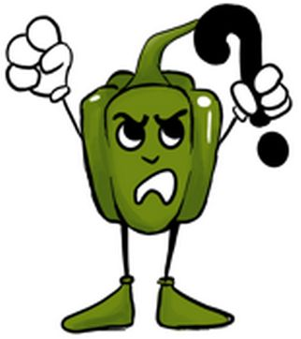
To Pick a Peck of Orange Peppers – Part II
To help us rigorously predict the dominance relationship between the wild-type allele of CaSGR and our mutant allele of interest (deletion of the gene’s promoter), let’s start by predicting the following:
 | Plant’s genotype (CaSGR gene)
Phenotype | Homozygous wild-type | Homozygous mutant | Heterozygous
Presence of CaSGR mRNA | yes, present
Amount of CaSGR mRNA | two ‘doses’
Amount of CaSGR protein | two ‘doses’
Amount of chlorophyll in ripe fruits | none
Color of ripe fruit | red
17
Notes:
Ideally, a copy of slide 17 (with Question 6 table) is displayed in a format that instructors can edit or write on (e.g., document camera, overhead projector, or a prepared-in-advance table on the blackboard). As many students may find the material quite challenging (especially in introductory courses), it is generally effective to work through the Question 6 table as a class, with instructors soliciting contributions from different students, providing feedback, asking if the rest of the class agrees, and adding to the table until it is filled.
The column for the homozygous mutant usually goes very quickly until the fruit color phenotype, where it is not unusual for students to first think that the fruit will be green. Making predictions for the heterozygote is initially more challenging, but once students build some confidence with the first couple of phenotypes, they are able to collectively complete the rest comfortably.

Slide 18
To Pick a Peck of Orange Peppers – Part II
Reconsider: A pepper plant has one CaSGR allele that is wild-type and one that has a large deletion in the promoter region, making it non-functional. What do you expect the dominance relationship between these two alleles to be?
The wild-type allele is dominant to the “deletion” allele.
The wild-type allele is recessive to the “deletion” allele.
The wild-type allele and the “deletion” allele are neither dominant nor recessive to each other.
We do not have enough information to predict the dominance relationship between these two alleles.
18
Notes:
The slide is displayed and students are given about 30 seconds to select their answer to Question 7 (that is, to reconsider Question 5 in light of the work completed for Question 6), then instructors open the “polls” for 10 to 15 seconds and students vote. Before debriefing, instructors can encourage students to compare their answer to Questions 7 and 5, noticing if their choice has changed.
We expect most students to select option D and suggest that instructors start the debrief by inviting students who chose this answer to share their rationale and ask them what additional information they would need to have (i.e., they would need to know what the phenotype of interest is). Students who selected other answers could then also be invited to share their rationale as well as the phenotype on which they based their answer; their logic may be valid, with the only caveat of needing to be explicit about the phenotype considered. Finally, this can be an opportunity to emphasize to the class that that no matter how well-reasoned our prediction/expectation is, it is still only a prediction. In order to establish it as a fact, we would need to carefully, empirically assess the phenotype of interest in the homozygous wild-type, homozygous mutant, and in the heterozygote; and this is precisely one of the things that researchers would do.

Slide 19
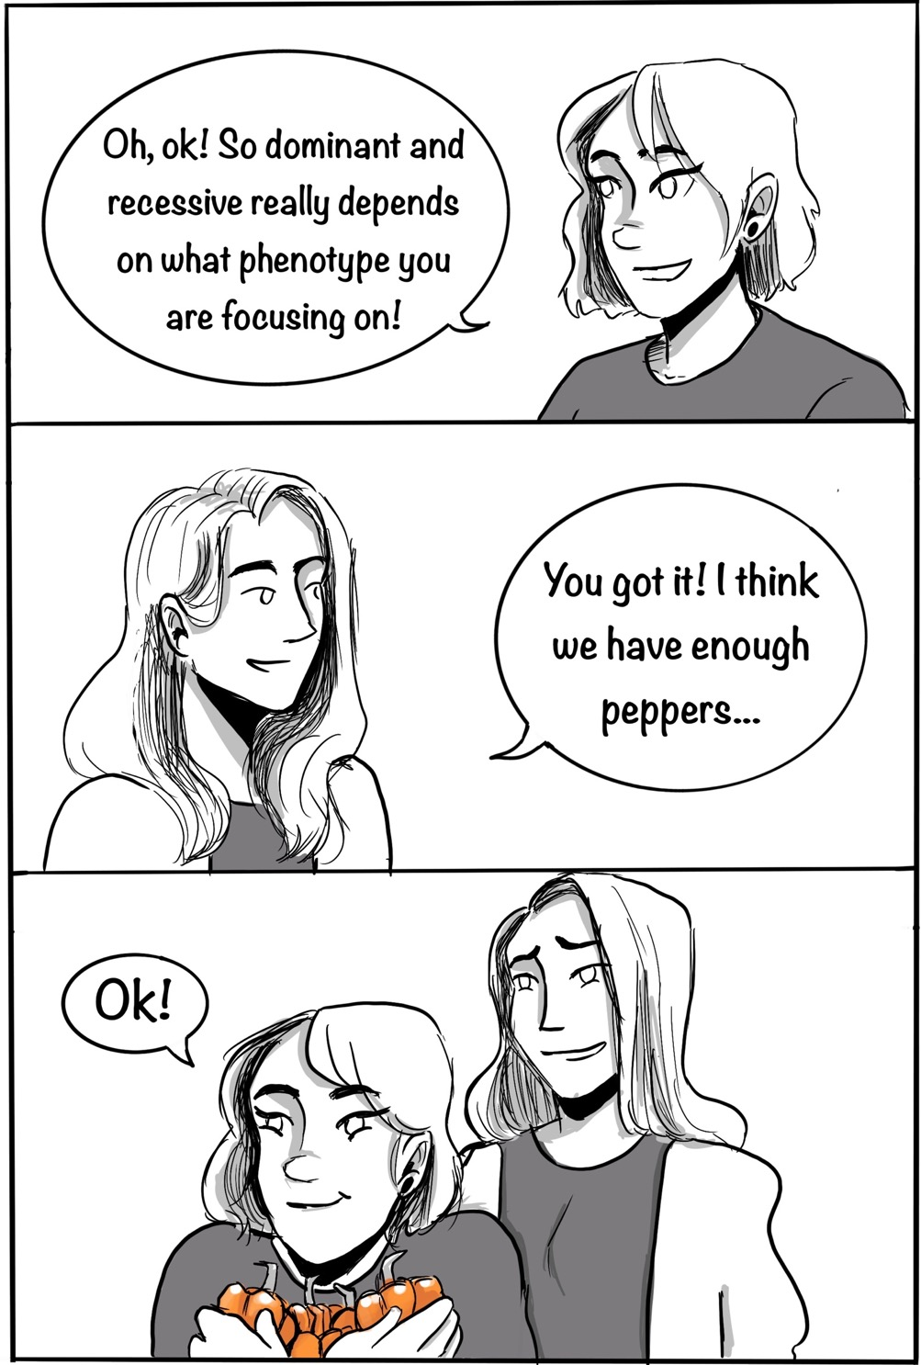
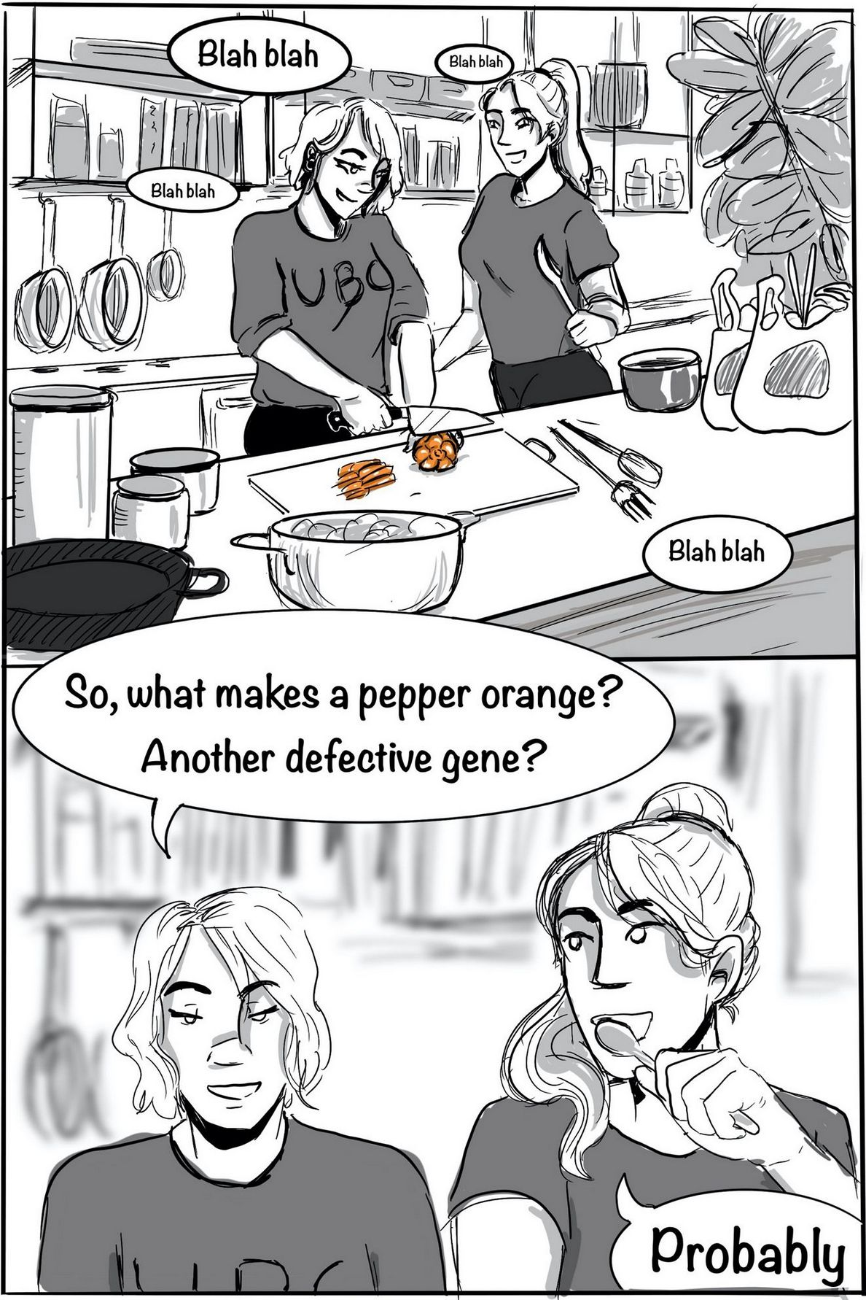
To Pick a Peck of Orange Peppers – Part III
19
Notes:
The slide is displayed as Part III of the handout is distributed, and students are invited to form groups of four while they follow the unfolding of the story.

Slide 20
To Pick a Peck of Orange Peppers – Part III
Form groups of about four. Then, in your groups, answer the following:
What could cause a plant to produce orange peppers? Propose at least two distinct hypotheses that would explain the production of orange peppers. Please ensure that each of your hypotheses:
is consistent with what you have learned about fruit color in bell peppers;
is testable, i.e., it makes one or more predictions that you could verify experimentally through measurements and observations.
20
Notes:
Instructors may ask the students whether any of them has ever wondered what makes orange peppers orange and invite groups to spend about five to six minutes working collaboratively on the question. It can be helpful to point out to students the orange pepper character in the corner of the slide, which signals a more challenging question that will require focus. Directions on how to work productively as a group should also be provided as necessary, and it is important that while the students work, instructors circulate among the groups (see suggestions in the Teaching Notes). Note also that groups may need substantial encouragement and prodding to get started – they should spend their time discussing the question at hand and writing down ideas, not debating whether to use a sharable electronic document, or the esthetics of their written answers.
Once the time is up, instructors invite groups to share their hypotheses, comment on them, and (if possible) write and display them on a blackboard, document camera, flip chart paper, etc. To get a sense for the most common hypotheses, after a group has proposed theirs, instructors can ask if other groups have produced something similar, and keep a tally. If a group proposes a “hypothesis” that is not clearly testable, or that or very generic (e.g., a new enzyme, or directional selection) instructors should point this out and steer students toward a testable and/or more specific option.

Slide 21
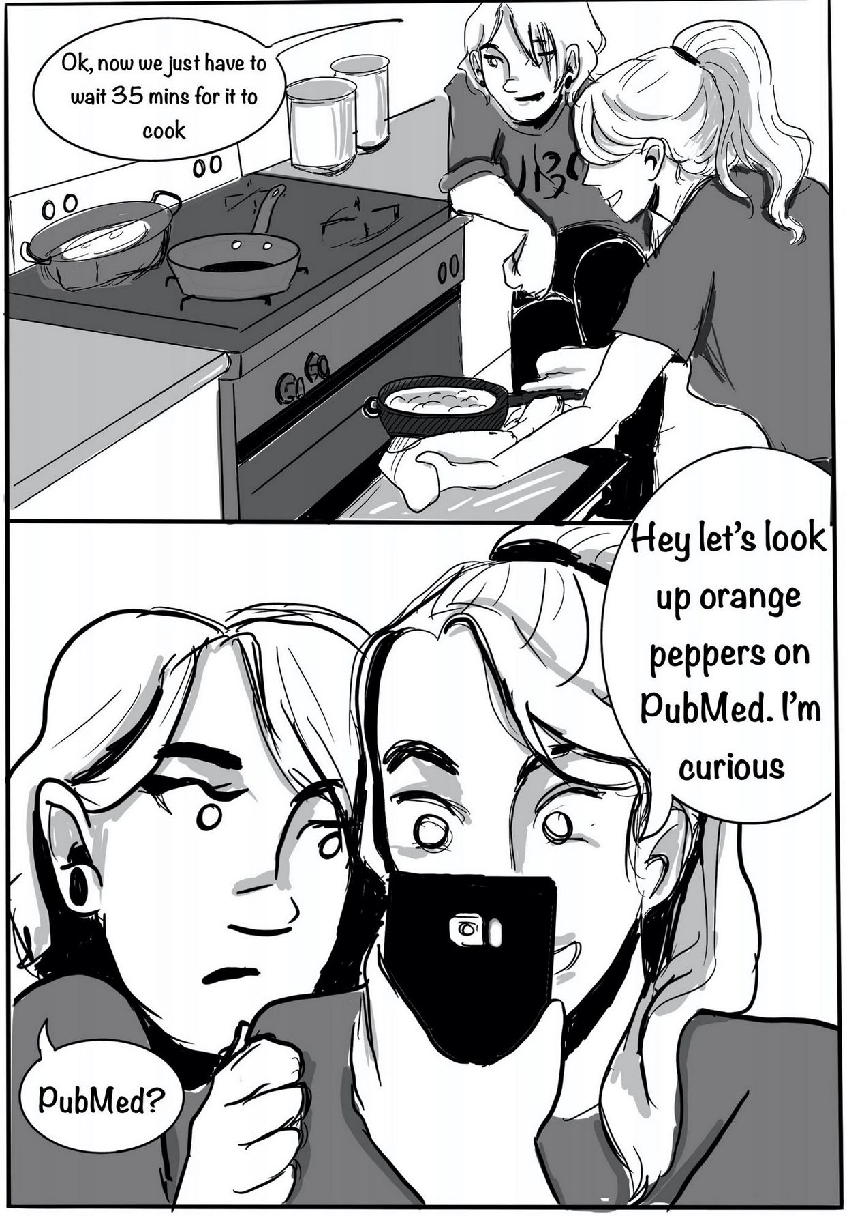
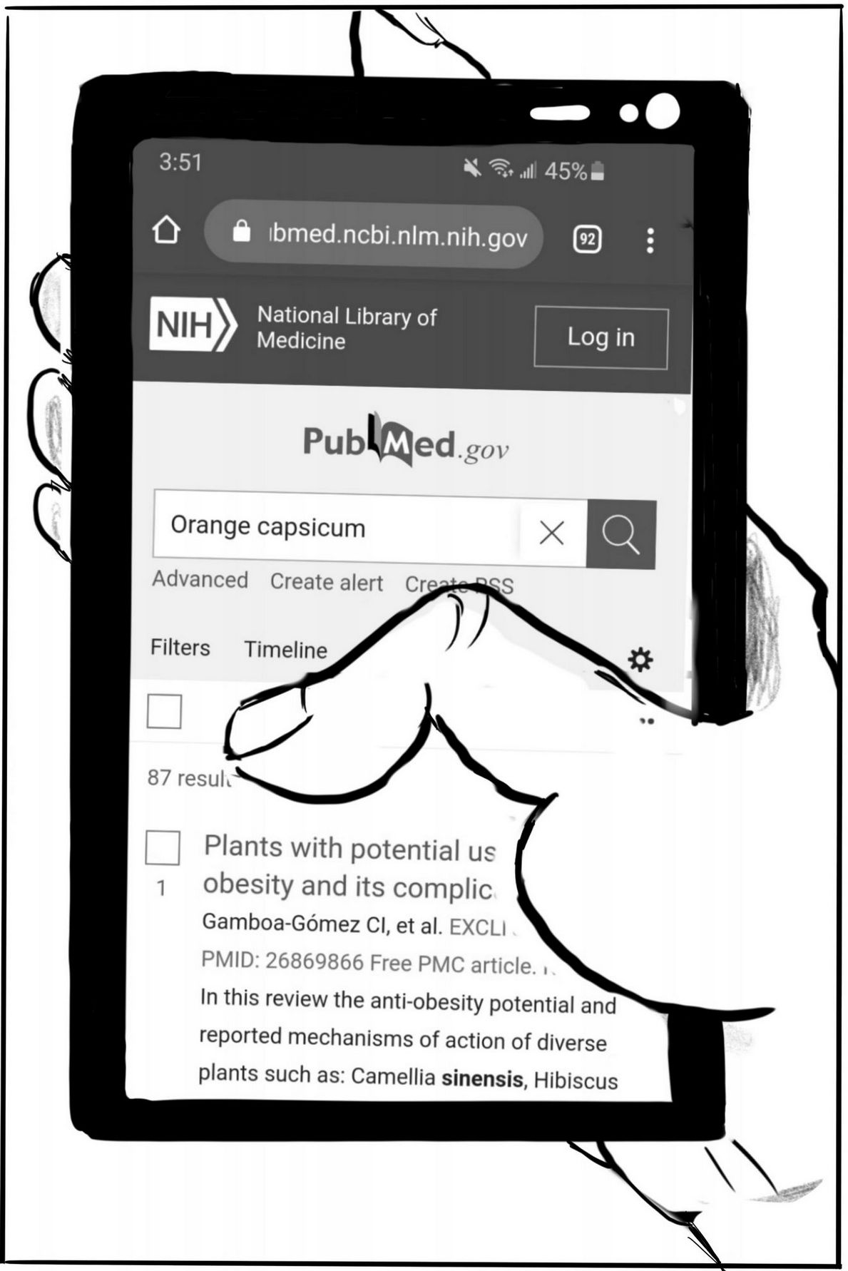
To Pick a Peck of Orange Peppers – Part III
21
Notes:
Slide 21 is displayed, signaling to the groups that the story continues and they should focus on what it to come. It is shortly followed by Slide 22; instructors can briefly ask the class whether they think the article will support any of the hypotheses now listed on the board.

Slide 22
To Pick a Peck of Orange Peppers – Part III
While dinner is in the oven, our friends find a very relevant article on orange peppers:
Rodriguez-Uribe, L., I. Guzman, W. Rajapakse, R.D. Richins, & M.A. O’Connell. (2012). Carotenoid accumulation in orange-pigmented Capsicum annum fruit, regulated at multiple levels. Journal of Experimental Botany 63(1): 517–26.
Do the results reported in this article support one of your hypotheses?
We will soon find out!
22
Notes:
For Slide 22, instructors can briefly ask the class whether they think the article will support any of the hypotheses now listed on the board.

Slide 23
To Pick a Peck of Orange Peppers – Part III
As part of their study, Dr. Laura Rodriguez-Uribe and her colleagues at New Mexico State University studied fruits from several orange cultivars, as well as one yellow and one red ones. For most of them they examined:
levels (amounts) of several pigments present in the fruits;
levels (amounts) of RNAs encoding carotenoid biosynthesis pathway enzymes;
sizes (length in bases) of RNAs encoding carotenoid biosynthesis pathway enzymes; and
DNA sequence of the Ccs gene promoter.
What would their results have been if your Hypothesis 1 was correct? What about if your Hypothesis 2 was correct?
Discuss with your group and report your prediction in your Question 9 tables.
23
Notes:
This is one of the longer and more complex questions, groups should be given about eight to ten minutes to work on it. As the slide is displayed, it can be helpful for instructors to take a minute and read it through, point by point, and direct the groups to report their predictions in the tables provided on their case handout. For efficiency, groups may decide to have two members focus on the predictions for Hypothesis 1 and two members on Hypothesis 2. Once the groups start working, instructors display the next slide, set up a version of the Question 9 table that can be annotated, and start circulating as for Question 8.

Slide 24
To Pick a Peck of Orange Peppers – Part III
Tables 9.i. and 9.ii. – For amounts, you may use arbitrary values or semi-quantitative designation such as zero, low, medium, or high.
* in ripe fruits
Phenotype (measurement) | Red cultivar | Yellow cultivar | Orange cultivar
amount of b-carotene*
amount b-cryptoxanthin*
amount of lutein*
amount of zeaxanthin*
amount of violaxanthin*
amount of capsanthin*
amount of Psy RNA*
amount of LcyB RNA*
amount of CrtZ2 RNA*
amount of Ccs RNA*
length of the Psy RNA* (compared to length in WT red)
length of the LcyB RNA* * (compared to length in WT red)
length of the CrtZ2 RNA* * (compared to length in WT red)
length of the Ccs RNA* * (compared to length in WT red)
mutation(s) in Ccs gene promoter
24
Notes:
The slide, or an editable form of Question 9 table, is displayed while the groups work together and instructors circulate. It is critical that instructors do not spend too much time with any one group, and instead focus on visiting as many groups as possible and provide as much specific feedback as possible. When the allotted time is expired, the class reconvenes and instructors can ask those groups who had proposed the most frequent hypotheses to share their predictions. As the groups do so, instructors provide feedback where necessary and display and fill out their editable copy of the Question 9 table. Alternatively, instructors can choose a hypothesis among the ones proposed and invite all students to contribute to filling out the table.
The debrief is also an opportunity to point out how the measurements made by the article’s authors may not be able to distinguish between, or test, everyone’s hypotheses. For instance, the authors do not look at the sequence of potentially relevant genes, such as Ccs (although they will report prior data on it). Once the debrief is complete, students should be given access either to the full article by Rodriguez-Uribe et al. (2012), or to copies of the figures and table documents included in the case.

Slide 25
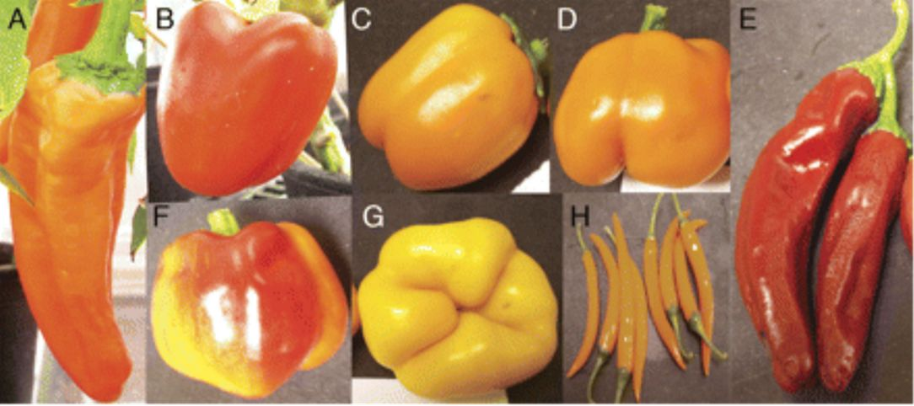
To Pick a Peck of Orange Peppers – Part III
The authors studied fruits from eight cultivars, but we will focus on the following:
NewMex Sunset (A)
Valencia (B)
Orange Grande (C)
Oriole (D)
NewMex Garnet (E)
Canary (G)
NewMex Garnet has the wild-type, red fruit color phenotype. How would you define the respective fruit colors of the other five cultivars of interest?
Figure 2 from: Rodriguez-Uribe, L., I. Guzman, W. Rajapakse, R.D. Richins, & M.A. O’Connell. (2012). Carotenoid accumulation in orange-pigmented Capsicum annum fruit, regulated at multiple levels. Journal of Experimental Botany 63(1): 517–26.
25
Notes:
The slide is displayed and instructors can explain that before launching into a study on orange peppers, it is helpful to become familiar with the cultivars examined and their appearances. Students can be invited to share their perspectives on the fruit colors of the cultivars of interest; instructors can point out how the perception of color is somewhat subjective, and share the color definitions from the article’s authors. This is also an excellent opportunity for students to notice that even within a single color phenotype, there is a range (e.g. very dark orange to light orange), and remember that here we just see single fruits for each cultivar, but there is likely some variation within cultivars as well.

Slide 26
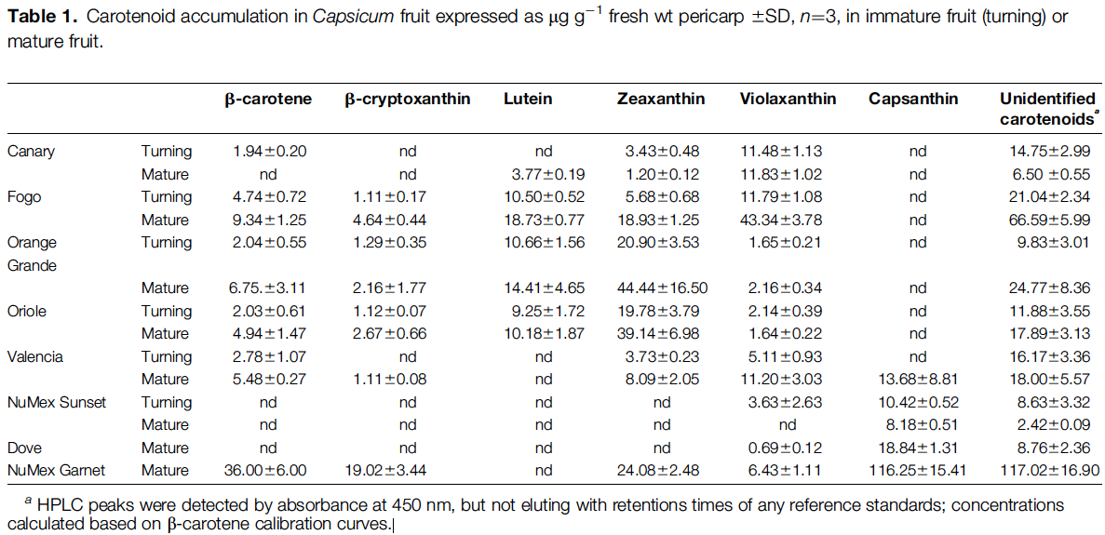
To Pick a Peck of Orange Peppers – Part III
Examine Table 1 from Rodriguez-Uribe and colleagues’ paper, focusing only on mature (ripe) fruits.
What pigments are present in high amounts, in low amounts, or absent in the yellow and red cultivars, respectively? Do the data match either of your hypotheses’ predictions?
orange
yellow
red
*
*
*
*
*
*
26
Notes:
Instructors display Slide 26 and invite groups to spend three minutes working on, and writing down their answers to, Question 11. It is a good idea to point out that the question has three parts and remind students that the yellow cultivar is Canary, and the red one is NuMex Garnet. After about one minute, instructors can display Slide 27 and signal to students that they should now be working on parts ii. and iii. When the time is up, the display goes back to Slide 26 for a quick debrief before returning to 27 to go over the answers to parts ii. and iii. Question 11 is usually quite straightforward for students, but they may (rightly so) feel baffled by some of the data. It may be helpful for instructors to reassure them that some of the data are indeed surprising, and emphasize the importance of experimental work and empirical measurements.
Alternative for classes where students are more advanced and/or more independent: Instead of having them work on Question 11, then debrief and move on to the next question, instructors can give the groups 15 minutes or so to work through Questions 11 – 14, then reconvene and debrief/discuss the answers. To ensure that each question has been discussed thoroughly by at least some of the groups, and there will be enough students in a position to contribute meaningfully to the debrief discussion, different groups can be asked to start from different questions (e.g., the groups in the front left quarter of the classroom start from Question 11, those in the back left from Question 12, etc.).

Slide 27
To Pick a Peck of Orange Peppers – Part III
Examine Table 1 from Rodriguez-Uribe and colleagues’ paper, focusing only on mature (ripe) fruits.
What do you notice about the pigments present in high amounts, in low amounts, or absent in the orange cultivars of interest? Are there any patterns?
Do any of these orange cultivars match the predictions made by one of your hypotheses?
orange
yellow
red
*
*
*
*
*
*
27

Slide 28
To Pick a Peck of Orange Peppers – Part III
Examine Figure 4 from Rodriguez-Uribe and colleagues’ paper, focusing only on mature (ripe) fruits, denoted “2.” The picture shows the results of a northern blot.
Do any of the yellow or orange cultivars of interest have RNAs that are different in size from those of NuMex Garnet? If so, which ones?
In terms of the relevant RNAs size, do any of these cultivars match the predictions made by one of your hypotheses? If so, which ones?
*
*
*
*
*
*
28
Notes:
The suggested “choreography” for Slides 28 & 29 and Question 12 is the same as for Question 11, with the caveat that parts (iii) and (iv) (Slide 29) are not essential for groups to answer and can be simply explained/clarified by instructors during the debrief. The purpose of including them as part of the question is that if some groups are very comfortable with reading and interpreting northern blot data, they will complete parts (i) and (ii) very quickly, and parts (iii) and (iv) will keep them engaged.
If students have not worked on a northern blot picture before, some of them will likely have questions, even if they have completed the supplementary readings and video viewings. The most common explanations/clarifications that they need include:
Here, each of the five labelled horizontal “strips” is a picture of a northern blot performed with the same RNA samples, but with five different probes. E.g., the first strip shows us bands where the probe for the Psy RNA hybridized.
The position of a band (toward the top, middle, or bottom of the strip) is indicative of the length of the RNA molecules forming that band.
The intensity of the band indicates the amount of RNA that is hybridizing to the probe in question – dark, thick, intense bands indicate that a lot of RNA has hybridized to that probe, but this is only partly quantitative (i.e., double the intensity does not necessarily mean double the amount of RNA).
The big “blobs” that do not look like bands are the result of very large amounts of probe hybridizing to their target RNA; they are indicative of very large amounts of target RNA.

Slide 29
To Pick a Peck of Orange Peppers – Part III
Examine Figure 4 from Rodriguez-Uribe and colleagues’ paper, focusing only on mature (ripe) fruits, denoted “2.” The picture shows the results of a northern blot.
The data for the LcyB RNA shows two distinct bands. What could they represent?
What is the 28S RNA? Why did the authors include it in the northern blot?
*
*
*
*
*
*
29

Slide 30
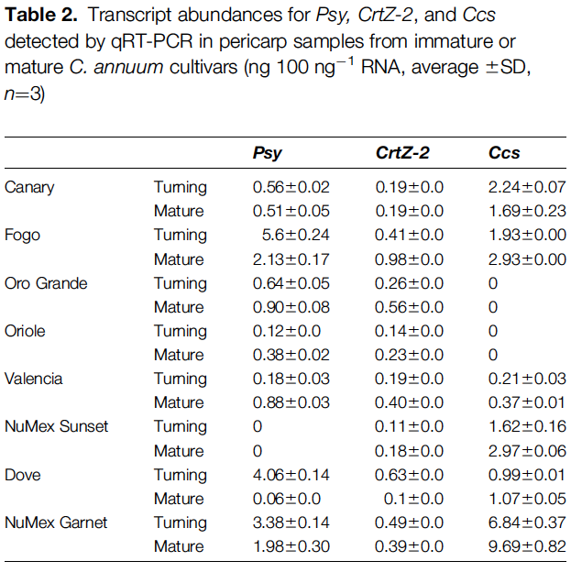
To Pick a Peck of Orange Peppers – Part III
Examine Table 2 from Rodriguez-Uribe and colleagues’ paper, focusing only on mature (ripe) fruits. This table reports the results of their qRTR-PCR experiments.
What RNAs are present in high amounts, in low amounts, or absent in the yellow and red cultivars, respectively? Do the data match either of your hypotheses’ predictions? If so, which ones?
*
*
*
*
*
*
30
Notes:
The suggested “choreography” for slides 30-31 and Question 13 is the same as for Question 11. As slide 30 is displayed, instructors can explain that, since northern blots are only partially quantitative (especially with the technologies available in 2012), the authors used qRT-PCR to assess RNAs levels.

Slide 31
To Pick a Peck of Orange Peppers – Part III
Examine Table 2 from Rodriguez-Uribe and colleagues’ paper, focusing only on mature (ripe) fruits. This table reports the results of their qRTR-PCR experiments.
What do you notice about the RNAs present in low amounts, in high amount, or absent in the orange cultivars of interest? Are there any patterns?
Do any of the orange cultivars match the predictions made by one of your hypotheses?
*
*
*
*
*
*
31

Slide 32
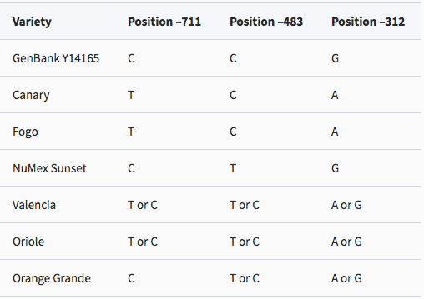
To Pick a Peck of Orange Peppers – Part III
The authors report DNA sequences of three critical regions of the Ccs gene promoter in several cultivars to the wild-type reference sequence (GenBank Y14165). Examine the data reported in Table 3.
What cultivars of interest have a Ccs promoter sequence different from the wild-type one? What are these differences?
In some cases, two different bases are reported for a position (e.g., T or C at position -711 for Valencia). What do you think this means about the Ccs genotype of those cultivars?
32
Notes:
The suggested “choreography” for slides 32-33 and Question 14 is the same as for Question 11. This is generally a straightforward question for students.

Slide 33
To Pick a Peck of Orange Peppers – Part III
The authors report DNA sequences of three critical regions of the Ccs gene promoter in several cultivars to the wild-type reference sequence (GenBank Y14165). Examine the data reported in Table 3.
Do any of these findings match with what is predicted by one of your hypotheses? If so, in what way?
Review the qRT-PCR data for Ccs RNA in our cultivars of interest. Could the difference in promoter sequence explain any of them? If so, how?
33

Slide 34
To Pick a Peck of Orange Peppers – Part III
Consider these additional pieces of information provided in the article by Rodriguez-Uribe et al. (2012):
Previous work by Guzman et al. (2010) has shown that the coding regions of the Psy, LcyB, CrtZ-2 and Ccs genes are wild-type (no mutations) in all the orange cultivars except for Fogo, which has mutant alleles of Ccs (nonsense mutation).
A protein corresponding in size to CCS was detected in NuMex Sunset, Dove and Valencia, but not in Fogo, Orange Grande, Oriole, or Canary.
With your group, review all the information you have about NewMex Sunset and another orange cultivar of your choice (you may also want to review the data for NuMex Garnet and Canary, as comparisons).
Then, propose a comprehensive model that explains how your two orange cultivars come to produce orange fruits.
Your model should be consistent with the data discussed in your group and include a step-by-step mechanism (e.g., “a mutation in the promoter of gene X results in reduced production of transcript X, leading to reduced levels of enzyme X, so step Y in the carotenoid biosynthesis pathway occurs inefficiently…,” etc.).
34
Notes:
The suggested “choreography” for this slide and Question 15 is generally the same as for Question 11. However, groups should be given sufficient time to develop sensible models. With instructors circulating, encouraging, prompting, and addressing pressing questions, most groups should be able to do so in about 15 minutes.
As an alternative, if pressed for time or if many groups are taking much longer than anticipated, groups can get started on Question 15 in class and then complete and submit it as homework. This requires that students be able to communicate and work collaboratively outside of class time, and we recommend instructors offer suggestions on how to do this effectively within their course and institution’s context. If the question is completed as homework, we suggest that after the due date instructors set aside a few minutes of class time to provide some general feedback and a wrap-up (see Slide 35). In addition, all groups should be provided with feedback on their proposed models.

Slide 35
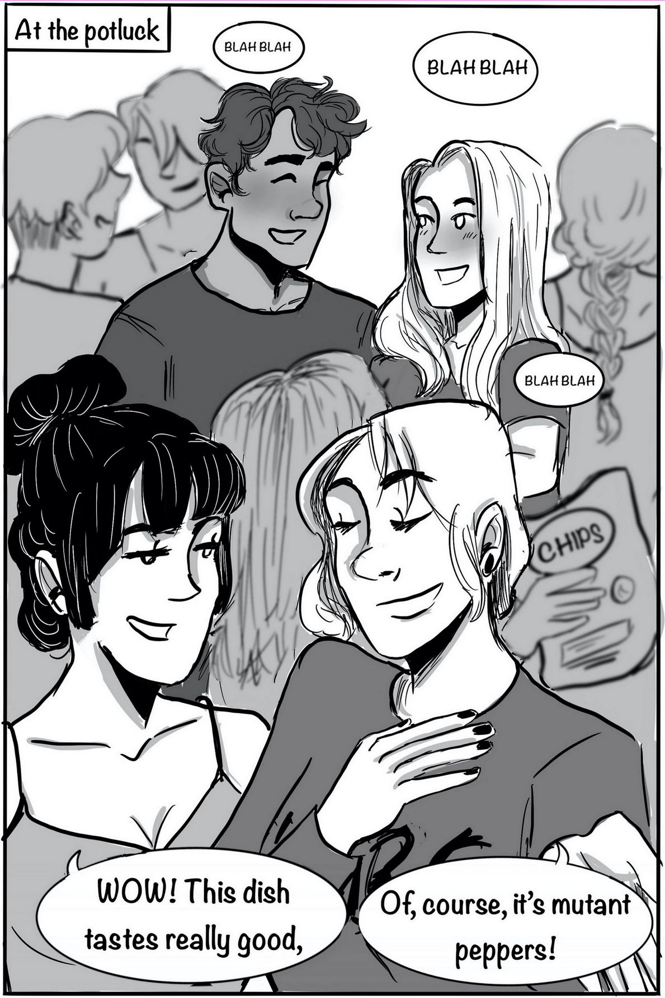
To Pick a Peck of Orange Peppers – Part III
After your hard work, you and your group can finally join the potluck – and the conversation about mutant peppers!
In one sentence, how would you answer the question:
“What causes pepper plants to produce orange fruits”?
If you feel so inclined, illustrate a scene that incorporates your answer, to conclude the story presented in this case study.
35
Notes:
This slide is displayed to signal the end of the case study story, and invite students to synthesize what they have learned about molecular mechanisms behind pepper colors (particularly, orange). If students are assigned Question 15 as homework, this slide can be displayed right after instructors provide general feedback in class, as it can serve as a starting point for an overall wrap-up of the case. Instructors solicit brief (one-sentence) answers to the question of what causes pepper plants to produce orange fruits from the class and from there proceed to a short wrap-up highlighting major points covered in the case study. Note that some of the one-sentence explanations provided by students may themselves illustrate one of the major points. Finally, as an optional assignment, students or groups can be invited to illustrate a concluding scene for the case study that encompasses their one-sentence answer and submit it for sharing with the rest of the class.
Suggested wrap-up points:
Unlike many of the examples presented in textbooks and introductory courses, the genetics behind differences in pepper fruit color is complex, and there is still much that we don’t know about it. (Students often sum this up with “It’s complicated.”)
However, we know that differences in macroscopic phenotypes (e.g., fruit color) do not magically appear because of differences in DNA sequence. Rather, DNA differences may cause differences in the presence, or in the functioning, of proteins required for particular biochemical and physiological processes (e.g., the biosynthesis of pigments), resulting in macroscopic phenotype differences.
Phenotypes are not limited to macroscopic characteristics; molecular and biochemical characteristics (e.g., presence or amount of a given RNA or pigment) are also phenotypes.
A particular phenotype (e.g., producing orange fruits instead of red ones) can be caused by different sets of alterations in a molecular or biochemical process (e.g., carotenoid biosynthesis enzymes and genes that encode them) in different individuals (idea of genetic heterogeneity, a term that students are not expected to know).

