Slide 1
Three Cases from the Membrane Files: The Exploding Fish The Pleasurable Poison The Dangerous Diet
by
Eric Ribbens
Western Illinois University
Department of Biology

Slide 2
The Case of
The Exploding Fish

Slide 3
I was lounging in my office when a client called.
“Do fish explode?”

Slide 4
I was stumped. Do fish explode? And why did she want to know? I made a list.
Why would fish explode?
Why don’t they explode?
How do fish handle the very different freshwater and saltwater environments?
It was time for some research.

Slide 5
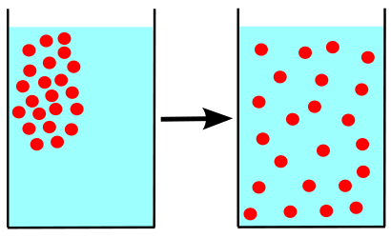
Principle
Diffusion: A chemical will spread out and become completely the same concentration wherever it can go (unless some other force is acting on it).

Slide 6
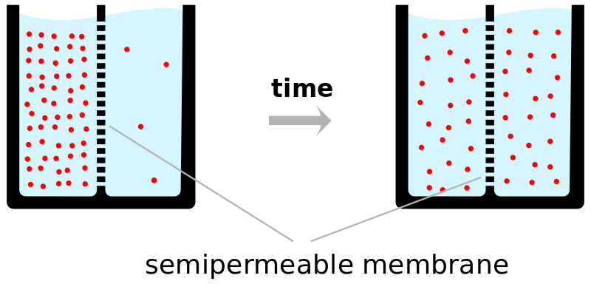
What about across a membrane?
If it can cross the membrane, it will attempt to diffuse.

Slide 7
CQ#1: You are looking at solutes (red dots) after plenty of time has elapsed. Most of the dots are on the left. This means:
They cannot cross membranes.
They do not obey the law of diffusion like other chemicals.

Slide 8
So a semipermeable membrane will allow some chemicals to diffuse across it, and prevent other chemicals from diffusing across it, and proteins can act as gates.

Slide 9
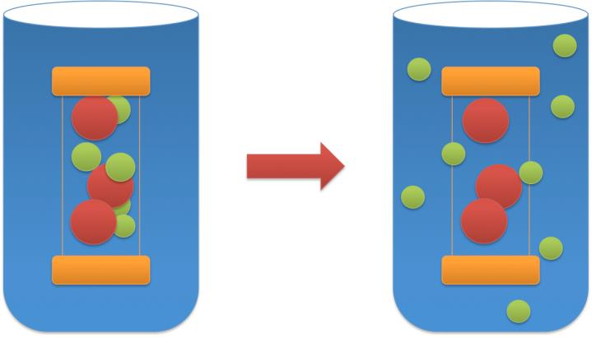
A good example: kidney dialysis
Salts and urea can cross the membrane, blood cells cannot.

Slide 10
Another tricky piece of diffusion:
The chemical tries to achieve equal concentration of it relative to the total solution. So if there are equal amounts of water on each side of the membrane, but on one side the solution is only water while on the other side it is a mixture, water will still keep moving to the mixture side.

Slide 11
Water Diffusing

Slide 12
In my office …
I sat back and tried to think. What did I know?
What diffusion is;
What happens across membranes; and
Kidney dialysis.
A far cry from exploding fish, I thought. It was time for some questions.

Slide 13
CQ#2: A solution is 90% water on the left, and 80% water on the right, of a membrane that only water can cross. Assuming no other forces are operating, which direction will water move?
Water will move from left to right.
Water will move from right to left.
It depends.
It is impossible to tell.

Slide 14
CQ#3: Remember that it is important to think about the concentration of the substance that can move. Consider this question: The solution on the left is 10% salt. On the right it is 5% salt. Salt cannot cross the membrane, but water can. Which way will water move?
Water will move from left to right.
Water will move from right to left.
It depends.
It is impossible to tell.

Slide 15
Consider this experiment:
You place an animal cell in a container of distilled water. What will happen? Make a hypothesis with your neighbor.

Slide 16
CQ#4: What do you predict will happen when you place an animal cell in a container of distilled water?
Water will not move.
Water will move from the cell into the beaker holding the experiment.
Water will move into the cell for a while.
Water will move into the cell and the cell will explode!

Slide 18
Water will move into the cell and the cell will explode!
Why?
Start: concentration of water is higher outside the cell than inside, so water moves in.
As time passes: the concentration of water inside the cell increases, but it never gets as high as the distilled water.
The water moving in increases the cell’s volume until it can’t handle the volume and explodes.

Slide 19
Now consider this:
You place a plant cell in the same solution. The animal cell has exploded, but the plant cell never does. Why not? (Group work!)

Slide 20
CQ#5: The plant cell doesn’t explode because …
Plants are tougher than animals.
Plants have a cell wall that pushes back against the increased cell volume.
Plants don’t let water cross membranes.
We have no idea.

Slide 21
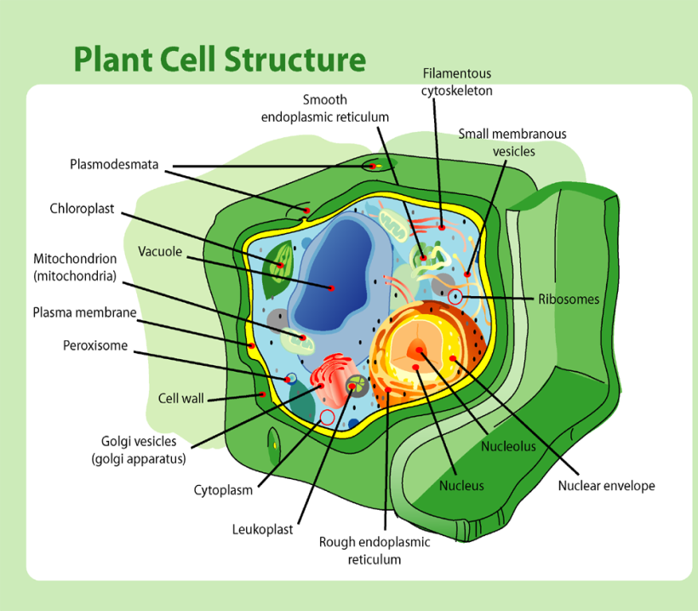

Slide 22
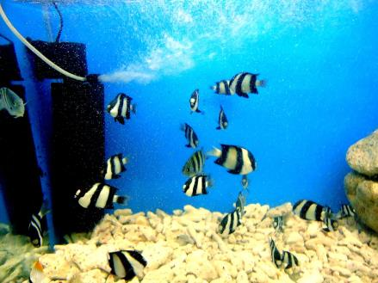
Ok. I was on to something here.
Animal cells explode when placed in fresh water. But there are many animals that live in fresh water. We don’t find fish that have exploded! Why not?

Slide 23
CQ#6: Why don’t freshwater fish explode?
They really do, but underwater where we don’t see it.
They don’t explode because they have cell walls.
They don’t explode because they have kidneys to get rid of excess water.

Slide 24
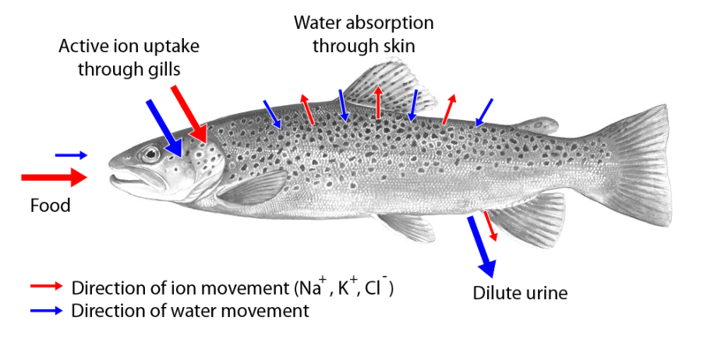
Freshwater Fish

Slide 25
“Fish pee in there, you know!”

Slide 26
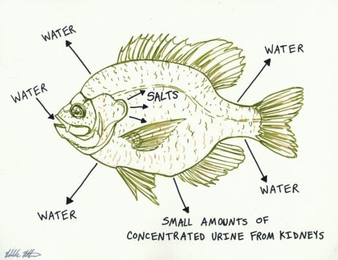
How about a saltwater fish?
Freshwater: water is continually entering the fish.
Saltwater: water is continually exiting the fish.

Slide 27
Or another strategy:
What else could a fish do to reduce or stop water from leaving its body? Think about it!
Hint: The only way to keep water from moving in or out is to have the concentration of water the same inside and out.

Slide 28
The only way to prevent water from moving out is …
Make the inside of the fish as solute-concentrated as the outside!
How?
Urea!
Sharks and other cartiliginous fish build up urea in their muscle tissues. This means the fish fluid is more concentrated, similar to the concentration of ocean water.

Slide 30
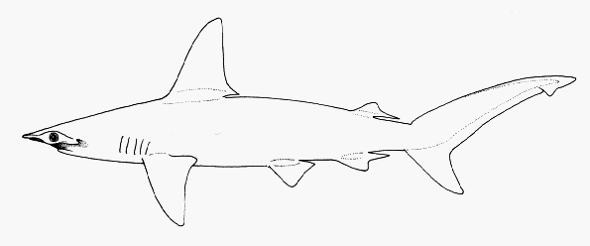
CQ#7: So the next time you see this you will think:
Bleah, that meat is soaked with fish pee.
A great example of osmotic balance.
Um, I’m supposed to know something about this from biology.

Slide 31
Conclusion
I called the client. “No, they don’t explode. Well, at least if they have kidneys.”
She sounded disappointed, and hung up. Leaving me to wonder, why did she want a fish to explode?

Slide 32
The Case of
The Pleasurable Poison

Slide 33
It was a case of poisoning.
Jealous lover?
Nefarious deeds in the murky realms of business?
It was my job to find out. I hunted up my informant, who squealed. Here’s what I learned.

Slide 34
All Systems Green!
Obediently the neurons chugged away, firing signals back and forth inside the protective membranes holding the neural mass, sending messages out and processing the inflow of information. Pigments responded to incoming light signals. Fibers changed shape, chemical signals were released into the circulating fluid, and the pump rhythmically contracted, pushing the circulating fluid throughout the body. All was well.

Slide 35
Yellow Alert
“We might have a problem, boss! There’s a contaminant in the circulatory fluid!”
“Hmm. That’s not good. But the waste management system should be able to disassemble it.”

Slide 36
Yellow Alert
“Uh, sir? Yes, but disassembling takes some time, and the waste management system will fail if it is overloaded with the invading substance. Meanwhile, the invader is able to penetrate the membrane protecting the central processing unit!”
“What? That membrane was carefully designed to keep contaminants out. How can this invader get through?”

Slide 37
Yellow Alert
“Good question. Oh, here’s a new report just in. Some of the neurons under attack are malfunctioning. Contracting fibers are not responding properly. Neuron communication is being disrupted, and some neurons have disintegrated. The backfail judgement test indicates the system is significantly compromised. And research has just notified us that it is possible for systems to fail completely!”

Slide 38
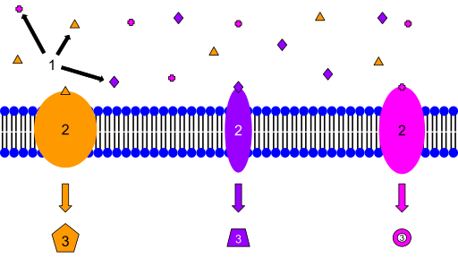
Hmm. What is a membrane, anyhow?
Membranes, while very thin, are important barriers.
They consist of a double layer of phospholipids, arranged with the tails pointing in and the heads pointing out.
The head region is attracted to water, while the tail region is repelled by water.
A
A
A

Slide 39
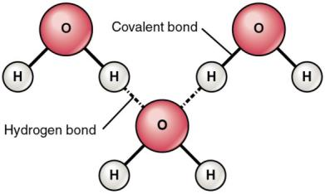
That led me to polarity. What is polarity, and why do we care?
It seems a bit of a love story, two hydrogens mated with an oxygen. But the oxygen was greedy, hogging the electrons. That left the hydrogens deprived, and the oxygen negative. Oh, the imbalance was weak compared to the passion of their union. But the hydrogens would hook up with passing oxygens, at least for a moment of electrical connection.

Slide 40
OK, so the case involves membranes, and poisoning. But what chemicals can get through a membrane?
Not many. Any charged chemical cannot slip through a membrane, so ions cannot cross. Larger chemicals also cannot pass.
Gases (such as O₂, N₂, or CO₂) can cross membranes.
Small uncharged particles (such as urea or water) can cross as well.
But all other chemicals can only cross with the aid of proteins floating in the membrane.

Slide 41
Back to my informant: Yellow Alert
“So what’s the dangerous drug, and how is it entering the system?”
“It doesn’t appear to be a gas. Apparently it entered the chemical intake vent, probably accidentally, and is able to slip through the membrane barriers!”

Slide 42
“Of course it’s accidental intake! The entire system has been carefully designed to minimize accidental intake and to flush the system if a toxin does enter! Duh. Well, notify waste management of the problem, and try to shut down the intake!”
“Sir! Sir! Red alert! Systems are not responding at acceptable error thresholds. We are loxignfy dontactk wif pdrifmsi …”

Slide 43
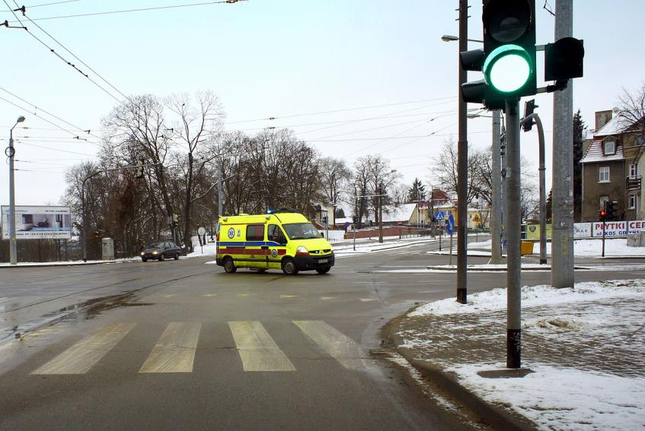
System Failure

Slide 44
In the Ambulance
“We’re transporting a young white male, unresponsive. Probably drunk.”
“Keep his airway open. Make sure he can breathe. Be prepared for vomiting. Do you have an IV in?”
“Yes, he’s on a drip right now. We’ll be there in two.”
“Great! Well, not much we can do except try to keep him alive until the alcohol breaks down. Another one of those college idiots?”

Slide 45
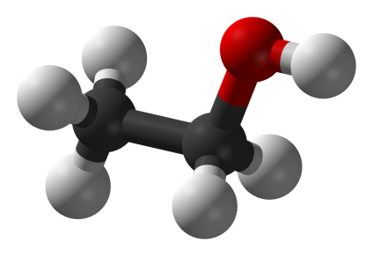
Aha! The usual suspect: ethanol.
CH₃CH₂OH: soluble in both water and lipids.
Psychoactive at normal doses.
Therefore probably the world’s oldest recreational drug.

Slide 46
Human Effects
Effects are complicated, but can include confusion, dizziness, loss of motor control, feelings of euphoria or lethargy, nausea, and if concentrations are high enough comas or death.
Alcohol causes an estimated 4% of all deaths worldwide. That’s more than AIDS, tuberculosis, or violence. (Cardiovascular disease is the #1 cause of death.)

Slide 47
The Next Day
“And we’re back! Good morning, sir!”
“Good morning to you! Report?”
“Well, some neurons are unhappy, and we lost the ends of some dendrites, but repair is working on that. And we added quite a few unneeded calories. But I think we had a narrow escape.”
“Good, good! Any idea how the toxin got into the intake vent?”
“Well, you won’t believe this, but …”

Slide 48
The Next Day
“Apparently management consumed it deliberately!”
Notes:
https://www.google.com/search?q=phospholipid&hl=en&tbo=d&source=lnms&tbm=isch&sa=X&ei=qNMRUbHgGImAygG7voGQAw&sqi=2&ved=0CAcQ_AUoAA&biw=1280&bih=659#hl=en&tbo=d&tbm=isch&sa=1&q=alcohol+is+cool&oq=alcohol+is+cool&gs_l=img.3...144956.148701.0.148981.15.13.0.2.2.0.192.973.12j1.13.0...0.0...1c.1.2.img.pidFt2llzHU&bav=on.2,or.r_gc.r_pw.r_qf.&bvm=bv.41934586,d.aWc&fp=ce4bc0f18b21784d&biw=1280&bih=659&imgrc=uuxvX2l6P6eCbM%3A%3Bvx6eY3nsKqlzOM%3Bhttp%253A%252F%252Fwww.coolgraphic.org%252Fwp-content%252Fuploads%252F2011%252F06%252FLiquor-In-HawaiAlcohol-Graphic.jpg%3Bhttp%253A%252F%252Fwww.coolgraphic.org%252Fcategory%252Fseasons%252Fsummer%252F%3B261%3B370

Slide 49
The Case of
The Dangerous Diet

Slide 50
It was a dark alley. I stumbled on a body. Breathing, so still alive. But hot. I eavesdropped on the control room.

Slide 51
Something isn’t right …
“Something is a bit strange, sir. The overall system is running a bit on the hot side.”
“That probably means an infection.”
“There are no other signs of infection. Mitochondria are reporting unusually high activity levels. But that’s the only other unusual thing.”
“The mitochondria are critical. Better have this checked out!”

Slide 52
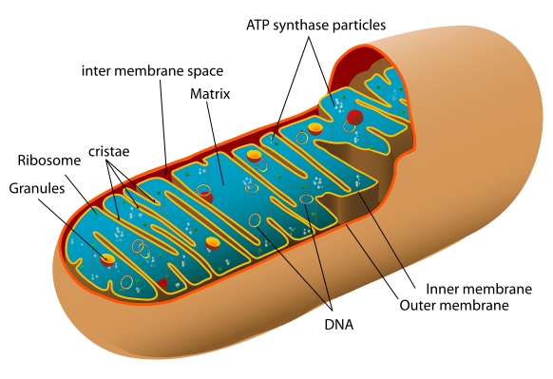
Mitochondria
Two membranes, inner one highly folded.
Have their own DNA.
Make ATP for all sorts of uses for energy.
Notes:
http://www.google.com/search?q=part+i&hl=en&tbo=d&source=lnms&tbm=isch&sa=X&ei=OekTUfnKArOMyAHQjYEQ&ved=0CAcQ_AUoAA&biw=1680&bih=946#hl=en&tbo=d&tbm=isch&sa=1&q=mitochondria+man&oq=mitochondria+man&gs_l=img.3..0i24.104.11024.14.11217.17.4.13.0.5.0.82.227.4.4.0...0.0...1c.1.2.img.w9mFYyylydU&bav=on.2,or.r_gc.r_pw.r_qf.&bvm=bv.42080656,d.aWc&fp=8b3ccabeaf5ce617&biw=1680&bih=946&imgrc=WFvAJQ9TeDruFM%3A%3Bm9u_vMwhl1p-HM%3Bhttp%253A%252F%252Fchristinemarsh.com%252Fwp-content%252Fuploads%252F2010%252F01%252FMitochondria_Man1.jpg%3Bhttp%253A%252F%252Fchristinemarsh.com%252Findex.php%252Fstore%252Fmitochondria-man%252F%3B1086%3B1456

Slide 53
Mitochondria
Break sugar down (eventually into water and carbon dioxide).
Convert the energy from sugar to ATP:
Pump protons into the intermembrane space, creating a pH gradient.
The protons push back inside through an ATP synthase pump.
The pump uses the force to attach a phosphate to adenosine diphosphate.

Slide 54
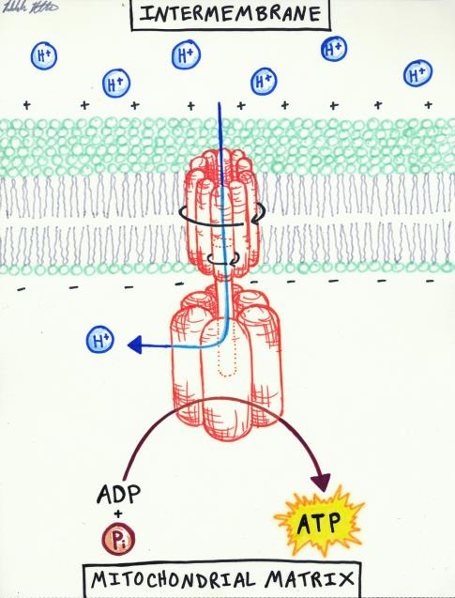
ATP pump
ADP and P+ and push produce ATP (with more energy).
Notes:
http://www.google.com/search?q=part+i&hl=en&tbo=d&source=lnms&tbm=isch&sa=X&ei=OekTUfnKArOMyAHQjYEQ&ved=0CAcQ_AUoAA&biw=1680&bih=946#hl=en&tbo=d&tbm=isch&sa=1&q=atp+synthase&oq=atp+synthase&gs_l=img.3..0l8j0i5l2.78.5877.11.6052.13.10.1.2.2.0.59.547.10.10.0...0.0...1c.1.2.img.q_HR5yyZol0&bav=on.2,or.r_gc.r_pw.r_qf.&bvm=bv.42080656,d.aWc&fp=8b3ccabeaf5ce617&biw=1680&bih=946&imgrc=vpzMZoZ3FWvg5M%3A%3B_mibCDTxFoJGEM%3Bhttp%253A%252F%252Ffiles.myopera.com%252FKYren%252Falbums%252F638725%252FATP%252520synthase.jpg%3Bhttp%253A%252F%252Fmy.opera.com%252FKYren%252Falbums%252Fshowpic.dml%253Falbum%253D638725%2526picture%253D42418081%3B796%3B958

Slide 55
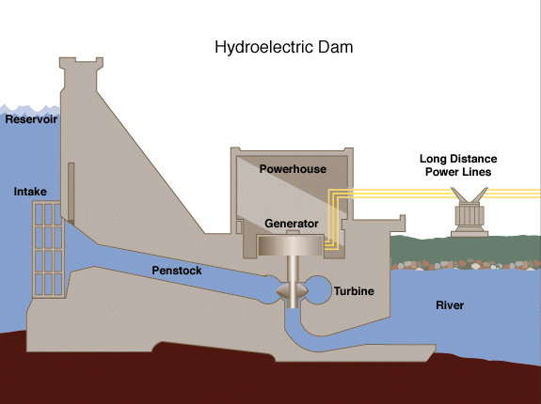
Compare it to a hydroelectric dam
Notes:
http://en.wikipedia.org/wiki/File:Hydroelectric_dam.svg

Slide 56
Results …
“Well, we do have a mitochondria problem, sir. It seems that a strange chemical called DNP is interfering with ATP synthesis.”
“How can something interfere with that?”

Slide 57
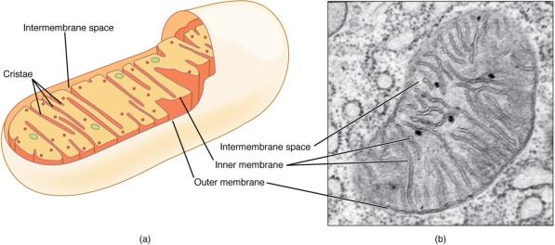
Results …
“You will remember that it is essential to have a membrane separating the protons from the inner space, since it is the push of the protons that drives the synthase pump.”
“Of course. Is the membrane falling apart?”
Notes:
http://www.google.com/search?hl=en&q=mitochondria+membrane&bav=on.2,or.r_gc.r_pw.r_qf.&biw=1680&bih=946&um=1&ie=UTF-8&tbm=isch&source=og&sa=N&tab=wi&ei=PQMUUYijKofJyQGTpIGADw#imgrc=rRTHqk-FD4grsM%3A%3BMFzuYh5-vcR8hM%3Bhttp%253A%252F%252Fimg.sparknotes.com%252Ffigures%252F1%252F152b2a1fc24da028d51724fedfa06fff%252Fmitochondria.gif%3Bhttp%253A%252F%252Fwww.sparknotes.com%252Fbiology%252Fcellrespiration%252Foxidativephosphorylation%252Fsection1.rhtml%3B420%3B330

Slide 58
Results …
“Not exactly. Apparently this chemical has penetrated the mitochondria. It binds to a proton and then lets the proton slip through the inner membrane.”
“Which means that ATP is not being synthesized, so the mitochondria have to work harder!”
“That’s right. And of course the harder the mitochondria work the more heat is generated.”

Slide 59
Think about that statement:
“Apparently this chemical has penetrated the mitochondria. It binds to a proton and then lets the proton slip through the inner membrane.”
Using the diagram on the right, explain how DNP reduces ATP production.

Slide 60
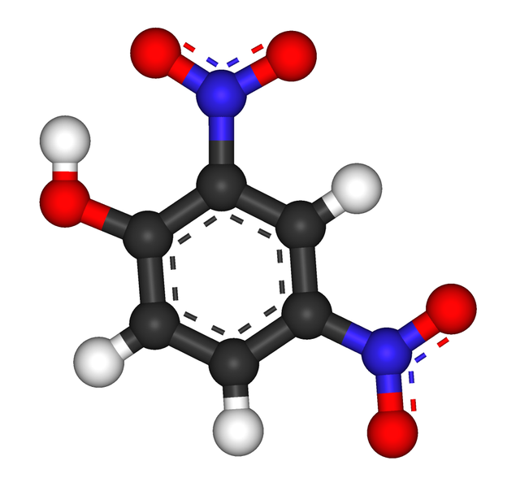
Dinitrophenol

Slide 61
Dinitrophenol
“Where is this dinitrophenol stuff coming from?”
“Remember management hasn’t been happy about the energy reserves we’ve stored?”
“Oh, yes, those fat cells. I’ve told him that if he doesn’t want us storing excess for use later, then he needs to reduce intake or increase activity.”

Slide 62
Dinitrophenol
“Apparently he’s found another solution. Indirectly increase activity by reducing the effectiveness of the mitochondria.”
“Huh?”
“Yes, He bought some DNP to try to lose weight.”
“But that’s dangerous! Does he know what he’s doing?”

Slide 63
DNP for sale
Notes:
http://www.steroidbazaar.com/Scripts/prodView.asp?idproduct=17

Slide 64
Danger
Lethal dose is close to the therapeutic dose.
“Typical signs and symptoms seen in these patients included hyperthermia, tachycardia, diaphoresis, and tachypnea. Severe neurological effects such as confusion, agitation, convulsions, and coma are common. Methemoglobinemia can be seen. There is no specific antidote. Treatment is supportive, with an emphasis on rapid reversal of severe hyperthemia.
Notes:
http://www.thepoisonreview.com/2011/08/04/dinitrophenol-the-deadly-diet-aid/

Slide 65
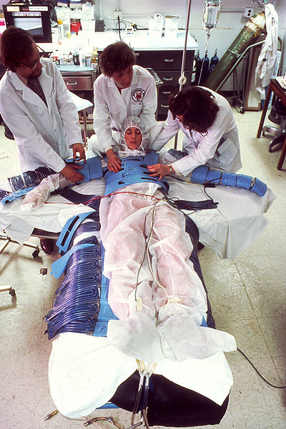
One of the patients reviewed here had a pre-mortem body temperature in excess of 43ºC (110ºF).”

Slide 66
“We report the cases of two individuals, one in Tacoma, WA, and the second in San Diego, whose deaths were attributed to ingestion of 2,4-dinitrophenol (2,4-DNP)… The drug causes a marked increase in fat metabolism that has led to its use to aid weight loss. Both cases reported here involved its use for this purpose. Features common to both cases included markedly elevated body temperature, rapid pulse and respiration … Death in both cases was attributed to 2,4-DNP toxicity. Review of information available on the internet suggests that, although banned, 2,4-DNP is still illicitly promoted for weight loss.”
Notes:
http://www.ncbi.nlm.nih.gov/pubmed/16803658

Slide 67
From SteroidBazaar:
“…for practical uses, basal metabolic rate can safely increase by 30-50% without putting one's life in danger. It is not unheard of for people to lose up to one pound of pure fat per day while on DNP.” (From slide 63.)

Slide 68
The Case of the Dangerous Diet
I sighed. Membrane failure! Another case of stupidity. What will people think of next?
Oh, well. Without stupidity, I wouldn’t have customers. I sighed, and called the cops.

Slide 69
Why do mitochondria need two membranes?
They don’t, it is an evolutionary artifact.
They need two membranes because the contents inside the inner membrane are too dangerous.
They need two membranes so they can move protons back and forth across the inner membrane without having them mixed with the general contents of the cytoplasm.

Slide 70
How does DNP work?
It allows protons to move across the inner mitochondrial membrane without moving through the ATP pump.
It allows protons to escape into the cytoplasm where they attack and destroy cell contents.
It allows protons to become electrons.

Slide 71
Image Credits
Slide 1: Licensed image, ©Art3D | Fotolia, ID#62321821.
Slides 2 & 3: Exploding fish illustration by Rebekah Ribbens, used with permission.
Slide 5: Illustration of diffusion by Wikimedia Commons user JrPol, CC BY 3.0, http://commons.wikimedia.org/wiki/Diffusion#mediaviewer/File:Diffusion.svg
Slide 6: Schematic drawing of diffusion over a semipermeable membrane, by Quasar Jarosz, p.d., http://commons.wikimedia.org/wiki/File:Diffusion.en.svg
Slide 8: Licensed image, ©Ivx267 | Dreamstime.com, ID#30027532.
Slide 9: Dialysis diagram by Alain Bombardier at English Wikipedia, CC BY-SA 3.0, https://commons.wikimedia.org/wiki/Category:Dialysis#/media/File:Dialysis_new.jpg
Slide 11: Rebekah Ribbens, used with permission.
Slide 17: ©Raimond Spekking / CC BY-SA 3.0 (via Wikimedia Commons), https://commons.wikimedia.org/wiki/File:Feuerwerk_Ruhrort_4.jpg
Slide 19: Illustration by Martorell, CC BY-SA 3.0,
http://commons.wikimedia.org/wiki/Question_mark#mediaviewer/File:Presa_de_decissions.png
Slide 21: Plant cell diagram by LadyofHats, p.d., http://commons.wikimedia.org/wiki/Plant_cell#mediaviewer/File:Plant_cell_structure.png
Slide 24: Illustration of movement of water and ions in freshwater fish, p.d., https://commons.wikimedia.org/wiki/File:Bachforelle_osmoregulatoin_bw_en2.png
Slide 25: Photo of horses, Trish Steel, CC BY-SA 2.0, http://commons.wikimedia.org/wiki/File:Horses_at_Dockens_Water_-_geograph.org.uk_-_608050.jpg
Slide 26: Illustration of salt water fish by Rebekah Ribbens, used with permission.
Slide 29: Illustration of shark by Rebekah Ribbens, used with permission.
Slide 30: Illustration of shark, p.d., http://commons.wikimedia.org/wiki/Shark#mediaviewer/File:Sphyrna_couardi.gif

Slide 72
Slides 32, 33: Poison sign, p.d., http://commons.wikimedia.org/wiki/File:ISO_7010_W016.svg
Slide 34: Illustration of check mark, p.d., http://commons.wikimedia.org/wiki/File:Checkmark.svg
Slides 35-37: “Attention” diagram, p.d.,
http://commons.wikimedia.org/wiki/Road_signs#mediaviewer/File:Sweden_road_sign_A40.svg
Slide 38: Illustration of membrane receptors by Isaac Webb, CC BY-SA 3.0, http://commons.wikimedia.org/wiki/File:Membrane_Receptors.svg
Slide 39: Diagram of hydrogen bonds between water molecules, OpenStax College, CC BY 3.0, http://commons.wikimedia.org/wiki/File:210_Hydrogen_Bonds_Between_Water_Molecules-01.jpg
Slide 42: “Alert” illustration, p.d., http://commons.wikimedia.org/wiki/Sign#mediaviewer/File:Sec-Ac_AC.svg
Slide 43: Photo of ambulance by Stiopa, CC BY-SA 3.0, http://commons.wikimedia.org/wiki/Ambulance#mediaviewer/File:Ambulans_-_pojazd_uprzywilejowany.jpg
Slide 44: Photo of medical treatment by Terysa M. King, CC BY 2.0, http://commons.wikimedia.org/wiki/File:U.S._Army_Africa_personnel_prepare_for_medical_emergencies_%288102350711%29_%282%29.jpg
Slide 45: Ethanol, p.d., http://commons.wikimedia.org/wiki/Ethanol#mediaviewer/File:Ethanol-3D-balls.png
Slide 48: Advertisement for Malt Rainier, p.d., http://commons.wikimedia.org/wiki/File:Malt_Rainier_ad.jpg
Slide 49: Photo of body builder posing by Layne Norton, CC BY-SA 3.0, https://commons.wikimedia.org/wiki/File:David_the_bodybuilder.jpg
Slide 52: Mitochondrion diagram, p.d., http://commons.wikimedia.org/wiki/Category:Mitochondria#mediaviewer/File:Animal_mitochondrion_diagram_en.svg
Slides 54, 59: Diagram of ATP pump by Rebekah Ribbens, used with permission.
Slide 55: Illustration of hydroelectric dam, p.d., http://commons.wikimedia.org/wiki/File:Hydroelectric_dam.png
Slide 57: Two-panelled figure of mitochondrion, OpenStax College, CC BY 3.0, http://commons.wikimedia.org/wiki/Category:Mitochondria#mediaviewer/File:0315_Mitochondrion_new.jpg
Slide 60: Diagram of Dinitrophenol , p.d., http://commons.wikimedia.org/wiki/File:2,4-Dinitrophenol_3D.png
Slide 63: Screen capture of http://www.steroidbazaar.com/Scripts/prodView.asp?idproduct=17.
Slide 65: Photo of hyperthermia treatment, p.d., http://commons.wikimedia.org/wiki/File:Nci-vol-1953-300_hyperthermia_patient.jpg

