Slide 1
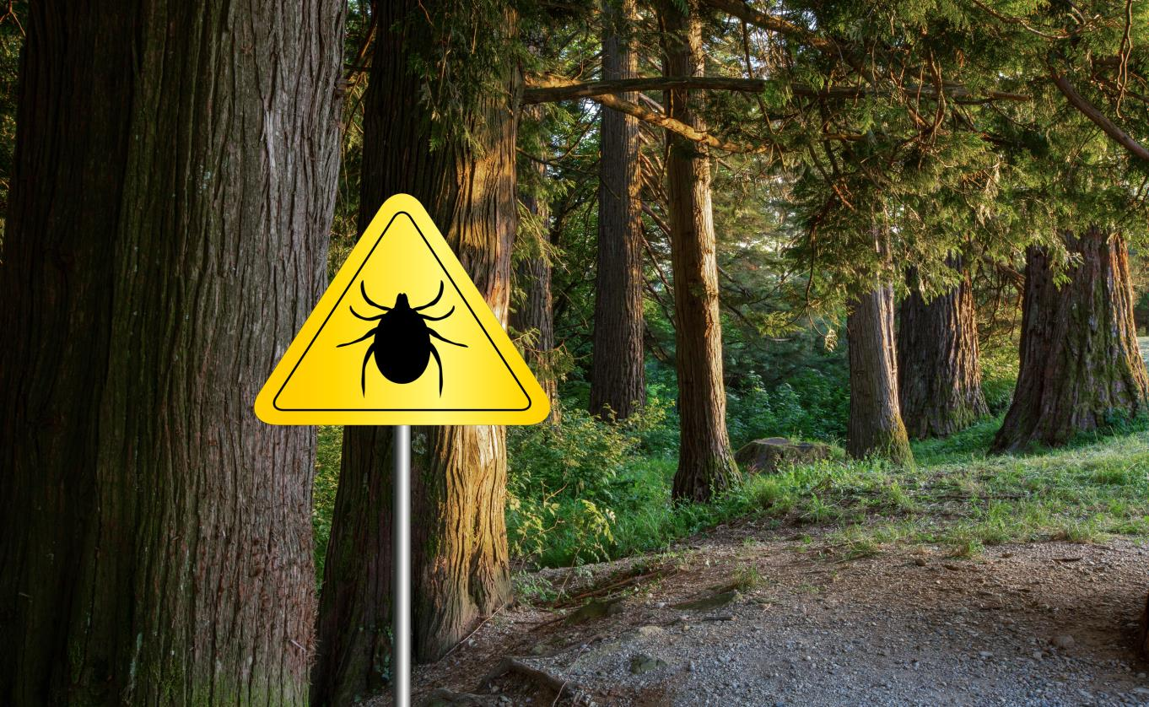
Failing to See the Forest for the
Trees in Lyme Disease
NATIONAL CENTER FOR CASE STUDY TEACHING IN SCIENCE
by
Travis J. Bailey
Department of Biology
SUNY Geneseo, Geneseo, NY
Notes:
Licensed image © Gregor Jeric | Dreamstime.com, ID 157761124.

Slide 2




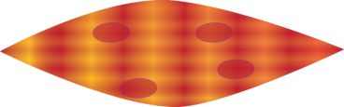
Lyme disease
Borrelia burgdorferi –
Spirochete bacterium
What do you want to know most about Lyme disease?
Notes:
Schematics of differing cell types, including polymorphonuclear neutrophils, neurons, spirochete bacterium, microglia, and muscle.

Slide 3
Sufferers of Lyme disease
What do you remember about the young girl?
What were her symptoms?
“I was a little naïve in the beginning thinking it would be a quick fix,” her mother said.

Slide 4
Symptoms of Lyme Disease
Early Lyme
Swollen Lymph Nodes
Trouble Sleeping
Muscle Pain
Joint Pain
Headache
Fatigue
Sweats
Fever
Rash
Lyme
Fatigue
Joint Pain
Muscle Pain
Facial palsy
Headache
Depression
Heart damage
Trouble Sleeping
Trouble Concentrating
What organ(s) might be affected in someone who has body pain and muscle fatigue?

Slide 5
Can we test how B. burgdorferi affects cells?
B. burgdorferi causes dysfunction in organs.
Since organs are made of cells, this likely involves cellular processes.
Understanding the way in which the pathogen affects cells is a key to designing helpful treatments.
But how do we understand how the pathogen affects cells?

Slide 6
One possibility of how B. burgdorferi affects cells
General hypothesis:
B. burgdorferi damages nerve cells directly or indirectly.

Slide 7
One possibility of how B. burgdorferi affects cells
How might axonal dysfunction explain some of the features of Lyme disease?
(Think-Pair-Share)

Slide 8
One possible mechanism is that
Borrelia burgdorferi causes inflammation and that inflammation damages neurons.

Slide 9
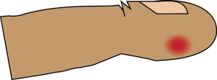

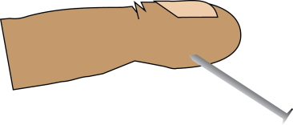
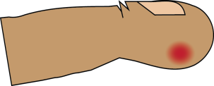
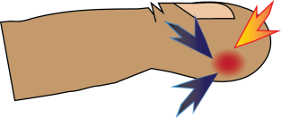
Hallmarks of Inflammation
redness
swelling
heat
pain
Injury leads to…
In addition to killing foreign cells, like the pathogen Borrelia burgdorferi, immune cells often cause native cells to die by apoptosis.
This inflammation causes collateral damage, the sacrifice of some healthy cells to prevent spread of infection.
Inflammation can lead to loss of function in the affected area.

Slide 10
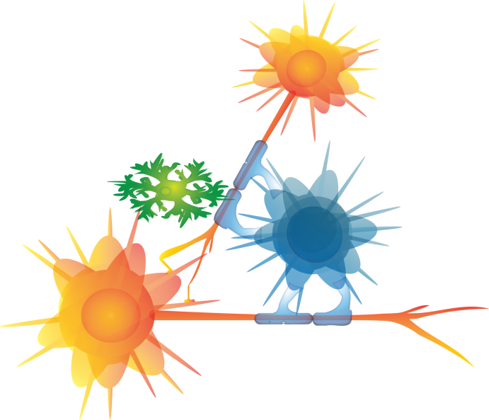
Potential players in our hypothesis
Neurons direct electrical impulses along their axons and communicate with other cells.
Macroglia (glia) protect and nurture the neurons.
Microglia are immunological sentinel cells.
They fight infections.
neuron
microglia
macroglia
neuron

Slide 11
What happens when Lyme disease bacteria infect people?
Borrelia burgdorferi
neuron
In response to contact with bacteria, the macroglia will generate and secrete some signals (cytokines). Microglia produce cytokines in even greater amounts.
The cytokines stimulate inflammation.
microglia
macroglia
neuron
Inflammation!

Slide 12
CQ#1
Which cells made the signals of inflammation?
(Mark all that are true)
a. Borrelia burgdorferi
b. macroglia
c. microglia
d. neuron

Slide 13
Inflammation has been implicated as a contributor to symptoms of diseases in the central nervous system.
Could that also be true in chronic Lyme disease?
Before we can answer this question, we need to learn how to 1) identify cells and 2) assay their response to the bacterium.

Slide 14
Can we test how B. burgdorferi affects cells?
Other problems:
How do we identify cells?
How do we assay how cells respond?
Cells look like clear gel.
Hundreds of cells side by side

Slide 15
Can we test how B. burgdorferi affects cells?
Solution: use markers
Markers are molecules present in particular cells or organelles or are produced by the same cells, but only under particular conditions.
Some markers are particular nucleic acids or proteins.
For example, rhodopsin is a marker of photoreceptors, and is the pigment that helps the photoreceptors detect photons of light.
However, markers are frequently colorless like the cells.

Slide 16

Labels bind markers.
Cells look like clear gel.
How can we make things visible?
Useful labels are visible stains or dyes that bind only to specific markers.
Example: ToPro is a chemical that dyes DNA blue.

Slide 17
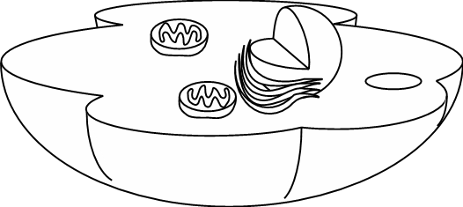
Using labels
CQ#2
What cell structure will To-Pro label?
a. Cell Membrane
b. Endoplasmic Reticulum
c. Golgi
d. Lysosomes
e. Nucleus
To-Pro = DNA
What do you predict the blue label will paint?

Slide 18

Using labels
CQ#2
What cell structure will To-Pro label?
a. Cell Membrane,
b. Endoplasmic Reticulum
c. Golgi
d. Lysosomes
e. Nucleus
To-Pro = DNA
What do you predict the blue label will paint?

Slide 19
Using labels
CQ#3
What cells will To-Pro label?
a. Neurons
b. Macroglia
c. Microglia
d. All of the above
e. None of the above
To-Pro = DNA

Slide 20
Using labels
CQ#3
What cells will To-Pro label?
a. Neurons
b. Macroglia
c. Microglia
d. All of the above
e. None of the above
To-Pro = DNA

Slide 21
Using specific labels
label
We use antibodies tagged with a label to bind markers that are otherwise colorless.
antibody
Label = something of color that binds the marker
Tag = chemical linkage of two molecules, i.e., the label linked to the antibody
Marker = molecule detected by the label
Marker
(antigen)

Slide 22
Using labels
CQ#4
What cell structure will be labeled by an antibody that binds to proteins of the energy producing machinery?
a. Lysosomes
b. Mitochondria
c. Golgi
d. Nucleus
e. Cell Membrane
To-Pro = DNA
Antibodies bound to energy production proteins = ?
What do you predict the red label will paint?

Slide 23
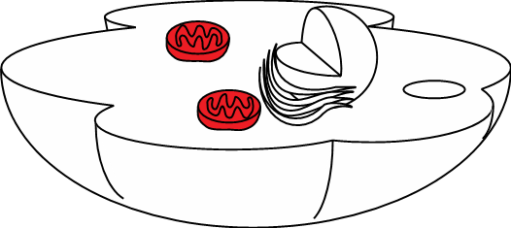
Using markers
CQ#4
What cell structure will be labeled by an antibody that binds to proteins of the energy producing machinery?
a. Lysosomes
b. Mitochondria
c. Golgi
d. Nucleus
e. Cell Membrane
To-Pro = DNA
Antibodies bound to energy production proteins = ?
What do you predict the marker will paint?

Slide 24
Specific labeling of nucleic acids
Color-tagged antisense probes label specific RNAs.
antisense-RNA
label
Matched antisense-RNA will
5’
bind as a label to targeted RNA
Targeted RNA
X X X X X X X X
Unmatched RNA will not bind
5’
as a label to other RNAs
Other RNA

Slide 25
Detecting markers
Cells look like clear gel.
How can we make things visible?
Cells that express the gene
Cells that do not express the gene
Because the RNA is expressed only in some cells, the antisense label distinguishes the cells that express the gene from those cells that do not express the gene.

Slide 26
Can we figure out what’s wrong in the cells of people infected with Borrelia burgdorferi?
If we can test for the presence of specific markers in different cells, we can distinguish healthy from sick cells and one cell type from another.
Key Concept
A marker indicates where it is, but not what or where any other things are. The absence of a neuronal marker doesn’t tell you that it is a glial cell. It only tells you it is not the neuron.

Slide 27
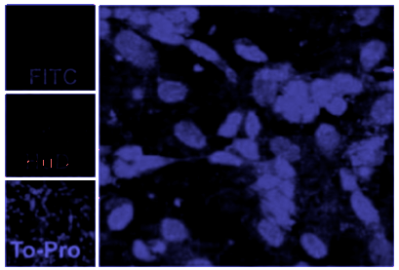
Labeling markers to show where cells are
Blue = DNA dye
Using a DNA dye we can locate the nuclei of cells in a dark field of view.
c
Two cells are numbered.
1
2
Notes:
Because cells are mixed together, we label them to distinguish which cell is which. We can distinguish cells from non cells by labeling DNA.
Image modified from
Microglia Are Mediators of Borrelia burgdorferi–Induced Apoptosis in SH-SY5Y Neuronal Cells
Tereance A. Myers, Deepak Kaushal, Mario T. Philipp

Slide 28
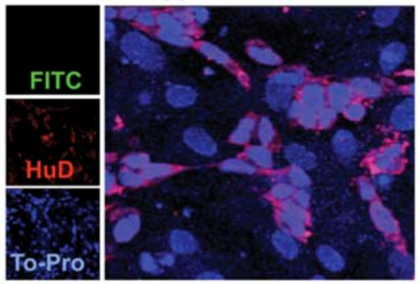
Labeling markers to identify the type of cell
Red = Fluorescent antibodies bound to HuD, a neuron protein
Blue = DNA dye
CQ#5
What is Cell 1?
a. Glia
b. Muscle
c. Neuron
d. Unknown
c
1
2
Fluorescent markers
can be seen at the same time
Review of Fluorescence
Notes:
We can distinguish neuronal cells from other cells by labeling a marker for neuronal cells, HuD.
Image modified from
Microglia Are Mediators of Borrelia burgdorferi–Induced Apoptosis in SH-SY5Y Neuronal Cells
Tereance A. Myers, Deepak Kaushal, Mario T. Philipp

Slide 29
Labeling markers to identify the type of cell
Red = Fluorescent antibodies bound to HuD, a neuron protein
Blue = DNA dye
CQ#6
What is Cell 2?
a. Glia
b. Muscle
c. Neuron
d. Unknown
c
1
2
Fluorescent markers
can be seen at the same time
Notes:
We can distinguish neuronal cells from other cells by labeling a marker for neuronal cells, HuD.
Image modified from
Microglia Are Mediators of Borrelia burgdorferi–Induced Apoptosis in SH-SY5Y Neuronal Cells
Tereance A. Myers, Deepak Kaushal, Mario T. Philipp

Slide 30
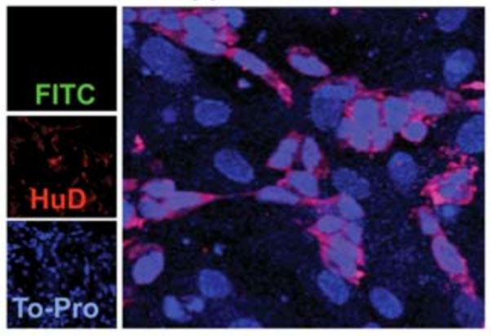
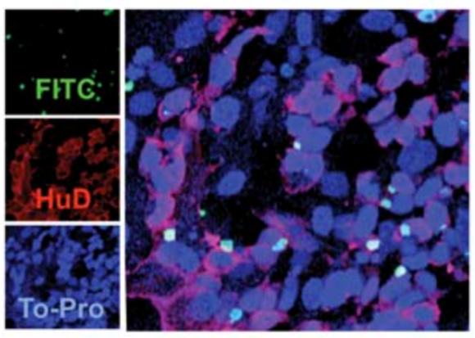
Markers show us which cells are dying.
Myers et al. looked at cultured cells before and after B burgdorferi infection.
Cultured cells are labeled for a cell death marker.
FITC = Apoptosis, HuD = Neurons, To-Pro = Nuclei
Notes:
Microglia Are Mediators of Borrelia burgdorferi–Induced Apoptosis in SH-SY5Y Neuronal Cells
Tereance A. Myers, Deepak Kaushal, Mario T. Philipp

Slide 31
Markers show us which cells are dying.
Myers et al. looked at cultured cells before and after B burgdorferi infection.
FITC cells are labeled for a cell death marker.
CQ#7: Which picture showed infection with Borrelia burgdorferi?
a. left picture b. right picture
Notes:
Microglia Are Mediators of Borrelia burgdorferi–Induced Apoptosis in SH-SY5Y Neuronal Cells
Tereance A. Myers, Deepak Kaushal, Mario T. Philipp

Slide 32
Can we test how B. burgdorferi affects cells?
First, we can study isolated cells.
If an infection is expected to damage cells, we look for any changes in small parts of cells, even small molecules, that can be detected before the changes affect the whole cell and the tissue of the body.
To analyze cells, they often have to be removed from the body. There are major risks and ethical questions in obtaining nervous system cells. Cell culture is an imperfect replication of the whole system, but it prevents placing patients at risk.

Slide 33
What is wrong with the cells in people infected with Borrelia burgdorferi?
Myers et al. first hypothesized that microglial cells caused increased inflammation and neuron cell death. They cultured the following cells:
1. Neurons or
2. Microglia or
3. Mixed cultures of Neurons and Microglia
and infected each culture dish with Lyme disease bacteria.

Slide 34



CQ#8 Predict what Myers et al. expected to see.
Microglia + Bb
Neurons + Bb
Microglia + Neurons + Bb
Markers of Inflammation
Markers of
Cell Death
Answer Yes or No
Answer Yes or No
Answer Yes or No

Slide 35
Could treatment of a patient be as simple as calming her microglia?
Inflammation has long been implicated as a contributor to disease symptoms in the central nervous system.
What about the inflammation response of microglia?
The scientists then tested various mixed-cell cultures with and without B burgdorferi infection…
Referring to the answers about cell death in CQ#8, let’s consider how that data would be recorded.

Slide 36




CQ#9 Predict what Myers, et al. expected.
Answer using a symbol equal to (=), less than (<), or greater than (>) the number recorded in the green box where B. burgdorferi has not yet been added (immediately above).
Culture | % apoptosis in single-cell culture | % Glial apoptosis in mixed culture | % Neuronal apoptosis in mixed culture
Neuron | 1.6
Neuron + B burgdorferi | 1.6
Neuron + Glia | 0.2 | 1.5 | 1.6
Neuron + Glia + B burgdorferi | 0.6
Neuron + Glia + Microglia | 0.9 | 3.6 | 5.4
Neuron + Glia + Microglia + B burgdorferi | 0.7

Slide 37
CQ#9 Predict what Myers, et al. expected part 2.
Compare whether your answers are consistent with the actual numbers recorded.
Culture | % apoptosis in single-cell culture | % Glial apoptosis in mixed culture | % Neuronal apoptosis in mixed culture
Neuron | 1.6
Neuron + B burgdorferi | 1.6
Neuron + Glia | 0.2 | 1.5 | 1.6
Neuron + Glia + B burgdorferi | 0.6 | 1.5 | 2.0
Neuron + Glia + Microglia | 0.9 | 3.6 | 5.4
Neuron + Glia + Microglia + B burgdorferi | 0.7 | 3.4 | 12.0

Slide 38
Conclusions based on the data of Myers, et al.
CQ#10: Did B. burgdorferi infection increase glial cell death in mixed cultures?
  Yes
  No
CQ#11: Did B. burgdorferi infection increase neuronal cell death in mixed cultures?
  Yes
  No

Slide 39
Summary: How can scientists help patients with Lyme disease?
We can study cellular disease by detecting different cell markers.
Study of the inflammatory cascade markers may reveal the cellular mechanism of Lyme disease and other inflammatory diseases of the central nervous system.
Studying Lyme disease will help identify targets in the disease process that are amenable to therapeutic intervention.

Slide 40
What cellular process would you target to prevent chronic Lyme disease?
Take one minute to write about the following question:
In addition to antibiotic treatment for infection with Borrelia burgdorferi, what would you do to prevent the damaging effects of chronic Lyme disease?

Slide 42
Review: How we see
Sunlight
Eye
Sunlight gives all types of light. In the daylight things appear to us as their “true” colors.
Some photons are red, some green, some blue, and other colors (diagram).
We have three photoreceptors that distinguish daytime light, red-sensitive, green-sensitive, and blue-sensitive.
Lemon
Since she doesn’t have any yellow photoreceptors, how do you see the yellow of the lemon?
Notes:
https://en.wikipedia.org/wiki/Cone_cell cite_note-Jameson_2001-7

Slide 43
Review: How we see
Sunlight
Eye
Sunlight gives all types of light. In the daylight things appear to us as their “true” colors.
Some photons are red, some green, some blue, and other colors (diagram).
We have three photoreceptors that distinguish daytime light, red-sensitive, green-sensitive, and blue-sensitive.
Each photoreceptor can detect other colors of light, but at a reduced capability. Both red and green photoreceptors detect yellow equally.
Lemon
Our brain helps us to “see”the colors between colors. When both red and green photoreceptors see equally, the brain “sees” yellow.
The colorblind may not have both red- and green- sensitive photoreceptors .
Notes:
https://en.wikipedia.org/wiki/Cone_cell cite_note-Jameson_2001-7

Slide 44
Review: Fluorescence vs pigment dyes
Sunlight
Eye
Dyes bind to substrates differentially.
Fluorescent dyes (fluorochromes) are different than classical pigment dyes due to their unique properties of physics and how they are detected by our eye neurons, the photoreceptors.
Whereas pigments subtract light from all light, fluorochromes add light to the other light.
We see pigments when looking at the printed page, and something like fluorochromes when looking at a computer monitor.
Blue photons are absorbed
Pigment
Fluorochromes
CMYK
RGB
Notes:
RGB = red green blue; CMYK = cyan magenta yellow black. Black dye is added to insure a deep absorbance of all light.

Slide 45
Review: Electromagnetic radiation (visible light)
Light with more energy has a shorter wavelength.
The wavelength determines the color or hue.
Because fluorochromes give off some energy as heat, they cannot give off as much light energy as they absorbed.
Energy
Common colors used in microscopy
420 480 535 580 680
Wavelength (nm)
Maximum sensitivity of eye photoreceptor:
Blue cone
Green cone
Red cone
Notes:
RGB = red green blue; CMYK = cyan magenta yellow black. Black dye is added to insure a deep absorbance of all light.
Bowmaker & Dartnall (1980)

Slide 46
Review: Electromagnetic radiation (visible light)
Which colors would most likely excite a green emitting fluorochrome?
Violet Blue Green Yellow Orange Red
Energy
Common colors used in microscopy
420 480 535 580 680
Wavelength (nm)
Maximum sensitivity of eye photoreceptor:
Blue cone
Green cone
Red cone
Notes:
RGB = red green blue; CMYK = cyan magenta yellow black. Black dye is added to insure a deep absorbance of all light.
Bowmaker & Dartnall (1980)

Slide 47
Review: Excitation of fluorochrome
Return to Case
Which colors would most likely excite a green emitting fluorochrome?
Violet Blue Green Yellow Orange Red
Energy
Common colors used in microscopy
420 480 535 580 680
Wavelength (nm)
Maximum sensitivity of eye photoreceptor:
Blue cone
Green cone
Red cone
Notes:
RGB = red green blue; CMYK = cyan magenta yellow black. Black dye is added to insure a deep absorbance of all light.
Bowmaker & Dartnall (1980)

