Slide 1
Small Girl, Huge Appetite
NATIONAL CENTER FOR CASE STUDY TEACHING IN SCIENCE
by
Shuangying Yu and
Weston McNeely
Sciences Division
Central Piedmont Community College Charlotte, North Carolina

Slide 2
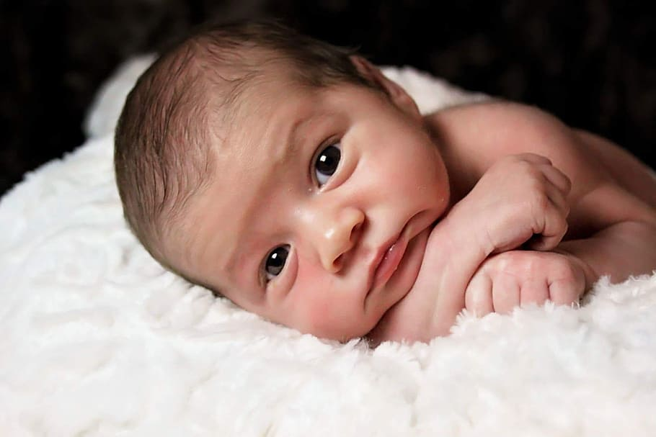
Meet the Family
Maria and Vanessa were so excited to receive the news that they had been approved for the adoption of a baby girl, a newborn whom they would name Hannah. After what seemed like an eternity of paperwork, negotiations, and anticipation, their dream of starting their own family had finally come true.
About a year after their daughter was settled into her new home, the new parents noticed that Hannah behaved strangely when it came time for her to eat. As the girl grew into childhood, these problems continued to get worse.

Slide 3
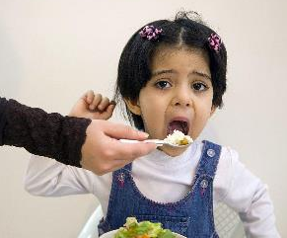
She would scream and cry for more food after every meal and experience temper tantrums throughout the day if food was not provided. Somehow, she was always hungry no matter how much or how recently she’d eaten.
In fact, her weight increased rapidly right alongside her abnormal eating habits, a sign that she could possibly be experiencing hyperphagia.
Clicker Question 1 (CQ1): What might be the symptoms of someone who is experiencing hyperphagia?
Increased body temperature and excessive sweating
Extreme hunger with an intense appetite
Short term memory loss and acute fatigue
Irregular heartbeat and seizures

Slide 4
Hannah’s extreme obsession with food was affecting her life and the lives of everyone around her. Hannah’s weight increased rapidly and she developed insulin resistence. Her mothers tried everything to help their daughter, from visits to pediatricians and mental health professionals to enrollment in a local weight loss institute. Various examinations for thyroid disorder and abnormal adrenal gland and pituitary gland revealed nothing out of the ordinary.
By this point, Hannah had reached the age of eleven and was being tormented by bullies at her middle school. Hannah would come home from school in tears because she just couldn’t escape the meanness and social isolation.

Slide 5
Hannah was due for an annual physical with her pediatrician, a fact that worsened her distressed state even further. Her doctor decided that the girl was old enough to understand the issues of obesity and nutrition, especially considering her ever increasing weight. The girl’s weight and height were measured, and the doctor calculated her BMI.

Slide 6
Body mass index (BMI) – Indicator of body fat content
BMI is commonly used to determine a person’s weight category, which may be associated with health problems. It is calculated based on a person’s mass (weight) and height.
For adults 20 years or older, BMI = $\frac{weight (kg)}{\left[height \left(m\right)\right]2 }$
Quick note: In the United States, weight and height are not usually measured in metric units. Thus, you need to convert the units before calculating the BMI.
Example: weight = 150 lbs = 150 lbs × $\frac{0.4536 kg}{1 lb}$ = 68.04 kg
height = 5' 5" = 65 in × $\frac{0.0254 m}{1 in}$= 1.65 m
BMI = 68.04 ÷ (1.65)² = 25.0

Slide 7
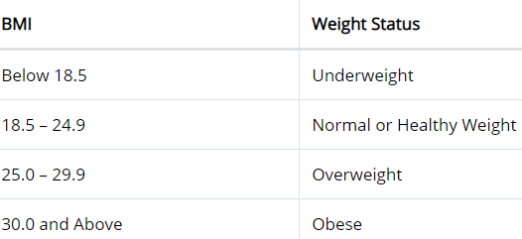
CQ2: Calculate Maria’s BMI and determine her weight status using the standard weight status categories from the United States CDC.
Maria: age 32, weight 113 lb, height 5' 3"
(Convert units first: Weight = 113 lbs = ___kg; Height = 5' 3" = ___m. Then calculate BMI = Weight/Height² = ___)
underweight
normal weight
overweight
obese

Slide 8
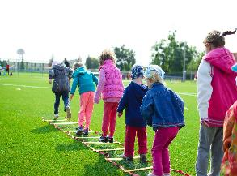
BMI for children and teens (2–19 years old)
BMI for children and teens is age and sex specific because their body fat changes with age and differs between girls and boys. BMI for children and teens is calculated using the same formula for adults but it is interpreted differently.
A specific BMI value will be compared against BMI data from the rest of the population in the same age and sex group as a percentile ranking.
Obesity is defined if the BMI is at or above the 95th percentile of children of the same age and sex from the reference population.

Slide 9
BMI for children and teens (2–19 years old) cont.
Example:
A 10-year-old girl of average height (4' 8") who weighs 108 pounds would have a BMI of 24.3 kg/m².
Unit conversion: 4' 8" = 56 in = 1.42 m, 108 lbs = 49.00 kg
BMI = $\frac{weight (kg)}{\left[height \left(m\right)\right]2 }$= 49.00/(1.42)² = 24.3
Use the girls growth chart on the next page to determine her weight status.

Slide 10
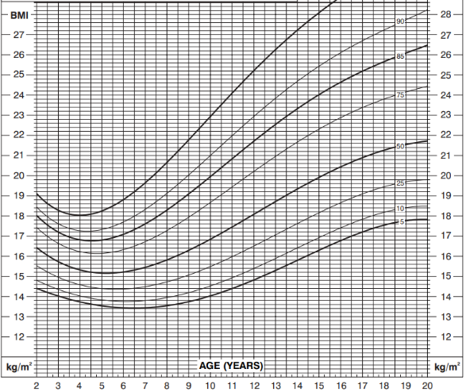
2–20 years: Girls Body Mass Index-for-Age Percentiles
http://www.cdc.gov/growthcharts
95
10-year-old girl
BMI = 24.3
Note that the chart shown here is not complete. BMI percentile ranking for age 16 and higher with BMI of 28.6 or higher is not shown due to limited space of the slide.

Slide 11
2–20 years: Girls Body Mass Index-for-Age Percentiles
95
A BMI of 24.3 would place the girl above the 95th percentile for age 10 (meaning that her BMI is greater than that of 95% of girls in this age group) and she would be considered to be obese.
BMI
95th percentile

Slide 12
2–20 years: Girls Body mass index-for-age percentiles
CQ3: Now, calculate the BMI for Hannah and determine her weight status. (Hint: convert weight and height to kg and m and then calculate BMI to determine weight status.)
Age: 11
Weight: 183 lbs; Height: 4' 5"
Weight Status:__________?
underweight
normal weight
overweight
obese
95

Slide 13
2–20 years: Girls Body Mass Index-for-Age Percentiles
95
183 lbs = 83.00 kg
4' 5" = 53 in = 1.35 m
BMI = 83.00/(1.35)² = 45.5
A BMI of 45.5 is above the 95th percentile for age 11 (95th percentile = 24.2).
95th percentile

Slide 14
Now age 16, after Hannah had a gastric bypass surgery, Vanessa and Maria hired a personal trainer to work with Hannah on exercising and learning proper nutrition. After a thorough search for the best possible fit, the parents found Sam, one of the most highly rated and established personal trainers in their city.
They invited Sam and his husband over for dinner to get to know the professional. Dinner was wonderful and so was the conversation, but one story stood out as particularly interesting ...

Slide 15
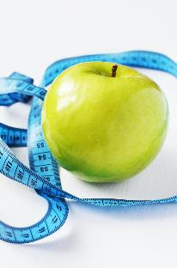
Sam recalled an experience he had with a former client some years ago. One of his former clients came to him in tears, confused and unable to figure out why she couldn’t lose any body fat or control her appetite. For two months straight, Sam put his client on a very strict diet and trained her using the most rigorous techniques he could think of to help her lose weight.
Alas, it had been to no avail. She lost no weight and, feeling hopeless, spiraled into a depression. He had a feeling that there was more to the issue than his client’s behavior and lifestyle.

Slide 16
Sam’s instinct that the client had a more serious medical condition led him to recommend that she be seen by clinicians who specialize in obesity and endocrinology. After some laboratory tests and even a collection of pedigree information, the specialists were finally able to explain why Sam’s client was suffering from obesity. It was due to a rare genetic condition! Considering this past experience, Sam suggested the mothers take Hannah to the same specialists.
It was discovered that Hannah had an extremely low level of leptin, a hormone produced by fat cells that regulates appetite and body weight. The reference value range of circulating leptin for females is 3.7–11.1 ng/ml, but the level of leptin in Hannah was undetectable (below the detection limit of the assay kit).

Slide 17
The condition is called congenital leptin deficiency, caused by a genetic mutation that resulted in Hannah’s inability to produce functional circulating leptin.
CQ4: What does it mean for an illness to be congenital?
It causes irreparable harm to the genitals
It is given to the patient for the sake of research
It is present at birth
It is incurable and deadly

Slide 18
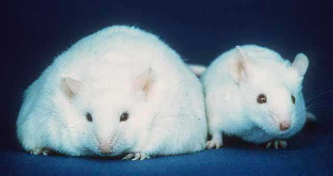
Leptin
The amount of leptin released depends upon how much adipose (fat) tissue is present and generally shows a positive correlation with the amount of fat tissue. The more adipose tissue there is, the more leptin is released, effectively delivering a feeling of satiety (fullness). This feeling is achieved by the binding of leptin to leptin receptors, located on the surface of cells throughout the body and in particular, the hypothalamus that controls appetite.
Leptin deficiency may lead to:
Severe obesity
Hyperphagia
Hyperinsulinemia
Insulin resistance
The image demonstrates the effect of leptin deficiency. Compared to the control on the right, the mouse on the left develops severe obesity due to a lack of functional leptin.

Slide 19
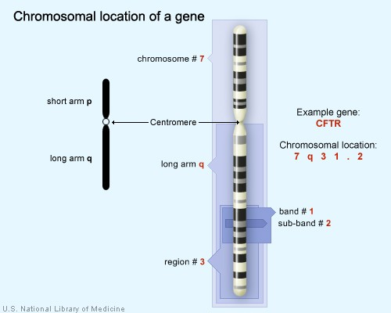
LEP Gene
Leptin is encoded by the LEP gene, which is located on chromosome 7q31.3.
Use the image on the right to learn how 7q31.3 indicates the cytogenetic location of the LEP gene.

Slide 20
CQ5: Cells of many organs and tissues possess leptin receptors on their surface and respond to leptin secreted by fat cells. Mutations of this gene (LEPR) have been linked to obesity and dysfunction of the pituitary gland. The cytogenetic location for the LEPR gene is 1p31.3. Based on what you just learned, where can you find this gene?
Chromosome 1, long arm, region 31, band 3
Chromosome 1, short arm, region 3, band 3, sub-band 1
Chromosome 1, short arm, region 31, band 3
Chromosome 1, short arm, region 3, band 1, sub-band 3

Slide 21
LEP sequence
View the NCBI GenBank page with information on the LEP gene (use the link below). Use the information on the webpage to answer the following question.
https://www.ncbi.nlm.nih.gov/nuccore/NC_000007.14?report=genbank&from=128241201&to=128257629
CQ6: How many nucleotides are there in the LEP gene based on the information on the NCBI website?
16429 bp
128241201 bp
128257629 bp

Slide 22
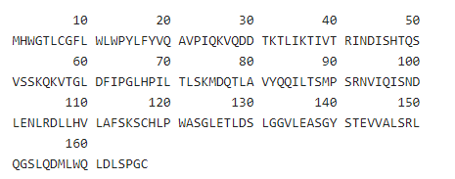
CQ7: Below is a screenshot of the amino acid sequence of leptin. How many amino acids is leptin composed of? (Amino acids can be represented by single letters, which is shown in the figure below.)
160
165
167
180

Slide 23
CQ8: The 18th, 19th, and 20th amino acids of leptin are_________.
arginine, serine, glutamine
threonine, valine, glutamic acid
tyrosine, valine, glutamine
tryptophan, valine, glutamic acid

Slide 24
CQ9: As you might recall, each genetic codon is composed of three nucleotides and codes for one amino acid. For leptin, which consists of 167 amino acids, the size of the gene would be 167 × 3 = 501 bp. This is much less than the 16429 bp you learned earlier regarding the size of the LEP gene. What do you think may explain the discrepancy?
Presence of introns
Presence of the promoter region
Presence of noncoding 5' and 3' regions
All of the above

Slide 25
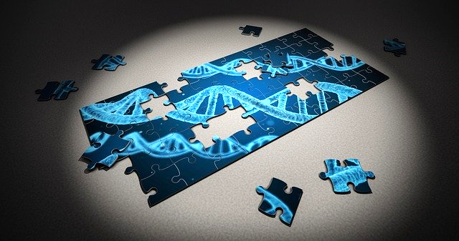
Figuring out the genetic cause...
The next few slides will walk you through a novel mutation discovered in Hannah’s LEP gene which led to her ferocious appetite that never seemed to be satisfied.

Slide 26
CQ10: Based on the results (see figure below) of Yupanqui-Lozno et al. (2019), how many exons are present in the LEP gene?
A. 1 B. 2 C. 3 D. 4

Slide 27
CQ11: What are the segments of sequences between exons?
A. Promoter B. Introns C. 5' cap D. 3' poly A tail

Slide 28
CQ12: It turned out that Hannah had a mutation in her LEP gene (Fig. B below). Can you identify the point mutation in the coding DNA strand shown below?
G is substituted by C
C is substituted by G
A is substituted by T
G is substituted by T

Slide 29
CQ13: The mutation occurred in Exon_______.
1
2
3
4

Slide 30
Using the sequence of the coding DNA strand (sense strand) provided below, determine how the wild type and Hannah’s LEP gene differ in the amino acid sequence due to the single nucleotide mutation shown in the previous slide.
CQ14. Wild type DNA: AAG AGC TGC CAC TTG; Amino acid sequence:_________?
Phe-Ser-Thr-Val-Asn
Lys-Ser-Cys-His-Leu
Gln-Val-Ala-Ala-Leu
CQ15. Mutant type
DNA: AAG AGC TTC CAC TTG; Amino acid sequence:_________?
Gln-Val-Glu-Ala-Leu
Lys-Ser-Phe-His-Leu
Phe-Ser-Lys-Val-Asn

Slide 31
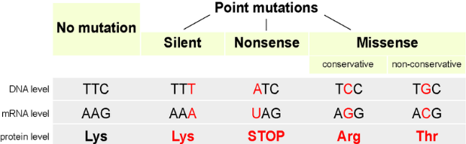
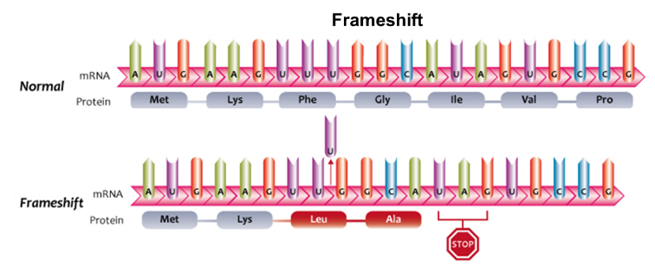
CQ16: Based on the information you have learned so far, what type of point mutation occurred in Hannah’s LEP gene?
silent
nonsense
missense
frameshift

Slide 32
Another type of mutation has also been documented to cause congenital leptin deficiency, found in two patients from a consanguineous (inbred) family of Pakistani origin (Montague et al., 1997). Below is part of the nucleotide sequence between nucleotides 387 and 407. Note: The sequence is grouped in sets of three nucleotides for easy comparison, and transcription and translation begins at GTC.
Wild type: 5' GTC GGA CCC CCC ACA GGA CCT 3'
Mutant type: 5' GTC GGA CCC CCA CAG GAC CTT 3'
CQ17: What type of point mutation is shown above?
silent
nonsense
missense
frameshift

Slide 33
CQ18: As you learned earlier, the mutation that occurred in Hannah’s LEP gene leads to the substitution of one amino acid with a different amino acid. This is an alteration of the _________structure of protein.
primary
secondary
tertiary
quaternary

Slide 34
CQ19: Using the figure provided, identify the impact of the mutation on the protein structure. The mutant leptin lacks___________.
hydrogen bond between two cysteines
disulfide bond between two cysteines
hydrophobic force between cysteine and phenylalanine
disulfide bond between cysteine and phenylalanine

Slide 35
CQ20: The lack of disulfide bond between amino acid 117 and 167 due to the mutation will most likely affect which level of the leptin structure?
primary
secondary
tertiary
quaternary

Slide 36
Researchers suggest that the lack of a disulfide bond due to Hannah’s mutation may impair the normal secretion of leptin, as disulfide bonds have been documented to prevent the undesired aggregation of protein molecules.
Hannah’s diagnosis sparked the interest of the specialists involved in her treatment and care. They suggested Hannah’s moms obtain information on Hannah’s birth parents and family medical history as research has shown that mutations of the leptin gene are often associated with higher rate of consanguinity.

Slide 37
CQ21: Using your knowledge of genetics and inheritance, can you explain why inbreeding increases the likelihood of genetic disorders?
Parents that are closely related tend to develop similar lifestyles and behavior, which may increase the risk of certain diseases, such as smoking and lung diseases, sedentary lifestyle and obesity, etc. Children under the influence of their parents are more likely to show such behavior and develop the diseases.
Parents that are closely related are more likely to both carry a copy of the same defective gene and pass it to the offspring, increasing the likelihood that the child carries two copies of the defective gene (homozygous mutations) causing the disease to manifest.

Slide 38
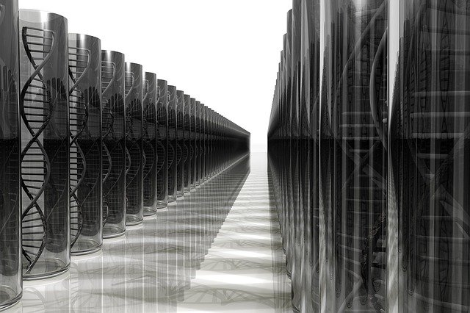
With the help of the adoption agency and some friends, Maria and Vanessa finally got a hold of some information of Hannah’s biological parents.
It turned out that Hannah came from a highly consanguineous family in Columbia. Her parents were first cousins and her maternal and paternal grandmothers were sisters. Hannah had two paternal aunts who were also extremely obese and one of them had passed away.

Slide 39
A Happy Ending...
It’s not often that a diagnosis provides more good than bad, but Maria and Vanessa were extremely relieved upon learning of their daughter’s medical condition and that there was a solution! Doctors prescribed leptin replacement therapy, a medical regimen of daily leptin injections.
The improvement in Hannah’s condition was immediate and drastic! Along with proper nutrition and exercise, her weight eventually dropped to the normal weight category. At long last after years of turmoil, the family was finally at ease and able to start their happy and healthy journey together.

Slide 40
References
Montague, C.T., I.S. Farooqi, J.P. Whitehead, et al. (1997). Congenital leptin deficiency is associated with severe early-onset obesity in humans. Nature 387(6636): 903–8. https://doi.org/10.1038/43185
Yupanqui-Lozno, H., R.A. Bastarrachea, M.E. Yupanqui-Velazco et al. (2019). Congenital leptin deficiency and leptin gene missense mutation found in two Colombian sisters with severe obesity. Genes 10: 342. https://doi.org/10.3390/genes10050342

Slide 41
Image Credits
Slide 1: Obesity in children
Source: From Pixabay by SerenaWong, https://pixabay.com/illustrations/weight-fat-diet-health-overweight-3949588/
Clearance: Used in accordance with Pixabay license.
Slide 2: Newborn baby
Source: From pxfuel, https://www.pxfuel.com/en/free-photo-elpyg
Clearance: Free for commercial use
Slide 3: A crying baby
Source: From Wikipedia Commons by Mostafameraji https://commons.wikimedia.org/wiki/File:%DA%AF%D8%B1%DB%8C%D9%87_%DA%A9%D8%B1%D8%AF%D9%86_%D8%AF%D8%AE%D8%AA%D8%B1_%D8%A8%DA%86%D9%87_Cry_baby_girl_06.jpg,
Clearance: Creative Commons Attribution-Share Alike 4.0 International license.
Slide 4: Image of an obese girl, supposedly the fictional character of the case, Hannah. The girl in the image is a patient documented in a real medical case of congenital leptin deficiency published by Yupanqui-Lozno et al. (2019) in the Journal Genes.
Source: https://www.mdpi.com/2073-4425/10/5/342
Clearance: Used in accordance with the Creative Commons Attribution 4.0 International (CC by 4.0)
Slide 5: Blue measuring tape on a scale
Source: From Pexels, https://www.pexels.com/photo/blue-tape-measuring-on-clear-glass-square-weighing-scale-53404
Clearance: Used in accordance with Pexels License
Slide 8: School children doing outdoor activities
Source: From Pexels by Lucas, https://www.pexels.com/photo/action-activity-boy-children-296301/
Clearance: Used in accordance with Pexels License

Slide 42
Slide 14: Exercise equipment and scale
Source: https://www.pikist.com/free-photo-ssdxj
Clearance: Used in accordance under Pekist public domain license
Slide 15: Green apple beside measuring tape
Source: From Pexel.com, by Breakingpic, https://www.pexels.com/photo/apple-norms-size-standards-3301/
Clearance: Used in accordance with Pexels License
Slide 16: Doctor
Source: From Pxhere, by Mohamed Hassan https://pxhere.com/en/photo/1451109
Clearance: Used in accordance with Creative Commons CC0
Slide 18: Obese vs normal mice
Source: Human Genome wall for SC99 on ornl.gov, https://commons.wikimedia.org/wiki/File:Fatmouse.jpg
Clearance: This work is in the public domain in the United States
Slide 19: Cytogenic location of the LEP gene
Source: https://ghr.nlm.nih.gov/primer/howgeneswork/genelocation
Clearance: This work is in the public domain in the United States
Slide 20: LEPR gene location
Source: The U.S. National Library of Medicine, https://ghr.nlm.nih.gov/gene/LEPR#location
Clearance: This work is in the public domain in the United States
Slides 22 and 23: Amino acid sequence of LEP gene
Source: From uniprot.org, https://www.uniprot.org/uniprot/P41159
Clearance: Used in accordance with Creative Commons Attribution (CC BY 4.0) License
Slide 25: Puzzle DNA research
Soure: From Pixabay by qimono, https://pixabay.com/photos/puzzle-dna-research-genetic-piece-2500333/
Clearance:Used in accordance with Pixabay license.

Slide 43
Slides 26–29: Figures of wild type and mutant type sequences from Yupanqui-Lozno et al. (2019)
Source: https://www.mdpi.com/2073-4425/10/5/342
Clearance: Used in accordance with the Creative Commons Attribution 4.0 International (CC by 4.0)
Slide 31:
Top image: Different types of point mutations
Source: From Wikipedia Commons, https://commons.wikimedia.org/wiki/File:Point_mutations-en.png
Clearance: Used in accordance with Creative Commons Attribution-Share Alike 4.0 International, 3.0 Unported, 2.5 Generic, 2.0 Generic and 1.0 Generic license.
Bottom image: Frameshift mutation
Source: From Wikipedia Commons, https://commons.wikimedia.org/wiki/File:Frameshift_mutations_(13080927393).jpg
Clearance: Used in accordance with Creative Commons Attribution-Share Alike 2.0 Generic license.
Slides 34–35: Protein sequences of wild type and mutant type published by Yupanqui-Lozno et al. (2019)
Source: https://www.mdpi.com/2073-4425/10/5/342
Clearance: Used in accordance with the Creative Commons Attribution 4.0 International (CC by 4.0)
Slide 36: Pedigree icon
Source: From Pixabay by mcmurryjulie, https://pixabay.com/vectors/pedigree-icon-pedigree-icon-2316458/
Clearance: Used in accordance with Pixabay License
Slide 38: DNA
Source: From Pixabay, https://pixabay.com/vectors/pedigree-icon-pedigree-icon-2316458/
Clearance: Used in accordance with Pixabay License
Slide 39: People-family
Source: From Pixabay by StockSnap, https://pixabay.com/photos/people-women-talking-laugh-happy-2567915/
Clearance: Used in accordance with Pixabay License

