Slide 1
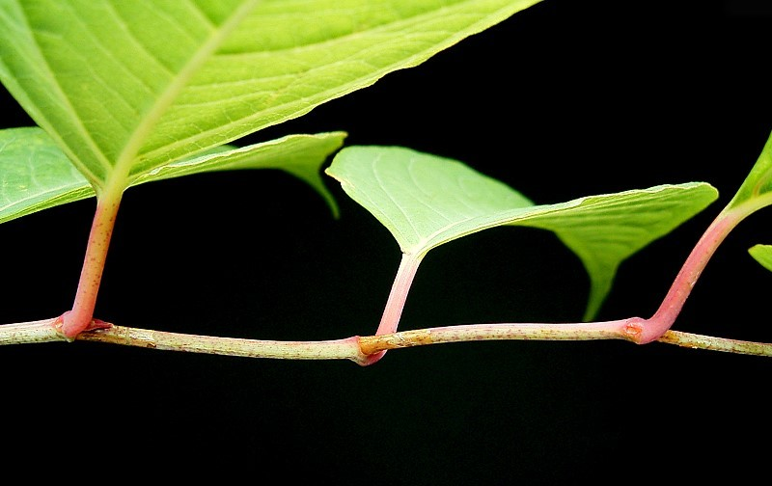
Knot Your
Typical Weed
by Eric Ribbens Department of Biological Sciences Western Illinois University, Macomb, IL

Slide 2
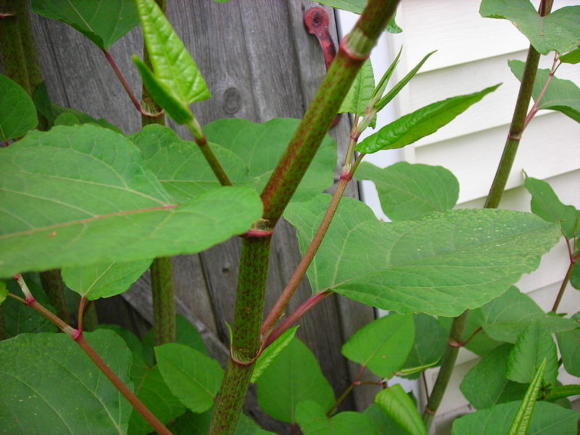
Jeff stopped abruptly as the two friends carried the ladder around the corner of Dave’s house.
“Uh oh! Dave, you’ve got a real problem here.”
“What’s wrong?”
“See that plant? That’s Japanese knotweed. You probably
won’t be able to sell this place until it’s gone.”
“Wow, really? So I guess I need to dig out my RoundUp?
“Sorry, dude. This is hard to get rid of.”

Slide 3
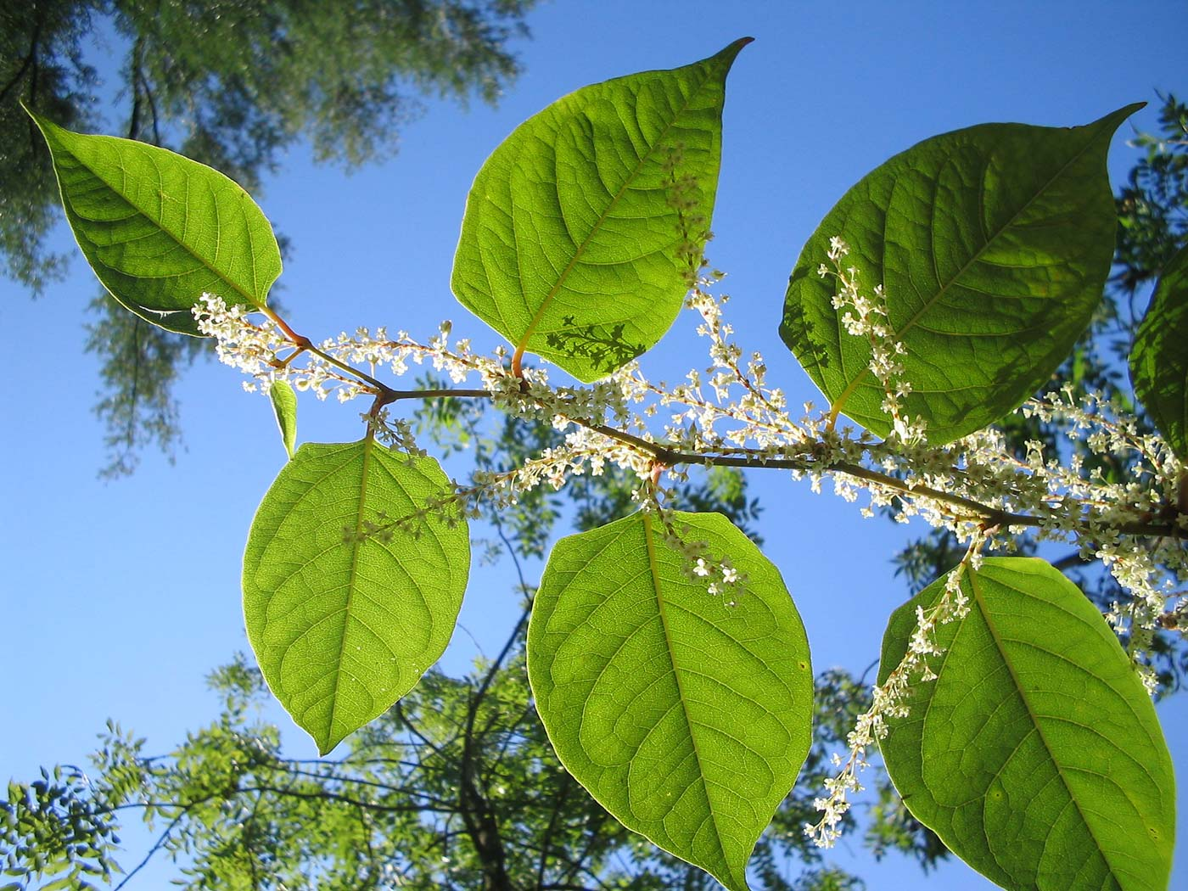
Fallopia japonica: Japanese knotweed
The German botanist Philipp von Siebold sent specimens to the Royal Botanical Gardens at Kew in August 1850.
Heart-shaped leaves
Lacy trails of white flowers
Bamboo-like stems
Native to Japan

Slide 4
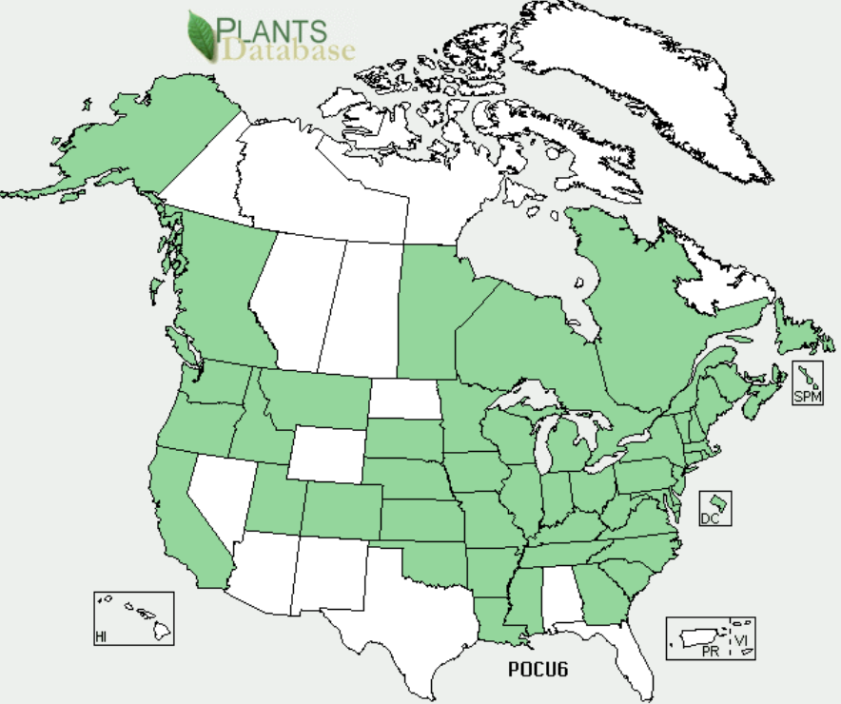
Invasive:
Japanese knotweed grows today in 26 European countries, many Canadian provinces, and throughout the United States.

Slide 5
Here’s your assignment:
Research Japanese knotweed control. Why is this plant a problem, and what can be done to eliminate it?
Prepare a two-page paper explaining the problem to Dave and your recommendations for a solution. Turn it in at the beginning of next class.

Slide 6
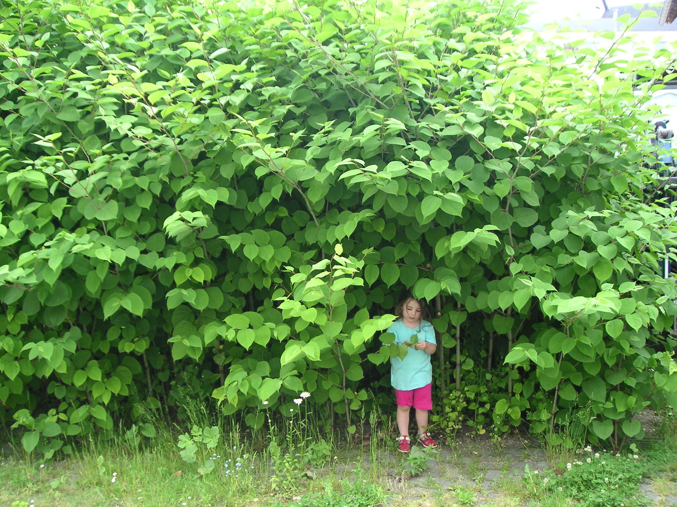
“Eradication requires steely determination,” warns the U.K.’s Royal Horticultural Society, stressing that it has cost £70 million ($120 million U.S. dollars) just to remove knotweed from the site of the London Olympic Games. “Its rapid annual growth and relentless spread allows it to overwhelm other garden plants.”
All over Europe nations are on knotweed alert; they’ve got it in Latvia, Germany, Hungary, Austria and Switzerland. Meanwhile across the other side of the world in Staten Island, New York, residents have been telling TV crews how the weed is “Frightening, scary and taking over everything.”
Notes:
These paragraphs were excerpted from “Japanese Knotweed: The Invasive Plant That Eats the Value of Your Home” by Christopher Middleton, Newsweek, July 5, 2014. http://europe.newsweek.com/japanese-knotweed-driving-men-murder-257257
The photo is from Wikimedia Commons, https://commons.wikimedia.org/wiki/File:Riesenknoeterich.jpg.

Slide 7
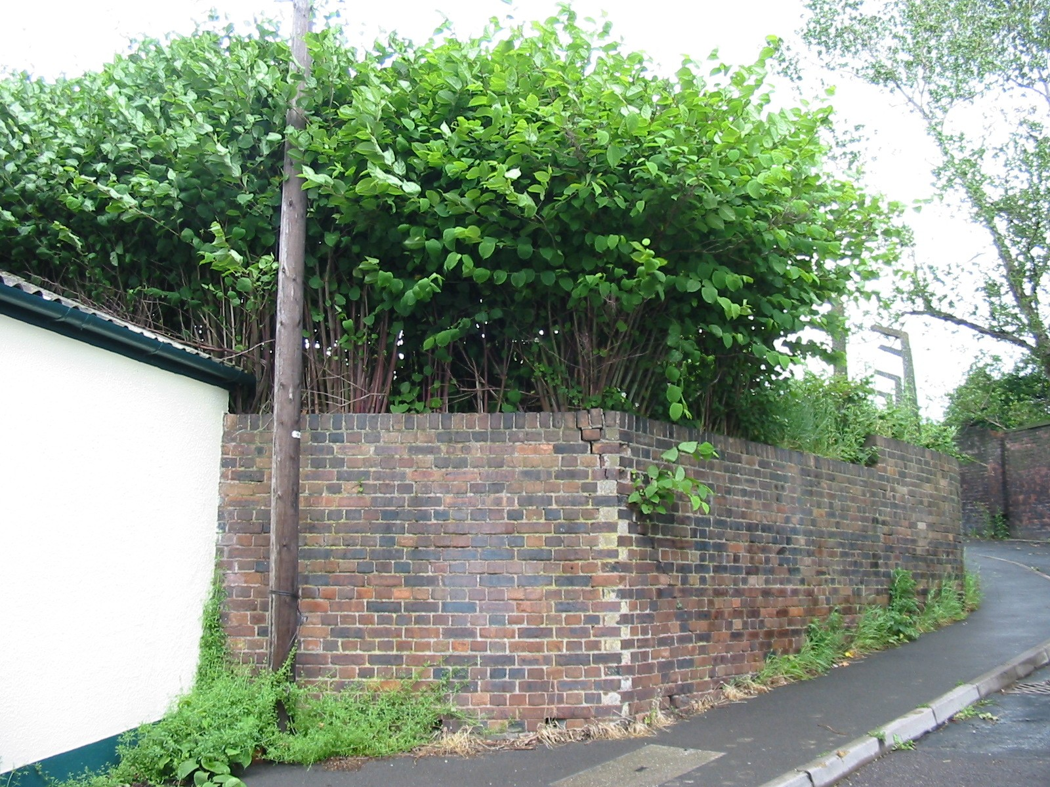
It can grow right through walls …
Notes:
http://www.wiseknotweed.com/media/resources/galleries/45/fullsize.jpg

Slide 8
and asphalt

Slide 9
The next day …
“Well, you have a nice little problem here, Dave!”
Joe, from Joe’s Weed Control, sounded cheerful.
“Look here. The knotweed has gotten under your foundation. I can see cracks in the foundation, and the wall has been weakened. What I recommend is we dig out this whole area, make sure we have all of the plant out, and have someone rebuild this part of your house. My guess is you are looking at $10,000 to $15,000, including the money to treat all that material removed as hazardous waste.”

Slide 10
“What?”
Dave was incredulous.
“Sorry, but yep, you are going to be spending some serious money. Actually, I think you are getting off fairly cheaply. People have spent well over $200,000 to deal with knotweed sometimes.”

Slide 11
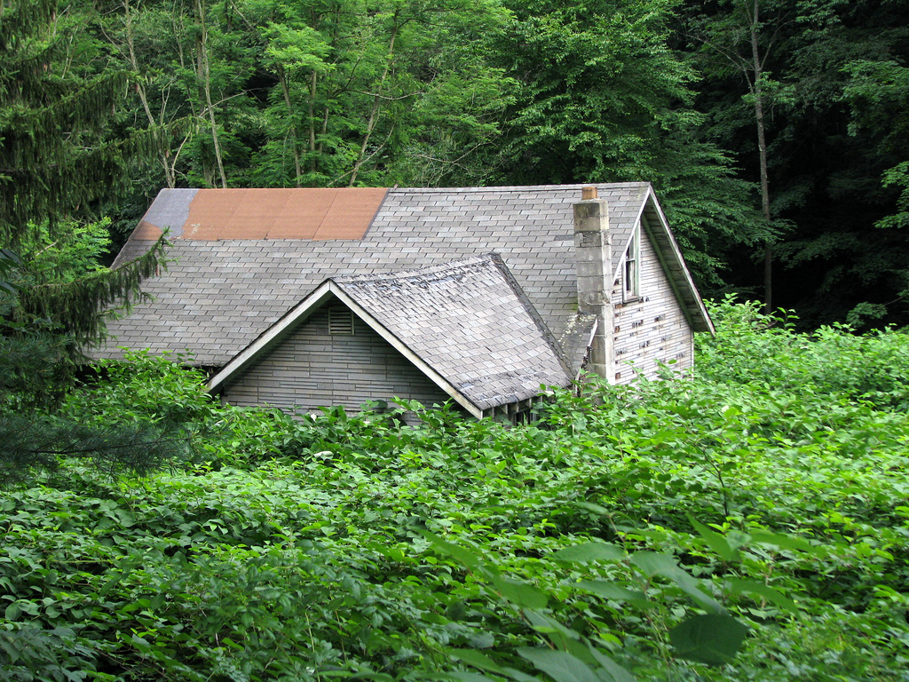
Why is Japanese knotweed such a problem to eradicate?
It grows quickly.
It can regrow from any leftover piece of the plant.
People often don’t realize it is a problem until real damage has already happened.
All of the above.
Notes:
https://www.flickr.com/photos/kwixted0/2649178187/in/photolist-pTuFG9-8V4N51-536JnZ-apMwyq-nKLoGp-K37nQ-bAqF3b

Slide 12
Image Credits
Slide 1
Description: Photo of Fallopia japonica.
Source: Photo by Frank Vincentz, downloaded from Wikimedia Commons at https://commons.wikimedia.org/wiki/File:Fallopia_japonica2_ies.jpg.
Clearance: Used in accordance with CC BY-SA 3.0 (https://creativecommons.org/licenses/by-sa/3.0/deed.en).
Slide 2
Description: Photo of Fallopia japonica stalk growing next to building.
Source: Photo by Ancatdubh43, downloaded from Wikimedia Commons at https://commons.wikimedia.org/wiki/File:Knotweed.jpg.
Clearance: Released to the public domain by the photographer.
Slide 3
Description: Photo of Fallopia japonica.
Source: Photo by Michael Gasperl, downloaded from Wikimedia Commons at https://commons.wikimedia.org/wiki/File:Fallopia-japonica%28Blaetter%29.jpg.
Clearance: Used in accordance with CC BY-SA 3.0 (https://creativecommons.org/licenses/by-sa/3.0/deed.en).
Slide 4
Description: Map showing distribution of Fallopia japonica. Throughout U.S.A. and Canada.
Source: USDA, NRCS. 2015. The PLANTS Database (http://plants.usda.gov). National Plant Data Team, Greensboro, NC 27401-4901 USA.
Clearance: Public domain (http://www.usda.gov/wps/portal/usda/usdahome?navtype=FT&navid=POLICY_LINK)
Slide 6
Description: Photo of Fallopia japonica with child who is about 90cm in height.
Source: Photo by gerald_at_volp_dot_com, downloaded from Wikimedia Commons at https://commons.wikimedia.org/wiki/File:Riesenknoeterich.jpg.
Clearance: Used in accordance with CC BY-SA 3.0 (https://creativecommons.org/licenses/by-sa/3.0/deed.en).
Slide 7
Description: Photo of knotwood growing through brick wall.
Source: Image courtesy of Wise Knotweed Solutions (http://www.wiseknotweed.com/), downloaded from http://www.wiseknotweed.com/media/resources/galleries/45/fullsize.jpg
Clearance: Used with permission.
Slide 8
Description: Photo of knotwood shoot pushing up through tarmac.
Source: Photo by Lamiot, downloaded from Wikimedia Commons at https://commons.wikimedia.org/wiki/File:Renou%C3%A9e_macadam1FL_Lille.jpg.
Clearance: Used in accordance with CC BY-SA 3.0 (https://creativecommons.org/licenses/by-sa/3.0/deed.en).
Slide 10
Description: Photo of money going down the drain.
Source: Copyright stymbox | Fotolia, image ID #42730620.
Clearance: Licensed stock image.
Slide 11
Description: Photo of abandoned house in a sea of knotweed.
Source: Photo by Kerry Wixted , downloaded from Flickr at https://www.flickr.com/photos/kwixted0/2649178187/in/photolist-pTuFG9-8V4N51-536JnZ-apMwyq-nKLoGp-K37nQ-bAqF3b.
Clearance: Used in accordance with CC BY-NC 2.0 (https://creativecommons.org/licenses/by-nc/2.0/).

