Slide 1
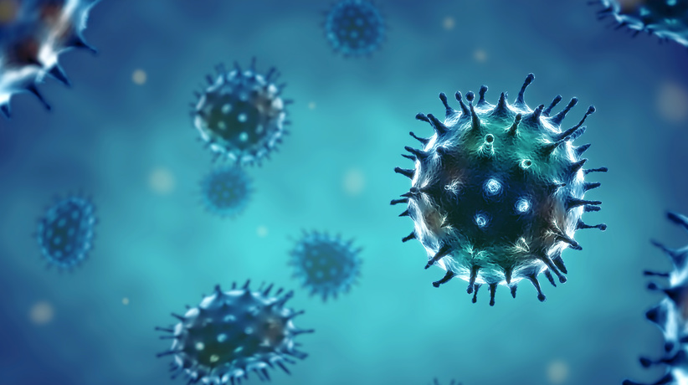
Campus Outbreak! Modeling Seasonal Influenza
NATIONAL CENTER FOR CASE STUDY TEACHING IN SCIENCE
by
Marcia Harrison-Pitaniello, Jessica L. Shiltz, Robert E. Hughes, Roger L. Estep, and Anna B. Mummert Marshall University, Huntington, WV
Notes:
Licensed image #76016323 © Feydzhet Shabanov|fotolia.

Slide 2
Part I: How Fast Can It Spread?
Overview:
Robert, Roger and Jessie explore a campus outbreak of influenza using a basic mathematic model that was developed to simulate an influenza outbreak and its progression.

Slide 3
Narrator:
Robert, Roger and Jessie were walking to their Microbiology class one November afternoon.
When they arrived, they noticed a sign on the door that said “Micro is cancelled today because the professor and several students are infected with influenza.”
Roger:
“Um, now what are we supposed to do?”
Jessie:
“I don’t know about you guys, but, I’m kind of hungry. Want to grab some lunch at the cafeteria?”

Slide 4
Robbie:
“What time is it, 1:00? Won’t it be super crowded?”
Roger:
“Let’s grab lunch anyway. We have plenty of time, and I think they are having [insert delicious food item] today.”
Narrator:
The three exit the Science Building and start to walk to the cafeteria. They are expecting to see a line out the door, but are surprised to see a practically empty dining room. The dining room attendant smiles and tells them that they she is happy to finally see someone show up for lunch as she swipes their ID cards.

Slide 5
Narrator:
After they grab their food they sit down and begin to discuss if their class cancelation is related to the deserted dining hall that they are currently occupying.
Jessie:
“The cashier said that the entire campus has a flu outbreak. There’s an article in the student newspaper about it.”

Slide 6
Roger:
According to the newspaper,
“State University had a severe outbreak in October. It is believed that the source of the outbreak on our campus was from contact with students from State at the away game two weeks ago. It is estimated that 40% of campus has contracted the flu since then.”
Robbie:
“Really? Could that many people on campus be infected in only two weeks?”

Slide 7
CQ#1: Do you think an influenza outbreak could affect 40% of campus within only two weeks?
Yes
No

Slide 8
CQ#2: What is influenza?
A viral infection
A bacterial infection
An amoebic infection
A parasitic infection
None of the above

Slide 9
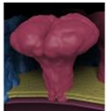
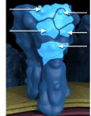
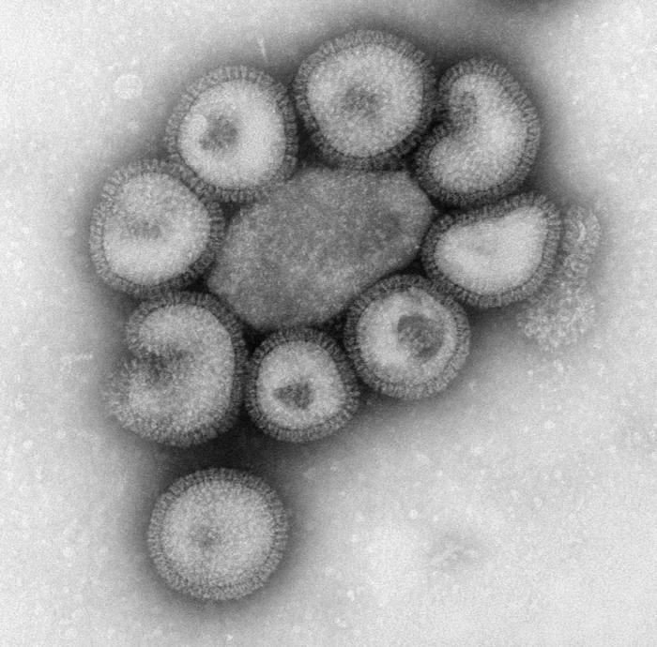
CDC Public Health Image Library (http://phil.cdc.gov/phil/home.asp). ID# 17346 (Photo credit: Dan Higgins); ID# 8432 (Photo credit: Dr. F. A. Murphy)
Surface Proteins
neuraminidase
Antigen sites
(Recognized by human antibodies) which will lead to virus destruction.
hemagglutinin
Genetic code
RNA surrounded by protein
(ribonucleoprotein)
Electron micrograph of a group of influenza virus particles.

Slide 10
CQ#3: What is the primary transmission route that would allow influenza to spread throughout the campus?
The virus spreads by contact with bodily fluids
The virus spreads by air-borne droplets
The virus can survive on inanimate objects

Slide 11
http://www.cdc.gov/flu/about/disease/spread.htm

Slide 12
Seasonal Influenza
A respiratory disease caused by a virus.
Influenza is most common in the colder months. The number of infected individuals usually peaks between December and February.
http://www.cdc.gov/flu/weekly/weeklyarchives2013-2014/weekly39.html

Slide 13
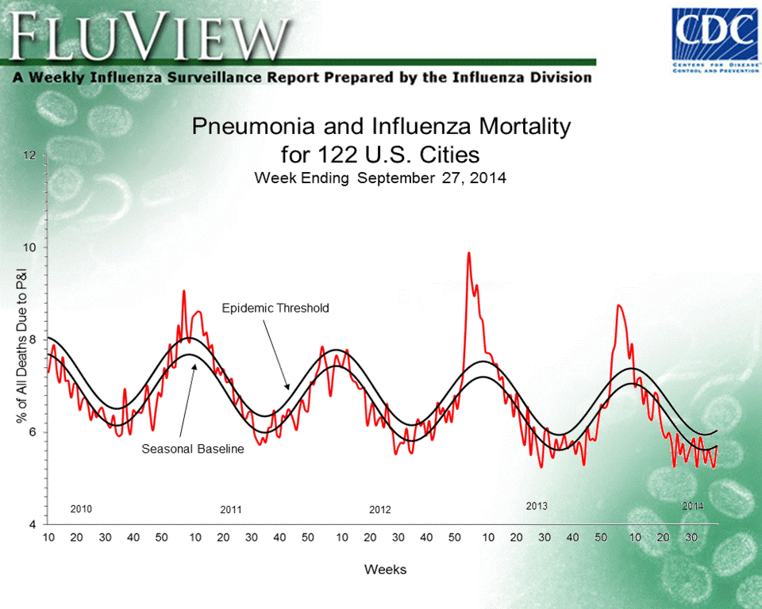
Seasonal Influenza
In the United States, seasonal influenza causes anywhere from 3,000 to 49,000 deaths each year.
http://www.cdc.gov/flu/weekly/weeklyarchives2013-2014/weekly39.html

Slide 14
Base Seasonal Model
Contact with Infectious Individual
Time Length
Time Length
Susceptible
Exposed
Infectious
Recovered
Chance of Transmission
Susceptible: Individuals do not have an immune response and do not produce antibodies against the influenza proteins.
Exposed: Usually influenza is spread by droplets from coughing or sneezing. The droplets can enter the mouth or nasal passage with potential to attach to the tissue.
Infectious: For seasonal flu, people may become infectious within the first day of exposure and up to 5-7 days after they are symptomatic.
Recovered: Antibodies recognize and destroy the virus. This results in permanent immunity to that strain of influenza.

Slide 15
Click to view animation on influenza SEIR model
(Internet connection required)

Slide 16
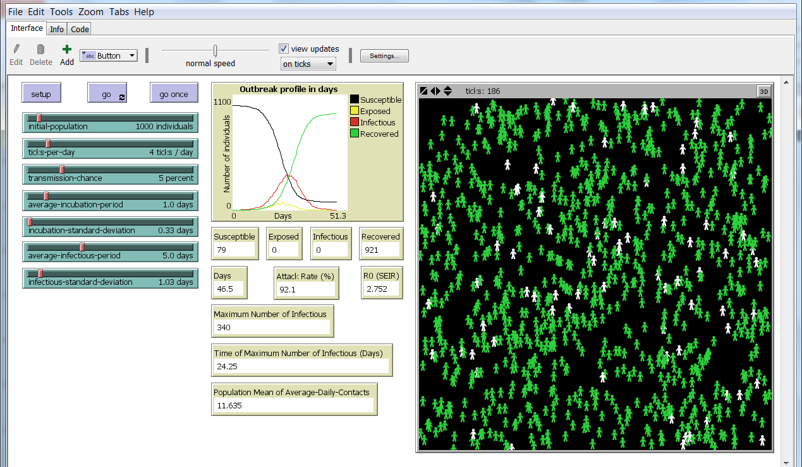
NetLogo interface of the Base Seasonal Model
NetLogo is a modeling tool that can help predict trends in outbreaks.

Slide 17
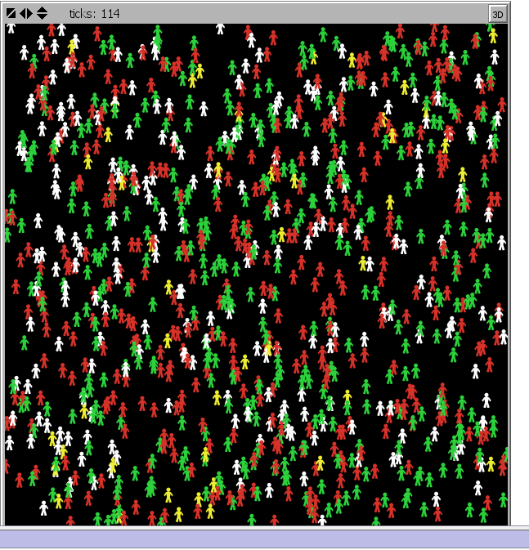
World Space
Initial population:
1000 within the world space
Susceptible
Exposed
Infectious
Recovered and immune

Slide 18
Fixed Parameters – Influenza
mean value of the incubation (latency) time for the exposed class.
standard deviation of the incubation period.
mean value of the infectious period for the infectious class.
standard deviation of infectious period.
Average infectious period and incubation period were based on the values provided in Pandemic Influenza Preparedness and Response: A WHO Guidance Document. Geneva, World Health Organization, 2009.
Standard deviations were based on 95% confidence levels.

Slide 19
Variable Parameters – Initial settings
population size within the world space. This parameter defines the population density on campus.
indicates the number of encounters with potential to contract influenza per day. E.g. number of classes and/or campus activities per day.
indicates the likelihood of the infected individuals to cause infection. Higher values indicate greater chance of transmission.

Slide 20
Base Model – How it works
Susceptible
Exposed
Infectious
Recovered
A single individual begins the outbreak. All others in the population are susceptible.
Individuals move randomly in the world. When a susceptible individual comes into contact with an infectious individual there is a probability (chance) that the susceptible individual will become infected.
If a susceptible individual becomes infected, the individual moves into the exposed class.
After a time, exposed individuals move into the infectious class where they are able to infect others.
Then, after another time interval, infectious individuals recover and move into the recovered class. Recovered individuals gain permanent immunity
The model simulation ends when no individuals are exposed or infectious.

Slide 21
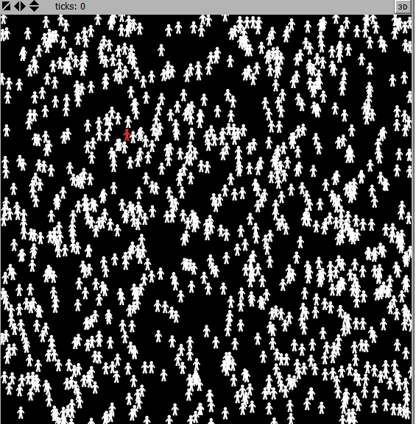
Run the program SEIR-Model-Base-Seasonal.nlogo
Use the initial parameter values set upon opening the program.
Infectious
Initially, one individual is in the infectious class (red) and the remaining individual are susceptible (white).

Slide 22
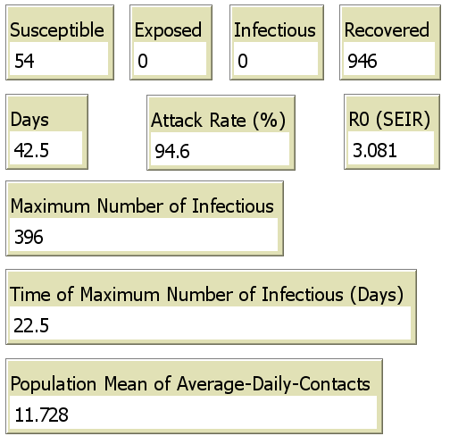
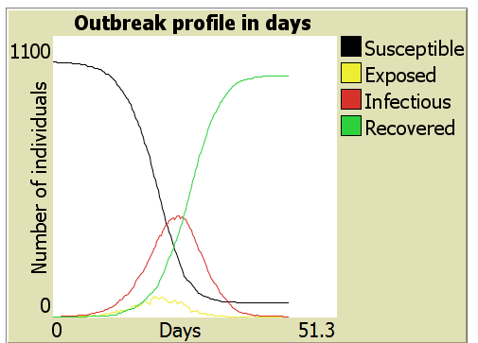
Example output – Base Seasonal Model

Slide 23
R0 = basic reproduction number.
If R0 is less than 1, then the infection will not progress.
If R0 greater than 1, then the infection will spread through the population.
Attack rate = percent of the population that was infected.

Slide 24
CQ#4: Based on the initial NetLogo simulation, would an influenza outbreak affect 40% of campus within only two weeks?
Yes
No

Slide 25
Robbie:
“How can we use NetLogo to simulate the outbreak and test the newspaper’s claim?”
Roger:
“Can’t we just adjust the three variable parameters and see what the pattern is?”
Jessie:
“But, if we change them all at once, how will we know which really has the most influence?"

Slide 26
Robbie:
“And even if we separately try 5 different settings for each, won’t we have to run over 100 tests?”
Roger:
“Maybe….. I have math class next, I’ll ask my math professor.

Slide 27
Later that day
Robbie:
“Hi Roger, did you get ideas on how to use NetLogo to simulate the outbreak?”
Roger:
“According to my math professor, we need to vary each parameter one at a time and always return to the base parameter value before changing another parameter. And Robbie, you were right, testing 5 values for each parameter would mean 125 (5^3) tests.”
Robbie:
“OK, then let’s work with each parameter individually, and compare the simulations.”

Slide 28
Use different parameter values to run the simulaiton. Keep track of: -Attack rate -Time of maximum number of infectious (days) Which settings speed the infection so it spreads within two weeks? Also, test settings that would slow the outbreak.
Run the program SEIR-Model-Base-Seasonal.nlogo

Slide 29
Discussion
How well does the base model mimic seasonal flu data?
What might appropriate values be for a campus outbreak?
What other factors should be considered in a campus outbreak?
http://www.cdc.gov/flu/weekly/weeklyarchives2013-2014/weekly39.html

Slide 30
http://www.cdc.gov/flu/news/predict-flu-challenge-winner.htm

Slide 31
Modeling Seasonal Influenza – The Outbreak Continues
Narrator:
A few days later, it was time for Robbie, Roger, and Jessie to go back to their microbiology class. Robbie decided that it would probably be a good idea to check their email before making the long trek to the Science Building.
Sure enough, there was an email from the professor that stated, “I have received several emails from students informing me that they are still experiencing influenza symptoms and won’t be able to attend class today. Unfortunately, I am experiencing these symptoms as well, therefore, class is canceled again.”

Slide 32
Assignment for next class:
Your assignment is to research influenza and find two different influenza control strategies that are available to the public.
Include a definition of what these control strategies are, how they reduce influenza cases, and their effectiveness.
Suggested Websites:
Flu News & Spotlights (http://www.cdc.gov/flu/news.htm)
CDC-Influenza (Flu) (http://www.cdc.gov/flu/index.htm)
WHO Health topics – Influenza (http://www.who.int/topics/influenza/en/)

Slide 33
Part II: How Do We Control It?
Overview:
Robert, Roger, and Jessie discuss control strategies and predict their potential effectiveness using adaptations of the SEIR Basic Seasonal model in NetLogo.

Slide 34
What control strategies are available to reduce the number of influenza cases?
What is their effectiveness?

Slide 35
Review: In the context of mathematical modeling of epidemics, what does S-E-I-R stand for?
Stress-Enhanced Ion Release
Susceptible-Exposed-Infected-Recovered
State Environmental Impact Report
Social and Economic Indicator Resource

Slide 36
Narrator:
When we last saw our heroes, they had just received an email from their microbiology professor – class was cancelled and a research assignment was given. After reading the email, Robbie decided to call Roger and Jessie.
Robbie:
“Hey, did you guys get the email about our Micro class today? Do you want to head to the library and get this report over with?”
Roger and Jessie:
“Yeah, that sounds good, meet you there in a minute.”

Slide 37
Robbie:
“First things first, we need to find what kind of different influenza control strategies are out there.”
Jessie:
“That’s easy enough. After a Google search, I found that there are two broad categories of control strategies, biologic and behavioral. The outbreak is pretty severe on campus. I’m glad I got my flu shot before the outbreak. That’s a biologic control.”

Slide 38
Roger:
“I got mine last year, so I’m OK.”
Robbie:
“I’m just careful, you know. I follow the advice on all those signs around campus – wash my hands, sneeze into my arm, and stay away from sick people. That’s behavioral – right? It’s worked for me so far.”
Jessie:
“I don’t know. My roommate is pretty careful, but she started to get sick. They gave her an antiviral medication. That seemed to help.”

Slide 39
CQ#5: Which control strategy do you think is the most effective?
This year’s flu shot (vaccination)
A previous vaccination
Antiviral medication
Behavior (hand washing, covering sneezes, and avoiding sick people)
From the class list of control strategies, indicate whether they are biologic or behavioral.

Slide 40
Jessie:
“I got my flu vaccine in September when they had free shots at the student center. I bet if more students were vaccinated the outbreak would not be as bad.”
Roger:
“Well, there would be fewer students with the flu.”
Robbie:
“But, how many fewer? Is there anyway to find out?”

Slide 41
Roger:
“How are we supposed to find out how effective any of these strategies are?”
Robbie:
“I think NetLogo can help with this. It has influenza control strategy models too.”

Slide 42
Vaccination
Overview (activity):
http://www.historyofvaccines.org/content/how-vaccines-work
PBS LearningMedia: Immunity & Vaccines (3:37 minutes)
http://www.pbslearningmedia.org/resource/nvvs-sci-immunity/immunity-vaccines/
For seasonal influenza vaccinations are developed annually based on the prominent types that are predicted for the upcoming year. Current vaccines protect against 3 (trivalent) or 4 (quadrivalent) types of flu virus. (From: http://www.cdc.gov/flu/about/qa/flushot.htm)

Slide 43
CQ#6: Vaccinations are the injection of antigens into the body.
True
False

Slide 44
CQ#7: The flu vaccination always targets four new viral types.
True
False

Slide 45
Vaccination
Vaccination introduces an inactivated virus or antigen, which will trigger an immune response. The immune response will then “remember” the viral type and destroy it before an infection occurs.
How would vaccination prior to an outbreak affect the model?
Contact with Infectious Individual
Time Length
Time Length
Susceptible
Exposed
Infectious
Recovered
Chance of Transmission

Slide 46
Vaccine Model – How it works
sets the time when the first exposed individual appears in the world. Here, vaccines are given for 30 days before the outbreak begins.
the probability that a susceptible or exposed individual gets vaccinated.
- a white shield indicates that an individual has received the vaccine but is still susceptible.

Slide 47
Vaccine Model – How it works
sets the mean value for the seroconversion period of individuals for whom the vaccine is effective.
a blue shield indicates that an individual has received the vaccine and is now protected by the vaccine.
sets the efficacy of the vaccine.
yellow, red, and green shields represent individuals that have received the vaccine but still contract influenza before they seroconvert and, therefore, progress to exposed, etc.

Slide 48
Vaccine Model – How it works
Vaccines are available before any individuals are infected.
Once each day, there is a chance that a susceptible (and later exposed) individual will take the vaccination.
Each vaccination has a chance of being effective.
Individuals who are not already exposed and who were given an effective vaccine, after a time, will seroconvert [blue flag].
Individuals who seroconvert gain permanent immunity; those who do not may become infected [green flag].
The recovered values indicates those that contracted influenza, both those that received the vaccine and those that did not.

Slide 49
Run the program SEIR-Model-Vaccination-Seasonal.nlogo
Begin with the initial parameter values set upon opening the program. .
Use alternate settings to test the effectiveness of vaccination on a seasonal influenza outbreak.
Setting the DAILY-VACCINATION-CHANCE or the VACCINE-EFFICACY to 0 percent per day or percent, respectively, results in a model identical to the Base Model for seasonal influenza.
DAY-OF-FIRST INFECTION, if an outbreak occurs, the length of the outbreak will increase, the attack rate will decrease, and the maximum number infected at one time will decrease. Similar results hold for decreasing the AVERAGE-SEROCONVERSION-PERIOD.

Slide 50
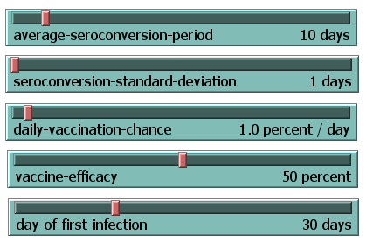
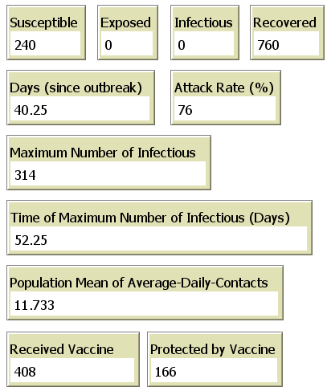
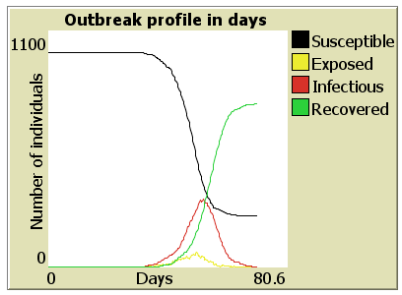
Example output - Vaccination

Slide 51
Discussion
What is the average seroconversion time for the influenza vaccine?
What was the effectiveness of last year’s vaccine?
What percentage of the population gets vaccinated?
Was Jessie right, if more people received the vaccine prior to the outbreak, would it have affected the course of the outbreak? What percentage would have to be vaccinated to stop the outbreak?

Slide 52
Isolation
The CDC recommends that individuals with flu-like symptoms should stay home and remain home until at least 24 hours after the fever is gone, without the use of a fever-reducing medicine.
How would this type of isolation during an outbreak affect the model?
Contact with Infectious Individual
Time Length
Time Length
Susceptible
Exposed
Infectious
Recovered
Chance of Transmission

Slide 53
Isolation Model – How it works
sets the probability than an infectious individual will enter isolation per day.
indicates an individual in isolation
When the model starts the individuals in the infected class are able to expose those in the susceptible class.
Infectious individuals have a chance, determined on a daily basis, of entering isolation.
Each infected individual has a chance every encounter (tick) to move from the infected class to the recovered class.
Once the entire population is a member of the recovered or susceptible class, the model stops.

Slide 54
Test the effectiveness of isolation on the influenza outbreak. Setting the DAILY-ISOLATION-CHANCE to 0 percent per day results in a model identical to the Base Model for seasonal influenza with a high attack rate (usually >90%). Isolation of 15% or greater usually is needed to impact the attack rate. Increasing the DAILY-ISOLATION-CHANCE will increase the chance that the disease will die out quickly before causing an outbreak in the population.
Run the program
SEIR-Model-Isolation.nlogo

Slide 55
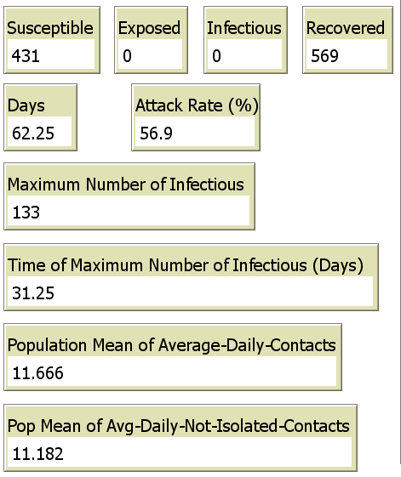
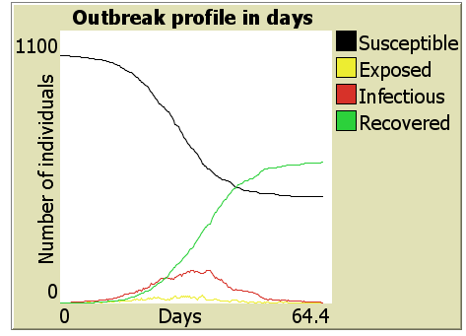
Example output - isolation

Slide 56
Discussion
At what setting will isolation stop the speed of the flu?
Is this a realistic expectation for a behavioral strategy?

Slide 57
Antiviral Medications
View the CDC video “Antiviral Drugs: Seasonal Flu” (1:19 minutes): https://tools.cdc.gov/medialibrary/index.aspx#/media/id/121591
Click to view animation on antiviral medications (1:05 minutes, Internet connection required)

Slide 58
CQ#8: Antivirals reduce the flu symptoms, shorten the time of infection, and are effective any time after the onset of the symptoms.
True
False

Slide 59
CQ#9: Antivirals act by inhibiting viral uncoating, blocking nucleic acid biosynthesis, or by preventing the assembly and release of viral particles.
True
False

Slide 60
Antivirals
Antivirals are used for treating the flu. These reduce the symptoms, shorten the time of the illness, and reduce complications.
How would antiviral treatment during an outbreak affect the model?
Contact with Infectious Individual
Time Length
Time Length
Susceptible
Exposed
Infectious
Recovered
Chance of Transmission

Slide 61
Antiviral Model – How it works
determines the probability that an individual in the infectious class will receive treatment.
the length of the infectious period past which antivirals are no longer effective and thus not given.
the benefit of taking antivirals in terms of the reduction in time an infectious individual will be infectious.
treated infectious (red) and recovered (green).
Once each day, an infectious individual, who has not been infectious too long, may be treated with antivirals.

Slide 62
Run the program SEIR-Model-Antivirals.nlogo
Compare the peak of infection when no individuals receive treatment to the peak of infection produced when antivirals are made available to the individuals.
Setting the ANTIVIRAL-TREATMENT-CHANCE or the LATEST-ANTIVIRALS-GIVEN to 0 percent per day or days, respectively, results in a model identical to the Base Model for seasonal influenza.
When increasing the ANTIVIRAL-TREATMENT-CHANCE, the LATEST-ANTIVIRALS-GIVEN, or the AVERAGE-ANTIVIRAL-EFFECT-PERIOD, if an outbreak occurs, the length of the outbreak will increase, the attack rate will decrease, and the maximum number infected at one time will decrease.

Slide 63
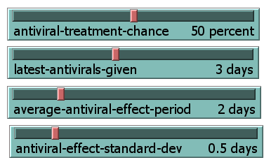
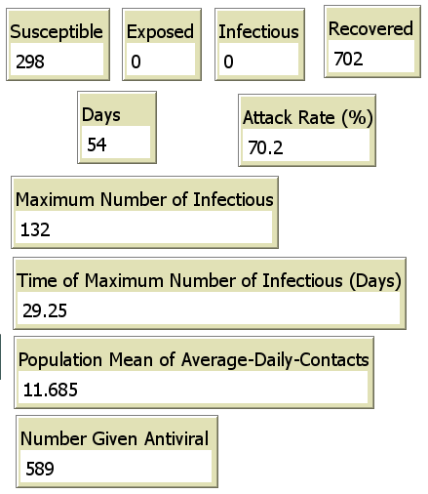
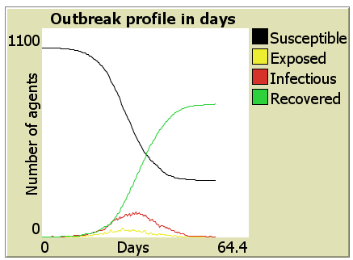
Example output- antivirals

Slide 64
Discussion
Based on the model, what percentage of the infected population needs to be treated in order to reduce the attack rate during an outbreak?
Based on the model, when is the ideal time to administer antivirals? Is this a feasible goal?
What would you advise a student who has been experiencing flu-like symptoms for the past 3 days?

Slide 65
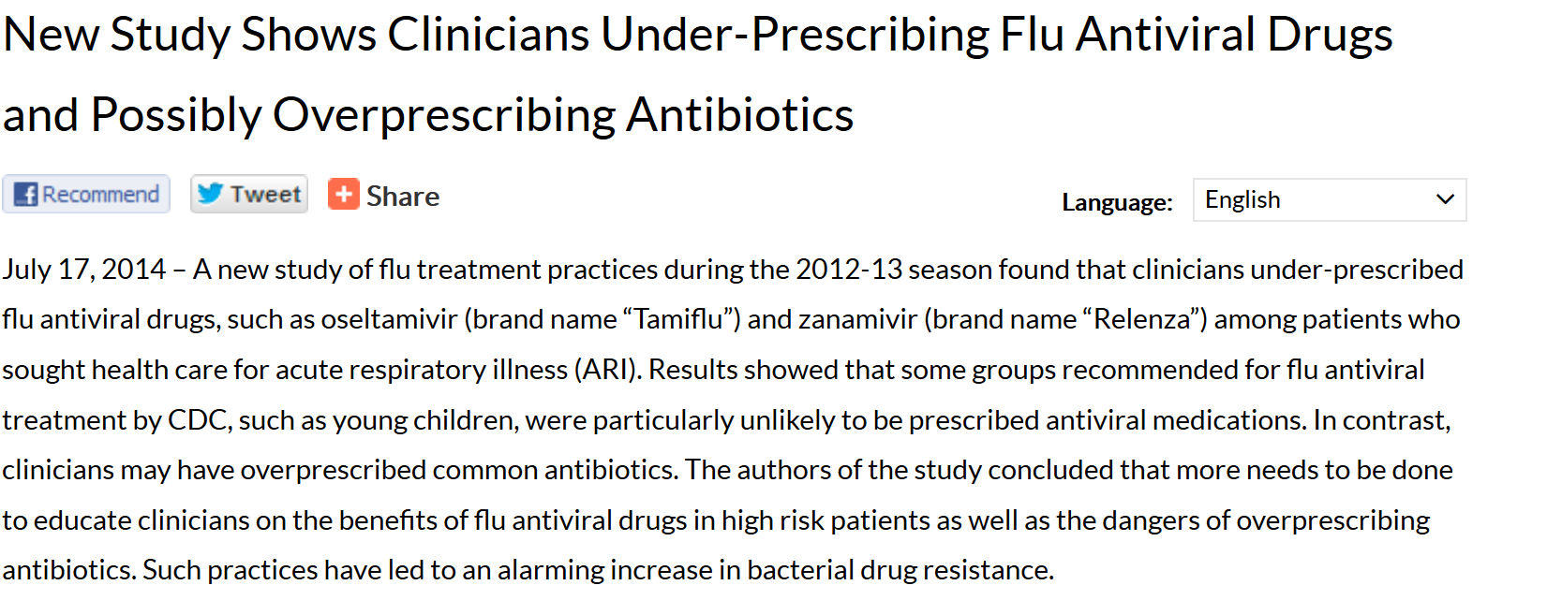
http://www.cdc.gov/flu/news/influenza-prescribing-study.htm

Slide 66
CQ#10: Receiving an antiviral medication after potential exposure to influenza is considered a _________ control strategy.
Biologic
Behavioral
Could be either biologic or behavioral
Neither biologic nor behavioral

Slide 67
CQ#11: A child comes into a clinic with acute respiratory illness. You suspect that it is a case of influenza. What would be the best treatment for the child?
Antibiotics
Antiviral medication
Both antibiotics and antiviral medications
Bed rest and isolation

Slide 68
CQ#12: Isolating yourself after potential exposure to influenza is considered a _________ control strategy.
Biologic
Behavioral
Could be either biologic or behavioral
Neither biologic nor behavioral

Slide 69
Assignment for next class:
Review the conditions and outbreak data for the 2009-2010 influenza pandemic (e.g., http://www.cdc.gov/flu/pastseasons/0910season.htm).
Read the article, “A Perspective on Multiple Waves of Influenza Pandemics” (http://www.plosone.org/article/info%3Adoi%2F10.1371%2Fjournal.pone.0060343).
Keep in mind the following questions for class discussion.
What was unique about the 2009-2010 pandemic compared to a normal flu season?
What factors could have caused the change in the outbreak pattern that caused the pandemic?

Slide 70
Part III: The Beginning of a Pandemic?
Overview:
Robert, Roger and Jessie explore the difference between seasonal and pandemic outbreaks using data from known pandemics and an adaptation of the SEIR Basic Seasonal model in NetLogo.

Slide 71
Narrator:
Robbie, Roger, and Jessie survived their Micro class and had a great winter break with their families, but are excited to start the next semester.
All three of them are enrolled in Emerging Infectious Diseases. They are all shocked when they walk into the lecture and see “Breaking News: Unrelenting Influenza Outbreak Rears Its Ugly Head Yet Again” written on the white board.

Slide 72
Narrator:
In class, Robbie, Roger, and Jessie learn that there was a pandemic in 2009.
The Professor asks the students to compare the spread of the 2009 infection with the pattern they studied using the NetLogo Base Seasonal model.
Roger:
“I remember the 2009 outbreak! There were so many kids sick in my little brother’s school, they cancelled classes for an entire week in October.”

Slide 73
Jessie:
“I wonder if the professor thinks that our campus is experiencing a pandemic?”
Robbie:
“If so, we can count on Google to help us find and explanation for why a large portion of the people on campus have influenza and our old pal NetLogo can help us estimate how influenza might be affecting the campus.”
Jessie:
“What would cause those two peaks?”

Slide 74
CQ#13: What is a pandemic?
An outbreak that is above the epidemic threshold.
An outbreak caused by an old viral strain that continually reappears.
An outbreak caused by a new viral strain.
An especially pathogenic viral strain.
An outbreak that spreads on a global level.

Slide 75
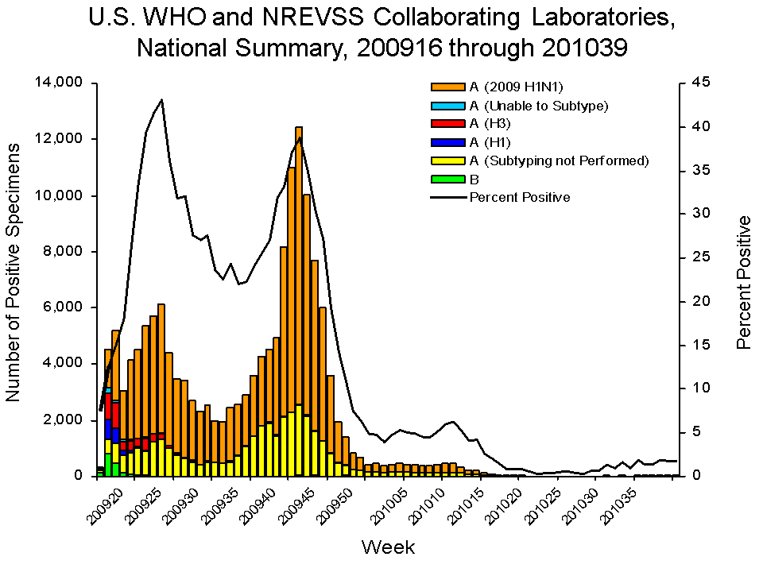
Comparison of the 2009-2010 and 2013-2014 flu seasons
2009-2010
2013-2014
http://www.cdc.gov/flu/weekly/weeklyarchives2013-2014/weekly39.html; http://www.cdc.gov/flu/pastseasons/0910season.htm

Slide 76
In a research study, the following mathematical models reproduced the two waves of acute infections waves of the 2009 H1N1 influenza pandemic, quantitatively. The models include:
a periodic transmission rate to capture the seasonal contact rate;
all sources of variability in contacts and transmissibility using a time-dependent transmission rate;
a heterogeneous population with individuals split into two weakly interacting sub-populations; and
waning immunity where recovered individuals lose immunity to the influenza virus at which point they again become susceptible to infection.
From: A Perspective on Multiple Waves of Influenza Pandemics, Anna Mummert, Howard Weiss, Li-Ping Long, José M. Amigó, Xiu-Feng Wan, http://www.plosone.org/article/info%3Adoi%2F10.1371%2Fjournal.pone.0060343

Slide 77
Periodic transmission model – How it works
sets the minimum value for the periodic transmission chance function.
sets the month where the maximum value for the transmission chance will occur.
Month 1 will have the maximum starting at day 1; month 7 will have the maximum half way through the year; units = month.
Which settings for these parameters or the base model parameters result in a double peak for the periodic transmission model?

Slide 78
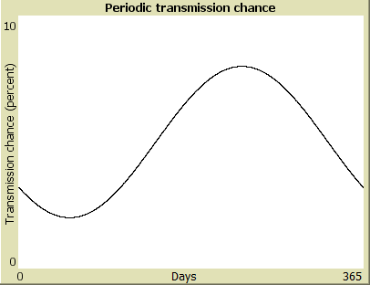
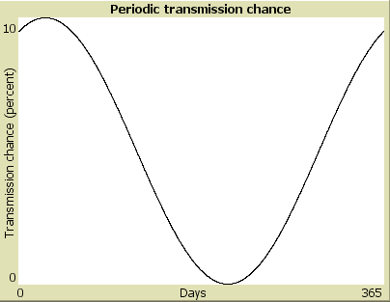
Example periodic transmission functions both with average transmission chance of 5%

Slide 79
Setting the MINIMUM-TRANSMISSION-CHANCE to 0 percent and the MONTH-OF-MAXIMUM-TRANS-CHANCE to 1 will result in an outbreak profile resembling that of the Base Model for seasonal influenza. Run the initial settings, then identify parameters to test. Change the MINIMUM-TRANSMISSION-CHANCE and The MONTH-OF-MAXIMUM-TRANS-CHANCE slide sets independently to see how they affect the base model. When the MONTH-OF-MAXIMUM-TRAN-CHANCE is larger than 6, the transmission chance function will begin moderately high and immediately decrease. In these situations it is possible that the resulting outbreak profile will have two peaks.
Run the program SEIR-Model-Periodic-Transmission.nlogo

Slide 80
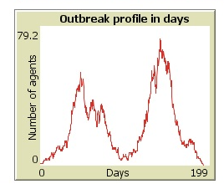
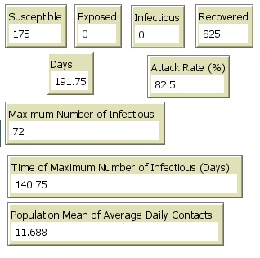
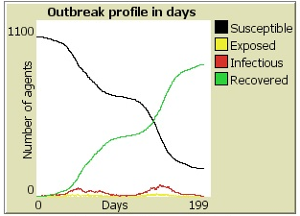
Example output – Periodic Transmission

Slide 81
Discussion
Which settings for these parameters or the base model parameters result in a double peak for the periodic transmission model?
Do you think these realistic parameters?
How might control measures affect the pattern of the outbreak?

Slide 82
Narrator:
Robbie, Roger, and Jessie are enjoying their class in infectious diseases. They are now making summer plans.
Roger:
“Did you see the flyer for the summer undergraduate research projects? My math professor is looking for a team for a mathematical biology project on modeling infectious outbreaks.”
Jessie:
“Great! I plan to apply for graduate work in public health. This sounds like a perfect fit for me.”
Robbie:
“I agree. Let’s all apply!”

