Slide 1
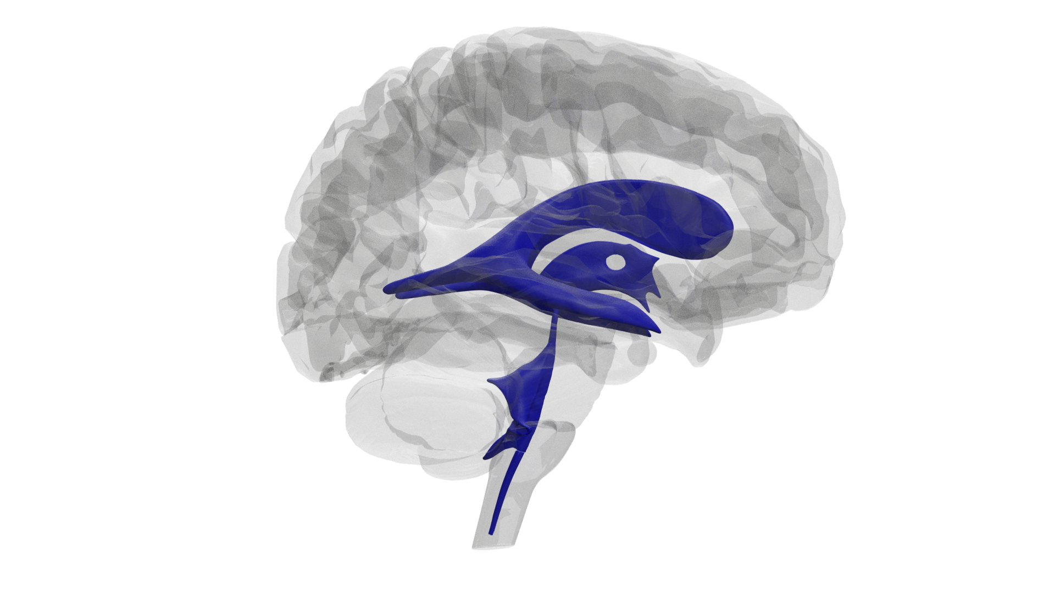
Exploring the Ventricles of the Brain Using a Four-Step Systematic Approach
NATIONAL CENTER FOR CASE STUDY TEACHING IN SCIENCE
by
Natascha Heise*, Katelyn E. Brown†, and Tod R. Clapp†
* Eastern Virginia Medical School, Norfolk, VA
† Department of Biomedical Sciences, Colorado State University, Fort Collins, CO

Slide 2
Four-Step Systematic Approach
Define unfamiliar terms.
Create a timeline associated with the problem.
Describe the (anatomical) systems involved.
Identify any unique features associated with the case.

Slide 3
Background
An 18-month-old child is brought to their pediatrician for a routine check-up. The patient has historically missed important developmental milestones, and the father is now concerned that the child’s head appears to be enlarged, not proportional to their face and body. The father explains that the child has been fussy for several weeks now. In addition, the child appears very lethargic on some days and mentation seems slower than usual.

Slide 4
Physical Examination
Patient is conscious, afebrile, and has an enlarged head. An MRI reveals heavily dilated lateral, third and fourth ventricles, in addition to a swollen subarachnoid space surrounding the brain. Further examination reveals papilledema, indicating elevated intracranial pressure.

Slide 5
Question 1
Describe the ventricular system of the brain, including boundaries and structures that allow for communication. What is the purpose of these spaces?

Slide 6
Question 2
Describe the flow of cerebrospinal fluid (CSF) through the ventricles in terms of overall function, production, and resorption.

Slide 7
Question 3
Based on the symptoms presented, is the patient suffering from communicating or noncommunicating hydrocephalus? How do you know? Include a description of the flow of CSF in your justification.

Slide 8
Question 4
Explain the signs and symptoms observed in the patient.

Slide 9
Question 5
Most hydrocephalus cases are the result of a blockage between ventricles, as opposed to a tumor or blockage within an individual ventricle. How can you explain this?

