Slide 1
Date Night Gone Wrong: An Unusual Case of Alcoholic Fermentation
NATIONAL CENTER FOR CASE STUDY TEACHING IN SCIENCE
by
Cocoa T. Dixon
Department of Life Sciences
Wake Technical Community College, Raleigh, NC
Notes:
Image credit: Licensed, © Oblickstudio | Dreamstime.com, ID 18140651.

Slide 2
Learning Outcomes
By the end of this case study, you should be able to:
Recognize the starting materials and products of alcoholic fermentation.
Explain the alcoholic fermentation process.
List organisms that carry out alcoholic fermentation.
Explain how anaerobic conditions in the human body contribute to health issues when yeast such as Saccharomyces cerevisiae proliferate.
Describe a health issue that results from the overgrowth of yeast in the gut.
Apply theoretical knowledge and critical thinking skills to a real-world healthcare scenario.

Slide 3
Case Scenario
Natasha had taken a late nap. She woke up around 8 p.m. Tuesday evening with a throbbing headache and some nausea. The room and hall seemed to be spinning as she walked from her bedroom to the bathroom. On her way back to bed, she asked her husband, Greg, if he could bring her some water, because her mouth was unusually dry. Greg hurried to grab the water. Natasha drank the water and tried to go back to bed. However, only a few minutes later she found herself vomiting. Unsure of what was going on, Natasha and Greg headed to the emergency room.

Slide 4
At the ER
Once in triage, the triage nurse asked Natasha about her symptoms.
Her symptoms included:
Headache
Dizziness
Nausea and vomiting
Dry mouth

Slide 5
Clicker Question 1
What do you think is wrong with Natasha?
Natasha could have COVID or the flu.
Natasha could have food poisoning.
Natasha could be pregnant.
Not sure yet.

Slide 6
Testing for COVID and Flu
The triage nurse put in an order to have Natasha tested for COVID and the flu. The results came back negative.

Slide 7
New Symptoms
As the night progressed, Natasha’s speech began to slur, and she became visibly disoriented.

Slide 8
More Questions
Due to Natasha’s slurred speech and disorientation, Greg jumped in to answer the nurse’s questions regarding alcohol consumption and pregnancy. Greg told the nurse that Natasha never drinks, and that he is pretty sure she is not pregnant since they have been trying for years with no success.
The nurse asked if Natasha had any allergies. She also asked if she was currently taking any medications and if she had any pre-existing conditions. Greg responded that Natasha has a history of recurrent urinary tract infections and that she is pre-diabetic.

Slide 9
More Questions cont.
The triage nurse proceeded to ask when was the last time Natasha had eaten. Greg stated that she hadn’t eaten much since the other night.
Natasha and Greg had gone to an Italian restaurant the evening before for a date night. Natasha had ordered the never-ending chicken alfredo pasta bowl. She had three refills and had even sampled some of Greg’s shrimp linguine. Natasha typically limited her carbohydrate intake due to her being pre-diabetic, but this date night had been an exception.

Slide 10
Discussion 1: Tests
Based on Natasha’s medical history and symptoms, what tests do you think the ER team should order to determine what is wrong?

Slide 11
More Tests Ordered
The triage nurse completed her assessment, which indicated intoxication, and Natasha was placed in a room to await the ER physician.
While waiting for the ER physician, Natasha was asked for a urine sample to rule out a pregnancy and infection.
The pregnancy test results came back negative and there were no signs of infection.
The physician later ordered a series of additional blood tests, including a test to check Natasha’s blood alcohol level.

Slide 12
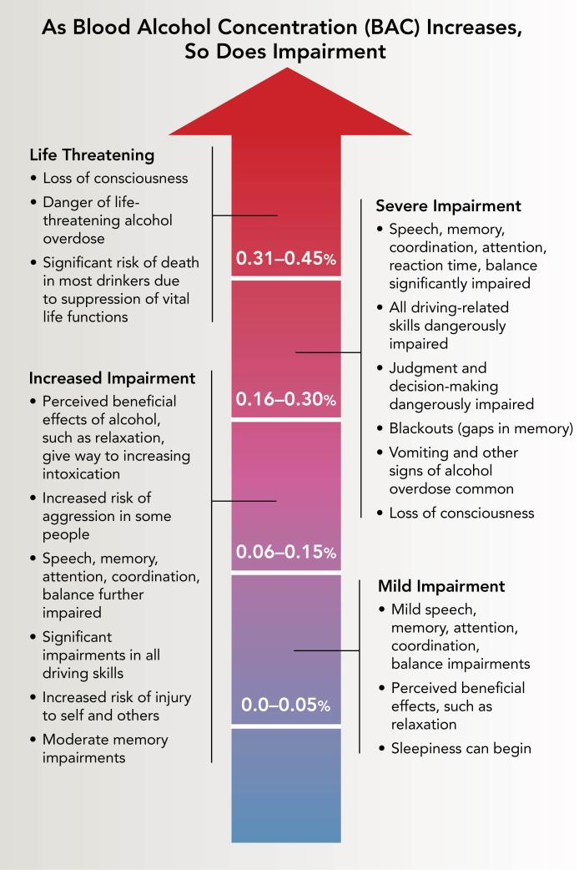
Blood Alcohol Concentration
Blood alcohol concentration (BAC) is the amount of alcohol in the blood due to the consumption of products like beer and wine that contain alcohol.
BAC levels can range from 0% to over 0.40%. A BAC over 0.40% is potentially fatal.
If a person drinks alcohol faster than their liver can break it down, they become intoxicated.
Notes:
Image credit: National Institute on Alcohol Abuse and Alcoholism. (2023). Understanding the dangers of alcohol overdose. U.S. Department of Health and Human Services. https://www.niaaa.nih.gov/publications/brochures-and-fact-sheets/understanding-dangers-of-alcohol-overdose

Slide 13
Clicker Question 2
Natasha’s husband claims she has not been drinking; however, her symptoms indicate intoxication. Given Natasha’s symptoms, what BAC should the doctor expect?
BAC between 0 – 0.05%
BAC between 0.06% - 0.15%
BAC between 0.16 – 0.30%
BAC between 0.31 – 0.45%
Notes:
Image credit: National Institute on Alcohol Abuse and Alcoholism. (2023). Understanding the dangers of alcohol overdose. U.S. Department of Health and Human Services. https://www.niaaa.nih.gov/publications/brochures-and-fact-sheets/understanding-dangers-of-alcohol-overdose

Slide 14
Blood Test Results
Natasha’s blood test results revealed one major abnormality. Her blood ethanol concentration was unusually high at 0.26%.
This was extremely strange since Greg had confirmed that Natasha never drinks.

Slide 15
Natasha Admitted
Natasha was admitted to the hospital while the medical staff try to determine what was causing her BAC to be so high.
The ER team was having a hard time believing that Natasha had not been drinking, but they gathered to discuss other possibilities that could result in a such an elevated BAC.

Slide 16
Discussion 2: Causes
Given Natasha’s symptoms and test results, what other possibilities do you think could be causing such a high BAC?
Consider the metabolic processes we have been discussing in class. Could any of these processes contribute to Natasha’s unusually high BAC? What additional tests should the doctors order to narrow down the diagnosis?

Slide 17
Yeast Overgrowth
Since Greg mentioned Natasha had eaten an extreme amount of pasta (carbohydrates), the ER Team had an idea of what might be causing Natasha’s high BAC levels.
They tested Natasha’s stool for yeast overgrowth. She was tested for the presence of five common yeast strains:
Candida utilis
Candida krusei
Kluyveromyces lactis
Saccharomyces cerevisiae
Saccharomyces boulardii

Slide 18
Clicker Question 3
Which of the following processes do yeasts undergo that produces alcohol as a byproduct?
Aerobic respiration
Anaerobic respiration
Lactic acid fermentation
Alcoholic fermentation
None of the above

Slide 19
Alcoholic Fermentation
Some yeasts undergo alcoholic fermentation. During this process, glucose is converted into ethanol.

Slide 20
Clicker Question 4
Take some time to research each of the yeast strains identified. Use a chart to guide your research.
Which of the following yeast strains do you think will appear in abundance when the test results come back?
Candida utilis
Candida krusei
Kluyveromyces lactis
Saccharomyces cerevisiae
Saccharomyces boulardii

Slide 21
Test Results
All five yeast strains were found in Natasha’s stool sample. However, Saccharomyces cerevisiae proliferation was the highest.

Slide 22
Clicker Question 5
Which of the following health conditions is a consequence of high alcohol production in the human body?
Cystic fibrosis
Pompe disease
Pyruvate dehydrogenase complex disease
Phenylketonuria
Auto-brewery syndrome

Slide 23
What’s Wrong with Natasha?
The medical staff suspected that Natasha had auto-brewery syndrome, also known as gut fermentation syndrome.
Auto-brewery syndrome (ABS) is a condition in which ethanol is produced in the gut by over-active yeasts through fermentation.
Natasha’s high carbohydrate meal mixed with her overgrowth of yeast resulted in the production of ethanol that caused her elevated BAC.

Slide 24
This Has Happened Before
The ER physician remembered a similar case from a few years back. A women facing a DUI charge claimed that she had not been drinking. However, her breathalyzer results demonstrated a high blood alcohol content.
A breathalyzer is a handheld device commonly used by law enforcement to measure a person’s BAC. On average, in the United States, a driver must not exceed a BAC of 0.08% while driving.
Let’s take a look at the following video:
https://youtu.be/EYpOrB1FsgM

Slide 25
Clicker Question 6
Why might breathalyzer tests be problematic for people with auto-brewery syndrome?
Breathalyzers cannot detect blood alcohol concentration.
Breathalyzers are unable to differentiate between alcohol consumption and internal alcoholic fermentation.
Breathalyzers can only measure a blood alcohol concentration of 0.01% or less.
Breathalyzers are large devices that can only be used in emergency situations.

Slide 26
Confirming the Diagnosis
By this time, Natasha had been in the hospital for a few days. Her symptoms had improved. To confirm their diagnosis, the medical staff waited until Natasha’s BAC returned to normal levels. Then she was administered a 200 g oral glucose solution that should elevate her blood alcohol levels just enough to confirm the diagnosis, but not enough to produce the symptoms she had experienced beforehand.
The doctors monitored her BAC for the next 48 hours.

Slide 27
Glucose Test Results
Table 1: Blood alcohol concentrations were measured using a validated headspace gas chromatograph-mass spectrometry (HS-GC-MS) method.
Time (hour) | Ethanol (mg/dL)
0 | 0.00
0.5 | 0.02
1 | 0.02
4 | 0.03
8 | 0.05
24 | 6.98
36 | 15.13
48 | 0.2

Slide 28
Clicker Question 7
Analyze the results of Natasha’s glucose test. Did Natasha’s BAC increase at any point?
Yes
No

Slide 29
Glucose Test Conclusion
Sure enough, Natasha’s BAC increased over time.
The medical team members concluded that Natasha was suffering from auto-brewery syndrome.
They next needed to determine the best treatment plan for her.

Slide 30
Discussion 3: Treatment
Now that we know the Natasha is suffering from auto-brewery syndrome, what are the most appropriate treatment options for Natasha?

Slide 31
Prognosis
It is recommended that Natasha modify her diet. She should adopt a high-protein diet and avoid sugary foods and alcohol. She will also need to take an antifungal to regulate the growth of yeast in her gut.
If she sticks to this treatment plan, her symptoms should subside.

Slide 32
Discussion 4: Implications
Auto-brewery syndrome (ABS) can have serious social, legal, and medical consequences, often causing patients and their families significant distress. Due to its rarity and the challenges of diagnosing it, many individuals with ABS may be mistakenly thought to be secretly consuming alcohol, leading to multiple trips to the hospital or doctor before the correct diagnosis is made. Given these challenges,
How might ABS impact a patient’s social relationships, legal standing (e.g., in cases of DUI or alcohol-related offenses), and overall quality of life?
What are the potential consequences for both patients and healthcare providers when ABS is misdiagnosed?
How can healthcare professionals improve awareness and diagnosis of this condition?

Slide 33
References
Akhavan, B.J., L. Ostrosky-Zeichner, & E.J. Thomas. (2019). Drunk without drinking: a case of auto-brewery syndrome. 6(9), e00208. https://doi.org/10.14309/crj.0000000000000208
Centers for Disease Control and Prevention. (2024, June 25). Symptoms of COVID-19. CDC. https://www.cdc.gov/covid/signs-symptoms/index.html
Centers for Disease Control and Prevention. (2024, August 26). Signs and symptoms of flu. CDC. https://www.cdc.gov/flu/signs-symptoms/index.html
Iftikhar, N. (2018, November 2). Auto-brewery syndrome: can you really make beer in your gut? [Webpage]. Healthline. https://www.healthline.com/health/auto-brewery-syndrome
Painter, K., B.J. Cordell, & K.L. Sticco. (2025). Auto-brewery syndrome. StatPearls [Internet]. Treasure Island (FL): StatPearls Publishing. https://www.ncbi.nlm.nih.gov/books/NBK513346/
Parapouli, M., A. Vasileiadis, A.S. Afendra, & E. Hatziloukas. (2020). and its industrial applications. 6(1): 1–31. https://doi.org/10.3934/microbiol.2020001
Ser, M.H., F.Z. Çalıkuşu, N. Erener, O. Destanoğlu, E. Kıykım, & A. Siva. (2023). Auto brewery syndrome from the perspective of the neurologist. 96, 102514. https://doi.org/10.1016/j.jflm.2023.102514
WKBW TV, Buffalo, NY. (2019, December 10) What is auto brewery syndrome? [Video]. Running time: 2:39 min. YouTube. https://youtu.be/EYpOrB1FsgM

