Slide 1
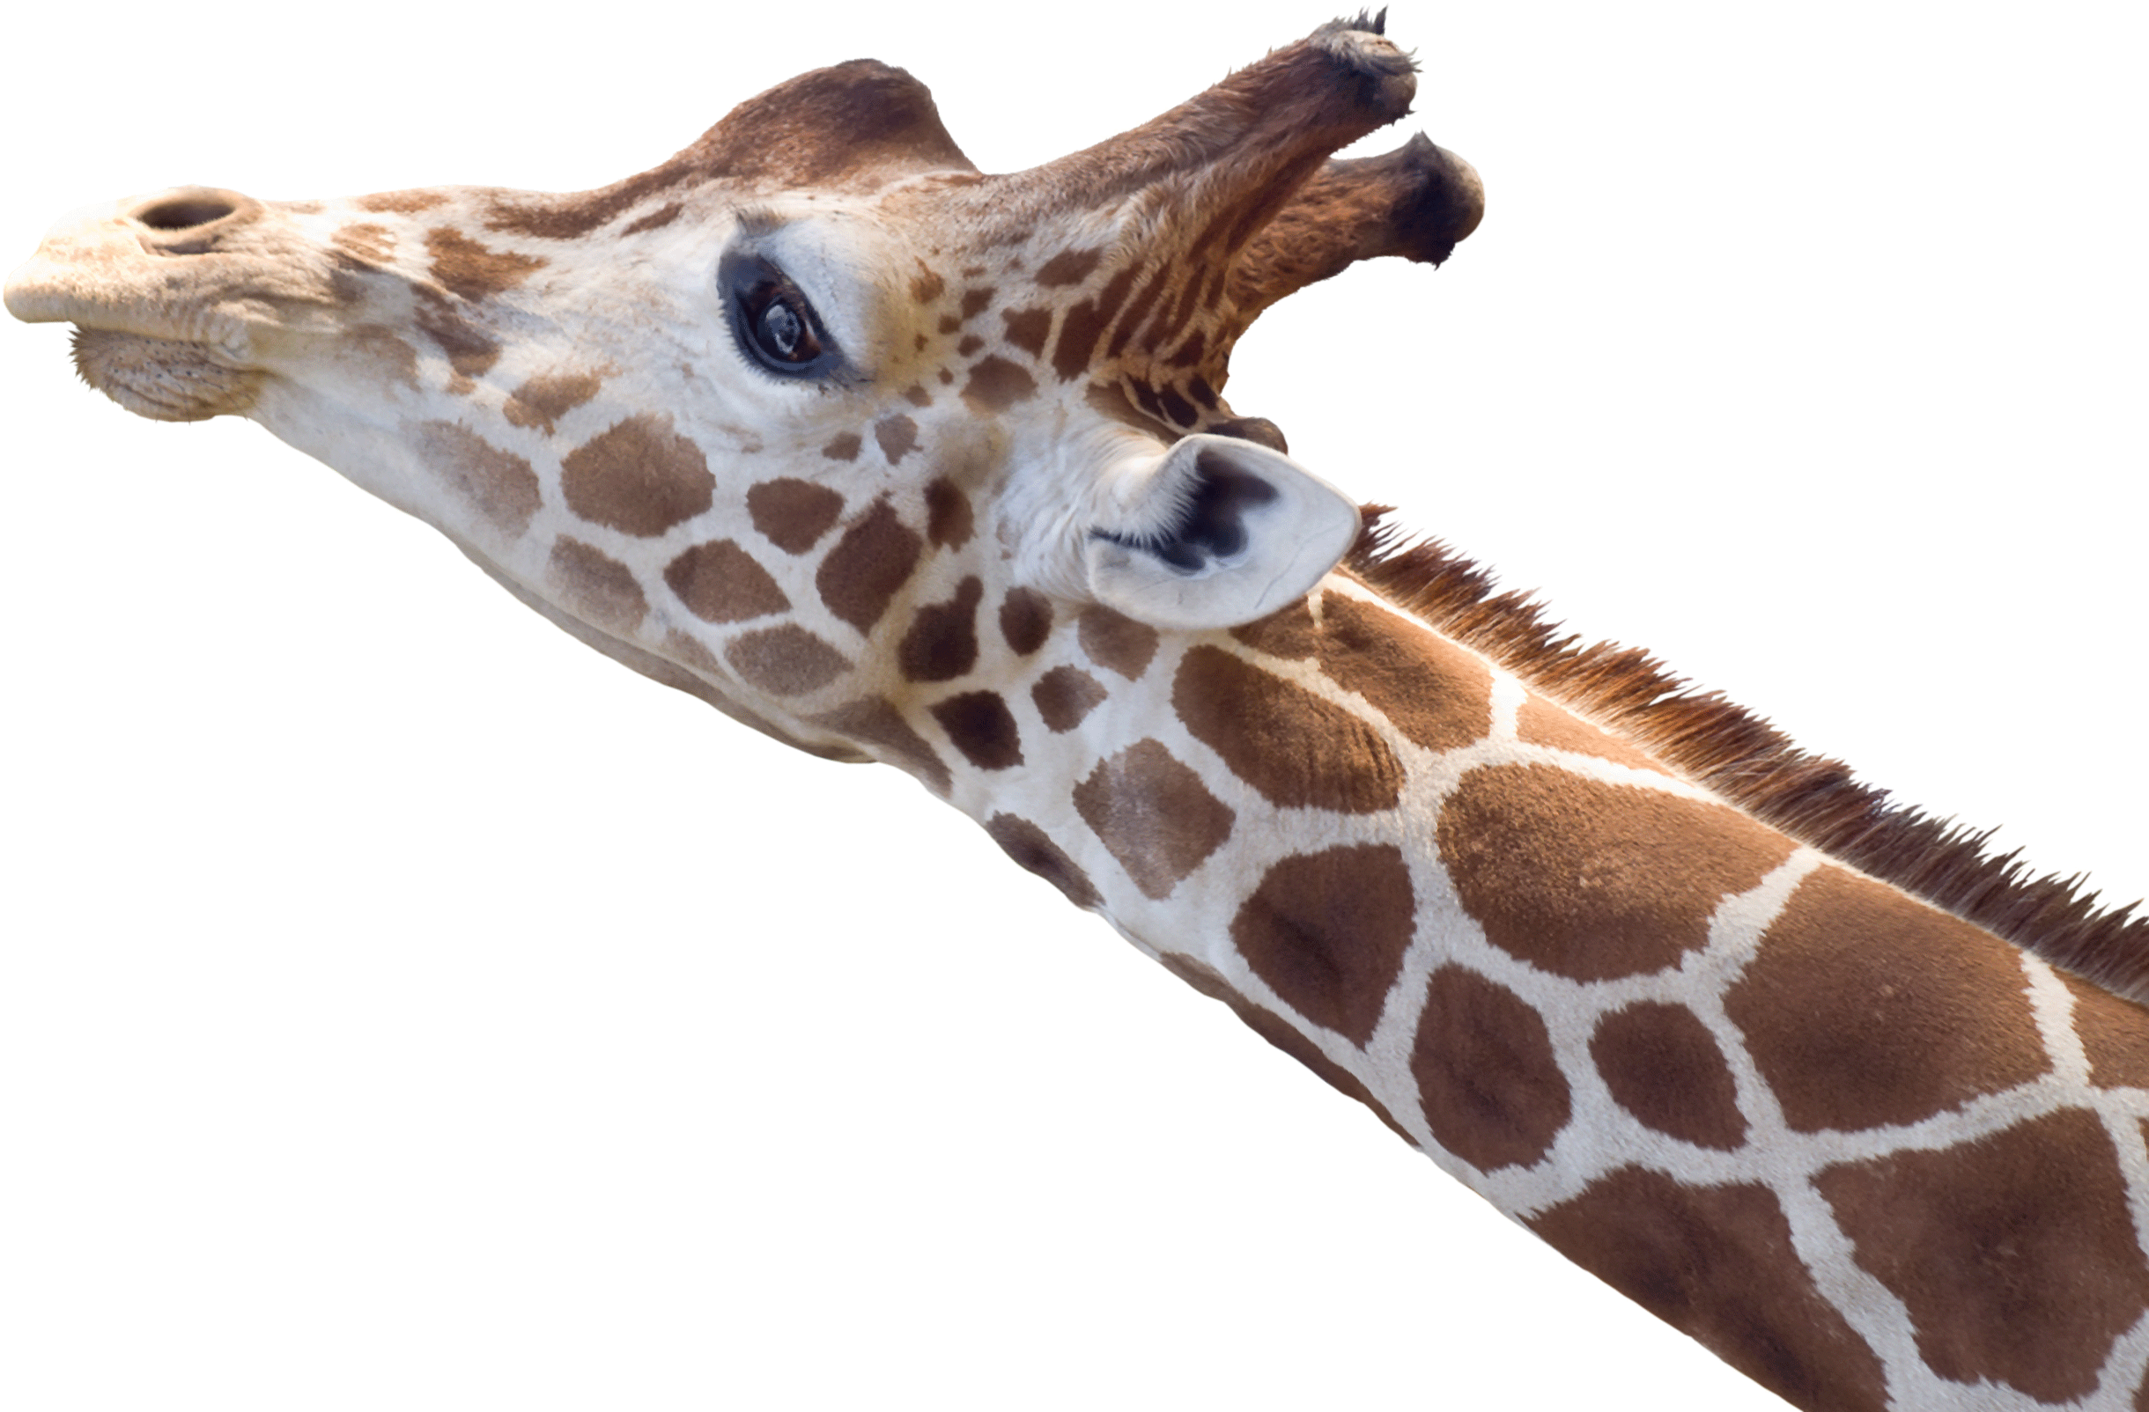
NATIONAL CENTER FOR CASE STUDY TEACHING IN SCIENCE
Winning by a Neck:
A Case Study in the Scientific Process
^{by}
^{Stephanie J. Toering Peters}
^{Department of Biology}
^{Wartburg College, Waverly, IA}
Notes:
This case study is based on the following article:
Simmons, R.E., and L. Scheepers. 1996. Winning by a neck: sexual selection in the evolution of giraffe. The American Naturalist 148(5):771–786.

Slide 2
The Scientific Process
Observation
Hypothesis Development
Design a Scientific Study
Make Predictions
Collect Data and Draw Conclusions

Slide 3
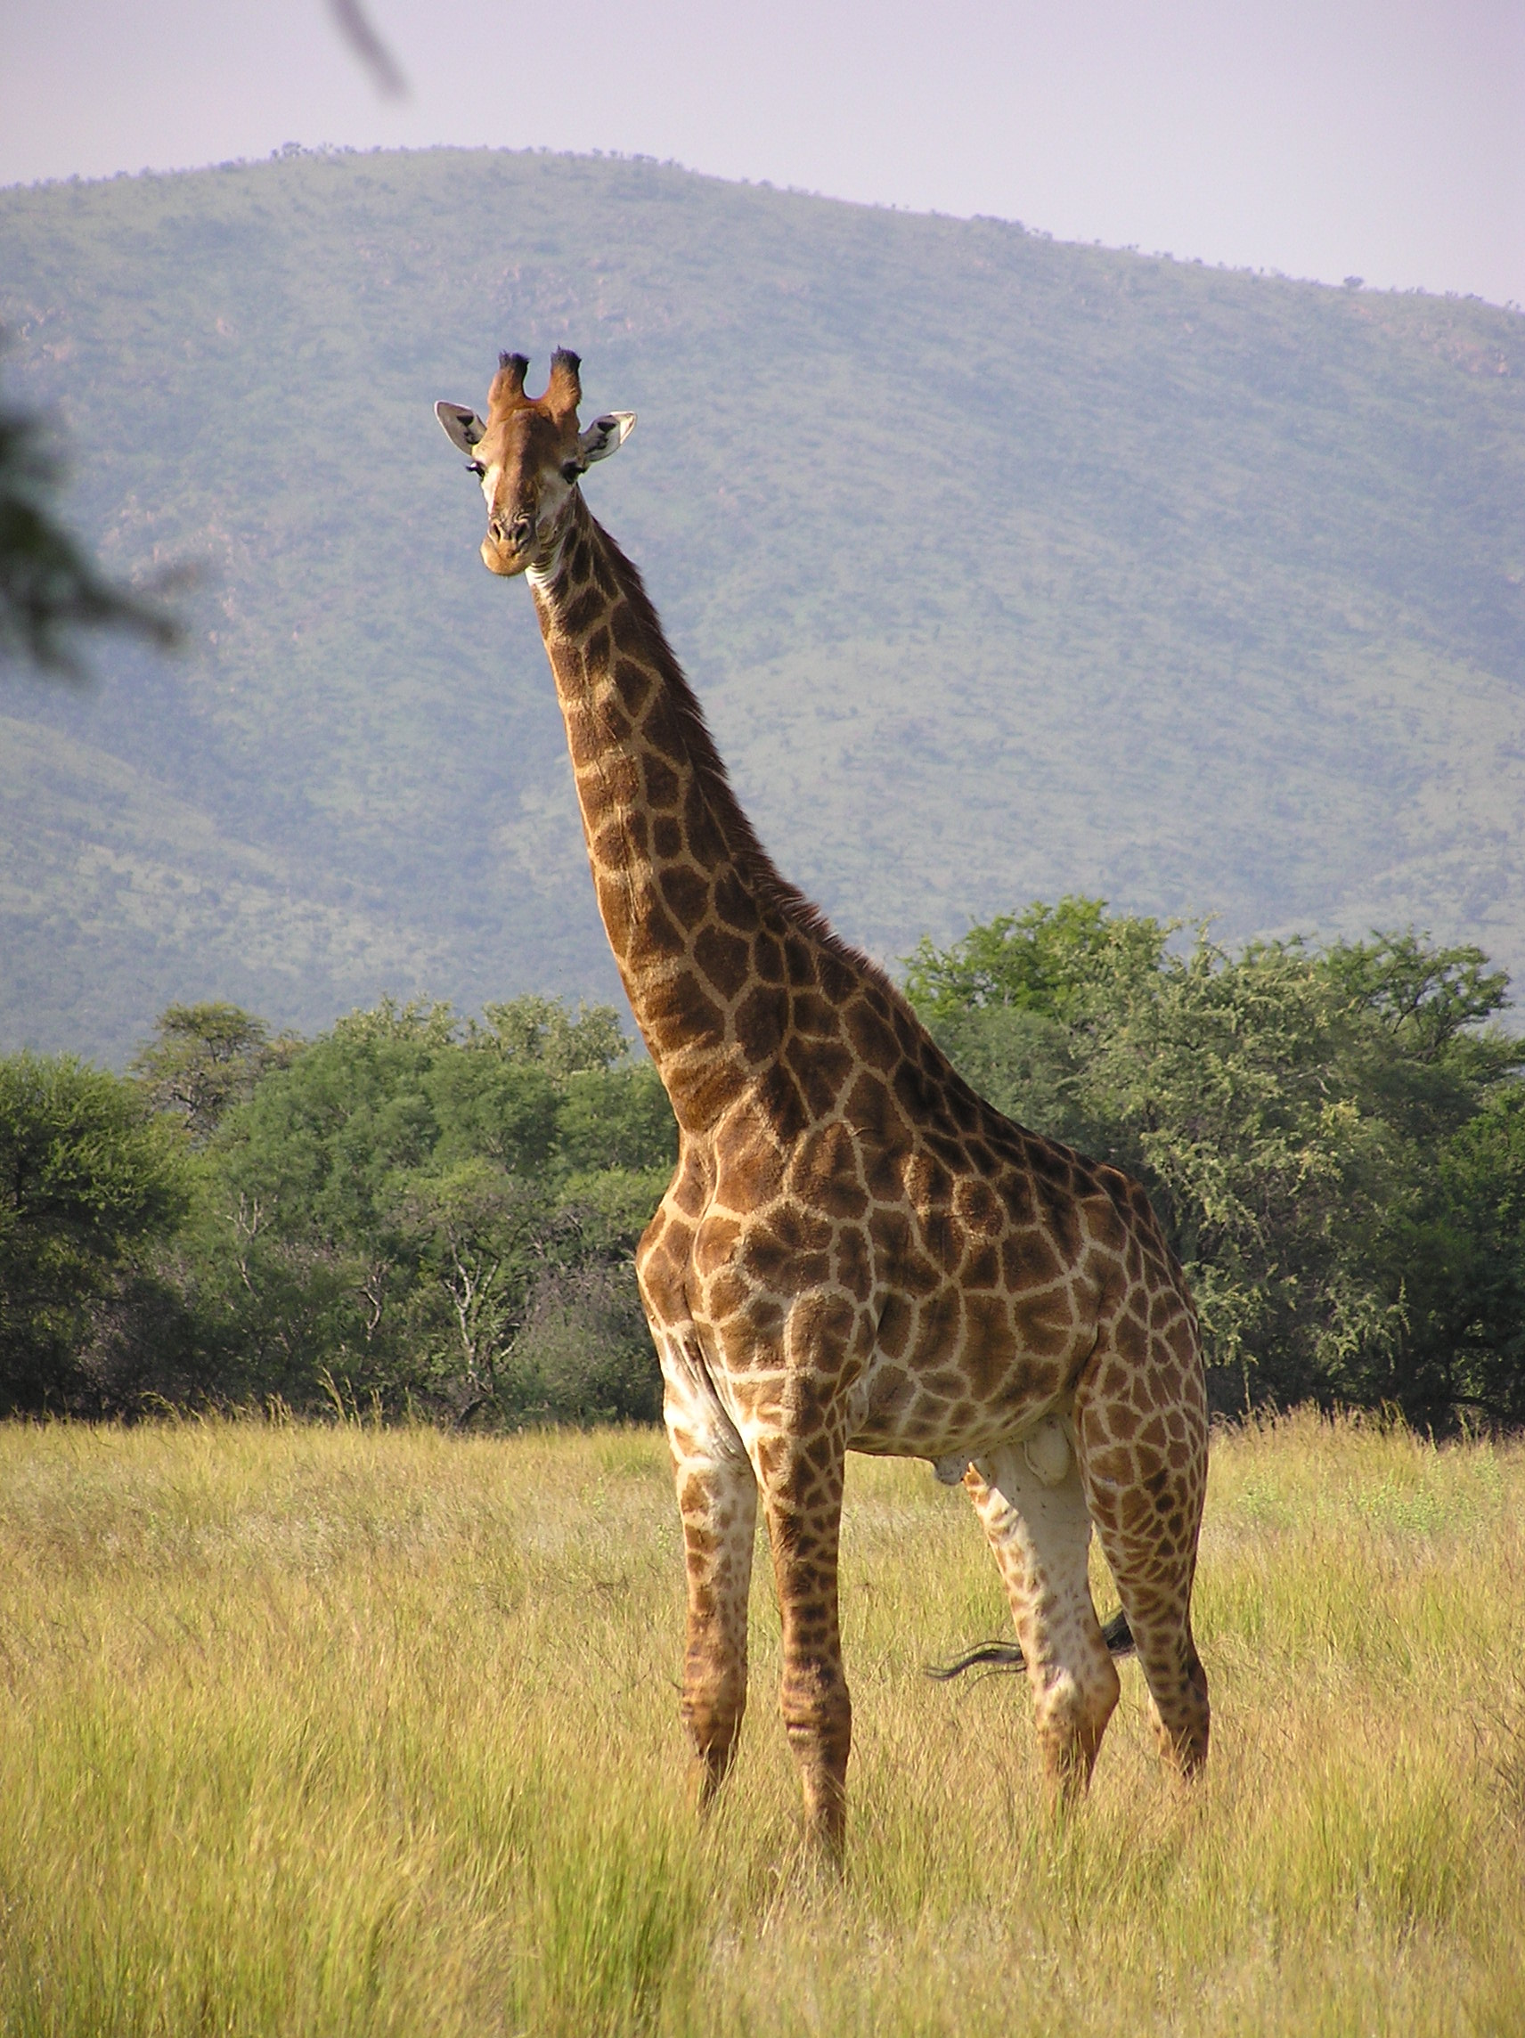
Giraffes have long necks …
Stage 1: Observation
Notes:
Photo credit: Miroslav Duchacek, CC BY-SA 3.0, https://en.wikipedia.org/wiki/File:Giraffe_standing.jpg

Slide 4
Why do giraffes have long necks?
Develop at least two hypotheses that can answer the question above.
Stage 2: Hypothesis Development

Slide 5
Hypothesis 1
Giraffes have long necks in order to take advantage of high food sources.
How can you test this hypothesis?
Stage 3: Design a Scientific Study

Slide 6
Experiment 1: Feeding Habits
Field observations of giraffe feeding (Young and Isbell 1991)
15 minute samples (n=39)
Record
plant species
plant height
# bites per eating bout
time per eating bout
giraffe identity
What do you expect to see based on your hypothesis?
Stage 4: Make Predictions

Slide 7
Experiment 1: Feeding Habits
Percent feeding at different feeding heights for adult male and females giraffes.
Adult giraffes are 4.5-5.5 m tall.
(based on Young and Isbell 1991)
Do these data support your hypothesis?
Stage 5: Collect Data and Draw Conclusions
Notes:
Data condensed from Figures 5 and 6 of Young and Isbell 1991

Slide 8
Experiment 2: Feeding Habits
Field observations of giraffe feeding (Leuthold and Leuthold, 1972)
Performed in both green and dry seasons
For each time a giraffe feeds (n=3124), record
plant species
browsing height: low (<2 m) or high (>2m)
What do you expect to see based on your hypothesis?
Stage 4: Make Predictions

Slide 9
Experiment 2: Feeding Habits
Percent feeding at low heights. Every feeding observations was classified as low (<2m) or high (>2m).
(based on Leuthold and Leuthold 1972)
Do these data support your hypothesis?
Stage 5: Collect Data and Draw Conclusions
Notes:
Data from Table 4 of Leuthold and Leuthold 1972

Slide 10
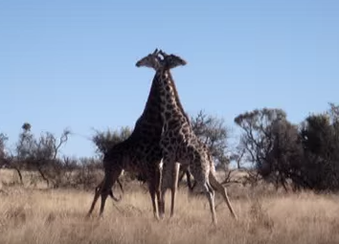
A New Direction …
As you observed giraffe feeding, you also noticed that males would frequently spar (and sometimes fight) by swinging their heads and necks at each other.
Develop a new hypothesis based on these observations.
Propose an experiment to test your hypothesis.
Stage 2: Hypothesis Development
Stage 3: Design a Scientific Study
Notes:
Image is from the YouTube video. Click on the image in Slide Show mode to go to the video on You Tube. This video has no commentary and just shows giraffes sparring. (Link: https://youtu.be/m9hcvIxASAI)
Two other professionally done videos with commentary are available:
from National Geographic: https://www.youtu.be/JWsPrvQRNqo
from Good Morning America: https://youtu.be/VDhNutbXpFE

Slide 11
Hypothesis 2
Male giraffes have long necks in order to compete for females.
Experiment 3: Field observations of giraffes (Pratt and Anderson, 1985)
Classify all males as
A (large, thick necks, and massive horns)
B (thicker necks and longer horns than C)
C (young, narrow necks, small horns)
Record dominance interactions between males and courting behavior with females.
What do you expect to see based on your hypothesis?
Stage 4: Make Predictions

Slide 12
Experiment 3: Dominance Interactions
Number of bulls displaced by A, B, and C bulls. A bulls are the largest, B bulls are intermediate, and C bulls are the smallest.
The ability of a bull to displace another bull indicates dominance.
(based on Pratt and Anderson 1985)
Do these data support your hypothesis?
Stage 5: Collect Data and Draw Conclusions
Notes:
Data from Table 4 of Pratt and Anderson 1985

Slide 13
Experiment 3: Dominance Interactions
Number of bulls observed courting cows. A bulls are the largest, B bulls are intermediate, and C bulls are the smallest.
(based on Pratt and Anderson, 1985)
Do these data support your hypothesis?
Stage 5: Collect Data and Draw Conclusions
Notes:
Data from Table 8 of Pratt and Anderson 1985

Slide 14
Why do giraffes have long necks?
Hypothesis 1: Giraffes have long necks in order to take advantage of high food sources.
  NOT SUPPORTED
Hypothesis 2: Male giraffes have long necks in order to compete for females
  SUPPORTED
Stage 5: Draw Conclusions

Slide 15
Conclusion
Hypotheses need to be tested to determine whether they should be accepted.
Hypotheses are not always correct, but rejecting a hypothesis allows you to move on to the next hypothesis.
A hypothesis that is tested in many ways and is supported by many experiments is elevated to a theory.

Slide 16
Summary Questions
What have you learned about the scientific process in this exercise?
What is the role of experiments/observations in the process of science?
How does a hypothesis help move science forward, even if it is not supported by the evidence?

