Slide 1
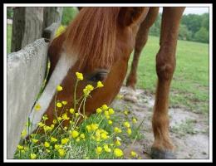
The Thorny Issue of the Yellow Star-Thistle
by Mariëlle H. Hoefnagels
Department of Microbiology and Plant Biology
University of Oklahoma
Notes:
Disclaimer: Please note that this case study is a work of fiction. The persons portrayed in the photos are not the actual characters represented in the story.

Slide 2
How do flowering plants have sex and make babies?
Write your name here.
Write your 1-2 sentence answer here.

Slide 3
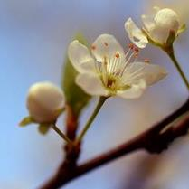
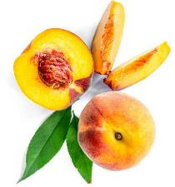
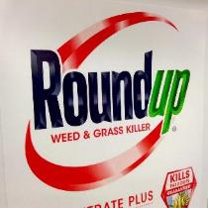
Objectives
Recognize the structures and functions of the parts of a flower.
Trace the events of sexual reproduction in flowering plants.
Propose strategies to prevent sexual reproduction in flowering plants.

Slide 4
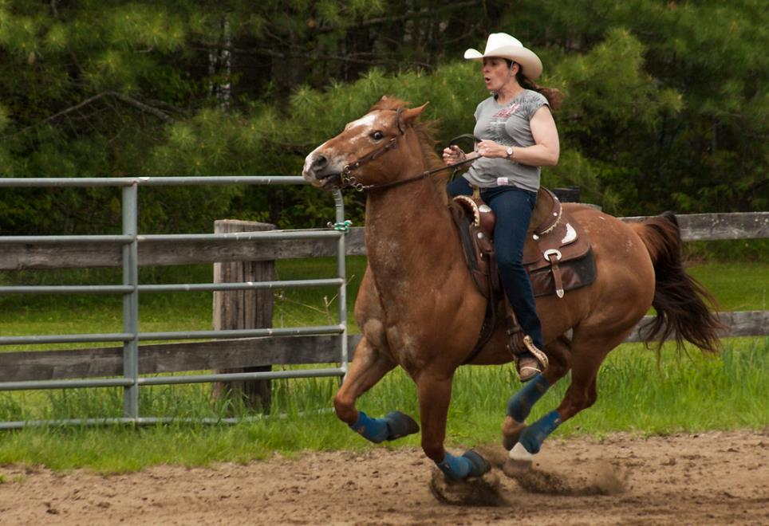
Meet Maria and her horse, Coco.

Slide 5
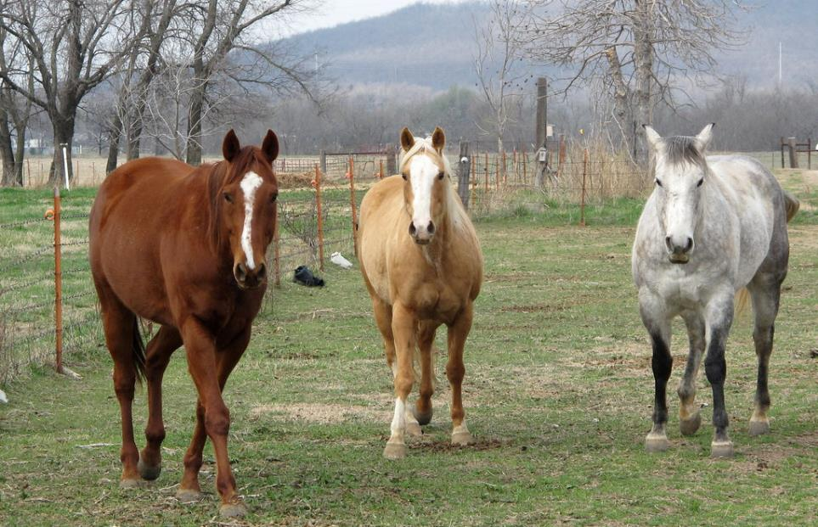
They live on a farm in the countryside. Their land includes pastures where their horses roam, and open fields surround the farm.

Slide 6
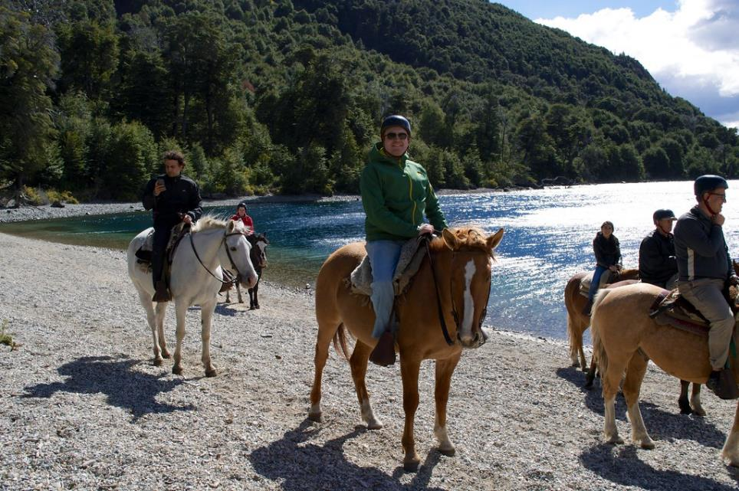
The family owns a small business, giving horseback riding lessons and renting out horses for trail rides.

Slide 7
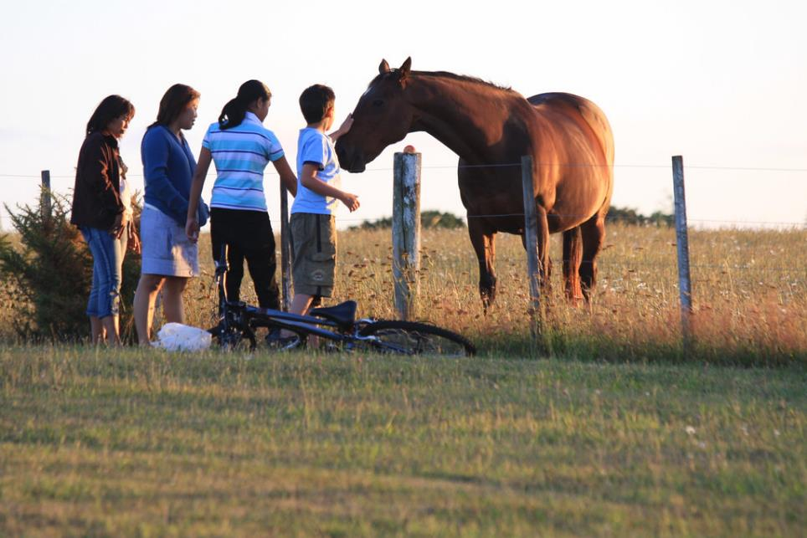
The horses are also popular with kids who live nearby.

Slide 8
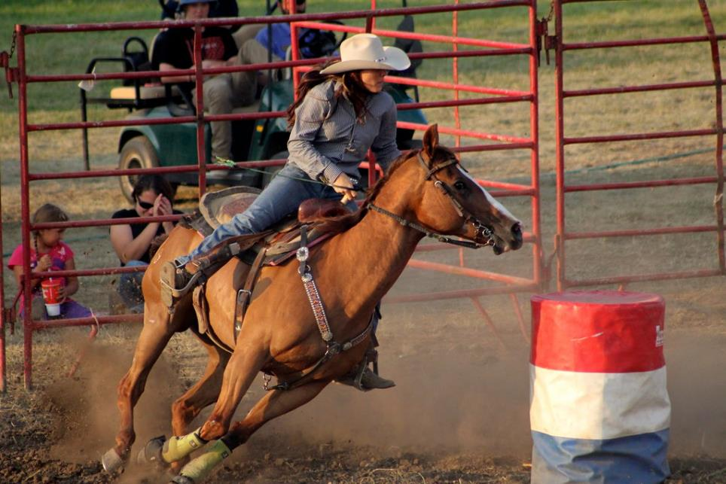
But barrel racing at the rodeo is Maria’s passion, and over the years, she and Coco have built a close, trusting relationship.

Slide 9
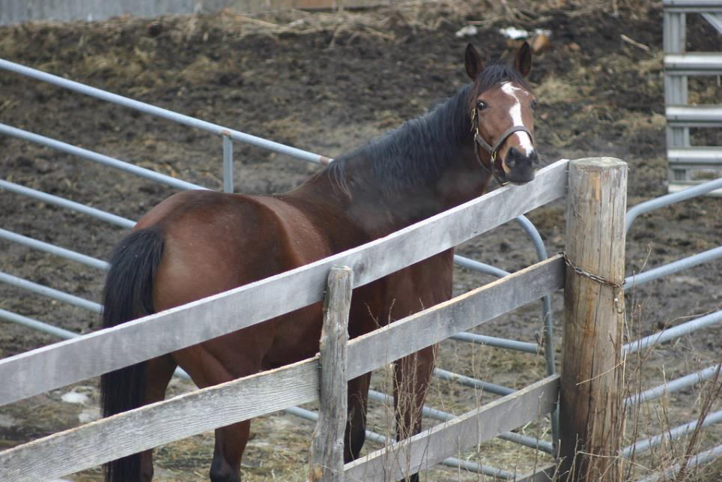
One day, Maria noticed that Coco was acting strangely, so she sent for a veterinarian.

Slide 10
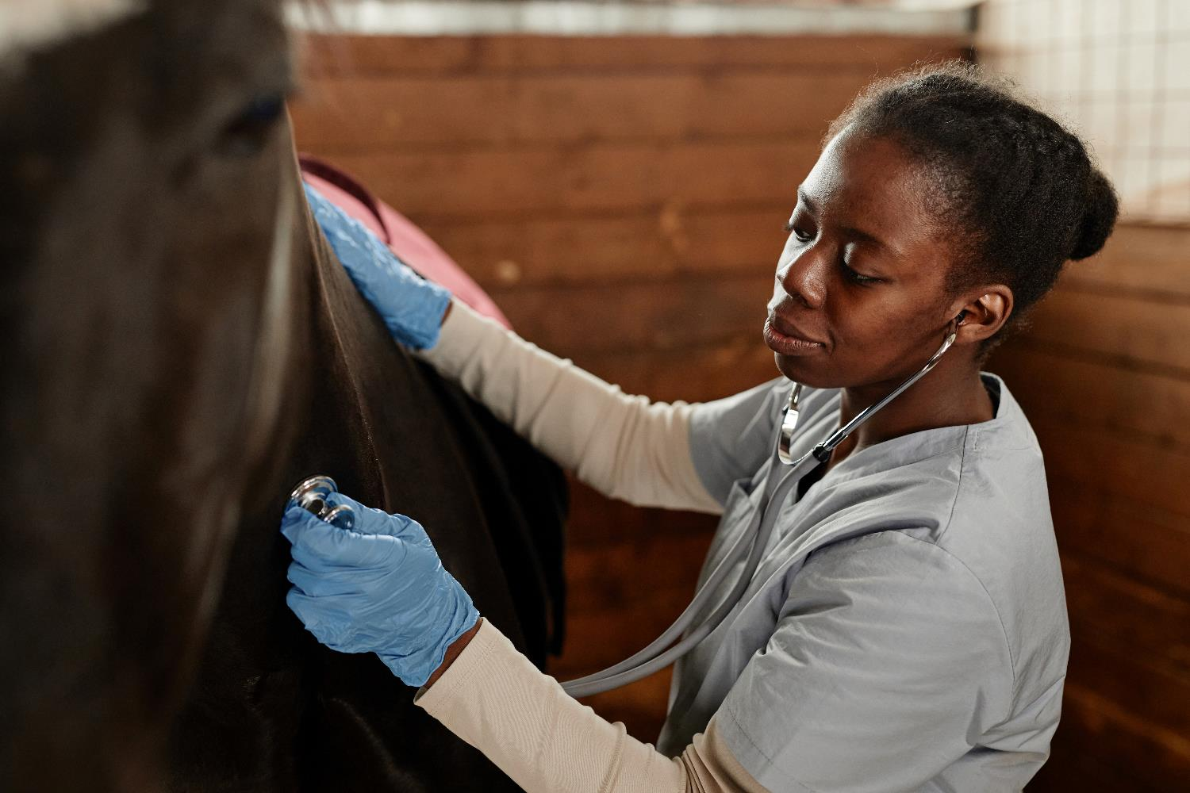
The vet, Dr. Newman, quickly diagnosed Coco’s problem.

Slide 11
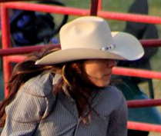
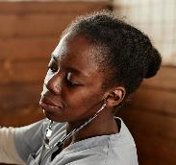
Maria
Dr. Newman, DVM
At the County Equine Clinic …
Give it to me straight, doc. Is Coco going to live?
I’m afraid the outlook is bleak, Maria. Coco has a neurological disorder called horse chewing disease.
That’s kind of a weird name for a disease.

Slide 12
Maria
Dr. Newman, DVM
At the County Equine Clinic …
It’s called that because affected horses make continuous chewing movements.
What’s so bad about that?
Well, it’s just one sign of underlying nerve damage. I’m sad to tell you that the disorder is irreversible. There’s nothing I can do for Coco.
Oh, no! How did this happen?
Coco must have been eating a poisonous plant in your pasture.

Slide 13
Maria
Dr. Newman, DVM
At the County Equine Clinic …
How awful! What plant was it?
It’s an invasive species called the yellow star-thistle. It only affects horses that eat a lot of it. Looks like Coco had a taste for it.
Poor Coco! I have to protect our other horses. How do I get rid of the yellow star-thistles in my pasture?
I don’t know much about that, but I’ll put you in touch with a friend who is an expert on plants.

Slide 14
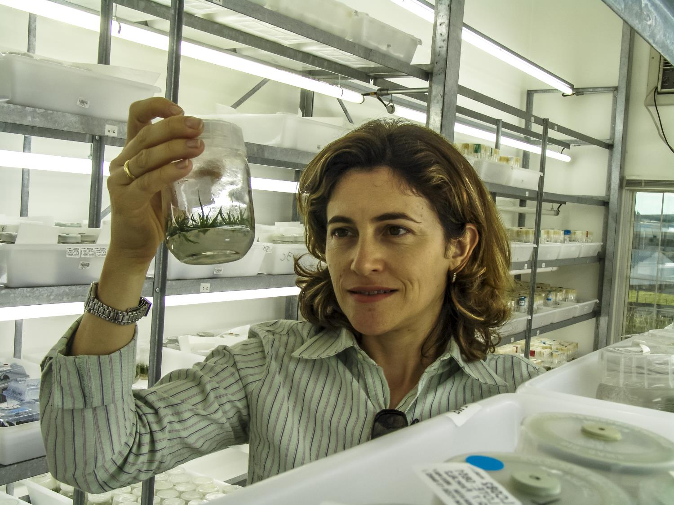
Meet Dr. Ramona Luna. She’s a botanist who studies toxic plants.

Slide 15
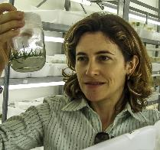
Maria
Dr. Luna
At the University…
Dr. Luna, I have to get rid of the yellow star-thistle in my pasture. My favorite horse is probably going to die, and I have to save the others. How do I kill those plants?
I’m going to walk you through an exercise to help you figure out your best options. Ready?
Sure! Let’s get started.

Slide 16
Discussion Question 1
What are all the ways you can think of to get rid of unwanted plants? Get out a blank sheet of paper. Working in pairs, list as many as you can think of, no matter how outlandish.

Slide 17
Discussion Question 2
The listed strategies fall into four basic categories. Which set of strategies do you think is least likely to hurt other organisms (plants, animals, microbes)?
Mechanical (burn, mow, hoe, chop, cover entire plants)
Chemical (spray plants with herbicides that kill their cells)
Reproductive (mutilate or omit the plant’s flowers)
Ecological (introduce competition, natural enemies, or grazers)

Slide 18
Maria
Dr. Luna
At the University…
Blocking reproduction of yellow star-thistle might be less damaging than killing a bunch of plants and animals. Let’s focus on that, OK?
OK, but I don’t know much about flowering plant reproduction.
Then let me show you how it works with a familiar example: a peach tree.

Slide 19
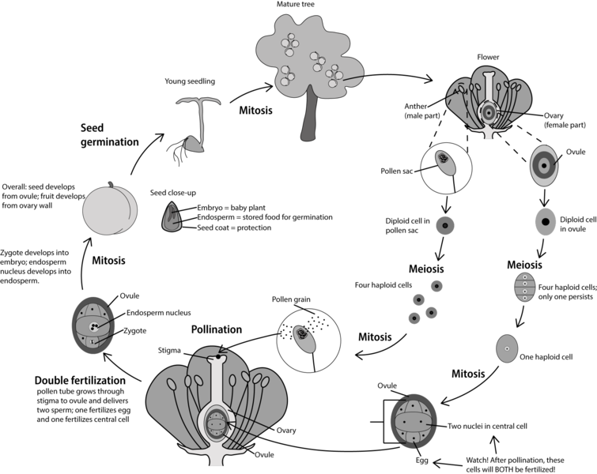
I know it looks complicated, but we’ll work through it step by step.

Slide 20
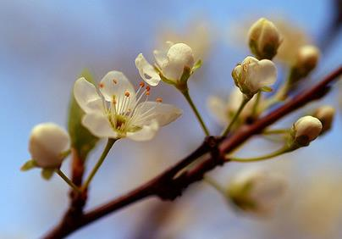
Peach flower
Let’s start with the basic parts of a flower.

Slide 21
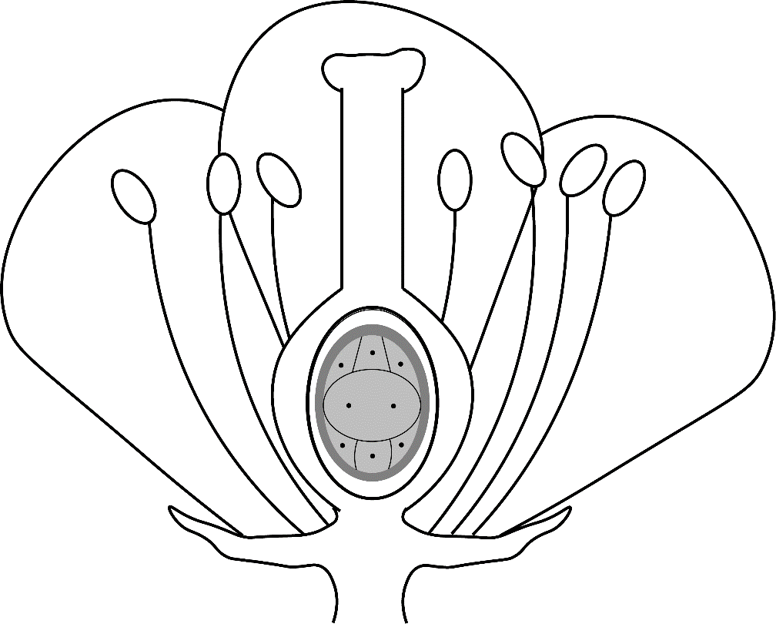
Flower: Sterile parts
As we walk through this figure and the next one, feel free to label up the flower on your handout.
Petals
Sepals

Slide 22
Flower: Male parts
As we walk through this figure and the next one, feel free to label up the flower on your handout.
Anther = part of stamen that makes pollen grains
Pollen grains contain sperm
Stamen = Whole male part

Slide 23
Flower: Female parts
As we walk through this figure and the next one, feel free to label up the flower on your handout.
Stigma
Style
Ovary
Ovule is inside ovary
Egg cell is inside ovule

Slide 24
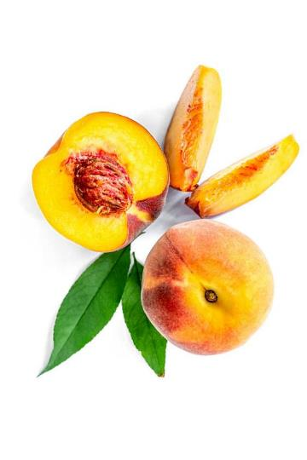
Any questions about flower anatomy?
Next, let’s see how flower parts develop into peach fruits.

Slide 25
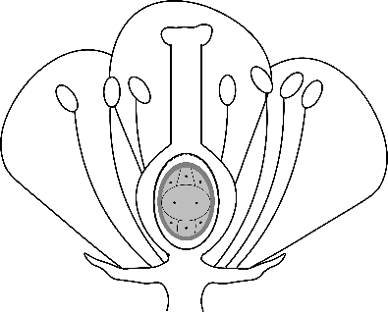
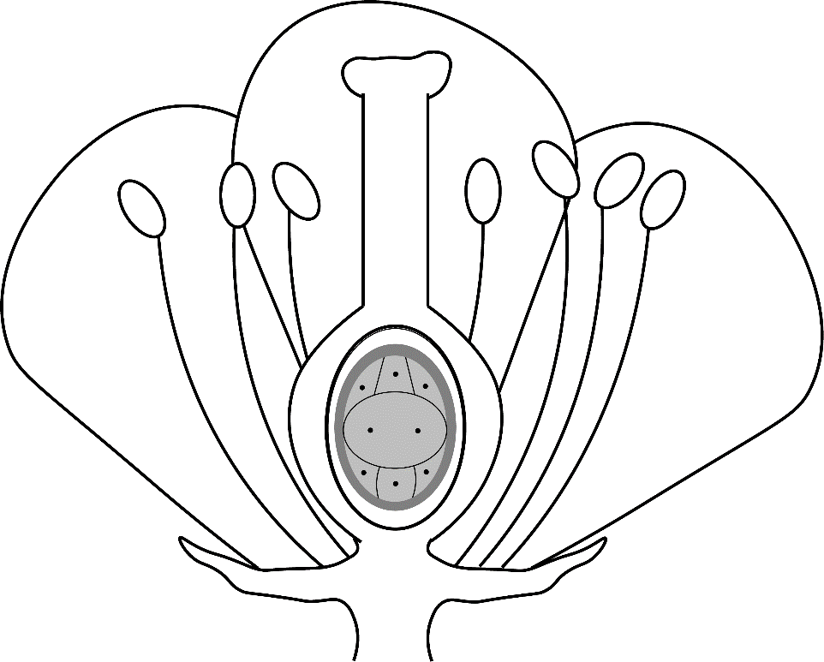
Pollen
Male Female
1. Pollination:
Pollen grain arrives at stigma.
2. Pollen tube grows toward ovary.
Fertilized egg
3. Fertilization: Pollen tube delivers sperm to egg in ovule.

Slide 26
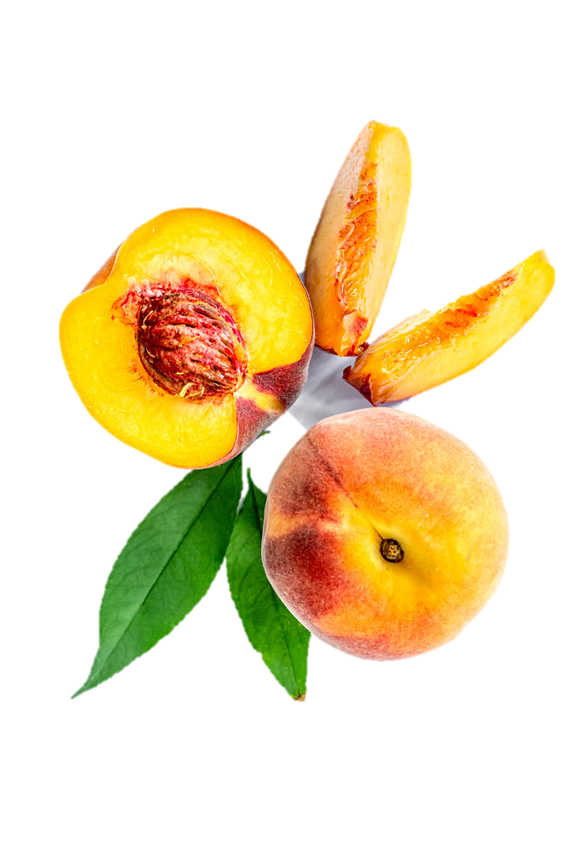
Three things happen after fertilization.
Ovary develops into outside of fruit.
Ovule develops into seed inside the fruit.
Fertilized egg develops into embryo (baby plant!) inside the seed.

Slide 27
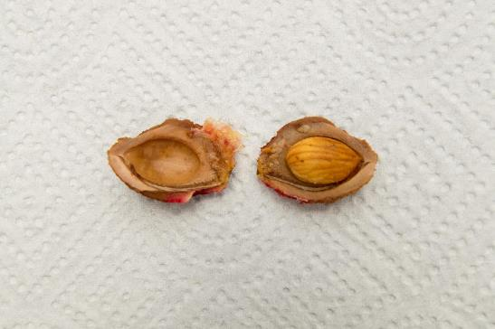
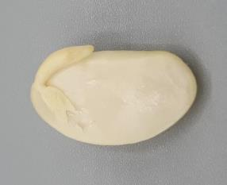
Each seed contains one embryo + its food supply
Plant’s embryo* (developed from fertilized egg)
Food source for embryo’s early growth.
*Image shows a bean seed; peach seed’s embryo is too small to see.

Slide 28
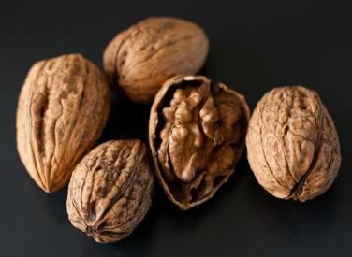
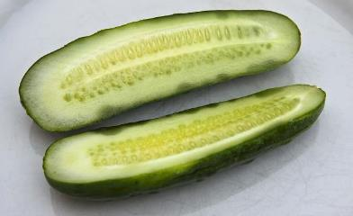
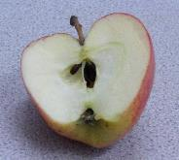
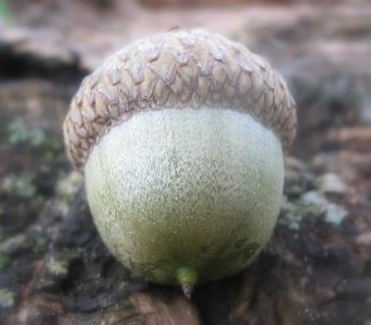
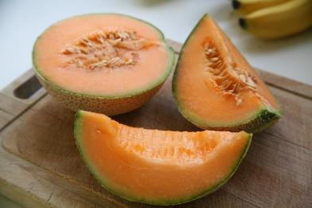
Peaches and many other fruits are fleshy.
Others are dry, like nuts.

Slide 29
Does plant reproduction make sense now?

Slide 30
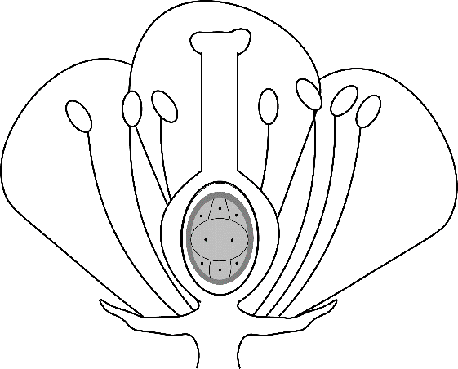
Let’s work through five statements and decide if each is true or false.
One flower function is to make pollen.
True
False

Slide 31
Let’s work through five statements and decide if each is true or false.
One flower function is to make pollen.
True
False

Slide 32
Let’s work through five statements and decide if each is true or false.
One flower function is to make pollen.
Sperm + egg = pollen
True
False

Slide 33
Let’s work through five statements and decide if each is true or false.
One flower function is to make pollen.
Sperm + egg = pollen
True
False

Slide 34
Let’s work through five statements and decide if each is true or false.
One flower function is to make pollen.
Sperm + egg = pollen
A pollen grain’s wall develops into a fruit.
True
False

Slide 35
Let’s work through five statements and decide if each is true or false.
One flower function is to make pollen.
Sperm + egg = pollen
A pollen grain’s wall develops into a fruit.
True
False

Slide 36
Let’s work through five statements and decide if each is true or false.
One flower function is to make pollen.
Sperm + egg = pollen
A pollen grain’s wall develops into a fruit.
A seed turns into a fruit.
True
False

Slide 37
Let’s work through five statements and decide if each is true or false.
One flower function is to make pollen.
Sperm + egg = pollen
A pollen grain’s wall develops into a fruit.
A seed turns into a fruit.
True
False

Slide 38
Let’s work through five statements and decide if each is true or false.
One flower function is to make pollen.
Sperm + egg = pollen
A pollen grain’s wall develops into a fruit.
A seed turns into a fruit.
A seed contains a plant embryo.
True
False

Slide 39
Let’s work through five statements and decide if each is true or false.
One flower function is to make pollen.
Sperm + egg = pollen
A pollen grain’s wall develops into a fruit.
A seed turns into a fruit.
A seed contains a plant embryo.
True
False

Slide 40
Any questions so far?

Slide 41
Maria
Dr. Luna
At the University…
How does this apply to yellow star-thistle?
I’m just getting to that. Let’s look more closely at that species.

Slide 42
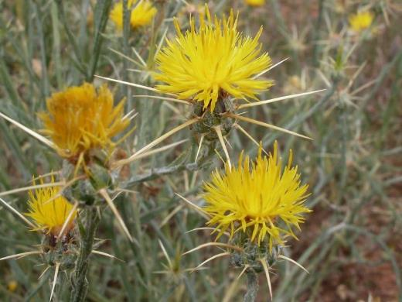
Yellow star-thistle biology
How many flowers do you see in this photo?
None
Seven
A couple dozen
100 or more

Slide 43
Yellow star-thistle biology
How many flowers do you see in this photo?
None
Seven
A couple dozen
100 or more

Slide 44
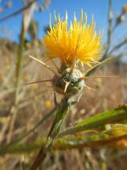
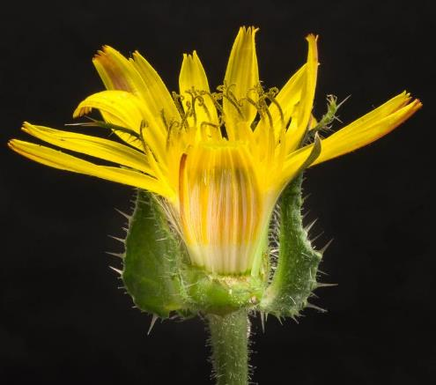
Yellow star-thistle biology
What looks like one big “flower” is really a tightly packed cluster of 10-50 florets (mini-flowers).
One floret
See the florets in this cross-section? (It’s from a close relative of the yellow star-thistle.)

Slide 45
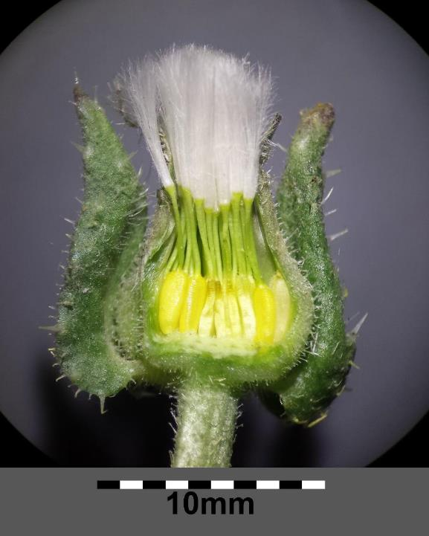
Fruit
After pollination/ fertilization, each floret develops into a separate fruit, each containing one seed.

Slide 46
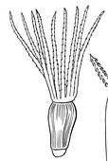
Yellow star-thistle biology
Each “flower” therefore produces
Fruit
10-50 dry fruits, each with a seed inside.
x 10-50

Slide 47
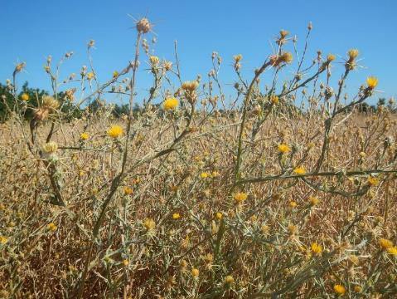
How many seeds are in Maria’s pasture?
Multiply 10-50 seeds per thistle…
… by the number of thistles in the pasture.

Slide 48
Maria
Dr. Luna
At the University…
That’s a lot of seeds!
I know. That’s part of the reason this plant is so invasive.
Do you think there’s a way to stop them from reproducing?
Let’s think about that for a while.

Slide 49
Discussion Question 3
Using what you know so far, what steps in reproduction could you interfere with to prevent yellow star-thistle plants from producing seeds/fruits? List as many as you can think of.
(Hint: Mark your flower structure handout with each of your ideas.)

Slide 50
Maria
Dr. Luna
At the University…
Can we actually interfere with reproduction in such specific ways?
Not yet. But someday, we may be able to use DNA technology to control invasive plants and animals.
How would that work?
It’s complex, but overall the idea is to turn off genes required for reproduction in just the species we’re trying to control.

Slide 51
Discussion Question 4
Suppose that it were possible to turn off any gene(s) in yellow star-thistle in Maria’s pasture. If the goal is to reduce the population of yellow star-thistle in Maria’s pasture, which would be the most effective approach?
Prevent Maria’s plants from making pollen.
Prevent the stigmas of Maria’s plants from receiving pollen.
Both strategies would be equally effective.

Slide 52
Maria
Dr. Luna
At the University…
That’s going to be awesome, but what can I do right now?
Well, there are no perfect solutions. Today’s best options are to mow them down before they flower, dig up the plants by hand, or use herbicides.
Thanks so much, Dr. Luna. I’ll be sad to lose Coco, but at least I know what I have to do to keep my other horses healthy.
You bet. I’m happy to help.

Slide 53
Now that Maria’s all set …
Any last questions?

Slide 54
Let’s review the lesson’s objectives
Recognize the structures and functions of the parts of a flower.
Trace the events of sexual reproduction in flowering plants.
Propose strategies to prevent sexual reproduction in flowering plants.

Slide 55
How do flowering plants have sex and make babies?
Write your name here.
Write your 1-2 sentence answer here.

Slide 56
Image credits
Slide 1 and slide 53: "Horse Chow" by Clearly Ambiguous is licensed under CC BY 2.0
Slide 3 and slide 54:
"Peach flower" by strollers is licensed under CC BY-SA 2.0
"Whole, half and slices of peaches on a white background" by wuestenigel is licensed under CC BY 2.0
"Roundup, Monsanto" by JeepersMedia is licensed under CC BY 2.0
Slide 4: "Crossing The Start Line" by Me in ME is licensed under CC BY 2.0
Slide 5: "Three Horses" by OakleyOriginals is licensed under CC BY 2.0
Slide 6: "Horseback Riding" by Tristan in Ottawa is licensed under CC BY-SA 2.0
Slide 7: "Children and Horse" by russellstreet is licensed under CC BY-SA 2.0
Slides 8, 11-13, 15, 18, 41, 48, 50, and 52: "Barrel Racing at DuPage County Fair" by danxoneil is licensed under CC BY 2.0
Slide 9: "horse behind fence" by grendelkhan is licensed under CC BY-SA 2.0
Slides 10-13: Licensed image of veterinarian examining horse, © Seventyfourimages | Dreamstime.com, ID 251244683.

Slide 57
Image credits
Slides 14-15, 18-19, 29, 41, 48, 50, and 52: Licensed image of researcher in a laboratory, © Alf Ribeiro | Dreamstime.com, ID 146501423.
Slides 19 and 29: "File:Angiosperm LIfe Cycle.png" by Sarah Greenwood is licensed under CC BY-SA 4.0
Slide 20: "Peach flower" by strollers is licensed under CC BY-SA 2.0
Slides 21-23, 25, 30-39: Flower Illustration © Sarah Greenwood used under a CC BY-SA 4.0 license (ovary modified by M. Hoefnagels) https://commons.wikimedia.org/wiki/File:Flower_Illustration.png
Slides 24 and 40:
"Peach flower" by strollers is licensed under CC BY-SA 2.0
"Whole, half and slices of peaches on a white background" by wuestenigel is licensed under CC BY 2.0

Slide 58
Image credits
Slide 26:
Flower Illustration © Sarah Greenwood used under a CC BY-SA 4.0 license (ovary modified by M. Hoefnagels) https://commons.wikimedia.org/wiki/File:Flower_Illustration.png
"Whole, half and slices of peaches on a white background" by wuestenigel is licensed under CC BY 2.0
Slide 27:
"File:Prunus persica pit.jpg" by An.ha is licensed under CC BY-SA 3.0
Seed embryo photographed by M. Hoefnagels
Slide 28:
"half-sour pickles" by Muffet is licensed under CC BY 2.0
"Half apple" by richard_north is licensed under CC BY 2.0
"Sliced Open" (cantaloupe) by Bruno Girin is licensed under CC BY-SA 2.0
"Walnuts" by Pauline Mak is licensed under CC BY 2.0
"Acorn" by joshme17 is licensed under CC BY 2.0
Slides 42-43: "St Barnabys Thistle" by John Tann is licensed under CC BY 2.0

Slide 59
Image credits
Slide 44:
(whole thistle, upper left): "Centaurea solstitialis" by Matt Lavin is licensed under CC BY-SA 2.0
(cutaway flower): "Helminthotheca echioides" by Elaine with Grey Cats is licensed under CC BY-SA 2.0
Slide 45:
(cutaway flower, upper left): "Helminthotheca echioides" by Elaine with Grey Cats is licensed under CC BY-SA 2.0
(cutaway showing fruits/seeds): "File:Helminthotheca echioides sl14.jpg" by Stefan.lefnaer is licensed under CC BY-SA 4.0
Slide 46:
(flower): "Centaurea solstitialis" by Matt Lavin is licensed under CC BY-SA 2.0
(individual fruit): "Indet. sp." is marked with CC0 1.0
Slide 47:
(individual flower): "Centaurea solstitialis" by Matt Lavin is licensed under CC BY-SA 2.0
(field): "Centaurea solstitialis" by Matt Lavin is licensed under CC BY-SA 2.0

Slide 60
Image credits
Slide 44:
(whole thistle, upper left): "Centaurea solstitialis" by Matt Lavin is licensed under CC BY-SA 2.0
(cutaway flower): "Helminthotheca echioides" by Elaine with Grey Cats is licensed under CC BY-SA 2.0
Slide 45:
(cutaway flower, upper left): "Helminthotheca echioides" by Elaine with Grey Cats is licensed under CC BY-SA 2.0
(cutaway showing fruits/seeds): "File:Helminthotheca echioides sl14.jpg" by Stefan.lefnaer is licensed under CC BY-SA 4.0
Slide 46:
(flower): "Centaurea solstitialis" by Matt Lavin is licensed under CC BY-SA 2.0
(individual fruit): "Indet. sp." is marked with CC0 1.0
Slide 47:
(individual flower): "Centaurea solstitialis" by Matt Lavin is licensed under CC BY-SA 2.0
(field): "Centaurea solstitialis" by Matt Lavin is licensed under CC BY-SA 2.0

