Slide 1
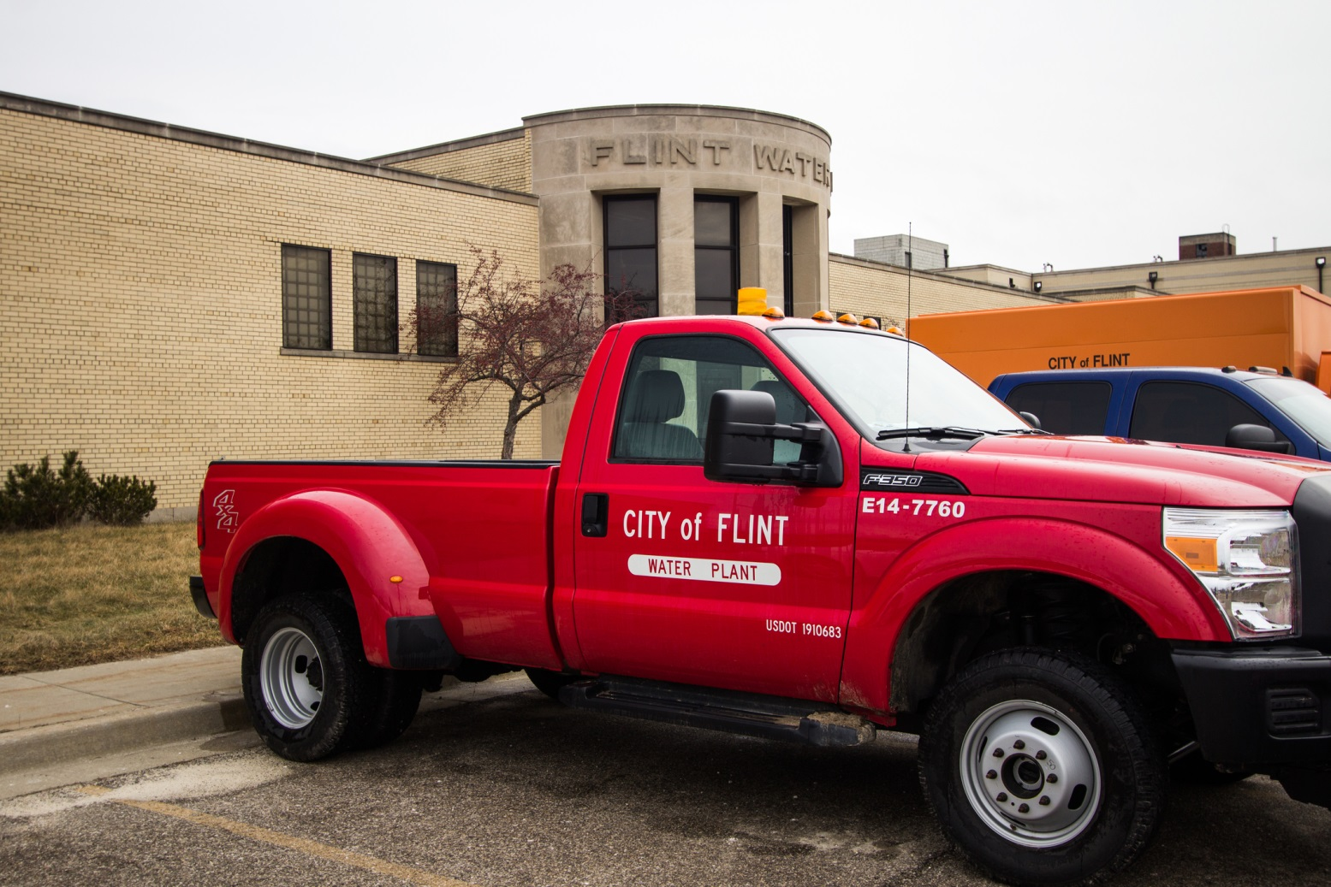
The Flint Water Crisis:
An Introduction to Chemical Reactions
by
Tracy J. Terry The University of New Mexico–Valencia Campus
Notes:
Licensed image © Ehrlif | Dreamstime, ID 66055181.

Slide 2
By the end of this activity, you should be able to…
Identify the chemical reaction as precipitation, acid-base, or oxidation-reduction.
Write balanced chemical equations for each type of chemical reaction.
Use a solubility table to identify the products and spectator ions of precipitation reactions.
Identify the oxidation state of simple species (metals and simple non-metals).
Identify the oxidizing agent and reducing agent of redox reactions.

Slide 3
Pre-class assignment
Read your text about types of chemical reactions.
Read Chemical & Engineering News article from February 2016: http://cen.acs.org/articles/94/i7/Lead-Ended-Flints-Tap-Water.html
Answer the Reading Quiz questions.

Slide 4
Reading Questions
Which type of reaction involves the exchange of electrons between species?
Acid-Base Reactions
Precipitation Reactions
Oxidation-Reduction Reactions
Combustion Reactions

Slide 5
Reading Questions
Which type of reaction involves the exchange of hydrogen cations (H⁺) between species?
Acid-Base Reactions
Precipitation Reactions
Oxidation-Reduction Reactions
Combustion Reactions

Slide 6
Reading Questions
Which type of reaction involves the formation of solid species from a homogeneous aqueous solution?
Acid-Base Reactions
Precipitation Reactions
Oxidation-Reduction Reactions
Combustion Reactions

Slide 7
Reading Questions
Classify the following unbalanced chemical reaction:
Na₃PO₄(aq) + FeCl₂(aq) → Fe₃(PO₄)₂(s) + NaCl(aq)
Acid-Base Reactions
Precipitation Reactions
Oxidation-Reduction Reactions
Combustion Reactions

Slide 8
Reading Questions
Classify the following unbalanced chemical reaction:
Fe(s) + Cl₂(aq) → Fe²⁺(aq) + Cl⁻(aq)
Acid-Base Reactions
Precipitation Reactions
Oxidation-Reduction Reactions
Combustion Reactions

Slide 9
Reading Questions
Classify the following unbalanced chemical reaction:
Fe(OH)₂(s) + HCl(aq) → FeCl₂(aq) + H₂O(l)
Acid-Base Reactions
Precipitation Reactions
Oxidation-Reduction Reactions
Combustion Reactions

Slide 10
Reading Questions
Classify the following unbalanced precipitation reaction:
Fe²⁺ (aq) + OH⁻(aq) → Fe(OH)₂(s)
Complete Ionic Equation
Molecular Equation
Net Ionic Equation
Spectator Ion Equation

Slide 11
Reading Questions
Which of the following was NOT a problem seen in Flint after the water source was changed?
High levels of lead in the water
Water-born bacterial disease outbreaks
High levels of rust (iron) in the water
Drought
High levels of toxic trihalomethanes in the water

Slide 12
Reading Questions
What was the MAIN issue that led to ALL the problems seen in the Flint water supply?
The high lead content in the Flint River
Not controlling for the corrosion ability of Flint River water
Lead containing pipes
Iron containing pipes

Slide 13
Reading Questions
Dissolved oxygen and chlorine molecules act as
Acids
Bases
Reducing agents
Oxidizing agents
Insoluble ions

Slide 14
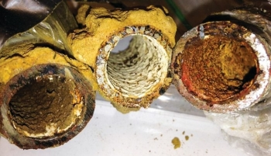
Flint Water Supply: Before 2014
Cl₂
Mineral Passivation Layer
Cl₂
Cl₂
Cl₂
Passivation layer in metal pipes.
PO₄³⁻
Cl⁻
Phosphate Corrosion
Inhibitor
Cl₂
Cl₂
Flint’s water was supplied by Detroit.
Detroit added phosphate (PO₄³⁻) to the water to precipitate all metal cations.
These solids coat the inside of the pipes creating a passivation layer that protects the pipes from corrosion.
No exposed metal in pipes allows chlorine (Cl₂) levels to remain stable.

Slide 15
Solubility Rules for Aqueous Ionic Compounds
Generally Soluble | Exceptions
Li⁺, Na⁺, K⁺, and NH₄⁺ | None
NO₃⁻ and C₂H₃O₂⁻ | None
Cl⁻, Br⁻, and I⁻ | Compounds with Ag⁺, Hg₂²⁺, or Pb²⁺ are insoluble.
SO₄²⁻ | Compounds with Sr²⁺, Ba²⁺, Pb²⁺, Ag⁺, or Ca²⁺ are insoluble.
Generally Insoluble | Exceptions
S²⁻ | Compounds with Li⁺, Na⁺, K⁺, NH₄⁺, Ca²⁺, Sr²⁺, and Ba²⁺ are soluble.
OH⁻ | Compounds with Li⁺, Na⁺, K⁺, and NH₄⁺ are soluble. Compounds with Ca²⁺, Sr²⁺, and Ba²⁺ are slightly soluble.
CO₃²⁻ and PO₄³⁻ | Compounds with Li⁺, Na⁺, K⁺, and NH₄⁺ are soluble.

Slide 16
Flint Water Supply: Before 2014
Predict the precipitation product of the following reaction:
Na₃PO₄(aq) + FeCl₃(aq) →
Fe₃(PO₄)₂ b. FePO₄ c. Fe₂(PO₄)₃
d. NaCl e. PO₄Cl₃

Slide 17
Flint Water Supply: Before 2014
Select the coefficients to balance the following chemical reaction:
Na₃PO₄(aq) + FeCl₂(aq) → Fe₃(PO₄)₂(s) + NaCl(aq)
1, 1, 1, 3
2, 3, 1, 6
2, 3, 1, 3
2, 3, 1, 2

Slide 18
Flint Water Supply: Before 2014
Predict the precipitation product of the following reaction:
Na₃PO₄(aq) + Pb(NO₃)₂(aq) →
Pb₃(PO₄)₂ b. PbPO₄ c. Pb₂(PO₄)₃
d. NaNO₃ e. PO₄NO₃

Slide 19
Flint Water Supply: Before 2014
Na₃PO₄(aq) + Pb(NO₃)₂(aq) →
Identify the spectator ions in the chemical equation above.
a. NaPb b. NaNO₃ c. Na₃(NO₃)₂ d. PbPO₄
Write net ionic equations for the chemical equation above . (Worksheet only)

Slide 20
Flint Water Supply: Before 2014
Mineral Passivation Layer
Cl₂
Cl₂
Metal pipe with passivation layer
Cl₂
Cl₂
PO₄³⁻
Cl⁻
Phosphate Corrosion
Inhibitor
Cl₂
Cl₂
Phosphate in the water also reduced the acidity of the water.
PO₄³⁻(aq) + H₂O(l) → HPO₄²⁻(aq) + OH⁻(aq) creating OH⁻
PO₄³⁻(aq) + H⁺(aq) → HPO₄²⁻(aq) removing H⁺
PO₄³⁻(aq) + H₃O⁺(aq) → HPO₄²⁻(aq) + H₂O(l)

Slide 21
Flint Water Supply: Before 2014
Mineral Passivation Layer
Cl₂
Cl₂
Metal pipe with passivation layer
Cl₂
Cl₂
PO₄³⁻
Cl⁻
Phosphate Corrosion
Inhibitor
Cl₂
Cl₂
Basic conditions protect the passivation layer
Acidic conditions dissolve the passivation layer.
Basic conditions: Pb²⁺(aq) + 2OH⁻(aq) → Pb(OH)₂(s)
Acidic conditions: Pb(OH)₂(s) + 2H⁺(aq) → Pb²⁺(aq) + 2H₂O(l)

Slide 22
Flint Water Supply: Before 2014
(Worksheet only)
Predict the products and balance the following reactions:
Na₃PO₄(aq) + HCl(aq) →
Pb(OH)₂(s) + HCl(aq) →
Fe(OH)₃(s) + HCl(aq) →

Slide 23
Flint Water Supply: After switching to Flint River water – April 2014
Flint’s water supply was switched to the city’s own water treatment plant on the Flint River.
Phosphate (PO₄³⁻) was NOT added to the Flint River water in the new plant.
Affects on passivation layer:
Lack of phosphate (PO₄³⁻) prevents removal of dissolved Fe^{2+/3+} & Pb^{2+/4+}
Acidic river water directly dissolves passivation layer by neutralizing OH⁻
Result: The passivation layer dissolved, exposing the metal pipes.

Slide 24
Exposed metal pipes react with Cl₂ & O₂
Cl⁻
Cl₂
Lead Pipe
Lead is oxidized by dissolved oxygen (O₂) and it is difficult to detect.
Cl⁻
Cl⁻
Cl₂
Cl⁻
Cl₂
Pb²⁺
Pb²⁺
Cl₂
O₂
O₂
2Pb(s) + O₂(aq) + 4H⁺(aq) → 2Pb²⁺(aq) + 2H₂O(l)
2Fe(s) + O₂(aq) + 4H⁺(aq) → 2Fe²⁺(aq) + 2H₂O(l)
Fe(s) + Cl₂(aq) → FeCl₂(aq)
Iron Pipe
Iron is oxidized by dissolved oxygen (O₂) and chlorine (Cl₂). It turns the water rust colored.
Cl⁻
Cl⁻
Cl⁻
Cl⁻
Cl⁻
Cl⁻
Cl⁻
Fe²⁺
Fe²⁺
Cl⁻
Cl₂
O₂

Slide 25
Flint Water Supply: After 2014
Identify the oxidation state of each species in the balanced chemical equation:
Fe(s) + Cl₂(aq) → FeCl₂(aq)
Fe(s) a. 0 b. 1+ c. 2+ d. 1- e. 2-
Cl₂(aq) a. 0 b. 1+ c. 2+ d. 1- e. 2-
Fe in FeCl₂(aq) a. 0 b. 1+ c. 2+ d. 1- e. 2-
Cl in FeCl₂(aq) a. 0 b. 1+ c. 2+ d. 1- e. 2-

Slide 26
Flint Water Supply: After 2014
Identify redox species in the redox equation:
Fe(s) + Cl₂(aq) → FeCl₂(aq)
The species that gets reduced is the
a. Fe(s) b. Cl₂(aq) c. Fe in FeCl₂ d. Cl in FeCl₂
The species that gets oxidized is the
a. Fe(s) b. Cl₂(aq) c. Fe in FeCl₂ d. Cl in FeCl₂

Slide 27
Flint Water Supply: After 2014
Identify redox species in the redox equation:
Fe(s) + Cl₂(aq) → FeCl₂(aq)
The oxidizing agent is the
a. Fe(s) b. Cl₂(aq) c. Fe in FeCl₂ d. Cl in FeCl₂
The reducing agent is the
a. Fe(s) b. Cl₂(aq) c. Fe in FeCl₂ d. Cl in FeCl₂

Slide 28
The Switch to Flint River Water
Cl⁻
Cl⁻
Cl⁻
Iron Pipe
The reduction of chlorine (Cl₂) and oxidation of iron (Fe) encourages bacterial growth.
Cl⁻
Cl⁻
Cl⁻
Cl⁻
X
Fe²⁺
Fe²⁺
Cl⁻
Cl₂
X
O₂
Exposed iron reduces chlorine.
Water becomes rust colored.
Chorine (Cl₂) is added to water to kill bacteria.
Cl₂ is being reduced by the exposed iron pipes: Cl₂ + 2e⁻ → 2Cl⁻
The iron is being oxidized by the chlorine: Fe(s) → Fe²⁺ + 2e⁻
Both Legionnaires and E coli bacterial infections increase in Flint.
Bacteria thrive in a high Fe²⁺/Fe³⁺ environment.

Slide 29
After switching to Flint River water
Cl⁻
Fe²⁺
Cl⁻
Cl⁻
Cl⁻
Cl⁻
Cl⁻
Fe²⁺
Cl⁻
Pb²⁺
Pb²⁺
Fe²⁺
Cl⁻
Cl⁻
Pb²⁺
Cl⁻
Fe²⁺
June 2014 – Legionnaires infections begin appearing in Flint.
Flint 2014 87 people infected - 10 died
Flint annual normally: 6-13 infections
*http://www.forbes.com/sites/judystone/2016/01/14/legionnaires-disease-compounds-flints-lead-poisoning-water-crisis/#f82ea01702df
Other bacterial outbreaks occur during 2016 due to lack of hand washing by residents suspicious of the water.
*http://www.cnn.com/2016/10/03/health/flint-water-shigellosis-outbreak/

Slide 30
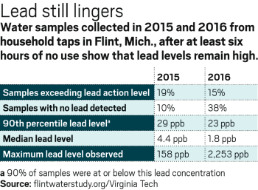
Water analysis before and after return to Detroit water supply in 2016.
EPA action limit:
90th percentile lead levels below 15 ppb
In other words:
90% of samples below 15 ppm
In other words:
If >10% of tap water samples have lead levels over 15 ppb, the EPA requires the water provider to take action.
A Jan 2017 study resulted in a 90th percentile lead level of 12 ppm for Flint. - under the EPA action limit
*http://www.nbcnews.com/storyline/flint-water-crisis/water-lead-level-falls-below-federal-limit-flint-n711716

Slide 31
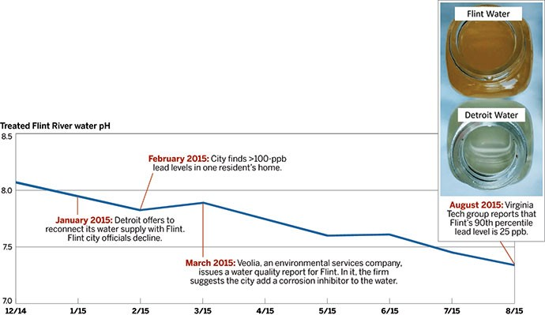
Timeline
Sept 2015 – Flint pediatrician reports increases in lead poisoning of Flint children.
April 2014 – City of Flint, MI switches water supplies to Flint River.
June 2014 – Cases of Legionnaires disease begin occurring in Flint.
Oct 2014 – General Motors quit using Flint, MI water due to high levels of corrosion.
Feb 2015 – City finds >100 ppb lead levels in one resident’s home.
Aug 2015 – VA Tech group: Flint’s 90th percentile lead level is 25 ppb.
Jan 2015 – Detroit offers to reconnect water supply with Flint – offer declined.
March 2015 – Environmental review recommends Flint add corrosion inhibitor to water.

Slide 32
Review Questions
What led to the dissolution of the passivation layer, exposing of the metal (Pb and Fe) pipes?
Less phosphate = fewer insoluble anions in solution
Less phosphate = more soluble anions in solution
Put a theta (θ) next to the relevant reactions on your worksheet.

Slide 33
Review Questions
What led to the dissolution of the passivation layer, exposing of the metal (Pb and Fe) pipes?
Less phosphate = more acidic water, acids dissolve passivation layer by neutralizing OH⁻, a mostly insoluble anion
Less phosphate = more basic water, bases dissolve passivation layer because OH⁻ is a mostly soluble anion
Put a pi (π) next to the relevant reactions on your worksheet.

Slide 34
Review Questions
What led to the release of Fe and Pb from the exposed pipes?
dissolution with increased acid (H⁺) content
dissolution with soluble anions (more Cl⁻, less PO₄³⁻)
dissolution by oxidation with chlorine and oxygen
Put a star (*) next to the relevant reactions on your worksheet.

Slide 35
Related Resources
Torrice, Cecil Michael “How Lead Ended Up In Flint’s Tap Water”, C & E News, Vol 94(7), pp 26-29. Web Date: Feb 11, 2016.
http://cen.acs.org/articles/94/i7/Lead-Ended-Flints-Tap-Water.html
http://cen.acs.org/articles/94/i7/Lead-Ended-Flints-Tap-Water.html?utm_source=UNM&utm_medium=Partner&utm_campaign=CEN
Davenport, Matt “Lead levels remain high in Flint’s water”, C & E News, 94(16), April 15, 2016
http://cen.acs.org/articles/94/i16/Lead-levels-remain-high-Flints.html
http://flintwaterstudy.org/
http://www.nbcnews.com/storyline/flint-water-crisis/water-lead-level-falls-below-federal-limit-flint-n711716
Bacterial outbreaks:
http://www.cnn.com/2016/10/03/health/flint-water-shigellosis-outbreak/
http://www.forbes.com/sites/judystone/2016/01/14/legionnaires-disease-compounds-flints-lead-poisoning-water-crisis/#f82ea01702df
Maynard, J. B. “Overview of Lead Scale Formation and Water Solubility:
http://www.sedimentaryores.net/Pipe%20Scales/Lead%20Scale%20Formation%20and%20Solubility%20-%20overview.pdf
http://www.sedimentaryores.net/Pipe%20Scales/Lead%20Solubility.html
Flint’s Water Crisis and the ‘Troublemaker Scientist’
https://www.nytimes.com/2016/08/21/magazine/flints-water-crisis-and-the-troublemaker-scientist.html?_r=0

