Slide 1
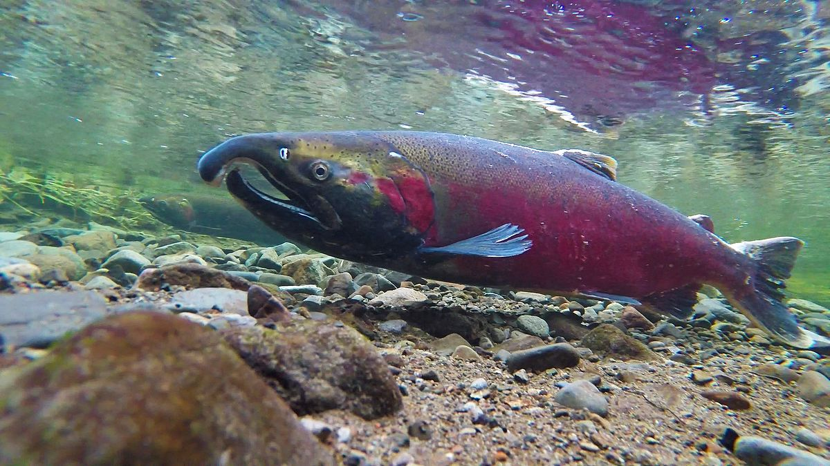
How Failing in Science Helped Solve the Coho Salmon Mystery
NATIONAL CENTER FOR CASE STUDY TEACHING IN SCIENCE
by
Meghan Ward¹, Krystal Nunes², Nicole Laliberté³, and Fiona Rawle⁴
¹Department of Biology, Trent University, Peterborough ON Canada
²Department of Chemistry and Biology, Toronto Metropolitan University, Toronto ON Canada
³Department of Geography, Geomatics, and Environment, University of Toronto Mississauga, Mississauga ON Canada
⁴Department of Biology, University of Toronto Mississauga, Mississauga ON Canada
Notes:
Credit: Licensed photo © Yisi Li | Dreamstime.com, ID 208770258.

Slide 2
Learning Objectives
Re-evaluate the stigma associated with failure in science.
Examine how failure is a key component of the scientific method in the context of salmon die offs.
Recognize how negative results inform research direction and the revision of hypotheses.
“We learn from failure and should not be discouraged by failure”
– Dave Sowden (Mohawk), Educator in Six Nations

Slide 3
What is “Failure” in Science?
Negative results; trial and error.
Failing in science is very common but holds a negative stigma in the scientific community.
(Nunes et al., 2021; Simpson & Maltese, 2017)
Negative results build knowledge, inform
revision of hypotheses, and redirect future
research efforts.
This leads to scientific innovations!

Slide 4
It’s part of the scientific process!
Make an Observation
Develop General Theories
Think of an Interesting Question
Refine, Expand, or Reject Hypothesis
Gather Data to Test Predictions
Formulate a Testable Hypothesis
Develop Testable Predictions

Slide 5
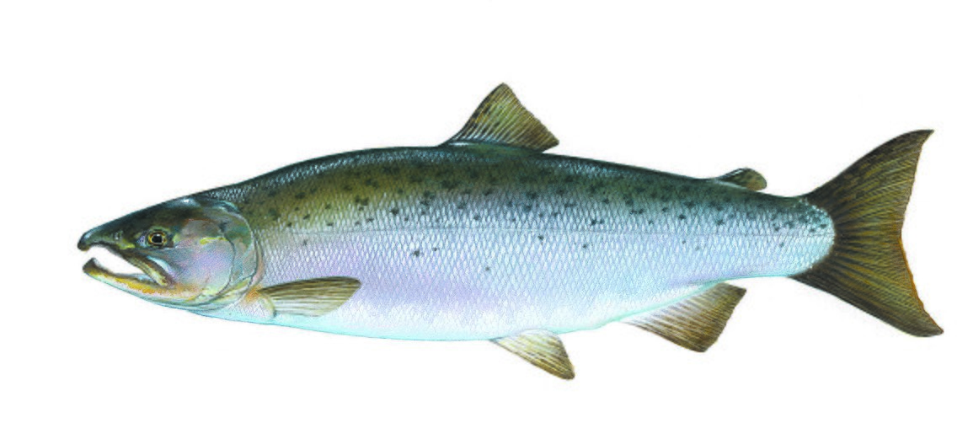
What is the connection between salmon and learning through failure?
(That’s what we’ll explore…)
Coho Salmon
(US Fish and Wildlife Service, Wikimedia Commons)

Slide 6
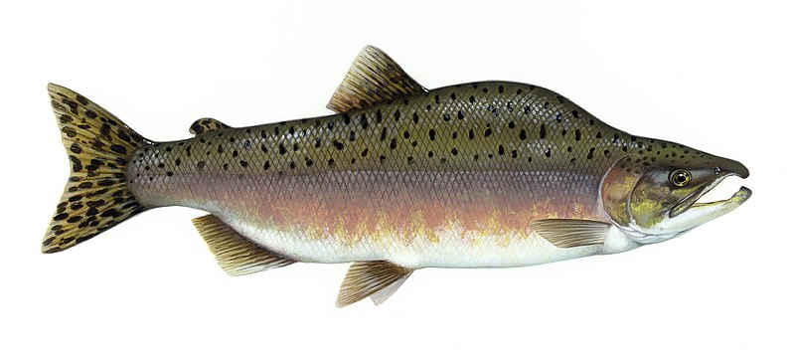
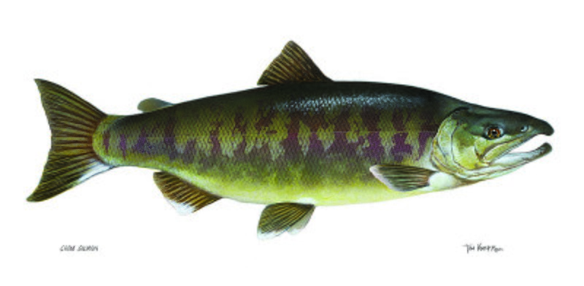
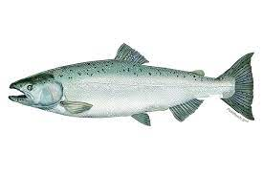
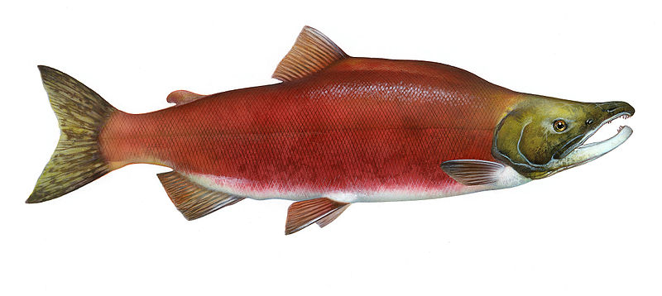
5 Species of West Coast Salmon
Coho Salmon
Pink Salmon
Chum Salmon
(US Fish and Wildlife Service, Wikimedia Commons)
(US Fish and Wildlife Service, Wikimedia Commons)
Chinook Salmon
Sockeye Salmon
(US Fish and Wildlife Service, Wikimedia Commons)
(NOAA, Wikimedia Commons)
(US Fish and Wildlife Service, Wikimedia Commons)

Slide 7
The Cultural and Economic Importance of Salmon
Play a critical role in indigenous cultures, traditions, and legends.
Have been sustainably harvested for generations by indigenous communities.
Many common names for salmon species stem from indigenous languages.
Wild salmon fishing is a billion-dollar industry (from 2012-2015, $1.3B in Canada, $3.3B in United States).
(Gislason & Lam, 2017)
Commercial and recreational salmon fisheries support ~40 000 full-time employment positions directly, many more positions indirectly (development, construction, research, etc.).
(Gislason & Lam, 2017)

Slide 8
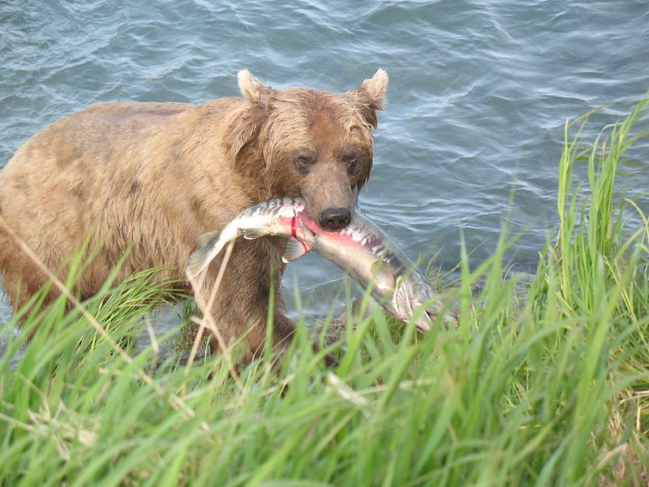
The Biological Importance of Salmon
Presence benefits aquatic and terrestrial ecosystems.
During spawning season, predators (bears, wolverines, etc.) pull salmon onto shore.
Salmon carcasses introduce marine nutrients to riparian terrestrial soils, which supports tree growth and feeds other organisms.
Brown bear (Ursus arctos) with chum salmon (Oncorhynchus keta)
(United States Geological Survey, Wikimedia Commons)

Slide 9
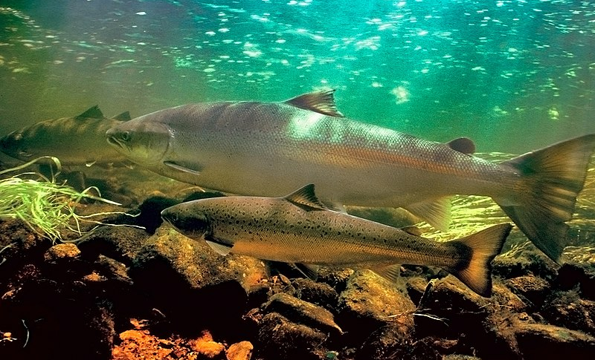

Coho Salmon Life History
Eggs laid in freshwater spawning sites.
Fry spend 1.5 years in freshwater before migrating to Pacific ocean.
After ~3 years, adults migrate to same spawning site where they were born.
Females lay eggs in loose gravel pits, males fertilize laid eggs.
After spawning, adults die.
(NOAA, Wikimedia Commons)
(Bureau of Land Management Oregon and Washington, Wikimedia Commons)

Slide 10
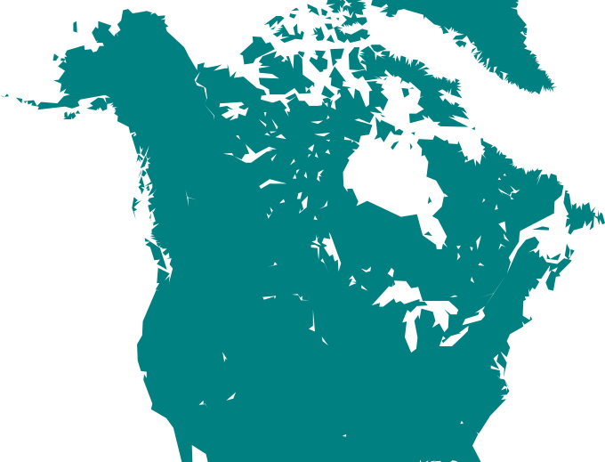
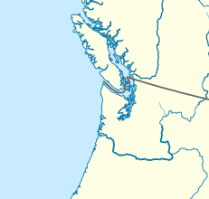
Where Can We Find Salmon?
Sockeye
Chinook
Freshwater Spawning Sites
Chum
Puget Sound, Washington
Pink
Coho
(Uwe Dedering, Wikimedia Commons)
(Heraldry, Wikimedia Commons)

Slide 11
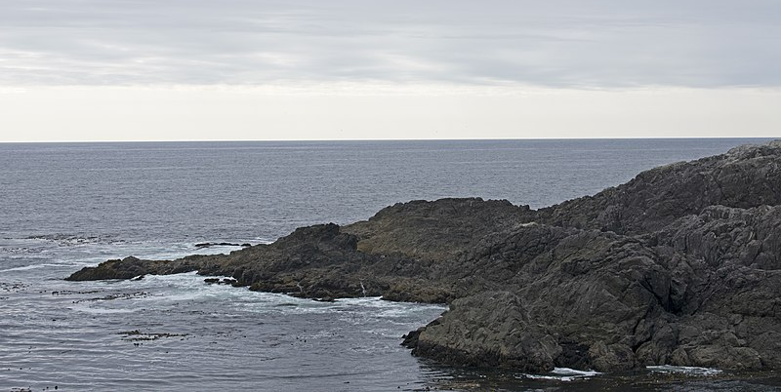
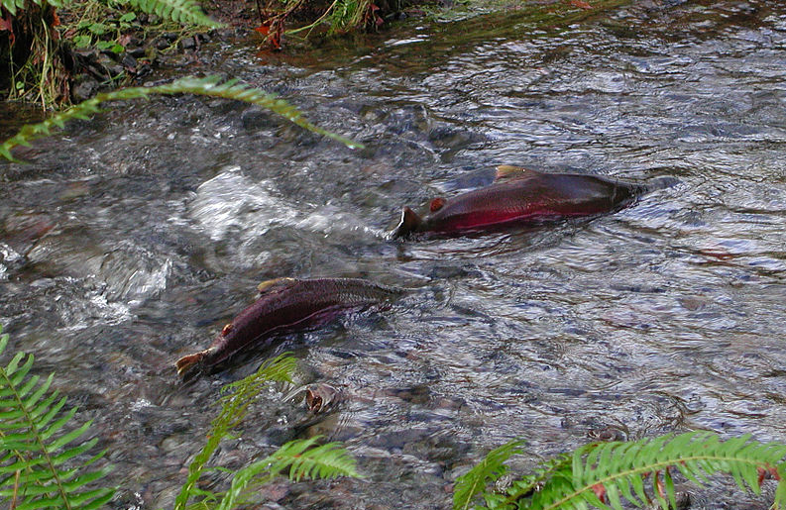
Coho Salmon Habitat
Saltwater: Pacific Ocean
Spawning: Loose Gravel Pits
(Ymblanter, Wikimedia Commons)
Freshwater: Streams and Rivers
(Bureau of Land Management Oregon and Washington, Wikimedia Commons)
Q: What issues might prevent adult coho salmon from being able to spawn?
(Oregon Department of Forestry, Wikimedia Commons)

Slide 12
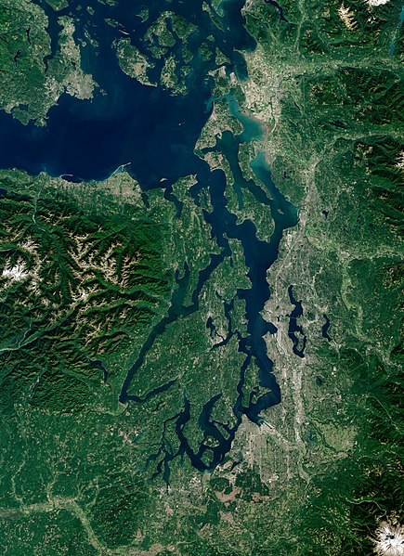
Coho Conservation in Washington:
A Difficult Problem
For 20+ years, scientists in Puget Sound, Washington observed mass coho salmon die-offs during spawning migration.
In some years, all the female coho salmon died before being able to spawn.
Cause unknown.
Brainstorm: What might be causing the coho salmon to die?
(Copernicus Sentinel-2 2018, ESA, Wikimedia Commons)

Slide 13

5 Major Clues

Slide 14
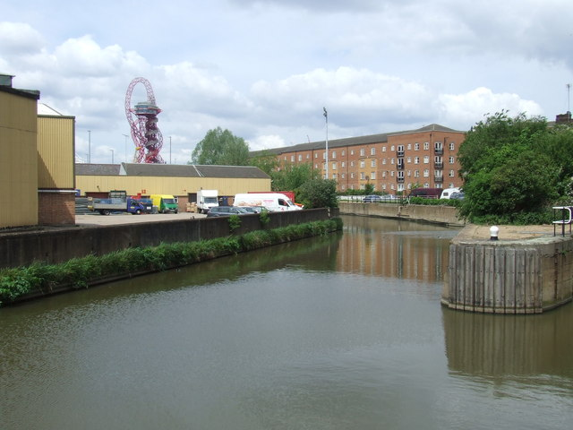
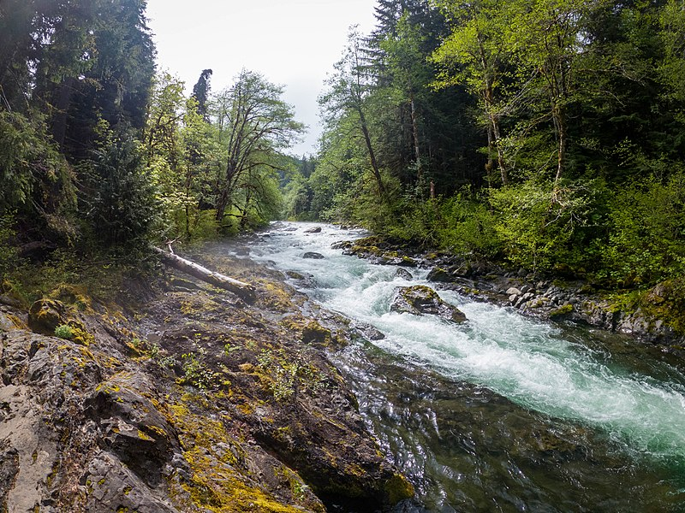
Urban Streams vs. Natural Streams
Clue 1
(Malc McDonald, Wikimedia Commons)
(Sea Cow, Wikimedia Commons)
Scientists from Washington State University and the NOAA observed coho salmon death rates of 60-90% in urban streams and <1% in natural streams.
Notes:
Note: NOAA = National Oceanic and Atmospheric Administration

Slide 15
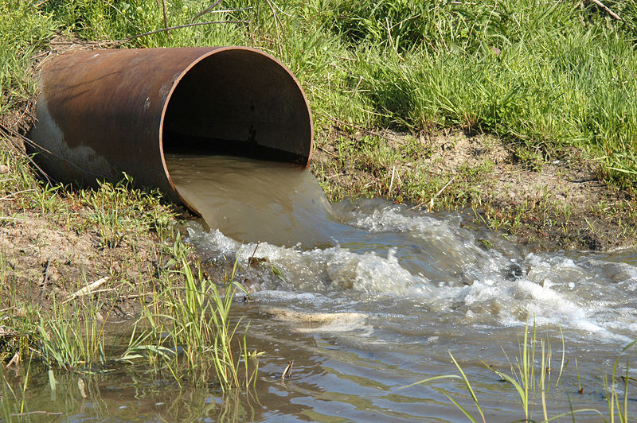
Clue 1
Urban vs. Natural Streams
Urban streams can be used as draining source for stormwater runoff, wastewater treatment effluent, and sanitary sewer overflow.
Toxins and pollutants enter streams near urban centers.
Natural streams do not contain the same toxins and pollutants.
(USDA, Wikimedia Commons)

Slide 16
Clue #1:
Mass die-offs of coho salmon observed in urban streams, not in natural streams.
Urban Streams

Slide 17
Potential Causes of High Mortality
Brainstorm: If you were a scientist investigating this issue, what physical/chemical properties of the water would you measure? Why?
(US Fish and Wildlife Service, Wikimedia Commons)

Slide 18
Common Causes of Pre-Spawner Mortality in Coho Salmon
Reduced dissolved O₂ concentrations
Warmer temperatures
Increased fish stress
Urban Streams
Insecticide exposure
Increased pathogen
presence
Exposure to metals

Slide 19

Common Causes of Pre-Spawner
Mortality in Coho Salmon
Dissolved oxygen
DO
levels normal at all sites
concentrations in decline
2
Warmer water temperatures
Water temperatures normal at all sites
Insecticide exposure
No indication of insecticide exposure
Exposure to metals
Some exposure, but no causality
Increased pathogen presence
No increase in pathogens detected
Increased fish stress
Physiological stress not detected
Scholz et al., 2011

Slide 20
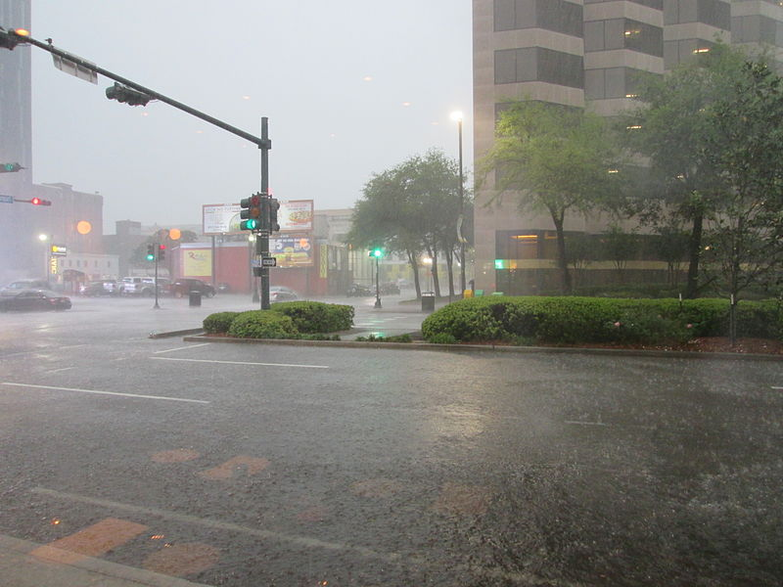
Clue 2
An observation:
Most of the mass die-offs followed rainfall events
Chemicals and pollutants are released onto roadways daily (driving, biking, emptying residential pools, cleaning cars, etc.) and are washed into streams during rainfall events.
(Infrogmation of New Orleans, Wikimedia Commons)

Slide 21
Scientists’ Hypothesis:
Rainfall is causing stormwater runoff to enter urban streams, which causes coho salmon to become lethargic and die.
Clue 2
Coho Salmon Death Following Rainfall
Break into small groups and design an experiment to test the above hypothesis.

Slide 22
The Scientists’ Experiment
Clue 2
Methods:
Treatments: Clean well water (control) and stormwater runoff
Coho salmon exposed to well water or stormwater runoff for 3.5 hours.
Results:
Coho salmon exposed to well water were active and swimming.
Coho salmon exposed to stormwater runoff were lethargic, could no longer swim, and some died.
Q: Was the hypothesis supported?
A: Yes
B: No

Slide 23
Urban Streams
Stormwater
Runoff
Clue #2:
Something in the stormwater runoff is killing coho salmon.

Slide 24
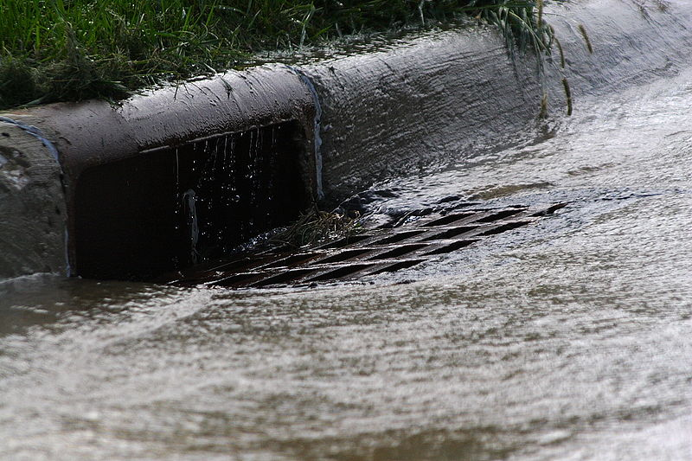
The Ingredients in Stormwater Runoff
Clue 3
Q: What pollutants might be present on roadways that could be washed away during a rainfall event?
(Robert Lawton, Wikimedia Commons)

Slide 25
Pollutants in Stormwater Runoff
Clue 3
Antifreeze
Windshield wiper fluid
Power steering fluid
Tire wear particles
Stormwater Runoff
Motor oil
Automatic transmission fluid
Gear oil

Slide 26
Comparing Stormwater Runoff to Potential Contaminants
Clue 3
Highly abundant
Hierarchical Cluster Analysis
Obtain chemical profiles of potential contaminants (i.e., antifreeze, gear oil, transmission fluid, etc.) that might cause coho salmon death.
Compare known chemical profiles to the chemical profile of stormwater runoff.
Absent

Slide 27
Comparing Chemical Profiles
Clue 3
Power steering fluid
Stormwater Runoff
Antifreeze
Wiper fluid
Gear oil
Motor oil
Transmission fluid
Tire wear particles
Highly abundant
Absent

Slide 28
Matching Chemical Profiles
Clue 3
Stormwater Runoff
Tire wear particles
Highly abundant
Absent

Slide 29

Matching Chemical Profiles
Clue 3
Antifreeze
Windshield wiper fluid
Power steering fluid
Tire wear particles
Stormwater Runoff
Motor oil
Automatic transmission fluid
Gear oil

Slide 30
Scientists’ Hypothesis:
Tire wear particles in urban streams cause coho salmon to become lethargic and die.
Clue 3
Tire Wear Particles as the Source of Toxins Killing Coho Salmon
Break into small groups and design an experiment to test the above hypothesis.

Slide 31
The Scientists’ Experiment
Clue 3
Methods:
Scientists created tire wear particle leachate in lab.
Treatments: Clean well water (control), stormwater runoff, and tire wear particle leachate.
Results:
Coho salmon exposed to TWP leachate showed same negative side effects as stormwater runoff.
Coho salmon exposed to the well water showed no negative effects.
Q: Was the hypothesis supported?
A: Yes
B: No

Slide 32
Urban Streams
Stormwater
Runoff
Tire Wear
Particles
Clue #3:
Tire wear particles were the source of toxins causing mass mortality in coho salmon.

Slide 33
Individual Chemicals in Tire Wear Particles
Tires consist of over 2000 chemicals. One, or some combination of these chemicals, are causing coho salmon to die.
Which chemical is responsible?
Fractionation using chemical analysis
High resolution mass spectrometry
Find the chemical!

Slide 34

What is Fractionation?
Fractionation organizes the individual chemicals into groups based on their response to a chemical stimuli
Fractionation Chamber
(Test tube: Timothy Dilich, Wikimedia Commons)

Slide 35
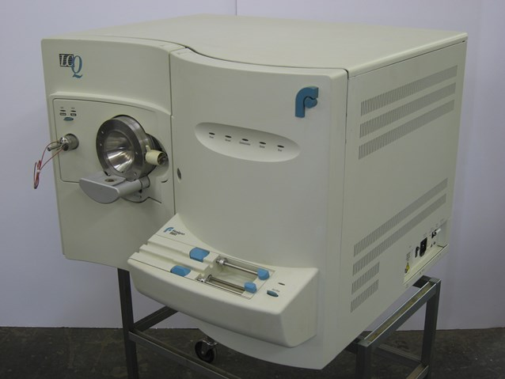
What is high resolution mass spectrometry?
Determines elemental composition of unknown compounds using mass-to-charge ratio.
Molecular formula of chemicals can be determined.
(Kitmondo Marketplace, Wikimedia Commons)

Slide 36



A Long Process of Elimination
Clue 4
Potentially toxic to coho salmon
Scientists tested hundreds of chemicals hypothesized to cause coho salmon death.
Gradually ruled out as non-toxic over two years of testing.
Hundreds of negative results
Science takes time!
Non-toxic to coho salmon
2216
1355
659
225
26
4
Over a 2-Year Long Process!
Adapted from Peter et al. 2018

Slide 37
Clue 4
Identifying the Culprit
Potentially toxic to coho salmon
Non-toxic to coho salmon
2216
1355
659
225
26
4
The scientists identified the toxic chemical as
C₁₈H₂₂N₂O₂
Over a 2-Year Long Process!
Adapted from Peter et al. 2018

Slide 38
Urban Streams
Stormwater
Runoff
Tire Wear
Particles
C₁₈H₂₂N₂O₂
Clue #4:
The chemical formula of the toxin causing coho salmon to die is C₁₈H₂₂N₂O₂

Slide 39
Do you know the common name for the chemical formula C₁₈H₂₂N₂O₂?

Slide 40
Do you know the common name for the chemical formula C₁₈H₂₂N₂O₂?
Don’t worry, the scientists didn’t know the common name either!
No mention of C₁₈H₂₂N₂O₂ in the literature or any chemical database.

Slide 41
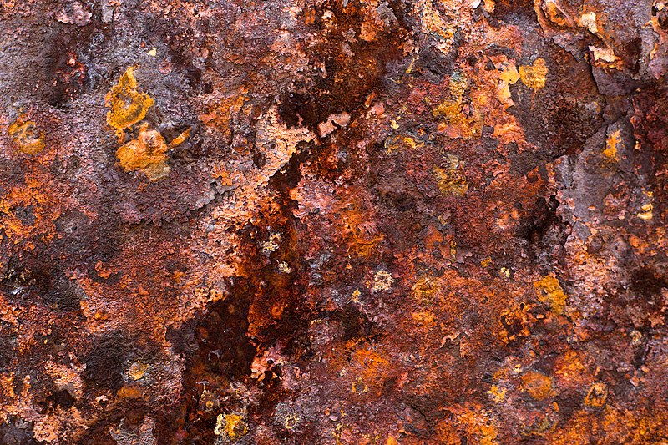
After months of searching, the scientists made a discovery…
Clue 5
TRANSFORMATIONS!
Occur when parent chemicals react with something in the environment.
Forms a new product.
E.g., iron (parent product) + oxygen = rust (transformed product).
(Laitr Keiows, Wikimedia Commons)

Slide 42
What is the parent chemical of C₁₈H₂₂N₂O₂?
Clue 5
A few key points:
The molecular formula of the parent and transformed products are similar.
The parent product is a chemical added to tires.
The parent product must have reacted with something in the environment to produce C₁₈H₂₂N₂O₂.

Slide 43
Scientists discovered…
Clue 5
C₁₈H₂₄N₂ is the parent product of C₁₈H₂₂N₂O₂
6PPD ozone 6PPD-quinone

Slide 44
Urban Streams
Stormwater
Runoff
Tire Wear
Particles
C₁₈H₂₂N₂O₂
6PPD
Clue #5:
The parent compound is 6PPD.

Slide 45
Testing the Effects of 6PPD
Hypothesis:
6PPD-quinone in stormwater causes coho salmon to become lethargic and die.
Methods:
Coho salmon exposed to stormwater runoff and 6PPD-quinone.
Behavior and blood analyses.
Results:
Identical results (blood analysis, equilibrium, swimming pattern) in coho salmon exposed to stormwater runoff and 6PPD-quinone.
Q: Was the hypothesis supported?
A: Yes
B: No

Slide 46
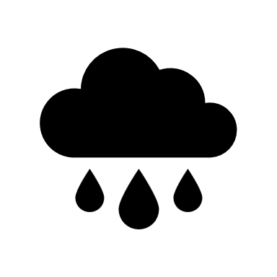


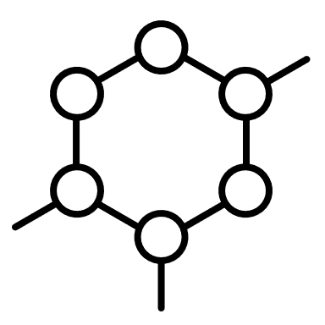

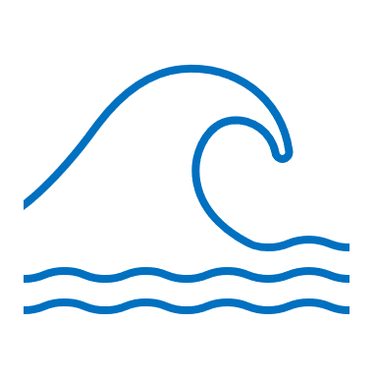

What is 6PPD?
Preservative added to tires to protect them from deterioration.
When 6PPD reacts with ozone in the environment, it produces 6PPD-quinone.
Vehicles
6PPD from tires
6PPD-quinone
6PPD-quinone
6PPD-quinone
Roadway runoff from rainfall
Coho salmon mortality
Adapted from Tian et al., 2021

Slide 47
The Economy of Tires
Possible Solutions
A Challenge of Feasibility
Automotive is $2 trillion industry, 3.1B tires / year produced.
Many cities do not have infrastructure to effectively support alternative means of transportation.
Remove all cars from the road
Remove 6PPD from tires entirely
Tires fall apart after ~5000km without 6PPD.
Brainstorm another solution for minimizing/preventing 6PPD contamination of urban streams.

Slide 48
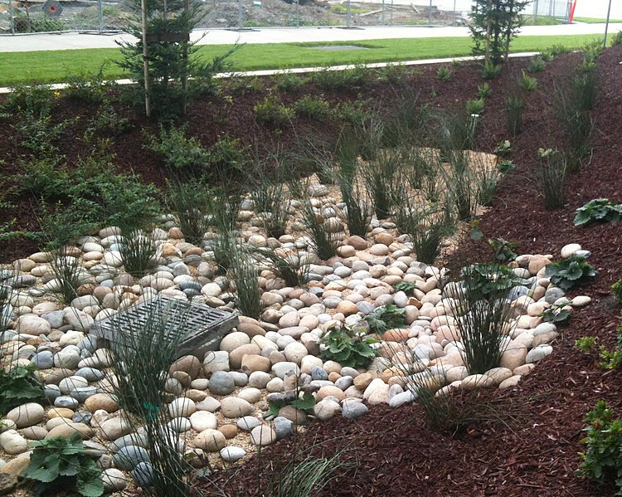
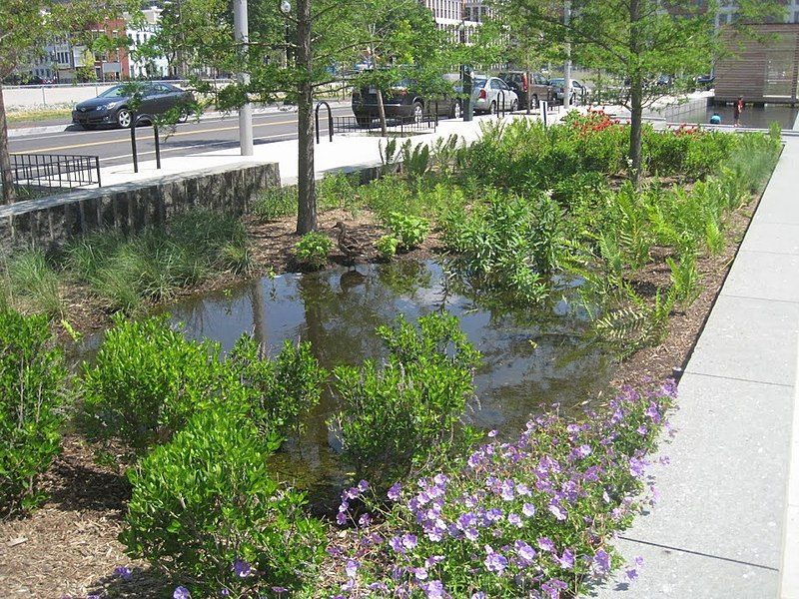
One Possible Solution:
Green Infrastructure
Replacing or modifying existing infrastructure to make it more sustainable and environmentally-conscious.
E.g., use vegetation for stormwater runoff prevention and biotreatment areas.
(Guzzardo Partnership, Wikimedia Commons)
(U.S. EPA, Wikimedia Commons)

Slide 49
Science Always Leads to More Questions
How does 6PPD affect the circulatory system?
How can we implement green infrastructure?
(US Fish and Wildlife Service, Wikimedia Commons)
What other species does 6PPD impact?
Does 6PPD affect the brain?
How might this impact tire manufacturing, repurposing, and disposal?

Slide 50
The Value of Negative Results
Q: Why is this case of salmon die-offs a good example of the value of failure to the scientific process?

Slide 51

To learn more about learning through failure and additional resources, please see: www.LearningFromFailure.ca

Slide 52
Image Sources:
Slide 1:
Coho spawning on the Salmon River. Wikimedia Commons. 2015. Author Bureau of Land Management Oregon and Washington. Creative Commons Attribution 2.0 Generic license. https://commons.wikimedia.org/wiki/File:Coho_Spawning_on_the_Salmon_River_(16335492972).jpg
Slide 5:
Coho Salmon. Wikimedia Commons. 2013. Author Timothy Knepp, U.S. Fish and Wildlife Service. Public domain. https://commons.wikimedia.org/wiki/File:Salmon_coho_fish_oncorhynchus_kisutch.jpg
Slide 6:
Coho Salmon. Wikimedia Commons. 2013. Author Timothy Knepp, U.S. Fish and Wildlife Service. Public domain. https://commons.wikimedia.org/wiki/File:Salmon_coho_fish_oncorhynchus_kisutch.jpg
Chinook Salmon. Wikimedia Commons. 2012. Author NOAA FishWatch. Public domain. https://commons.wikimedia.org/wiki/File:Oncorhynchus_tshawytscha.png
Chum Salmon. Wikimedia Commons. 2013. Author Timothy Knepp, U.S. Fish and Wildlife Service. Public domain. https://commons.wikimedia.org/wiki/File:Salmon_chum_fish_oncorhynchus_keta.jpg
Pink Salmon. Wikimedia Commons. 2001. Author Timothy Knepp, U.S. Fish and Wildlife Service. Public domain. https://commons.wikimedia.org/wiki/File:Pink_salmon_FWS.jpg
Sockeye Salmon. Wikimedia Commons. 2001. Author Timothy Knepp, U.S. Fish and Wildlife Service. Public domain. https://commons.wikimedia.org/wiki/File:Oncorhynchus_nerka.jpg
Slide 8:
Brown bear with chum salmon. Wikimedia Commons. 2006. Author United States Geological Survey. Public Domain. https://commons.wikimedia.org/wiki/File:Bear_predation_on_salmon_can_be_high_in_many_Alaskan_rivers.jpg
Slide 9:
Coho salmon (top image). Wikimedia Commons. 2016. Author National Oceanic and Atmospheric Administration (NOAA). Public Domain. https://commons.wikimedia.org/wiki/File:GFNMS_-_coho_salmon_(27551306402).jpg
Coho salmon spawning site (bottom image). Wikimedia Commons. 2015. Author Bureau of Land Management Oregon and Washington. Creative Commons Attribution 2.0 Generic license. https://commons.wikimedia.org/wiki/File:Coho_Spawning_on_the_Salmon_River_(16335492972).jpg

Slide 53
Image Sources:
Slide 10:
North America base map. Wikimedia Commons. 2009. Author Heraldry. Creative Commons Attribution-Share Alike 3.0 Unported license. https://commons.wikimedia.org/wiki/File:Cartography_of_North_America.svg
Inset map of Seattle, Washington. Wikimedia Commons. 2010. Author Uwe Dedering. Creative Commons Attribution-Share Alike 3.0 Unported license. https://commons.wikimedia.org/wiki/File:North_America_laea_location_map.svg
Saltwater migration routes drawn by author K. Nunes. Information on migration routes gathered from Central Coast Biodiversity. 2014. https://www.centralcoastbiodiversity.org/chinook-salmon-bull-oncorhynchus-tshawytscha.html
Slide 11:
Pacific Ocean. Wikimedia Commons. 2019. Author Ymblanter. Creative Commons Attribution-Share Alike 4.0 International license. https://commons.wikimedia.org/wiki/File:Ocean_from_the_Wild_Pacific_Trail_4.jpg
Coho salmon swimming upstream. Wikimedia Commons. 2014. Author Oregon Department of Forestry. Creative Commons Attribution 2.0 Generic license. https://commons.wikimedia.org/wiki/File:Homestead_coho_salmon_Tillamook_Forest.jpg
Coho salmon spawning site. Wikimedia Commons. 2015. Author Bureau of Land Management Oregon and Washington. Creative Commons Attribution 2.0 Generic license. https://commons.wikimedia.org/wiki/File:Coho_Spawning_on_the_Salmon_River_(16335492972).jpg
Slide 12:
Puget Sound, Washington. Wikimedia Commons. 2018. Author Copernicus Sentinel-2 ESA. Creative Commons Attribution-ShareAlike 3.0 IGO license. https://commons.wikimedia.org/wiki/File:Puget_Sound_by_Sentinel-2,_2018-09-28_(small_version).jpg
Slide 14:
Urban stream. Wikimedia Commons. 2013. Author Malc McDonald. Creative Commons Attribution-Share Alike 2.0 Generic license. https://commons.wikimedia.org/wiki/File:City_Mill_River_near_Stratford_-_geograph.org.uk_-_3487391.jpg
Natural stream. Wikimedia Commons. 2022. Author Sea Cow. Creative Commons Attribution-Share Alike 4.0 International license. https://commons.wikimedia.org/wiki/File:Sol_Duc_river_salmon_cascades.jpg
Slide 15:
Storm drain. Wikimedia Commons. 2007. Author United States Department of Agriculture. Public Domain. https://commons.wikimedia.org/wiki/File:Discharge_pipe.jpg

Slide 54
Image Sources:
Slide 17:
Coho Salmon. Wikimedia Commons. 2013. Author Timothy Knepp, U.S. Fish and Wildlife Service. Public domain. https://commons.wikimedia.org/wiki/File:Salmon_coho_fish_oncorhynchus_kisutch.jpg
Slide 20:
Rainy day on Poydras Street. Wikimedia Commons. 2014. Author Infrogmation of New Orleans. Creative Commons Attribution-Share Alike 2.0 Generic license. https://commons.wikimedia.org/wiki/File:NOCBD_Rain_Poydras.jpg
Slide 21:
Storm drain. Wikimedia Commons. 2006. Author Robert Lawton. Creative Commons Attribution-Share Alike 2.5 Generic license. https://commons.wikimedia.org/wiki/File:Storm_Drain.JPG
Slide 33:
Test tube. Wikimedia Commons. 2017. Author Timothy Dilich. Creative Commons CC0 1.0 Universal Public Domain Dedication. https://commons.wikimedia.org/wiki/File:Test_Tube_-_The_Noun_Project.svg
Slide 35:
Thermo-Finnigan Mass Spectrometer. Wikimedia Commons. 2014. Author Kitmondo Marketplace. Creative Commons Attribution 2.0 Generic license. https://commons.wikimedia.org/wiki/File:Thermo_-_Finnigan_LCQ_Mass_Spectrometer_(15797493459).jpg
Slide 41:
Rust. Wikimedia Commons. 2010. Author Laitr Keiows. Creative Commons Attribution-Share Alike 3.0 Unported license. https://commons.wikimedia.org/wiki/File:Rust_on_iron.jpg
Slide 48:
Stormwater management (top). Wikimedia Commons. 2012. Author Guzzardo Partnership. Creative Commons Attribution-Share Alike 4.0 International license. https://commons.wikimedia.org/wiki/File:2012-12-04_Stormwater_Bio-Treatment_Area_View3.jpg
Rain garden (bottom). Wikimedia Commons. 2014. Author U.S. Environmental Protection Agency. Public Domain. https://commons.wikimedia.org/wiki/File:Rain_Garden_%2815455930908%29.jpg

Slide 55
Image Sources:
Slide 49:
Coho Salmon. Wikimedia Commons. 2013. Author Timothy Knepp, U.S. Fish and Wildlife Service. Public domain. https://commons.wikimedia.org/wiki/File:Salmon_coho_fish_oncorhynchus_kisutch.jpg

Slide 56
Presentation References
Nunes, K. A., S. Du, R. Philip, M. M. Mourad, Z. Mansoor, N. Laliberte, and F. Rawle. 2021. Science students’ perspectives on how to decrease the stigma of failure. FEBS Open Bio 12:24-37.
Peter et al 2018. Using high-resolution mass spectrometry to identify organic contaminants linked to urban stormwater mortality syndrome in coho salmon. Environmental Science and Technology 52 10317-10327
Scholz, N. L., M. S. Myers, S. G. McCarthy, J. S. Labenia, J. K. McIntyre, G. M. Ylitalo, L. D. Rhodes, C. A. Laetz, C. M. Stehr, B. L. French, B. McMillan, D. Wilson, L. Reed, K. D. Lynch, S. Damm, J. W. Davis, and T. K. Collier. 2011. Recurrent die-offs of adult coho salmon returning to spawn in Puget sound lowland urban streams. PLOS One 6: e28013
Simpson, A. and A. Maltese. 2017. “Failure is a major component of learning anything”: the role of failure in the development of STEM professionals. Journal of Science Education and Technology 26:223-237.
Tian, Z., H. Zhao, and E. P. Kolodziej. 2021. A ubiquitous tire rubber-derived chemical induces active mortality in coho salmon. Science 371(6525):185-189.

