Slide 1
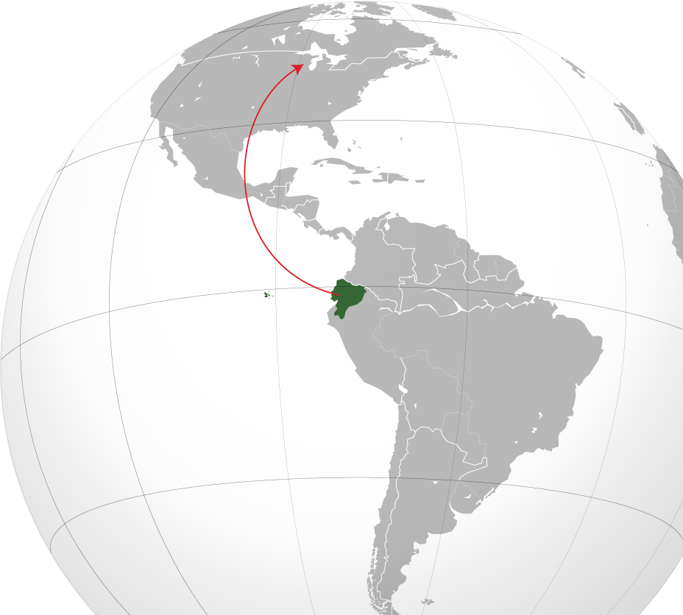
National Center for Case Study Teaching in Science
Ethnomedicine in Latino Communities of
^{Madison}
by
David S. Kiefer
Department of Family Medicine
University of Wisconsin—Madison

Slide 2
Welcome! You are a student intern working with me, David Kiefer, MD, a family physician and herbal medicine expert. I have a grant from The City of Madison Public Health Department to investigate the use of herbal medicines by Latinos living in Madison. Herbs are a common and useful part of this culture, but may also be unsafe.
I am aiming to help the city, clinics, and area stores learn about these plants. For example, there are unknowns about plant medicines:
Dr. Kiefer

Slide 3
Gaps in our knowledge about plant medicines:
Which plants are being used as medicines?
For what health conditions are plant medicines used?
Are these plants safe and/or effective?
Where do the plants come from?
What are some of the beliefs surrounding plant medicines?

Slide 4
Your role in this project
I have contacts from prior work in Ecuador, so you will be learning about plants and people from this country as an example of Latino herbal use.
Your tasks will include:
Reading a research paper and background information
Gleaning content from interviews
Taking notes in the Homework Handout throughout the process
And…
Please fill in the Homework Handout you have been given for each part of your work!
Notes:
Photo should be in office/clinic

Slide 5
The Final Report
By the end of your work with me, I will need two things:
The Homework Handout: I need all of the questions answered and blanks filled in.
A final report to the City of Madison: Topics in this report are:
Summarize what you learned about Ecuadorians’ plant use.
Make suggestions to clinics and stores about this topic
Brainstorm about “next steps”
Keep these Report topics in mind as you work with me on this grant. I’ll help you with the report at the end of your work.
OK, let’s get started…
Notes:
Photo should be in office/clinic

Slide 6
First Task
Please read this article:
Link:
etnobotanica.de/Ceuterick%20et%20al.,%202008.pdf
It is a long article so focus on these points:
Introduction: understand changes in plant use due to immigration
Table 1: focus on the “garlic” entry.
Discussion: skim this section for general conclusions about cross-cultural plant use.
Take notes about these points in the Homework Handout!

Slide 7
Read the background information that follows
Four topics relevant to our project:
Taxonomy Matters
Ecuador demographics
Madison’s Latino Community
Medicinal Plants in Madison

Slide 8
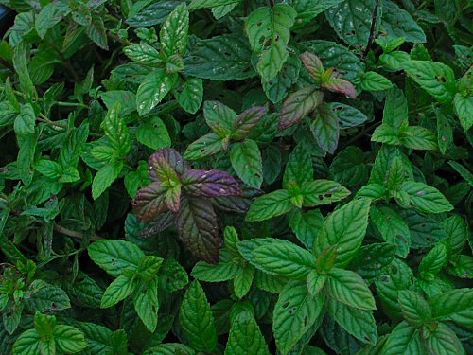
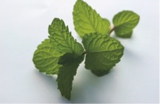
Taxonomy Matters
These two plants are commonly used by Latinos. Each can be called either “mentha” or “hierba buena,” but they are actually different plants with different medicinal properties; the commonly used plant names can be confusing. Do you recognize them?

Slide 9
Although both are in the mint family (Lamiaceae) and have long histories of medicinal and culinary uses, their physiological actions are distinct. For example, peppermint has a particularly high concentration of menthol, which acts to calm the spasm of smooth muscle, making it adept at controlling some intestinal symptoms. It can be very easy to confuse these two species of Lamiaceae, and many people have developed their own methods for distinguishing them. For example, some Latinos use aroma to accurately distinguish hierba buena from mentha. Try this sometime at home and see if you can tell the difference between them!
Taxonomy matters: take notes in the Homework Handout please
This is “Hierba buena” (aka “yerba buena” or peppermint). Hierba buena has the scientific name of Mentha x piperita and is a cross between spearmint (“mentha,” Mentha spicata) and water mint (Mentha aquatica).
This is “mentha” or spearmint (scientific name Mentha spicata).

Slide 10
Ecuador demographics: take notes in the Homework Handout please
Population: 15,223,680 (67% urban, gains 2% annually)
65% mestizo (mixed Amerindian, white), Amerindian 25%, Spanish and others 7%, 3% black
Languages: Spanish (official), Kichwa, Shuar Chicham (indigenous)
Life expectancy at birth: 75.9 years (US = 78.5 years)
Infant mortality: 19 deaths per 1000 live births (100th worst in the world) (US 6 deaths per 1000 live births)
Health expenditures: 5% of GDP (2009) 139th in world (US 16.2% GDP, 2nd in world)
Major causes of mortality (highest to lowest): circulatory diseases, cancer, communicable diseases, disease originating from perinatal period

Slide 11
Madison’s Latino Community: take notes (Homework Handout)
6.83% of Madison’s population is composed of people of Latin American descent.
The primary area of town for Latino residences is the Southside, along the Beltline and South Transfer Point (S. Park Street area)
Latinos in Madison are predominantly Mexican, followed by Puerto Rican and Cuban. A small percentage of the Latino community is Ecuadorian.
Madison experienced 75% growth in its Latino community from 2000 – 2010. Over 80% of Latino households in Madison are estimated to be 1st generation immigrants. About 50% of the Latino population growth is estimated to come from high birthrates.
38% of adult Latinos responding to a 2011 Literacy Network survey stated that their English as a Second Language (ESL) needs are not met.

Slide 12
Medicinal plants in Madison: take notes (Homework Handout)
Latinos in Madison find medicinal and food-medicinal plants in several places in Madison:
Grocery stores, also called “tiendas” or “botánicas”
Local integrative and regular pharmacies
Friend’s gardens (http://www.cityofmadison.com/residents/communitygardens/index.cfm)
In packages sent by relatives

Slide 13
Interview Ecuadorians
in Madison
You’re meeting with Señor and Señora Alvarez at a community center and asking them some questions. You hope that this lends some insight about the use of plants by people from South America.
Señor and Señora Alvarez are from Quito, Ecuador and have been living in Madison for 10 years. They each regularly use medicinal plants to cure various ailments and love to talk about the topic.

Slide 14
Interview Ecuadorians
in Madison
Q1: Señor and Señora Alvarez, thank you so much for agreeing to meet and talk about medicinal plants. What are some of your favorites?
You ask:
Q1: Señor and Señora Alvarez, thank you so much for agreeing to meet and talk about medicinal plants. What are some of your favorites?
Q2: I hear garlic mentioned often. What about garlic?
Señor Alvarez: De nada. We commonly use manzanilla, mentha, gordolobo, and estafiate. Although, we only use estafiate rarely.
Q3: Does it have medicinal effects?
Q4: Is garlic the same here as in Ecuador?
Remember to keep taking notes in the Homework Handout

Slide 15
Interview Ecuadorians
in Madison
Q2: I hear garlic mentioned often. What about garlic?
You Ask:
Q1: Señor and Señora Alvarez, thank you so much for agreeing to meet and talk about medicinal plants. What are some of your favorites?
Q2: I hear garlic mentioned often. What about garlic?
Señora Alvarez: Well, I think of garlic more as a food, like onions and tomatoes.
Q3: Does it have medicinal effects?
Q4: Is garlic the same here as in Ecuador?
Remember to keep taking notes in the Homework Handout

Slide 16
Interview Ecuadorians
in Madison
Q3: Does it have medicinal effects?
You ask:
Q1: Señor and Señora Alvarez, thank you so much for agreeing to meet and talk about medicinal plants. What are some of your favorites?
Q2: I hear garlic mentioned often. What about garlic?
Señor Alvarez: For example, my father used to eat garlic, sometimes raw, sometimes in a pill, every morning before breakfast, just as his dad did. He said that it prevented many different diseases, such as high blood pressure and heart problems.
Q3: Does it have medicinal effects?
Q4: Is garlic the same here as in Ecuador?
Remember to keep taking notes in the Homework Handout

Slide 17
Interview Ecuadorians
in Madison
Q4: Is garlic the same here as in Ecuador?
You ask:
Q1: Señor and Señora Alvarez, thank you so much for agreeing to meet and talk about medicinal plants. What are some of your favorites?
Señora Alvarez: (To her husband) Mi amor, I can answer this. In Ecuador, we used to grow garlic, but sometimes we would buy it from the market. Here, because of the long winters and no space for a garden, I am always buying garlic. It seems reasonably fresh and the taste seems similar to what I was used to. Because of that, I assume that it has the same health benefits. However, for other plants like manzanilla and yerba buena, it is very hard to find fresh plants. This is mostly because it is hard to grow them for most of the year. The dried plants that I can find at some of the markets in Madison, or the capsules being sold in pharmacies, are just not the same. I don’t think those plants work as well. But at least I have my garlic.
Q2: I hear garlic mentioned often. What about garlic?
Q3: Does it have medicinal effects?
Q4: Is garlic the same here as in Ecuador?
Remember to keep taking notes in the Homework Handout

Slide 18
Interview a doctor in Madison
Since garlic seems so important from your interviews, you decide to ask a doctor with expertise in integrative medicine.
Hello. I am Doctor Junsy, a family physician in Madison. I have an interest in integrative medicine, including medicinal plants. So, I have researched some of them and regularly talk to my patients about what they are taking. How can I be of help?

Slide 19
Interview a Doctor in Madison
Q1: How common is the medicinal use of garlic?
You ask:
Q1: How common is the medicinal use of garlic?
Q2: How do your patients use garlic for healing?
Q3: Well, does it work?
Q4: How much garlic does one need to eat to achieve these benefits?
Well, the last I checked, it was one of the top 10 herbal products sold in the United States, and that doesn’t include people that purchase garlic in the grocery stores.
Remember to keep taking notes in the Homework Handout

Slide 20
Interview a Doctor in Madison
You ask:
Q2: How do your patients use garlic for healing?
Q1: How common is the medicinal use of garlic?
Q2: How do your patients use garlic for healing?
Q3: Well, does it work?
Q4: How much garlic does one need to eat to achieve these benefits?
Many of my patients will use garlic specifically for coronary artery disease, cholesterol, or high blood pressure. Other people regularly ingest garlic just for general preventive health.
Remember to keep taking notes in the Homework Handout

Slide 21
Interview a Doctor in Madison
You ask:
Q3: Well, does it work?
Q1: How common is the medicinal use of garlic?
Q2: How do your patients use garlic for healing?
Q3: Well, does it work?
Q4: How much garlic does one need to eat to achieve these benefits?
I’ve extensively reviewed the literature, and there are some interesting results. For example, regular intake of garlic once daily may slightly lower blood pressure, say, 5-8 mmHg (the units of blood pressure readings). This is probably not clinically significant. However, after 2-3 months of treatment, garlic does seem to lower total cholesterol by 17, and triglycerides by 19. It does not seem to affect HDL cholesterol (a subset of cholesterol, often called “good” cholesterol) levels.
Remember to keep taking notes in the Homework Handout

Slide 22
Interview a Doctor in Madison
You ask:
Q4: How much garlic does one need to eat to achieve these benefits?
Q1: How common is the medicinal use of garlic?
Q2: How do your patients use garlic for healing?
Q3: Well, does it work?
Q4: How much garlic does one need to eat to achieve these benefits?
Two cloves a day is probably an adequate medicinal dose. It should be minced, diced, or chopped, or it won’t work medicinally. This is because of an enzymatic reaction that occurs when garlic is processed in that way. It causes a precursor chemical to be converted into the medicinally active molecule, allicin. Also, you shouldn’t overcook garlic or it will destroy some of the active compounds. It is possible to purchase garlic extracts in capsule form, which may have some of the medicinal effects but it depends on the specific product.
Remember to keep taking notes in the Homework Handout

Slide 23
Video phone call: To understand more about plant use, specifically garlic, in Ecuador, you follow up on a contact in Quito, Ecuador, the Andi couple.
Señor and Señora Andi are from Quito, Ecuador, although both grew up in the “Oriente,” or Eastern/Amazonian part of Ecuador. Each of their parents and grandparents knew a lot about medicinal plants, and took care of the entire family’s health with herbal remedies. The Andis picked up this expertise and made it a part of their lives and health care.

Slide 24
Video phone call: Questions
Q1: Señor and Señora Andi. Thank you for having this call. Ajo, or garlic, is common in market stands. Why?
You Ask:
Q1: Señor and Señora Andi. Thank you for having this call. Ajo, or garlic, is common in market stands. Why?
Q2: What are garlic’s medicinal effects?
Señor Andi: De nada. You’re welcome. Garlic is an important part of our diet, but it also has medicinal effects. We probably eat some garlic every day.
Q3: Do you mean like cancer and infections?
Q4: How much garlic do you have to eat to obtain a medicinal effect?
Remember to keep taking notes in the Homework Handout

Slide 25
Video phone call: Questions
Q2: What are garlic’s medicinal effects?
You Ask:
Q1: Señor and Señora Andi. Thank you for having this call. Ajo, or garlic, is common in market stands. Why?
Q2: What are garlic’s medicinal effects?
Señora Andi: For example, my father used to eat garlic, sometimes raw, sometimes in a pill, every morning before breakfast, just as his dad did, and he said that it prevented many different diseases.
Q3: Do you mean like cancer and infections?
Q4: How much garlic do you have to eat to obtain a medicinal effect?
Remember to keep taking notes in the Homework Handout

Slide 26
Video phone call: Questions
Q3: Do you mean like cancer and infections?
You Ask:
Q1: Señor and Señora Andi. Thank you for having this call. Ajo, or garlic, is common in market stands. Why?
Q2: What are garlic’s medicinal effects?
Señor Andi: Yes. But it wasn’t always just for one specific disease, rather a variety of medical conditions, like high blood pressure, heart problems, angina, and rheumatism. This is what our ancestors thought and we continue to believe this to this day.
Q3: Do you mean like cancer and infections?
Q4: How much garlic do you have to eat to obtain a medicinal effect?
Remember to keep taking notes in the Homework Handout

Slide 27
Video phone call: Questions
Q4: How much garlic do you have to eat to obtain a medicinal effect?
You Ask:
Q1: Señor and Señora Andi. Thank you for having this call. Ajo, or garlic, is common in market stands. Why?
Q2: What are garlic’s medicinal effects?
Señora Andi: It depends on each person, but my grandfather used to say “take enough garlic.” Probably 1-2 dientes, or cloves a day.
Q3: Do you mean like cancer and infections?
Q4: How much garlic do you have to eat to obtain a medicinal effect?
Remember to keep taking notes in the Homework Handout

Slide 28
Very interesting. A lot of focus on garlic, huh?
Well, my experience in international field research and with my Latino patients in Madison indicates that cayenne pepper (also called chile or ají) has ethnobotanical importance as well.
Will you please interview the same people again and learn about a different plant?
Thanks!
Then, we’ll be just about ready to compile your information and prepare the report for the city.

Slide 29
Interview Ecuadorians
in Madison
You meet with Señor and Señora Alvarez again at a community center and ask them some more questions. This time, your focus is on chile pepper, also called cayenne.
Remember that Señor and Señora Alvarez are from Quito, Ecuador and have been living in Madison for 10 years. They each regularly use medicinal plants to cure various ailments and love to talk about the topic.

Slide 30
Interview Ecuadorians
in Madison
Q1: My boss would like to know about chile peppers, or chiles. Is it a medicine?
You Ask:
Señora Alvarez: Well, we think of chiles more as a food, like garlic, onions and tomatoes. We certainly don’t use chiles as much as our Mexican friends, but it is still important to us.
Q1: My boss would like to know about chile peppers, or chiles. Is it a medicine?
Q2: Does it have medicinal effects?
Remember to keep taking notes in the Homework Handout

Slide 31
Interview Ecuadorians
in Madison
Q2: Does it have medicinal effects?
Señor Alvarez: Possibly. Although I have heard it used by my Latino friends as a gargle for sore throat, I disagree; I think chile irritates the throat. I’ve heard that it can fight infections, and maybe even help with stomach problems. Though, again, too much chile can cause heartburn and gastritis. I treat this plant with respect and just add a little bit in my food for flavor.
Señora Alvarez: I agree. I cook with chile, but just use a small amount. It’s funny, but the chiles here in America seem different than what I was used to. Maybe not as hot, with a slightly different taste. It makes me think about how the plants are not the same as in Ecuador. The long winters and small yard (I don’t have a garden here) makes it tough to grow things. I buy almost everything (herbs, spices, vegetables) in the grocery store now, sometimes at the farmer’s market. The plants don’t seem as fresh when I do find the ones I was used in Ecuador. For example, it is very hard to find fresh manzanilla and yerba buena. Mostly because it is hard to grow them for most of the year. The dried plants that I can find at some of the markets in Madison, or the capsules being sold in pharmacies, are just not the same. I don’t think those plants work as well.
You Ask:
Q1: My boss would like to know about chile peppers, or chiles. Is it a medicine?
Q2: Does it have medicinal effects?
Remember to keep taking notes in the Homework Handout

Slide 32
Interview Doctor Junsy, the integrative medicine doctor in Madison, again.
This time you will be asking about cayenne.
Hello again. I hope that your research project has been going well. How can I be of help this time?

Slide 33
Interview a Doctor
in Madison
Q1: When we talk about cayenne, or chile peppers, what do we mean?
You Ask:
Q1: When we talk about cayenne, or chile peppers, what do we mean?
Q2: It has medicinal effects?
There are a variety of common names for this plant. Chile peppers and cayenne refer to the fruits or seeds, or powdered dried fruits or seeds, from plants in the genus Capsicum (Family Solanaceae), native to Central and South America but now part of cuisines throughout the world.
Q3: Anything else to know about Capsicum?
Remember to keep taking notes in the Homework Handout

Slide 34
Interview a Doctor
in Madison
Q2: It has medicinal effects?
You Ask:
Yes. Most of cayenne’s medicinal effects come from a phytochemical called capsaicin, which is also responsible for the “heat” that we feel on our mucus membranes when we eat foods with chile peppers. Capsaicin dulls nerve endings by depleting a neurotransmitter called Substance P, leading to a decrease in pain. For this reason, this chemical is being put into lotions and creams that are used on the skin over areas of pain, like arthritic joints or irritated low back muscles. In addition, chile is considered a diaphoretic herb, or one that causes us to sweat. No surprise here. This can be useful when someone has a cold virus, and sweating can be one method for helping the body to expel the infection.
Q1: When we talk about cayenne, or chile peppers, what do we mean?
Q2: It has medicinal effects?
Q3: Anything else to know about Capsicum?
Remember to keep taking notes in the Homework Handout

Slide 35
Interview a Doctor
in Madison
Q3: Anything else to know about Capsicum?
You Ask:
Q1: When we talk about cayenne, or chile peppers, what do we mean?
Well, it has good research to back it up. That is important to me as a clinician, that my patient’s use of a plant has data behind it. Also, a patient should know that their pain might get worse for a few days before it gets better; Capsicum depletes Substance P over time, but initially it causes more Substance P to be released and that can cause a flare in symptoms. Capsaicin creams and lotions can cause a rash on the skin for some people, and it is very important to wash your hands thoroughly after applying the product (or cooking with cayenne!), before touching your eyes or other sensitive body areas; it can burn!
Q2: It has medicinal effects?
Q3: Anything else to know about Capsicum?
Remember to keep taking notes in the Homework Handout

Slide 36
Video phone call: To understand more about plant use, specifically cayenne in Ecuador, you follow up with the Andi couple.
As you remember, Señor and Señora Andi are from Quito, Ecuador, although both grew up in the “Oriente,” or Eastern/Amazonian part of Ecuador. Each of their parents and grandparents knew a lot about medicinal plants, and took care of the entire family’s health with herbal remedies. The Andis picked up this expertise and made it a part of their lives and health care.

Slide 37
Video phone call: Questions
Q1: Señor and Señora Andi. Thank you for having this call. I am interested in learning more about cayenne. Can you tell me about it?
You Ask:
Q1: Señor and Señora Andi. Thank you for having this call. I am interested in learning more about cayenne. Can you tell me about it?
Señor Andi: I don’t know what that is.
You: Umm, cayenne is a spice, probably better known as chile, picante, or ají.
Señora Andi: Oh! Ají! Yes, I cook with that sometimes, and a small bowl of it (mixed with onions, lime and salt) is almost always on our kitchen table. There is always a little of it in the kitchen, dried, that I had picked from my backyard garden. We like a little bit of the “heat” from chiles in our food, but not too much. When we go to a restaurant, there is also always a little dish of ají that we add to our food.
Q2: In some cultures, it is considered a medicine. How about in Ecuador?
Q3: Is chile safe? Such as, with some medicines should we worry about adverse effects?
Remember to keep taking notes in the Homework Handout
Notes:
.

Slide 38
Video phone call: Questions
Q2: In some cultures, it is considered a medicine. How about Ecuador?
You Ask:
Q1: Señor and Señora Andi. Thank you for having this call. I am interested in learning more about cayenne. Can you tell me about it?
Señor Andi: Hmmm. That is interesting. Maybe. I have read about that, such as how picante can kill bacteria. Maybe that is why we add it to our food, in case the food wasn’t safe. It makes me think of how we drink oregano tea after eating ceviche. Ceviche has raw fish, and although the acid in the lime juice that is always added to ceviche certainly helps to “clean” the fish, I bet that the anti-bacterial effects of oregano tea (that I heard mentioned in a TV ad) might be part of why that food is always paired up with that spice. Interesting. I’m glad you asked about that.
Q2: In some cultures, it is considered a medicine. How about in Ecuador?
Q3: Is chile safe? Such as, with some medicines should we worry about adverse effects?
Remember to keep taking notes in the Homework Handout

Slide 39
Video phone call: Questions
Q3: Is chile safe? Such as, with some medicines should we worry about adverse effects?
You Ask:
Q1: Señor and Señora Andi. Thank you for having this call. I am interested in learning more about cayenne. Can you tell me about it?
Q2: In some cultures, it is consider a medicine. How about in Ecuador?
Señora Andi: Don’t be silly, it’s just a food. But, don’t eat too much of it or it can cause stomach problems. And after picking or chopping it, I always wash my hands well to get the “heat” off my fingers. Other than that, I don’t worry about chiles, and don’t really think of it like a medicine. I would never, for instance, tell my doctor or pharmacist about it. It’s just a food!
Q3: Is chile safe? Such as, with some medicines should we worry about adverse effects?
Remember to keep taking notes in the Homework Handout

Slide 40
Our Last Tasks Together
We have arrived at the end of your internship. It has been great working with you. A couple of things:
Please complete the Homework Handout. Then, your professor will tell you what to do with it.
Please answer the questions in the Final Report to the City of Madison. These questions draw on all of your work and encourage you take it one more step (you’ll see). Remember, I need your help in planning for the future phases of this grant; part of your report will guide the next interns!
Again, thank you for all of your work on my grant!

Slide 41
Image Credits
Slide 1: Adapted from map of Ecuador by Wikipedia user Addicted04, http://commons.wikimedia.org/wiki/File:Ecuador_%28orthographic_projection%29.svg, CC BY-SA 3.0
Slide 2: Photo of Dr. Kiefer, used with permission of case author, David S. Kiefer.
Slides 8, 9: Photo of Mentha x piperita,
Slides 8, 9: Photo of Mentha spicata,
Slides 13, 29: © Monkey Business - Fotolia.com, ID 17893106, licensed.
Slides 23, 36: © Jkha | Dreamstime.com, ID 9478888, licensed.
Slides 18, 32: © Photographerlondon | Dreamstime.com, ID 29663835, licensed.

