Slide 1
Equilibria in the Environment
NATIONAL CENTER FOR CASE STUDY TEACHING IN SCIENCE
by
Tracy J. Terry
Division of Math, Engineering, and Computer Science
University of New Mexico—Valencia, Los Lunas, NM
Notes:
Licensed image © Maciej Bledowski | Dreamstime.com, ID 147899685.

Slide 2
Part I – Bubble, Bubble, Toil and Trouble
1. Read the experiment description:
The 250 mL beaker contains a small amount of pH indicator in about 100 mL of neutral water. A student will exhale into a straw to blow bubbles into the solution. Then, ambient air will be pumped through the solution.
2. Answer questions #1–3 on the student handout.
3. Perform the experiment:
First, blow bubbles through a straw into the solution. Note any pH changes. Next, pump ambient air into the same solution. Note any pH changes.
4. Answer questions #4–6 on the student handout.

Slide 3
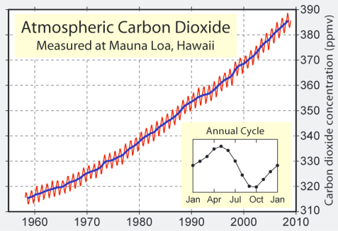
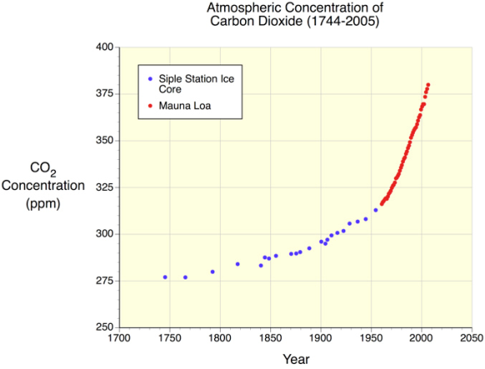
Extrapolate Develop a new hypothesis based on your information
As the CO₂ concentration in the atmosphere increases…
What do you think is happening to the pH of the oceans?
Answer question #7 on the student handout.
http://www.physicalgeography.net/fundamentals/7aCO2.html

Slide 4
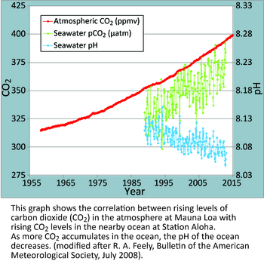
Ocean Acidification: The Other Carbon Dioxide Problem
“Fundamental changes in seawater chemistry are occurring throughout the world's oceans. Since the beginning of the industrial revolution, the release of carbon dioxide (CO₂) from humankind's industrial and agricultural activities has increased the amount of CO₂ in the atmosphere. The ocean absorbs about a quarter of the CO₂ we release into the atmosphere every year, so as atmospheric CO₂ levels increase, so do the levels in the ocean. Initially, many scientists focused on the benefits of the ocean removing this greenhouse gas from the atmosphere. However, decades of ocean observations now show that there is also a downside — the CO₂ absorbed by the ocean is changing the chemistry of the seawater, a process called OCEAN ACIDIFICATION.” NOAA—PMEL
Answer question #8 on the student handout.
Notes:
The text on this slide is from:
NOAA—PMEL (National Oceanic and Atmospheric Administration—Pacific Marine Environmental Laboratory). n.d. Ocean acidification: the other carbon dioxide problem. [Webpage]. <http://www.pmel.noaa.gov/co2/story/Ocean+Acidification>.

Slide 5
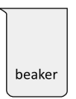
Part II – Dissolution of Antacids
1. Read the experiment description:
There are three beakers containing solutions of different pH. Use a pH meter or universal pH indicator to determine the pH for each solution. One antacid tablet will be added to each beaker. The active ingredient in the antacid tablet is calcium carbonate.
2. Answer questions #1–5 on the student handout.
3. Perform the experiment:
Drop one antacid in each of the beakers. Observe the results.
4. Answer questions #6–9 on the student handout.
pH 2
pH 7
pH 10

Slide 6
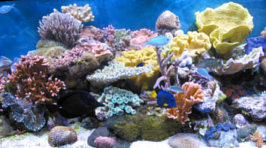
Extrapolate Develop a new hypothesis based on your information
Recap…
Increasing CO₂ concentrations in the atmosphere raises the H⁺ concentration in the ocean, lowering ocean pH.
⬆[CO₂]_{atmosphere} → ⬆[H⁺]_{ocean} → ⬇pH_{ocean}
Lower pH increases solubility of calcium carbonate.
⬇pH_{ocean} → ⬆ solubility CaCO₃
Given
Coral reefs are diverse underwater ecosystems held together by calcium carbonate structures secreted by corals. -WIkipedia
Shells of mollusks, such as oysters, are held together by calcium carbonate structural secretions.
How is ocean acidification going to affect coral reefs and ocean mollusks?
Answer question #10 on the student handout.

Slide 7
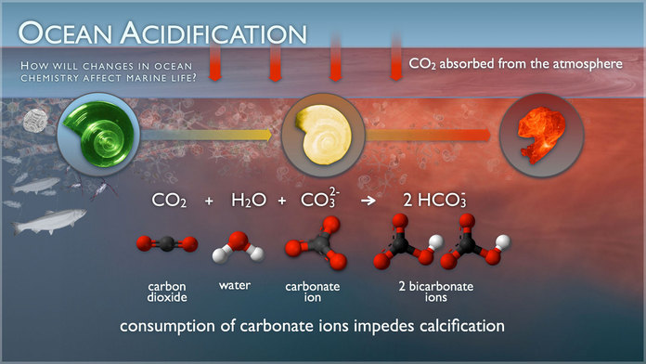
http://www.pmel.noaa.gov/co2/story/Ocean+Acidification
Notes:
NOAA—PMEL (National Oceanic and Atmospheric Administration—Pacific Marine Environmental Laboratory). n.d. Ocean acidification: the other carbon dioxide problem. [Webpage]. <http://www.pmel.noaa.gov/co2/story/Ocean+Acidification>.

Slide 8
In the news…
“Oregon State researchers trace oyster larvae die-off to increasing ocean acidity”
Headline of article from The Oregonian, April 13, 2012.
“Ocean acidification is the main suspect as some farms report mortality rates as high as 90%”
“Mystery surrounds massive die-off of oysters and scallops off of B.C. coast,” The Globe and Mail, Feb 27, 2014.
“[T]he oyster [larvae] need to exert more energy for shell building and have less for swimming and getting food…these tiny oysters just sink in the water and stop swimming.”
“Ocean acidification causing Pacific oyster die-off,” Seeker, Dec 16, 2014 .
Answer question #11 on the student handout.

Slide 9
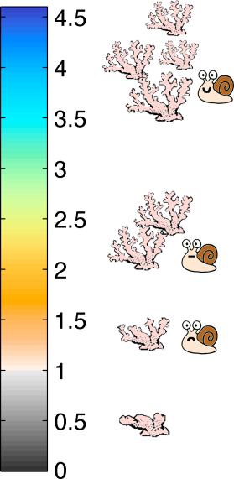
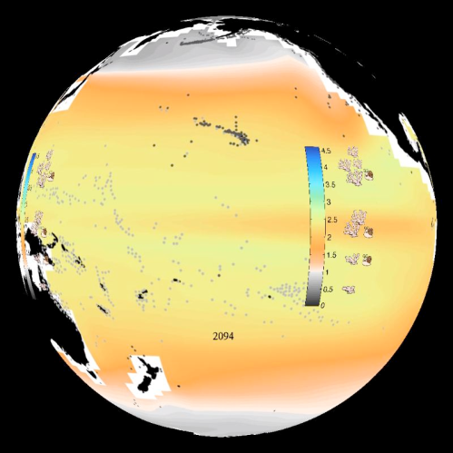
Ocean Acidification and CaCO₃ Saturation Watch: https://sos.noaa.gov/Datasets/view-movie.html?video=ocean_acid_arag_400

Slide 10
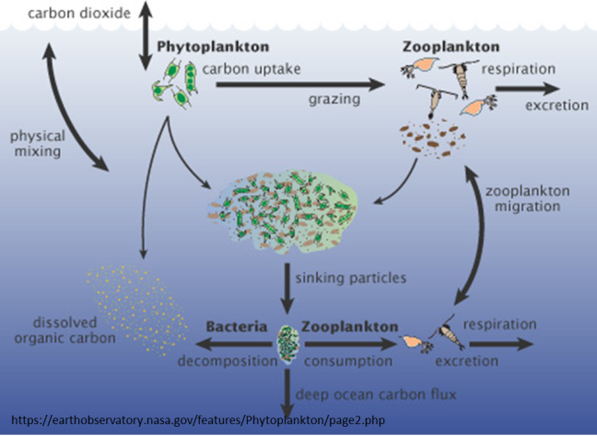
Plankton - “Biological carbon pump”
Phytoplankton consume as much CO₂ as land plants.
Most of the CO₂ consumed by phytoplankton during photosynthesis is returned to near-surface waters, but some falls into the ocean depths.
“Even small changes in the growth of phytoplankton may affect atmospheric carbon dioxide concentrations…”
Notes:
Image and quote from: Lindsey, R. and M. Scott. 2010. What are phytoplankton? [Webpage]. Earth Observatory—NASA. <https://earthobservatory.nasa.gov/features/Phytoplankton>.

Slide 11
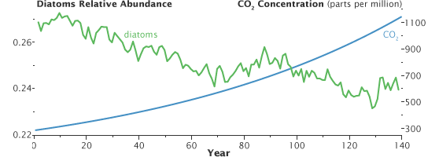
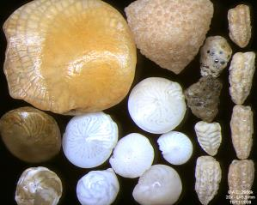
Effect of CO₂ on Plankton
The predominant form of phytoplankton in oceans are diatoms – single celled algae with silica shells
Diatom populations are expected to decrease as CO₂ concentration increases
http://www.edc.uri.edu/restoration/html/gallery/plants/phyto.htm
https://earthobservatory.nasa.gov/features/Phytoplankton/page1.php
Graph adapted from Bopp 2005 by Robert Simmon.
L. Bopp, et al. “Response of diatoms distribution to global warming and potential implications: A global model study,” Geophysical Research Letters, 2005
Foraminifera – an amoeba-like marine plankton with calcium carbonate shells
Foraminifera are predicted to be extinct by end of century due to decreased pH of oceans
S. Uthicke, et al., “High risk of extinction of benthic foraminifera in this century due to ocean acidification”, Scientific Reports, 3, 2013.
By Psammophile - Microphotographie personnelle
http://www.arenophile.fr/Pages_IMG/P2966e.html, CC BY-SA 3.0,
https://commons.wikimedia.org/w/index.php?curid=20886081

Slide 12
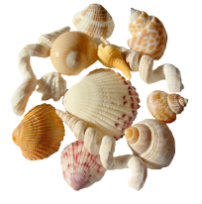
Part III – Shell-lacked!
1. Read the experimental description
Beaker A contains sea shells soaked overnight in tap water.
Beaker B contains sea shells soaked overnight in vinegar (~4% acetic acid).
2. Answer questions #1–5 on the student handout.
Work through the scientific method on the student worksheet in order to develop a hypothesis and an experiment to test it.
3. Perform a new experiment.
Propose experiments to the instructor. Perform a new experiment(s).
4. Answer questions #6–8 on the student handout.

Slide 13
Homework
Answer questions #9-10 on the student handout.
9. Develop a hypothesis related to ocean acidification that applies to a broader situation than the one specifically tested during class.
10. Based on the information you have learned today, propose a method to slow or counter the process of ocean acidification.

Slide 14
References
Atmospheric CO₂
http://www.physicalgeography.net/fundamentals/7aCO2.html
Siple Station Ice Core Data
Neftel, A., H. Friedli, E. Moore, H. Lotscher, H. Oeschger, U. Siegenthaler, and B. Stauffer. 1994. Historical carbon dioxide record from the Siple Station ice core. pp. 11-14. In T.A. Boden, D.P. Kaiser, R.J. Sepanski, and F.W. Stoss (eds.) Trends'93: A Compendium of Data on Global Change. ORNL/CDIAC-65. Carbon Dioxide Information Analysis Center, Oak Ridge National Laboratory, Oak Ridge, Tenn. U.S.A.
Mauna Loa Data
Keeling, C.D. and T.P. Whorf. 2006. Atmospheric CO2 records from sites in the SIO air sampling network. In Trends: A Compendium of Data on Global Change. Carbon Dioxide Information Analysis Center, Oak Ridge National Laboratory, U.S. Department of Energy, Oak Ridge, Tenn., U.S.A.
Ocean CO₂ and pH
http://www.pmel.noaa.gov/co2/story/Ocean+Acidification
Heltzel, P. December 16, 2014. Ocean acidification causing Pacific oyster die-off. Seeker. <https://www.seeker.com/ocean-acidification-causing-pacific-oyster-die-off-1769373751.html>.
Hume, M. February 27, 2014. Mystery surrounds massive die-off of oysters and scallops off of B.C. coast. The Globe and Mail. <https://www.theglobeandmail.com/news/british-columbia/mystery-surrounds-massive-die-off-of-oysters-and-scallops-off-bc-coast/article17156108/>.
Tobias, L. April 13, 2012. Oregon State research traces oyster larvae die-off to increasing ocean acidity. The Oregonian. https://www.oregonlive.com/pacific-northwest-news/2012/04/oregon_state_research_traces_o.html.
CaCO₃ predictive video: https://sos.noaa.gov/Datasets/view-movie.html?video=ocean_acid_arag_400
Phytoplankton
https://earthobservatory.nasa.gov/features/Phytoplankton
Bopp, L. (2005). Response of diatoms distribution to global warming and potential implications: A global model study. Geophysical Research Letters, 32(L19606).
S. Uthicke, et al., “High risk of extinction of benthic foraminifera in this century due to ocean acidification,” Scientific Reports 3, 2013. http://www.edc.uri.edu/restoration/html/gallery/plants/phyto.htm

