Slide 1
MaGic Bullets A Case on Enzyme inhibition
National Center for Case Study Teaching in Science
by Sarah A. Wojiski School of Arts and Sciences MCPHS University, Boston, MA
Notes:
Licensed image ©Igrik | Fotolia, ID#81131012.

Slide 2
Just a routine checkup?
Oliver Casey, age 53, was visiting his doctor, Ariana Kagan, for his annual physical. Aside from feeling a little more tired than usual, which he attributed to increased responsibilities at work, Oliver thought he was in good health. However, during the physical examination, Dr. Kagan noted that Oliver had an enlarged spleen.
“I’m going to order some blood work to see if we can figure out why your spleen is enlarged. You may have an infection; it’s probably nothing serious,” Dr. Kagan told Oliver.
Oliver left the doctor’s office that day feeling a little unsettled, but hopeful that his enlarged spleen was caused by nothing more than a virus.

Slide 3
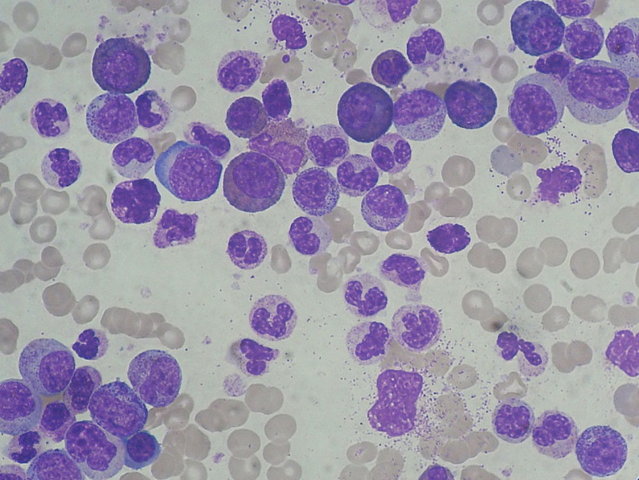
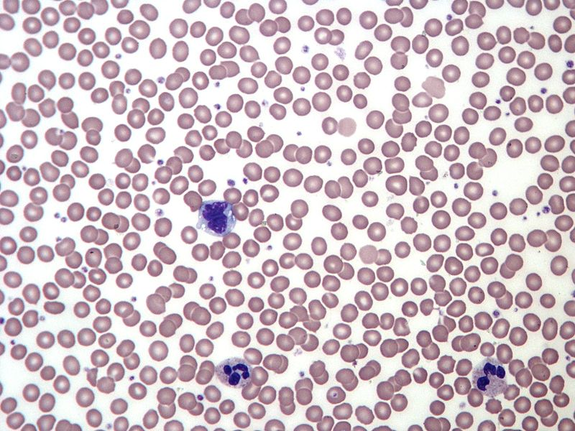
The results
Oliver’s palms were sweaty and his heart was racing as he sat across from Dr. Kagan in her office. He knew it couldn’t be good news that he had been called in to discuss his blood test results in person. Here are some of the findings:
Oliver’s white blood cell count | 225 x 10⁹ cells/L
Normal white blood cell count range | 4.5 - 10 x 10⁹ cells/L
Oliver’s Blood Smear
Normal Blood Smear
Notes:
In the blood smear, point out the fact that the pale-centered, smaller cells (showing up as beige in Oliver’s blood smear and pink in the normal blood smear) are the red blood cells, and the larger, purple cells with odd-shaped nuclei are the white blood cells. The red blood cells contain hemoglobin and are responsible for transporting oxygen to tissues in the body, while the white blood cells are primarily involved in fighting infections.

Slide 4
Clicker Question #1
Based upon the data shown in the previous slide, Oliver appears to be suffering from
anemia: too few red blood cells
leukocytosis: too many white blood cells
leukopenia: too few white blood cells
polycythemia: too many red blood cells

Slide 5
The results, continued
Oliver sat in stunned silence while Dr. Kagan reviewed his blood test results. “Your very high white blood cell count and enlarged spleen prompted me to perform some additional testing on your blood cells, and I’m afraid the results are not very good. The results reveal that your blood cells contain a mutation that has caused you to develop a blood disease called Chronic Myeloid Leukemia, or CML. This is a slowly progressing cancer of the blood cells. I am going to refer you to a doctor called a hematologist, who specializes in blood diseases, who will discuss your treatment options.”
“Chronic what?” replied Oliver, snapping out of his silent state.
Dr. Kagan explained to Oliver a little more about what CML is, and what causes the disease.

Slide 6
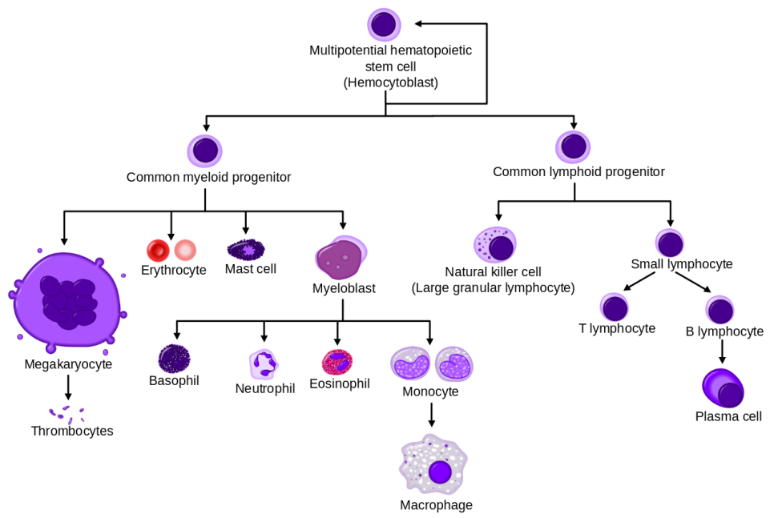
Genetics of CML
CML is characterized by an overproduction of a particular type of white blood cell called the granulocyte
Granulocytes
Notes:
Granulocytes are comprised of basophils, neutrophils, and eosinophils, important white blood cells required to fight bacterial infections. The most abundant of these cell types is the neutrophil, a phagocytic cell of the innate immune system. Neutrophils are easily identified by their oddly shaped segmented nuclei. Note from the blood smear shown in Slide 3 that one can see a large number of neutrophils present in Oliver’s blood as compared to the normal control blood smear.

Slide 7
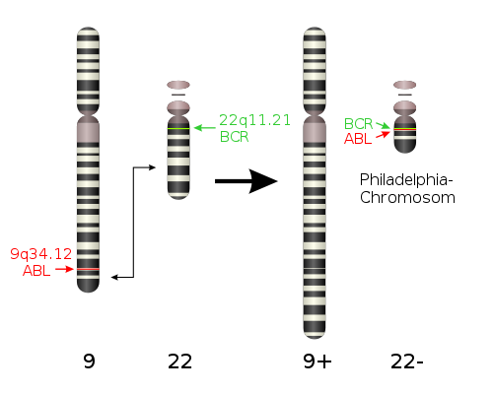
Genetics of CML
The vast majority of cases of CML are caused by a chromosomal translocation, a specific type of mutation in which two different chromosomes swap their DNA
Generates the Philadelphia chromosome, containing the BCR-ABL fusion protein
Philadelphia Chromosome
Chromosome
Notes:
The image shows chromosome ideograms denoting the approximate locations of the ABL and BCR genes on chromosomes 9 and 22, respectively. The arrows indicate the sites of translocation between the two chromosomes, resulting in the juxtaposition of the ABL gene onto chromosome 22, adjacent to the BCR gene, generating the Philadelphia Chromosome that contains the BCR-ABL fusion gene. This gene will lead to the expression of the BCR-ABL fusion protein.

Slide 8
What is a kinase?
BCR-ABL is a mutated version of the ABL protein, a tyrosine kinase
A kinase is an enzyme that catalyzes phosphorylation reactions
Transfers a phosphate group from ATP to the substrate
Therefore, a kinase must be able to bind both ATP and its substrate

Slide 9
Clicker Question #2
What part of an enzyme binds to the substrate?
Initiation site
Reaction site
Transformation site
Active site
Energy site

Slide 10
Clicker Question #3
Which of the following statements is FALSE?
The shape of the active site is determined by the amino acid sequence of the enzyme.
The shape of the active site is constantly changing, allowing the enzyme to bind many different substrates, catalyzing many different chemical reactions.
When a substrate encounters the active site of its enzyme, the substrate and enzyme become held together by weak chemical bonds.
The active site of an enzyme is specific, recognizing only one particular substrate.

Slide 11
Clicker Question #4
One function of the ABL kinase is to phosphorylate substrates that tell white blood cells to grow and divide.
The ABL kinase is mutated in CML, giving rise to the BCR-ABL protein. Based on the normal function of ABL in white blood cells, how do you think the mutated version of the kinase (BCR-ABL) contributes to the development of CML, a cancer of the white blood cells?
The kinase becomes overactive (too much enzyme activity)
The kinase becomes inactive (too little or no enzyme activity)
Not sure

Slide 12
Biology of CML
Normal Granulocytes
Cancerous Granulocytes
ABL kinase is regulated
Granulocyte proliferation is regulated
BCR-ABL mutant kinase is constitutively active
Granulocyte proliferation is unregulated
ABL
Kinase
ON
ABL
Kinase
OFF
ABL
Kinase
ON
ABL
Kinase
OFF
Notes:
In normal cells, there is a balance between ABL being active and able being inactive, which helps to controls the growth and proliferation of granulocytes. Explain that constitutively active means that the kinase is always turned “On”, always in an active state, phosphorylating substrates. Since ABL is responsible for phosphorylating substrates that tell WBCs to grow and divide, the mutated kinase is always telling the cell to grow and divide, and thus granulocyte proliferation becomes uncontrolled.

Slide 13
A visit to the specialist
Oliver’s meeting with the hematologist, Dr. Clement, went well. The doctor was optimistic about Oliver’s treatment options, particularly since they had caught the cancer at a relatively early stage.
“We will start you on a drug called imatinib, more commonly known as Gleevec, and we will monitor your white blood cell count to see how you respond to the drug,” Dr. Clement advised Oliver. “Please see the receptionist to schedule a follow-up appointment, and call the office if you experience any negative side effects.”
Oliver left the office and picked up his prescription for Gleevec.

Slide 14
Clicker Question #5
Predict the mechanism of action of imatinib. Which of the following mechanisms would best treat Oliver’s cancer?
Imatinib inhibits the function of all kinase enzymes.
Imatinib promotes the function of all kinase enzymes.
Imatinib inhibits the function of the BCR-ABL kinase.
Imatinib promotes the function of the BCR-ABL kinase.

Slide 15
How does imatinib work?
Video: Gleevec® mechanism of action https://youtu.be/alsAk4pyWlE
Notes:
Show video clip “Gleevec Inhibits BCR-ABL” by clicking on the link in the slide that will stream the video from YouTube. Alternatively, you can download and save the clip to your computer from http://sciencecases.lib.buffalo.edu/cs/videos/enzyme_inhib_flip_vid1.mp4
Used with permission from the Howard Hughes Medical Institute, copyright 2013, all rights reserved, www.BioInteractive.org.

Slide 16
Clicker Question #6
What type of inhibitor is imatinib/Gleevec?
Non-competitive inhibitor
Competitive inhibitor
Not sure

Slide 17
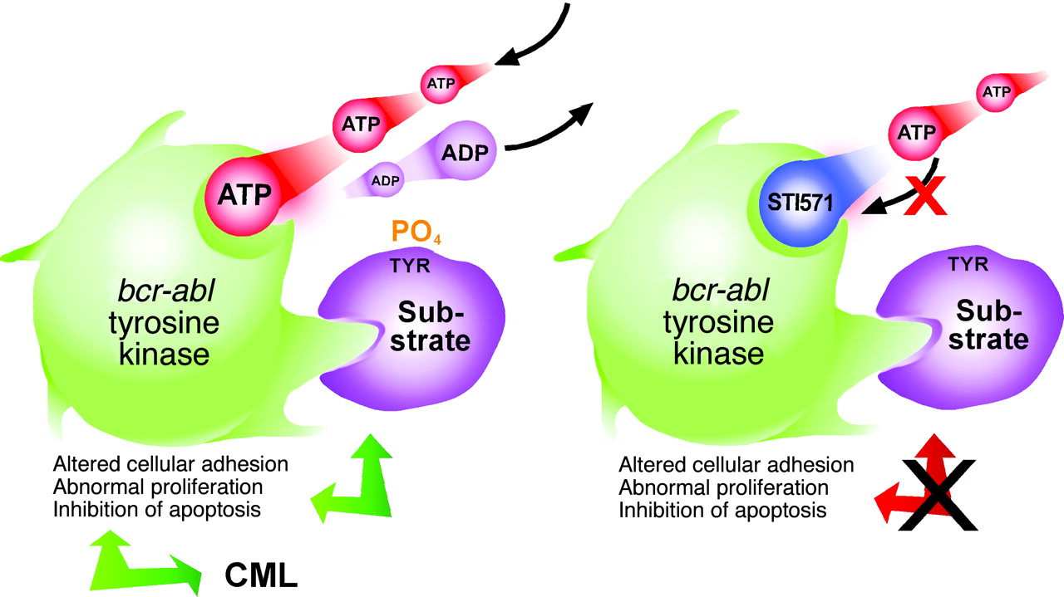
Gleevec is a competitive inhibitor of BCR-ABL
Competes with ATP for binding site
Blocks ATP from binding to enzyme
Gleevec
CML
CML
Notes:
Note that BCR-ABL can still bind substrates in the presence of Gleevec; it just cannot phosphorylate them.

Slide 18
Blood tests, blood tests, and more blood tests!
Oliver had to admit it; he was getting used to the needle stick. Eighteen months ago, Dr. Clement had warned Oliver that it would be crucial to routinely monitor Oliver’s blood to determine if the Gleevec was effectively fighting his cancer. And Dr. Clement was right! There sure were a lot of blood tests! And each time Oliver went to the phlebotomy lab, he hoped that his test results would reveal good news.

Slide 19
Clicker Question #7
Refer to the graph below, charting some of Oliver’s blood test results over the past 18 months. Based on this graph, is Oliver’s treatment working?
Yes
No
Not Sure

Slide 20
Clicker Question #8
Predict what would happen to Oliver’s white blood cell count if he stopped taking Gleevec.
His white blood cell count would stay within the normal and healthy range.
His white blood cell count would drop below the normal and healthy range.
His white blood cell count would rapidly increase above the normal and healthy range.

Slide 21
Feeling good
Oliver was pleased. It had been about 18 months since his initial diagnosis of CML, and it appeared that the Gleevec was working. His white blood cell counts were back to within normal range, and Dr. Clement indicated that other testing revealed that the BCR-ABL mutation was no longer detectable in his blood cells.
He would continue to have his blood tested every three months, and was scheduled for a checkup with Dr. Clement in 6 months, provided everything continued to look good.
Notes:
Students may ask why/how the drug reduces the detection of the BCR-ABL mutation in Oliver’s blood cells. The BCR-ABL mutation is an acquired mutation. At some point in Oliver’s life, this mutation arose in one of his blood cells, causing it, and all future daughter cells, to grow uncontrollably. The drug Gleevec blocks the growth signal provided by BCR-ABL, ultimately leading to the death of blood cells that contain this specific mutation (the cancer cells become dependent on the growth signal from BCR-ABL for their survival). If Gleevec is working in the patient’s body, only blood cells with non-mutated, normal versions of the ABL kinase will survive, while those cancerous blood cells that harbored the BCR-ABL mutation die. Response to treatment is monitored in patients by measuring whether or not the BCR-ABL mutation is detectable in the blood. No detectable BCR-ABL means that the cancer cells are dying and the drug is working.

Slide 22
Troubling Results
Dr. Benjamin Clement frowned as he looked at the latest blood test results on his patient, Oliver Casey. Oliver had been taking imatinib for a little over 21 months now, and had responded beautifully. But the most recent blood work showed Oliver’s white blood cell count was very high again. And genetic analysis revealed the presence of the BCR-ABL mutant kinase in his cells again. It was time to call Oliver in for a discussion.
Notes:
Related to the notes given in the previous slide, a patient is considered to be relapsed if the BCR-ABL mutation reappears in the blood cells. This means that some of the cancerous cells survived the treatment and are growing and dividing, making the mutation detectable once again in the patient’s blood.

Slide 23
What happened?
In groups of 2-3, discuss what could be the possible causes of Oliver’s relapse. Be prepared to share at least one possible cause of Oliver’s relapse with the rest of the class.

Slide 24
Resistance!
Dr. Clement shared the bad news with his patient. “I’m sorry, Oliver, but it appears that the Gleevec you have been taking is no longer working against your cancer, and your white blood cells are growing out of control again. We’ll do some genetic testing to confirm, but the most likely cause of this relapse is that the BCR-ABL gene has mutated once again, and that mutation has rendered the protein resistant to the Gleevec you have been taking.”
Video: mechanism of resistance to Gleevec
https://youtu.be/Jns9IiMrbeo
Notes:
Show video clip “Gleevec resistant BCR-ABL Part 1” by clicking on the link in the slide that will stream the video from YouTube. Alternatively, you can download and save the clip to your computer from http://sciencecases.lib.buffalo.edu/cs/videos/enzyme_inhib_flip_vid2.mp4
Used with permission from the Howard Hughes Medical Institute, copyright 2013, all rights reserved, www.BioInteractive.org.

Slide 25
Clicker Question #9
According to the video, what do “resistance mutations” do to render imatinib/Gleevec ineffective?
The resistance mutation allows Gleevec to bind to BCR-ABL, but not ATP.
The resistance mutation allows both Gleevec and ATP to bind to BCR-ABL.
The resistance mutation allows ATP to bind to BCR-ABL, but not Gleevec.
The resistance mutation does not allow Gleevec or ATP to bind to BCR-ABL.

Slide 26
Dasatinib vs. Imatinib
Dr. Clement sat in his office reviewing the most recent genetic testing results with Oliver. “As I expected,” he said, “you have acquired a resistance mutation in BCR-ABL that is preventing Gleevec from doing its job. But the good news is, we have another drug, dasatinib, that should be able to counteract this mutation. I am going to call in a prescription for dasatinib that you should start right away.”
Oliver was skeptical. If Gleevec wasn’t working against his cancer, what was so magical about this new drug, dasatinib?

Slide 27
How does dasatinib work?
Video: dasatinib mechanism of action https://youtu.be/3Tpz1et18gM
Notes:
Show video clip “Gleevec resistant BCR-ABL Part 2” by clicking on the link in the slide that will stream the video from YouTube. Alternatively, you can download and save the clip to your computer from http://sciencecases.lib.buffalo.edu/cs/videos/enzyme_inhib_flip_vid3.mp4
Used with permission from the Howard Hughes Medical Institute, copyright 2013, all rights reserved, www.BioInteractive.org.

Slide 28
Clicker Question #10
What type of inhibitor is dasatinib?
Competitive inhibitor
Non-competitive inhibitor
Not sure

Slide 29
Clicker Question #11
Which of the following distinguishes the function of dasatinib from the function of imatinib?
Dasatinib binds in the ATP-binding pocket of BCR-ABL, while imatinib does not.
Dasatinib binds BCR-ABL in its inactive and active conformation, while imatinib binds BCR-ABL only in its inactive conformation.
Dasatinib is a competitive inhibitor of BCR-ABL, while imatinib is a noncompetitive inhibitor of BCR-ABL.
Dasatinib prevents BCR-ABL from phosphorylating substrates, while imatinib blocks other functions of BCR-ABL.

Slide 30
And what does the future hold for Oliver?
The development and use of tyrosine kinase inhibitors that specifically block the function of BCR-ABL has revolutionized the treatment of CML
Mortality has dropped from 10-20% per year to 1-2% per year
Treated as a chronic disease rather than life-threatening cancer
Tyrosine kinase inhibitors are a lifelong treatment
Stopping therapy often results in relapse
Resistance mutations are always a threat; new tyrosine kinase inhibitors that are effective against known resistance mutations are currently in Clinical Trials
Allogeneic bone marrow transplantation is the only truly “curative” treatment available, though this is often not an option due to patient age, other health issues, and lack of a suitable donor

Slide 31
References
Jabbour, E. & Kantarjian, H. (2012). Chronic myeloid leukemia: 2012 update on diagnosis, monitoring, and management. American Journal of Hematology, 87 (11), 1037-45.
National Cancer Institute. (May 23, 2014). Chronic Myelogenous Leukemia Treatment (PDQ) Health Professional Version. Retrieved from http://www.cancer.gov/cancertopics/pdq/treatment/CML/HealthProfessional.
National Cancer Institute. (June 27, 2014). Chronic Myelogenous Leukemia Treatment (PDQ) Patient Version. Retrieved from http://www.cancer.gov/cancertopics/pdq/treatment/CML/HealthProfessional
United States Food and Drug Administration. (August 26, 2013). Gleevec (Imatinib Mesylate) Questions and Answers. Retrieved from http://www.fda.gov/Drugs/DrugSafety/PostmarketDrugSafetyInformationforPatientsandProviders/ucm110505.htm

Slide 32
Image Credits
Slide 3
Description: Chronic myeloid leukemia (CML): marked leucocytosis with granulocyte left shift.
Author: Paulo Henrique Orlandi Mourao
Source: http://commons.wikimedia.org/wiki/File:Chronic_Myeloid_Leukemia_smear_2009-04-09.JPG
Clearance: This file is licensed under the Creative Commons Attribution-Share Alike 3.0 Unported license.
Description: Blood smear from a normal healthy adult. Stained with Giemsa. Note the uniform staining and size of cells.
Author: Keith Chambers
Source: http://commons.wikimedia.org/wiki/File:Normal_Adult_Blood_Smear.JPG
Clearance:This file is licensed under the Creative Commons Attribution-Share Alike 3.0 Unported license.
Slide 6
Description: This diagram shows the hematopoiesis as it occurs in humans.
Author: A. Rad
Source: http://commons.wikimedia.org/wiki/File:Hematopoiesis_%28human%29_diagram.png
Clearance: GFDL-self. This image is released under the GFDL-self license and is considered freely distributable. This image or any reproductions/customizations thereof (or any reproductions/customizations of its reproductions/customizations, and so forth) may NOT be sold without my explicit consent.
Slide 7
Description: Philadelphia Chromosome Translocation
Author: A Obeidat
Source: http://commons.wikimedia.org/wiki/File:Philadelphia_chromosome.jpg
Clearance: This file is licensed under the Creative Commons Attribution-Share Alike 3.0 Unported license.
Slide 8
Description: Basic Phosphorylation reaction
Author: Boc13
Source: http://commons.wikimedia.org/wiki/File:Basic_phosphorylation_reaction.png
Clearance: This file is licensed under the Creative Commons Attribution-Share Alike 3.0 Unported license.
Slide 17
Adapted from : Mauro M J , and Druker B J. STI-571: Targeting BCR-ABL as therapy for CML. The Oncologist 2001;6:233-238

Slide 33
Video Credits
Video clips adapted from:
http://www.hhmi.org/biointeractive/gleevec-inhibits-cancer-causing-kinase-bcr-abl
http://www.hhmi.org/biointeractive/gleevec-resistant-form-kinase-bcr-abl
Used with permission from the Howard Hughes Medical Institute, copyright 2013. All rights reserved. www.BioInteractive.org

