Slide 1
Differentiating Diabetes
NATIONAL CENTER FOR CASE STUDY TEACHING IN SCIENCE
Up All Night:
by
Natalie G. Farny
Department of Biology and Biotechnology
Worcester Polytechnic Institute
Worcester, MA

Slide 2
Objectives
By the end of this activity, you should be able to:
Explain the differences between type 1 and type 2 diabetes mellitus (DM).
Describe the most common laboratory tests used for the diagnosis of DM.
Explain how the differences in the root cause of disease in type 1 and type 2 DM relate to the laboratory tests used to differentially diagnose different forms of DM.
Read and interpret clinical laboratory data in charts and graphs.
Understand and appreciate the difficulties of obtaining a diagnosis for any disease with complete certainty.

Slide 3
Part I: Up, Again
“George? What are you doing up?” Mark asked, as George stumbled from their dorm room out into the common area. It was 2:30am, and as usual, Mark had left his studying to the last minute.
“Gotta pee again…,” said George groggily, trudging toward the bathroom.
When George emerged from the bathroom, Mark asked “Isn’t that the third time tonight? You really ought to drink less water before bed.”
“I can’t help it, I’ve been crazy thirsty lately,” George replied.
Mark’s brows furrowed slightly. “Dude, are you feeling ok? You’ve been going to bed pretty early the past two weeks. I feel like I hardly see you other than in the bathroom!”
“I don’t know, man. Things have been weird lately. I’ve definitely had trouble staying awake in class. And, I mean, I’ve always been a big guy with a big appetite, but in the past few weeks I’ve been eating a ton! I’m almost out of Meal Bucks for the semester!”
“That is weird,” replied Mark. “Have you thought about going to Health Services?”
“And tell them what?” said George in an irritated tone. “That I gotta pee a lot? Doesn’t exactly sound like a medical emergency.”

Slide 4
Questions for Discussion: What are George’s symptoms? Make a list. Are George’s symptoms consistent with type 1 DM, type 2 DM, both, or neither? As a healthcare provider, what other questions would you ask George? What tests would you like to run, and why?
“George? What are you doing up?” Mark asked, as George stumbled from their dorm room out into the common area. It was 2:30am, and as usual, Mark had left his studying to the last minute.
“Gotta pee again…,” said George groggily, trudging toward the bathroom.
When George emerged from the bathroom, Mark asked “Isn’t that the third time tonight? You really ought to drink less water before bed.”
“I can’t help it, I’ve been crazy thirsty lately,” George replied.
Mark’s brows furrowed slightly. “Dude, are you feeling ok? You’ve been going to bed pretty early the past two weeks. I feel like I hardly see you other than in the bathroom!”
“I don’t know, man. Things have been weird lately. I’ve definitely had trouble staying awake in class. And, I mean, I’ve always been a big guy with a big appetite, but in the past few weeks I’ve been eating a ton! I’m almost out of Meal Bucks for the semester!”
“That is weird,” replied Mark. “Have you thought about going to Health Services?”
“And tell them what?” said George in an irritated tone. “That I gotta pee a lot? Doesn’t exactly sound like a medical emergency.”

Slide 5
DQ#1: What are George’s symptoms?
Enter list of symptoms here

Slide 6
CQ#1: Are George’s symptoms consistent with type 1 DM, type 2 DM, both, or neither?
Type 1
Type 2
Both
Neither

Slide 7
DQ#2: As a healthcare provider, what other questions would you ask George? What tests would you like to run, and why?
Additional Questions:
Tests you want to run:
Type list here
Type list here

Slide 8
Part II: At the Clinic
After talking to George at an initial visit, Health Services asks him to return later that week first thing in the morning (without eating breakfast) to check his blood and urine glucose levels, and perform an oral glucose tolerance test.
 | Normal Range | George’s Result
Fasting plasma glucose | <100 mg/dL | 150 mg/dL
Urine glucose | 0–0.8 mmol/L | 1.4 mmol/L
Discuss George’s test results with your group – do you know what is going on yet? Can we determine whether he could have type 1 or type 2 DM (or neither) from this information?

Slide 9
CQ#2: Are George’s test results consistent with type 1 DM, type 2 DM, both, or neither?
Type 1
Type 2
Both
Neither

Slide 10
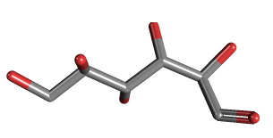
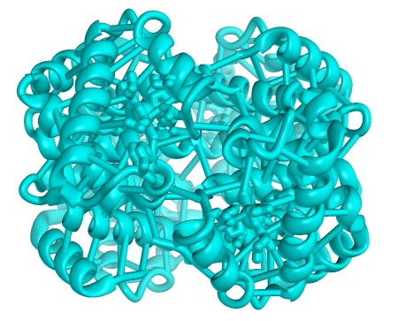
Glycated hemoglobin A1C reflects average blood glucose levels.
The A1C variant of hemoglobin becomes irreversibly glycated in the presence of glucose
When more glucose is present in the blood, the percentage of glycated HbA1C will increase
Normal HbA1C
Diabetic HbA1C
 | Glycated HbA1C (%)
Normal | 5.6% or less
Prediabetic | 5.7–6.4%
Diabetic | 6.5% or greater
Glucose
Source: American Diabetes Association Standards of Medical Care in Diabetes, 2015

Slide 11
CQ#3: Which of the following options would be the best way for a healthcare provider to decide whether George has type 1 or type 2 DM?
Biopsy George’s pancreas and look to see if the beta-islet cells are intact.
Test the levels of insulin in George’s blood before and after consuming glucose.
Repeat the OGTT using varying amounts of glucose intake and a longer time course.
Treat George with a dose of insulin, and see whether or not his blood glucose decreases.

Slide 12
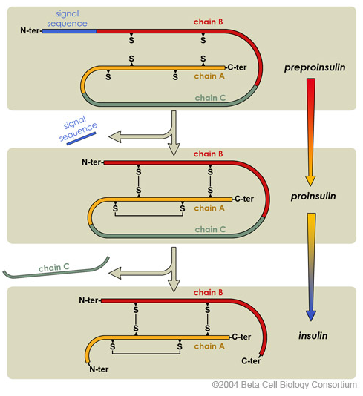
The Production of Insulin
Preproinsulin must be processed into mature insulin through a series of cleavage and folding steps.
C-peptide has a much longer half-life in plasma
(~30–35 minutes) than mature insulin
(~5 minutes)

Slide 13
George’s C-Peptide Levels
C peptide | Normal Range (ng/mL) | George’s Values (ng/mL)
Fasting (8–10 hr) | 0.4 – 2.1 | 2.6
2 hr post glucose | 2.0 – 4.5 | 5.5
CQ#4: Are George’s test results most consistent with type 1 DM or type 2 DM? (Discuss with your group, and be prepared to defend your choice!)
Type 1
Type 2
There is still not enough information to make a diagnosis

Slide 14
Final Thought Question
DQ#3: Often, the tests discussed here give ambiguous or borderline results. It is not always immediately evident to a health care provider whether a patient who is clearly diabetic is type 1 or type 2. Why do you think it can sometimes be difficult to obtain a diagnosis with complete certainty?

Slide 15
Additional Clicker Questions
To assess understanding and generate additional discussion

Slide 16
CQ#5: An insulin receptor antagonist (a “blocker” that binds but does not stimulate the receptor) would most closely mimic:
Type 1 diabetes
Type 2 diabetes
Neither, it would have no effect on cellular glucose metabolism.

Slide 17
CQ#6: If stem cell therapy to replace beta-islet cells were available, it could be effective for treating:
Type 1 diabetes only.
Type 2 diabetes only.
Both types could benefit.
Neither type would benefit.
Discuss with your group, and be prepared to defend your choice!

Slide 18
References:
American Diabetes Association. 2015. 2: Classification and diagnosis of diabetes. In: Standards of Medical Care in Diabetes. Diabetes Care. 38(Suppl. 1):S8-S16.
Endocrine Sciences, Inc. 2015. C-Peptide, Ultrasensitive; Clinical Information. [Internet]. [Cited 28 July 2015]. Available from http://www.endocrinesciences.com/test-menu/c-peptide-ultrasensitive/fd311250-a6fd-419b-9c1d-2a63519d65d1.
Jones AG, Hattersley AT. 2013. The clinical utility of C –peptide measurement in the care of patients with diabetes. Diabet Med. 30: 308-817.
Largay J. 2012. Case Study: New-Onset Diabetes: How to Tell the Difference Between Type 1 and Type 2 Diabetes. Clin Diabetes. 30(1): 25-26.
Marieb EN, Hoehn K. 2013. Human Anatomy and Physiology. 9th ed. New York (NY): Pearson Education. p 618-625.
Shier D, Butler J, Lewis R. 2013. Hole’s Human Anatomy and Physiology. 13th ed. New York (NY): McGraw-Hill. p 928-930.

Slide 19
Image Credits
Insulin processing image available from: https://www.betacell.org/content/articlepanelview/article_id/1/panel_id/1
Hemoglobin structure available from: http://3dprint.nih.gov/discover/3dpx-000023
Glucose structure (PubChem ID 10954115) available from: http://pubchem.ncbi.nlm.nih.gov/compound/L-Glucose

